Slide 1
Act 13 and Educator Effectiveness:
Beginning to End
Introductory Webinar

Slide 2
Act 13 Requirements
Classroom Teacher*
Non-Teaching Professional*
Principal*
Provides direct instruction to students related to specific subject or grade level
Provides services other than classroom instruction
Speech Language Pathologist, Social Worker, Home and School Visitor, School Psychologist, Health Specialist, Counselor, Instructional Technology Specialist, Other
Includes the following:
  Principal
  Assistant/Vice Principal
  Director of Career and Technical Education
  Supervisor of Special Education (new with Act 13)
*Includes Professional or Temporary Employee

Slide 3
What’s a Temporary Professional Employee?
Article XI of the Pa. Public School Code defines the term "temporary professional employee" (TPE) to mean any individual who has been employed to perform, for a limited time (established by the LEA), the duties of a newly created position or of a regular professional employee whose services have been terminated by death, resignation, suspension, or removal.
Although Pa. Act 13 of 2020 amends the measures by which a TPE will be evaluated, the legislation does not alter the definitions of professional employees under Article XI. Administrators should check with their Human Resource personnel on how professional employees are currently classified by the LEA.
Notes:
Article XI defines the term to mean any individual who has been employed to perform, for a limited time, the duties of a newly created position or of a regular professional employee whose services have been terminated by death, resignation, suspension, or removal.
While the definition does not address tenure explicitly, commonwealth case law has held that the distinction between a professional employee and a temporary professional employee is that the former has secured tenure.

Slide 4
Act 13: Temporary Teacher

Slide 5
Building Level Data
Act 82
15%
Act 13
10%
Academic Achievement - State Assessments
Closing the Achievement Gap - All students
Closing the Achievement Gap - Historically Underperforming Students
Academic Growth - PVAAS
Attendance
Promotion
Graduation
Advanced Achievement
Challenge Multiplier - Adjusted based on economically disadvantaged student population
Notes:
NOCTI is not currently part of the BLS.

Slide 6
Building Level Score
The Building Level Score will provide a quantitative academic score based upon a
100-point scale to represent the overall academic performance of each school in Pennsylvania.
Academic Achievement
Academic Growth
Academic Achievement
Other Academic Indicators
ELA 15 points
Math 15 points
Science 10 points
ELA 15 pts
Math 15 pts
Science 10 pts
ELA 15 points
Math 15 points
Science 10 points
Attendance Rate 10 pts
Graduation Rate 10 pts
*Absent a Graduation Rate, Attendance Rate is 20 Points.
Where a school is missing an Assessment or Growth indicator, the 100-point scale is reduced proportionally. For example, a K-3 school with no PVAAS data (40 points) and no Science Assessment data (10 points) will have a denominator of 50 points.
Notes:
In fall 2022, the Department made available Building Level Scores comprised of Assessment, Growth, Attendance Rate, and Graduation Rate for the 21/22 SY, where the measures are applicable to the building.
Note: If Part-time CTCs tested students from sending districts, they received a BLS. A BLS is assigned if there are at least 2 measures. Growth and attendance were attributed to their building.

Slide 7
Challenge Multiplier
 | Unadjusted Building Score | Adjusted Building Score
School A 92% Economically Disadvantaged | 61.0 | 65.1
School B 38.5% Economically Disadvantaged | 61.0 | 62.7
2021-22 Act 13 Building Level Score (pa.gov)
Notes:
Act 13 legislation details the formula for the challenge multiplier.
So, for a school with 92% ED (remember to use decimals) it is .0448 * .92 = .041 add that to the unadjusted building score of .61 you get .651 * 100 = 65 (rounded).
Then for 38.5 % ED it is .0448 * .385 = .017 add to the same unadjusted building score of .61 you get .627 or 62.7

Slide 8
Building Level Data Scenarios
Which employees do not receive a building level score as part of their evaluation?
What measures may be substituted in the case of a professional transferred from one building to another?
1
2
Notes:
TPE
Not employed by the LEA
Works in a building that does not receive a score (Kindergarten Academy, K-2 building, part-time CTC)
Transfer options –
A professional employee who transfers from one building to another within an LEA has the option of using a substitute measure in lieu of BLD for the first two school years of the new location assignment. Before evaluation in the new location assignment, the employee and the LEA must agree on the substitute measure(s) and the reallocation of the 10% weighting for calculating the final performance rating. The following table delineates permissible substitute measures by type of professional employee:
Classroom Teacher, NTP, and Principal may choose Observation & Practice
Classroom Teacher and NTP may choose LEA Selected Measures (not this is an option even though NTPs don’t typically have LEA Selected Measures as part of evaluation)
Classroom Teacher may choose Teacher-Specific Data
Principals may choose Performance Goals

Slide 9
Data vs. Non-Data Available
Who is classified as a Data Available Classroom Teacher?
Who is classified as a Non-Data Available Classroom Teacher?
vs

Slide 10
Act 13: Teacher Specific Data (Set 10%)
Academic Achievement
Only 2 Measures
available and directly attributable
Only 1 Measure
available and directly attributable
3 Measures
available and directly attributable
ELA 15 points
Math 15 points
Science 10 points
Applicable Measures (5% each)
State Assessments (2.5%)
PVAAS (5.0%)
IEP Goals Progress (2.5%)
Applicable Measure (10%)
If no measures are available and directly attributable to the teacher,
the 10% will be re-allocated to LEA Selected Measures.
Notes:
Reminder – these percentages cannot be altered.
In fall 2022, the Department will make available 21/22 SY Assessment data for Teacher-Specific Data attribution, where applicable to the professional employee.
Growth data for Teacher-Specific Data attribution will NOT be made available by the Department for the 21/22 SY or the 22/23 SY. However, the Department will make available 23/24 SY Growth data for Teacher-Specific Data attribution, where applicable to the professional employee, in the fall of 2024.

Slide 11
IEP Goals Progress Measure
Chapter 19 of the Pennsylvania School Code clarifies “applicable and attributable” thusly: “Regardless of certification area, all classroom teachers shall be accountable for student progress toward IEP Goals.”
The IEP Goals Progress measure is required under the Individuals with Disabilities Education Act if:
the teacher provides instruction to a sufficient number of students with IEPs (meeting n count), and
those students have similar academic or non-academic IEP Goals to which the teacher contributes data used by the IEP team to monitor student progress.

Slide 12
IEP Goals Progress Measure Continued
The n count is defined as follows:
The n count set must be less than or equal to 11.
An “active n count” based on the portion of instructional responsibility may be used rather than an “actual n count”.
The n count should apply to a grade-level cohort or correlate to all students within a subject area rather than a single class or course taught by the teacher.

Slide 13
Act 13 Teacher Specific Measures
Teachers will have a 1- year growth measure but will NOT have 3-year rolling average or a 3-year Growth Composite until fall 2024
  Need 3 years of consecutive reporting for inclusion in Act 13 evals
  SY21-22, SY22-23, SY23-24
Teachers will have 1-year %Proficient/Advanced metric EACH year
  Included in 13-1 evaluations for data-available teachers
  Calculated with roster verification weighting
  LEAs can choose to calculate this measure locally

Slide 14
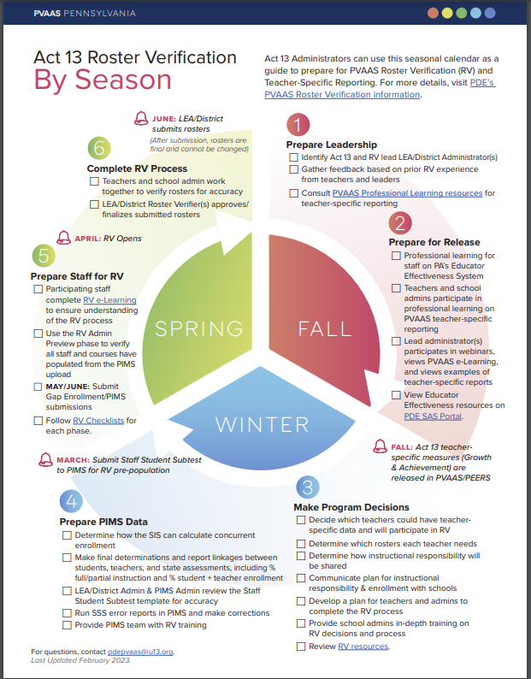
How are These Calculated?
Roster verification occurs each Spring and is the process that ensures data accuracy.
Roster Verification (RV): A Seasonal Approach for Your Lead Act 13 Administrator
Submission to PVAAS indicates that any, and all, disputes related to an individual educator’s roster data have been resolved prior to submission.

Slide 15

Where To Find These Measures
PVAAS provides teacher-specific reporting based on accurate data for use in:
Teacher Self-Reflection
Act 13 Teacher Specific PVAAS Growth
Act 13 Teacher Specific Achievement %Proficient/Advanced
Notes:
Our ultimate goal is to provide PVAAS teacher-specific reporting based on accurate data – and we use the PVAAS web-based roster verification system as a way to accomplish that.

Slide 16
SLO vs. LEA Selected Measure (SPM)
SLO (Act 82)
Required and complex template
Rigid structure
Quantitative (assessment focus)
Lack of alignment between educator and principal templates
SPM (Act 13)
Optional and streamlined template
Flexible structure
Qualitative addition
Close alignment to IEP Goals Progress and Principal Performance Goal Template
SAS Resources

Slide 17

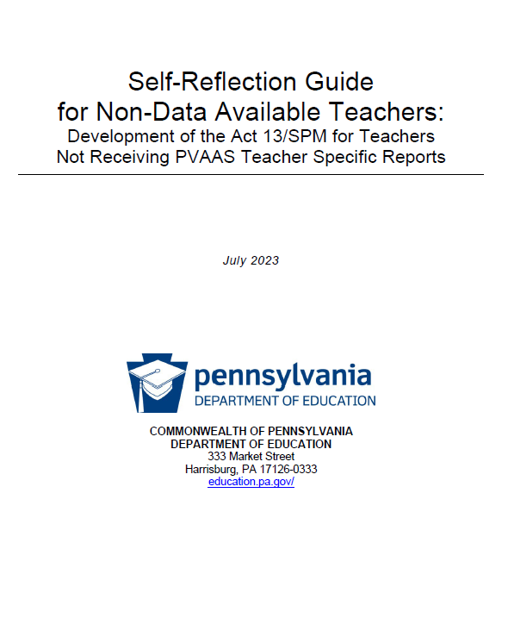
NEW!
Revised Teacher Self-Reflection Guides
Click to link to the
Teacher Self-Reflection Guide (Data Available)
Teacher Self-Reflection Guide (Non-Data Available)
Notes:
You may be already familiar with the PVAAS Teacher Self-Reflection Guides, which were originally developed in 2014.
You’ll notice that the guides are available in two versions. One [click] is for teachers who receive PVAAS reporting, the data- available teacher. The other [click] is for teachers who do not receive PVAAS reporting, or non-data available. Both of the guides provide a protocol for reviewing available data for the purpose of self-reflection and goal-setting. And, the SPM template is integrated into both guides. These can serve as a supportive resource for principals and teachers in the process of developing an SPM.

Slide 18
13-4 Interim Rating
Professional employees deemed Unsatisfactory in the last evaluation must be rated at least once a year using the measures and weightings appropriate to the employee, as indicated in the table above.
Subsequent ratings during the same evaluation period (i.e., interim evaluations) are not mandated; however, should an LEA elect to perform one, the interim evaluation must be comprised of the following:
  70% Observation & Practice (aligns with the 13-1, 13-2, 13-3)
  30% LEA Selected Measures
For the LEA Selected Measures rating, the LEA should use measure(s) appropriate to the type of professional employee. Examples as follows:
  Performance Goal benchmarks might serve as a locally developed rubric in the evaluation of a principal.
  Student career readiness portfolios might be used in the evaluation of a school counselor.
Notes:
For the Observation & Practice rating, the LEA should apply the same domains, weightings, and professional practice models utilized during the prior annual evaluation.
LEA Selected Measures reflective of the role and responsibility of the professional employee

Slide 19

Completing Act 13 Evaluation Forms
Pennsylvania
Educator
Effectiveness
Rating
System
PEERS is ready for your evaluations!

Slide 20
PEERS Intent and Purpose
No cost to LEAs
Voluntary, web-based tool for LEAs
Used for summative evaluation of:
    Classroom teachers (PDE 13-1 or 13-1 TPE)
    Principals/school leaders (PDE 13-2)
    Non-teaching professionals (PDE 13-3 or 13-3 TPE)
    Interim Evaluations for Unsatisfactory (Optional: PDE 13-4)
Provided by PDE through SAS® EVAAS
Notes:
The Pennsylvania Department of Education has contracted with SAS® EVAAS® to provide the web-based Pennsylvania Educator Effectiveness Rating System (PEERS). Participation is free and voluntary for all LEAs!
PEERS allows all administrators and teachers across the state to view their evaluation metrics, and to capture and store this information electronically as well as obtain a printable version (PDF). The system pre-populates Act 13 forms for educators with data from PIMS and allows evaluators to input final ratings for each evaluation component. Additionally, the forms can be designated by the LEA to individuals who are responsible for the evaluation process.

Slide 21
PEERS Intent and Purpose s2
Intended to be used alone – OR – in combination with other tools an LEA may use to manage the supervision and evaluation process
Can use the entire system or components of PEERS
Exclusive home of Act 13 forms (Excel forms migrated to this platform)
Note: If you want to talk with another district/LEA who has been using PEERS, email the PVAAS Statewide Team for PDE at pdepvaas@iu13.org.
Notes:
PEERS can be used alone or in combination with other supervision and evaluation tools. Or PEERS can be used in combination with other tools your LEA may employ to manage the entire supervision and evaluation process. LEAs can use the entire system or specific components of PEERS.
PEERS is now the exclusive home of the Act 13 Excel forms. The Excel forms were migrated to this platform for increased security.
PEERS is especially helpful to districts/LEAs who are currently using the Excel documents, as it provides a web-based, user friendly, and free tool to complete the Act 82 evaluations.

Slide 22
PEERS Intent & Purpose s3
Hosted within existing PVAAS web application
  Uses/leverages existing PVAAS account system
Manages evaluation process, not the supervision process
  Final Summative Rating forms
    Includes PDE 13-1, 13-1 TPE, 13-2, and 13-3, 13-3 TPE
    Pre-populated fields to save time
    Forms pre-populated with certain fields
  Interim Evaluations for employees unsatisfactory at the last evaluation (Optional: PDE 13-4)
Notes:
PEERS is hosted within the existing PVAAS application, which already provides district, school and teacher value-added reports as well as the verification mechanism for student-teacher linkages by teachers and principals. Users access PEERS using the existing PVAAS account system, through accounts that currently exist for users or through new accounts that are created locally. Secure access is available to final summary rating reports (13-1 PE & TPE, 13-2, 13-3 PE & TPE).
Altogether, PEERS will include evaluation metrics for:
Observation & Practice
Building-level data
Student performance measures
Teacher-specific data
% proficient/ advanced calculations
PEERS is designed to manage the “back end” of the supervision and evaluation process: the final summative rating forms, PDE 13-1, 13-2, 13-3.
Important: You are responsible for maintaining the confidentiality of the information provided in PVAAS. User accounts are intended for one user. Each person should have his/her own PVAAS user account.

Slide 23
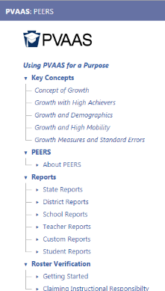
Resources
Access PEERS Resources:
  On the PVAAS site, https://pvaas.sas.com, in the online “Help” system (screenshot at right)
  PDE's Act 13 Resources
    PEERS FAQ
    PEERS Getting Started Guide
  Email pdepvaas@iu13.org if you’d like assistance accessing these resources!
Notes:
PEERS Resources can be accessed on the PVAAS website, https://pvaas.sas.com, via the online “Help” system. These resources can also be accessed on the “PVAAS Resources” Google site, https://sites.google.com/a/iu13.org/pvaas-pl-resources/peers-resources.
We’ll jump out to each of these websites to show you around– PVAAS and PDESAS for Act 13 resources. We’ll start with PVAAS to see PEERS.

Slide 24
Act 13 PD Requirements
Temporary Professional
Principal
School
Professional Employee
Complete Act 13 training during probationary period
Complete Act 13 training within the first six months of the employee's appointment as a principal.
Incorporate Act 13 training into induction programs.
Include training in the Future Ready Comprehensive Plan
Complete a condensed Act 13 training of the program every seven years

Slide 25
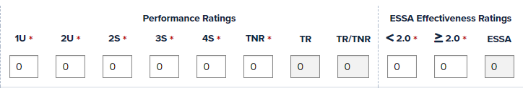
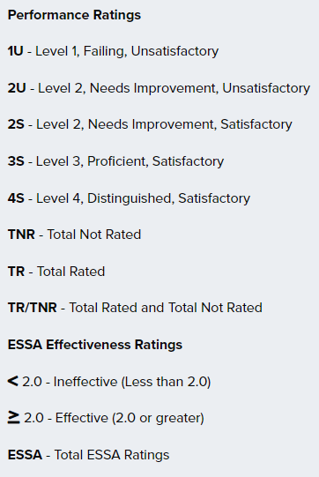
Educator Effectiveness Report - FRCPP
Classroom Teacher Data
Principal and Non-Teaching Professionals Data
Notes:
Due February 28, 2023 in the FRCPP

Slide 26

Contact Us!
Contact PDE, RA-PDE-Evaluation@pa.gov
  Act 13 questions
  Contact local IU PVAAS Point of Contact
  Link on PVAAS login page
Contact SAS EVAAS Support Team
  Needs concerning the accessing or navigating the system
Contact PVAAS Statewide Team, pdepvaas@iu13.org
  Needs concerning policies or use of the reporting
Notes:
When you have questions or need support you have the options of contacting your local IU Point of Contact, or clicking the “Contact Us” tab which will lead you to the SAS EVAAS Support team, or the PVAAS Statewide team for PDE.

