Slide 1
How to create a movie using Video Editor

Slide 2
Step one
Create a power point on your topic
Use more pictures than words
Graphs and charts are very useful
Choose a good design – remember people will need to see your pictures and words from far away on a video.

Slide 3
Step two
Keep each slide in your powerpoint simple.
You will be adding animation to pictures and too many words will slide by quickly or be zoned out.
Example:

Slide 4
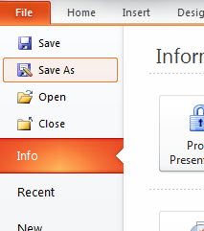
Step three
Save your powerpoint slides as pictures
Go to file and save as

Slide 5
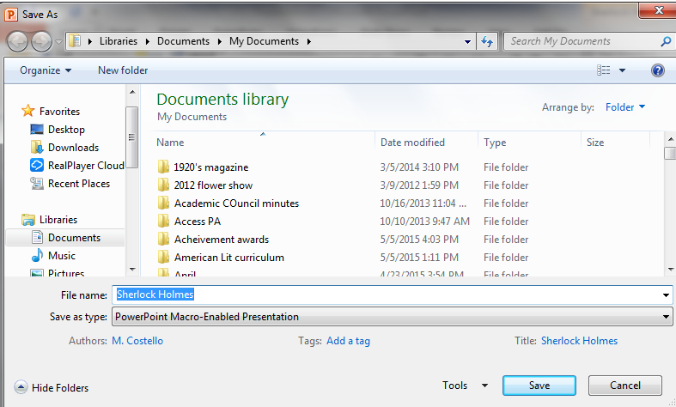
Step 4
At the bottom of the page is Save as type

Slide 6
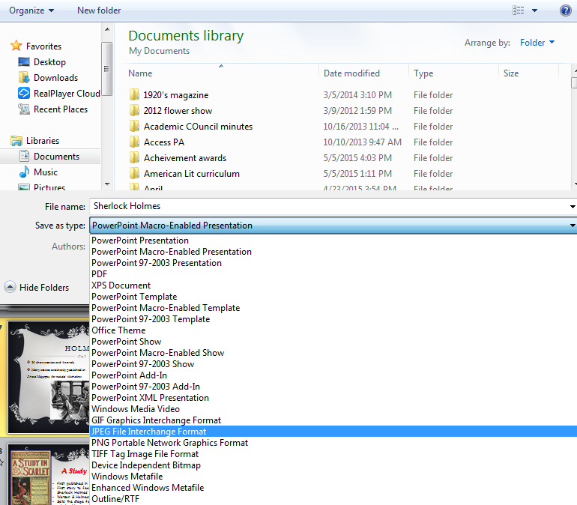
Save as type
Choose
JPEG format

Slide 7
Save as JPEG
Choose the every slide button.
This will save each slide as a separate picture IN ORDER

Slide 8
Step 5
Open Video editor
Click New video in upper right hand corner
Then give your video a name

Slide 9
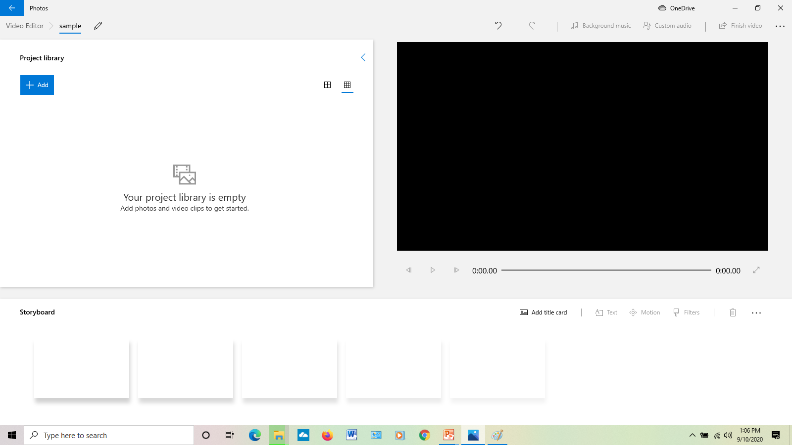
Step 6
Click ADD button in upper left to add pictures from your powerpoint.
Choose from this PC and find the folder you saved your powerpoint to

Slide 10
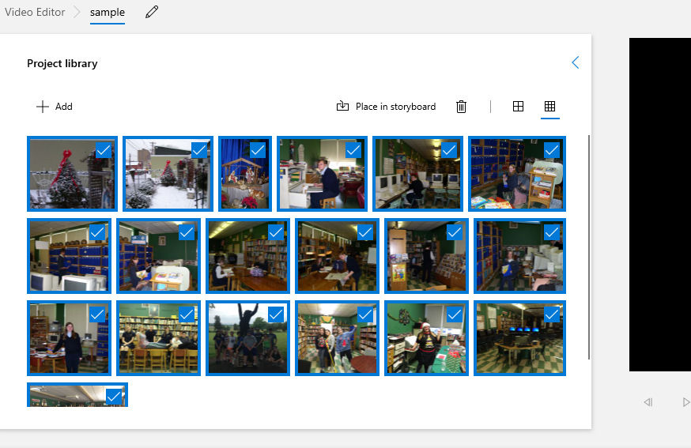
Add pictures
Highlight all the slides and click open. It will look like this

Slide 11
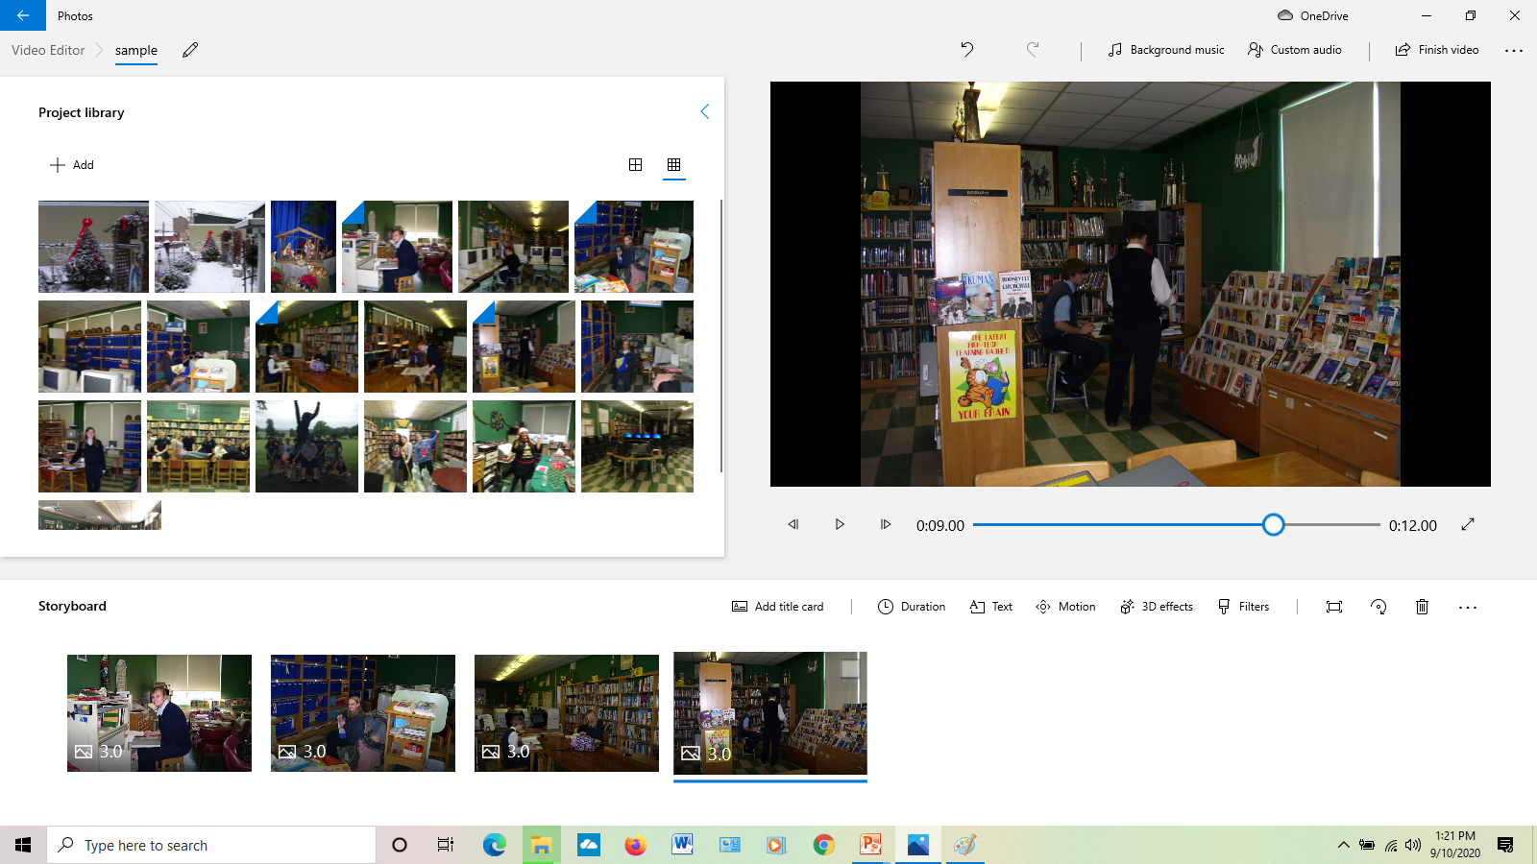
Step 7
Drag each picture to the storyboard into the slot where you want it.

Slide 12
Step 8
Add motion to each picture to make your movie move.

Slide 13
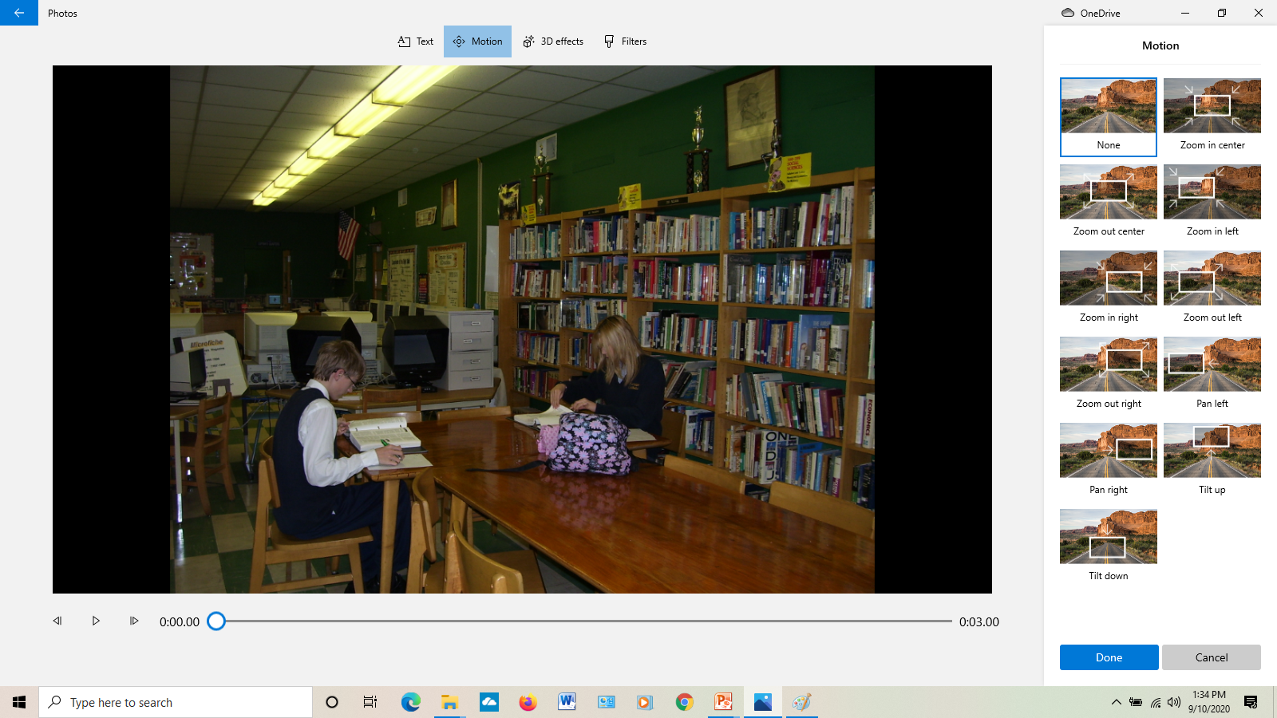
Motion choices click done

Slide 14
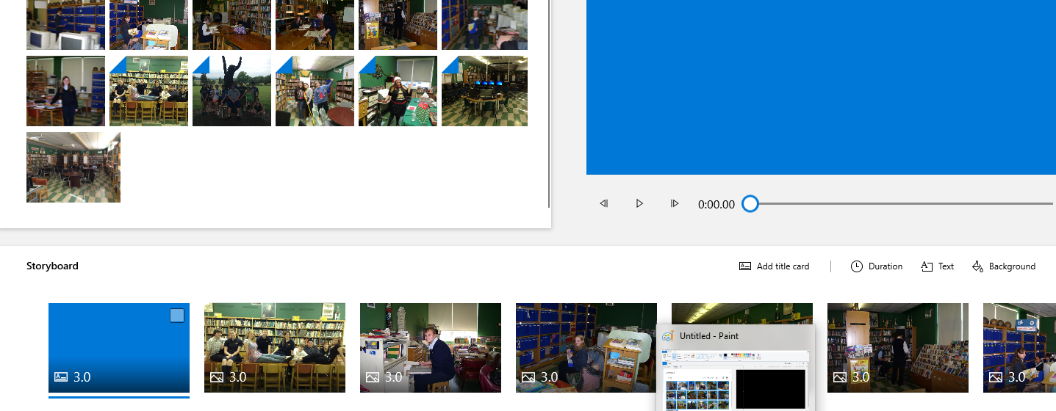
Step 9
Add a title card for your movie with your title and name
Add text – This is if you didn’t have a title page in your powerpoint

Slide 15
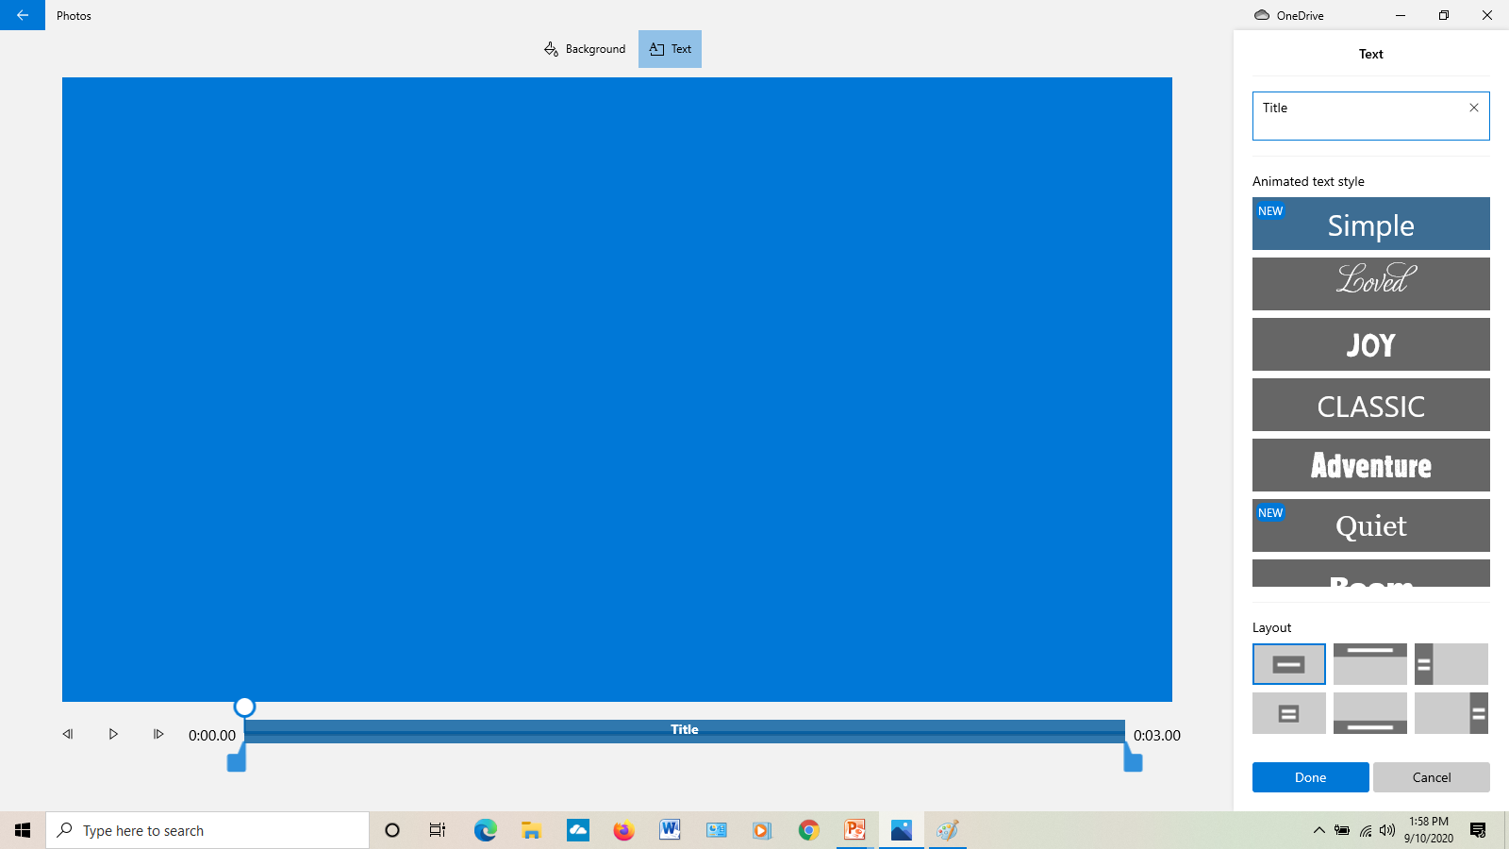
Text page
Choose the design on the right and type your info in the test box on top of choices. Click done when finished

Slide 16
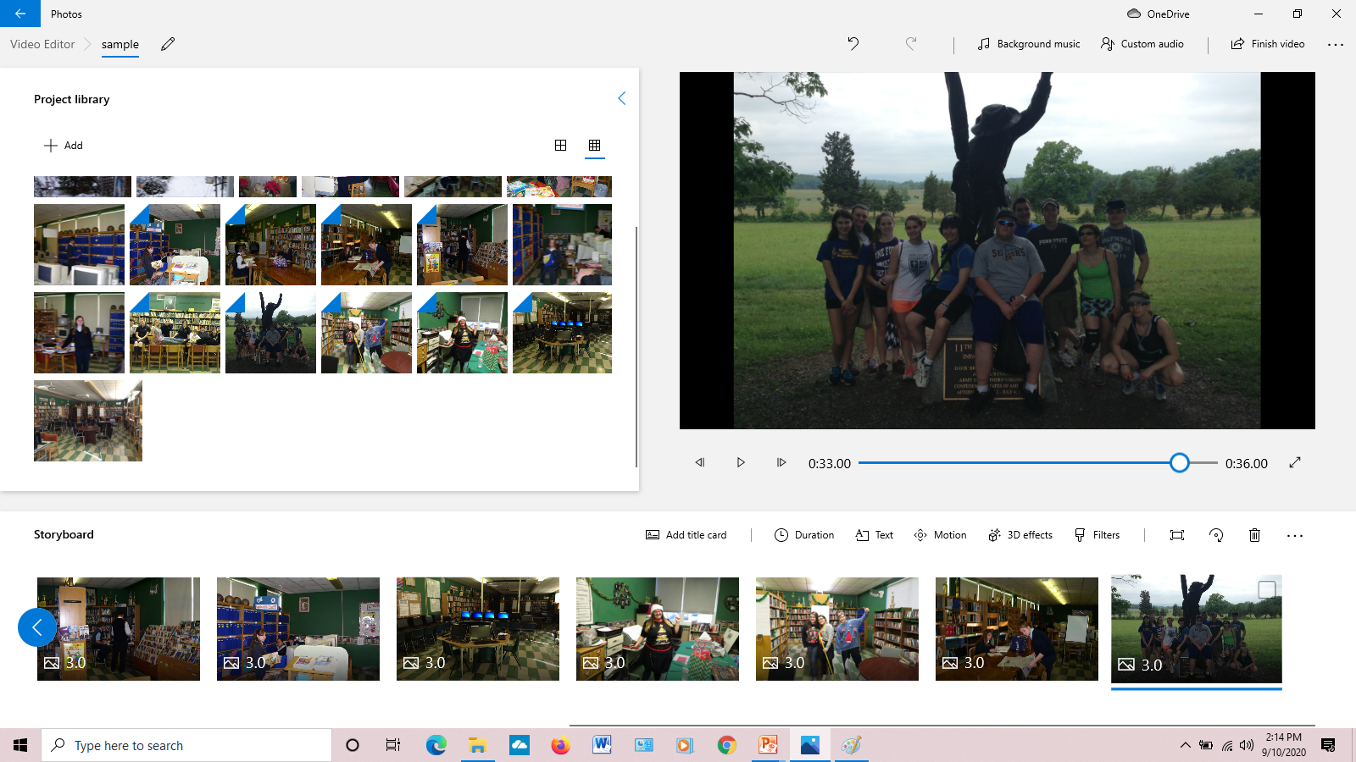
Step 10
Add audio. BUT first you need to record your audio using Audacity or something like that. Please make sure you have a file compatible with video editor.

Slide 17
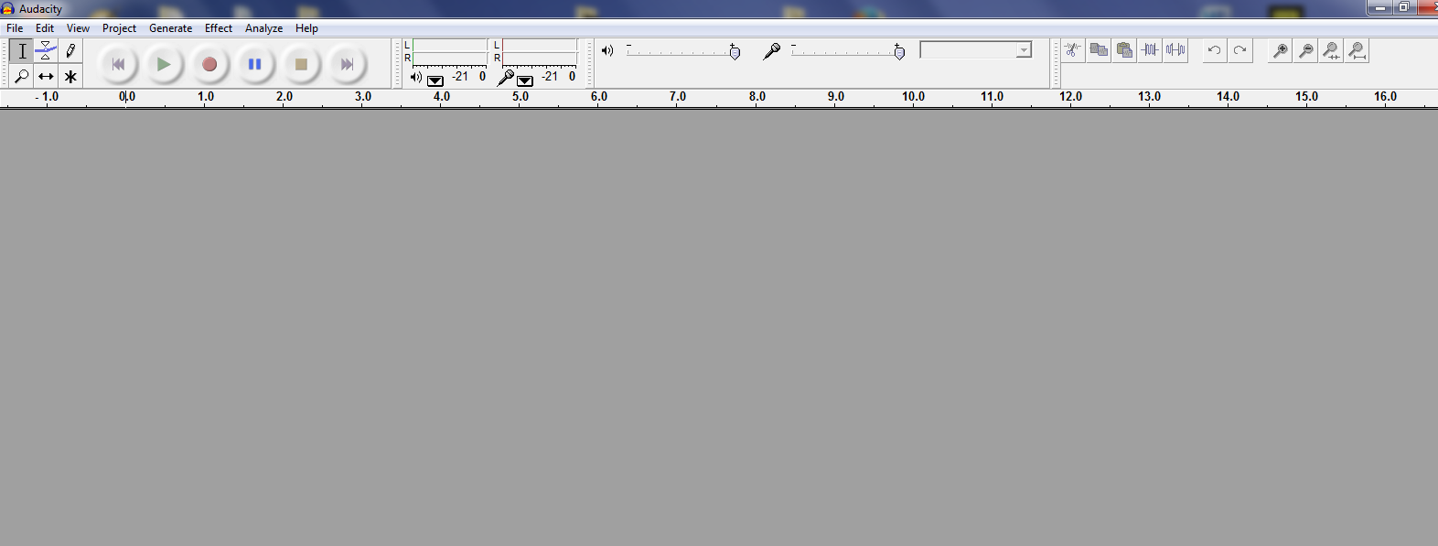
Step 11
The best program for recording your dialogue is Audacity.

Slide 18
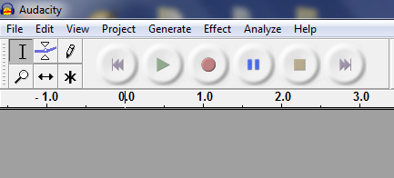
Audacity
All you have to do is write what you want to say and click the record button then the stop button when done

Slide 19
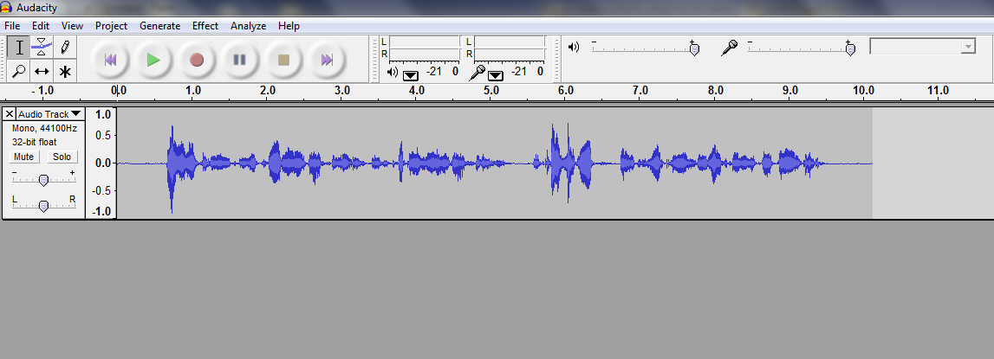
Audacity
This is what it looks like when you are done
Do one of these for each picture.
It makes it easier to match picture to sound length

Slide 20
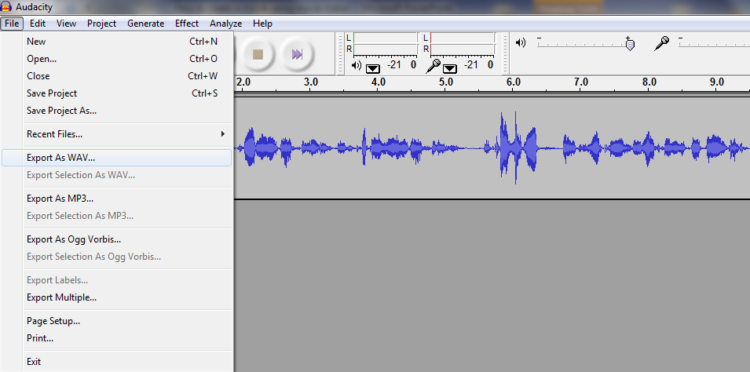
Audacity saving
To save export as a wav file and name slide 1, slide 2 etc.
Wav files work best. Save each as the slide number for
Your movie in a folder so you can find them easily.

Slide 21
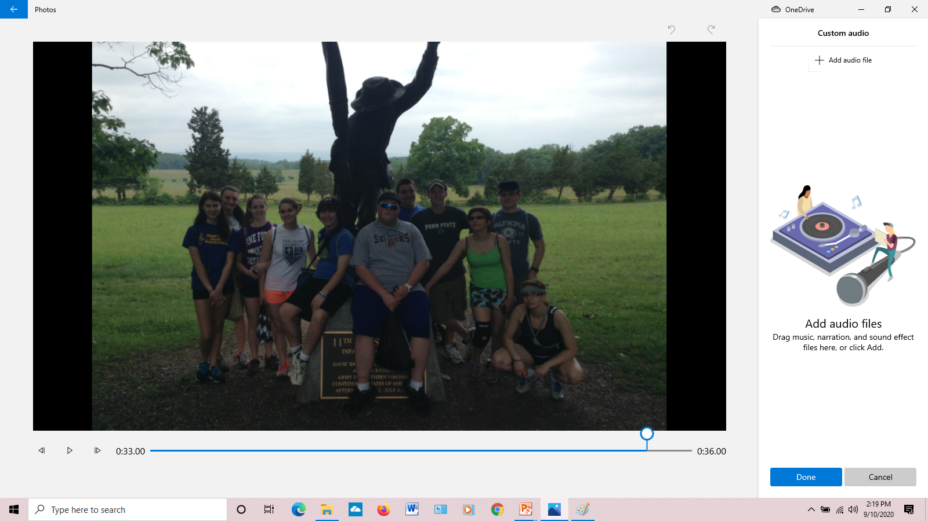
Back to video editor
Click Custom audio and either drag your audio files in or click add audio files and find in the folder you saved them in.

Slide 22
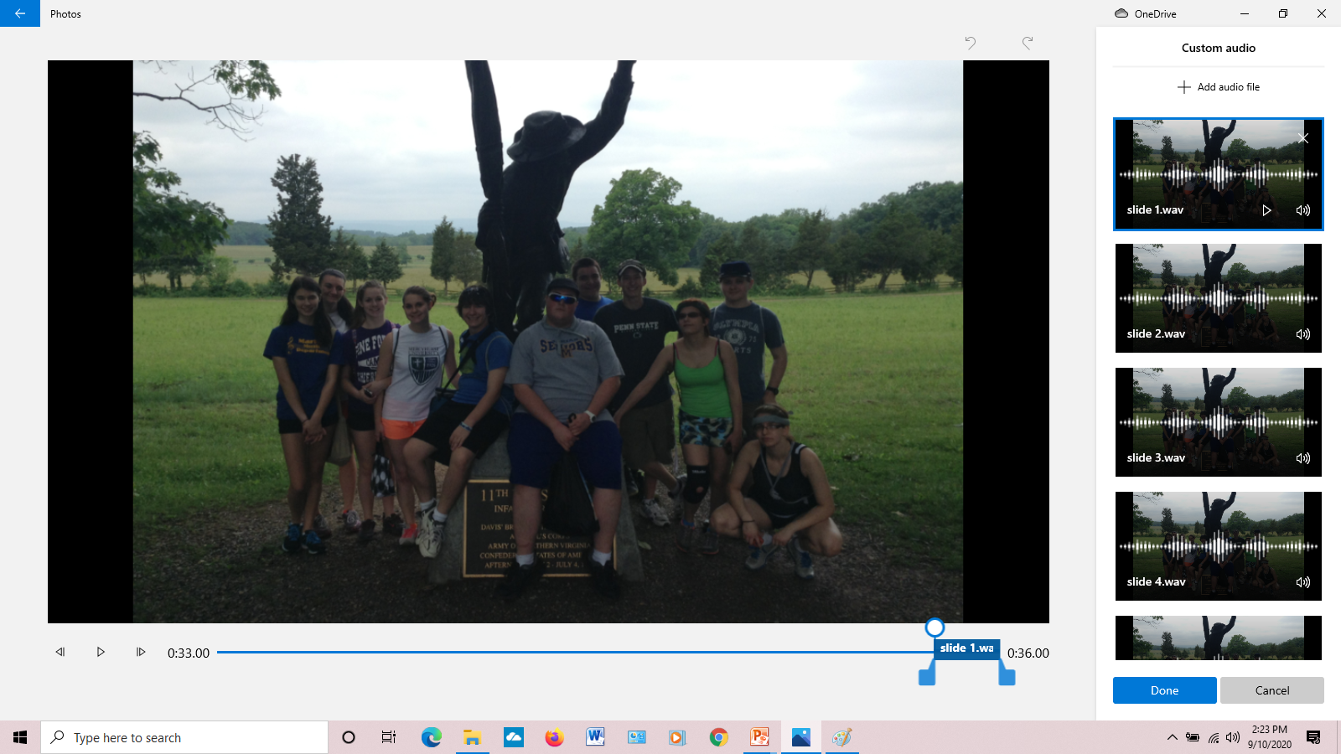
Looks like this

Slide 23
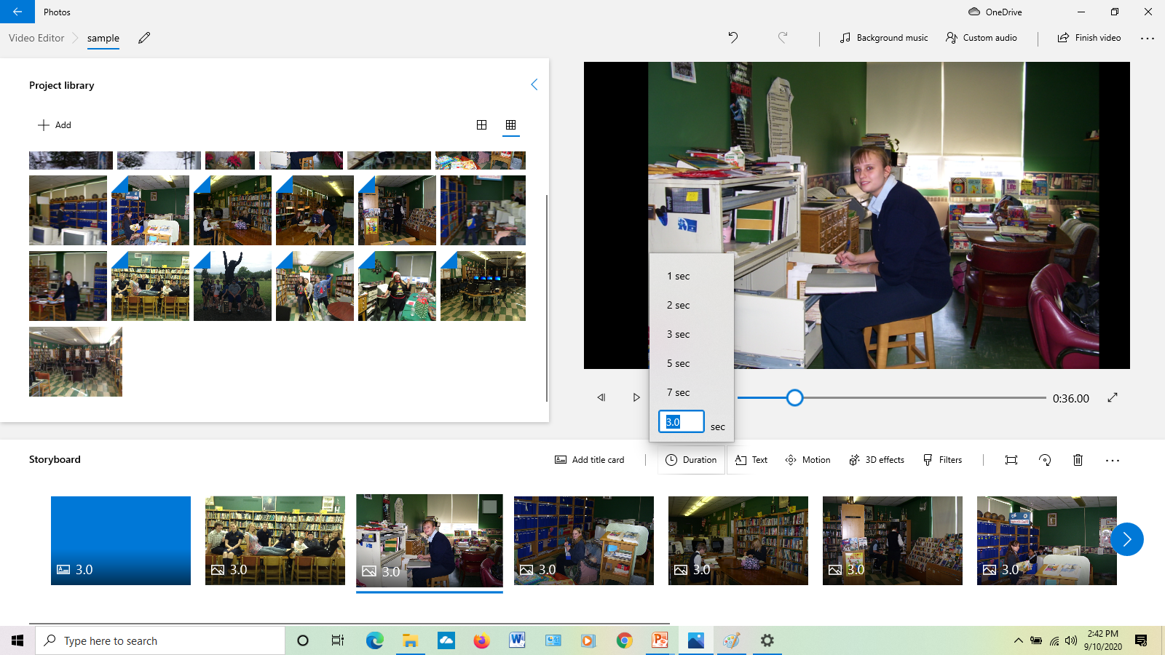
Timing
Estimate how long each of your audio clips are and extent the length of the time for the slide it matches. Or you can right click the picture for duration

Slide 24
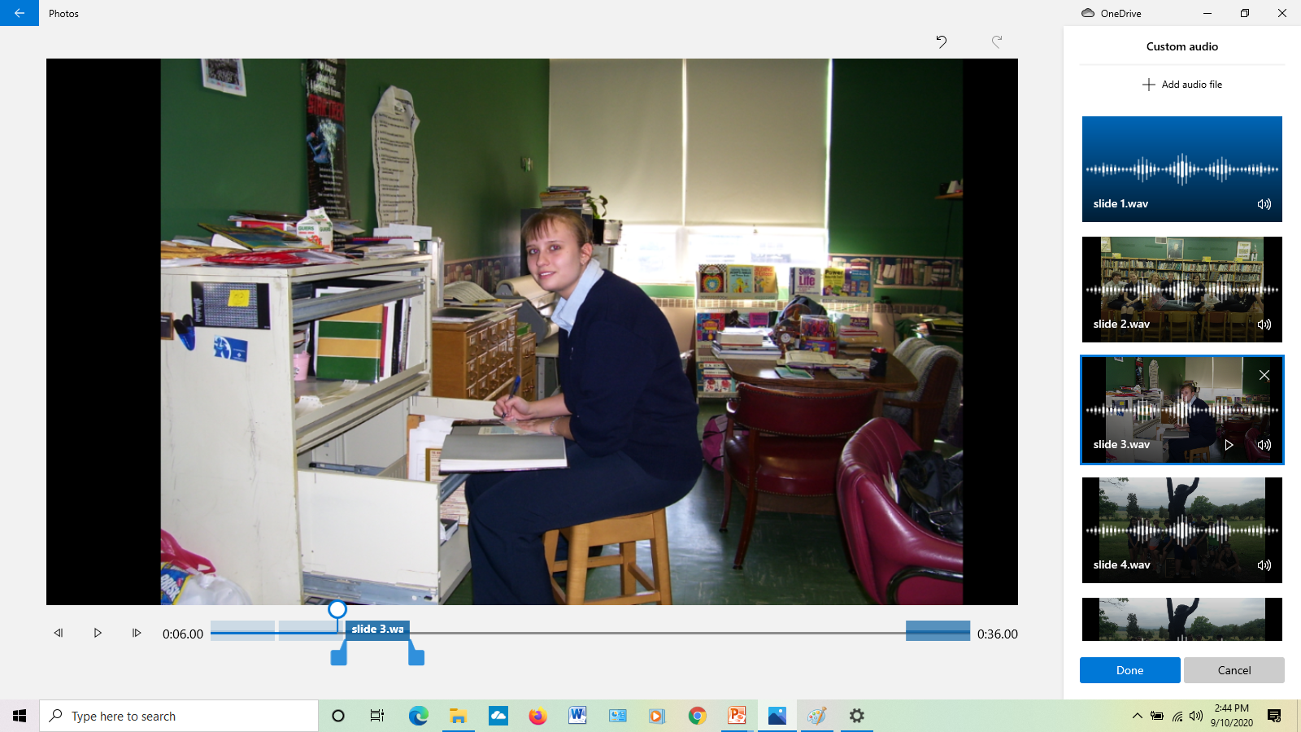
Line up and stretch each audio file where you want them on the line below the picture

Slide 25
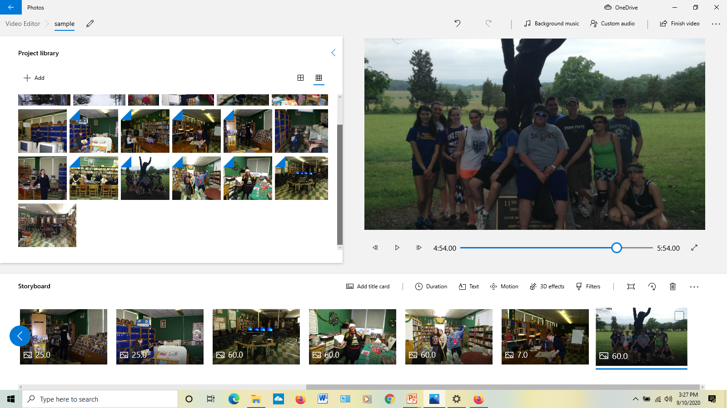
Last Step
Save your movie in Your backup drive on the server by clicking finish video and export to the backup drive.

Slide 26
Still Need help
Try the video tutorial on youtube
https://www.youtube.com/watch?v=edKDxJ7C8HE

