Slide 1
5-3: Organelles
Structures within the cell that are specialized to perform a particular life function

Slide 2
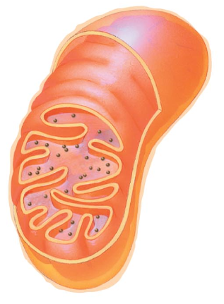
Mitochondria
Double membrane
Has its own DNA & Ribosomes
Throughout cytoplasm of all eukaryotic cells
Cellular respiration to make ATP
The Powerhouse of the cell

Slide 3
Ribosome
Complex of proteins & rRNA
No membrane
Made in nucleolus
Throughout cytoplasm of all cells &/or bound to rER
Site of protein production

Slide 4
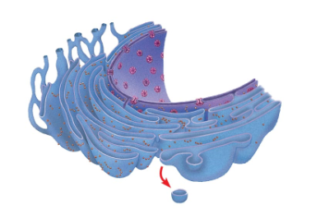
Rough Endoplasmic Reticulum (rER)
System of membranous channels covered with ribosomes
Found between nucleus and sER
Modification and transport of proteins

Slide 5
Smooth Endoplasmic Reticulum (sER)
System of membranous channels
Found between rER and Golgi Apparatus
Membrane (phospholipid) synthesis
Detoxification

Slide 6
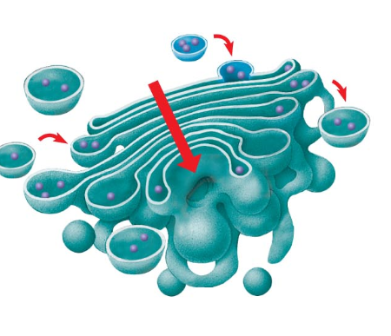
Golgi Apparatus
Series of flattened sacs (like a stack of pancakes)
Between sER and cell membrane
Processing, sorting and packaging of proteins

Slide 7
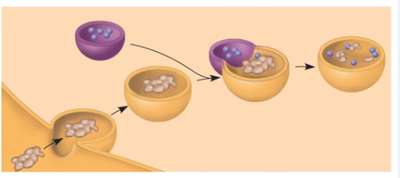
Lysosomes
Membrane-bound sac containing digestive enzymes
Throughout cytoplasm of animal cells
Digestion of food, cellular intruders, wastes and old cell parts
Suicide sacs

Slide 8
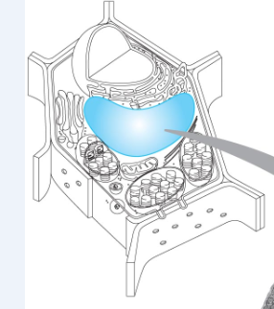
Vacuoles
Large Central Vacuole in plant cells
Membrane-bound sac
Very large in plant cells
Throughout cytoplasm of all eukaryotic cells
Store fluids and other materials
In plant cells, provides turgor pressure

Slide 9
Plastids
Triple membrane
Throughout cytoplasm in plant cells
Varied: starch storage, photosynthesis, etc

Slide 10
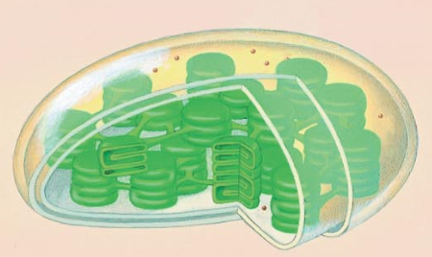
Chloroplast
Triple membrane
Type of plastid, contains chlorophyll, DNA & ribosomes
Throughout cytoplasm in plant cells
Photosynthesis (conversion of solar energy to chemical energy)
Production of glucose

Slide 11
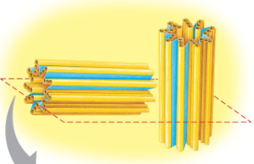
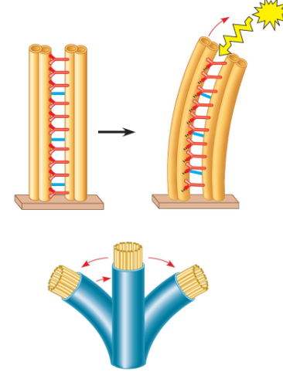
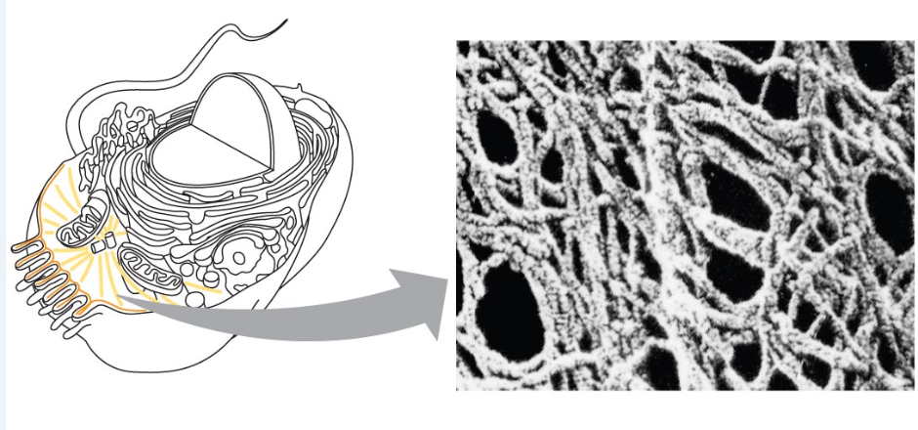
Cytoskeleton
Microtubules, microfilaments and intermediate filaments
Composed of proteins
Throughout cytoplasm of all cells and contiguous with cell membrane
Provide structure and shape to cell
Centrioles – cell division
Cilia & flagella – cell movement

Slide 12
Endomembrane System
A series of organelles involved in the production of proteins.
Includes the rER, sER, transport vessicles, golgi apparatus, lysosomes and secretory vessicles

Slide 13
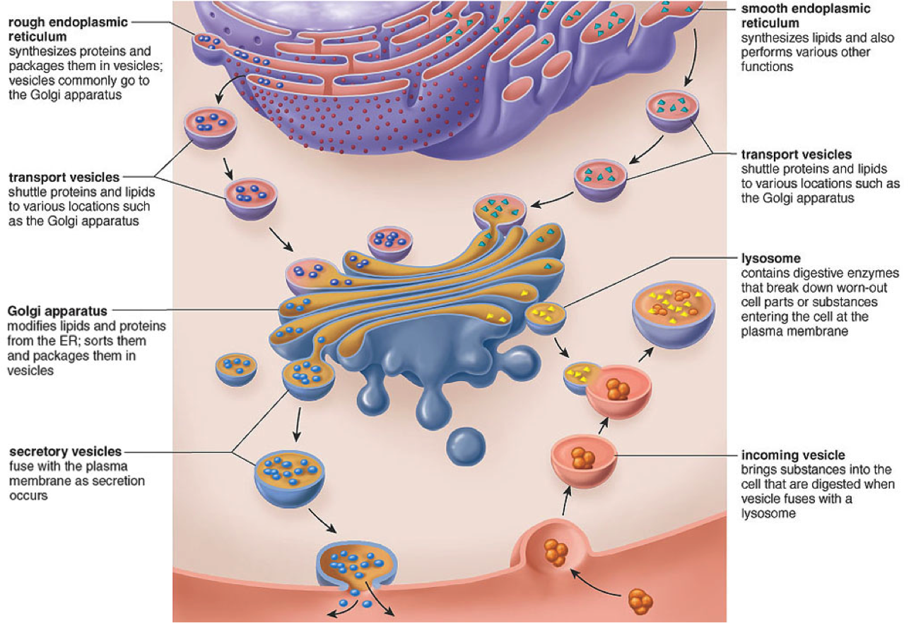
Endomembrane System
Rough endoplasmic reticulum
smooth endoplasmic reticulum
Transport vesicles
Transport vesicles
lysosome
Golgi apparatus
Secretory vesicles
Incoming vesicle

Slide 14
Endomembrane System
smooth endoplasmic reticulum
Transport vesicles
Transport vesicles
lysosome
Golgi apparatus
Secretory vesicles
Incoming vesicle

Slide 15
Endomembrane System
smooth endoplasmic reticulum
Transport vesicles
lysosome
Golgi apparatus
Secretory vesicles
Incoming vesicle

Slide 16
Endomembrane System
smooth endoplasmic reticulum
Transport vesicles
lysosome
Secretory vesicles
Incoming vesicle

Slide 17
Endomembrane System
smooth endoplasmic reticulum
Transport vesicles
lysosome
Incoming vesicle

Slide 18
Endomembrane System
Transport vesicles
lysosome
Incoming vesicle

Slide 19
Endomembrane System
lysosome
Incoming vesicle

Slide 20
Endomembrane System
Incoming vesicle

Slide 21
Endomembrane System

