Slide 1
Create a slide presentation for your

Slide 2
Requirements for presentation
1. At least 20 slides to teach your research paper
2. At least one graphic on each slide except Bibliography
3. Cite each graphic with the URL under the picture if online picture
4. Cover your topic completely with minimum words per slide (no paragraphs)
5. Must include slide transitions and object animation
6. Last slide copy your works cited or reference page

Slide 3
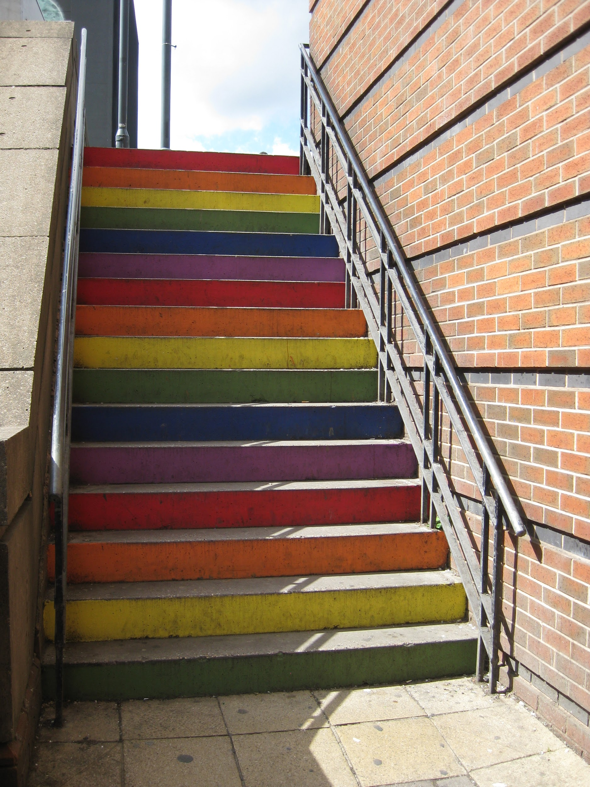
Steps to create
Use google slides
Create a theme or color scheme
Create a title page with your title and your name
See next slide for example

Slide 4
Title of Research Paper
By student name

Slide 5
Rubric
The following will be graded:
Number of slides
There is not too much text on a slide. Each slide contains a limited number of talking points as opposed to complete paragraphs or lengthy sentences.
Text is clear and easy for the audience to see.
Presentation is free of spelling and grammatical errors.
Graphic on each slide with citation
Slides display elements of effective design.Fonts, colors, backgrounds, etc. are effective, consistent and appropriate to the topic and audience.
Animations and/or sounds have been used to emphasize important points. They do not distract from the content.
Title Slide
Bibliography included
https://www.teenvogue.com/story/why-teachers-getting-rid-grades

