Slide 1
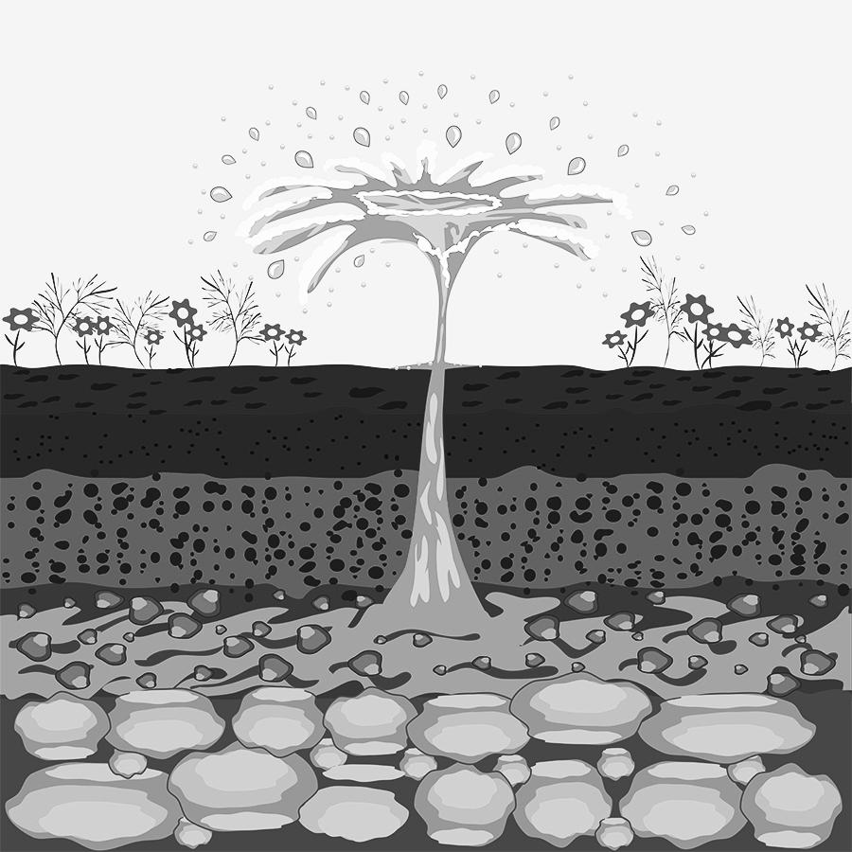
aquifer
large bodies of underground rock that contain fresh groundwater
Notes:
Teaching Tip: These slides can be used to support students understanding of the vocabulary words as they make sense of them throughout the unit. When bolded vocabulary words are mentioned during a lesson, you can use these slides to provide pictorial support to help build your students understanding of the words. The goal is not for students to memorize these definitions, but to use them to support their sensemaking of the phenomenon. Students should typically first make sense of the ideas and articulate them in their own words before being given complex science words to attach to those ideas.

Slide 2
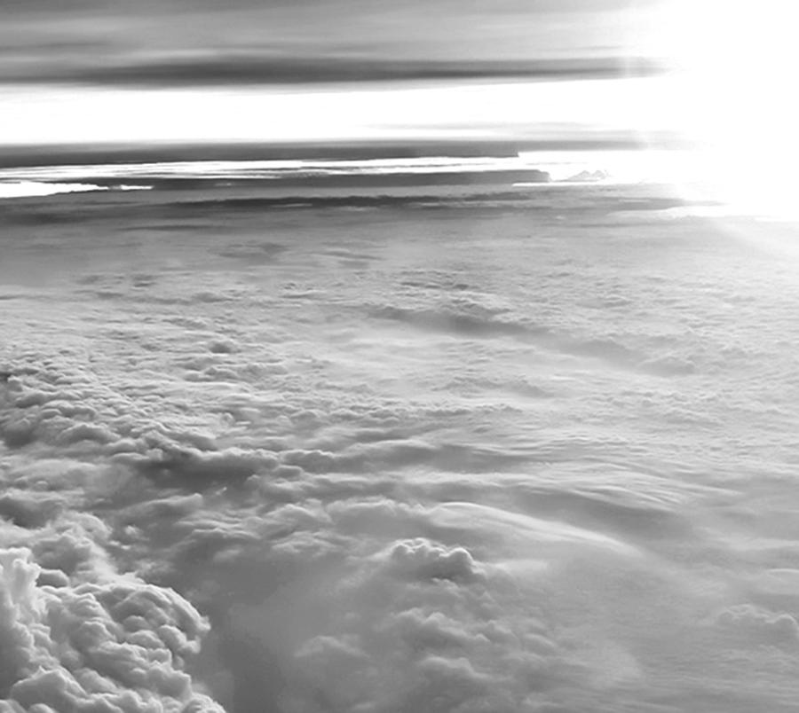
atmosphere
the air that surrounds Earth

Slide 3
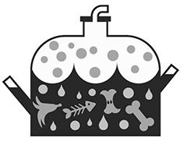
biodigester
a container that collects gas created by living things as they break down food

Slide 4
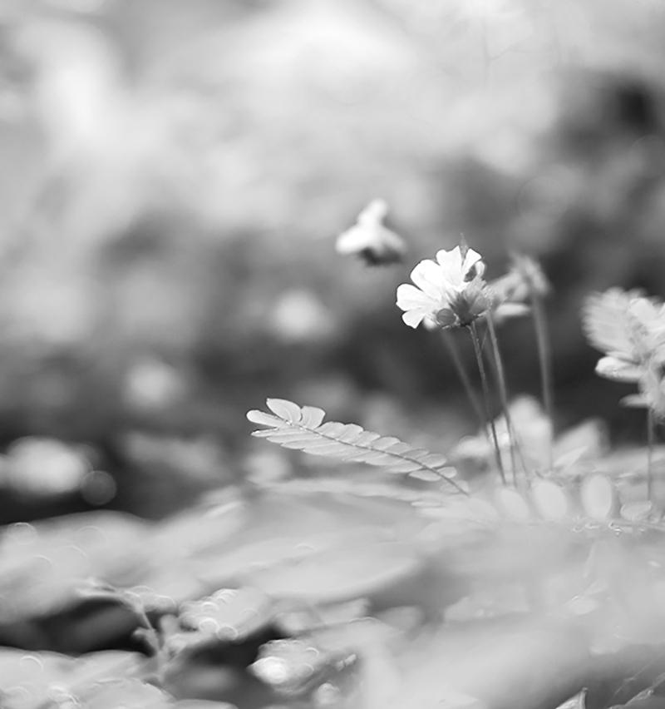
biosphere
parts of the Earth that contain organisms

Slide 5
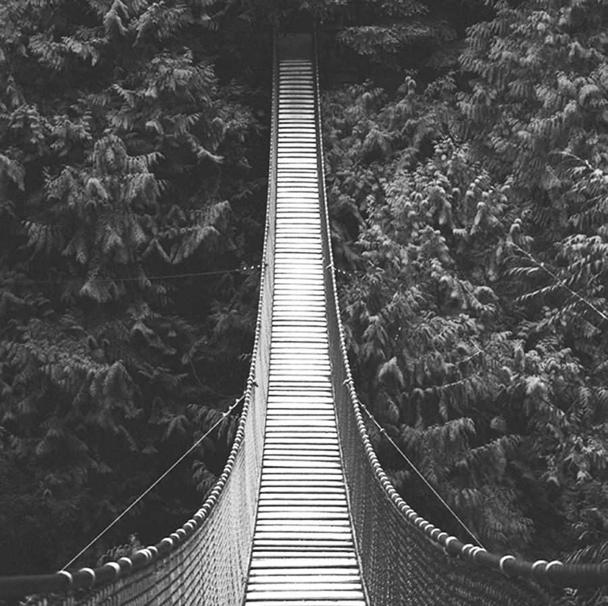
constraint
what the design is limited by or cannot do

Slide 6
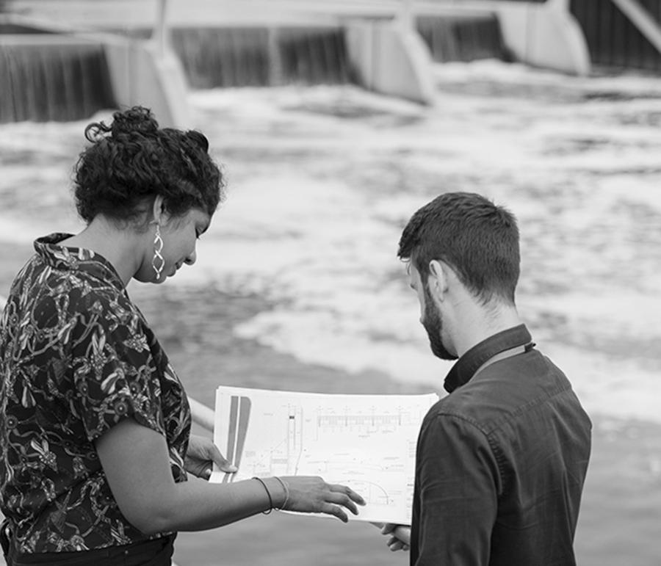
criteria
what the design must have or be like

Slide 7
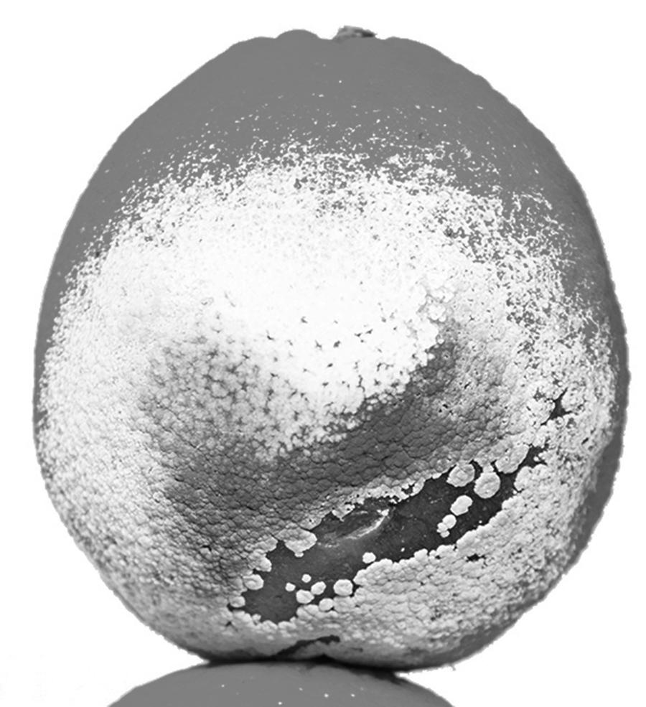
decomposer
an organism, such as bacteria or fungi, that breaks down dead organisms

Slide 8
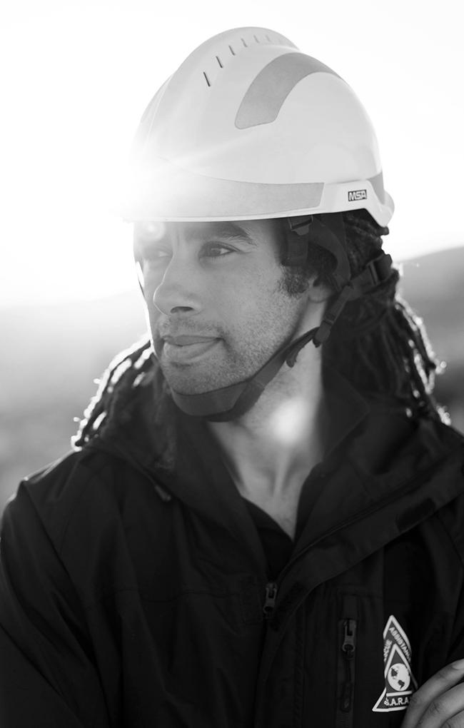
engineer
someone who designs solutions to problems

Slide 9
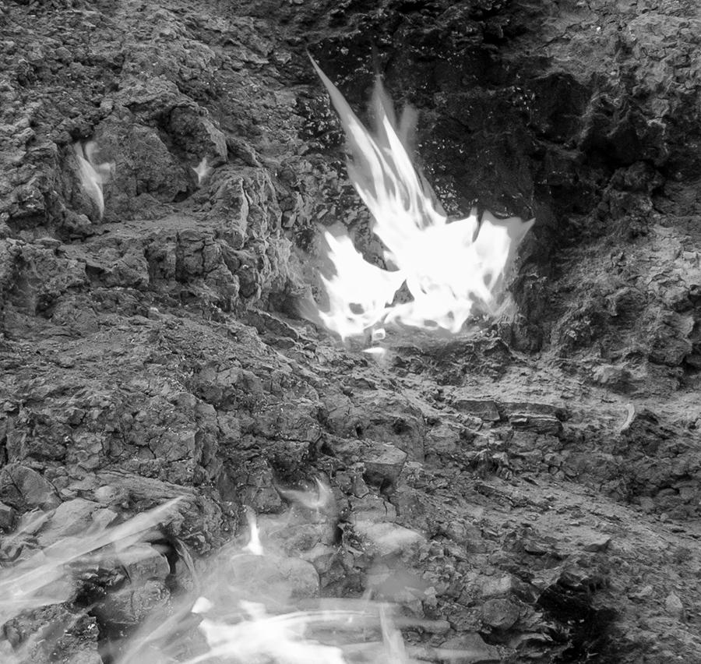
flammable
able to be lit on fire

Slide 10
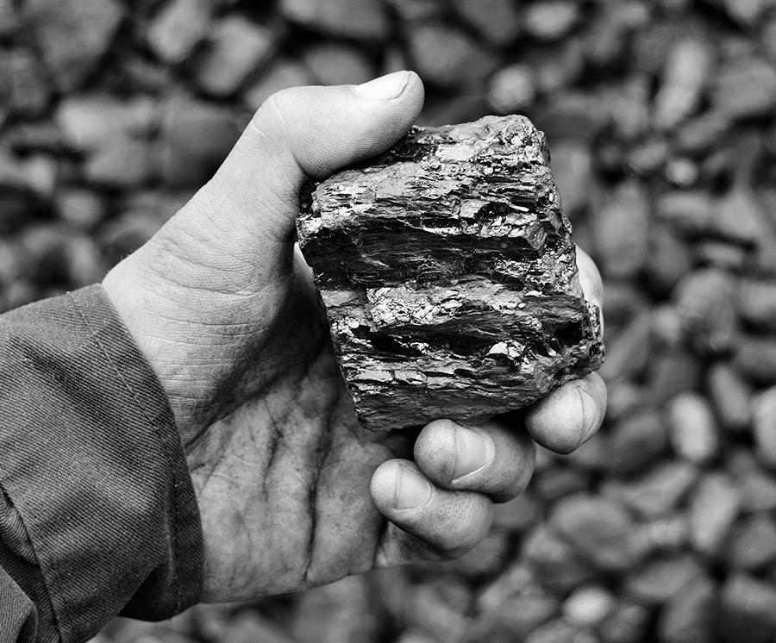
fossil fuel
a fuel that formed from the decayed remains of ancient plants and animals (coal, oil, and natural gas)

Slide 11
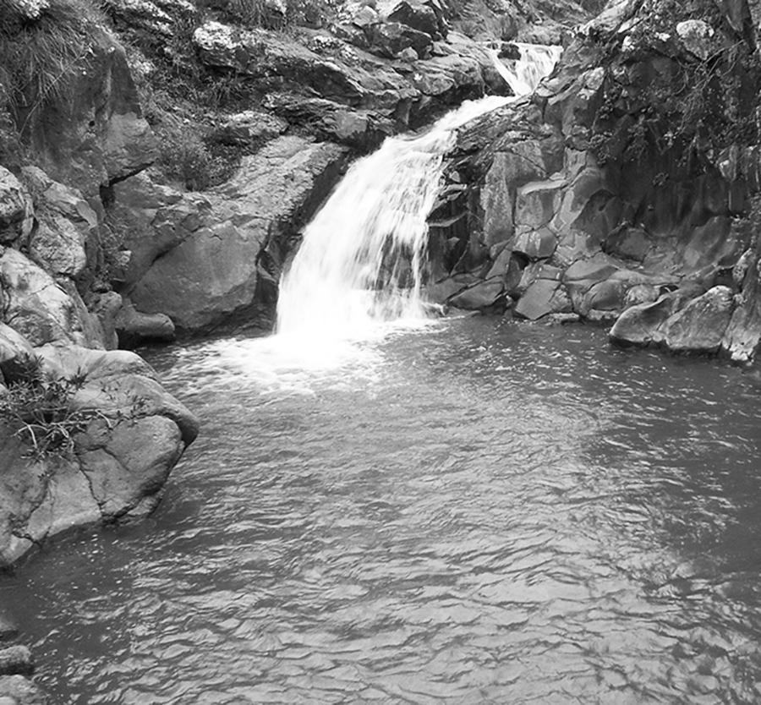
freshwater
water that does not contain a large amount of salt (like river or lake water)

Slide 12
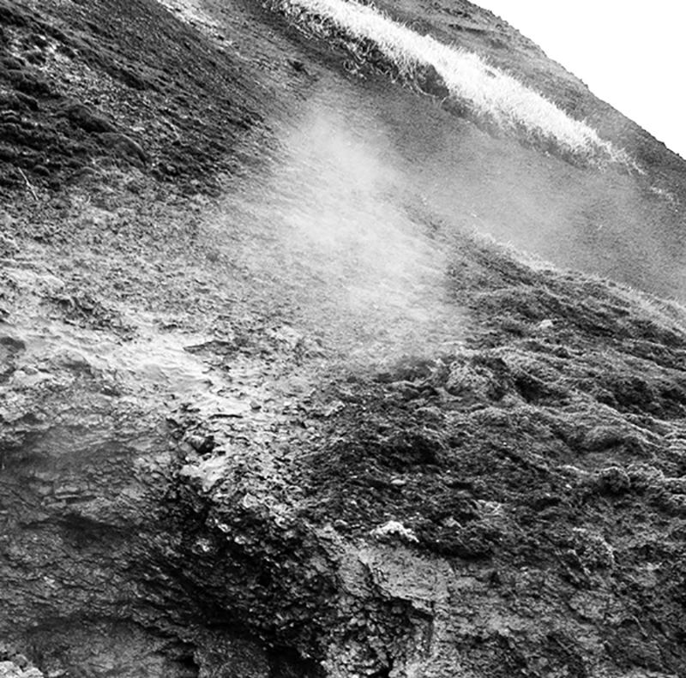
geosphere
Earth’s crust and mantle (soil, rocks, and molten rock)

Slide 13
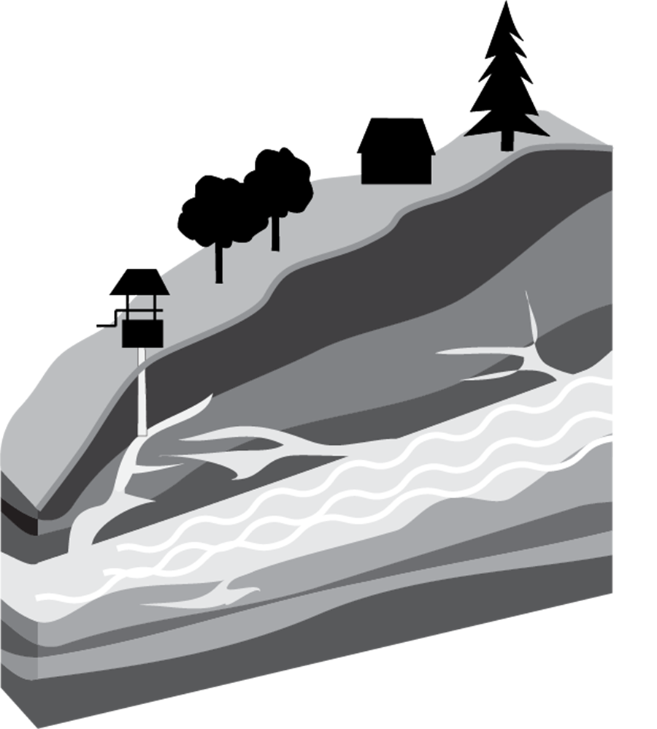
groundwater
water that collects underground in cracks and spaces in rock

Slide 14
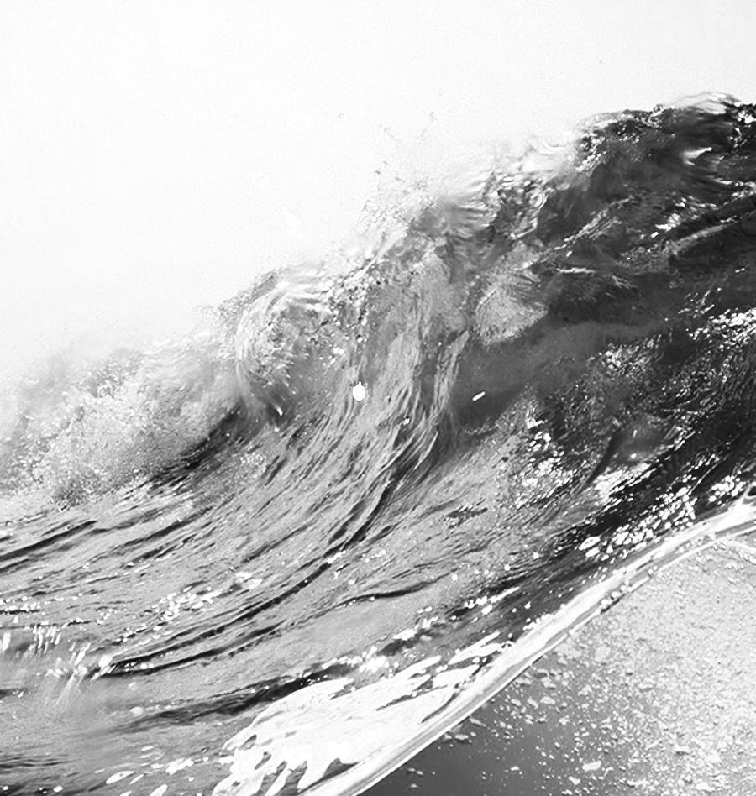
hydrosphere
liquid water on Earth’s surface, in the ground, and in the air

Slide 15
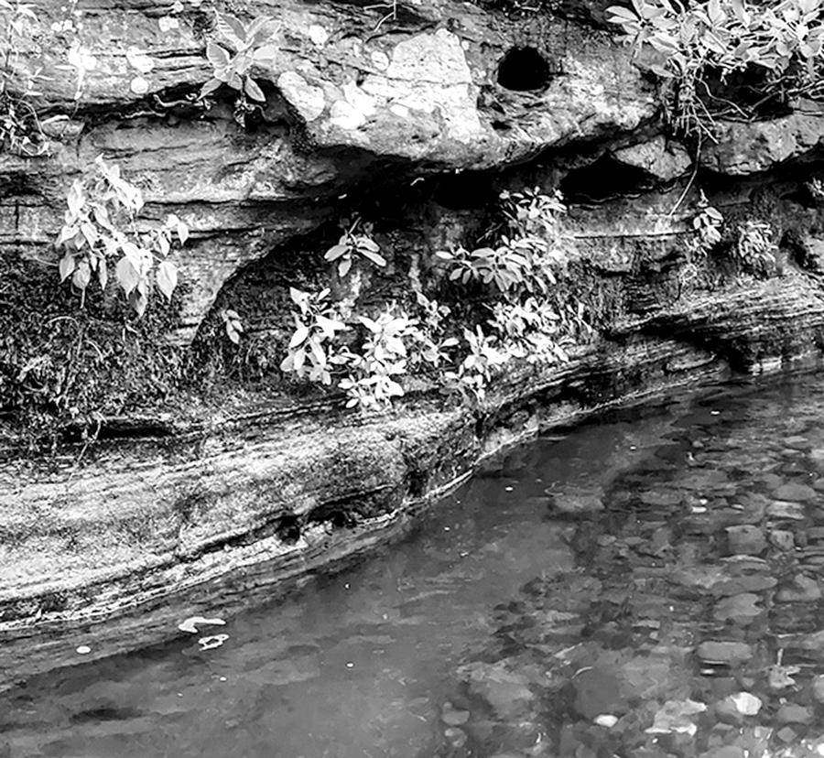
interact
have an effect on each other

Slide 16

natural resource
materials in Earth’s spheres that are useful to people

Slide 17
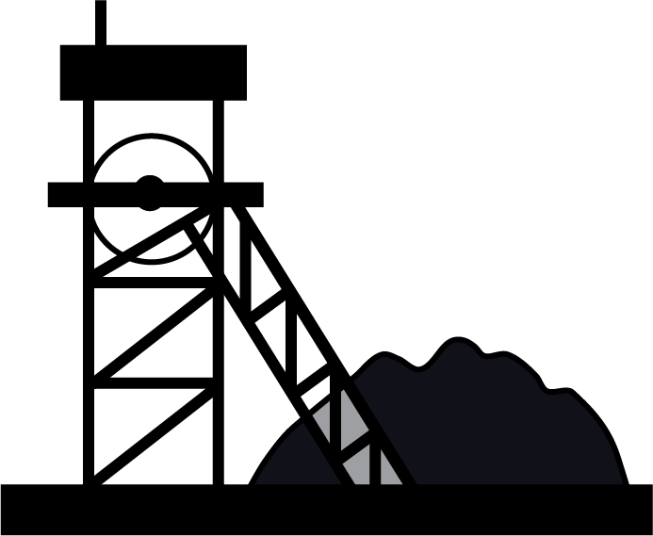
non-renewable resource
resource that is not replaced by nature as fast as it is used

Slide 18
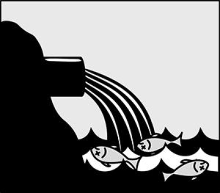
pollution
adding a harmful or poisonous substance to the environment

Slide 19
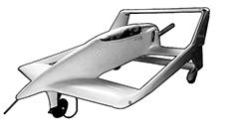
prototype
a first model or design of something

Slide 20
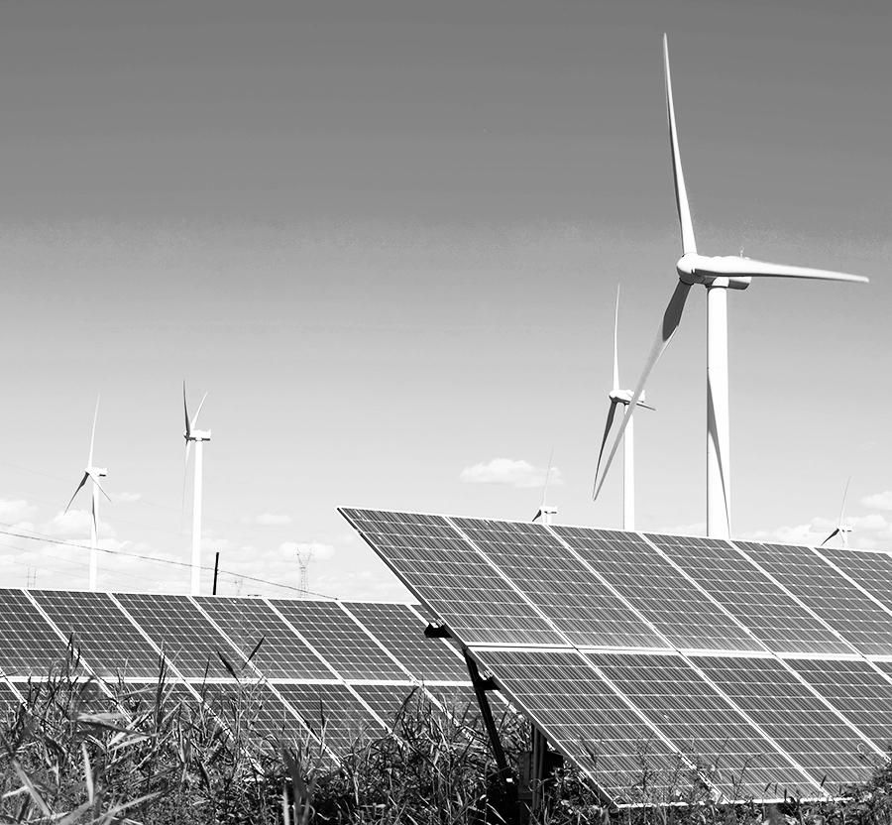
renewable resource
resources that are replaced by nature faster than they are used

Slide 21
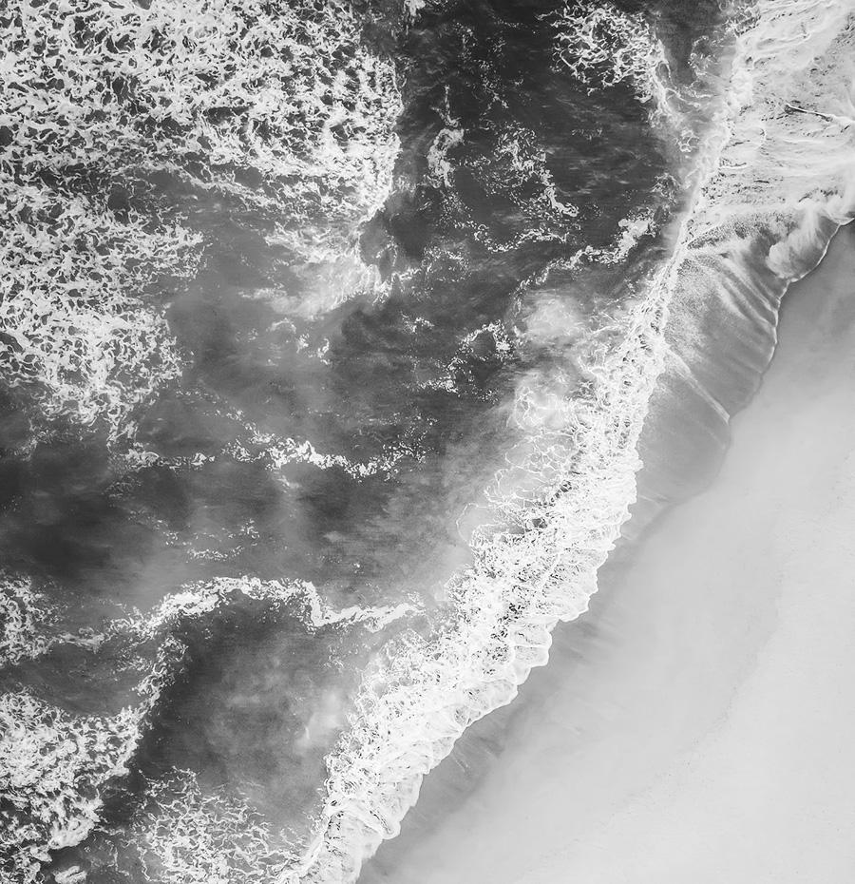
saltwater
water that contains a lot of salt (like ocean water)

Slide 22
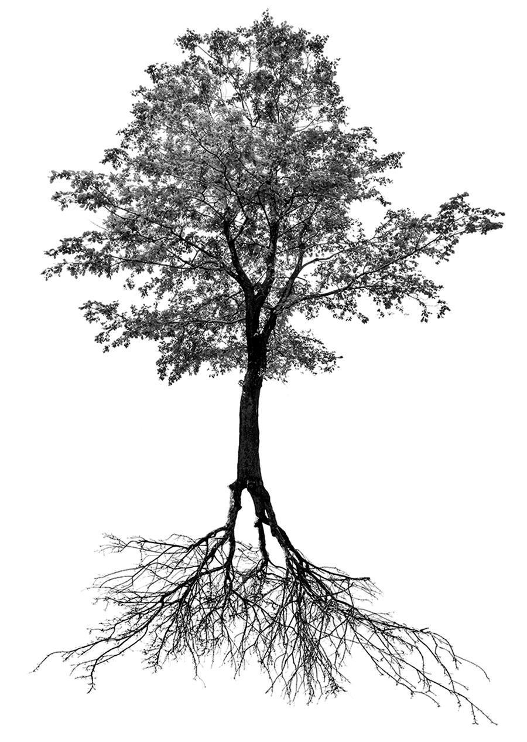
system
a group of related parts that function together as a whole

