Slide 1

The Pennsylvania STEELS Assessment Foundations Toolkit
Module 3: Cultivating a System Where Assessments Work Together to Improve Student Learning
[Date]

Slide 2
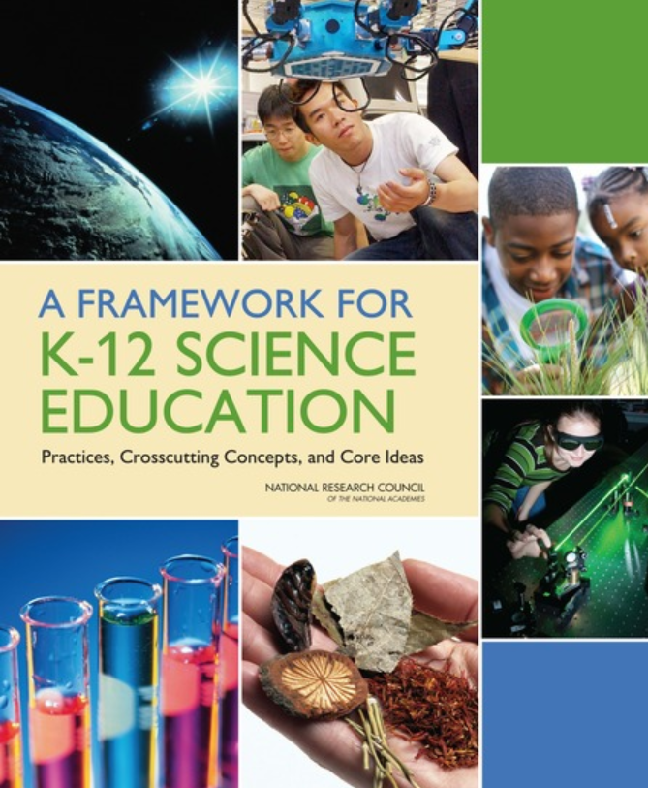

STEELS: Rigorous Learning Goals
In 2022, Pennsylvania adopted the Science, Technology & Engineering, Environmental Literacy Sustainability (STEELS) standards, new learning goals for K–12 students based on research of how kids learn.
Updated PSSA and Keystone exams are operational in spring 2026.

Slide 3
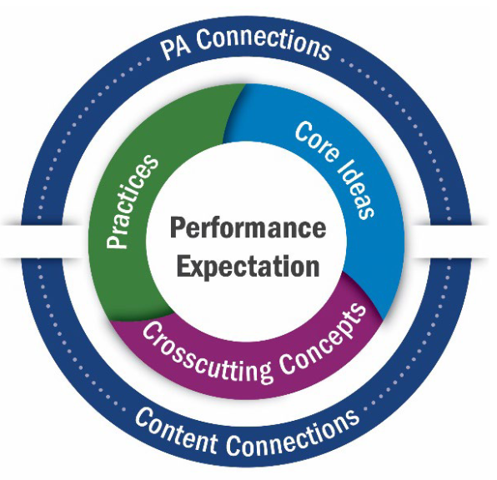
STEELS: Rigorous Learning Goals (cont.)
These K–12 standards represent not just what kids learn, but how they learn:
A shift from “learning about” to “figuring out” that puts students in the driver’s seat.
Learning about
Figuring out
Local Pennsylvania learning contexts
Cross-content connections

Slide 4
STEELS Assessment Foundations Toolkit
The three modules in this toolkit will support participants to build a foundation in how to monitor and further student learning of Pennsylvania’s STEELS standards.
Module 1: Features of Quality STEELS-Based Assessments
Module 2: Assessing Rigorous STEELS Learning of All Students
Module 3: Cultivating a System Where Assessments Work Together to Improve Student Learning

Slide 5
Module 3 Goal
Participants develop a common understanding of an assessment culture that focuses on how different types of assessments work together to improve student learning, not just check a box.
Just having quality science assessments is not enough — we need to create a culture that supports educators at all levels to appropriately use and know what the research shows is most effective way to use assessment data.

Slide 6
Module 3: Assessments Work Together to Improve Learning
Module 3 Progression
Session 3.1
Session 3.3
Session 3.2
Using Assessment Data to Improve Learning
Assessments Throughout a Learning Sequence
Different Assessments Working Together

Slide 7
Norms: Cultivating a Culture of Caring
Recognize that we all need care at some point, in some way.
Share what you need in order to be cared for well.
Protect your (and other people’s) time to rest.
Practice vulnerability in ways that are reciprocal.
Get to know your colleagues and students.
Make connections between the micro and the macro.
Keep a record of your progress over time.
Honor and recognize the leadership and knowledge of the people indigenous to where you are.
Value insights from those with different backgrounds.
Nurture imagination.
Celebrate
Adapted from Source: Othering & Belonging Institute, SPA-LC NGSS District Assessment Toolkit
Notes:
See supplement for more details: https://docs.google.com/document/d/1QFzXHdk2n8qdfj_XObgjFEQD_cV3fSZTvzdI19b_58I/edit?usp=sharing

Slide 8
Create Your Workspace
What could set you up to do your best learning, collaborating, and thinking in this context?
How do you want your workspace arranged today?
What resources do you want to have pulled up?
Source: SPA-LC NGSS District Assessment Toolkit

Slide 9
Module 3: Session 3.1 - Assessments Work Together to Improve Learning
Module 3 Progression
Session 3.1
Session 3.3
Session 3.2
Using Assessment Data to Improve Learning
Assessments Throughout a Learning Sequence
Different Assessments Working Together

Slide 10
Vision for Science Teaching and Learning
It’s important that assessments measure what we value for all learners.
Students as “doers” engaging as scientists and engineers
Critical thinking
All students
Flexible, creative reasoning
Figuring out the world around them
Relevant and authentic
Solving local community problems
Working in new contexts
Motivated, engaged, inspired students
Prepared for college, careers, and citizenship

Slide 11

Quick Write
In the past, what were the most useful ways that you used information from assessments?
What were the least useful ways you used that information?
What made these ways more or less useful?

Slide 12
Assessment for Learning Cycle: Step 1
Identify Learning Goal
Gather Evidence of Learning
Analyze and Interpret Evidence of Learning
Provide Feedback to Support Students’ Growth
Refine Instruction in Response to Evidence of Learning
Source: SCALE Science, https://scalescience.wested.org/

Slide 13
Example Task Assessment Grade 3–5 Targets
Science and Engineering Practices (SEPs) | Disciplinary Core Ideas (DCIs) | Crosscutting Concepts (CCCs)
Developing and Using Models Grade 3-5 Elements Use models to describe phenomena. | PS1.A: Structure and Properties of Matter Grade 3-5 Elements Matter of any type can be subdivided into particles that are too small to see, but even then the matter still exists and can be detected by other means. A model shows that gases are made from matter particles that are too small to see and are moving freely around in space can explain many observations, including the inflation and shape of a balloon and the effects of air on larger particles or objects. The amount (weight) of matter is conserved when it changes form, even in transitions in which it seems to vanish. | Energy and Matter Grade 3-5 Elements The total weight of the substances does not change. This is what is meant by conservation of matter.

Slide 14



Compare: Performance Outcomes
Students know where organisms get their energy.
Students develop a model to describe the cycling of matter and flow of energy among living and nonliving parts of an ecosystem.
VS.

Slide 15
Multi-Dimensional Learning Goal
Performance Outcome: Use a model to describe how changes in states of matter cause the movement and conservation of matter even when it seems to vanish.
Notes:
For sake of time, we're going to focus on analyzing one prompt - this is a good example of a three-dimensional prompt that addresses the phenomenon of the assessment and we can get lots of useful information about our students just from this prompt.
We first need to get really clear about which aspects of the dimensions this prompt assesses by looking at the performance outcome (click) so that we know what we are looking for in student work.

Slide 16
Multi-Dimensional Learning Goal: SEP
SEP
Performance Outcome: Use a model to describe how changes in states of matter cause the movement and conservation of matter even when it seems to vanish.
Notes:
For sake of time, we're going to focus on analyzing one prompt - this is a good example of a three-dimensional prompt that addresses the phenomenon of the assessment and we can get lots of useful information about our students just from this prompt.
We first need to get really clear about which aspects of the dimensions this prompt assesses by looking at the performance outcome (click) so that we know what we are looking for in student work.

Slide 17
Multi-Dimensional Learning Goal: DCI
DCI
Performance Outcome: Use a model to describe how changes in states of matter cause the movement and conservation of matter even when it seems to vanish.
Notes:
For sake of time, we're going to focus on analyzing one prompt - this is a good example of a three-dimensional prompt that addresses the phenomenon of the assessment and we can get lots of useful information about our students just from this prompt.
We first need to get really clear about which aspects of the dimensions this prompt assesses by looking at the performance outcome (click) so that we know what we are looking for in student work.

Slide 18
Multi-Dimensional Learning Goal: CCC
CCC
Performance Outcome: Use a model to describe how changes in states of matter cause the movement and conservation of matter even when it seems to vanish.
Notes:
For sake of time, we're going to focus on analyzing one prompt - this is a good example of a three-dimensional prompt that addresses the phenomenon of the assessment and we can get lots of useful information about our students just from this prompt.
We first need to get really clear about which aspects of the dimensions this prompt assesses by looking at the performance outcome (click) so that we know what we are looking for in student work.

Slide 19
Assessment for Learning Cycle: Step 2
Identify Learning Goal
Gather Evidence of Learning
Analyze and Interpret Evidence of Learning
Provide Feedback to Support Students’ Growth
Refine Instruction in Response to Evidence of Learning
Source: SCALE Science, https://scalescience.wested.org/

Slide 20
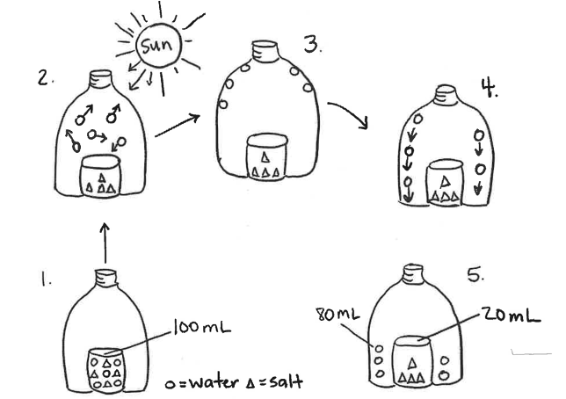
Gather Evidence of Learning
Prompt A: Use the steps in the model to explain how the salt is removed from the water in the solar still. In your explanations, include how changes in states of matter make the solar still work as a system.
Assessment tasks are the foundation for gathering evidence of learning.
An assessment “task” is a specific activity designed to collect evidence about a student's achievement of a targeted learning outcome.
Notes:
And last but not least, we are looking for whether students are able to clearly describe the movement and conservation of matter within the system.

Slide 21
Assessment for Learning Cycle: Step 3
Identify Learning Goal
Gather Evidence of Learning
Analyze and Interpret Evidence of Learning
Provide Feedback to Support Students’ Growth
Refine Instruction in Response to Evidence of Learning
Source: SCALE Science, https://scalescience.wested.org/

Slide 22
Analyze and Interpret Evidence of Learning
Prompt A: Use the steps in the model to explain how the salt is removed from the water in the solar still. In your explanations, include how changes in states of matter make the solar still work as a system.
Performance Outcome: Use a model to describe how changes in states of matter cause the movement and conservation of matter even when it seems to vanish.
Source: Scale Science at WestEd

Slide 23


Part I: Analyze Student Work
Color-code your answers by dimension.
For each student answer, describe each dimension as emerging, developing, or proficient by comparing it against the performance outcome.
SEP
DCI
CCC
In the first bottle, you can tell that the circles and triangles are meaning salt water. When you put the bottle in the sun, the water evaporates and then condenses onto the side, and when you flick it, all the water droplets fall on to the rim of the water bottle.
DCI | CCC | SEP
Developing
Indicates evidence of both DCI and CCC.
Source: Scale Science at WestEd

Slide 24

Part I: Analyze Student Work Reflection
Take a moment to reflect on the student work analysis and write a reflection for yourself:
What new ideas do you have after this analysis?
What are you left wondering about?

Slide 25


Part II: Identify Trends in Student Work
Identify Trends in Strengths: What are most of the students doing well related to the dimensions?
Identify Trends in Needs: What are most of the students struggling with in terms of the dimensions?

Slide 26
Assessment for Learning Cycle: Steps 4 and 5
Identify Learning Goal
Gather Evidence of Learning
Analyze and Interpret Evidence of Learning
Provide Feedback to Support Students’ Growth
Refine Instruction in Response to Evidence of Learning
Source: SCALE Science, https://scalescience.wested.org/

Slide 27
Shifting Instruction
Trends
Reasons
Instruction
Identified based on student work
What are some of the reasons for the trends we identified?
Lessons prior to the assessment​
Common misconceptions and challenges​
Confusion during the assessment or prompt design
So, how does instruction need to shift?
To meet learning goals
To address trends

Slide 28
Reflection
“Making this shift requires more than simply providing teachers with three-dimensional assessments. It also requires cultivating a community of practice within a school or district regarding the use of assessment to inform instructional practice responsive to students’ needs.”
- Lauren Stoll and Jill Wertheim, Scale Science at WestEd, Student Work is Gold blog post
What value do you see in this activity of student work analysis? ​
How might this process be useful in your role?​
Source: Stoll , L; Wertheim, J; Student Work is Gold, On the Same Wavelength Blog, ngs.wested.org, 2022

Slide 29

Role-Alike Reflection
Gather with others who work in your same role.
Discuss
  How can your role support the shifts in assessment needed for the new standards, particularly more time for examining student work?
  If you saw the trends from the Survivors Stranded student work, how would you address them in your role/setting?

Slide 30
Module 3: Session 3.2 - Assessments Work Together to Improve Learning
Module 3 Progression
Session 3.1
Session 3.3
Session 3.2
Using Assessment Data to Improve Learning
Assessments Throughout a Learning Sequence
Different Assessments Working Together

Slide 31
Quick Write
Think about a unit of instruction you have used or are familiar with in your current science program. How would you describe the assessments?
As you write, consider:
How many assessments are there?
Are the assessments connected to one another or are they all stand-alone?
Do the assessments focus on some dimensions or all dimensions?
Do the assessments focus on some SEPs and CCCs or all of them?
Other common features?

Slide 32

Sample Instructional Unit
Read your assigned lesson and consider:
What are the learning goals for the lesson?
How does student thinking change through the lesson?
Be prepared to discuss your ideas.

Slide 33
Chart Paper Organization
Lesson 1
Learning Goals
Add learning goal here
Emphasis is on the ideas students gain from the experiences, not the activities themselves.
“Students figure out animal waste can create natural gas.”
Only focus on the top two sections this first round
How Student Thinking Changes
Add student thinking here
Add and describe assessment opportunities (types, purpose, dimensions assessed)
Assessments

Slide 34
Tell the Story
What are the learning goals?
How does student thinking change over the course of the unit?
Lesson 1
Lesson 2
Lesson 3
Lesson 4

Slide 35

Assessment Opportunities
Read your assigned lesson again to analyze assessment opportunities.
Focus on the opportunities marked with an assessment icon.
For each assessment opportunity, make notes about:
Description
Dimensions assessed
Type/purpose of the assessment
Example
Dimensions: ESS2.A Earth Materials & Systems (DCI), Developing & Using Models (SEP), System & System Models (CCC)
Purpose: Formative feedback and self-monitoring learning (metacognition)
Description: Evaluation of key features in farm models (labeled components, different sphere interactions)
Type: Peer assessment

Slide 36
Team Discussion
With your team, discuss the assessment opportunities in your assigned lesson.
Be sure you agree on
Description
Purpose and Type
Dimensions Assessed
Choose a spokesperson to share your ideas with the whole group.
Lesson 1
Learning Goals
Add learning goal here
How Student Thinking Changes
Add student thinking here
Add and describe assessments (types, purpose, dimensions assessed)
Assessments

Slide 37
Assessment Across the Unit
How do the assessments contribute to coherent student learning?
How would the assessments support teacher instruction?

Slide 38

Continuum Reflection: Curriculum Embedded Assessments
Assessment is a series of isolated events, often after all the learning has occurred, with little chance for revision
Assessments are embedded into learning throughout and build over time; include varied types of feedback
Think of the assessments your students interact with over the course of a learning sequence. Where do they fall on this continuum right now?
Source: SPA-LC NGSS District Assessment Toolkit

Slide 39
Reflection (cont.)
How did the process of analyzing assessments across a learning sequence support your thinking about the high-quality assessments?
How might you use a process like this in your role?

Slide 40
Module 3: Session 3.3 - Assessments Work Together to Improve Learning
Module 3 Progression
Session 3.1
Session 3.3
Session 3.2
Using Assessment Data to Improve Learning
Assessments Throughout a Learning Sequence
Different Assessments Working Together

Slide 41
Thought Experiment: Jack and Jill
Jack and Jill are discussing new STEELS-based assessments, and they’ve run into some issues balancing different considerations for their tasks.
They have a shared overall vision for science education for all students…
…but they disagree about the “right” trade-offs to make to support all students.

Slide 42


Thought Experiment: Jack and Jill
Do you agree more with Jack or Jill? Why?
Jack
Jill
“I prefer to design assessments with a range of formats to get a fuller picture of what my students know and can do — like multi-day investigations. Although the format is different, I'm aligning my assessments with the state standards, so students will still do well on the state test."
“It’s my responsibility as a teacher to prepare my students to do well on the state test. I design my classroom assessments with the same format as the state test for that reason.”

Slide 43
Different Assessments Working Together
"No one assessment—or assessment occasion —can meet all the needs for information about what students know and can do in science.” ​​
​​
Developing Assessments for the NGSS (NASEM, 2017, page 21)
What are the different reasons for having students take science and engineering assessments?

Slide 44
Types of Assessments
Classroom Instructionally Embedded (Formative) Assessment
Classroom Monitoring (Summative) Assessment
District-Level Benchmark Assessment
State-Level Assessment
Join your expert group and complete the System of Assessments handout for your assigned assessment type.
Return to your home group and share your ideas.
Be sure to complete the other columns in the handout as your team members share.

Slide 45
Team Reflection
With your team, discuss the following. Relate the conversation to your own context.
Which assessment types do you value most? Why?
How do the assessments connect to one another to show what students know?
Where are there weak or no connections between types of assessments?

Slide 46
Assessments Working Together
Consistent
Assessments reflect the innovations of the STEELS standards
Common features across all types of assessments
Coherent
Assessments address what students actually had an opportunity to learn in instruction
Assessments build to tell a comprehensive story of student growth
ALL types of assessments reflect classroom instruction
Different kinds of assessments are used to meet different needs

Slide 47
System of Assessments

Slide 48
System of Assessments (cont.)
Revisit the Assessment Types Chart.
With your team, discuss the following related to your context.
  Which type(s) of assessment will need to change the most to offer consistency and coherence with the STEELS standards?
  How can you work towards a clearer system of assessments?

Slide 49

Action Item
"It's better to go slow in the right direction than to go fast in the wrong direction."
– Simon Sinek
What are some opportunities for action?

Slide 50

Vision
Revisit your vision for science learning and student performance.
Are there any ideas you want to add, revise, or delete?
Write a vision for your own work on a card and put it somewhere you will see it often.

Slide 51
Norms: Cultivating a Culture of Caring (cont.)
Recognize that we all need care at some point, in some way.
Share what you need in order to be cared for well.
Protect your (and other people’s) time to rest.
Practice vulnerability in ways that are reciprocal.
Get to know your colleagues and students.
Make connections between the micro and the macro.
Keep a record of your progress over time.
Honor and recognize the leadership and knowledge of the people indigenous to where you are.
Value insights from those with different backgrounds.
Nurture imagination.
Celebrate
Share one connection between the micro and macro you have made today.
Adapted from Source: Othering & Belonging Institute, SPA-LC NGSS District Assessment Toolkit
Notes:
See supplement for more details: https://docs.google.com/document/d/1QFzXHdk2n8qdfj_XObgjFEQD_cV3fSZTvzdI19b_58I/edit?usp=sharing

Slide 52
Contact/Mission
For more information on the Science, Technology & Engineering, Environmental Literacy Sustainability (STEELS) assessments, please visit PDE’s website at www.education.pa.gov.
The mission of the Department of Education is to ensure that every learner has access to a world-class education system that academically prepares children and adults to succeed as productive citizens. Further, the Department seeks to establish a culture that is committed to improving opportunities throughout the commonwealth by ensuring that technical support, resources, and optimal learning environments are available for all students, whether children or adults.

