Slide 1
Assessment Literacy Series
Design Process
Purpose Statement
Targeted Standards
Notes:
.

Slide 2
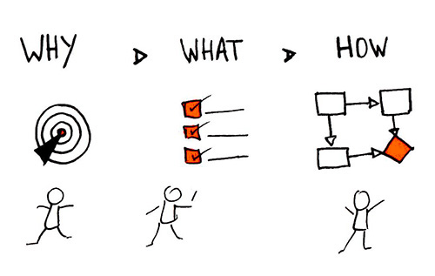
Purpose Statement
An assessment’s purpose statement outlines
why the assessment was developed,
what the assessment is measuring, and
how the results (scores) can be used.
Notes:
The first task in designing an assessment is developing a purpose statement. This statement establishes intent for the assessment and provides a framework around which all components of the completed assessment come together to meet that intent.
An assessment’s purpose statement outlines
why the assessment was developed
what the assessment is measuring
how the results (scores) can be used.

Slide 3
Types of Assessment
Diagnostic
Pre-tests
Work completed before instruction
Formative
Interim/
Summative
End of unit tests
State Assessments
Exit tickets
Quizzes
Midterms/Finals
Projects
Observations
Benchmark
Portfolios
Notes:
The purpose statement initially helps to define the type of assessment to be developed.
Diagnostic assessments are used to determine students’ knowledge and skills prior to instruction. These assessments are used to gather baseline information and can be
informal, including individual or group discussions with students or work completed prior to instruction, or
formal, using professionally developed online, written, or authentic assessments.
Formative assessments are used to monitor student learning for the purpose of adjusting ongoing instruction. These assessments can also be
informal, including exit ticket or verbal question and answer strategies, or
formal, using interim or benchmark assessments.
Interim assessments are administered at different intervals (hence the name) between instruction. The data from interim assessments can be used for several purposes – all of them intended to deliver instructionally useful information to teachers, students, principals, district administrators and parents. At the core, interim tests help teachers better understand what a student knows and what concepts teachers must focus on to ensure grade-level performance.
Benchmark assessments are administered periodically (e.g., at the end of each quarter or as frequently as once a month) throughout the school year. They establish baseline achievement data and measure progress toward academic standards and goals. Typically formal, these assessments may be computer-scored and provide teachers with insights into which content standards students have mastered and which require further instruction, helping to identify individual strengths and needs. Well-designed benchmark assessments can also track student progress over time.
Summative assessments are used to measure student achievement (or growth toward achievement) of standards at the of a unit of instruction. These assessments are formal and are presented as
End of unit tests
Midterms/Finals
Projects
Portfolios
State Grade or Course Assessments

Slide 4
Validity
The purpose statement supports validity.
The validity of a test refers to the degree of accuracy with which it measures what it intends to measure.
Without a relatively high degree of validity, a test is in effect a useless device as it is not serving the purpose for which it was designed.
Notes:
The purpose statement also supports validity.
“The validity of a test refers to the degree of accuracy with which it measures what it purports to measure” (Collins, Johansen & Johnson, 1976).
Without a relatively high degree of validity, a test is in effect a useless device as it is not serving the purpose for which it was designed.
Critical measures of test validity examine whether the test is built to achieve its purpose(s), and whether the results are used for the intended purpose(s). Test-design evidence is created to maximize the likelihood of meeting acceptable measures of test validity.
(Educational Measurement and Evaluation, 2nd Edition, Collins, Johansen & Johnson, 1976)

Slide 5
Purpose Statement Example 1
Why: The Civics Knowledge Test is designed to meet the requirements of “PA Act 35 of 2018: Assessment of Civic Knowledge.”
What: This summative assessment measures student proficiency of targeted content standards relating to "United States history, government, and civics that includes the nature, purpose, principles, and structure of United States constitutional democracy, the principles, operations and documents of United States government and the rights and responsibilities of citizenship.”
How: Scores will be used for (1) reporting to parents, (2) individual student certificates of recognition, (3) curriculum development, and (4) reporting to the PA Department of Education.
Notes:
Let’s look at an example of a purpose statement for the Civics Knowledge Test, as required by PA state law. The law gives great latitude for districts to build a written assessment, develop a project, or utilize the US citizenship test.
The first sentence establishes the “why” component of purpose statement: The Civics Knowledge Test is designed to meet the requirements of “PA Act 35 of 2018: Assessment of Civic Knowledge.”
The second sentence establishes the “what” component of the purpose statement: This summative assessment is intended to measure student proficiency of targeted content standards relating to "United States history, government, and civics that includes the nature, purpose, principles, and structure of United States constitutional democracy, the principles, operations and documents of United States government and the rights and responsibilities of citizenship.”
The third sentence establishes the “how” component of the purpose statement: Scores will be used for (1) reporting to parents, (2) individual student certificates of recognition, (3) curriculum development, and (4) as part of the district’s reporting to the PA Department of Education.
This example is unique in that legal language influences the purpose.

Slide 6
Purpose Statement Example 2
Why: The Science Unit Project is designed to provide opportunity for authentic application of 6th grade Science, Technology and Engineering Education
standards.
What: This summative unit assessment is intended to measure student proficiency of targeted content standards relating to “3.1.A Biological Sciences, Organisms and Cells .”
How: Scores will be used for reporting to parents/guardians
and (2) as part of the student academic record, (3) as evidence of student achievement as applied to the teacher’s evaluation, and (4) to assess readiness for instruction on genetics.
Notes:
Many teachers develop and implement assessments for the units they teach. Below is an example of a purpose statement for a 6th Grade Science Unit Project.
The first sentence establishes the “why” component of the purpose statement: The Science Unit Project is designed to provide an opportunity for the authentic application of 6th Grade Science, Technology, and Engineering Education standards.
The second sentence addresses the “what” component: This summative unit assessment is intended to measure student proficiency in targeted content standards related to “3.1.A Biological Sciences: Organisms and Cells.”
The third sentence outlines the “how” component: Scores will be used (1) for reporting to parents/guardians, (2) as part of the student academic record, (3) as evidence of student achievement for the teacher’s evaluation, and (4) to assess readiness for instruction on genetics.

Slide 7

Purpose Statement: Why?
Statement outlining why the assessment was developed.
The Civics Knowledge Test is designed to meet the requirements of “PA Act 35 of 2018: Assessment of Civic Knowledge.”
The Science Unit Project is designed to provide opportunity for authentic application of 6th grade Science, Technology and Engineering Education standards.
Notes:
A purpose statement provides focus for making decisions about the design of an assessment.
When writing a purpose statement, first specify why the assessment was developed. Assessment developers need to know the specific purpose(s) of the assessment to ensure that the items and forms are constructed to match the intended use. If the assessment does not meet the intended purpose, the results may be invalid.

Slide 8

Purpose Statement: What?
    Statement outlining what the assessment is measuring.
(Civics) This summative assessment measures student proficiency of targeted content standards relating to "United States history, government, and civics that includes the nature, purpose, principles, and structure of United States constitutional democracy, the principles, operations and documents of United States government and the rights and responsibilities of citizenship.”
(Science) This summative unit assessment authentically measures student proficiency of targeted content standards relating to “3.1.A Biological Sciences, Organisms and Cells.”
Notes:
The purpose statement should also define what the assessment is intended to measure. In most cases, language from the content standards and curriculum frameworks will help to define what.

Slide 9
Purpose Statement: How?
    Statement outlining how the scores should be used.
USE OF TEST SCORES
Making Instructional Decisions
Reporting to Parents
Ranking Students
Determining Promotion
Assessing Certification
Evaluating Teachers
(Civics) Scores will be used for (1) reporting to parents, (2) individual student certificates of recognition, (3) curriculum development, and (4) reporting to the PA Department of Education.
(Science) Scores will be used for (1) reporting to parents/guardians, (2) as part of the student academic record, (3) as evidence of student achievement as applied to the teacher’s evaluation, and (4) to assess readiness for instruction on genetics.
Notes:
The purpose statement should also reflect how the information derived from the assessment is intended to be used. Some of these uses might include, but are not limited to:
Making instructional decisions
Reporting to parents
Ranking students
Determining promotion
Assessing certification
Evaluating teachers
I

Slide 10

Quality Assurance Checklist: Purpose Statement
Statement is clear, concise, and free of technical jargon.
Statement identifies targeted content standards the performance measure is designed to evaluate.
Statement articulates how the information from the performance measure is intended for use and provides insight about what the scores mean.
Notes:
Once a purpose statement for an assessment is developed, a short quality assurance checklist can be applied.

Slide 11
Purpose Statement Importance
Item Construction
Purpose Statement
Design
Form Construction
Validity
Notes:
If the purpose is not well defined, there is a high risk that the assessment will not satisfy fundamental measures of test validity. The test design is specifically created to maximize the likelihood of meeting acceptable measures of test validity. Therefore, design components cannot be fully developed until the assessment’s purpose is clear.
Teachers need to know the specific purpose(s) of the assessment to make sure the items and forms are constructed to meet the intended use.

Slide 12
Practice Makes Progress: Purpose Statement
Practice Makes Progress
Write a purpose statement for an assessment appropriate to your teaching situation.
Use the Quality Assurance Checklist to self-evaluate your purpose statement.
Notes:
Implementing Assessment Literacy Learning
Write a purpose statement for an assessment appropriate to your teaching situation.
Self-evaluate your purpose statement with the Quality Assurance Checklist.

Slide 13
Standards Definition
“Know and be able to do”
Standards
are statements that articulate an essential core of knowledge and skills that students should master.
clarify what students are expected to know and be able to do at various points in their K-12 academic career.
Notes:
The second task in designing an assessment is identifying targeted content standards.
Content standards articulate an essential core of knowledge and skills that students should master. Standards clarify what students are expected to know and be able to do at various points in their K-12 academic career.
Content standard statements are numerous, given that they are written for multiple content areas and individual grade levels or grade bands within each content area.

Slide 14

Targeted Standards
Targeted standards provide
FOCUS on:
      essential learning
      assessment development
      alignment between instruction and assessment
Targeted standards reflect the
WHAT
of the purpose statement.
Notes:
Assessing targeted content standards is born out of practicality. Test developers must operate within constraints such as testing format (e.g., on-line, paper and pencil, etc.), testing time, developmental readiness of the test-taker, etc. Further, the test-takers’ ability to remain engaged for prolonged periods of time (which can be interpreted as "seat time" for a paper-and-pencil test or as several weeks to complete a project-based assessment) creates a fatigue factor. This phenomenon, like observer drift in qualitative research, introduces the potential for construct-irrelevant factors to become a component of the observed score.
When considering the purpose and design of an assessment, targeted standards provide FOCUS on
essential learning
assessment development, and
alignment between instruction and assessment.
Targeted standards should be reflected in the WHAT of the purpose statement.

Slide 15
Targeted Standards Selection Criteria
Endurance - Will this standard provide students with knowledge and skills that will be of value beyond a single test date?
Leverage - Does this standard provide knowledge and skills that will be of value in multiple disciplines?
Readiness for Next Level of Learning - Will this standard provide students with essential knowledge and skills necessary for success in the next level of learning?
Notes:
Three concepts should be addressed when selecting targeted standards to be assessed:
Endurance - Will this standard provide students with knowledge and skills that will be of value beyond a single test date?
Leverage - Does this standard provide knowledge and skills that will be of value in multiple disciplines?
Readiness for Next Level of Learning - Will this standard provide students with essential knowledge and skills necessary for success in the next level of learning?

Slide 16

Assessing Targeted Standards
Teaching
Testing
Notes:
In developing an assessment, it is important that targeted standards have been taught so that students will be successful with the assessment. Designing an assessment around targeted content standards PRIOR to instruction can guide teachers to provide focused instruction, ensuring that students will have the opportunity to learn the materials on which they will be assessed.
The “chicken and egg” relationship analogy relates to assessment, instruction and targeted standards:
Design and build assessments that have a strong technical alignment to the targeted standards prior to instruction; build tests before teaching.
Provide students the opportunity to learn the targeted standards in the manner they will be assessed; teaching before testing.

Slide 17
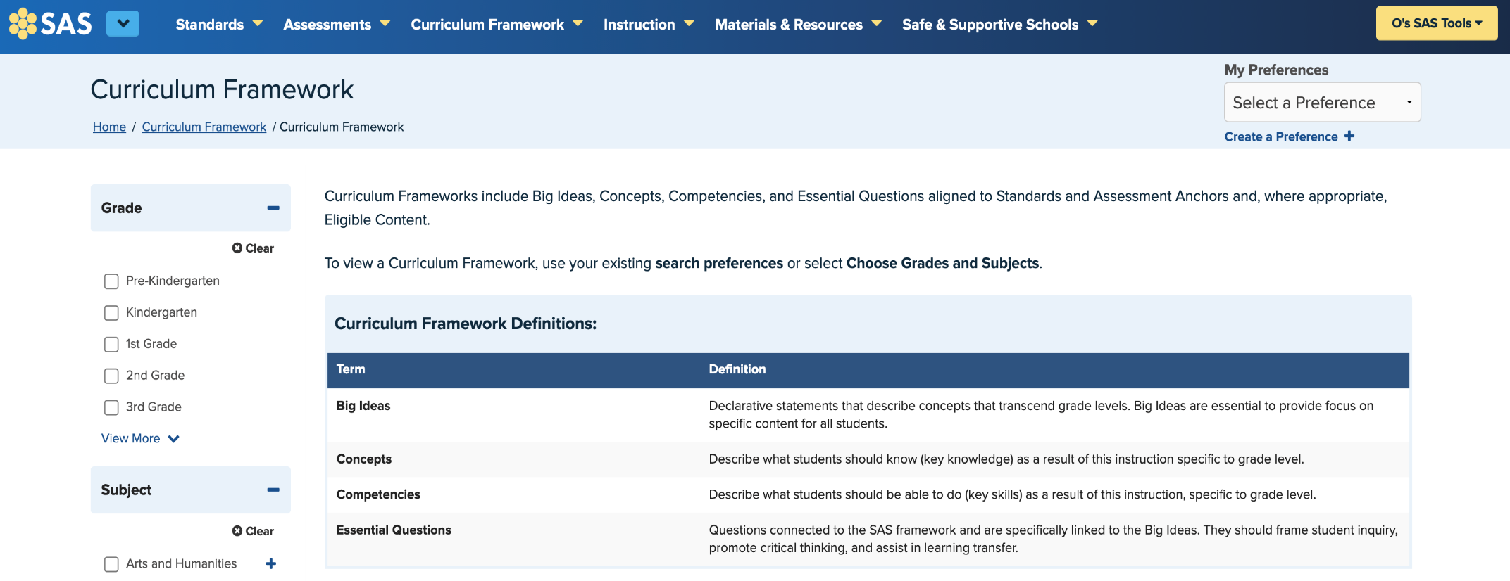
PA Standards Curriculum Framework
Notes:
The PDE SAS Portal provides help in the selection of targeted content standards through the curriculum frameworks. In Pennsylvania, Curriculum Frameworks include Big Ideas, Concepts, Competencies, and Essential Questions aligned to Standards as well as Assessment Anchors and Eligible Content, where appropriate.
Curriculum Framework Definitions are as follows:
Big Ideas: Declarative statements that describe concepts that transcend grade levels. Big Ideas are essential for providing a focus on specific content for all students.
Concepts: Describe what students should know (key knowledge) as a result of this instruction, specific to grade-level.
Competencies: Describe what students should be able to do (key skills) as a result of this instruction, specific to grade-level.
Essential Questions: Questions connected to the SAS framework and specifically linked to the Big Ideas. They should frame student inquiry, promote critical thinking, and assist in transfer of learning.

Slide 18
Targeted Standards ELA Gr 6 Example
Big Idea/Enduring Understanding: Students will interact with non-fiction text, providing critical thinking and responses; question, reflect on, and interpret essential content across texts; and cite evidence to support analysis.
Targeted Content Standards
Standard ID | Standard Statement | %
CC.1.2.6.A | Determine the central idea of a text and how it is conveyed through particular details; provide a summary of the text distinct from personal opinions or judgments. | 25
CC.1.2.6.B | Cite textual evidence to support analysis of what the text says explicitly as well as inferences and/or generalizations drawn from the text. | 25
CC.1.2.6.G | Integrate information presented in different media or formats (i.e. visually, quantitatively) as well as in words to develop a coherent understanding of a topic or issue | 20
CC.1.2.6.H | Evaluate an author’s argument by examining claims and determining if they are supported by evidence. | 15
CC.1.2.6.I | Examine how two authors present similar information in different types of text. | 15
Notes:
To assist with the process of identifying targeted content standards during an assessment’s design phase, it can be helpful to create a template that provides a visual overview of the standards to be assessed and percent at which each standard might be weighted within the assessment. This overview provides the educator an opportunity to reflect on ways in which the targeted standards will align with the purpose statement.

Slide 19
Quality Assurance Checklist: Targeted Standards
Are a component or dimension of Big Ideas/Essential Questions/Enduring Understandings or Long-Term Transfer Goals and identify key concepts and competencies for assessment.
When comprised of multiple tasks, performance measures target critical/key skills and knowledge from several standards.
Create transparency for families and the community about what is most important for student success and prepare students for the next level of learning.
Notes:
Once targeted standards are selected, a quality assurance checklist can be applied.
Targeted Standards are a crucial component of our Big Ideas, Essential Questions, and Enduring Understandings. They help us identify the key concepts and competencies that we want our students to master. This alignment ensures that our assessments are purposeful and focused on what truly matters in their learning journey.
Assessments are made up of multiple tasks, they are designed to target critical and key skills. This means that each task should align with the identified standards, allowing us to measure how well students are grasping these essential concepts. By doing this, we can ensure our assessments are comprehensive and reflective of student understanding.
Creating transparency for families and the community is vital. By clearly communicating what is most important for student success, we not only keep families informed but also empower them to support their children’s learning. This transparency prepares students for the next level of learning by ensuring everyone understands the goals and expectations.

Slide 20
Practice Makes Progress: Targeted Standards
Practice Makes Progress
Identify targeted standards for an assessment purpose statement appropriate to your teaching situation using a template format.
Use the Quality Assurance Checklist: Targeted Standards to self-evaluate.
Notes:
Implementing Assessment Literacy Learning
Identify targeted standards for an assessment purpose statement appropriate to your teaching situation using a template format.
Use the Quality Assurance Checklist: Targeted Standards to self-evaluate.

Slide 21
Contact/Mission
For more information on assessment literacy please visit PDE’s Standards Aligned System website at pdesas.org
The mission of the Department of Education is to ensure that every learner has access to a world-class education system that academically prepares children and adults to succeed as productive citizens. Further, the Department seeks to establish a culture that is committed to improving opportunities throughout the commonwealth by ensuring that technical support, resources, and optimal learning environments are available for all students, whether children or adults.

