Slide 1
Writing Meaningful LEA Selected Measures and Principal Performance Goals
Seminar
PDE SAS Institute

Slide 2
Welcome!
Amy Lena
Director, Bureau of School Support Pennsylvania Department of Education
Laurie Kolka
PVAAS Statewide Team for PDE
Lancaster-Lebanon IU 13
Amanda Lerew
Act 13 and FRCPP Content Support Specialist
Pennsylvania Department of Education
Questions? Email us!
PVAAS at pdepvaas@iu13.org Act 13 at RA-PDE-Evaluation@pa.gov

Slide 3
Who is Here Today?
LEA/District Admin or Leader
School Admin or Leader
Teacher Leader
Instructional Coach
IU Staff
Other
Notes:
Tell us a little bit about your role so we can best understand the perspective you are bringing to the table today.
At your tables, discuss how you currently use PVAAS data and share the other data you are using.

Slide 4
Today’s Purpose
Reinforce the power of self-reflection
Utilize a protocol to guide the process of self-reflection, goal-setting, and action planning
Construct data-based goals appropriate for inclusion in the evaluation process
Outcome for today’s session:
Using your own data sets, craft a complete goal and action plan to
1) focus your work and
2) support the evaluation process.
Notes:
This session today addresses the importance of supporting each teacher in enhancing their skills to consider and use their student performance data in a self-reflective process. The power of teacher self-reflection is discussed, a sequence of steps to engage in self-reflection of a teacher’s own student performance data as well as how accomplish this with the help of two newly revised resources titled Self Reflection Guide for Data Available Teachers and a Self Reflection Guide for Non-Data Available is overviewed. Highlighted within these newly revised tools is the integration of the Act 13 LEA Selected Measure, SPM template, bringing together the process of self-reflection leading to individual teacher goal setting and SPM identification.
The intent is that you will leave this session with some concrete strategies and a developed plan for individual teacher conferencing around student performance data to enhance the teacher’s own professional practice, leading to improved student outcomes for current and future students.

Slide 5
7-Step Protocol for Data-Based Self-Reflection
Appropriate process for teachers & administrators
Applicable across content areas
Guided process for utilizing data to make decisions

Slide 6
Scaffolded Resource: Revised Teacher Self-Reflection Guides
Teacher Self-Reflection Guide (Data Available)
Teacher Self-Reflection Guide (Non-Data Available)
Notes:
You may be already familiar with the PVAAS Teacher Self-Reflection Guides, which were originally developed in 2014.
These are the newly revised guides that we will be talking about during this session. These are the two guides we will be talking about today in this session.
You’ll notice that the guides are available in two versions. One [click] is for teachers who receive PVAAS reporting, the data- available teacher. The other [click] is for teachers who do not receive PVAAS reporting, or non-data available. Both guides provide a protocol for reviewing available data for the purpose of self-reflection and goal-setting. Later in the session we’ll review these guides in more detail.
For now, you can access these at the link provided and we’ll come back to them in a bit.

Slide 7
Outcome: Performance Templates
PDE SAS Educator Effectiveness

Slide 8
What’s Required?
The Act 13 connection to goal-setting

Slide 9
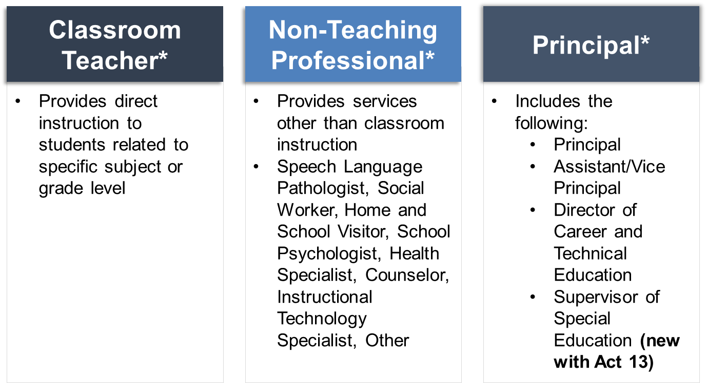
Types of Evaluations
There are five areas in which an employee may be evaluated:
Observation & Practice
Building Level Data: Assessment, Growth, Attendance, Graduation Rate
Teacher-Specific Data: Assessment, Growth, IEP Goals Progress
LEA Selected Measures, comprised of one or more of the following:
Locally developed school district rubrics
District-designed measures and examinations
Nationally recognized standardized tests
Industry certification examinations
Student projects pursuant to local requirements
Student portfolios pursuant to local requirements
Principal Performance Goals
Notes:
Act 13 has three “buckets” that each certificated individual being evaluated will fit within: Classroom teacher (data and non-data available), Non-Teaching Professional (provides support other than direct instruction), Principal (school principal, assistance/vice principal, director of career and technical education, supervisor of special education). Within these “buckets” are Professional Employees (employees that are tenured) and Temporary Employees (employees that are non-tenured. Each employee is evaluated based upon specific characteristics within their role. The five areas an employee may be evaluated are: Observation and Practice, Building Level Data, Teacher Specific Data, LEA selected measures (this is the specific component we will be focusing on within today’s presentation), and Performance Goals (this too is a focus area for us today and is only for those employees who fall within the “principal bucket”.)

Slide 10
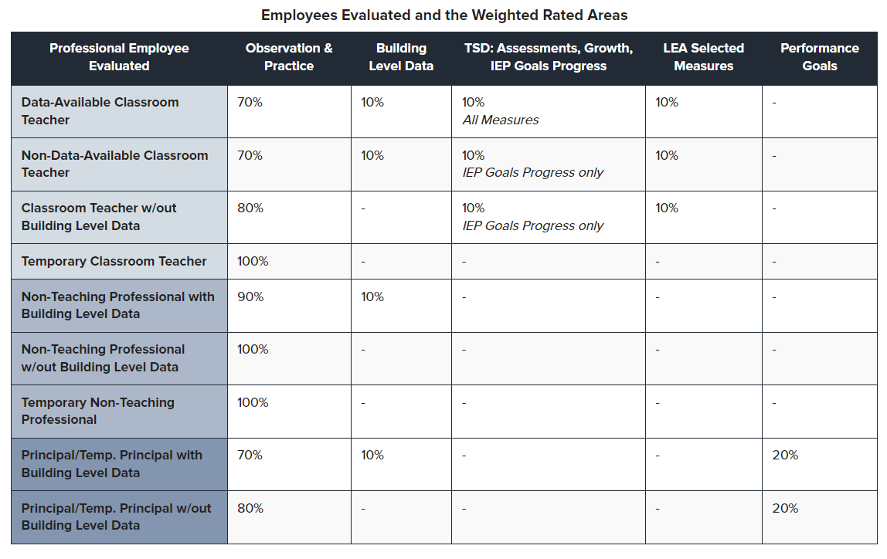
Act 13 Requirements
Classroom Teacher
Principal, Asst/Vice Principal, CTE Director, Spec. Ed. Supervisor
Notes:
Classroom teachers (Data and Non-Data Available) are required to complete an LEA Selected Measure. A Student Performance Measure (SPM) template has been created to assist with selecting a flexible goal setting process for classroom teachers to help fulfill the LEA Selected Measures requirement. Principals must work through setting and implementing Performance Goals. A template has also been created to help document this goal setting and monitoring process.

Slide 11
SLO vs. LEA Selected Measure (SPM)
Act 82
Act 13
Required and complex template
Rigid structure
Quantitative (assessment focus)
Lack of alignment between educator and principal templates
Optional and streamlined template
Flexible structure
Qualitative addition
Close alignment to other templates
Notes:
The Student Performance Measure is new to Act 13. There is a streamlined template we are going to review that assists an employee with establishing and moving through a data reflection, goal setting, and monitoring process. The SPM and Performance Goal elements are completely customizable to the employee. Qualitative and Quantitative data may be utilized within the process.

Slide 12
Why Reflect & Set Goals?
The practice of improvement

Slide 13
Data & Self-Reflection
“Try not to shy away from the potential contained within all of the student data that exist in abundance in our classrooms and schools. Incorporate them into the wide variety of decisions you make every day. Embrace this as an opportunity to bring a little ‘science’ of teaching into your ‘art’ of teaching.”
Craig A. Mertler, ASCD Author
From article, Educator Reflection Tip #73: Are you effectively using data to inform instruction?
Notes:
Self-reflection is an important process whether it be self-reflection on a professional or personal level!
I think we could all agree that for the most part we have a plethora of data in our classrooms and school – whether that is student learning data or other types of data like perceptual data or demographic data. We want to be sure teachers see how to incorporate all of the data into their decisions about their students, their instruction, their work.
Take a minute to read the quote on this slide.
The key is to use that abundant student data for a purpose – using it to better our supports and instruction for students and a big part of your role as a leader is supporting teachers in being able to engage in a structured self-reflection process.
The end of this quote challenges teachers to embrace this as a way to add the science of teaching into their art of teaching.

Slide 14
Teachers Matter!
“Although many personal, family, and neighborhood factors contribute to a student's academic performance, a large body of research suggests that—among school-related factors—teachers matter most.”
https://www.rand.org/topics/teacher-effectiveness.html

Slide 15
Emphasis and Focus
Hold deliberate data conversations with each teacher individually
Go beyond “compliance” issues to supporting teachers in their own self-reflection, goal setting, and planning for current and/or future students
Self-reflect on student learning data leads to teacher growth which in turn leads to enhanced student outcomes
TEACHER GROWTH
STUDENT GROWTH
Notes:
You will hear a theme throughout our discussion today that emphasizes the critical importance of investing the time to hold individual data conversations with teachers and having these data conversations be planned, structured and focused on the teacher’s historical and current available data for the purpose of enhancing the teacher’s own professional practice which, in turn, leads to enhanced student outcomes.
The importance of working with teachers individually cannot be overestimated!
With that said, let’s begin with some background information!

Slide 16
Jot It Down
To what degree do you engage in self-reflection using data?
1
2
3
4
5
Not at all Sometimes All the time
Notes:
Let’s pause and think about this question.
What would you say if you were asked to what degree do each of your teachers currently engage in self-reflection of their student data for the purpose of adjusting their instructional practices?
A 1 would be not at all, 3 would be sometimes and 5 would be all the time – with of course the 2 and 4 in there as well. And, if you don’t mind sharing, how do your teachers engage in self-reflection?
Ok, hit submit!

Slide 17
Watch & Reflect
Watch our dramatic reenactment and think:
What resonates with you?
What are some missed opportunities in reflection based on data?
For the teacher
For the principal
Share with a partner!

Slide 18
Power in the Self-Reflection Tool!
DON’T SAY
DO SAY
Go forth and self-reflect!
Here is the SPM form to fill out.
Choose a professional goal you are interested in and turn that into me.
Let’s work together to identify your professional goals (including your SPM) and the needed actions for meeting the needs of your current/future students.
The steps outlined in the Self-Reflection Guide will help us analyze your past and current data to plan for your current students.
Notes:
We can’t just say “please everyone self –reflect” More is needed to truly support teachers in engaging in this process. For example (click) these statements will not work.
But, the statements you see here on the right hold the power!

Slide 19
Power in Goal Setting
Benefits:
Focuses teacher on BOTH teacher AND student needs
Requires close monitoring of progress towards goal
Measures what matters most – the areas of highest priority need
Establishes ownership of student learning and accountability for student progress
“If you don’t know where you are going, any road will get you there.”
Lewis Carroll
Notes:
And, one other important component relative to the importance of conferencing with teachers, and guiding them through a process of data analysis, goal setting, action planning through self-reflection.
As we know, there is power in goal setting, whether that be in one’s professional career or personal life, and/or for students! When teachers set individual professional goals, we can anticipate teachers will be able to:
- focus on what matters informed by analysis and reflection on student data
measure what matters most, with a focus on the area(s) of highest priority needs
Engage in progress monitoring along the way to the established goal
Develop or increase a sense of ownership of student outcome data
and hold themselves accountable for increasing and/or enhancing student outcomes

Slide 20
Let’s Pause and Ask…
What questions do you have at this point?
Any ideas to share?

Slide 21
Guiding Self-Reflection with Data
Introduce the protocol

Slide 22
Data vs. Non-Data Available
ALL teachers have data to inform
self-reflection!
Who is classified as a Data Available Classroom Teacher?
Who is classified as a Non-Data Available Classroom Teacher?
vs
Notes:
ALL teachers have available data to help them self-reflect and set goals. The Teacher Self-Reflection guides support the process of gathering student data to help inform reflection.
In the context of Act 13, we use the term “data available” to mean those teachers who receive PVAAS reporting for growth or achievement and those who have data to report on IEP goals progress. These are your teachers of Keystone and PSSA-tested grades and subjects. Also, any teacher who meets the LEA-set n-count for IEP goals progress.
Alternatively, in the context of Act 13, non-data available teachers are those who do not receive PVAAS teacher-specific reporting and do not meet the LEA-set n-count for IEP goals progress. Think the Grade 7 Social Studies Teacher or K-2 classroom teachers, or the Calculus teacher at the HS.
[click]Again, all teachers have access to data to inform self-reflection, but for labeling the self-reflection guides, we used this Act 13 terminology.

Slide 23
Revised Teacher Self-Reflection Guides
Download the Guide!
Teacher Self-Reflection Guide (Data Available)
Teacher Self-Reflection Guide (Non-Data Available)
Notes:
Is anyone already familiar with the PVAAS Teacher Self-Reflection Guides, which were originally developed in 2014? (pause for show of hands) Does anyone have an experience to share?
The 2023 newly revised guides now reflect Act 13 requirements, and specifically the LEA Selected Measure requirement of Act 13.
There are still two guides, with titles changed to reflect those who are considered by PDE to be “data available teachers”, in other words, those teachers who receive PVAAS teacher specific reports and those who are considered to be “non data available teachers”, i.e., those who do NOT receive PVAAS teacher specific reports.

Slide 24
What to Expect
Useful protocol for ANY self-reflection and goal-setting template.
WHAT’S THE SAME?
NEW WITH THIS VERSION!
Continued emphasis on the importance of teacher self-reflection of their own student performance data
Protocol and step-by-step process of using data leading to action planning
Promotes ownership of student outcomes
Act 13 LEA Selected Measure (SPM) Alignment
PDE SPM template is integrated into the self-reflection process sequence of steps
PDE SPM template is aligned to the sequence of self-reflection steps to engage in data analysis of past practice to apply to current/future students
Notes:
Let’s talk about what to expect in these new Self Reflection Guides, meaning what is different from the previously existing guides which many of you might be familiar with.
The Self Reflection Guides remain the same in terms of focus. [click] There is continued emphasis on the importance of teacher’s engaging in structured steps, using a provided protocol, to analyze and act upon their own student performance data.
[click] The biggest change is that the guides now embed and integrate the required Act 13 identification of the Student Performance Measure. The PDE SPM template (which is optional) is now embedded into the relevant steps that walk the user (the teacher) through a sequence of data analysis and planning steps leading to the identification and completion of the SPM template. The emphasis continues to be on the importance of teachers engaging in a process of self reflection on their own data, and working through a series of actions that support a deep drive into their own teacher effectiveness and student outcome data.
[click] Note: For those who use an LEA developed SPM template, these guides can still be useful in supporting the process of self-reflection on a teacher’s own relevant data leading to the completion of the locally developed SPM measure tool/template.

Slide 25
Time to Use the Performance Templates
PDE SAS Educator Effectiveness
Download the template(s) now

Slide 26
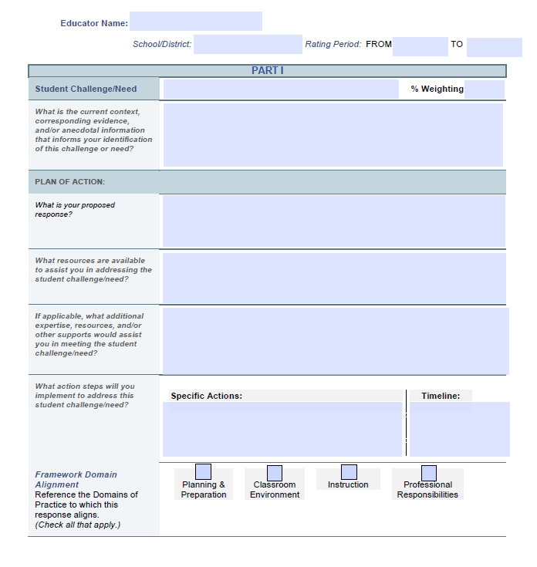
LEA Selected Measures (SPM)
Identify a collective need among your students and what your response will be to help meet that need
Describe the context and baseline to provide background information about your students
Create a plan of action around your identified need
Define what your levels of performance towards meeting success with these students’ needs are: Failing, Needs Improvement, Proficient, Distinguished
Conference with your supervisor before, during, and after the process to set expectations, monitor progress, and determine a final classroom teacher rating
Notes:
This might be a good time to remind you (the participants) of Act 13’s LEA Selected Measures. You might be wondering how this fits and why we want to pause a minute or so to review the info you see on this slide.
This slide shows the components of a Student Performance Measure, which is a required component of the 13-1 classroom teacher evaluation.
[click] It begins with identifying a collective need among students and what your response will be to help meet that need.
[click] Next, there’s a description of the context and baseline to provide background information about students.
[click] Then, create a plan of action around the identified need describing what actions will help students to meet the identified goal.
[click] Based on that description, define the performance levels towards meeting success – that is, what success means for you.
[click] As we discussed, conferencing with teachers before, during, and after this process to support self-reflection and set expectations is a crucial instructional leadership component.
The newly revised Self Reflection Guides --for data available teachers and also the guide for non data available teachers-- NOW include and integrate the steps in identification and completion of the Student Performance Measure Template.

Slide 27
Using the Self-Reflection Guides
Teachers may:
Collaborate with school leader to work through the steps in the guide
Emphasis on data analysis
Identification of teacher goals and areas for focus
Completion of Act 13 LEA Selected Measures, SPM template
Complete independently to prepare for a conference with school leader regarding SPM
Complete independently to reflect on past practice to apply to current/future students
Complete with academic coach/teacher leader/colleague for collaborative support
Notes:
The preferred way to use these guides is the first bullet[click] – the principal supporting the teacher in working together as the teacher self reflects on his/her data and collaborating on action steps and resources and supports needed to accomplish the teacher’s goals.
Sometimes getting started is the tough part. As you consider your process, how will you begin?
[pause for reflection/ sharing]
Once a teacher becomes more skilled in the self-reflection process, there are of course other ways to approach this work.
For example….
(go over bullets)

Slide 28
Benefits of USING the Guides
Benefits for
Teachers
Benefits for
Principals/School Leaders
Reflect on their own effectiveness
Identify & celebrate successes
Identify areas for growth and improvement
Set annual goals
Monitor their own progress
Evaluate their own growth and improvement
Reinforces ownership and accountability for professional practice
Keeps the eye on data analysis, goal setting based on reflection of one’s own data
Provides a structured process to guide/support teachers through to action planning
Notes:
[click] read benefits for teachers
[click] read benefits for principals/ school leaders

Slide 29
Let’s Build a Goal, Step by Step!
Going Inside the Guides!

Slide 30
Steps of the Protocol

Slide 31
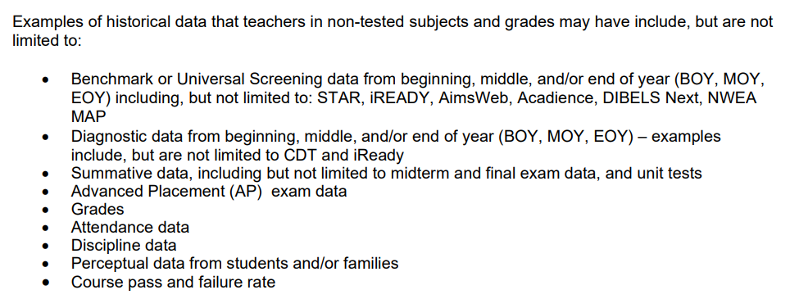
Step 1: Determine Data Sources
Review Step 1 of the guide
Brainstorm data sets to consider for your reflection
Consider:
What data can you access?
What are the broader initiatives in the LEA, school, or department?
Notes:
Introduce the step, then allow for independent data exploration

Slide 32
Step 2: Analyze Data
Key Considerations:
Look at trend data when available to identify patterns
Look for differences between student groups
Notes:
Introduce the step, then allow for independent work

Slide 33
Step 3: Document Observations
Key Considerations:
Document observations using data statements
Be specific, using quantitative and/or qualitative data
Notes:
Introduce the step, then allow for independent work

Slide 34
Ready to Record the Goal
Update your goal template:
What is your goal?
What is the context? Why did you select this goal?
Image from Principal Goal Template. SPM images available in Teacher Self-Reflection Guides
Notes:
Begin goal template

Slide 35
Step 4: Digging for Root Causes
Key Considerations:
Think about the why behind the data
Explore Digging Deeper Resource for elements in curriculum, instruction, assessment, and organization
Notes:
Introduce the step and resources, then allow for independent work

Slide 36
Digging Deeper Guides
Variables We CAN Control
Curriculum
Instruction
Assessment
Organization
Digging Deeper Guides
Notes:
One last important point: You will see in each of the two guides that there is discussion of the use of the PVAAS Digging Deeper Guides, and particularly the TEACHER section of the Digging Deeper Guides.
In both Self Reflection guides, there is a step that focuses on root cause identification. The Digging Deeper guides are quite helpful in considering the array of variables know to positively impact student outcomes and are therefore an important part of a teacher’s self reflection on her own practice and relative to her data analysis findings.
For more information on the Digging Deeper Guides, follow the link provided here.
.

Slide 37
Step 5: Identify Student Needs
Key Considerations:
What do you know about your current students?
Any BOY indicators available for your target population?
PVAAS projections to future assessments as a data set
Notes:
Introduce the step, then allow for independent work

Slide 38
Step 6: Create Action Plan
Key Considerations:
What strategies will be utilized?
Explore the Evidence Resource Center for strategies and resources
Notes:
Introduce the step and resources, then allow for independent work

Slide 39
ERC: The Purpose
https://www.evidenceforpa.org/
Developed by the Pennsylvania Department of Education to support continuous improvement
A clearinghouse of evidence-based strategies related to Future Ready PA Indicators, PA Essential Practices, and Student Wellness.
Provides access to resources on evidence-based strategies related to:
Future Ready PA Indicators
PA Essential Practices
Student Wellness
And more!
Note: Not intended to be a comprehensive
or exclusive list of strategies available to Pennsylvania’s LEAs and schools.
Notes:
The ERC is a resource website of evidence-based strategies aligned to areas of Future Ready PA Index and aligned to PAs Essential Practices for Schools. It was developed with the purpose of saving schools time by gathering information about possible evidence-based strategies to explore and consider.
The ERC is like Pennsylvania’s version of the What Works Clearinghouse; however, it is not meant to replace the What Works Clearinghouse or other evidence-based strategy sites. In fact, other evidence-based strategy sites are linked out of the ERC.

Slide 40
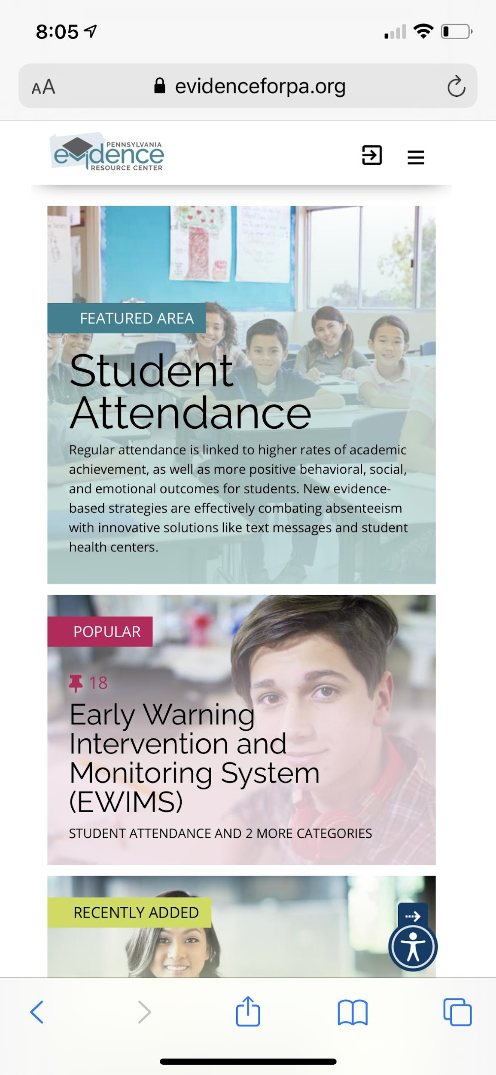
ERC: PA Priority Topics
Notes:
It is organized into featured areas and by strategies focused on Future Ready Indicators…
…then Academics, Learning Environment, and even Educators and Staff.
Note the many focus areas that this highlights.
The ERC can be easily accessed from either a computer or mobile device.

Slide 41
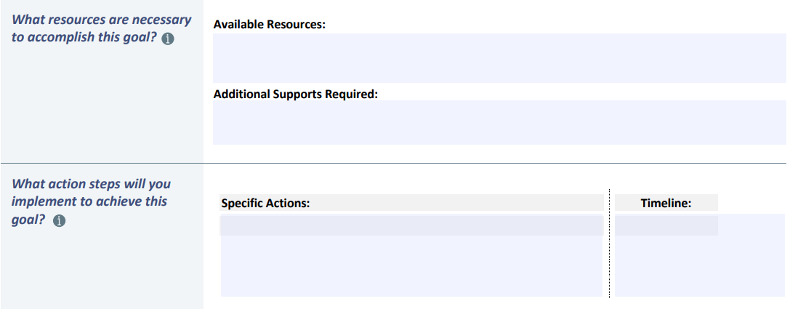
Ready to Record the Actions
Image from Principal Goal Template. SPM images available in Teacher Self-Reflection Guides

Slide 42
Step 7: Monitor Progress
Key Considerations:
What artifacts could demonstrate effectiveness?
How will you know if the strategies are working along the way?

Slide 43
Ready to Record Progress Measures
Image from Principal Goal Template. SPM images available in Teacher Self-Reflection Guides

Slide 44
Let’s Pause and Ask…
What questions do you have at this point?
Any ideas to share?

Slide 45
Model the Conversation
Remember the Non-Example video?
Let’s improve it!

Slide 46
Model a Conference
Choose a partner
One person will be the educator & will discuss their plan for goal and action steps
One person will be the supervisor & will help clarify the plan and offer feedback
Together they will establish evaluation criteria

Slide 47
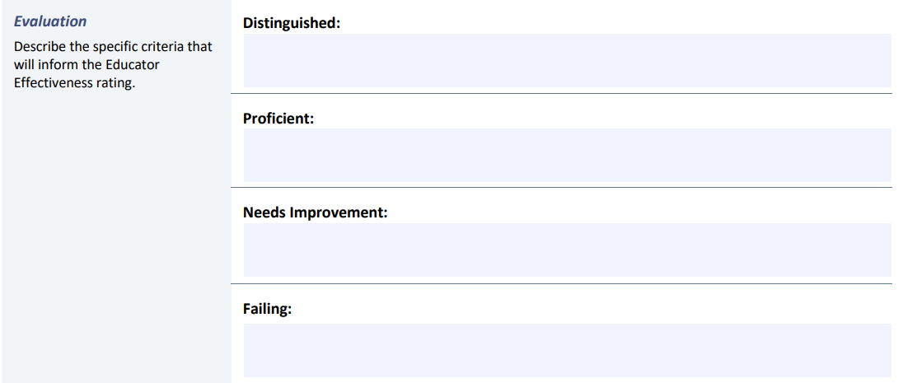
Ready to Record Evaluation Criteria
Image from Principal Goal Template. SPM images available in Teacher Self-Reflection Guides

Slide 48
Resources
Additional Information and Supports

Slide 49
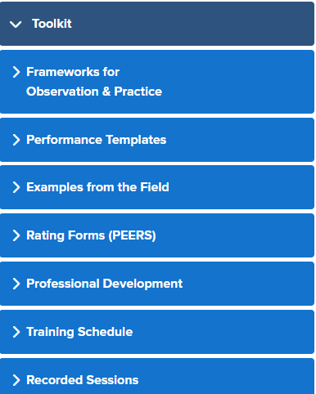
Act 13 Resources
One-stop shop for Educator Effectiveness!
Act 13 Toolkit
Templates
SPM examples from the field
Professional learning
And more!

Slide 50
Resources to Support the Conversation
Self-Reflection Guide for Data Available Teachers
Self-Reflection Guide for Non-Data Available Teachers
Common PVAAS Questions from Teachers
Digging Deeper Guides & Resources
Understanding PVAAS to Round the Bases and Head to Home (9 min video)
PVAAS Teacher-Specific Reporting (self-paced e-Learning)
PVAAS Student Search and Custom Student Report (self-paced
e-Learning)
Notes:
We have several different resources here to support your conversations.
Of course, first, is that Teacher Self-Reflection Guide.
We have a great webpage devoted to the top 15-20 questions teachers ask about PVAAS. This gives you good user-friendly language to use.
We mentioned a few times the Digging Deeper Guides.
We also have a quick 9-minute video that uses the game of baseball as an analogy for understanding the difference between achievement and growth. We find many administrators like using this video.
Finally, there are two self-paced eLearning for your own professional learning or that of your teachers – all available 24/7 within the PVAAS system (no login required).

Slide 51
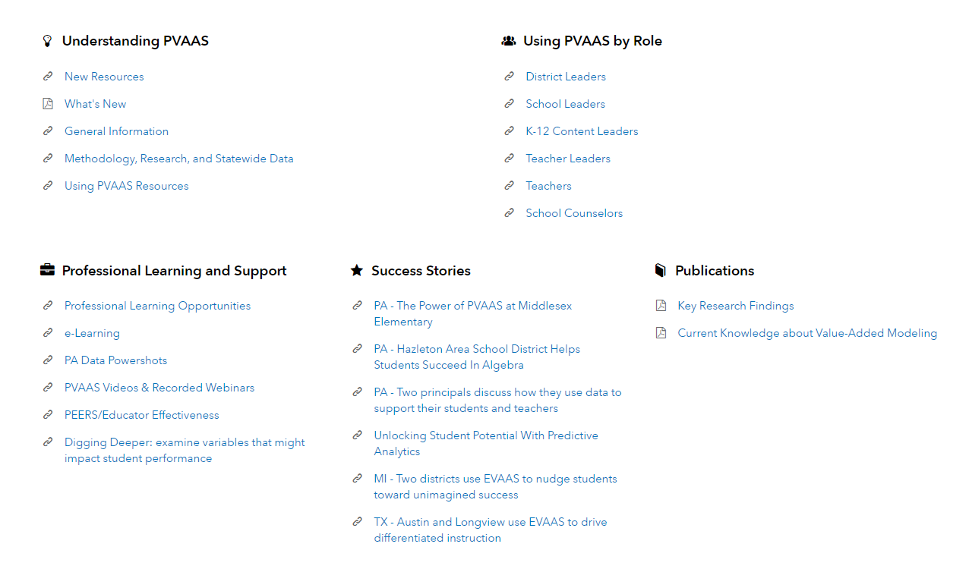
PVAAS Login Page
https://pvaas.sas.com
Notes:
The PVAAS login page has numerous links to resources.

Slide 52
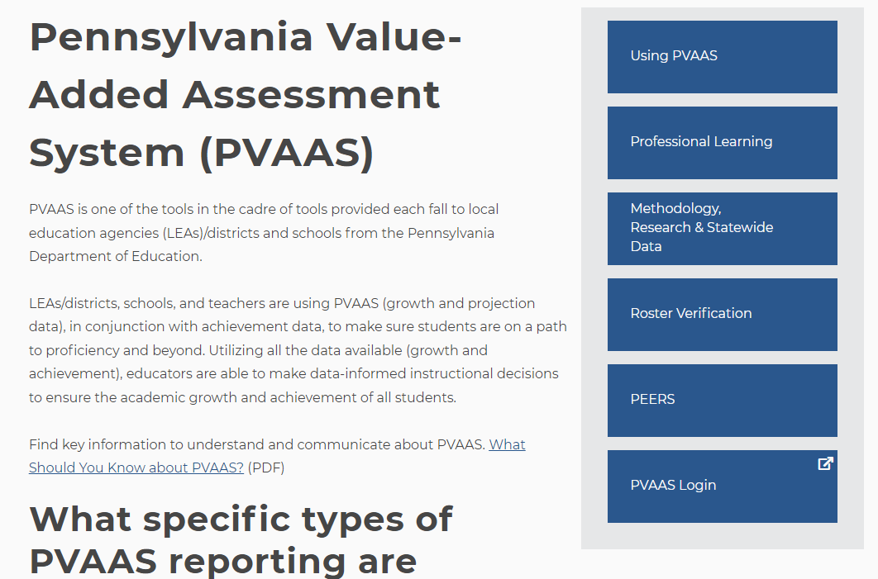
PDE PVAAS Web Page
PDE PVAAS Web Page
Notes:
Here is another way to access the PDE PVAAS webpages to find resources.

Slide 53
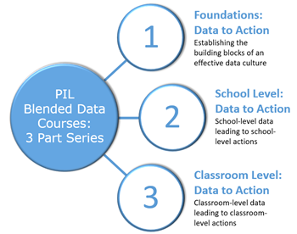
PIL Blended Data Courses
For more information, view the PIL Blended Course Offerings.
Notes:
And finally, please visit this link to learn more about the PIL Blended Data Courses offered to support your understanding and use of data – from foundations to using data at the school, grade, and classroom levels.

Slide 54
Contact Us!
Contact PDE, RA-PDE-Evaluation@pa.gov
Act 13 questions
Contact local IU PVAAS Point of Contact
Link on PVAAS login page
Contact SAS EVAAS Support Team
Needs concerning the accessing or navigating the system
Contact PVAAS Statewide Team, pdepvaas@iu13.org
Needs concerning policies or use of the reporting
Notes:
When you have questions or need support you have the options of contacting your local IU Point of Contact, or clicking the “Contact Us” tab which will lead you to the SAS EVAAS Support team, or the PVAAS Statewide team for PDE.

Slide 55
Thank you for joining us!

