Slide 1
What is Act 45?
Notes:
Why is this important? If you do not understand your professional development requirements, your certificate could go inactive or become invalid, which means that you can’t work.

Slide 2
Legislation

Slide 3
What is Act 45, PIL, and NCEE?
Act 45
PIL
NCEE (formerly NISL)
Act 45 of 2007 (24 P.S. §12-1205.5, §11-1109) defines requirements for induction and continuing professional education taken by Pennsylvania school or system leaders in specific administrative positions.
Pennsylvania Inspired Leadership (PIL)
PDE must provide at no cost to administrators:
An induction program
Continuing education programs
National Center on Education and Economy (NCEE)
Was the PIL Induction vendor
Vendor provides;
curriculum
online materials
training for facilitators to use their materials
Notes:
Act 45 is the law that was enacted on January 1, 2008, and it states that building principals, assistant building principals, CTE directors, assistant superintendents, superintendents, assistant executive IU directors, and IU executive directors must earn Act 45, which counts as their Act 48 credit as well. However, Act 48 doesn’t qualify for Act 45. Educators only need to earn Act 45 hours when in one of these roles. If an educator has an administrative cert but not in one of these roles, then it will remain active by completing Act 48 credits without the educator needing to earn Act 45. Additionally, educators only need to take an induction course within their first 5 years of becoming a building principal and/or assistant building principal.
PIL is the Pennsylvania Inspired Leadership Program – this refers to all of PDE’s free Act 45 courses (both induction and continuing education courses). Educators can earn free Act 45 hours by taking these courses, but they can also take courses from PDE’s Approved Providers. These courses can be found on PDE’s website. Only the courses listed are considered eligible for Act 45 hours.
NCEE, which was formerly NISL, was the vendor for the PIL Induction Program. Due to procurement law, PDE had to create a request for proposals for vendors to be selected as the induction program vendor. If others choose to be approved, they will be listed on PDE’s website and may charge a fee.

Slide 4
New – Principal’s Association
Act 45
PIL
Principal’s Association
Act 45 of 2007 (24 P.S. §12-1205.5, §11-1109) defines requirements for induction and continuing professional education taken by Pennsylvania school or system leaders in specific administrative positions.
Pennsylvania Inspired Leadership (PIL)
PDE must provide at no cost to administrators:
An induction program
Continuing education programs
PIL Induction vendor beginning in 2025
Vendor provides;
Curriculum
online materials
training for facilitators to use their materials
Induction Program
1 year in length
Summer – in person
School Year – virtual (2 hours in length)
Notes:
Principals Association is now the vendor and has replaced NISL

Slide 5
Act 45 Legislation (Continuing Ed)
WHO
Building Assistant/Vice Principals Building Principals Assistant Superintendents
Superintendents Assistant Executive Directors Executive Directors CTE Directors
WHAT
180 hours from PIL classes (free) or Approved Act 45 Providers (may charge a fee)
Up to 50 carryover hours
Act 45 hours counts for Act 48 hours but Act 48 hours do NOT count for Act 45 hours
WHEN
Must be one of the 7 roles listed above for Act 45 to be required
Every 5 years
May have extensions (2016, 2020, 2022)
Notes:
Approved Providers are on PDE’s website
Once you begin serving as a building assistant principal, building principal, assistant superintendent, superintendent, assistant executive director, executive director, or CTE director, Act 45 hours are required. Your original CE cycle doesn’t change or start over.
If you become an Act 45 administrator during your CE period, the number of Act 45 hours needed will be prorated accordingly (i.e., If you become a principal 2.5 years into the CE period, you need 90 hours instead of 180 hours.).

Slide 6
Act 45 Legislation (Level I to Level II)
WHO
Building Assistant/Vice Principals
Building Principals
WHAT
Complete PIL Induction Program or PDE Approved Induction Program
3 years of Satisfactory Service
Act 13 (PIL Induction Program 2025, PIL Act 13 and Beyond Course, or PDE Approved Course)
WHEN
Must Complete by end of 5th year served
No extensions
Notes:
NOT RELATED TO CONTINUING ED CYCLE

Slide 7
Online Registration

Slide 8
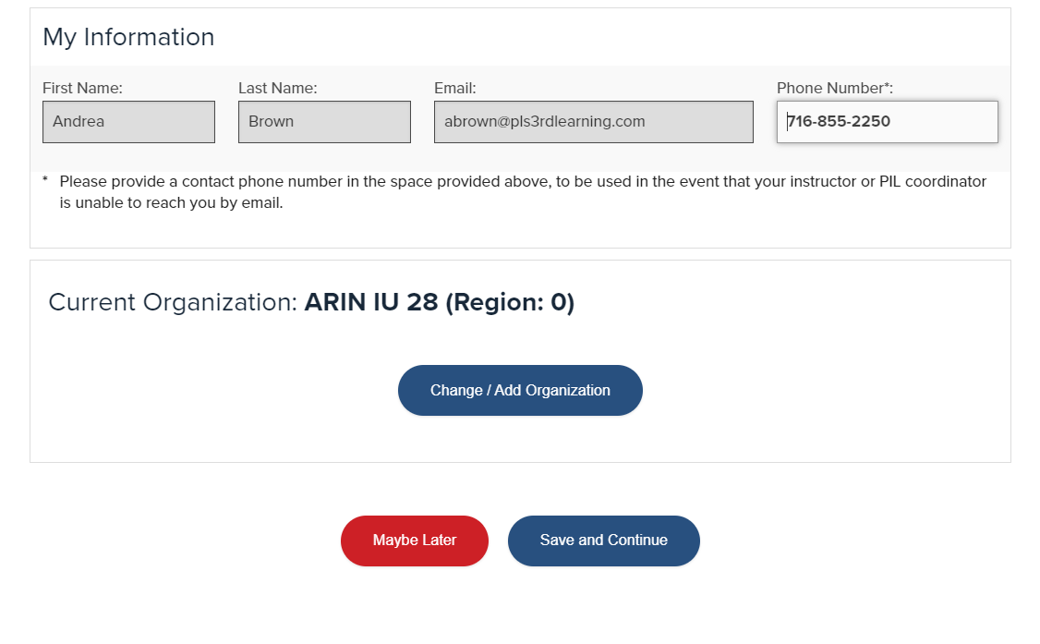
Online Registration – Profile
Notes:
This screen will appear every time you register. If you need to change anything, there is a link to take you to your profile.

Slide 9
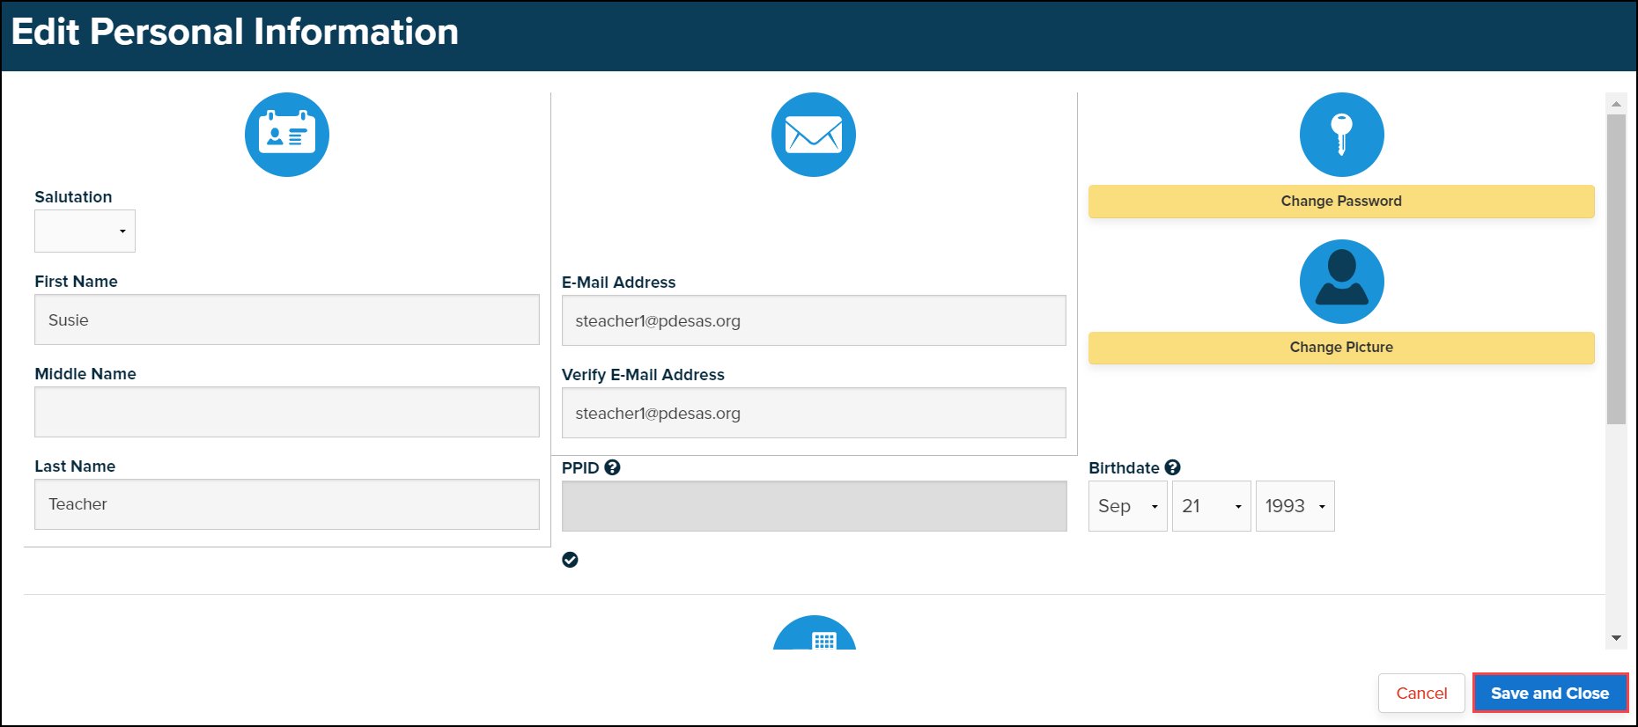
Online Registration – Editing Info.
Notes:
Please ensure your email address is correct because this is the email that PDE and facilitators will use to communicate information regarding classes and assignments.
Please ensure your PPID is entered here, so your hours can be uploaded into PERMS once the class is completed. This will take 2-3 weeks after the course is over for the hours to be uploaded into PERMS.

Slide 10
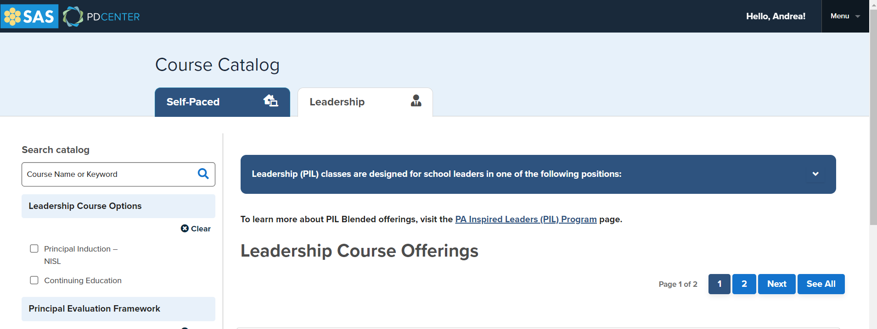
Register for Course (1/2)
Act 48
Act 45
Notes:
For the 8–10-week courses, it is important to look at the View Meeting Dates option. It shows when the F2F synchronous day or half days will be. Please ensure you can make it before signing up for the course.

Slide 11
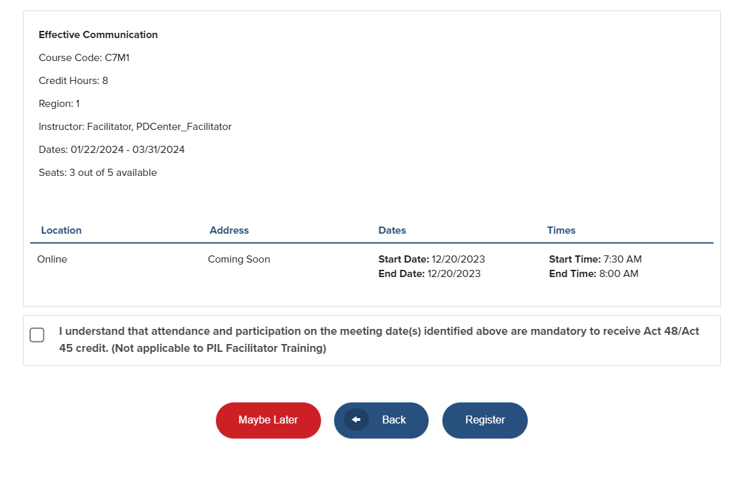
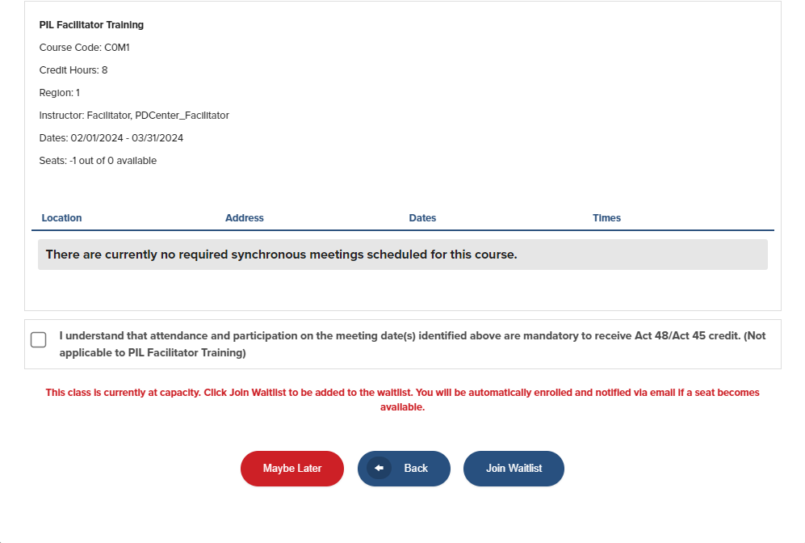
Register for Course (2/2)
Course is available. Participant may register.
Course is full. Participant may join waitlist.
Notes:
If you find that there is a waitlist and no additional courses, please add yourself. The waitlist allows PDE to know more people want to take the course. Then, those on the waitlist receive an email once new offerings are added.

Slide 12
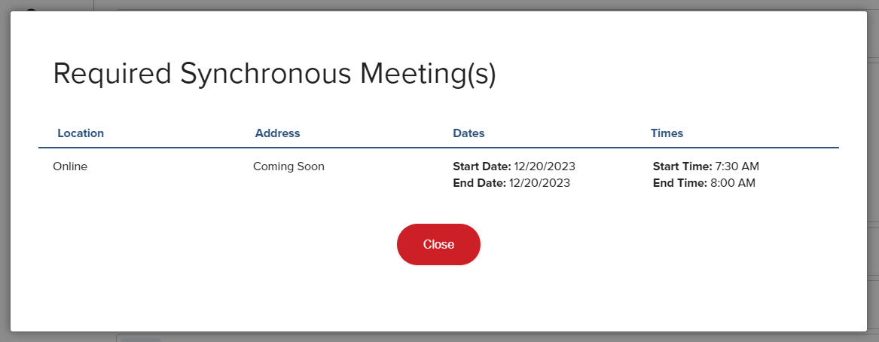
Confirmation
Notes:
You will receive automatic emails when you are registered either immediately or if you are taken off the waitlist and added to the course. Please note: if you sign up on multiple waitlists, the system will take you off the waitlists automatically if you get into a class.

Slide 13
Courses

Slide 14
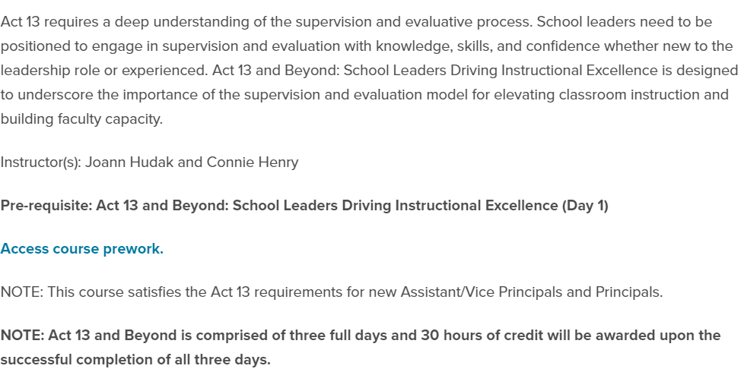
Course Descriptions
Prerequisites
If a course has a prerequisite, it will be listed in the description. Under Options, click on View Description.
Prework
Under Options, click on View Description. A link to Prework will be found there.
At least 1 week prior to course, prework will be emailed.
Hours
Act 13 & LBD require all 3 days to earn the 30 hours.
Notes:
Prerequisites are listed in the description of each course. Many courses do not have a prerequisites. However, you cannot attend a course that has prerequisites unless they are met.
Viewing prework in the description is the easiest and fastest way to view prework
Note: You can sign up for Act 13 and LBD for any days that work with your schedule, but you must take the days in order (Day 1 before Days 2 & 3, and Day 2 before Day 3.)

Slide 15
Resources

Slide 16
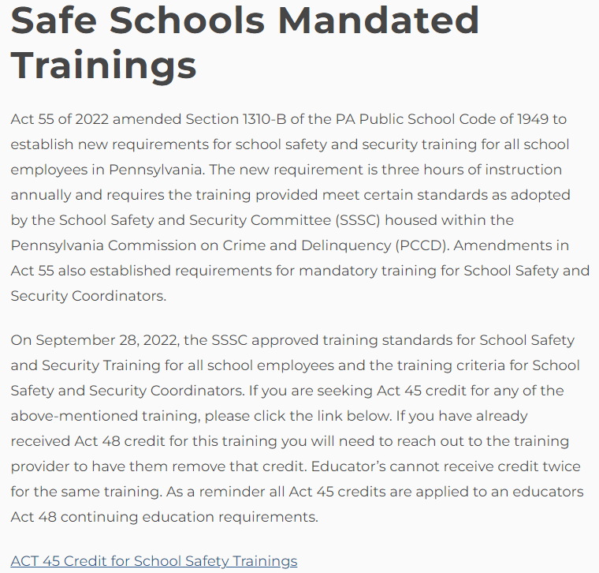
PDE Website (1 of 2)
PA Inspired Leadership (PIL) Program
Notes:
Act 45 Opportunities for Mandated Training by PDE.
Special Ed Fiscal Training now qualifies for Act 45 if taken through the link on the site.
Act 55 Mandated Training now qualifies for Act 45. The information has to be uploaded through the link on PDE’s website.

Slide 17
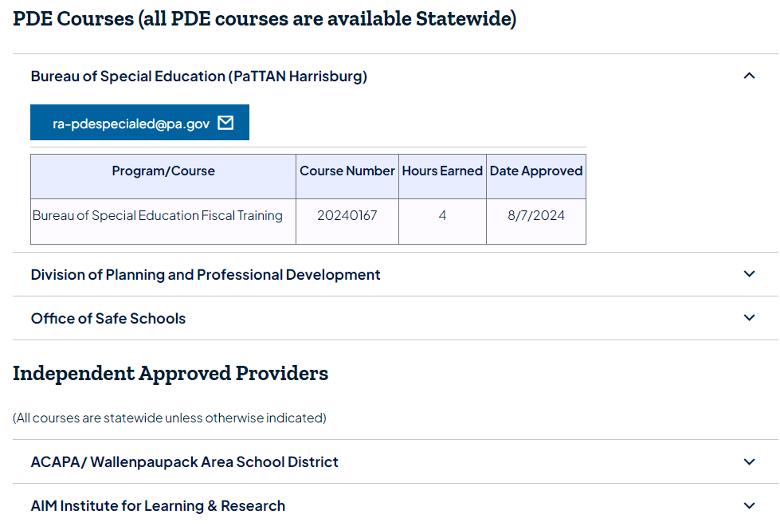
PDE Website (2 of 2)
Non-PIL Approved Courses
Notes:
Resources available on the side of PDE’s main PIL webpage.
Approved Non-PIL Continuing Education Courses link takes educators to a document that lists all the non-PIL (non-PDE free) providers who have been approved. Educators should check this document before signing up for courses to ensure they qualify for Act 45 courses. The only ones not listed are Letters of Eligibility courses offered through PA colleges and universities. These are approved. All other doctoral classes would be listed here if approved.
PIL Resources link takes educators to the new one-stop-shop.

Slide 18
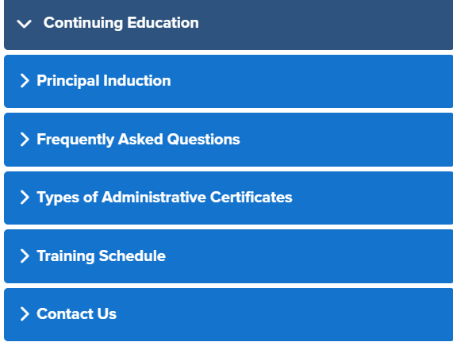
PDE One-Stop-Shop on SAS
Pennsylvania Inspired Leadership (PIL): Continuing Education - SAS
Professional Development
A list of all courses, the descriptions, prerequisites and number of hours
Frequently Asked Questions
A robust FAQ based on the questions sent to the Resource Account
Types of Administrative Certificates
Review of certificates and who earns Act 45
Contact us
RA-EDACT45@pa.gov
Notes:
Go to this page:
find one course with a prerequisite

