Slide 1
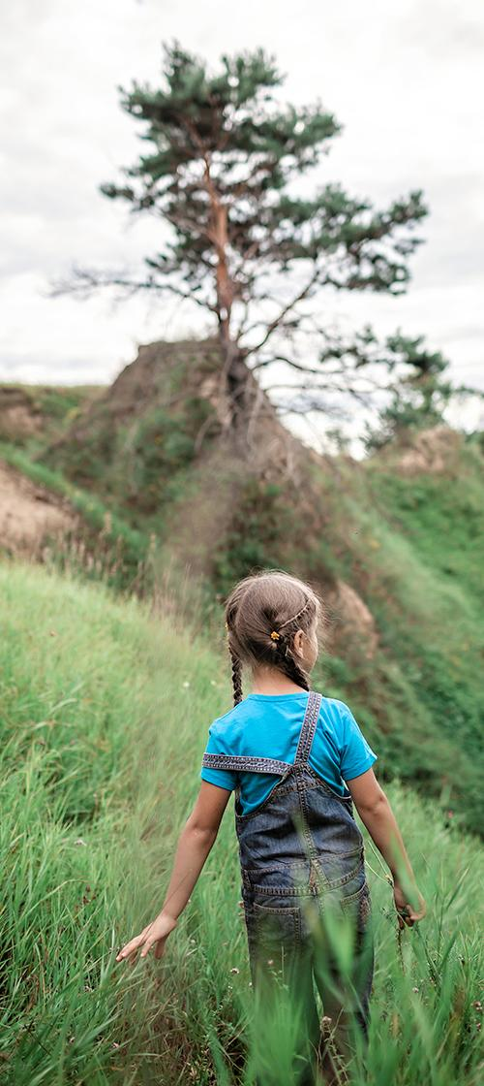



EARTH AND SPACE SYSTEMS
Unit 22
Using Our Resources Wisely
Section 2: Lessons 3, 4, 5 & 6
Section Driving Question:
How does our use of natural resources affect Earth systems?
1
Notes:
Teacher Note: This section has 4 lessons.

Slide 2










mySci symbols key
Indicates an opportunity for students to write
Indicates an opportunity for students to write
Indicates an opportunity for the teacher to make a chart
Indicates an opportunity for the teacher to make a chart
Indicates an opportunity for the teacher to read aloud to students
Indicates an opportunity for the teacher to read aloud to students
Indicates a vocabulary word for the lesson
Indicates a vocabulary word for the lesson
Indicates an opportunity for formative assessment
Indicates an opportunity for formative assessment
2
Notes:
Welcome to mySci google slides edition.
The following slides are designed to make the curriculum accessible to teachers and students in a presentation format.
Most slides should be viewed in presentation mode in order for all the features to work.
Each section of the unit is represented by a section question and photo. Each lesson in the unit begins with a lesson target slide followed by curriculum slides to support the 5E model. Student journal pages are shown, videos for students to watch are embedded in the slides and there are other interactive opportunities represented as well.
TEACHING TIP: Phrases in blue denote Science and Engineering Practices in the lesson. Phrases in green denote Crosscutting Concepts in the lesson.
We at mySci encourage teachers to view this slideshow as they read through the unit in the planning phase and determine if there are additional slides, activities or photos to add. Personalizing this slideshow for your particular group of students will make the material even more relevant and exciting for young learners. As always feedback is welcomed and appreciated.

Slide 3
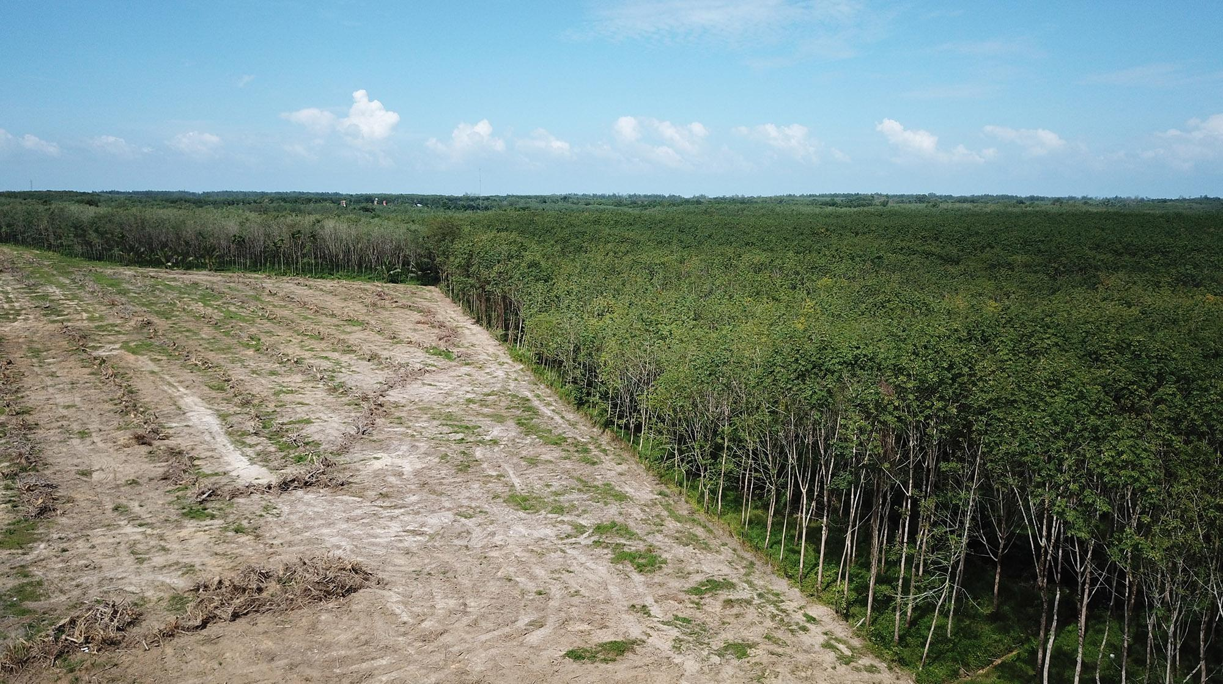
UNIT 22, SECTION 2:
How does our use of natural resources
on farms affect Earth’s systems?
Notes:
Section 2 consists of the first 4 lessons of this unit.
Total time: 11 days
NOTE: This question is provided for you as a model driving question to organize the learning progression. You can use this question to guide your instruction, however, you are encouraged to adapt this question using the language you develop with your students.
LESSON 3
What are natural resources and how do humans use them?
(3 days)
LESSON 4
How does our use of fossil fuels affect Earth’s systems?
(3 days)
LESSON 5
How does our use of water affect Earth’s systems?
(3 days)
LESSON 6
How does animal waste affect the environment, and what can we do about it?
(2 days)

Slide 4
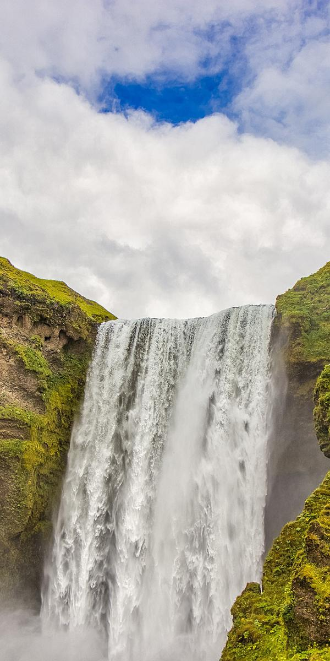
Lesson 3: Learning Target
Lesson 3:
LEARNING TARGET
LESSON 3:
What are natural resources and how do humans use them?
Notes:
In the last lesson, students explained complex interactions between Earth systems. They refined their farm models to include interactions between the components on the farm.
In this lesson, students track their daily routines and research to see how natural resources can be used as energy for our daily lives.
Students figure out that natural resources are Earth materials, such as air, water, soil, and energy that are used by humans to live.
In the next lesson, students will learn about how the use of natural resources by humans can affect the environment.

Slide 5
Lesson 3: Engage
Lesson 3:
ENGAGE
How do you think you are connected to the spheres on our planet?
Let’s collect some data to see how we are connected to the Earth.
Notes:
ENGAGE Summary: Students gather data about things they do and use in their daily lives.
Say to students: How do you think you are connected to the spheres on our planet? Allow students to Turn and Talk, then share a few answers. Let’s collect some data to see how we are connected to the Earth.

Slide 6
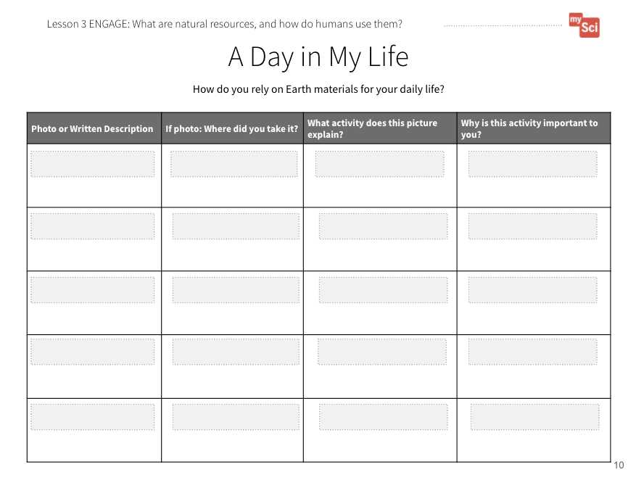
Lesson 3: Engage (part 2)
Lesson 3:
ENGAGE
What can we figure out about our connection to Earth’s spheres by
looking at our daily lives?
What do we use? What do we do?
Why are these things and activities
important to us?
We can start by looking at our school day.
An important opportunity to attend to equity is offered in the speaker notes area
A Day in My Life Student Journal Page
Notes:
Using self-documentation technique, ask students to examine their typical day (this could be in their home, at school, and places they go after school or on the weekend) to identify the objects and routines that are important to their lives. Students can either take photos using an iPad or other take-home device, or they can draw pictures.
Have them record their data on A Day in My Life Student Journal page. Launch the activity with students on the first day of this lesson, having them begin with their school day. Model with students the types of things they should track that might not be immediately obvious to them. They can then take photos or draw pictures over the next evening and before school. If you have time, you could do this over a weekend to get more data.
Attending to Equity:
Self-documentation technique is a powerful way to make learning meaningful and relevant for all students. This helps students see that their cultural connections and knowledge are valued and useful in the science classroom.

Slide 7
Lesson 3: Explore
Lesson 3:
EXPLORE
What patterns do you see in our photos or pictures?
Do we share any common activities or things we use?
Notes:
EXPLORE Summary: Students analyze data about their daily lives to see patterns of natural resources they commonly use.
Once students have gathered this data, have them share their photos or pictures with other students. You could have students upload the photos to a Google Slideshow or Flipgrid, for instance, so that students can sort and compare data about their lives. Provide questions for students to discuss with their groups such as: Do you see any patterns? Do you notice that many kids watched television, played video games, or read a book at night? Did many students use cars or other transportation to get to and from school, or music/sports practice? Did many students include meal time photos?

Slide 8

Natural Resources
Lesson 3
natural resources
materials in Earth’s systems that are useful to people

Slide 9
Let’s make a class chart!
Lesson 3:
EXPLORE
Object or Routine | Natural Resources
 | Materials We Needed from Earth’s Spheres to Make Object | Energy Source We Needed for it to Work
Notes:
Make a class chart like the following. As you make the chart, point out that though these objects may be human-made, they are made from natural resources that come from Earth’s systems, such as water, air, organisms, minerals and rocks (metals), and soil.
If students are struggling to make connections, ask questions such as: What are the pages of a book made from? Where does the plastic for your video game console come from? Where did the materials to make your meal or your clothing come from? You can also have students return to the journal pages from Lesson 2 to review aspects of Earth’s systems.

Slide 10
Lesson 3: EXPLORE (part 2)
Lesson 3:
EXPLORE
One common thread that you all might have noticed is that we use energy like electricity, natural gas, or gasoline to live our typical lives.
What do you wonder about this?
Notes:
Say to students: One common thread that you all might have noticed is that we use energy like electricity, natural gas, or gasoline to live our typical lives. What do you wonder about this? (Students may wonder how we are able to get this energy, and what effects this might have on the Earth and on us.)

Slide 11
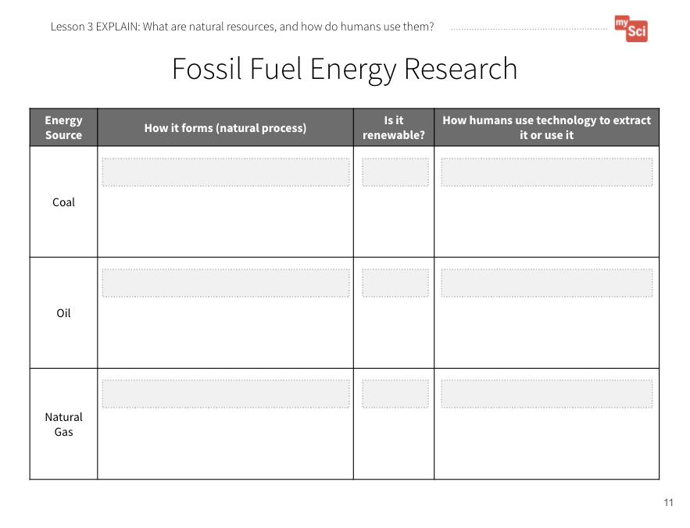
Lesson 3: Explain
Lesson 3:
EXPLAIN
We wonder...how are we able to
have electricity, gasoline, and oil
for our daily lives?
Let’s research to find out!
How should we find and keep track
of our research?
What are Fossil Fuels
EIA Energy Kids
Fossil Fuel Energy Research Student Journal page
Notes:
EXPLAIN Summary: Students obtain information to explain how energy resources form.
Say to students: In order to answer some of these questions, what kinds of information do you need and how might you go about finding this information? If students are struggling, say to students: Scientists use research to see what is known and to generate new questions. How can we use research to see how we are able to have electricity, gasoline, and oil for our daily lives? Provide students access to one or both of the following resources, as well as the Fossil Fuel Energy Research Student Journal page. Say to students: We need to keep track of our information in one spot. To help students develop the practice of obtaining information, provide one resource. In the following lesson they will be provided with multiple resources, and asked to combine information. You can walk through the resource (Coal) and model how to take notes on important information.
EIA Energy Kids
You can have students work in small groups to do this. Another way to approach this is to have different groups research coal, oil, or natural gas, then jigsaw together to share information. Students can share this research on paper or digitally, but be sure that their research contains the specifics outlined on the journal page. Students can draw pictures of the processes they research or write down the information.

Slide 12
Lesson 3: Explain (part 2)
Lesson 3:
EXPLAIN
Where do fossil fuel energy sources come from, and which Earth spheres are they from?
Why are these energy sources important to us?
What do we mean when we describe fossil fuels as non-renewable?
Notes:
Once students have finished, ask:
Where do fossil fuel energy sources come from, and which Earth systems are they from? (They are formed from the buried (geosphere) remains of plants and animals (biosphere)).
Why are these energy resources important to us? (Students should come to the conclusion that the energy that comes from natural resources is used to make the things we use in our lives, and to make them work.)
What do we mean when we describe fossil fuels as non-renewable? (These resources will not replenish over human timescales because they take millions of years to form.)
This activity is a chance to formatively assess students' understanding of the SEP Obtaining, Evaluating, and Communicating Information and DCI ESS3.A. See the student journal answer key for an example. If students are struggling to obtain information to describe how energy is derived from fossil fuels, read the resource as a class, pausing frequently to check if you have come across information needed to fill out the journal page.

Slide 13
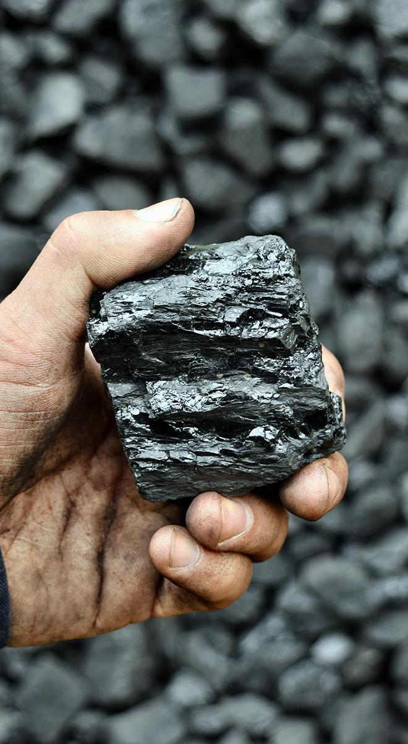
Fossil Fuel
Lesson 3
fossil fuel
a fuel that formed from the decayed remains of ancient plants and animals (coal, oil, and natural gas)

Slide 14
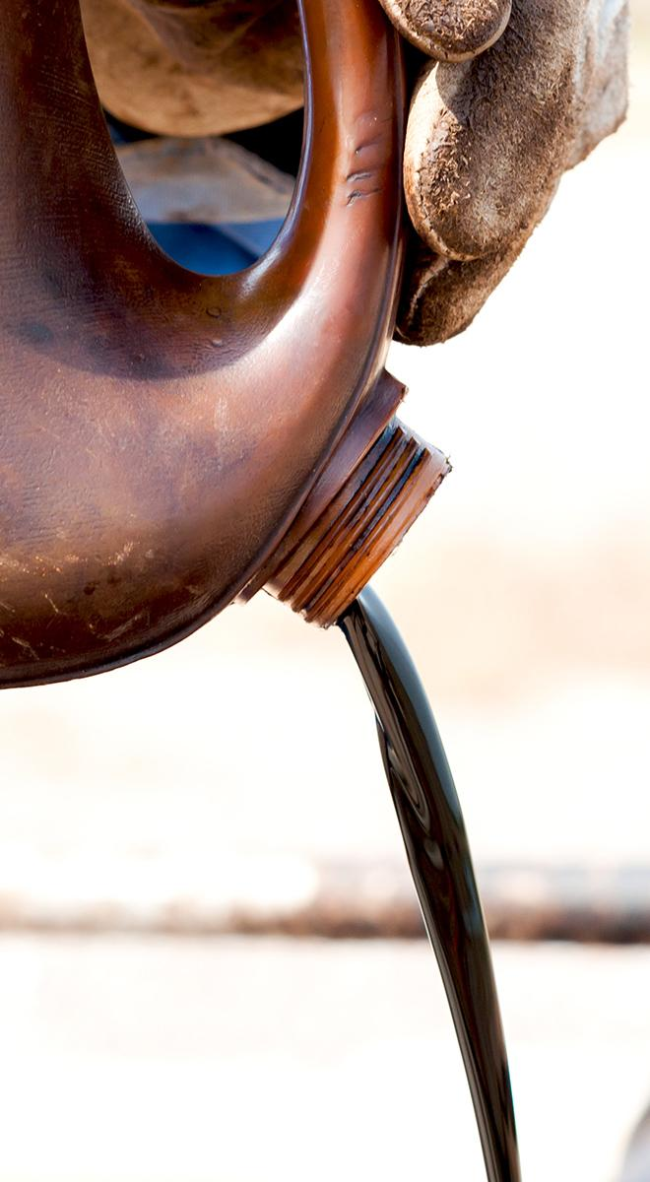
Non-Renewable Resource
Lesson 3
non-renewable resource
resource that is not replaced by nature as fast as it is used

Slide 15
Lesson 3: EXPLAIN (part 3)
Lesson 3:
EXPLAIN
Let’s revisit our class chart to show the natural resources we use more accurately.
Object or Routine | Natural Resources
 | Materials We Needed from Earth’s Spheres to Make Object | Energy Source We Needed for it to Work
Notes:
Go back to the chart you created in the Explore part of the lesson. Ask students: How can we revise this chart to better show our use of natural resources for energy? What has to happen for us to be able to have the energy to do the things we like and need to do in our daily lives? Students may add coal as an energy source for electricity, and oil as the root product of gasoline. Many people use gas for cooking. Have them trace their day back to the energy sources needed to do their daily activities.

Slide 16
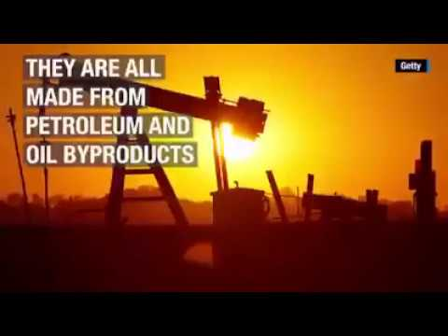
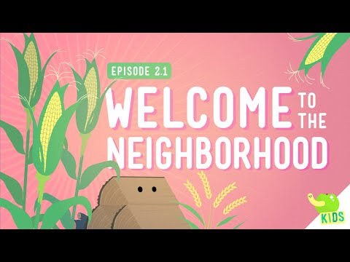
Lesson 3: EXPLAIN (part 4)
Lesson 3:
EXPLAIN
How are Earth’s systems involved in the things you used and did during your day?
An important opportunity to attend to equity is offered in the speaker notes area
Nine Surprising Things Made with Oil
Welcome to the Neighborhood
Notes:
You can watch the following videos with students to help them understand how natural resources are used to make objects we interact with daily: Nine Surprising Things Made with Oil (0:44) from Oil Field Team and Welcome to the Neighborhood (3:14) from Crash Course Kids.
Attending to Equity:
The “Nine Surprising Things Made with Oil” video does not include narration. You may need to narrate this video while watching if you have students who need support with reading.

Slide 17
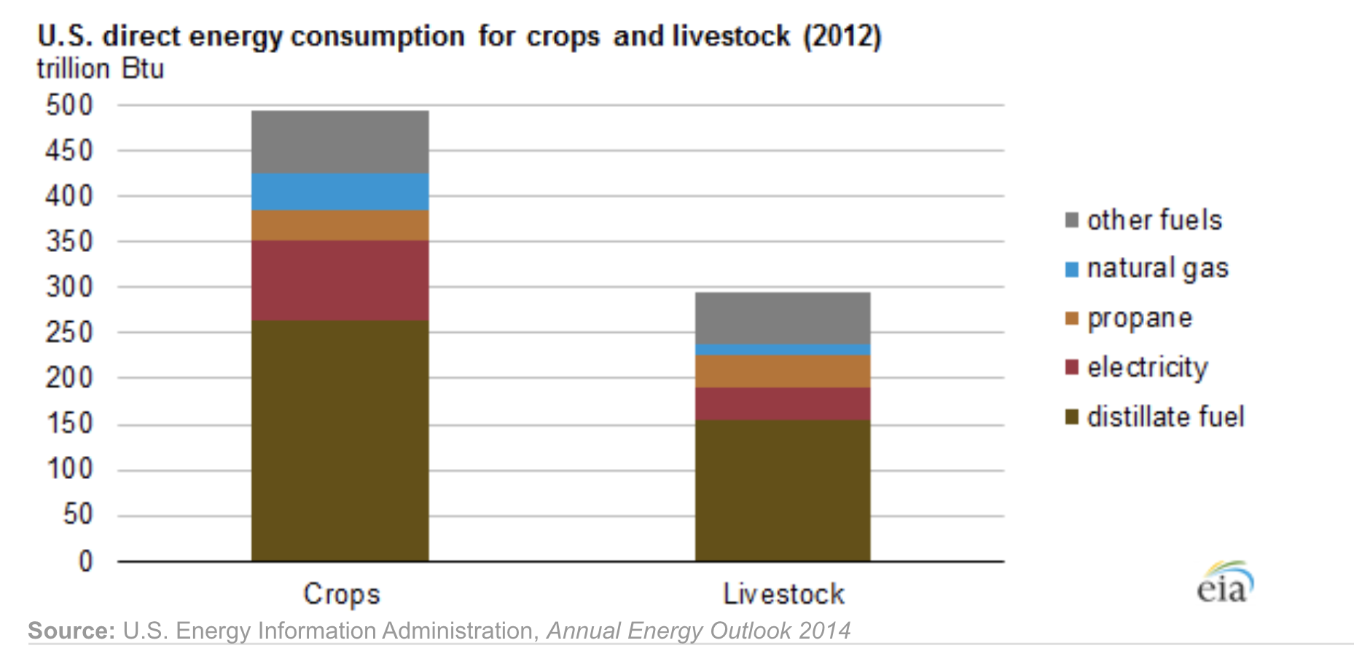
What do you notice and wonder about farm energy use?
Lesson 3:
ELABORATE
Notes: Distillate fuels come from oil. Electricity comes from coal usually. Propane is a type of natural gas.
Notes:
ELABORATE Summary: Students refine a model of a farm and illustrate the natural resources used and produced there.
Data Credit: https://www.eia.gov/todayinenergy/detail.php?id=18431#:~:text=Direct%20energy%20consumption%20includes%20the,such%20as%20fertilizers%20and%20pesticides.
Show students the data charts and photos that detail how energy is used for growing and harvesting crops and livestock on farms
Teacher Guidance: Students may notice that the energy consumed in livestock operations is relatively low compared with crop operations. In both cases the largest percentage of energy consumed is from distillates, like diesel fuel. Livestock operations consume direct energy for ventilation systems, refrigeration, lighting, heating, watering, motors, and waste handling. Crop operations use energy to plant, harvest, irrigate, and dry crops.

Slide 18
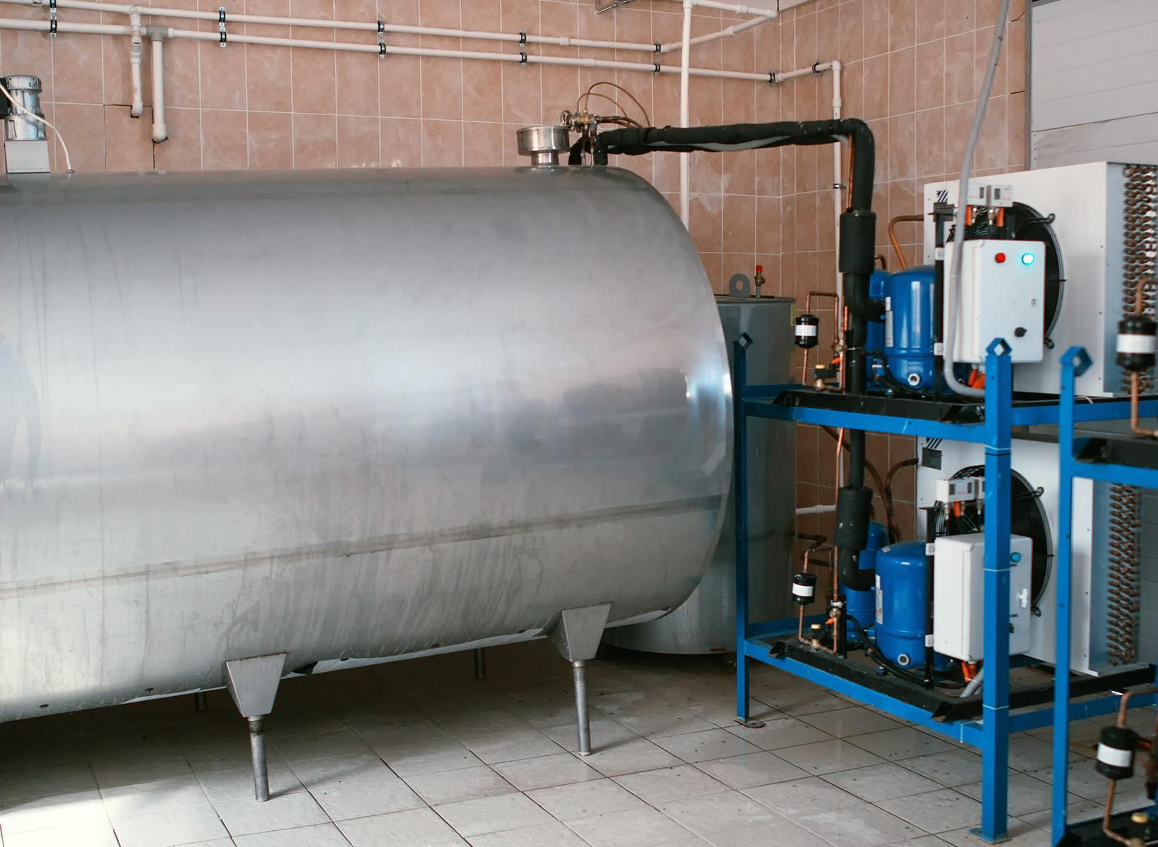
Lesson 3:
ELABORATE
Notes:
Livestock operations consume energy directly for refrigeration of commodities like milk, produced on dairy farms.

Slide 19
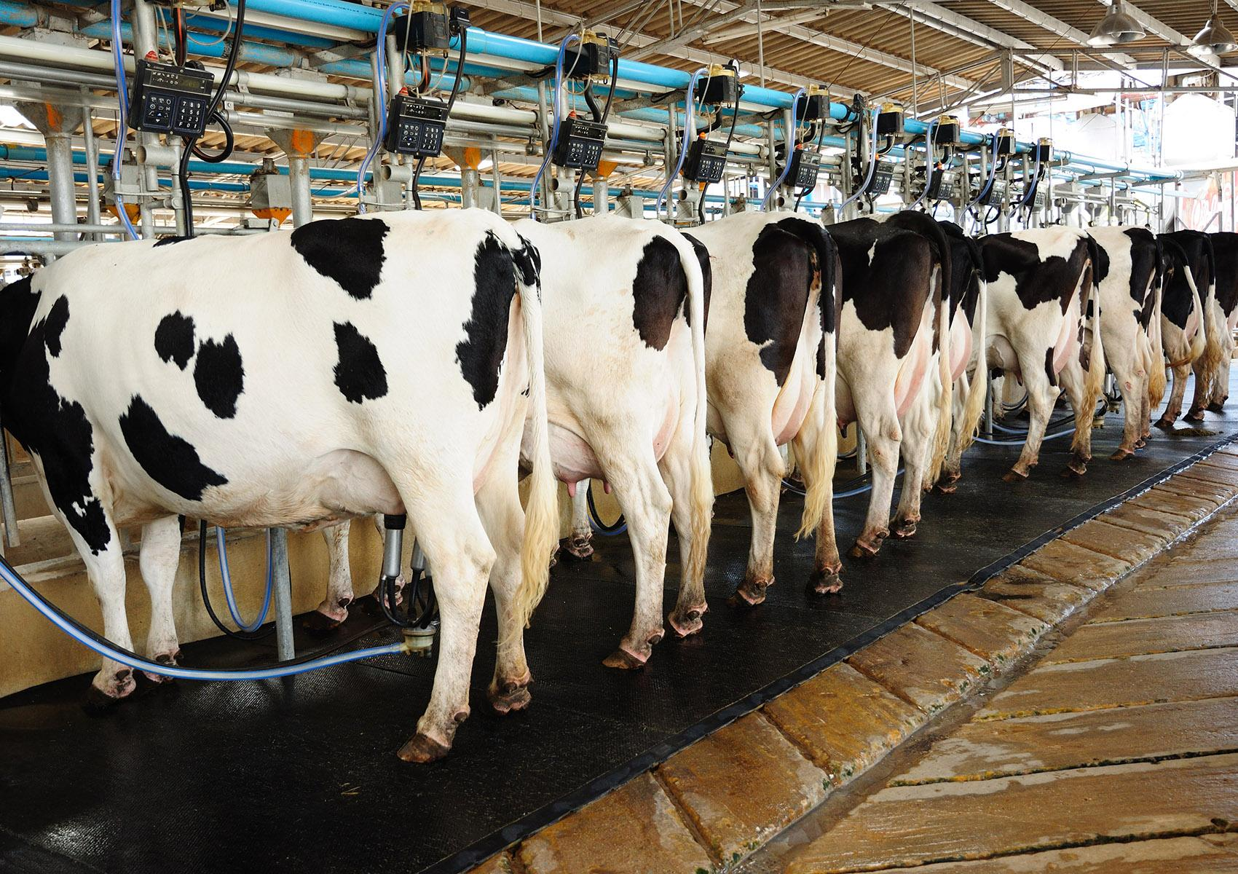
Lesson 3: Elaborate (part 2)
Lesson 3:
ELABORATE
Notes:
In this photo, cows are being milked using a robotic system that requires direct energy consumption.

Slide 20
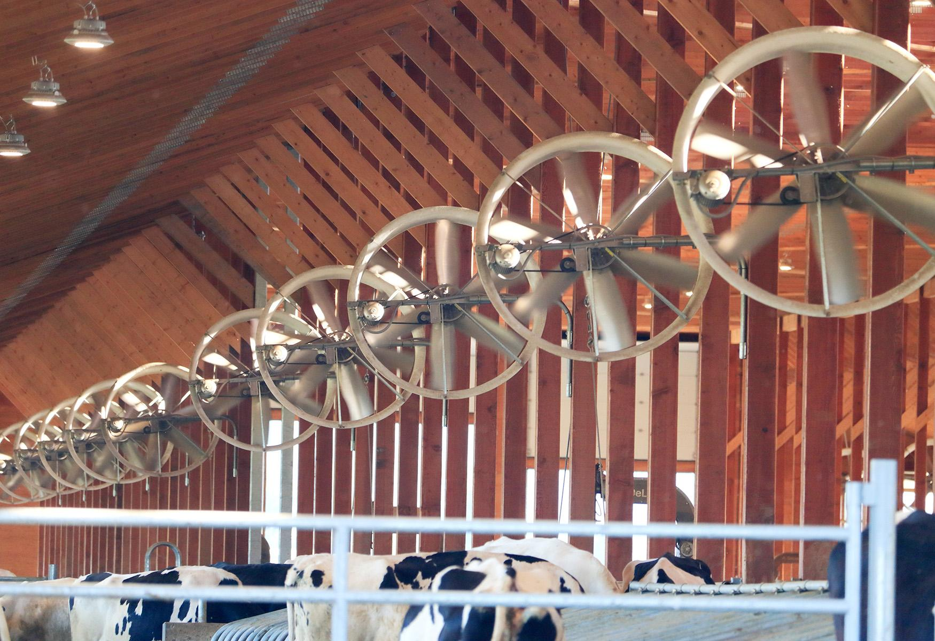
Lesson 3: Elaborate (part 3)
Lesson 3:
ELABORATE
Notes:
In this photo fans are being used to ventilate a livestock barn. Light are used in the barn. Both of these features require energy.

Slide 21
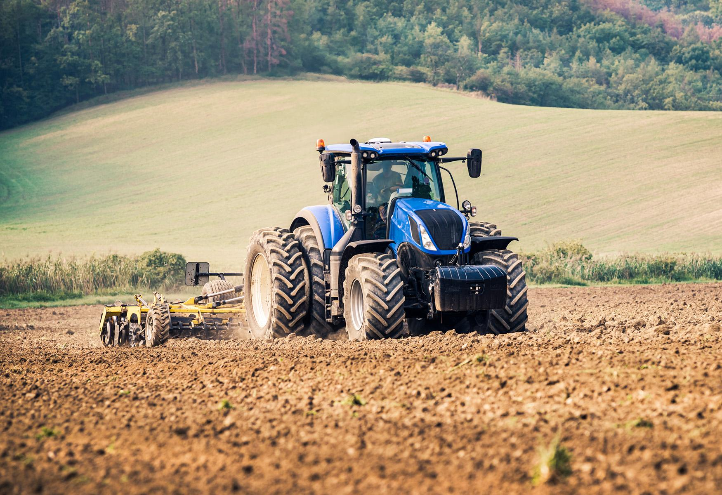
Lesson 3: Elaborate (part 4)
Lesson 3:
ELABORATE
Notes:
In this photo, a tractor is being used in a farm field to till the soil. Farm equipment like this uses diesel fuel for power.

Slide 22
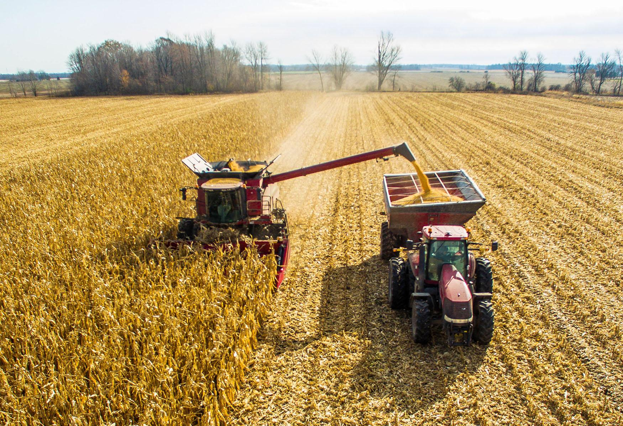
Lesson 3: Elaborate (part 5)
Lesson 3:
ELABORATE
Notes:
In this photo, a combine is being used in a farm field to harvest corn. Farm equipment like this uses diesel fuel for power.

Slide 23
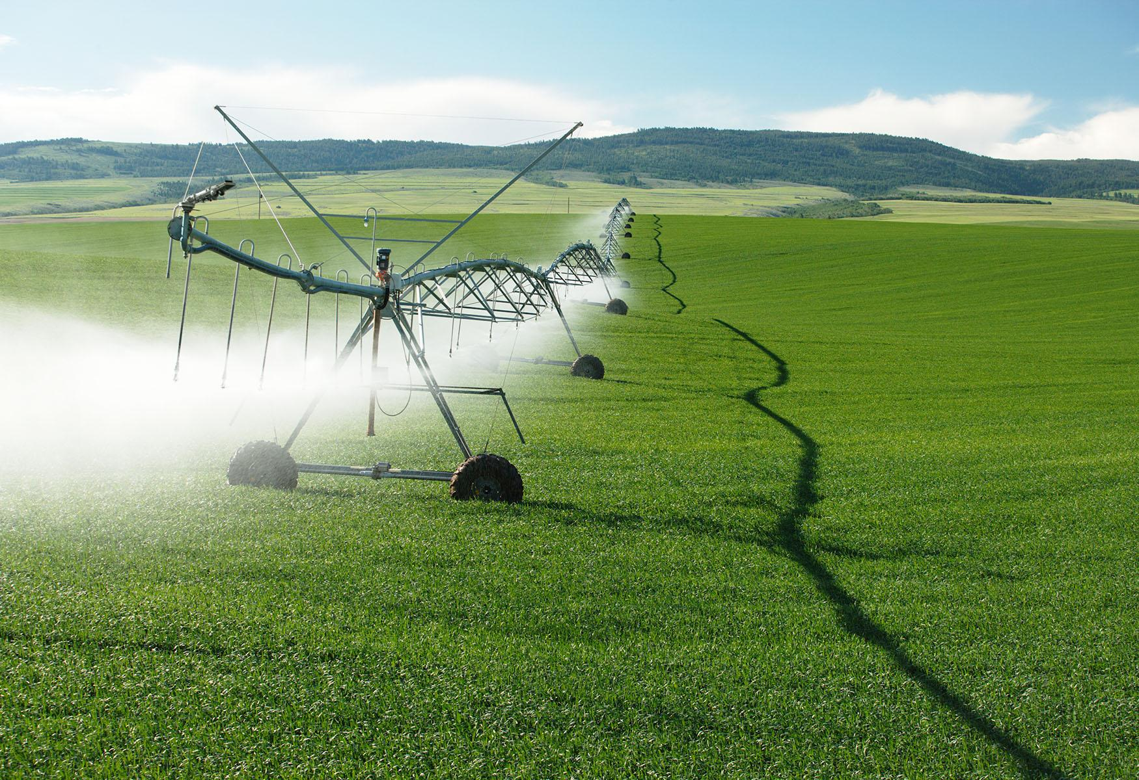
Lesson 3: Elaborate (part 6)
Lesson 3:
ELABORATE
Notes:
Supplying water can be very energy-intensive. Some farms have access to public water supplies. However, most farms pump water from wells and groundwater sources. Most pumping is done with electricity, but pumps in remote locations may use diesel or propane.

Slide 24
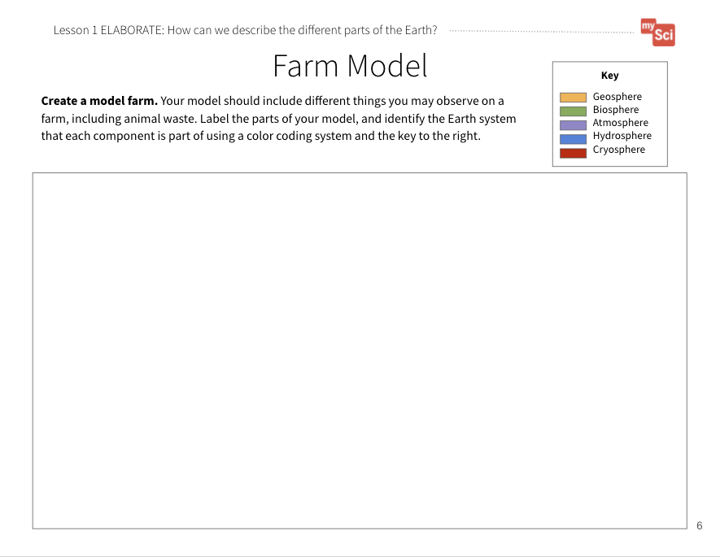
Lesson 3: Elaborate (part 7)
Lesson 3:
ELABORATE
A good model of a system shows relationships between parts of the system!
How will we show how natural resources, including energy, are used on a farm?
“Gotta Have It” Checklist: Our Farm Model has to have...
✔
✔
✔
✔
✔
✔
Farm Model
Student Journal page
Notes:
Say to students: We’ve been considering our farm from the perspective of Earth’s systems, and how they interact. But humans are using natural resources in certain ways to keep their farm operating smoothly. In the last lesson we developed a “Gotta Have It Checklist” to show the components and relationships we needed to include in the models. What would you add to the checklist today to make our models show how natural resources are being used on a farm?Examples of things the model’s “gotta have” might include:
Any natural resources or products made from natural resources found on the farm (For example, did they include any farm equipment, water, fuel for energy, metal for grain silos and fencing, etc.)
How energy is used on a farm, and what energy sources are used (For example, if the farmer uses a milking machine, what powers it?)

Slide 25
How Are Natural Resources Used on a Farm?
Lesson 3:
ELABORATE
Are natural resources being used by the farmer, produced by the farmer, or both?
How are natural resources used on a farm?
Farm Model
Student Journal page
Notes:
As students revise their models, ask them to discuss:
Whether the resource is used by the farmer or produced by the farmer (Ex. Soil is used by the farmer to grow crops, crops are produced by the farmer for food, clothing fibers, and building materials)
What the natural resource is used for (Ex. Soil is used to grow crops, fossil fuels are used to power building and farm equipment)

Slide 26
Could Animal Waste be Considered a Natural Resource?
Lesson 3:
ELABORATE
Could animal waste be considered a natural resource?
Why do you think it might be?
Farm Model
Student Journal page
Notes:
Ask students: Could animal waste be considered a natural resource? Why do you think it might be? Allow students to share their ideas. Students should use their understanding of what natural resources are, and begin to discuss their rationale for why animal waste should be considered a natural resource, or why it should not be considered a natural resource. You will return to this idea in lesson 6.

Slide 27
Let’s Share Our Models
Lesson 3:
EVALUATE
Let’s share our models and give each other feedback.
Then use the feedback to revise our models.
Farm Model
Student Journal page
Notes:
EVALUATE Summary: Students evaluate each other’s farm models and give feedback.
Have students share their models with a partner or another group and give each other feedback using the “Gotta Have It Checklist”. How do their models compare with each other’s? What natural resources did they include in their models and why? Did they identify animal waste as a natural resource in their model? Students will continue to refine this model over time. Bring the class back together, and ask students to share out the differences and similarities in their models. This supports students to see the different ways you can represent and label things in models. Based on their discussion, students should change their models to reflect feedback.
Return to the class consensus model that was created in the Engage portion of lesson 1. Revise the class model to include the natural resources the students described from their individual models. Ask students what labels you should put on your drawing. This helps scaffold the revision process and provides continuity throughout this unit.
This activity is a chance to formatively assess students' understanding of the SEP Developing and Using Models, DCI ESS3.A, and CCC System and System Models. See the student journal answer key for an example. If students are struggling to apply what they have learned in developing a model, use the class consensus model you created to support students to further develop their models.

Slide 28
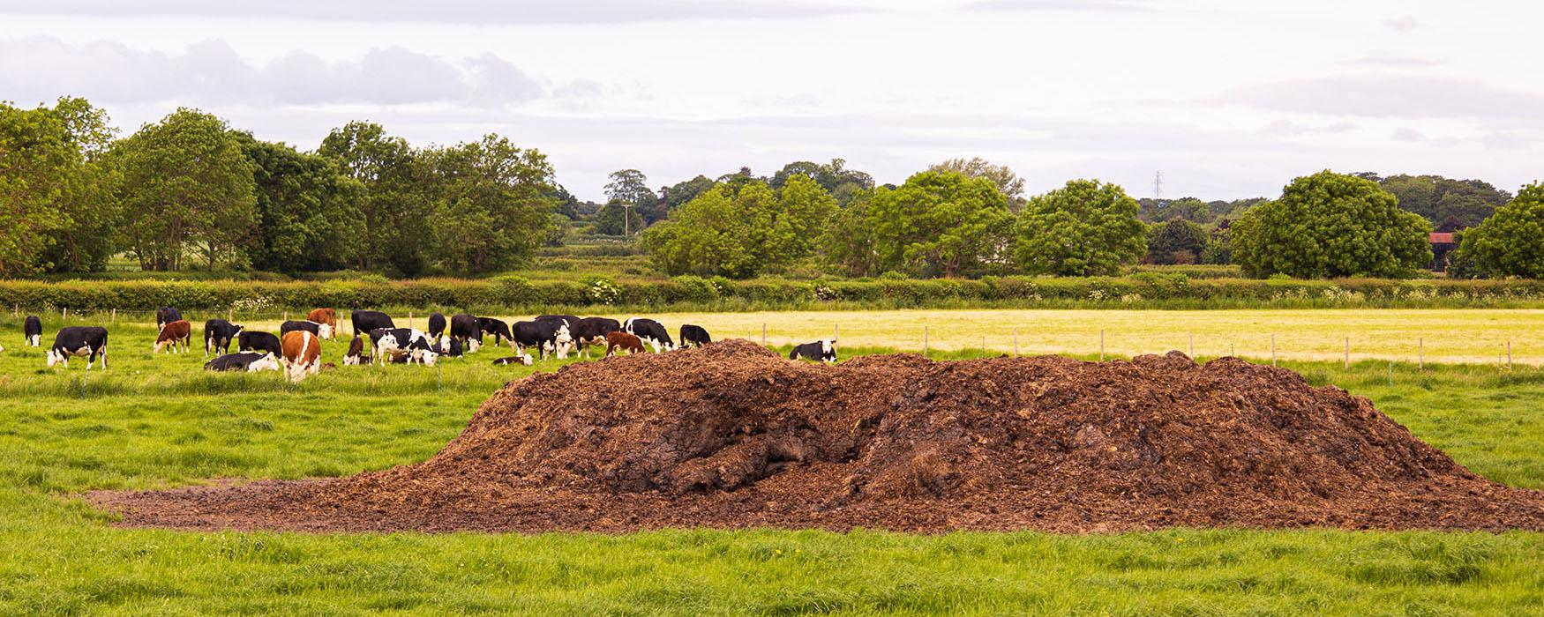
How Might This Help Us Figure Out How Our Use of Natural Resources on Farms Affects Earth’s Systems?
Lesson 3:
EVALUATE
How might this help us figure out how our use of natural resources on farms affects Earth’s systems?
Notes:
To support student sensemaking across the unit, orient students back to the DQB. Ask students: What did we observe during today’s activity? Record the activity and their observations. Next, ask students: What did we learn today? Record their responses. If students need a reminder, they can reference their student journals.
Ask students: How might this help us figure out how our use of natural resources on farms affects Earth’s systems? (Students may say that natural resources are Earth materials that humans use to live. Natural resources can include things like water (hydrosphere), oil and other fossil fuels (geosphere), metals and minerals (geosphere), etc. Farms use and produce different natural resources. This could have an effect on Earth systems because we know that systems interact.)

Slide 29
What New Questions Do Your Have?
Lesson 3:
EVALUATE
What new questions do you have?
Notes:
Next, ask students: What new questions do you have? Write student responses on the driving question board. (They may have new questions, such as: Can we run out of natural resources? Does our use of natural resources affect Earth systems?)
Do not provide these questions for students, instead help them start thinking about these ideas by focusing their attention to the different natural resources that they labeled on their models and how that could relate to the anchoring problem: We need farms to grow food, but the process of producing food for all of us can harm Earth systems. Have students place their questions into existing categories, or create new categories.

Slide 30
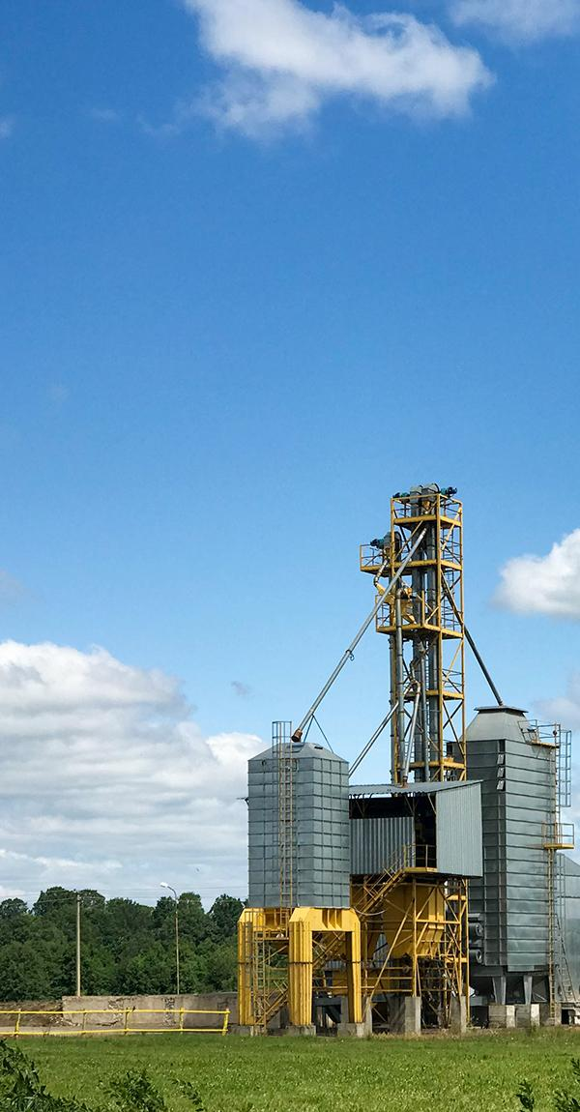
Lesson 4: LEARNING TARGET
Lesson 4:
LEARNING TARGET
LESSON 4:
How does our use of fossil fuels affect Earth’s systems?
Notes:
In the last lesson, students obtained information about how humans use natural resources, including energy. They refined their farm models to include natural resources used and produced on the farm.
In this lesson, students use text resources to draw relationships between natural resource use and impacts on Earth systems.
They figure out that the use of fossil fuels for energy causes pollution and can have negative impacts on human health, and Earth systems.
In the next lesson, students will consider how humans use water, the impacts of our water use, and how animal waste can impact the quality of the water we use.

Slide 31
Lesson 4: Engage
Lesson 4:
ENGAGE
Have you ever heard of asthma, or do you know someone who has asthma?
Notes:
ENGAGE Summary: Students ask questions about patterns in childhood asthma data.
Ask students: Have you ever heard of asthma, or do you know someone who has asthma? (Note: You likely have a student who either has asthma or has a family member with asthma- you can tell students they can share that if they are comfortable talking about it, but do not have to.) Asthma is a condition that makes it hard to breathe in certain circumstances, like if you’re running or if it’s hot outside. If you have asthma, certain things in the environment can trigger an asthma attack.
Let’s look at some data that shows rates of childhood asthma around our country. You can make observations and ask questions about the maps.

Slide 32
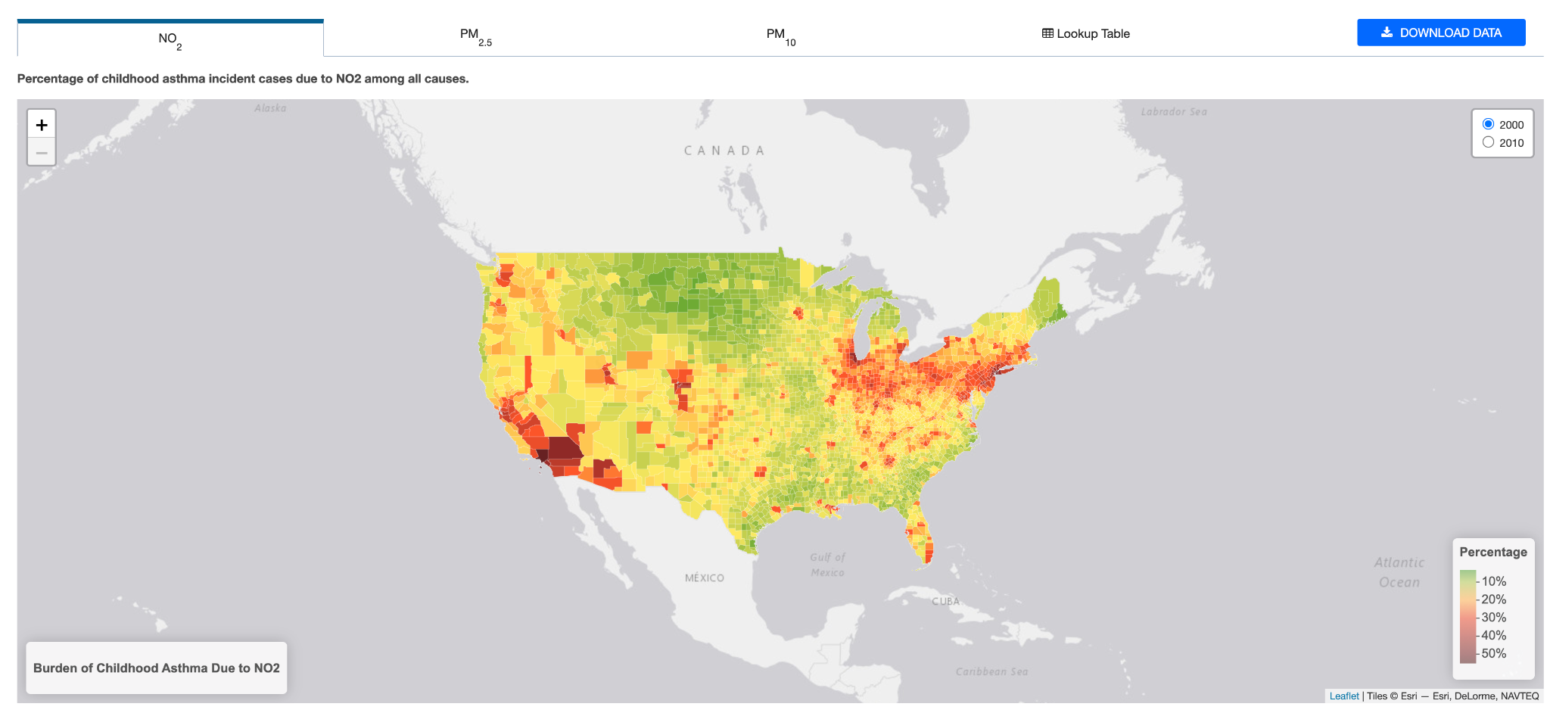
Let’s Look at Some Data
Lesson 4:
ENGAGE
Let’s look at some data that shows rates of childhood asthma around our country. You can make observations and ask questions about the maps.
Notes:
Project this interactive map from USDOT. You can point out all three maps. One map shows asthma caused by nitrous oxide, which is a gas. It also shows two types of particulate matter pollution, which are tiny pieces of solids and liquids in the air. PM_{2.5} and PM ₁₀ refer to the size of the pollutant. You can observe this data for 2 different years (2000 and 2010). You can also zoom on this map to show your particular county. To support students to analyze the data you can use the following prompts:
What do the different shapes on the maps mean? (These are counties)
What do the different colors on the map mean? (Green and yellow means lower rates of asthma caused by the pollution. Orange and red means higher rates of asthma caused by the pollution - Note: at first students may articulate that the colors show more or less of the pollutant. Remind students it is showing asthma rates caused by the pollution.)
What do you notice about asthma caused by nitrous oxide?
What do you notice about asthma caused by particulate matter?
What differences do you see between the maps?
What questions do you have?
Record student questions on the driving question board. Examples of observations: Particulate matter seems to cause worse rates of asthma than nitrogen dioxide. Some counties seem to have worse asthma rates than others. Things seem to get a little better in 2010, but there are still high rates in some places. Questions you may anticipate hearing might include: Why do some counties have worse asthma numbers? What are nitrogen dioxide and particulate matter? Why does traffic cause pollution? Why does pollution cause asthma? Why was it worse in 2000 than 2010? Consider if any of these questions are connected to the learning of this lesson. If so, highlight this question for students. Say to students: Today’s activity will support us in answering this question. By answering this question, we will be able to build on our understanding of the anchoring problem.
If students do not offer these questions, do not provide these questions for students;instead, help them start thinking about these ideas by focusing their attention to the different asthma numbers, any words they do not know, differences in asthma numbers during the ten year span. Have students place their questions into existing categories, or create new categories.

Slide 33
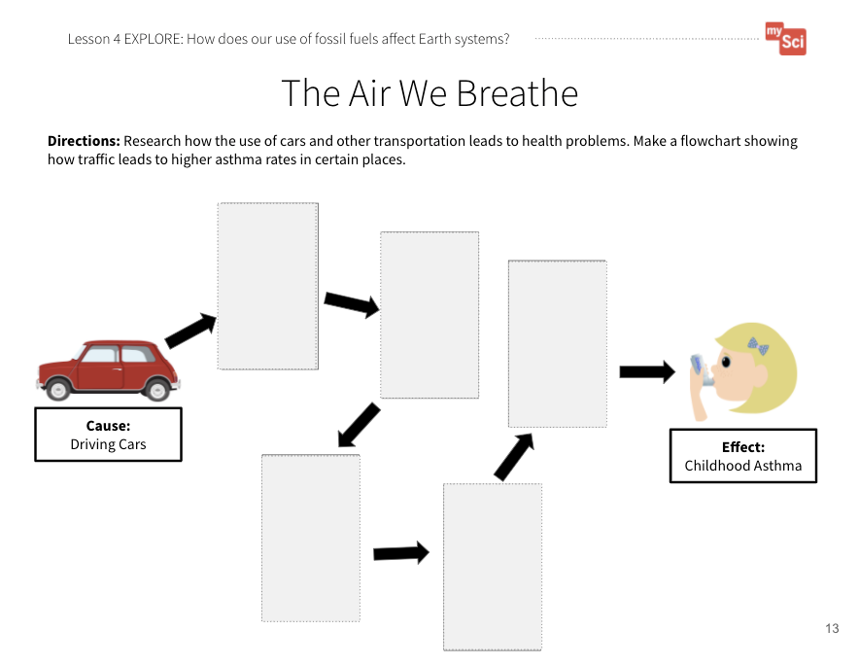
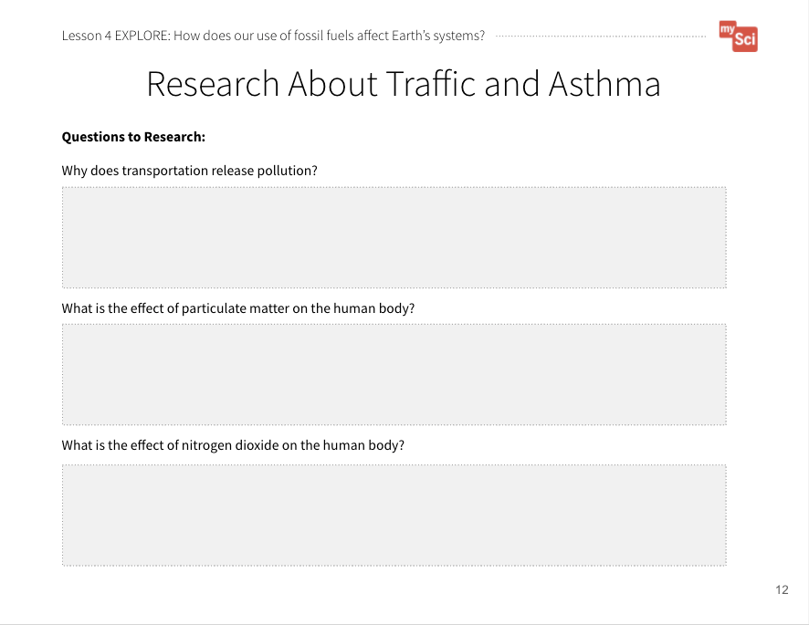
What information do you need to answer our questions?
Lesson 4:
EXPLORE
What information do you need to answer our questions?
How might you go about finding this information?
What Causes Air Pollution
Clean Air Outdoors
Research About Traffic and Asthma and
The Air We Breathe
Student Journal pages
Notes:
EXPLORE Summary: Students obtain information from text to describe the cause and effect relationship between transportation and asthma.
Say to students: In order to answer some of these questions, what kinds of information do you need and how might you go about finding this information? If students are struggling, say to students: How were we able to answer our questions in the previous lesson about natural resources? (Students may recall that they used an internet resource to gather specific information. In the last lesson, students developed the practice of obtaining information, using only one resource. In this lesson, they will use multiple resources, and combine information.
Provide students the following text resources and the Research About Traffic and Asthma and The Air We Breathe Student Journal pages. Show students that they can use the first page to record important facts, then put those facts into a flowchart that shows step by step how traffic causes asthma.
What Causes Air Pollution from NASA Climate Kids
Clean Air Outdoors from The American Lung Association
The most helpful starting point for research is the page titled What Makes Outdoor Air Unhealthy?. Have the students research the hyperlinks for Nitrogen Dioxide, Particulate Matter, and Transportation.
They can take time to read and take notes individually, then pair up to co-construct their flowcharts based on what they read. They can use pictures, drawings, and/or words to construct their flowcharts.
Teaching Tip: To help students build research skills, when you click on the links, first ask students which topics they think would be most relevant to help explain the cause and effect relationship between traffic and asthma.

Slide 34
Correlation between car traffic and high asthma rates
Lesson 4:
EXPLORE
Research About Traffic and Asthma and
The Air We Breathe
Student Journal pages
Notes:
After students create their flowcharts, create a class flowchart to make sure everyone comes to a consensus about the cause and effect relationship.

Slide 35
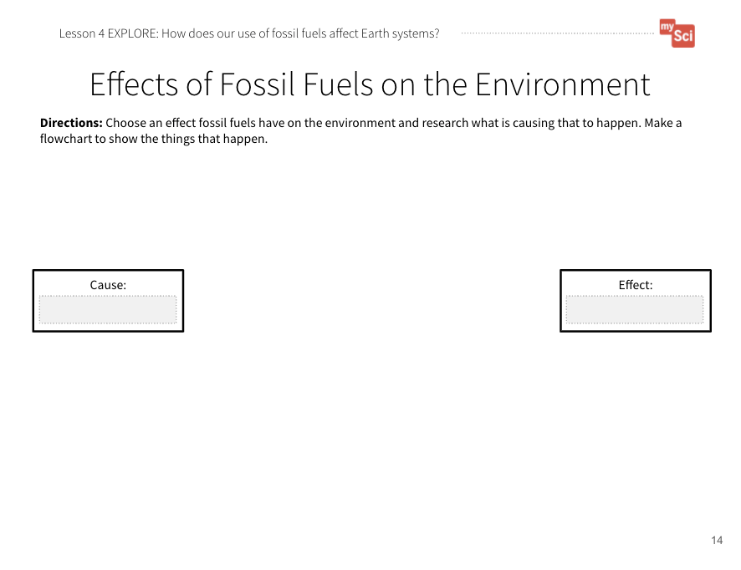
Researching Different Phenomenon
Lesson 4:
EXPLORE
Possible Phenomenon to Research
Coral Bleaching in the Oceans
Oil Spills and Aquatic Life
Earthquakes and Fracking
Flammable Water and Fracking
Increased Wildfires
Coal Ash Spills
Orange Water from Coal Pollution
Other Ideas?
Now, you are going
to research a different phenomenon related to the use of natural resources.
Science Journal For Kids
Science News For Students
Washington Post For Kids
Smithsonian Tween Tribune
Effects of Fossil Fuels on the Environment Student Journal Page
Notes:
Next, allow students to work in groups to choose another phenomenon related to humans' uses of natural resources, research using text and video resources, and create a flowchart to explain the cause on Effects of Fossil Fuels (Student Page 13). Examples students could choose from include:
Coral Bleaching in the Oceans
Oil Spills and Aquatic Life
Earthquakes and Fracking
Flammable Water from Fracking
Increased Wildfires
Coal ash spills
Orange Water from Coal Pollution
Other (based on student research and interest)
Some of these topics are able to be researched using the NASA and EIA Energy Kids websites. For other topics, here are other resources to find student-friendly news articles: Science Journal For Kids, Science News For Students, Washington Post For Kids, and Smithsonian Tween Tribune.

Slide 36

How do we determine if a resource is reliable?
Lesson 4:
EXPLORE
How do we determine if a resource is reliable?
What do you think we mean by reliable?
Writing Videos for Kids: How to Evaluate Sources for Reliability
Notes:
To support students in identifying reliable resources facilitate a discussion about important things to look for when examining websites: Writing Videos for Kids: How to Evaluate Sources for Reliability. From this video, highlight the following:
Identify the author. Who are they? What is their purpose for writing the article?
Look for common information between multiple articles on the same topic
Look at the date the article was written. Scientific knowledge can change over time.
As a class, examine one of the resources students will be using for today’s activity. Have the students identify the author, discuss the purpose of the writing, and identify the date the article was written. To help guide them you can ask: Who is the author of the article? Where can we find the author? What is their purpose for writing the article? Is it to inform? To persuade? To sell us something? When was this article written?

Slide 37
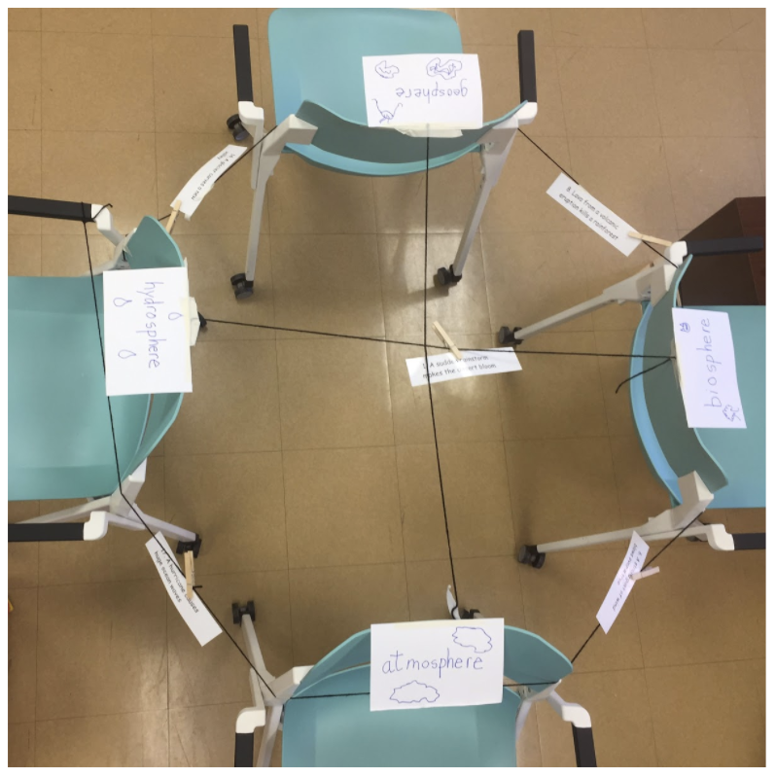
Class Interaction Model
Lesson 4:
EXPLAIN
Class Interaction Model
Let’s use the flowchart to trace how the human use of energy from driving affects the spheres.
Effects of Fossil Fuels on the Environment Student Journal Page
Notes:
EXPLAIN Summary: Students develop a model to explain how humans’ use of natural resources affects Earth systems.
Say to students: We have seen that when we use natural resources, we can cause pollution- adding a harmful or poisonous substance to the environment. Let’s break down how this affects the Earth.
Set up the spheres interaction model from Lesson 2. You will model the process for students, using the asthma example. Use the flowchart to trace how the human use of energy for driving affects the different spheres. Write down how the spheres are interacting on index cards, and use the clothes pins to place them along the string between two spheres. (Sample Guidance: 1. Biosphere → Geosphere- Humans extract oil from the ground. 2. Biosphere → Atmosphere- Humans burn gasoline when they drive their car, which releases pollutants into the air. 3. Atmosphere → Biosphere- Polluted air is breathed in by humans, which can cause asthma.)

Slide 38
Group Interaction Models
Lesson 4:
EXPLAIN
Group Interaction Models
Use your flowchart to talk through the sphere interactions.
Write them on the index cards.
Share out with the class.
Effects of Fossil Fuels on the Environment Student Journal Page
Notes:
Next, provide each student group several index cards. Say to students: Now, you are going to trace the interactions of the Earth systems involved in the topic you researched. Each group will have the chance to explain their phenomenon using the sphere model.
Give students time to talk through system interactions, write them on index cards, then share out to the whole class. If students provide system interactions that are not correct, ask them to explain their thinking. Then refer to the talk moves and have students agree and/or disagree with their thinking. Use this as an opportunity for students to continue to make sense of the different systems and their interactions.
This activity is a chance to formatively assess students' understanding of the SEP Obtaining, Evaluating, and Communicating Information and DCIs ESS3.A and ESS2.A. See the student journal answer key for an example. If students are struggling to obtain information to describe the connections between human events (transportation) and pollution, read the resources as a class, pausing frequently to check if you have come across information needed to fill out the journal page.

Slide 39
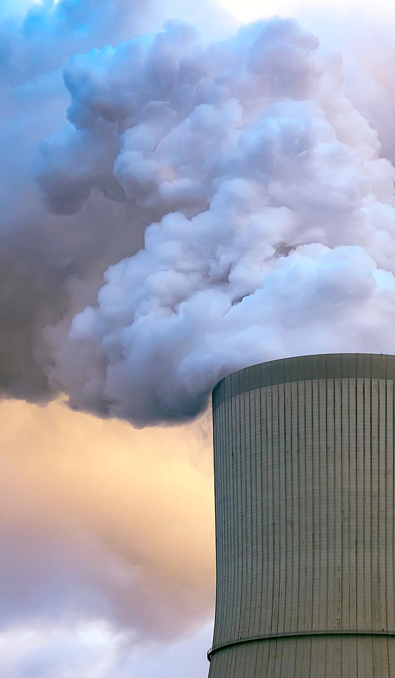
Pollution
Lesson 4
pollution
a substance or thing that has harmful or poisonous effects

Slide 40

What is The Greenhouse Effect??
Let’s consider another impact the use of fossil fuels has on Earth systems.
Lesson 4:
EXPLAIN
Greenhouse Effect
Notes:
Say to students: You might have noticed that things like wildfires and coral bleaching have to do with the planet warming up. Burning fossil fuels releases several pollutants, one of which is carbon dioxide gas. Let’s watch a video that shows how this affects our planet. Show Greenhouse Effect from NASA (2:29). his idea is an above grade-level expectation. However, it is a useful conversation to provide context for the engineering designs students will engage in during Lessons 8&9. After the video, use a student research example (about wildfires, for example) to talk about how greenhouse gasses such as carbon dioxide and methane increase the greenhouse effect, or warming of the Earth.

Slide 41
Lesson 4: Elaborate
Lesson 4:
ELABORATE
How do you think energy use on farms impacts Earth systems? Why?
Notes:
ELABORATE Summary: Students refine a model of a farm and illustrate the effects of natural resource use on Earth systems.
Ask students: How do you think energy use on farms impacts Earth systems? Why? (Students should connect the use of fossil fuels on farms to decreased air quality which impacts human health. They may also discuss how air pollution affects other Earth systems.)

Slide 42
Lesson 4: Elaborate (part 2)
Lesson 4:
ELABORATE
A good model of a system shows relationships between parts of the system!
How will we show how natural resources used on a farm affect Earth’s Systems?
“Gotta Have It” Checklist: Our Farm Model has to have...
✔
✔
✔
✔
✔
✔
Farm Model
Student Journal page
Notes:
In the last lessons we have used a “Gotta Have It Checklist” to show the components and relationships we needed to include in the models. What would you add to the checklist today to make our models show natural resources used on a farm affect the environment? Examples of things the model’s “gotta have” might include:
How fossil fuel use affects the atmosphere
How fossil fuel use affects the biosphere (human health)
When co-constructing the “gotta have it” checklist with your students, actively moderate the discussion using discourse moves such as probing, turn-and-talks, follow-up questions, revoicing, and wait time. During this process, students often challenge or build on a peer’s suggestion so it may be helpful to refer to your classroom norms around how to comment on another’s ideas. Emphasize to your students that the “gotta have it” checklist items should not be vocabulary words. They should be phrased as an idea that typically expresses a relationship.If key ideas are not mentioned by students, you must suggest or prompt students to look back at the DQB and ask them, Should any ideas here be part of our final explanations?

Slide 43
Let’s share our models and give each other feedback
Lesson 4:
EVALUATE
Let’s share our models and give each other feedback.
Farm Model
Student Journal page
Notes:
EVALUATE Summary: Students evaluate each other’s farm models and give feedback.
Have students share their models with a partner or another group and give each other feedback using the “Gotta Have It Checklist”. How do their models compare with each other’s? What interactions between fossil fuels and Earth’s systems did they identify? Students will continue to refine this model over time. Bring the class back together, and ask students to share out the differences and similarities in their models. This supports students to see the different ways you can represent and label things in models. Based on their discussion, students should change their models to reflect feedback.
Return to the class consensus model that was created in the Engage portion of lesson 1. Revise the class model to include the interactions between fossil fuels and Earth’s systems the students described from their individual models. Ask students what labels you should put on your drawing. This helps scaffold the revision process and provides continuity throughout this unit.
This activity is a chance to formatively assess students' understanding of the SEP Developing and Using Models, DCI ESS3.A and ESS2.A, and CCC System and System Models. See the student journal answer key for an example. If students are struggling to apply what they have learned in developing a model, use the class consensus model you created to support students to further develop their models.

Slide 44
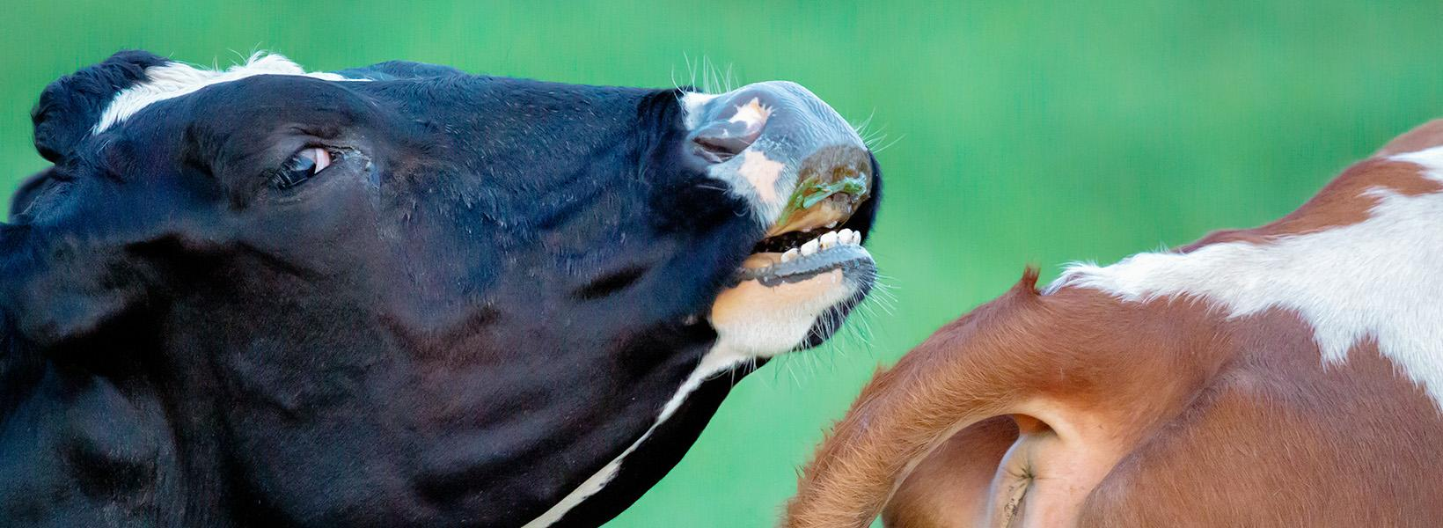
Lesson 4: EVALUATE
Lesson 4:
EVALUATE
How might this help us figure out how our use of natural resources on farms affects Earth’s systems?
Notes:
To support student sensemaking across the unit, orient students back to the DQB. Ask students: What did we observe during today’s activity? Record the activity and their observations. Next, ask students: What did we learn today? Record their responses. If students need a reminder, they can reference their student journals.
Ask students: How might this help us figure out how our use of natural resources on farms affects Earth’s systems? (Students may say that humans use fossil fuels for their everyday activities, but the use of fossil fuels can be bad for the environment. They may provide specific examples of how the burning of fossil fuels releases pollution into the atmosphere that can cause problems for living things.)

Slide 45
What new questions do you have?
Lesson 4:
EVALUATE
Notes:
Next, ask students: What new questions do you have? Write student responses on the driving question board. (They may have new questions, such as: How can we reduce the effect that the use of fossil fuels has on the environment? Do other natural resources have an impact on the environment? Are there other ways to get energy instead of fossil fuels?)
Do not provide these questions for students, instead help them start thinking about these ideas by focusing their attention to the different interactions between fossil fuel use and Earth systems that they labeled on their models and how that could relate to the anchoring problem: Farms use a large amount of resources. This can have a negative impact on the environment. Have students place their questions into existing categories, or create new categories.

Slide 46
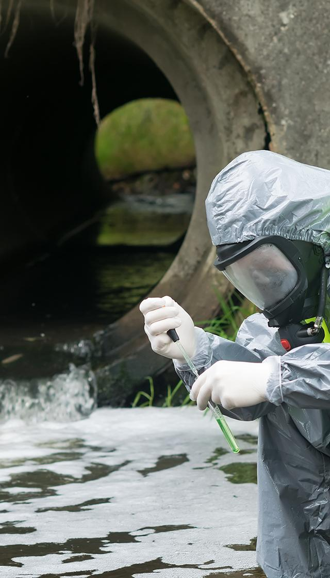
Lesson 5: Learning Target
Lesson 5:
LEARNING TARGET
LESSON 5:
How does our use of water affect Earth’s systems?
Notes:
In the last lesson students explained how our use of fossil fuels affects Earth systems.
In this lesson students analyze and graph data to show how water is distributed on Earth. They obtain information about how human activities can affect the amount and quality of our water resources.
Students figure out that the amount of freshwater available for human use is limited. Many activities, including farming, can deplete water resources. Human activities can also cause water resources to become polluted.
In the next lesson, students will set up biodigesters to investigate if we can use farm waste as a natural resource for energy.

Slide 47
Lesson 5: Engage
Lesson 5:
ENGAGE
We have spent a lot of time thinking about how humans use natural resources for energy, and what impacts this has on Earth systems.
Another important natural resource humans use is water.
All life on Earth depends on water.
Notes:
ENGAGE Summary: Students ask questions about water use farms.
Say to students: We have spent a lot of time thinking about how humans use natural resources for energy, and what impacts this has on Earth systems. Another important natural resource humans use is water. All life on Earth depends on water.

Slide 48
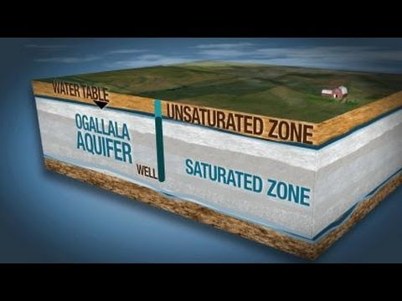
Lesson 5: Engage (part 2)
Lesson 5:
ENGAGE
The Ogallala Aquifer
Notes:
Show students the following video: The Ogallala Aquifer (Stop at 1:36) from the National Science Foundation.

Slide 49
What do you observe about water on farms?
Lesson 5:
ENGAGE
What do you observe about
water on farms?
Are there any problems that you can think of related to the use of water on farms?
Notes:
After students have observed the video, ask: What do you observe about water on farms? (Farms need water to grow food. Some farms pump water out of the ground.) If students don’t offer these responses you can ask: What do you think farms use water for? Where do you think farms get this water? Then ask: Are there any problems that you can think of related to the use of water on farms? (In the video farmers were using big watering systems. They look like they use a lot of water.) If students don’t offer these responses you can ask: What did you notice about the tools farmers used to water the plants? How much water do you think it takes to water all of those plants we saw in the video?

Slide 50
What questions do you have?
Lesson 5:
ENGAGE
What questions do you have?
Notes:
Then ask: What questions do you have? (Students may ask: Where else can farmers get water besides underground? How does the water get in the ground? Can farms run out of water? ) It is okay if students do not offer these questions.
Revisit the Driving Question Board. Review the words, phrases, or questions used to categorize student questions. Have students consider where they might place these new questions about water on farms. Consider if any of these questions are connected to the learning of this lesson. If so, highlight this (these) question for students. Say to students: Today’s activity will support us in answering this question. By answering this question, we will be able to build on our understanding of the anchoring problem.

Slide 51
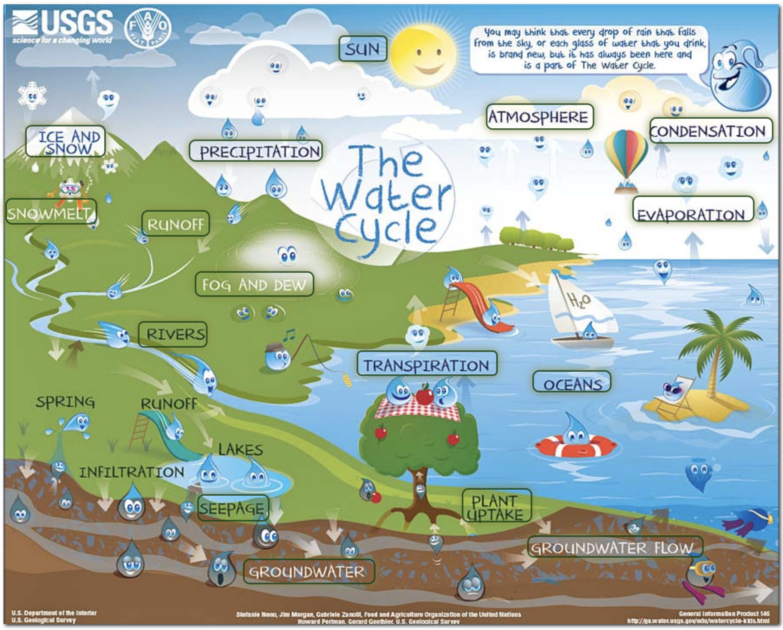
Lesson 5:
EXPLORE
What are the different types of water you see?
Is ocean water the same as river or lake water?
How are they different?
Notes:
EXPLORE Summary: Students use models to visualize amounts of different kinds of water on Earth, and how our waterways are connected.
Say to students: Let’s start by thinking about how we use water, and the forms of water on Earth. Use the USGS water cycle maps and have students look at the maps. The focus here is not on the process of the water cycle, but rather to visualize the different places we can find water on Earth. It is recommended to use the “beginner” version of this map since it is not as crowded with words. Ask: What are the different types of water you see? (Oceans, rivers, lakes, streams, ground water, ice) Is ocean water the same as river or lake water? How are they different? (Students may or may not know that ocean water is saltwater, while rivers and lakes are freshwater without high amounts of salt. If no one mentions this, point out that difference.)

Slide 52

Saltwater
Lesson 5
saltwater
water that contains a lot of salt (like ocean water)

Slide 53
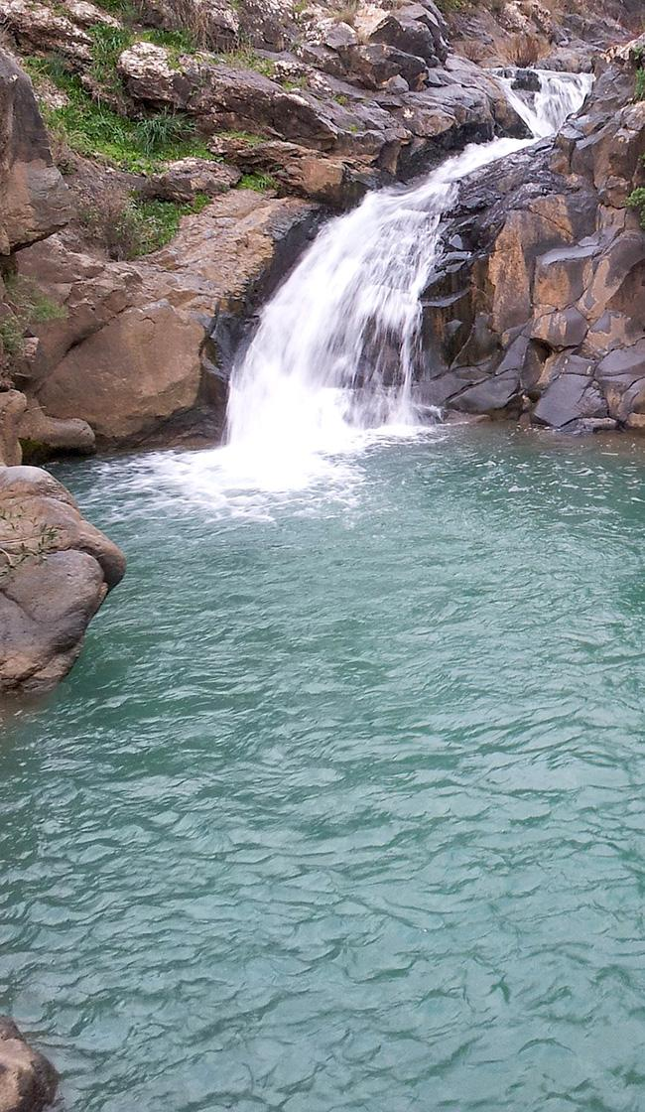
Freshwater
Lesson 5
freshwater
water that does not contain a large amount of salt (like river or lake water)

Slide 54
Lesson 5: EXPLORE (part 2)
Lesson 5:
EXPLORE
What type of water do we use as humans for drinking, watering plants, and taking care of farm animals?
Notes:
Ask students: What type of water do we use as humans for drinking, watering plants, and taking care of farm animals? (Freshwater from rivers, lakes, streams, and groundwater) Freshwater is very important for human activities. Let’s explore how much of each type of water resource we have on Earth.

Slide 55
Types of Water Found on Earth
Lesson 5:
EXPLORE
Water Source | Water Volume (Cubic Miles) | Percent of Freshwater | Percent of Total Water
Saltwater |  | -- | 97.4
Oceans, Seas, & Bays | 321,000,000 | -- | 96.5
Other Saltwater | 3,108,490 | -- | 0.937
Freshwater |  | -- | 2.6
Glaciers and Ice Caps | 5,773,000 | 68.6 | 1.74
Groundwater | 2,526,000 | 30.1 | 0.76
Ground Ice and Permafrost | 71,970 | 0.86 | 0.022
Lakes and Rivers | 42,829 | 0.27 | 0.007
Other Freshwater (Swamps, Atmosphere, Soil Moisture, Biological Water) | 10,075 | 0.17 | 0.071
Notes:
Show the data table of the amounts of types of water on Earth. Have students make observations and ask questions about the data.
Teaching Tip: This is an opportunity to integrate math standards. Students can change the decimals to fractions, notice the magnitude of difference between the numbers, compare different numbers on the chart, or make a number line to show the scale of difference between numbers. The CCC of this lesson is Scale, Proportion, and Quantity. It can be tough for students to visualize the vast difference between large percentages and 1/1000 of a percent, so these discussions can help students make sense of the data.

Slide 56
Lesson 5: EXPLORE (part 3)
Lesson 5:
EXPLORE
Let’s make a model to make it easier to understand these differences in amount and kind of water on Earth.
Notes:
Say to students: We noticed that there were big differences in the amounts of types of water on Earth. Let’s make a model to make it easier to understand these differences in amount.
Set up the graduated cylinder demo. Here is a teacher tutorial showing the setup. The detailed procedure for this activity can be found in Appendix C (Lesson 5 Water Demonstration Procedure).

Slide 57
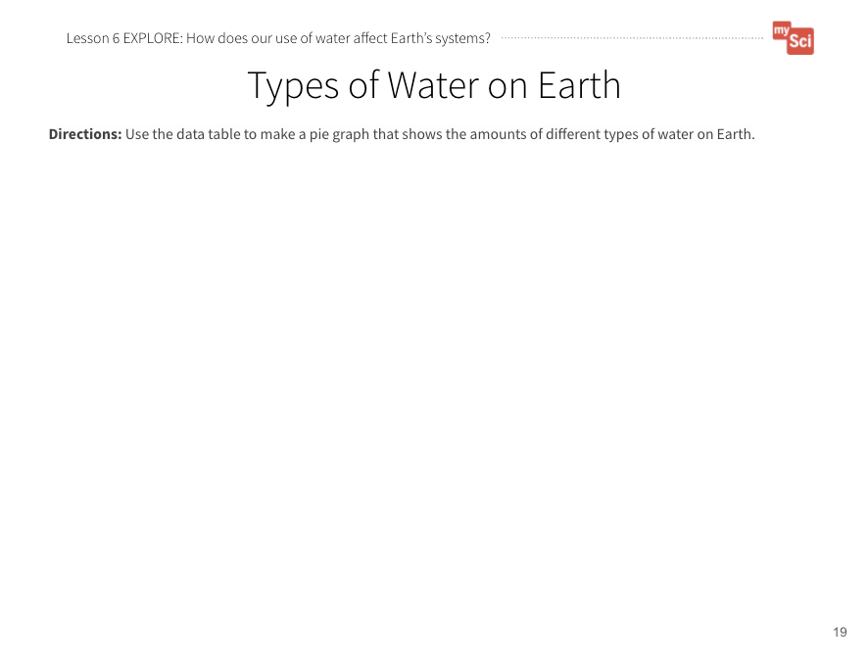
Lesson 5: EXPLORE (part 4)
Lesson 5:
EXPLORE
Now let’s take the data from the chart and make a graph of the types of water on Earth.
What type of graph would be best to show the different amounts of water on Earth?
Types of Water on Earth
Student Journal page
Notes:
Give students time to take the data from the chart on the previous slide and make a graph of the data on Types of Water on Earth Student Journal page. There are different ways to approach this. You could have students make a pie chart, but first discuss why this is the best way to represent this kind of data. You could have students graph only the amount of freshwater vs. saltwater, or have them graph the different kinds of freshwater.

Slide 58
Lesson 5: EXPLAIN
Lesson 5:
EXPLAIN
Based on the data table and the graph you made, what claim can you make about humans and freshwater on Earth?
Types of Water on Earth
Student Journal page
Notes:
EXPLAIN Summary: Students construct explanations about how humans' use of water resources affects Earth’s systems.
Have students work in groups to analyze their graphs. To support students to do this, ask: Which slice of the pie chart is the biggest? What does that tell you? Which slice of the pie chart is the smallest? What does that tell you? (The saltwater slice is the biggest. The freshwater slice is the smallest. This means most of the water on Earth is salt water.)
Ask students: What claim can you make about humans and freshwater on Earth, based on the data table and graph you made? (Most of Earth’s water is found in the ocean. We don’t have a lot of usable freshwater on Earth.) Give students time to work on developing their claims individually first. Then they can share them with their groups to come up with group claims. Finally, each group shares their claims with the class.
This activity is a chance to formatively assess students' understanding of the DCI ESS2.C, SEP Using Mathematics and Computational Thinking and CCC Scale, Proportion, and Quantity. See the student journal answer key for an example. If students are struggling to create their graphs, walk through graphing one data point as a class. If students are struggling to develop their claims, provide them with sentence starters.

Slide 59
Lesson 5: EXPLAIN (part 2)
Lesson 5:
EXPLAIN
How does what we saw in the video
apply to our farm models?
Use your model to talk to a partner about how humans are affecting Earth’s spheres by using groundwater for farming.
Farm Model
Student Journal page
Notes:
Say to students: Humans use water to drink, bathe, water their lawns, in the production of energy, etc. We also need a lot of it to keep up with all of the food we need to grow. We saw that groundwater is less than 1% of water on Earth. However, it makes a majority of the freshwater available for us to use. Let’s see what the effects are of our use of groundwater for farming.
Remind students of the video they watched at the beginning of the lesson. Then, have students pair up and look at their farm models (Farm Model Student Journal page). Say: Aquifers are large bodies of underground rock that contain fresh groundwater. How does what we saw in the video apply to our farm models? Use your model to talk to a partner about how humans are affecting Earth’s systems by using groundwater for farming. (Listen for students discussing how humans (biosphere) take water (hydrosphere) out of the aquifers in the ground (geosphere) to water crops. The water can’t be replaced fast enough, so the groundwater gets too low.) If students do not mention the system in their discussions, use these probing questions: Which system is water a part of? Which system are humans a part of? Which system are aquifers located in? What do you think happens to the aquifer as farmers use the water?
Teaching Tip:
Students can track their own water usage using the USGS website, or their own tracking method.

Slide 60
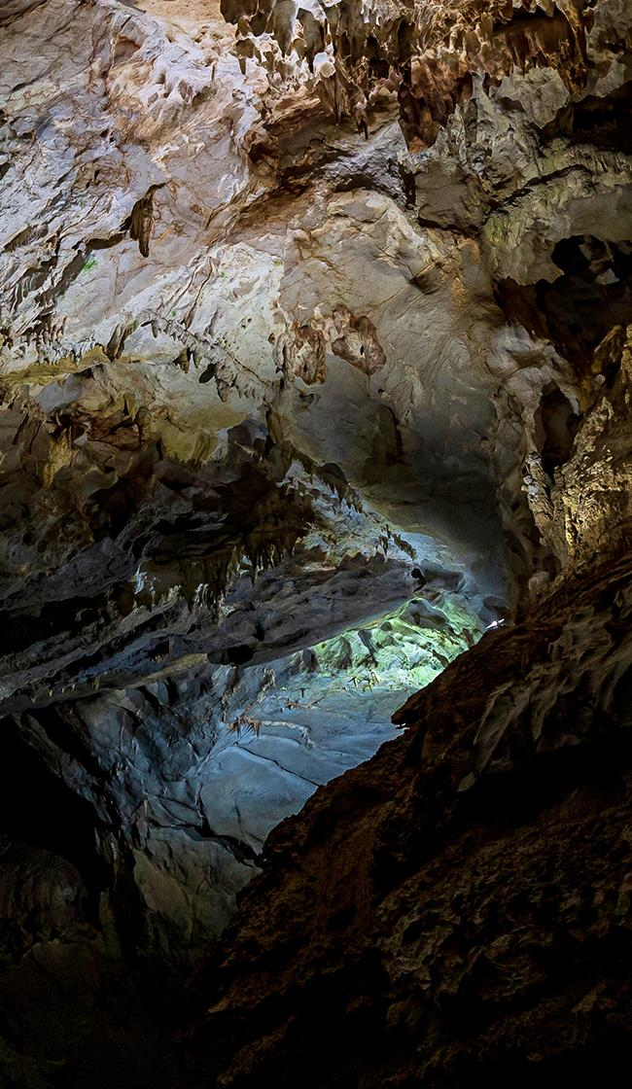
Aquifer
Lesson 5
Aquifer
large bodies of underground rock that contain fresh groundwater

Slide 61
Lesson 5: EXPLAIN (part 3)
Lesson 5:
EXPLAIN
We saw that groundwater is less than 1% of water on Earth. Let’s see what the effects are of our use of groundwater for farming.
The Ogallala Aquifer
Notes:
Show students the following video: The Ogallala Aquifer (5:37) from the National Science Foundation.Have them focus on the problem that comes from using water from the aquifer. The students can then add to their ideas they discussed prior to watching the video.

Slide 62
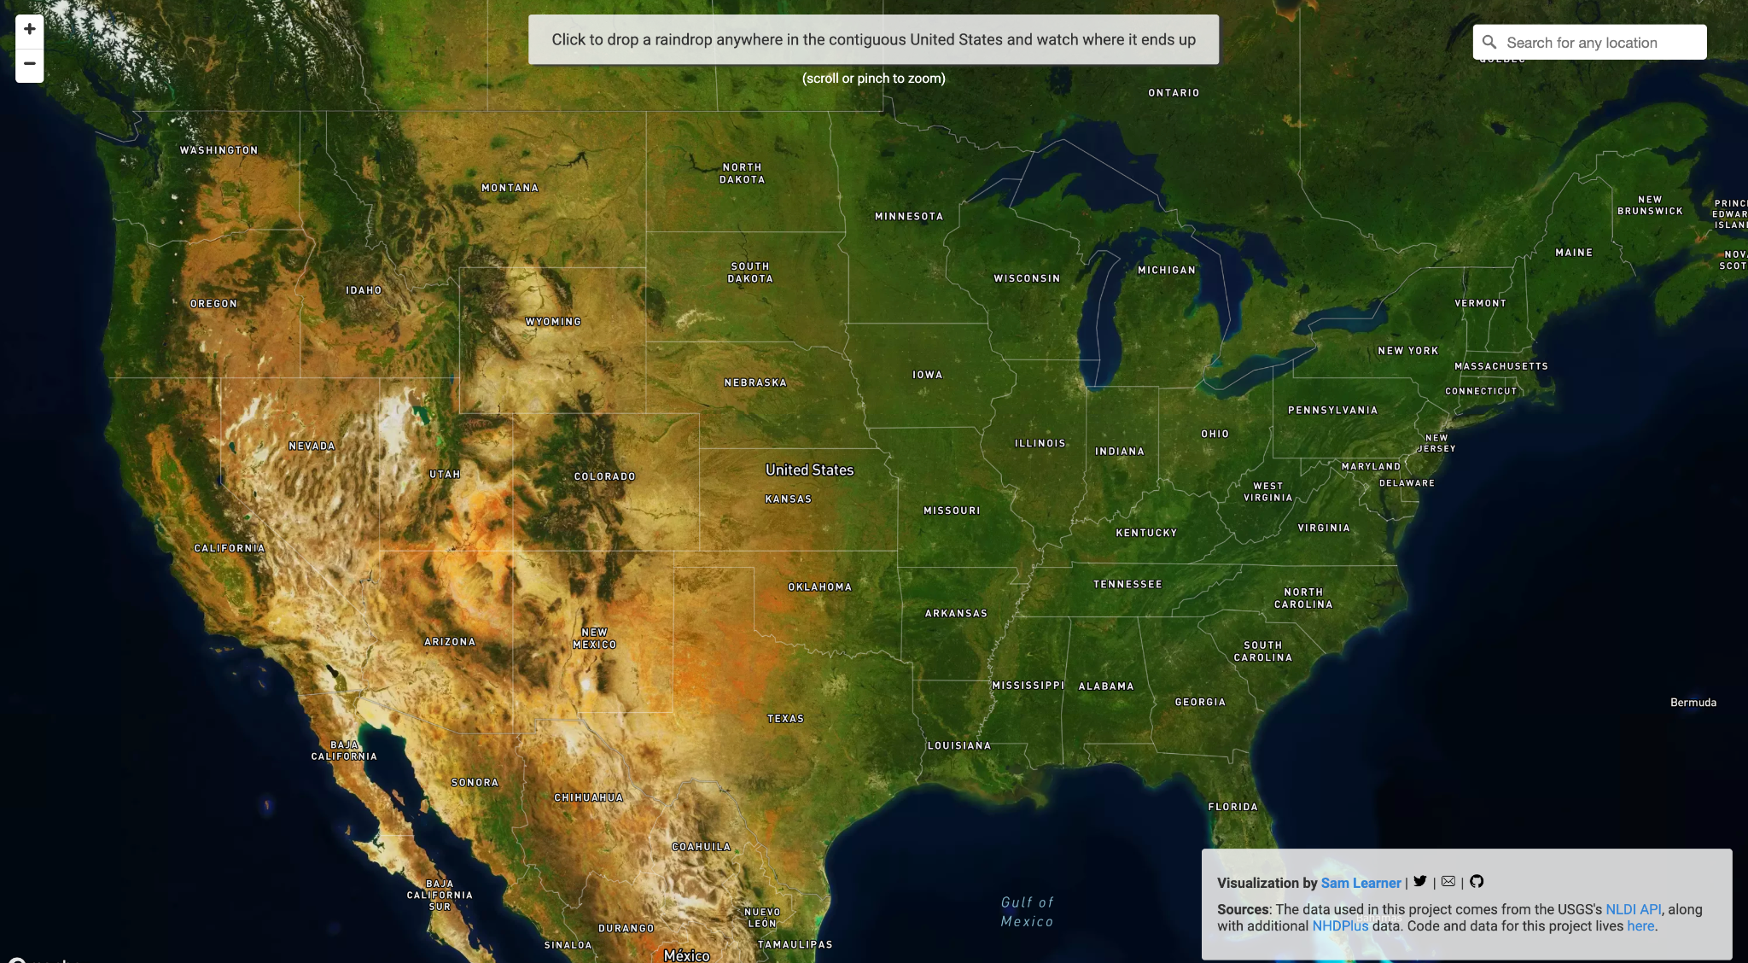
Lesson 5: ELABORATE
Lesson 5:
ELABORATE
Let’s consider a farm that produces
a lot of animal waste.
What do you think happens if it rains when
there is animal waste of the ground?
Let’s see where it goes!
An important opportunity to attend to equity is offered in the speaker notes area
River Runner
Notes:
ELABORATE Summary: Students develop a model to show how farms use water and how animal waste can pollute water resources.
Say to students: We now know that farms use a lot of water and we have limited amounts of freshwater on Earth. If we have limited fresh water, we want to make sure that the water stays clean so that it can be used. How do you think farms contribute to the cleanliness of Earth’s fresh water? What are some things that are produced as a result of farming? What happens after the cows or other animals are fed? Where does that poop go? What happens if it rains when there is poop on the ground? Let’s consider a farm that produces a lot of animal waste. When rain falls or water moves over the ground, some of that waste may get picked up and moved with it. Let’s see where it goes.
To help students develop their explanations further, project the following resource for students: River Runner. Locate an area near your school that appears to be farmland. Say to students: Let’s consider a farm that produces a lot of animal waste. When rain falls or water moves over the ground, some of that waste may get picked up and moved with it. Let’s see where it goes. (Students should observe that water in Missouri eventually ends up in the Mississippi River, and ultimately the Gulf of Mexico in Louisiana.)
What do you think might be some issues with animal waste running into rivers, lakes, and the ocean? Has anyone seen a lake or pond that looks like this before? (Show the photos of dead zones and pond eutrophication on the next 3 slides. Use the descriptions in the slides to provide context for students.
Attending to Equity:
People from different cultures across the globe view water as a sacred resource that deserves to be protected. You could read the children’s book We are Water Protectors by Carole Lindstrom to examine how Indigenous people of North America have rallied to protect the waters of the land. Missouri has many natural springs that have been important to both native tribes and early European settlers.

Slide 63
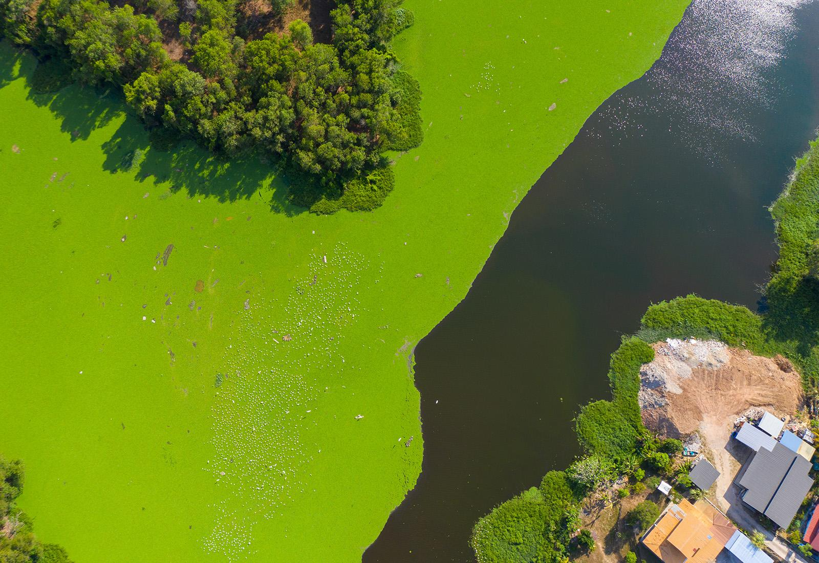
Lesson 5: ELABORATE (part 2)
Lesson 5:
ELABORATE
Notes:
The image shows an algae bloom caused by eutrophication in a lake.

Slide 64
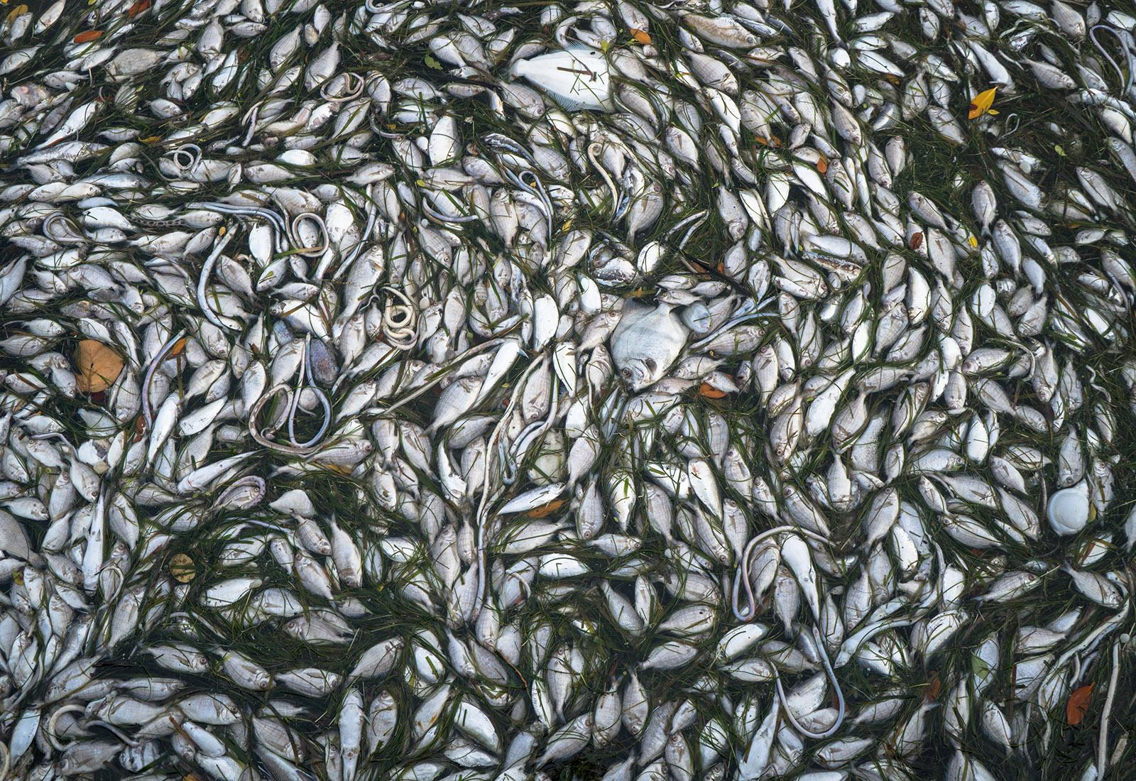
Lesson 5: ELABORATE (part 3)
Lesson 5:
ELABORATE
Notes:
The image shows a dead zone caused by eutrophication in a body of water.

Slide 65
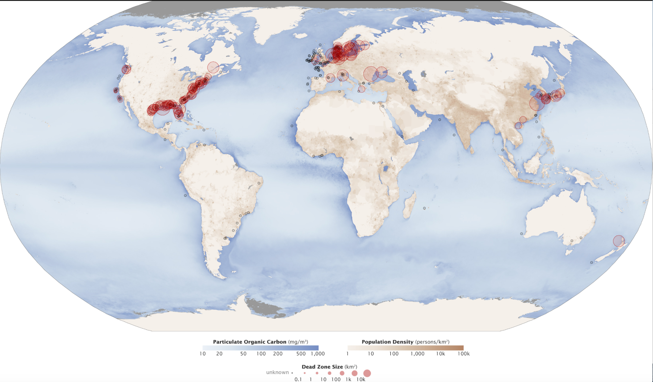
Lesson 5: ELABORATE (part 4)
Lesson 5:
ELABORATE
Notes:
The map shows the locations, the size, and the number of marine dead zones—areas where the deep water is so low in dissolved oxygen that sea creatures can’t survive.

Slide 66
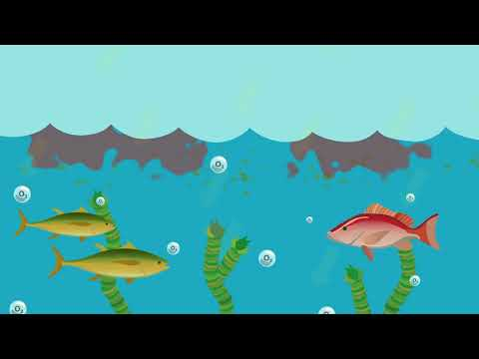
Lesson 5: ELABORATE (part 5)
Let’s watch a video that shows what is happening to cause water pollution.
Lesson 5:
ELABORATE
What is Eutrophication?
Farm Model
Student Journal page
After watching, we’ll revise our models.
Notes:
Say to students: Let’s watch a video that shows what is happening to cause water pollution. As you’re watching, think about how you could represent this on your farm model. Show What is Eutrophication? by USOceanGov (1:03). It is not critical that students understand the process of eutrophication (this is an above grade level expectation). The purpose of this video is to introduce students to one effect of water pollution so that they can visualize the harm it can cause.
After students watch the video, give them time to revise their models based on what they figured out from the video.

Slide 67
Lesson 5: ELABORATE (part 6)
Lesson 5:
ELABORATE
A good model of a system shows relationships between parts of the system!
How will we show how animal waste can pollute different water sources?
“Gotta Have It” Checklist: Our Farm Model has to have...
✔
✔
✔
✔
✔
✔
Farm Model
Student Journal page
Notes:
Have students draw on their farm models (Farm Model Student Journal page) to show how farm animal waste can pollute different water sources. Ask students what they should add to their “Gotta Have It” checklist so that their models are showing what they want them to show. Their models should show:
How water is being used on the farm
Where the water is coming from
Animal waste
How the pollution gets from a farm to a water source that is not near the farm
Something to show how the animal waste is affecting the water
As students are making their models, this is a good time to reinforce vocabulary about Earth systems, and ask students to point out how our water use affects Earth systems. For example, they might say that the biosphere (farming) is affecting the hydrosphere (lakes and oceans) by adding too much waste. This then circles back to affect the biosphere (too much algae grows, so aquatic animals die).

Slide 68
Lesson 5: EVALUATE
Lesson 5:
EVALUATE
Let’s share our models and give each other feedback.
Farm Model
Student Journal page
Notes:
Evaluate Summary: Students evaluate each other’s farm models and give feedback.
Have students share their models with a partner or another group and give each other feedback using the “Gotta Have It Checklist”. How do their models compare with each other’s? What interactions between water, animal waste, and Earth’s systems did they identify? Students will continue to refine this model over time. Bring the class back together, and ask students to share out the differences and similarities in their models. This supports students to see the different ways you can represent and label things in models. Based on their discussion, students should change their models to reflect feedback.
Return to the class consensus model that was created in the Engage portion of lesson 1. Revise the class model to include how farms use water resources, and how farming can impact water quality. Ask students what labels you should put on your drawing. This helps scaffold the revision process and provides continuity throughout this unit.
This activity is a chance to formatively assess students' understanding of the SEP Developing and Using Models, DCI ESS2.A, and CCC System and System Models. See the student journal answer key for an example. If students are struggling to apply what they have learned in developing a model, use the class consensus model you created to support students to further develop their models.

Slide 69
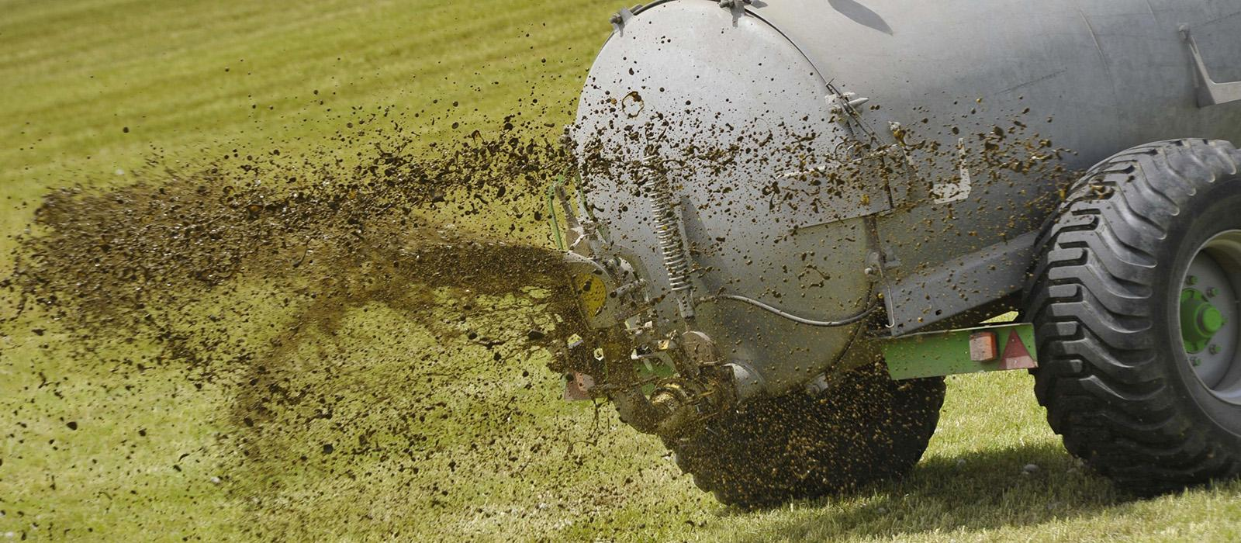
Lesson 5: EVALUATE (part 2)
Lesson 5:
EVALUATE
How might this help us figure out how our use of natural resources on farms affects Earth’s systems?
Notes:
To support student sensemaking across the unit, orient students back to the DQB. Ask students: What did we observe during today’s activity? Record the activity and their observations. Next, ask students: What did we learn today? (We examined how humans’ use of natural resources can impact the amount of usable water and the quality of water on Earth.) Record their responses. If students need a reminder, they can reference their student journals.
Ask students: How might this help us figure out how our use of natural resources on farms affects Earth’s systems? (Students may say that farms need water to grow food, and that using too much water can deplete the resource. They may also discuss how human activities can cause water pollution. For example, animal waste can be moved by water to different locations on Earth. The nutrients in the waste can lead to dead zones in lakes and oceans)

Slide 70
Lesson 5: EVALUATE (part 3)
Lesson 5:
EVALUATE
What new questions do you have?
Notes:
Next, ask students: What new questions do you have? Write student responses on the driving question board. (They may have new questions, such as: How can we reduce the amount of animal waste that gets into our waterways? How can we reduce the amount of water we use, so we don’t deplete it?)
Do not provide these questions for students, instead help them start thinking about these ideas by focusing their attention to the different interactions between water use and Earth systems that they labeled on their models and how that could relate to the anchoring problem: Farms use a large amount of resources. This can have a negative impact on the environment. Have students place their questions into existing categories, or create new categories.

Slide 71
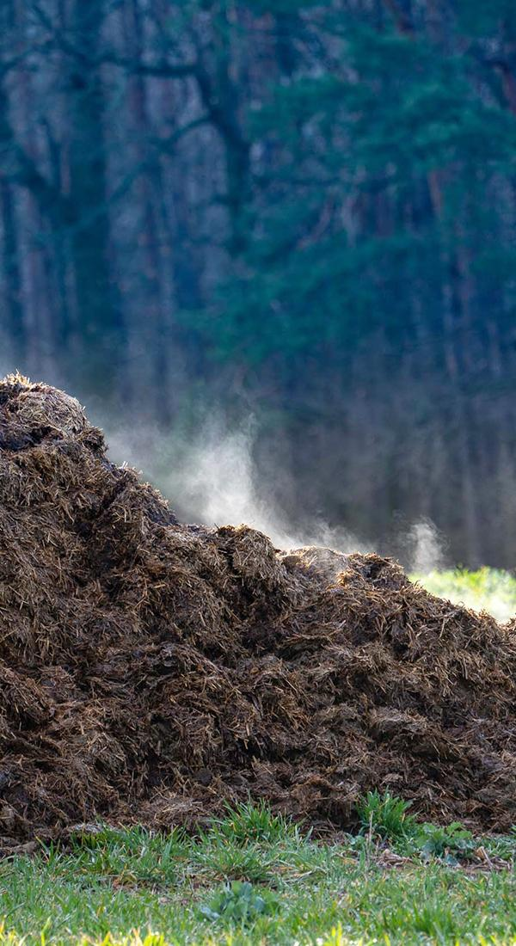
Lesson 6: Learning Target
Lesson 6:
LEARNING TARGET
LESSON 6:
How can we use animal waste as a natural resource?
Notes:
In the previous lesson, students analyzed and graphed data of the amount of freshwater and saltwater on Earth. They used this information to explain why it is important to protect water from pollution and depletion.
In this lesson, students will plan investigations to explore what environmental factors affect the amount of natural gas produced.
Students figure out that animal waste can create natural gas. We can use experimental design to consider how to opitimize the amount of gas produced from waste in a biodigester. This idea will be further investigated in Lesson 9, as a solution to energy use on farms.
In the next lesson, students use Samso as a case study to examine how people can reduce their own negative impacts on Earth’s systems.

Slide 72
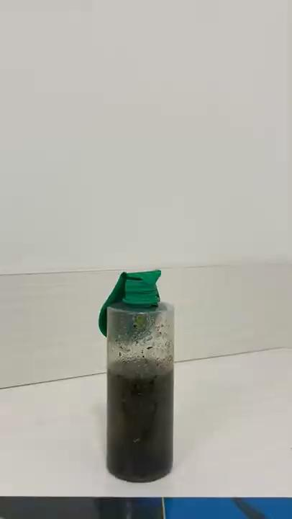
Lesson 6: ENGAGE
Lesson 6:
ENGAGE
Let’s look at one example of a way that farmers can store animal waste
Notes:
ENGAGE Summary: Students make observations and ask questions about a model biodigester.
Ask students: What did we learn about in the previous lesson? What do you remember about connections we made between farming and fresh water? (Freshwater makes up a small portion of the water on Earth and farms use a lot of fresh water. We also know that farms can pollute water when animal poop washes into rivers and streams.)Say to students: What can farmers do with all the poo? What ideas do you have? Students may say you could collect the poop in some sort of storage device. If they do not say this, ask: What if we designed a container for the poop with a lid on it so that way nothing can escape? What do you think would happen? Why do you think that? Allow students to share their ideas with the class.
Let’s look at one example of a way that farmers can store animal waste. Show the time lapse video of the biodigester. What do you notice happens over time? (The balloon was not inflated, but got inflated over time). What do you think is happening? (Some students may point out that there is gas in the balloon.) If students have completed Unit 24 the concept of gas particles taking up space is a review (DCI PS1.A). If they have not completed Unit 24, it is okay just to get students thinking that gas is filling up the balloon, but it is not expected that they understand the particle level of the states of matter at this point. If students do not make the connection that there is gas inside the balloon ask: What do you think is filling the balloon up? What do you know about balloons? What is typically inside a balloon? Then ask: What do you wonder? (Potential student question may include, but are not limited to:
Why did the balloon inflate? What happened inside the jar? Did air get inside the balloon from outside?)
Say to students this is a basic model of a biodigester (bio = life, digest = break down) set-up to collect natural gas from waste. The natural gas from the food waste formed in the plastic bottle and collected in a balloon.
Note: The biodigester time lapse video depicts the biodigester during 72 hours of recording.

Slide 73
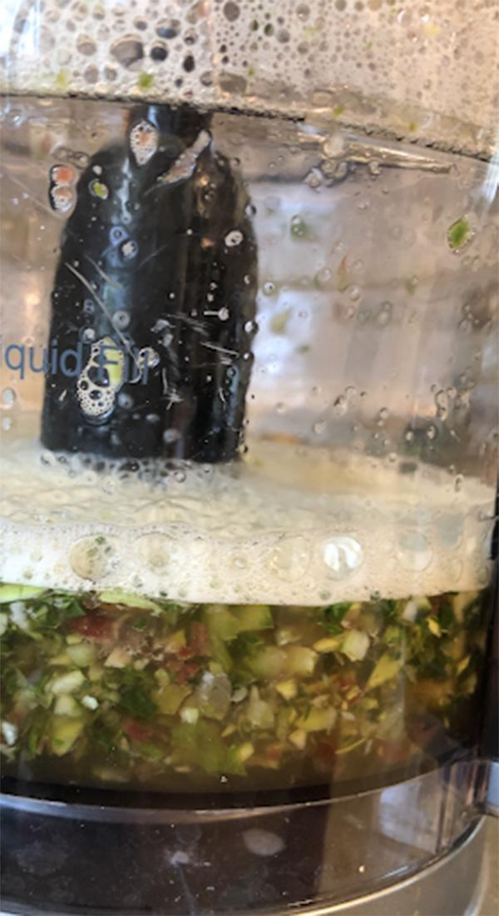
Biodigester
Lesson 6
biodigester
a container that collects gas created by living things as they break down food

Slide 74

Constraint
Lesson 6
Constraint
What the design is limited by or cannot do

Slide 75
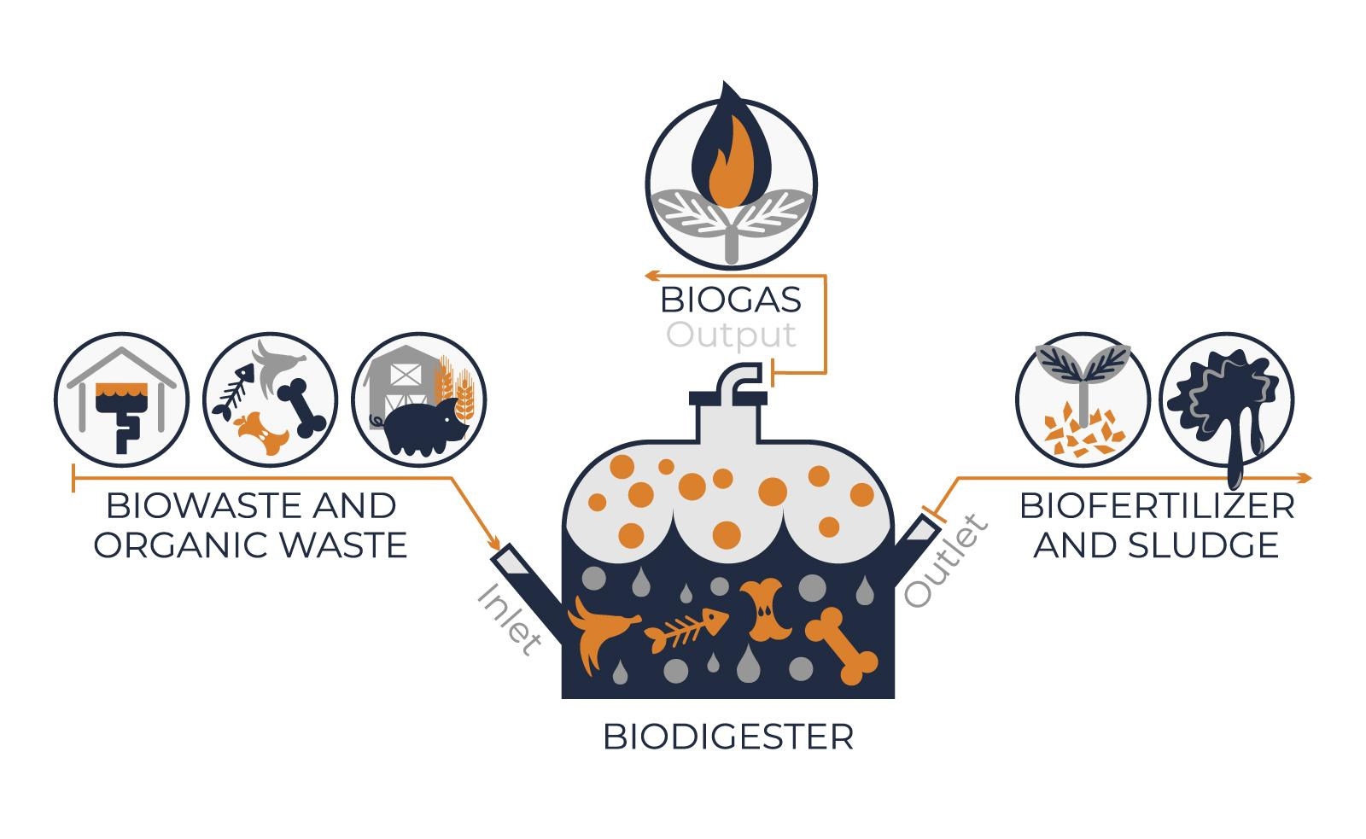
Lesson 6:
EXPLORE
Notes:
Show students a basic biodigester (bio = life, digest = break down) set-up to collect natural gas from waste. The natural gas from the food waste will form in a plastic bottle and be collected in a balloon.

Slide 76
Lesson 6: EXPLORE (part 2)
Lesson 6:
EXPLORE
What ideas are starting to form in your mind about how we could better use farm animal waste?
Does anyone know of any gas that is used for energy?
Notes:
EXPLORE Summary: Students brainstorm ways to investigate how to produce and capture gas from waste to use as an energy source.
Say to students: We just discussed that gas is filling the balloon of our biodigester. Does anyone know of any gas that is used for energy? Recall what we learned about fossil fuels from lesson 4. (Students may discuss the gas (gasoline) that runs cars or the natural gas they may use to cook with at home).

Slide 77
Lesson 6: EXPLORE (part 3)
Lesson 6:
EXPLORE
We want to test out our idea about how animal waste could be used as a natural gas energy source.
What could we use as a model of animal waste?
Notes:
Say to students: The gas captured by the biodigester can be used as a natural gas energy source. We want to figure out how to create a biodigester that creates the most gas from animal waste. This is the criteria for the designs. We know we can’t actually use animal waste in the classroom- that would not be safe. What else could we use as a model of animal waste? (We will use food scraps. Animals eat fruits and vegetables, and this is a part of their waste, so it is a good substitute.)

Slide 78
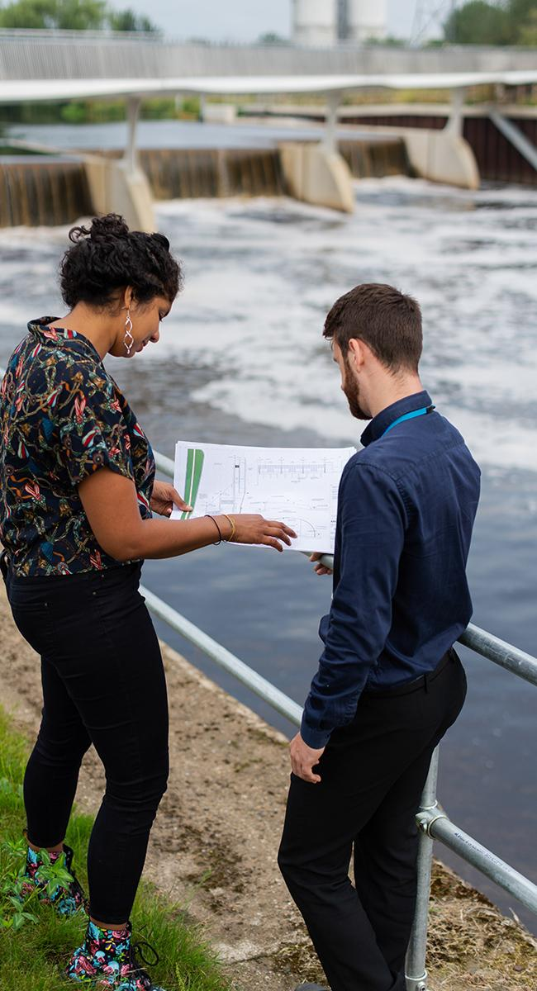
Criteria
Lesson 6
Criteria
What the design must have or be like

Slide 79
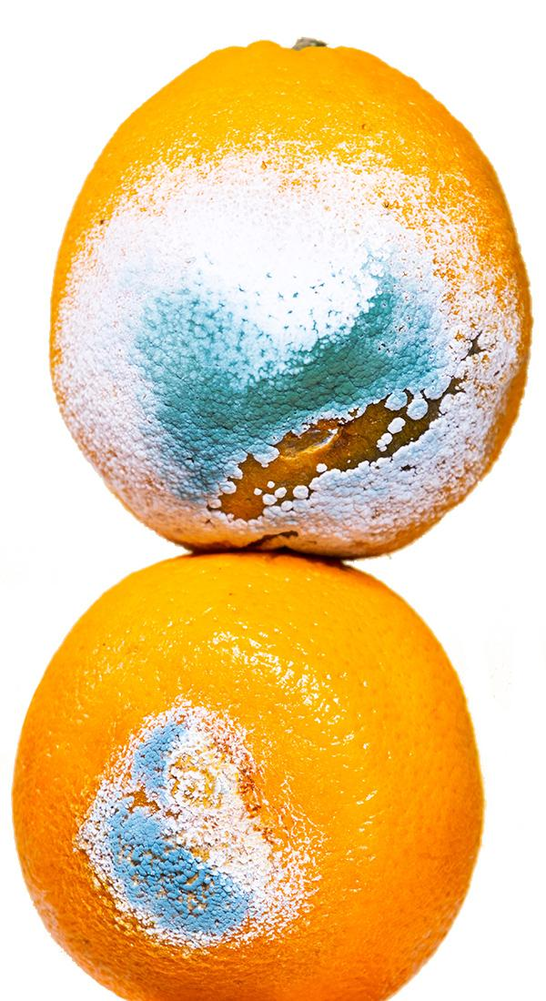
Decomposer
Lesson 6
decomposer
an organism, such as bacteria or fungi, that breaks down dead organisms
Notes:
There are opportunities to bring in life science connections- for example, if you have completed unit 21 you can review the concepts from DCIs LS2.A and LS2.B. However, if you have not completed unit 21 you should skip this section as students have not yet made sense of these concepts. The idea to review is decomposition or decomposers (there are bacteria, both on food and in soil, that help break down the food waste). The living bacteria release gas as a by-product of their own digestion, or breakdown, of the food (this is above grade level, so it is not crucial that you students understand this process). You may need to scaffold with students to discuss that bacteria are living, so just like you and me, they have a certain type of environment where they survive best. We have a range of temperatures where we survive best, and so do bacteria. We have a particular amount of acidity where we survive best, and so do bacteria. Bacteria make the most gas when they are “happiest”.

Slide 80
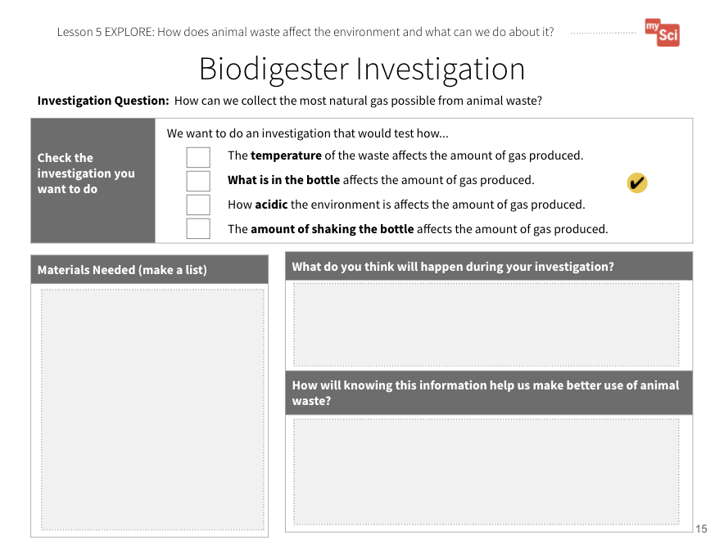
Lesson 6: EXPLORE (part 4)
Lesson 6:
EXPLORE
Let’s plan and setup an investigation to explore how different types of environments affect the amount of methane gas produced.
An important opportunity to attend to equity is offered in the speaker notes area
Biodigester Investigation
Student Journal page
Notes:
Say to students: If we want to make the best use of animal waste, we need the best environment possible to make gas. Different groups can test different types of bottle environments to see which conditions make the most gas to use. Let’s brainstorm the different things we could change about the environment of the bottle. To support this, show students the materials they have available to them. This will help narrow their suggestions. Discuss these as the constraints of their design. Record the different suggestions students come up with on chart paper.
Provide students with the first Biodigester Investigation Student Journal page. There are four different types of investigations listed, but students may come up with other ideas as part of the class discussion that you can approve based on classroom constraints. It is ok if two groups do the same variable – tell students this will just help us get more data. In groups, let them explore the materials and think about what they could investigate, and what that would tell them about using waste as an energy source. Discuss with students that the materials are constraints, or what their designs are limited by.
Attending to Equity:
In this exploration, students are given an opportunity to design their own investigation procedure to figure out what conditions will make the most methane gas from food scraps. This allows students to feel like “active and valued sensemakers” in their classroom science community. See more in this STEM Teaching Tool.

Slide 81
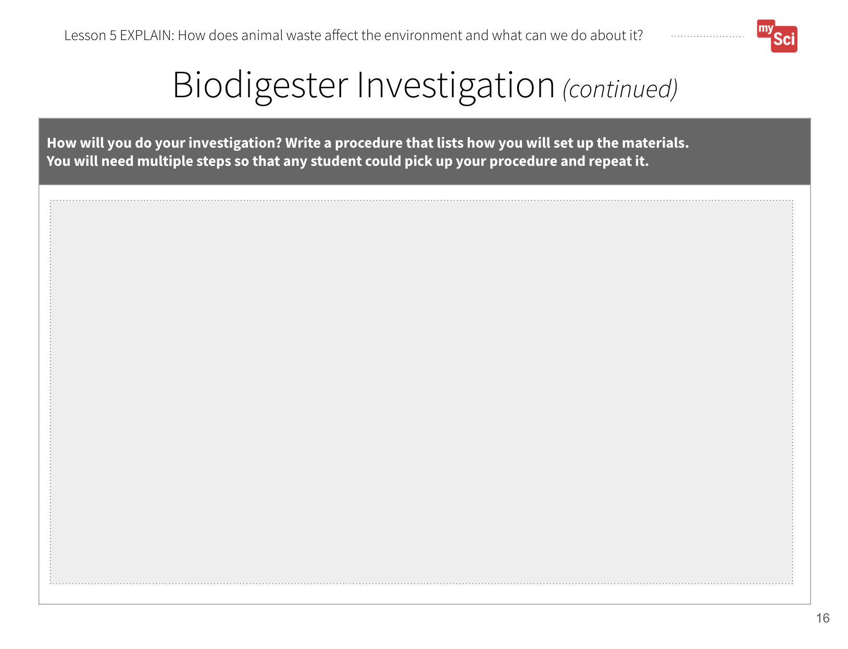
Lesson 6: EXPLAIN
Lesson 6:
EXPLAIN
Now that we have planned our investigations, let’s set up our biodigesters.
Biodigester Investigation
Student Journal pages
Notes:
EXPLAIN Summary: Students plan and set up an investigation about the environmental factors that affect gas production.
Give students time to fill out the second and third Biodigester Investigation Student Journal pages to solidify their plans. You may want to “sign-off” on their procedures before they can have access to the materials. Discuss with students the importance of including each of the 4 different scenarios so that the class can come together at the end of the investigation and create the best biodigesters possible for the design challenge.
Say to students: Now that we have planned our investigations, let’s set up our biodigesters.
Give students time to set up their experiments.
If students are struggling to come up with a procedure, walk a group or the whole class through using one of the experiment options as an example. If other groups finish early, you can use their procedure as an example.

Slide 82
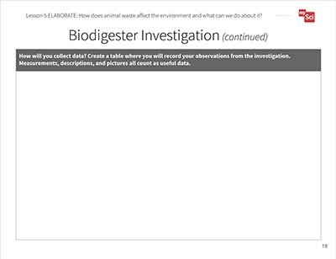
Lesson 6: ELABORATE
Lesson 6:
ELABORATE
Now we need to decide how we will collect data for our biodigesters.
Biodigester Investigation
Student Journal pages
Notes:
ELABORATE Summary: Students develop a plan for collecting data about the environmental factors that affect gas production.
Give students time to look at other group set ups and what they are testing. You could have one student share out, or have them do a gallery walk to view the other investigations. Say to students: Now we need to decide how we will collect our data. We need to collect data in a similar way so that we can compare group results and see which factors allowed for the best production of natural gas.
Have students use the fourth Biodigester Investigation Student Journal page to create their data table. You may need to scaffold so that students can make the connection that they could take numerical measurements by wrapping string around their balloons as they fill up with gas, and then laying the string on a ruler. You may notice that the balloons inflate and deflate over time, but any production of gas should be counted (the balloons may not be airtight). Students can also use qualitative data, like seeing bubbles forming when they tap on or gently shake the biodigester. Help students develop a plan to check their biodigesters every day for the rest of the unit.

Slide 83
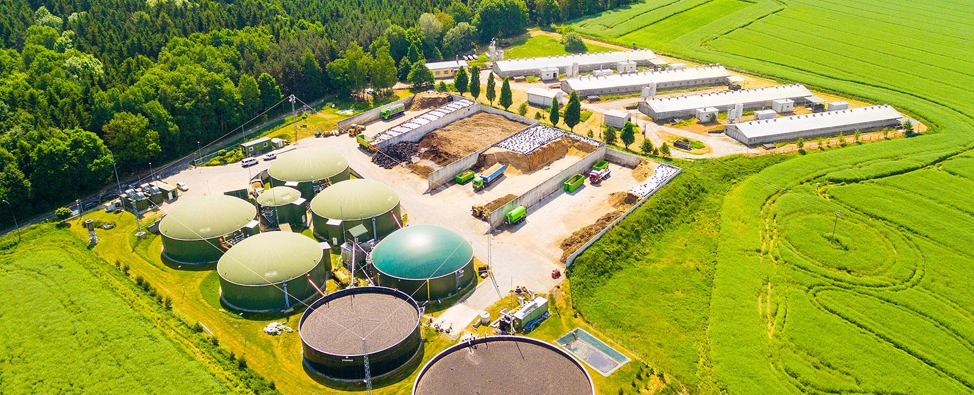
Lesson 6: EVALUATE
Lesson 6:
EVALUATE
How might this help us figure out how are use of natural resources on farms affects Earth’s Systems?
Notes:
Evaluate Summary: Students ask new questions about farm resources, the impact on the environment, and solutions to this problem.
To support student sensemaking across the unit, orient students back to the DQB. Ask students: What did we observe during today’s activity? Record the activity and their observations. Next, ask students: What did we learn today? (We observed that waste can produce gas. We observed this as a balloon inflating) Record their responses. If students need a reminder, they can reference their student journals.
Ask students: How might this help us figure out how our use of natural resources on farms affects Earth’s systems? (Students may say that farms use energy from fossil fuels, like natural gas. Waste can produce gas that could be used as an energy resource on a farm.)
The Biodigester Investigation Student Journal pages are a chance to formatively assess students' understanding of the SEP Planning and Carrying Out Investigations and the DCI ETS1.C. If students are struggling to plan and carry out their investigation, pick one investigation that is different from what the student groups choose and develop the procedure as a class to model the process.
PHOTO: Aerial view over biogas plant and farm in green fields. Renewable energy from biomass.

Slide 84
Lesson 6: Evaluate (part 2)
Lesson 6:
EVALUATE
What new questions do you have?
Notes:
Next, ask students: What new questions do you have? Write student responses on the driving question board. (They may have new questions, such as: What other ways can we protect the environment on farms? How can we reduce the amount of fossil fuels we use even more? Are biodigesters the only solution? Do biodigesters have any impacts on Earth systems?)
Do not provide these questions for students, instead help them start thinking about these ideas by focusing their attention to the problem that biodigesters are helping to solve to help orient them to thinking about other solutions and how that could relate to the anchoring problem: Farms use a large amount of resources. This can have a negative impact on the environment. Have students place their questions into existing categories, or create new categories.
PHOTO: Aerial view over biogas plant and farm in green fields. Renewable energy from biomass.

