Slide 1
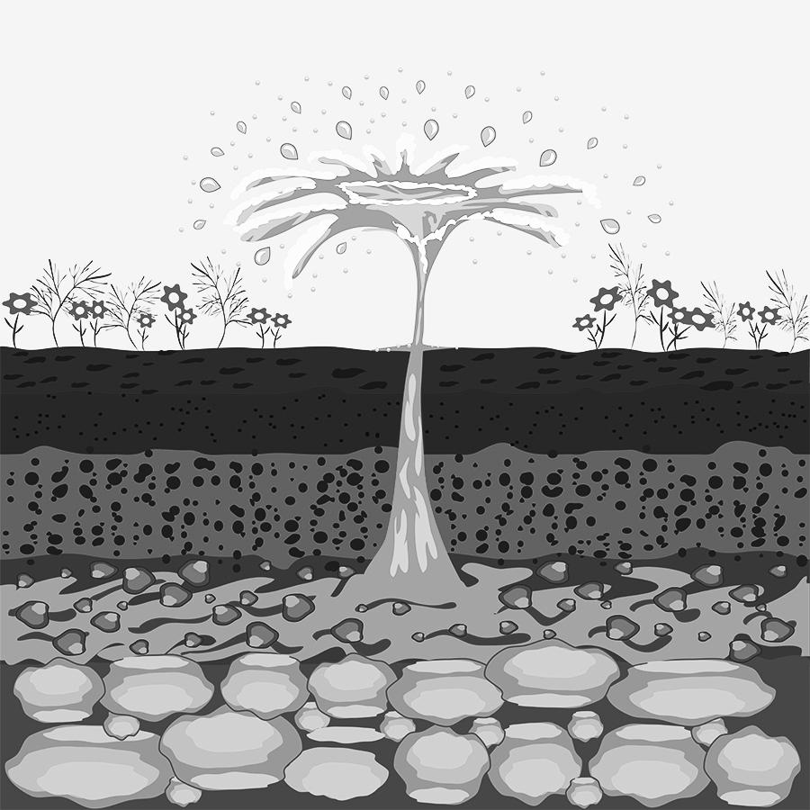
aquifer
large bodies of underground rock that contain fresh groundwater
acuífero
grandes cuerpos de roca subterránea que contienen agua subterránea dulce
Notes:
Teaching Tip: These slides can be used to support students understanding of the vocabulary words as they make sense of them throughout the unit. When bolded vocabulary words are mentioned during a lesson, you can use these slides to provide pictorial support to help build your students understanding of the words. The goal is not for students to memorize these definitions, but to use them to support their sensemaking of the phenomenon. Students should typically first make sense of the ideas and articulate them in their own words before being given complex science words to attach to those ideas.

Slide 2
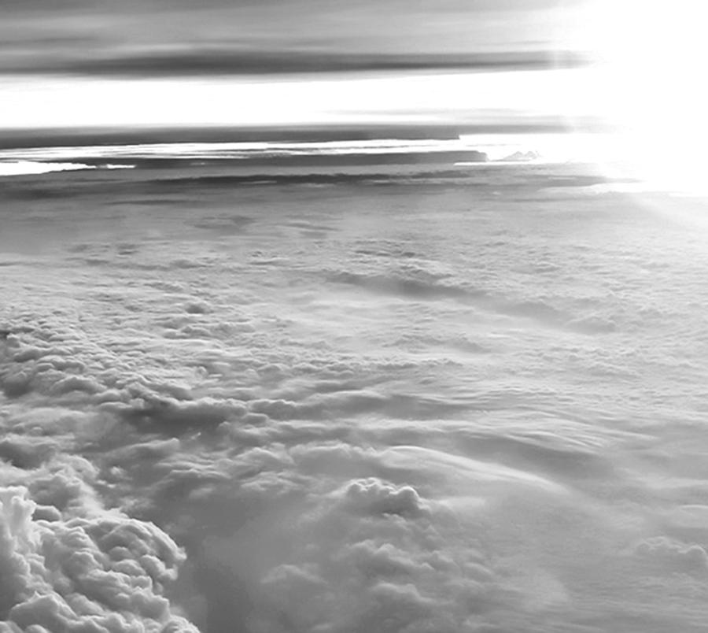
atmosphere
the air that surrounds Earth
atmósfera
el aire que rodea la tierra

Slide 3
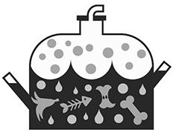
biodigester
a container that collects gas created by living things as they break down food
biodigestor
un recipiente que recoge el gas creado por los seres vivos a medida que descomponen los alimentos

Slide 4
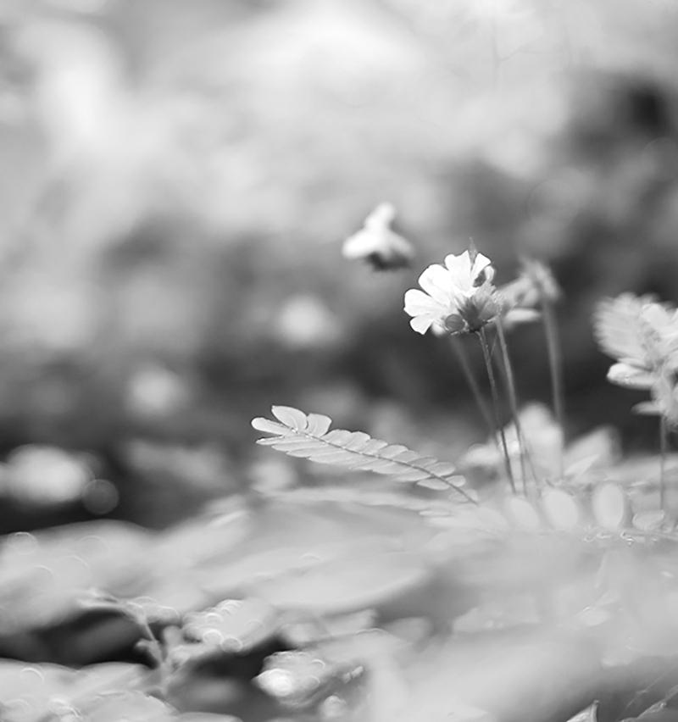
biosphere
parts of the Earth that contain organisms
biosfera
partes de la Tierra que contienen organismos

Slide 5
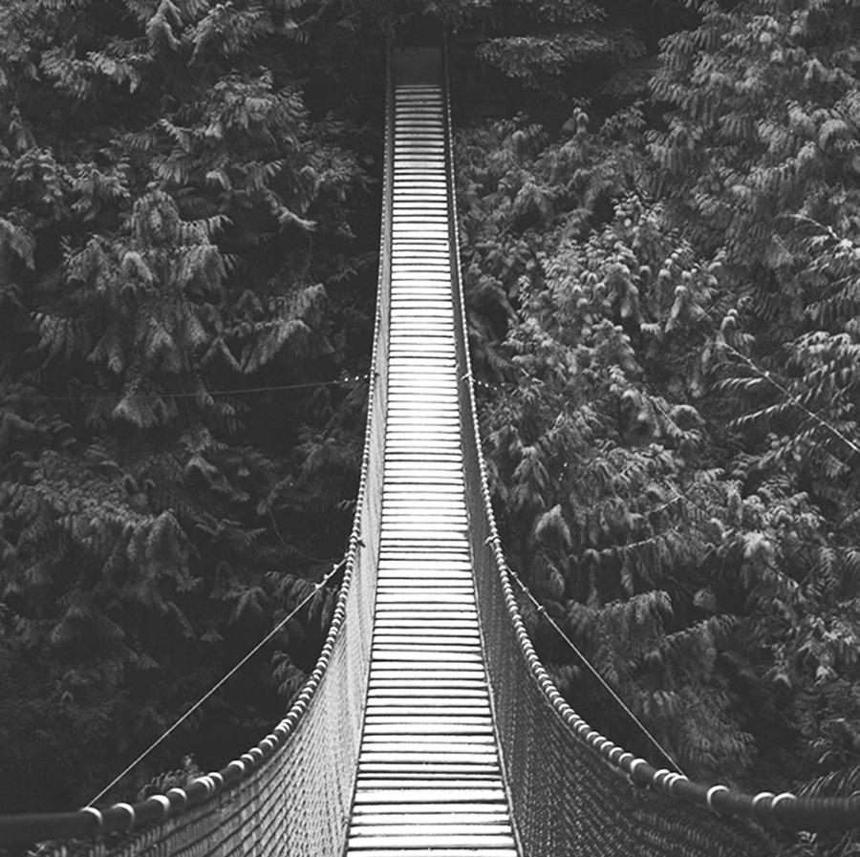
constraint
what the design is limited by or cannot do
restricción
lo que el diseño está limitado o no puede hacer

Slide 6
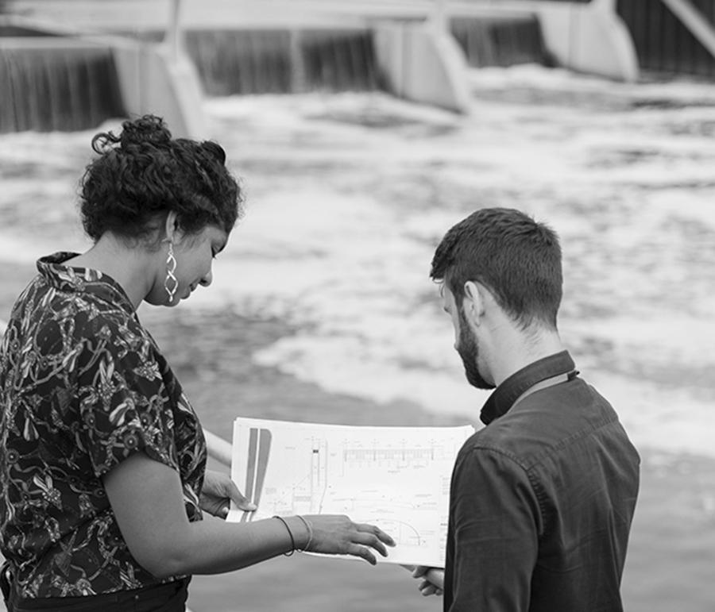
criteria
what the design must have or be like
criterios
cómo debe tener o ser el diseño

Slide 7
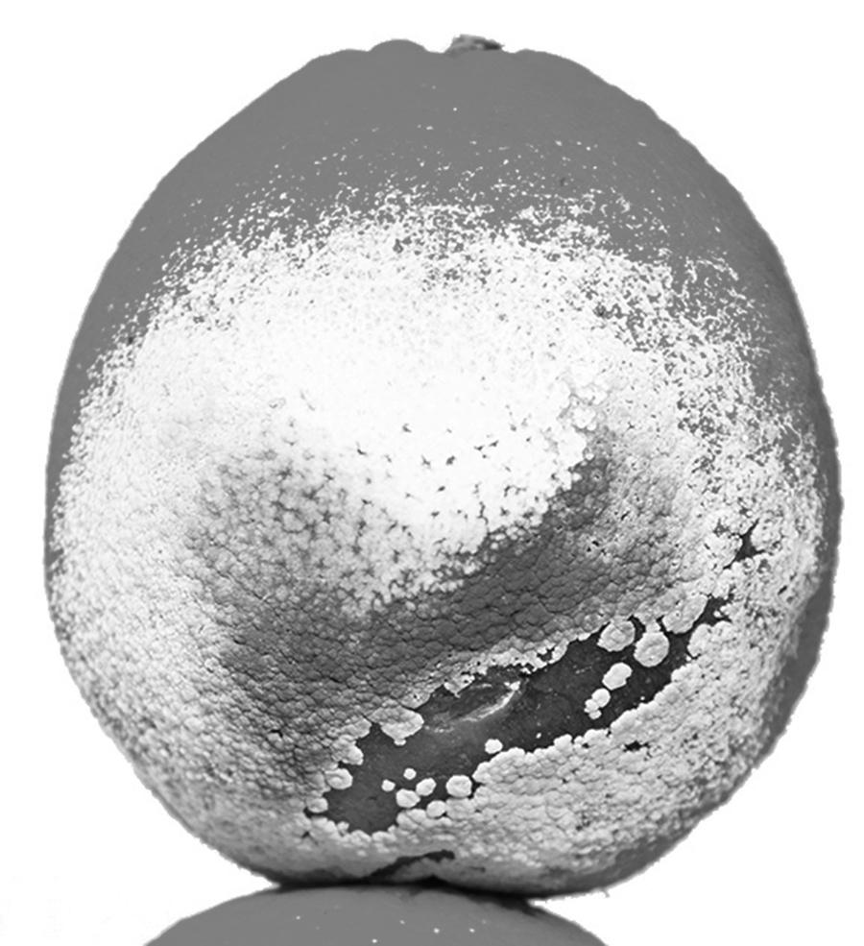
decomposer
an organism, such as bacteria or fungi, that breaks down dead organisms
descomponedor
un organismo, como bacterias u hongos, que descompone los organismos muertos

Slide 8
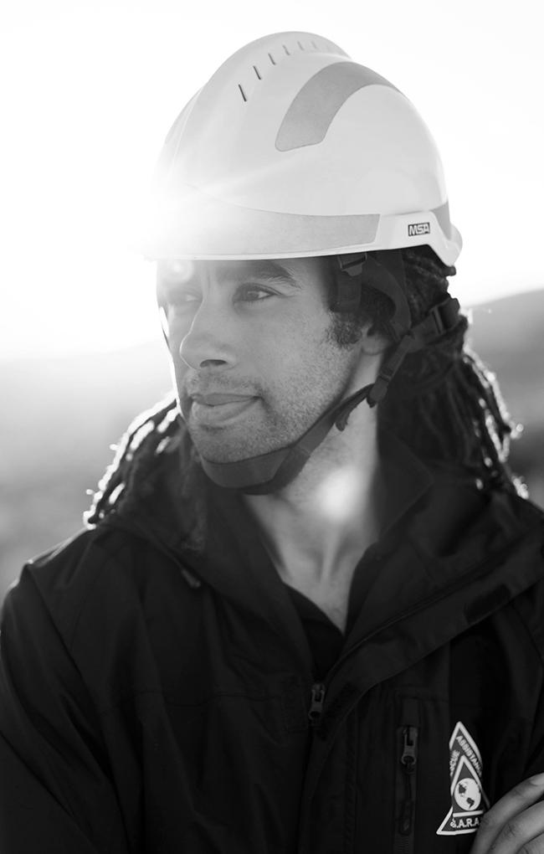
engineer
someone who designs solutions to problems
ingeniera (feminine)/ ingeniero (masculine)
alguien que diseña soluciones a problemas

Slide 9
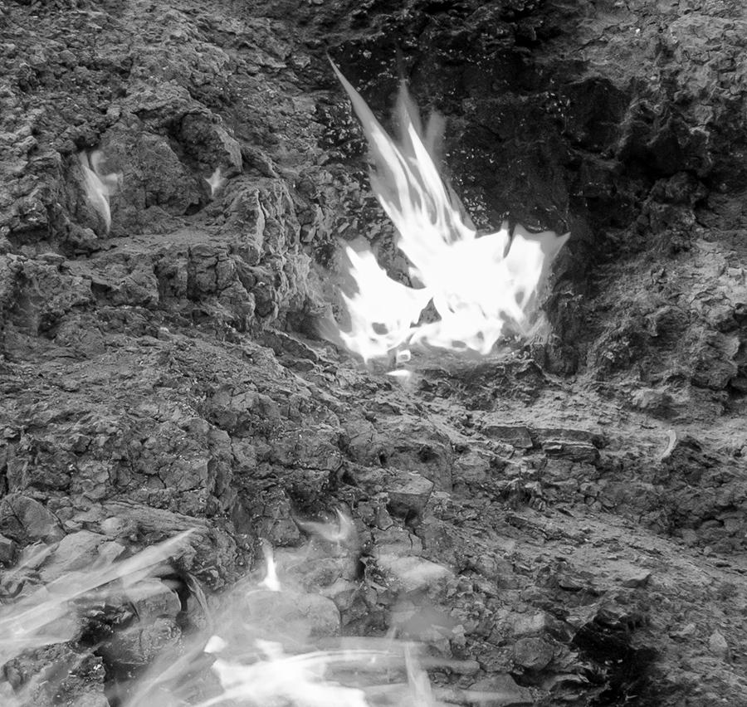
flammable
able to be lit on fire
inflamable
capaz de ser encendida en llamas (feminine) / capaz de ser encendido en llamas (masculine)

Slide 10
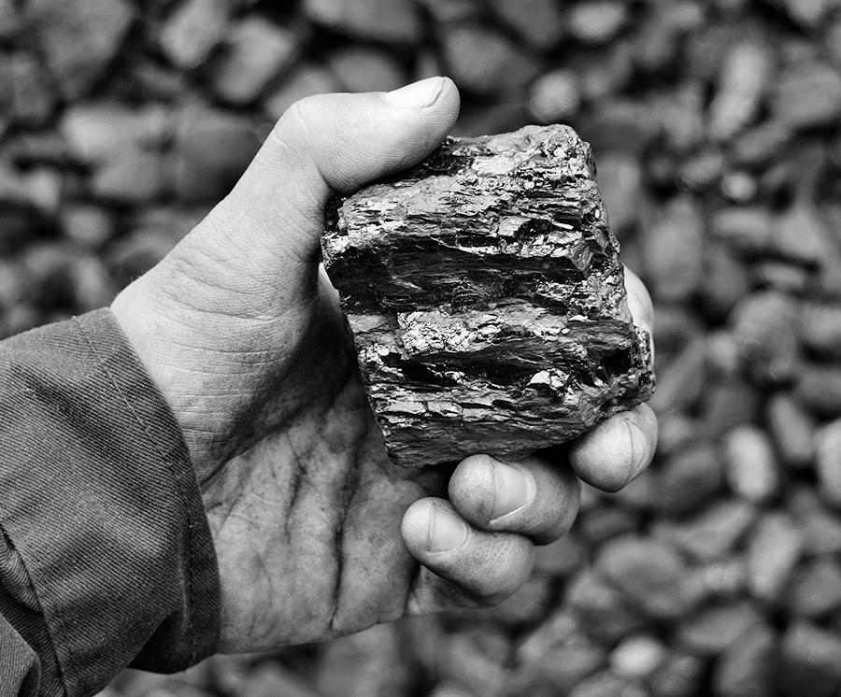
fossil fuel
a fuel that formed from the decayed remains of ancient plants and animals (coal, oil, and natural gas)
combustible fósil
un combustible que se formó a partir de los restos en descomposición de plantas y animales antiguos (carbón, petróleo y gas natural)

Slide 11
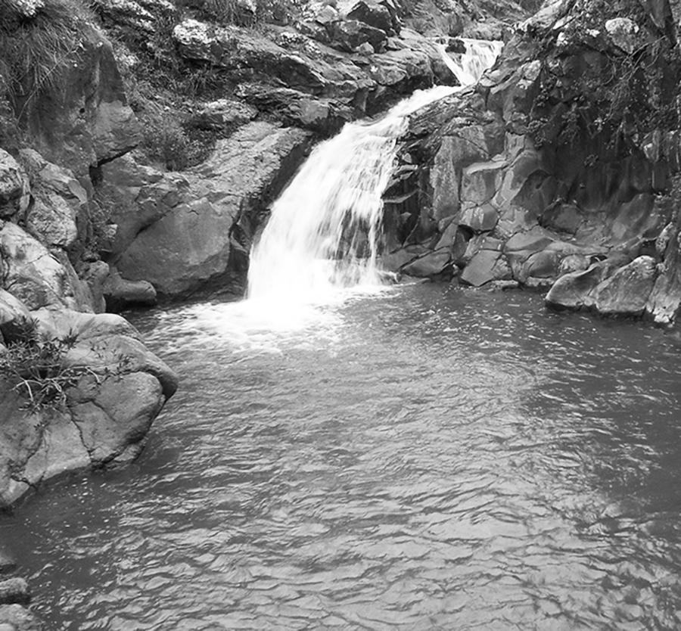
freshwater
water that does not contain a large amount of salt (like river or lake water)
agua dulce
agua que no contiene una gran cantidad de sal (como agua de río o lago)

Slide 12
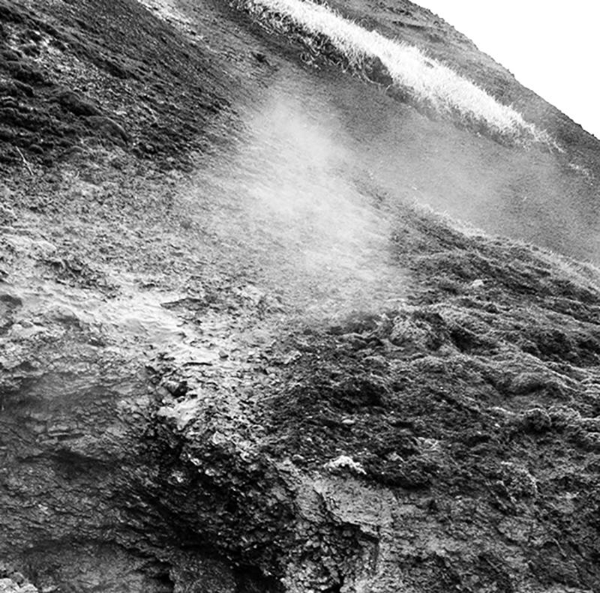
geosphere
Earth’s crust and mantle (soil, rocks, and molten rock)
geosfera
la corteza terrestre y el manto (suelo, rocas y roca fundida)

Slide 13
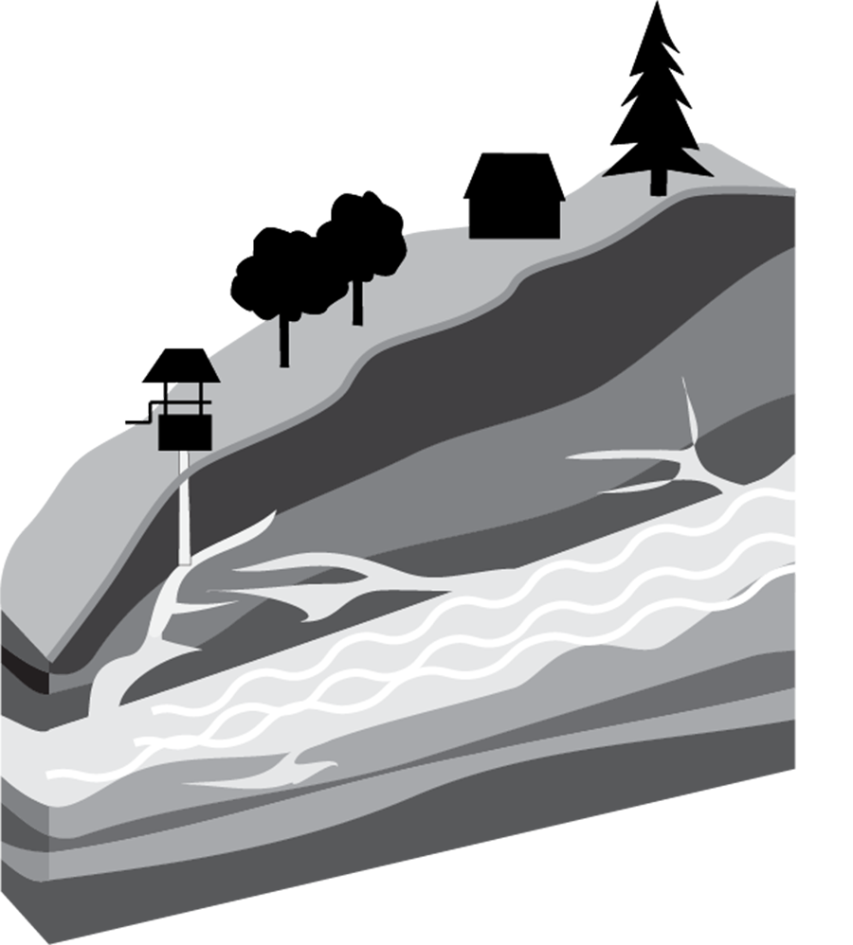
groundwater
water that collects underground in cracks and spaces in rock
agua subterránea
agua que se acumula bajo tierra en grietas y espacios en la roca

Slide 14
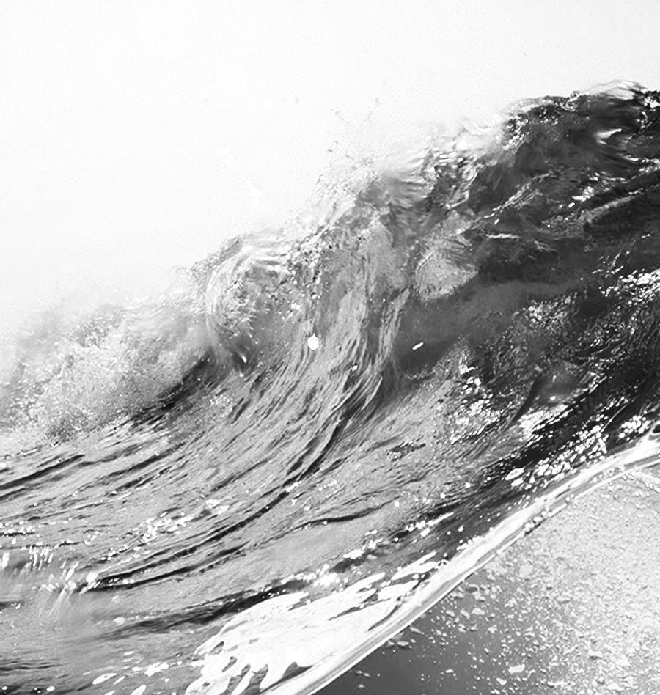
hydrosphere
liquid water on Earth’s surface, in the ground, and in the air
hidrosfera
agua líquida en la superficie de la Tierra, en el suelo y en el aire

Slide 15
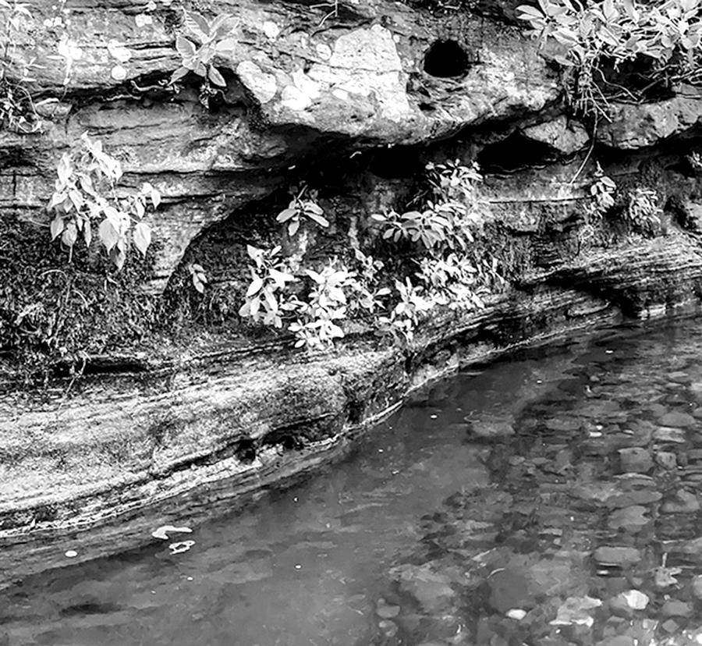
interact
have an effect on each other
interactuar
tener un efecto el uno en el otro

Slide 16

natural resource
materials in Earth’s spheres that are useful to people
recurso natural
materiales en las esferas de la Tierra que son útiles para las personas

Slide 17
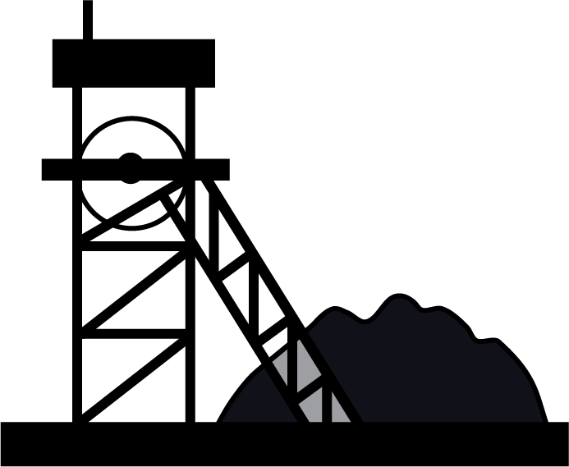
non-renewable resource
resource that is not replaced by nature as fast as it is used
recurso no renovable
recurso que no es reemplazado por la naturaleza tan rápido como se usa

Slide 18
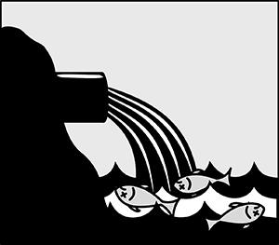
pollution
adding a harmful or poisonous substance to the environment
polución
agregar una sustancia dañina o venenosa al medio ambiente

Slide 19
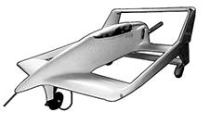
prototype
a first model or design of something
prototipo
un primer modelo o diseño de algo

Slide 20
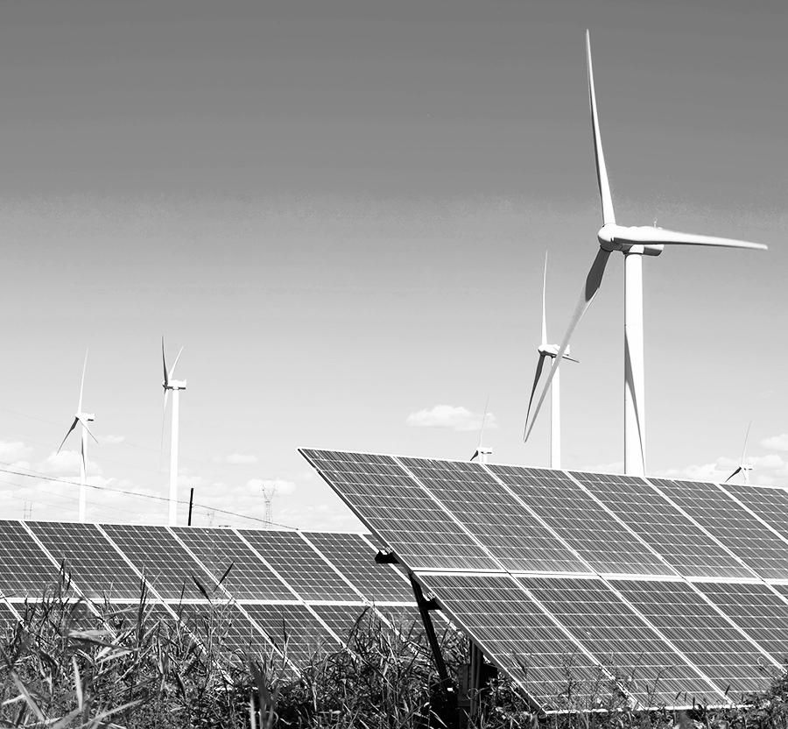
renewable resource
resources that are replaced by nature faster than they are used
recurso renovable
recursos que son reemplazados por la naturaleza más rápido de lo que se utilizan

Slide 21
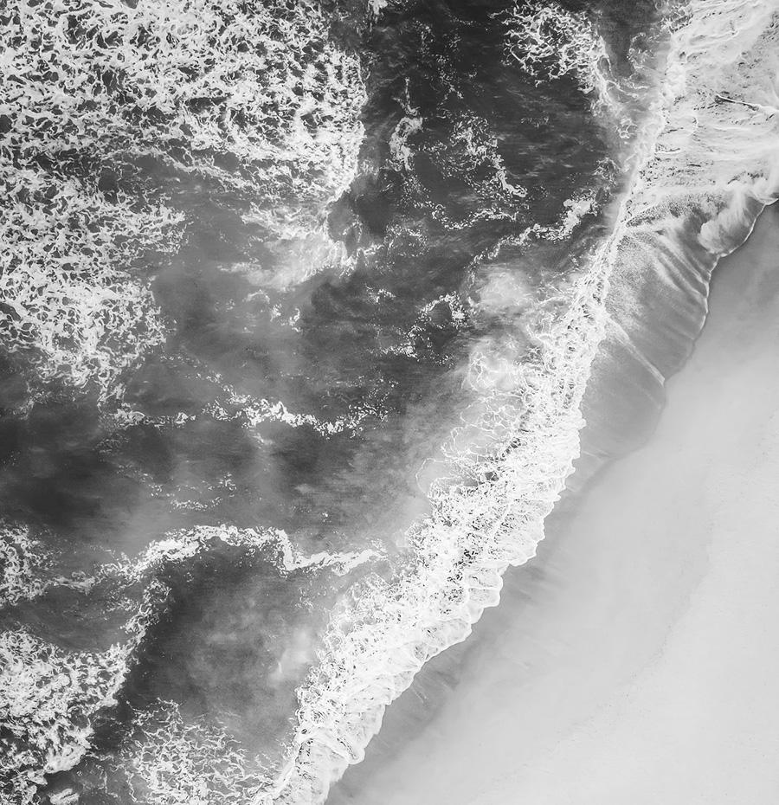
saltwater
water that contains a lot of salt (like ocean water)
agua salada
agua que contiene mucha sal (como agua de mar)

Slide 22
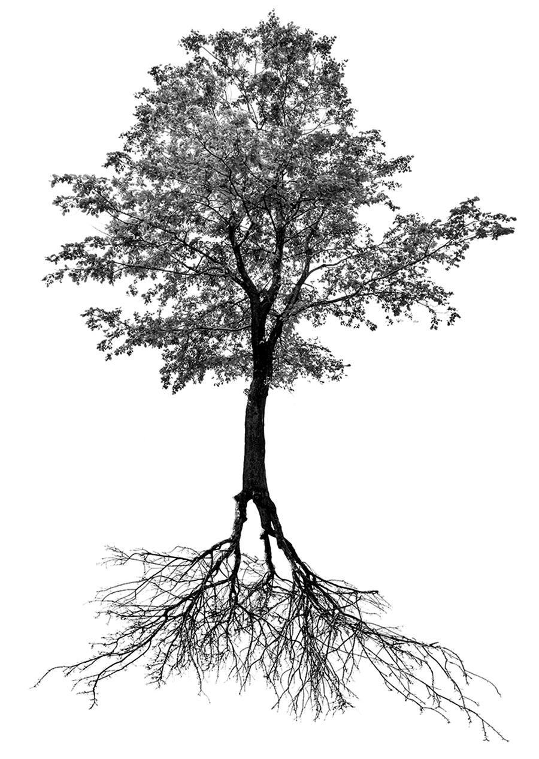
system
a group of related parts that function together as a whole
sistema
un grupo de partes relacionadas que funcionan juntas como un todo

