Slide 1
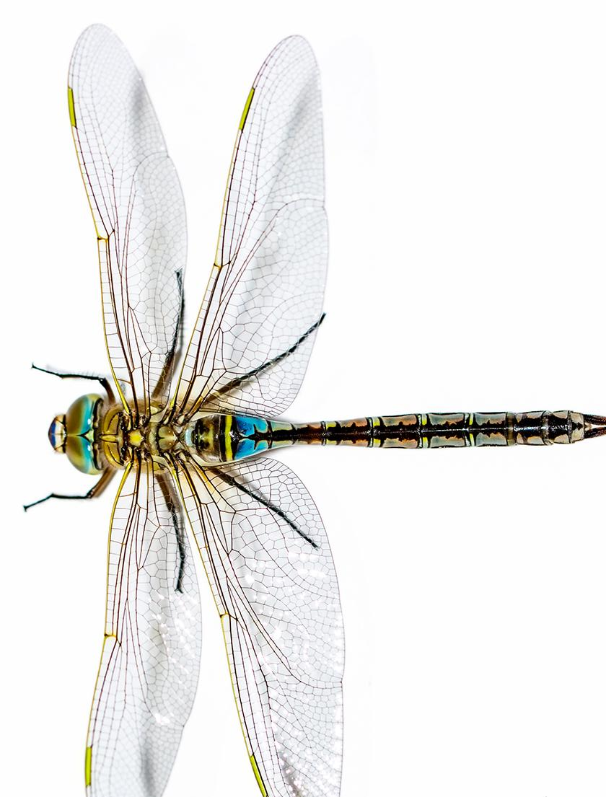



Unit 22: Lesson 5
Unit 22: Lesson 5
How does our use of water affect Earth’s systems?
Explore: Earth’s Water

Slide 2
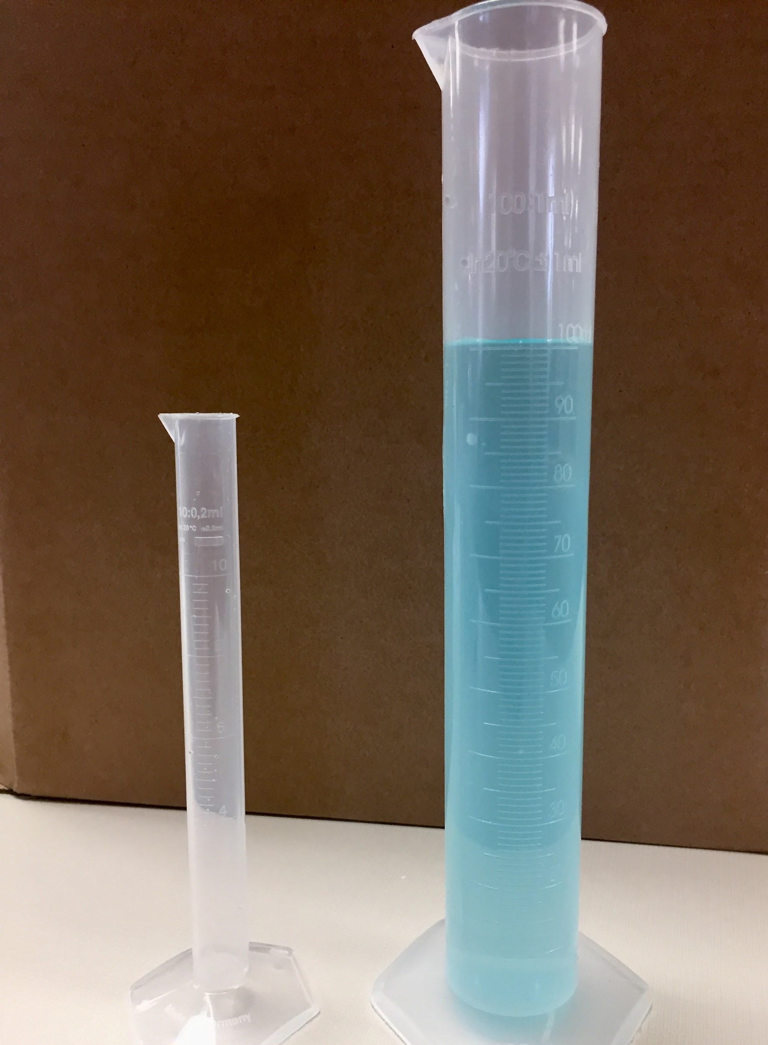
Explore: Earth’s Water
Have the 100 mL graduated cylinder filled with water. Put a few drops of food coloring so that the students can see the water level. Tell the students:
the water in this cylinder represents all of the water on earth.

Slide 3
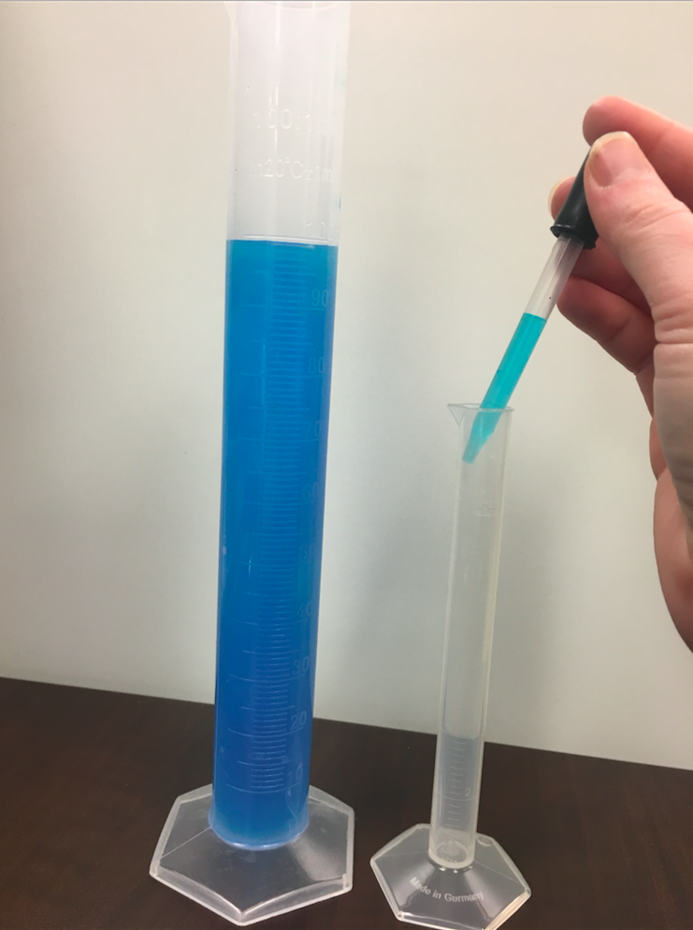
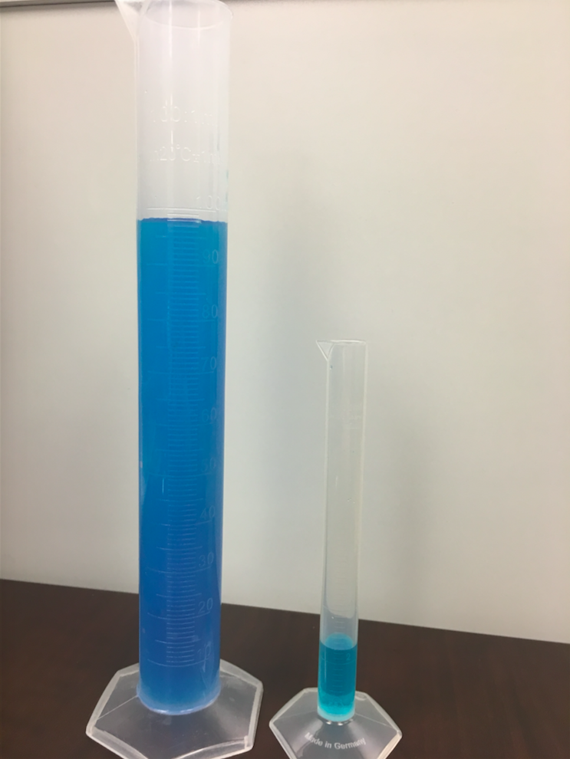
Explore: Earth’s Water; Experiment
Next, take out the 10 mL graduated cylinder and use the eyedropper to put 2.5 mL into it from the 100 mL graduated cylinder.

