Slide 1
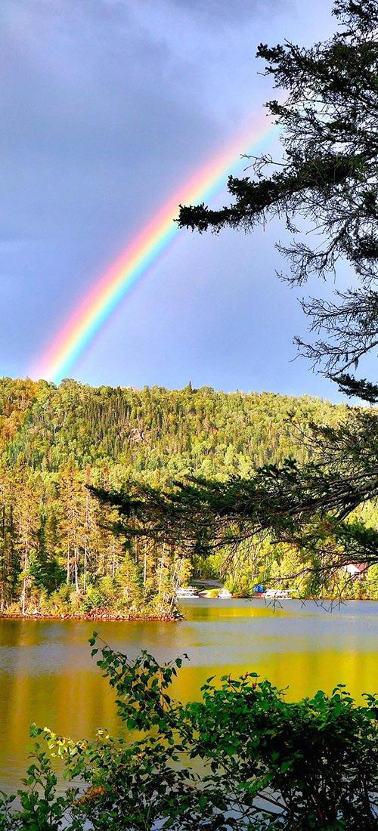



Unit 22: Using Our Resources Wisely Section 3: Lessons 7, 8, and 9
EARTH AND SPACE SYSTEMS
Unit 22
Using Our Resources Wisely
Section 3: Lessons 7, 8, & 9
Section Question:
How can farmers use resources wisely to protect Earth’s systems?
1
Notes:
Teacher Note: This section has 3 lessons.

Slide 2










mySci symbols key
Indicates an opportunity for students to write
Indicates link to a teacher facing mySci tutorial explaining how to set up the activity for students
Indicates an opportunity for the teacher to make a chart
Indicates link to a video
Indicates an opportunity to attend to equity and inclusion
Indicates an opportunity for the teacher to read aloud to students
Indicates an opportunity to employ a driving question board
Indicates a vocabulary word for the lesson
Indicates appropriate time to administer pre or post assessment
Indicates an opportunity for formative assessment
2
Notes:
Welcome to mySci google slides edition.
The following slides are designed to make the curriculum accessible to teachers and students in a presentation format.
Most slides should be viewed in presentation mode in order for all the features to work.
Each section of the unit is represented by a section question and photo. Each lesson in the unit begins with a lesson target slide followed by curriculum slides to support the 5E model. Student journal pages are shown, videos for students to watch are embedded in the slides and there are other interactive opportunities represented as well.
TEACHING TIP: Phrases in blue denote Science and Engineering Practices in the lesson. Phrases in green denote Crosscutting Concepts in the lesson.
We at mySci encourage teachers to view this slideshow as they read through the unit in the planning phase and determine if there are additional slides, activities or photos to add. Personalizing this slideshow for your particular group of students will make the material even more relevant and exciting for young learners. As always feedback is welcomed and appreciated.

Slide 3
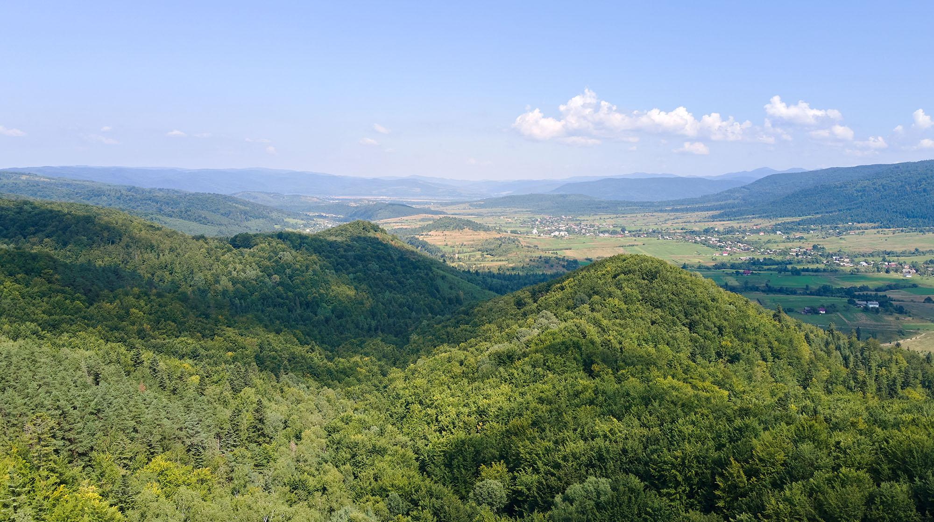
UNIT 22, SECTION 3:
How can farmers use resources wisely to protect Earth’s systems?
Notes:
Section 3 consists of 3 lessons.
Total time: 9 days
NOTE: This question is provided for you as a model driving question to organize the learning progression. You can use this question to guide your instruction, however, you are encouraged to adapt this question using the language you develop with your students.
LESSON 7
How can people use resources in a way that is less harmful to the Earth?
(3 days)
LESSON 8
How can we use farms to harness wind energy?
(3 days)
LESSON 9
How can farms make better use of animal waste?
(3 days)

Slide 4
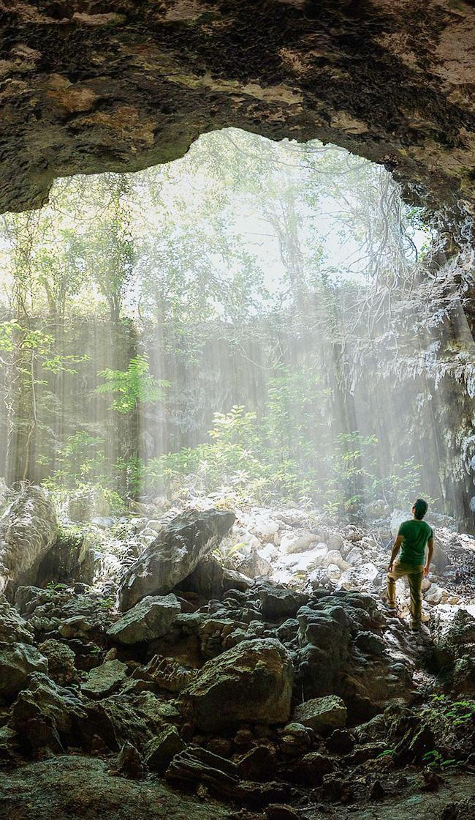
Lesson 7: LEARNING TARGET
Lesson 7:
LEARNING TARGET
LESSON 7:
How can people use resources in a way that is less harmful to the Earth?
Notes:
In the previous lesson, students designed biodigesters in order to determine the optimal setup for generating the most gas from waste.
In this lesson, students will use Samsø as a case study to examine how humans can change their impacts on the environment.
Students figure out that humans can make changes to how we use natural resources for energy that have less harmful impacts on Earth systems.
In the next lesson, students will engage in the engineering design cycle to develop a wind turbine that can be used to produce energy.

Slide 5
Lesson 7: ENGAGE
Lesson 7:
ENGAGE
We have explored a lot of the harmful effects human activities can have on our planet.
What are some of the effects we have
when we use fossil fuels and water resources, for example?
Notes:
ENGAGE Summary: Students engage in a discussion about what they have learned about human activities and how they can harm Earth systems.
Begin the lesson by revisiting the Driving Question Board. Orient students to the third driving question: How can farmers use resources wisely to protect Earth’s systems? Review the words, phrases, or questions used to categorize student questions that connect to this driving question. Also review specific student individual questions. Consider if any of these questions are connected to the learning of this lesson. If so, highlight this question for students. Say to students: Today’s activity will support us in answering this question. By answering this question, we will be able to build on our understanding of the anchoring problem.
Say to students: We have explored a lot of the harmful effects human activities can have on our planet. What are some of the effects we have when we use fossil fuels and water resources, for example? Give students time to Turn and Talk.
Listen for ideas such as: fossil fuels give off pollution, which affect Earth systems, like the air and water; fossil fuels are non-renewable resources, and get depleted over time; water use depletes groundwater; farming can cause animal waste to pollute water.
Have students share their ideas and record them on the board or on chart paper. Ask students: What similarities do you notice across the effects you shared? Are there any that we could combine into one category? What would we call the new category? After you have guided the students through creating categories ask them: What do you think are some solutions to these problems? (The purpose of this is to get the students thinking. You are not looking for correct answers. They will explore solutions as they move through the lesson. Some categories that might arise from this discussion include: air pollution, water pollution, resource overuse/depletion.)

Slide 6
Lesson 7: Engage (part 2)
Lesson 7:
ENGAGE
What similarities do you notice across the effects you shared?
Are there any we could combine
into one category?
What would we call the new category?
What do you think are some solutions to these problems?
Notes:
Have students share their ideas and record them on the board or on chart paper. Ask students: What similarities do you notice across the effects you shared? Are there any that we could combine into one category? What would we call the new category? After you have guided the students through creating categories ask them: What do you think are some solutions to these problems? (The purpose of this is to get the students thinking. You are not looking for correct answers. They will explore solutions as they move through the lesson. Some categories that might arise from this discussion include: air pollution, water pollution, resource overuse/depletion.)

Slide 7

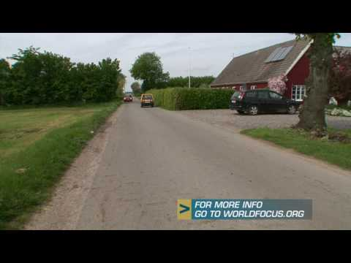
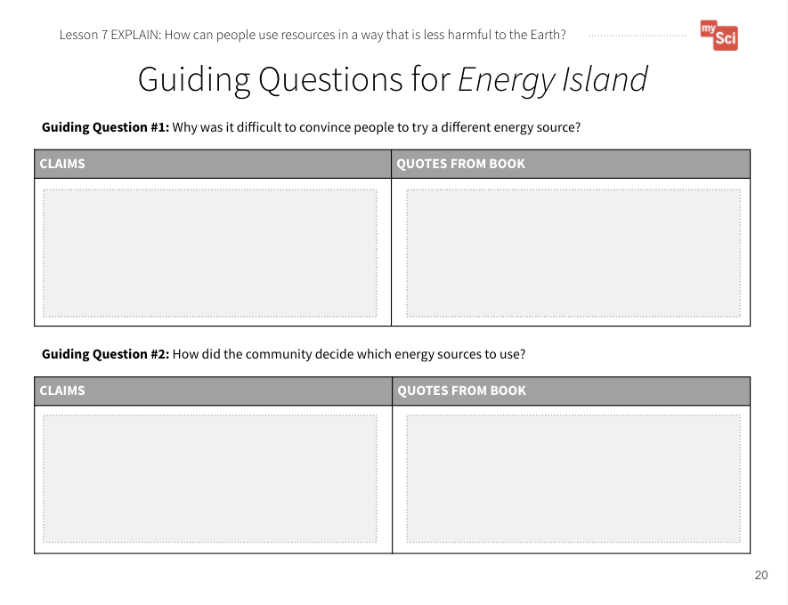
Lesson 7: Explore
Lesson 7:
EXPLORE
Let’s research how one community is creating solutions to the problems we have learned about.
Guiding Questions for Energy Island Student Journal pages
Energy Island: When Waste Becomes an Important part of the Island’s Circuit
Notes:
EXPLORE Summary: Students obtain and combine information about how Samso used science and engineering ideas to positively affect Earth systems.
Students will continue to build on the SEP Obtaining, Evaluating, and Communicating information. In lesson 3, students developed the practice of obtaining information, using only one resource. In lesson 4, they used multiple resources, and combine information. In this lesson students will again use multiple resources and combine information. They will use this information to create presentations to communicate this information.
Divide the students into eight groups. Provide each group with the following resources:
Energy Island
Island in Denmark Produces More Energy Than it Consumes
Website: Waste Becomes Important Part of Island Circuit
Students will work in groups to use the resources listed in order to develop a slide or poster about Samsø. Students will use the Guiding Questions for Energy Island Student Journal pages to help them gather information for their presentation. Discuss that a “claim” is what you think is true, and “evidence” is an observation or data that supports your claim. Students will make claims based on the book, video, and article and provide specific evidence for each claim. Make it clear that they can have more than one claim and that they can have more than one piece of evidence to support each claim.
Once students have obtained information from their resources, they can use a combination of pictures, drawings, and text to create their slide or poster presentations. For example, students may want to draw a model of the island that includes descriptions based on their research. Presentations should include information about the resources the island uses, why they use these resources, and the benefits of using these resources.

Slide 8
Lesson 7: EXPLAIN
Lesson 7:
EXPLAIN
Let’s communicate what we learned about Samsø.
Notes:
EXPLAIN Summary: Students communicate information about how Samso used science and engineering ideas to positively affect Earth systems.
When all groups are finished, have them share out with the class what they found. There are two different options for having students share.
Option 1: Students hang their posters around the room and then rotate around the room to look at the posters. While they walk around to each poster, students record the natural resources each group discussed as well as the benefits of using those resources. Once everyone has visited each poster, have students circle repeating natural resources in order to find patterns across the presentations.
Option 2: Each group presents their poster to the class. While one group is presenting, the other groups record the natural resources each group discussed as well as the benefits of using those resources. Once every group has presented, have students circle repeating natural resources in order to find patterns across the presentations.

Slide 9
Lesson 7 EXPLAIN (part 2)
Lesson 7:
EXPLAIN
Do you think the people of Samsø provided a solution to any of these problems?
If so, what was their solution?
Notes:
EXPLAIN Summary: Students communicate information about how Samso used science and engineering ideas to positively affect Earth systems.
Bring the class back together and review the problems that were discussed at the beginning of the lesson. Ask students: Do you think the people of Samsø provided a solution to any of these problems? If so, what was their solution?

Slide 10
Lesson 7: EXPLAIN (part 3)
Lesson 7:
EXPLAIN
What did you notice about the resources they used on Samsø?
How are they different than the energy resources we learned about in previous lessons?
Notes:
What did you notice about the resources they used on Samsø? How are they different than the energy resources we learned about in previous lessons? (Students may notice they moved away from using fossil fuels, replacing them with things like the wind, the sun, and plants. They may discuss that these resources get depleted over time. Students may also notice that they use multiple different resources to address their energy needs.)
Say to students: What makes Samsø Island so special is that they are using renewable resources. This means that the resources can be replaced by nature faster than they are used. Sun, wind, biofuels, and water are energy sources that can be replaced quickly by nature.
This activity is a chance to formatively assess students' understanding of the SEP Obtaining, Evaluating, and Communicating Information and DCI ESS3.C. See the student journal answer key for an example. If students are struggling to figure out how to organize their information for the presentation,

Slide 11
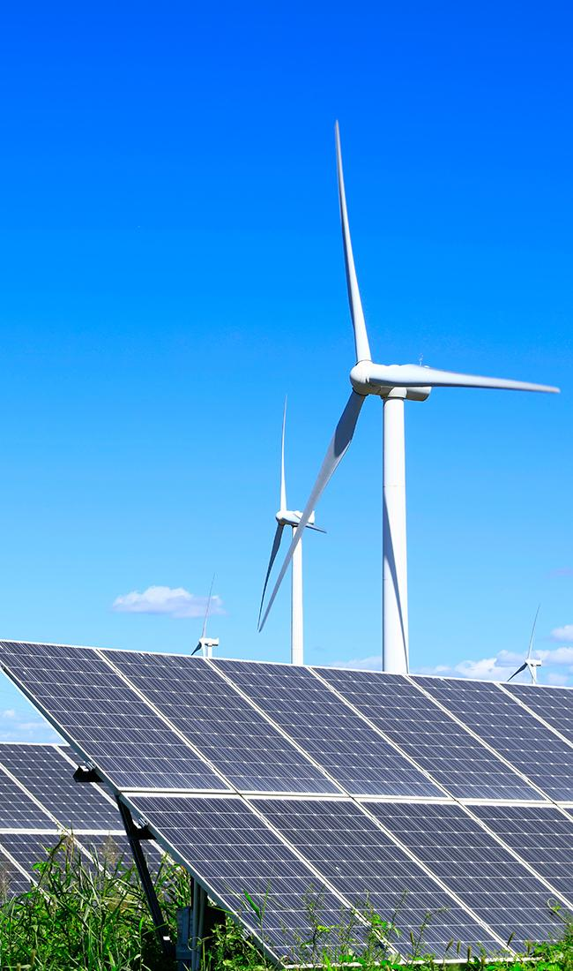
Renewable Resources
Lesson 7
renewable resource
a resource that is replaced by nature faster than it is used

Slide 12
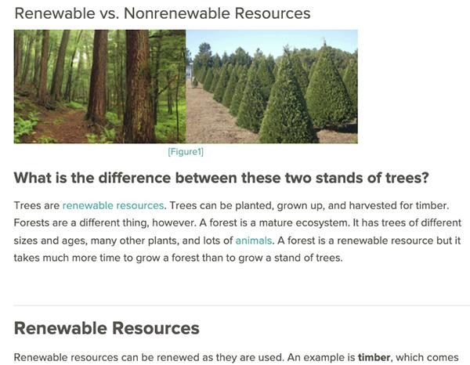
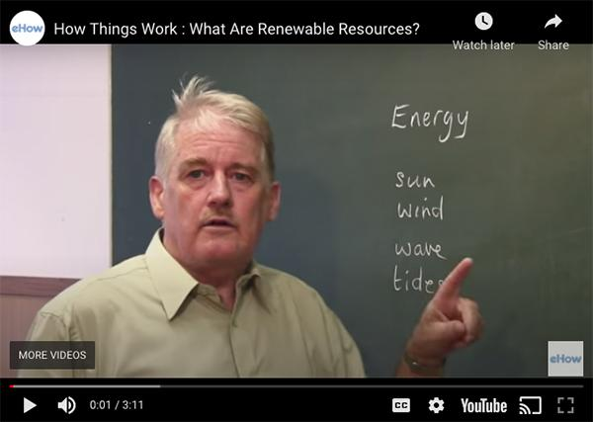
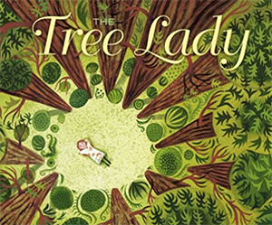
Lesson 7: EXPLAIN (part 4)
Lesson 7:
EXPLAIN
An important opportunity to attend to equity is offered in the speaker notes area
Read-Aloud Guide
CK-12.org
Notes:
Say to students: Let’s compare non-renewable and renewable energy sources. Give students time to read the hyperlinked CK-12 text and watch the embedded video on renewable resources.
Attending to Equity:
Historically women have been leaders in social and environmental movements, however their contributions often go unrecognized. You could read the children’s book The Tree Lady to examine the story of Kate Sessions, a woman who worked to make a positive impact on her community.

Slide 13
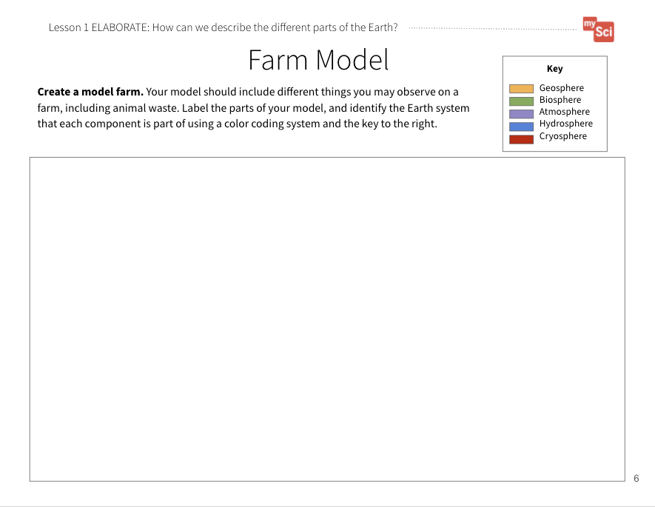
Lesson 7: ELABORATE
Lesson 7:
ELABORATE
A good model of a system shows relationships between parts of the system!
How will we show how a farm can use natural resources in a way that doesn’t harm Earth systems as much?
“Gotta Have It” Checklist: Our Farm Model has to have...
✔
✔
✔
✔
✔
✔
Farm Model
Student Journal page
A Farm that Helps Protect the Earth Student Journal page
Notes:
ELABORATE Summary: Students develop a model of a farm that shows how we can use science ideas to reduce harmful effects on Earth’s systems.
Say to students: During this unit, we have developed a farm model. In the model we identified:
The different Earth systems and natural resources represented
Interactions between the Earth systems
Effects of resource use on the Earth systems
Now, we are going to create a new farm model that includes our vision for what a farm that creates less impacts on Earth systems could look like. Give students the A Farm That Helps Protect the Earth Student Journal page.
Just like in our original farm model, we need to use a “Gotta Have It Checklist” to show the components and relationships we need to include in the models. What would you add to the checklist today to make our models show how a farm can use natural resources in a way that doesn’t harm Earth systems as much? Examples of things the model’s “gotta have” might include:
Renewable fuel sources for tractors and other farm equipment
Renewable energy sources for electric power

Slide 14
Lesson 7: EVALUATE
Lesson 7:
EVALUATE
Let’s share our models and give each other feedback.
Then use the feedback to revise our models.
A Farm that Helps Protect the Earth Student Journal page
Notes:
EVALUATE Summary: Students evaluate each other’s farm models and give feedback.
Have students share their models with a partner or another group and give each other feedback using the “Gotta Have It Checklist”. How do their models compare with each other’s? What new resources did they identify? Students will continue to refine this model over time. Bring the class back together, and ask students to share out the differences and similarities in their models. This supports students to see the different ways you can represent and label things in models. Based on their discussion, students should change their models to reflect feedback.
Return to the class consensus model that was created in the Engage portion of lesson 1. Revise the class model to include ways to create energy using renewable resources the students described from their individual models. Ask students what labels you should put on your drawing. Continuing to revisit and revise the class model provides continuity throughout this unit.
This activity is a chance to formatively assess students' understanding of the SEP Developing and Using Models, DCI ESS3.C, and CCC System and System Models. See the student journal answer key for an example. If students are struggling to apply what they have learned in developing a model, use the class consensus model you created to support students to further develop their models.

Slide 15
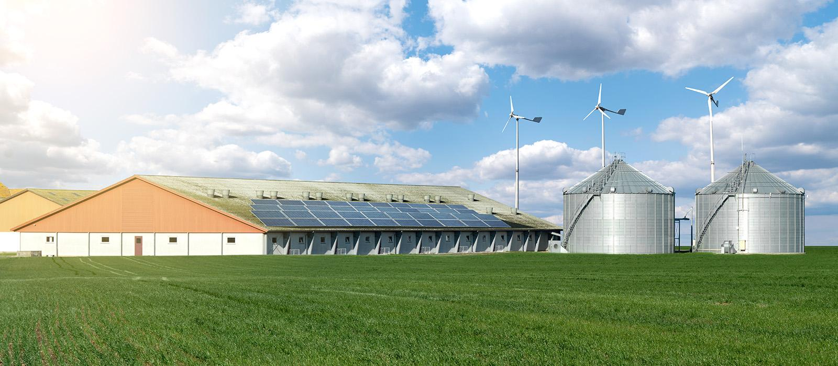
Lesson 7: EVALUATE (part 2)
How might this help us figure out how farmers can use resources wisely to protect Earth’s systems?
Lesson 7:
EVALUATE
Notes:
To support student sensemaking across the unit, orient students back to the DQB. Ask students: What did we observe during today’s activity? (We observed a community in Denmark.) Record the activity and their observations. Next, ask students: What did we learn today? (We learned that there are communities that are making changes in the natural resources they use for energy, in order to protect the environment.) Record their responses. If students need a reminder, they can reference their student journals.
Ask students: How might this help us figure out how farmers can use resources wisely to protect Earth’s systems? (Students may say that farms could use renewable resources such as the wind, the sun, or animal waste.)

Slide 16
Lesson 7: EVALUATE (part 3)
Lesson 7:
EVALUATE
What new questions do you have?
Notes:
Next, ask students: What new questions do you have? Write student responses on the driving question board. (They may have new questions, such as: Are there other places that have made changes like Samsø? Are there other types of renewable resources? Can renewable resources harm the environment? Could I power my home with renewable resources? How do you build a wind turbine? How does a wind turbine make energy from the wind? How do you build solar panels? How does a solar panel make energy from the sun? )
Do not provide these questions for students, instead help them start thinking about these ideas by focusing their attention to the solutions that the people of Samsø came up with and how that could relate to the anchoring problem: Farms use a large amount of resources. This can have a negative impact on the environment. Have students place their questions into existing categories, or create new categories.

Slide 17
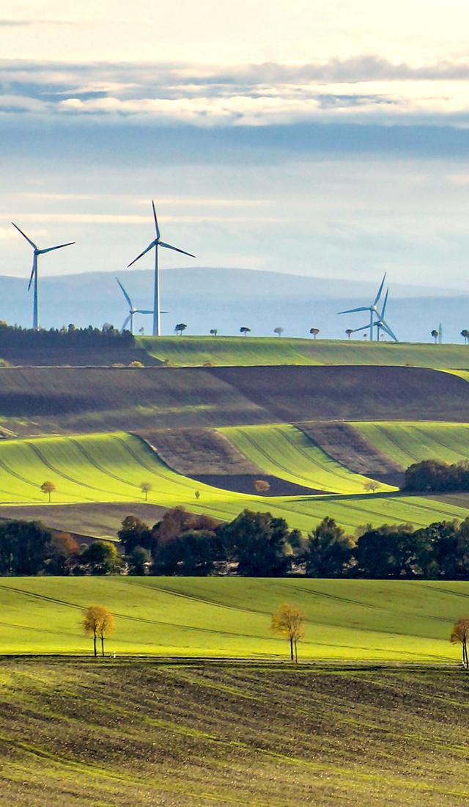
Lesson 8: LEARNING TARGET
Lesson 8:
LEARNING TARGET
LESSON 8:
How can we use farms to harness wind energy?
Notes:
In the previous lesson, students used Samsø as a case study to examine how humans can change their impacts on the environment.
In this lesson, students engage in the engineering design cycle to develop a wind turbine that can be used to produce energy.
Students figure out that wind turbines can be used to harness energy from the wind, and transfer it to energy that can be used as a resource. They learn that they can use the engineering design cycle to develop and test solutions, and make improvements to these solutions using evidence and feedback from others.
In the next lesson, students analyze their biodigester data and obtain information in order to consider how farms can best make use of animal waste as a resource.

Slide 18
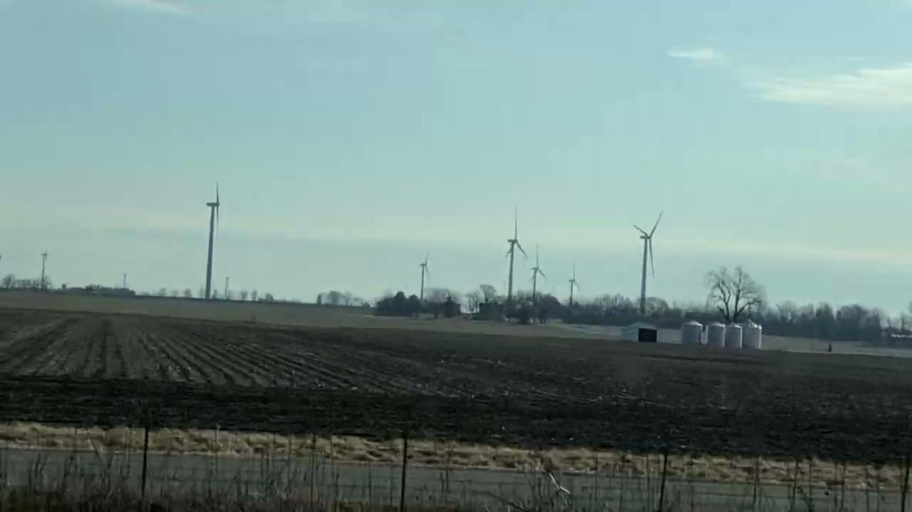
Lesson 8: ENGAGE
Lesson 8:
ENGAGE
Have you ever seen these fan-looking things while driving?
What do you observe? What new questions do you have?
Notes:
ENGAGE Summary: Students share initial ideas about wind turbines and how they work.
Begin the lesson by revisiting the Driving Question Board. Review the words, phrases, or questions used to categorize student questions. Also review specific student individual questions. Consider if any of these questions are connected to the learning of this lesson. If so, highlight this question for students. Say to students: Today’s activity will support us in answering this question. By answering this question, we will be able to build on our understanding of the anchoring problem and start to work towards a solution.
Show students a video of wind turbines on farmland from Jeanne Norris . Ask students: Have you ever seen these before while driving? One of the types of renewable energy we saw used on Samsø Island was wind energy. What do you observe from the video? (Students may notice that the wind turbines are on farms because they see plowed soil, farm buildings, etc.) What new questions do you have about wind energy? Let’s explore some of these questions today!

Slide 19
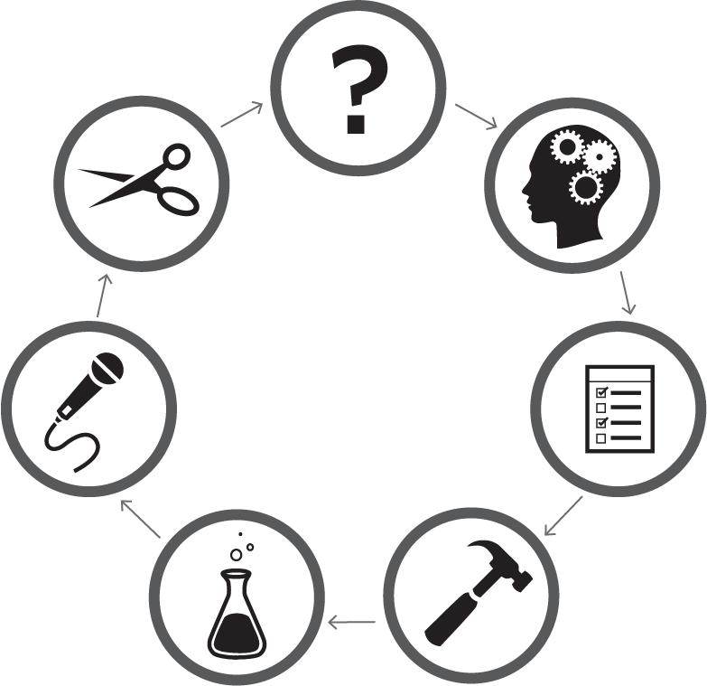
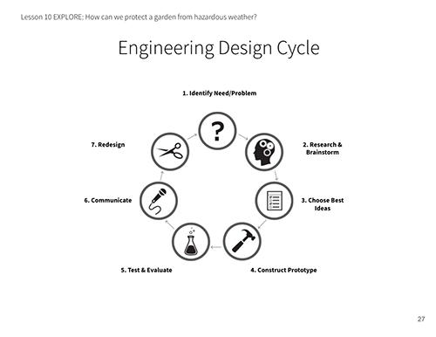
Lesson 8: EXPLORE
Lesson 8:
EXPLORE
 | 1. Identify Need/Problem
7. Redesign |  |  | 2. Research & Brainstorm
6. Communicate |  |  | 3. Choose Best Ideas
5. Test & Evaluate |  | 4. Construct Prototype
Engineering Design Cycle Student Journal page
Notes:
EXPLORE Summary: Students design and test a wind turbine with parts that act as a system to harness wind energy.
Almost every mySci unit incorporates the engineering design cycle. At this point, students should be familiar with the cycle. If not, remind students that engineers are people who work to design and build solutions to problems we face. Say to students: Engineers create new inventions that solve problems. Show students the Engineering Design Cycle Student Journal page and talk through each step. It is important for students to understand the cycle is a simplification of a complex process, and is not rigid. You won’t necessarily complete steps 1-7, in that order. For example, you may redesign, and then retest, and communicate. Or, as part of your redesign, you may have to do more research.

Slide 20
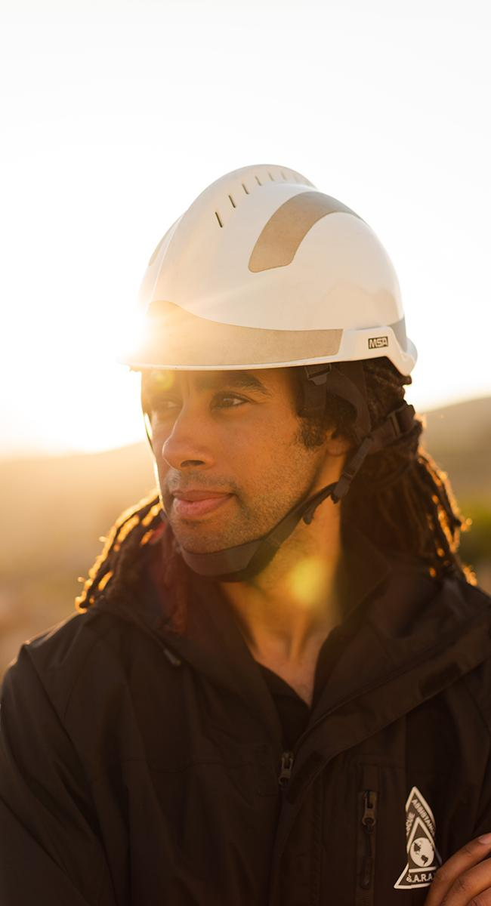
Engineer
Lesson 8
engineer
a person who designs and builds things that solve a problem

Slide 21
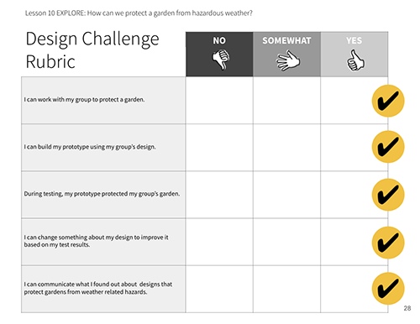
Lesson 8: Explore (part 2)
Lesson 8:
EXPLORE
 | 1. Identify Need/Problem
7. Redesign |  |  | 2. Research & Brainstorm
6. Communicate |  |  | 3. Choose Best Ideas
5. Test & Evaluate |  | 4. Construct Prototype
Engineering Design Cycle Student Journal page
Design Challenge Rubric Student Journal page
Notes:
Ask students: What is the most important problem we’ve been exploring in this unit? (We need energy to live our daily lives, but some sources of energy pollute the Earth more than others.)
Ask students: How could you use the design cycle to develop solutions, using wind turbines, that could help solve this problem?
Next, show students the Design Challenge Rubric Student Journal page. Ask students to compare the rubric to the engineering design cycle. How does each category of the rubric relate to the design cycle?.
Divide your class into six groups. Tell students that they will take on the role of an engineer as they work in groups to design their own wind turbines.

Slide 22
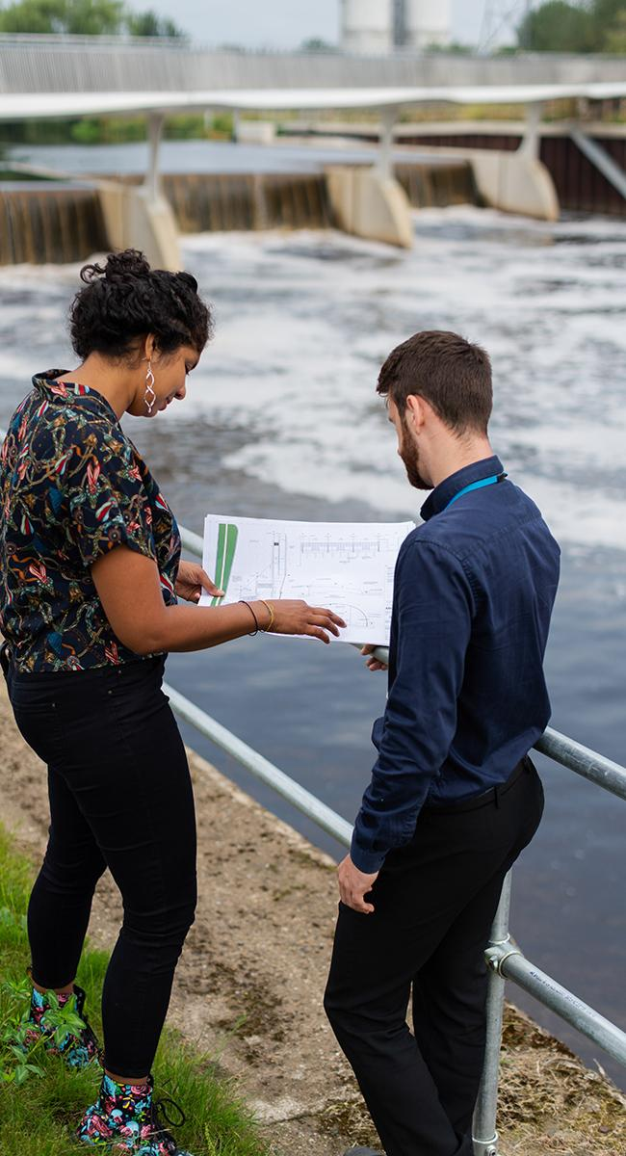
Criteria
Lesson 8
criteria
what the design must have or be like
Notes:
Have a conversation about criteria (what the solution must do or be like - In this case the criteria is to design a wind turbine that transfers energy) and constraints (what you are limited by or cannot do - In this case the constraints are time and materials).

Slide 23
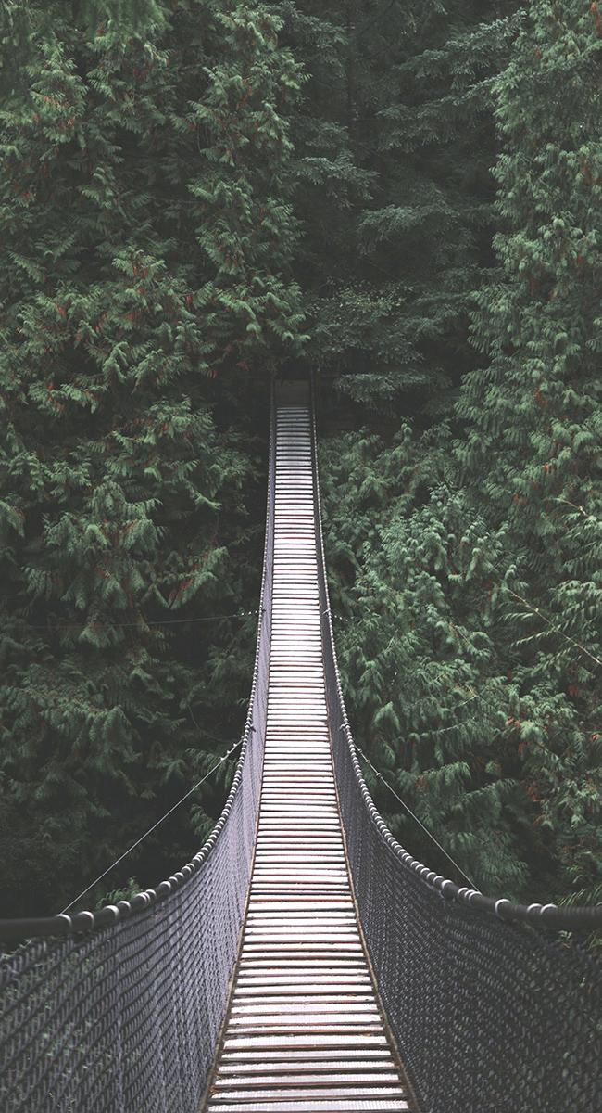
Constraint
Lesson 8
constraint
what the design is limited by or cannot do
Notes:
Have a conversation about criteria (what the solution must do or be like - In this case the criteria is to design a wind turbine that transfers energy) and constraints (what you are limited by or cannot do - In this case the constraints are time and materials).

Slide 24
Lesson 8: Explore (part 3)
Lesson 8:
EXPLORE
How might you use the materials to build a wind turbine that can harness energy from the wind?
How can we use the bucket, string, and pennies to observe energy transfer?
Notes:
Show them the materials they have available to them. Let them brainstorm in their groups how they could use the given materials to build a wind turbine that can harness energy from the wind. Bring the class back together, and have students discuss how they think the materials could be used to build a wind turbine that meets the criteria. Say to students: We need to be able to observe evidence that energy is being transferred using these materials. How might we use the bucket, string, and pennies to do that? (If students do not say it, discuss with students how you can lift these materials using the wind turbine). Is there any other evidence we could look for to know that energy is being transferred in our designs? (Students may say: the blades might move, the wind turbine could make a sound)
There is an opportunity to review 4th grade physical science standards around energy transformations (mySci Unit 20, DCI PS3.A). If students are struggling to see how these materials could form a wind turbine, display Bucket Lift Drawing (in Section 3 curriculum slides) and point out how the materials are used to make the turbine.

Slide 25
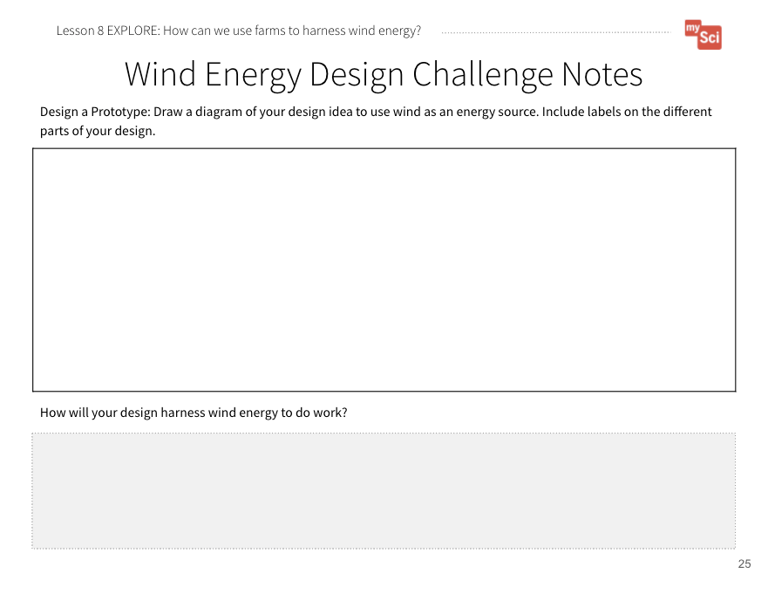
Lesson 8: Explore (part 4)
 | 1. Identify Need/Problem
7. Redesign |  |  | 2. Research & Brainstorm
6. Communicate |  |  | 3. Choose Best Ideas
5. Test & Evaluate |  | 4. Construct Prototype
Lesson 8:
EXPLORE
Wind Energy Design Challenge Notes Student Journal pages
Notes:
Have students access the Wind Energy Design Challenge Notes Student Journal pages. Individually, students research and brainstorm. Prior to this lesson, students have been provided with resources to research. In this lesson, students will be expected to research on their own. Review the guidelines for identifying reliable resources from lesson 4. Below are resources to support students if they are struggling:
How to Make a Windmill
Windmill
Wind Energy Facts Video for Kids.
Alliant Energy Whispering Willow Wind Farm 360-degree Tour

Slide 26
Lesson 8: Explore (part 5)
 | 1. Identify Need/Problem
7. Redesign |  |  | 2. Research & Brainstorm
6. Communicate |  |  | 3. Choose Best Ideas
5. Test & Evaluate |  | 4. Construct Prototype
Lesson 8:
EXPLORE
Wind Energy Design Challenge Notes Student Journal pages
Notes:
Based on their research, students should create an initial model of a wind turbine. Have students share their models with their groups. They should use evidence from their research to support their design ideas. Use the following questions to help students discuss their individual models with one another, and determine what a group model would look like: How will this design solve the problem? Why is this design choice the best? Would combining any of your ideas create a better solution? Why do you think that?
Based on their discussions, have groups choose the best ideas from their research and brainstorming. They should then draw a model of their group prototype. Remind students that it is important to label the parts of the design, the materials they will use for those parts, and how much material will be used.
After they show you their prototype, they can work together to construct it using the materials they have chosen.

Slide 27
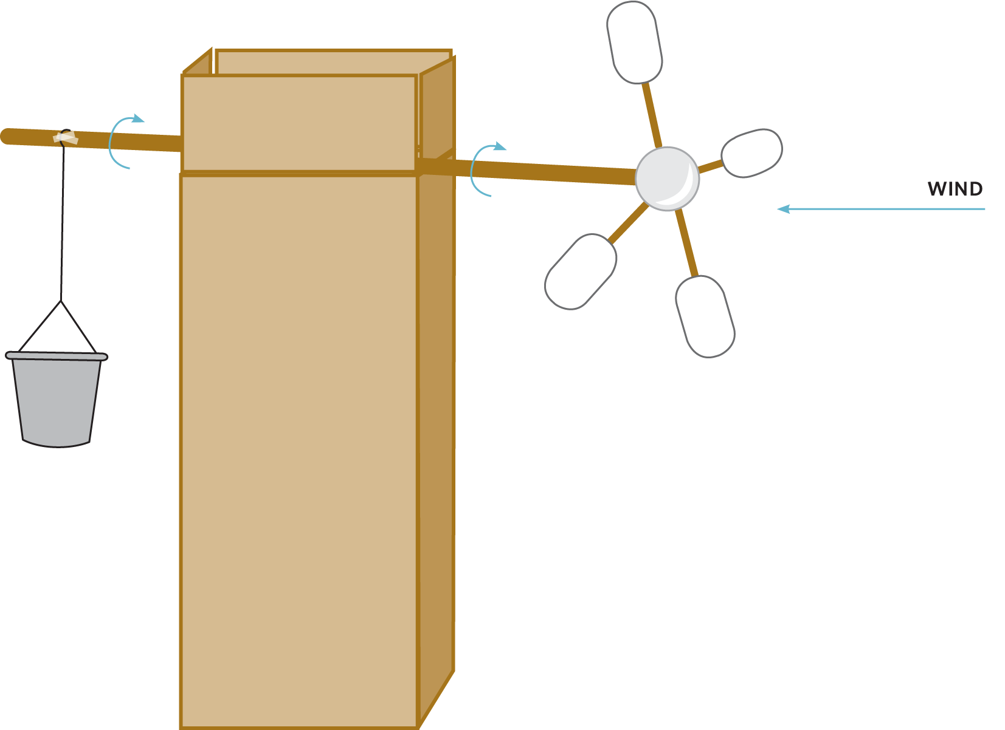
Lesson 8: Explore (Homemade Wind Turbine)
Lesson 8:
EXPLORE
Notes:
If students are struggling to see how these materials could form a wind turbine, display the Bucket Lift Drawing and point out how the materials are used to make the turbine.

Slide 28
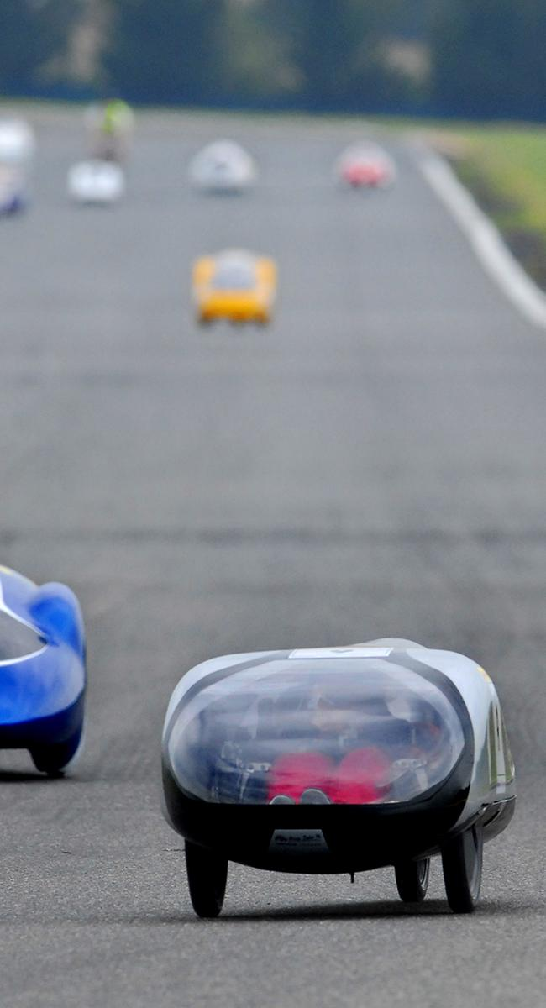
Prototype
Lesson 8
prototype
a first model or design of something

Slide 29
Lesson 8: Explore (part 6)
Lesson 8:
EXPLORE
 | 1. Identify Need/Problem
7. Redesign |  |  | 2. Research & Brainstorm
6. Communicate |  |  | 3. Choose Best Ideas
5. Test & Evaluate |  | 4. Construct Prototype
An important opportunity to attend to equity is offered in the speaker notes area
Design Challenge Tutorial
Wind Energy Design Challenge Notes Student Journal pages
Notes:
Refer back to the Engineering Design Cycle Student Journal page. After students construct their prototype, they can test and evaluate it.
Explain to students that they must do a fair test. To do this, show them the fan that will be used for testing and the coins that will serve as the weight in the bucket. Here is a teacher tutorial for the wind turbine activity.
Say to students: The materials here are what everyone will be able to use for their wind turbines and they are the same for each group. Is there anything else that we should keep the same to make sure it is a fair test? Keep a list of their responses on the board.
Decide how you will measure your success as a class.
Example 1: Speed Challenge: Use a timer and measure how long it takes the bucket to reach the top of the windmill. (Use the same fan on the same setting, the wind turbine is the same distance from the fan, each team lifts the same amount of coins, each team lifts the same distance, teams have the same amount of time to work)
Example 2: Distance Challenge: Use a ruler to measure the maximum height the bucket reaches before it stops. (Use the same fan on the same setting, the wind turbine is the same distance from the fan, each team lifts the same amount of coins, teams have the same amount of time to work)
Example 3: Weight Challenge: See which wind turbine can lift the most pennies in the bucket. (Use the same fan on the same setting, the wind turbine is the same distance from the fan, each team lifts the same distance, teams have the same amount of time to work.)
If students miss any of these variables, prompt them. For example, if they miss “same distance from the fan” ask if it would be a “fair test” to place one wind turbine right next to the fan and one far away. As a class, determine the length of the string (40 cm is good), the weight of the bucket (or number/type of coins) and any other variables that would be controlled for a fair test.
Attending to Equity:
Engineering challenges are a great opportunity to show students how to “fail forward” and manage frustration. In order to allow students to bring their funds of knowledge to the table during engineering design challenges, allow them to help generate the list of criteria and constraints of the challenge. Here is a STEM Teaching Tool that discusses this topic.

Slide 30
Lesson 8: EXPLAIN
Lesson 8:
EXPLAIN
 | 1. Identify Need/Problem
7. Redesign |  |  | 2. Research & Brainstorm
6. Communicate |  |  | 3. Choose Best Ideas
5. Test & Evaluate |  | 4. Construct Prototype
Wind Energy Design Challenge Notes Student Journal pages
Notes:
EXPLAIN Summary: Students obtain and communicate information to see how others designed wind turbines to best harness wind energy. Students use models to explain how their design worked to harness energy from the wind.
Once all groups are done testing, ask the groups to communicate their design and test results to the class. Ask students: Why do you think it is important that we share or designs and results with each other? How will this help us improve our designs? Students can share the design they chose for their wind turbine, and why they thought it would be the most effective at transferring energy. After each group shares, provide space for other groups to give feedback. Tell students that they must provide at least one piece of feedback for each group. Make sure feedback is helpful, specific, and kind.
Examples of feedback students may provide:
Praise: Tell why you like it/why it is a strength.
Questions: Ask questions about components of the plan that are unclear.
Polish: Tell what is confusing/provide suggestions for improvement.

Slide 31
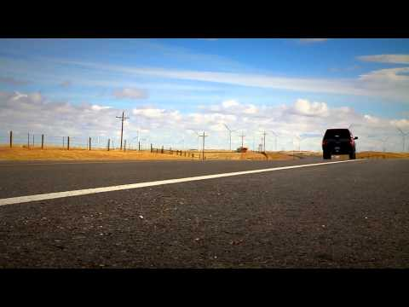
Lesson 8: EXPLAIN (part 2)
Lesson 8:
EXPLAIN
Let’s learn about how wind turbines harness the wind to create electricity.
Wind Turbines from the US EPA
Wind Energy
Notes:
After seeing what students have come up with, have students obtain information about how wind turbines harness the wind to create electricity.
Show students the link to this slide: Wind Turbines from the US EPA. Focus their attention on the photo of a wind farm at the top of the slide.
To further help students explain how wind turbines use technology to harness wind energy and transform it into electricity, show this Energy 101 video (3:16) from the Office of Energy Efficiency and Renewable Energy. Here is a reading that can also help support this topic: How do wind turbines work? from Alliant Energy. Be sure to focus students on the role of windmill technology and how this technology has evolved over time to meet the needs of humans (from windmills to wind turbines).
Have students use chart paper or whiteboards to create a chart. On one side of the chart students can draw a model of their design, and use their data and what they have learned to explain how energy is being transferred. For example, students may say energy was transferred from the fan to the blades. We know this because the blades and dowel rod began to move. This caused the bucket to lift. On the other side of the chart, students can draw an actual wind turbine, and show how energy transfer is occurring. Have students use the models to make comparisons. What are the limitations of their prototypes? How are they similar to an actual wind turbine? How are they different?
This activity is a chance to formatively assess students' understanding of the SEPs Planning and Carrying Out Investigations and Developing and Using Models , PS3.A and PS3.B, and CCC Energy and Matter. See the student journal answer key for an example. If students are struggling, develop a class comparison

Slide 32
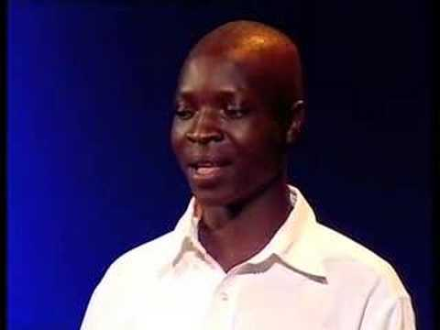

Lesson 8: ELABORATE
Lesson 8:
ELABORATE
Let’s learn about how one person engineered a wind turbine for his community.
Read-Aloud Guide
William Kamkwamba on Building a Windmill
Notes:
ELABORATE Summary:
Read the book, The Boy Who Harnessed the Wind by William Kamkwamba and Bryan Mealer. Read-Aloud Guide.
Next show William Kamkwamba on Building a Windmill from William Kamkwamba via TED.

Slide 33
Lesson 8: ELABORATE (part 2)
Lesson 8:
ELABORATE
How many times do you think William had to design and redesign before he had a result he was satisfied with?
How did he modify his design?
How did he get feedback from others?
Notes:
Ask students: How many times do you think William had to design and redesign before he had a result he was satisfied with? How did he modify his design? Let’s go back to the end of the story when William’s turbine was successfully operating. How did he get feedback from others? (The doubters clapped and cheered for him, one man told him “Well done!”).

Slide 34
Lesson 8: ELABORATE (part 3)
Lesson 8:
ELABORATE
 | 1. Identify Need/Problem
7. Redesign |  |  | 2. Research & Brainstorm
6. Communicate |  |  | 3. Choose Best Ideas
5. Test & Evaluate |  | 4. Construct Prototype
Wind Energy Design Challenge Notes Student Journal pages
Notes:
Say to students: Now, you are going to have time to redesign your prototype and see if you can make a change to improve your wind turbine. Keep the following in mind when redesigning:
What you observed in your initial design
What you observed in other groups’ initial designs
The feedback you received from classmates
Information about how wind turbines work
Information from The Boy Who Harnessed the Wind
Time permitting, have students retest their designs, and communicate the results to their classmates. Did their designs improve? What evidence do they have to support this?

Slide 35
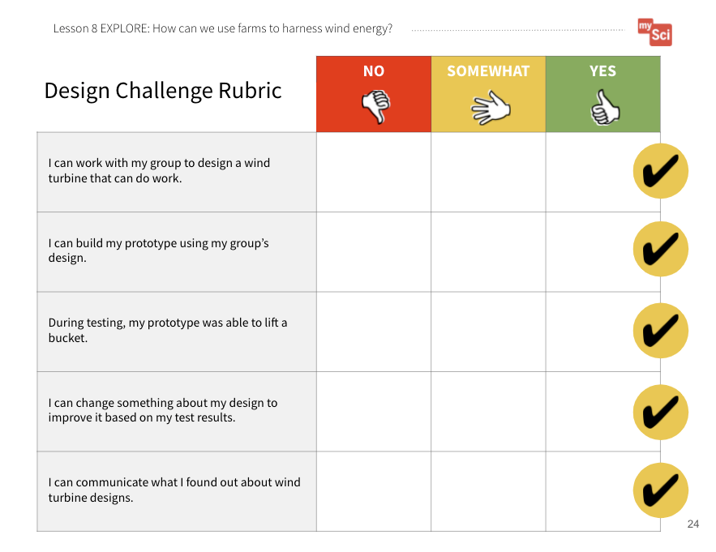
Lesson 8: EVALUATE
Lesson 8:
EVALUATE
Let’s use our Design Challenge Rubric to self-assess our wind turbine designs.
A Farm that Helps Protect the Earth Student Journal page
Design Challenge Rubric Student Journal page
Notes:
EVALUATE Summary: Students evaluate their wind turbine designs using a rubric.
Evaluate student’s wind turbine designs outlined in the Wind Energy Design Challenge Notes Student Journal pages according to the Design Challenge Rubric Student Journal page. Also allow students to self-evaluate using the rubric.

Slide 36
Lesson 8: EVALUATE (part 2)
Lesson 8:
EVALUATE
How might this help us figure out how farmers can use resources wisely to protect Earth’s systems?
Notes:
To support student sensemaking across the unit, orient students back to the DQB. Ask students: What did we observe during today’s activity? (We observed how well different wind turbine designs addressed the problem we are trying to solve. ) Record the activity and their observations. Next, ask students: What did we learn today? (Wind turbines transfer wind energy to electrical energy. We also learned about how engineering can be used to design solutions to problems. We learned how to use evidence from our tests and communication with others to revise our designs to better solve the problem.) Record their responses. If students need a reminder, they can reference their student journals.
Ask students: How might this help us figure out how farmers can use resources wisely to protect Earth’s systems? (Students may say that farms could use renewable resources such as the wind, the sun, or animal waste.)

Slide 37
Lesson 8: EVALUATE (part 3)
Lesson 8:
EVALUATE
What new questions do you have?
Notes:
Next, ask students: What new questions do you have? Write student responses on the driving question board. (They may have new questions, such as: How many wind turbines would you need to power a farm? How much space do wind turbines take up on a farm? What do we use for energy when it is not windy?)
Do not provide these questions for students, instead help them start thinking about these ideas by focusing their attention to what we might need to consider about wind turbines and energy. Have students place their questions into existing categories, or create new categories.

Slide 38
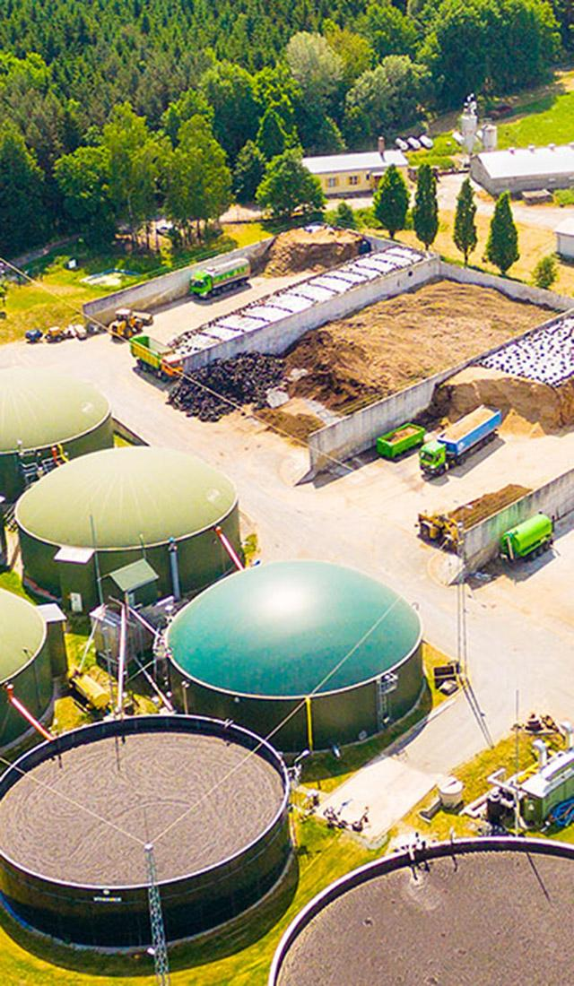
Lesson 9: LEARNING TARGET
Lesson 9:
LEARNING TARGET
LESSON 9:
How can we design a farm that protects Earth’s systems?
Notes:
In the last lesson, students engaged in the engineering design cycle to develop a wind turbine that could be used to produce energy.
In this lesson, students will analyze their biodigester data and obtain information in order to consider how farms can best make use of animal waste as a resource. They will obtain information about the advantages and disadvantages of wind turbines and biodigesters, and revise their farm using what they have learned about these solutions over the course of the unit.
Students figure out that biodigester technology is used in a specific way so that the most natural gas is produced from animal and food waste. This technology harms the Earth less than fossil fuel use. Farms have a lot of space that can be used for wind turbines and/or biodigesters. Even renewable energy sources have some disadvantages, so it is best to have a wide variety of renewable energy sources.
This unit prepares students for middle school studies in climate change and unequal distribution of natural resources on Earth.

Slide 39
Lesson 9: ENGAGE
Lesson 9:
ENGAGE
What are some of the most important things you have figured out in this unit?
Notes:
ENGAGE Summary: Students communicate what they have figured out about how humans affect the environment.
Begin the lesson by revisiting the Driving Question Board. Review the words, phrases, or questions used to categorize student questions. Also review specific student individual questions. Consider if any of these questions are connected to the learning of this lesson. If so, highlight this question for students. Say to students: Today’s activity will support us in answering this question. By answering this question, we will be able to build on our understanding of the anchoring problem and work towards a solution.
Say to students: We have figured out so much about Earth’s systems, how we use the natural resources of our planet, and how we affect the Earth by using natural resources. What are some of the most important things you have figured out in this unit? Give students time to Turn and Talk, then share a few answers.

Slide 40
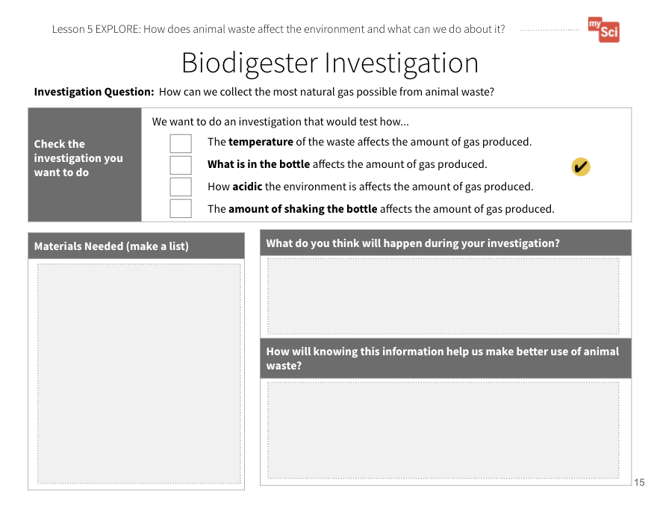
Lesson 9: EXPLORE
Lesson 9:
EXPLORE
Let’s analyze our biodigester data.
You will share:
The conditions you investigated
Data you collected
Your claim about which the conditions needed for the most natural gas to be produced
An important opportunity to attend to equity is offered in the speaker notes area
Biodigester Investigation
Student Journal pages
Notes:
EXPLORE Summary: Students analyze data to see how different factors affect how much natural gas is produced from waste.
Say to students: In the last lesson, we looked at how people design solutions to address problems caused by how we use natural resources. We saw how farms can use wind as an energy source. We also set up our own energy solution, biodigesters, so that we could see how we can use farm animal waste in ways that aren’t as harmful to the Earth. (You may need to remind students of the life science connections from Lesson 6, such as- decomposers break down waste into natural gas.) Let’s analyze our data to see which conditions met our criteria - making the most amount of gas from waste - given the materials constraints.
Have students get into their groups and finalize the data they will present to the class using the Biodigester Investigation Student Journal pages. To guide students in determining what to share, tell them they will need to share what conditions they investigated as part of their experiment, qualitative and quantitative data (measurements of balloon inflation which represents the amount of gas produced) they collected, and what claim they can make about which environment has better conditions for the most natural gas to be produced.
Optional Math Connection: You could choose to have students create a line plot of their data to share as a mathematical representation. They would create a plot to see how the amount of gas changed each day.
Attending to Equity:
Investigation results that are confusing or surprising offer important moments of “productive uncertainty” that can be used to deepen understanding. Providing sentence stems for respectful argumentation can be helpful. See more in this STEM Teaching Tool.

Slide 41
Lesson 9: EXPLAIN
Lesson 9:
EXPLAIN
How would you design a biodigester that had the perfect environment to create the most methane gas?
Use evidence from our investigations
to support your claim.
Biodigester Investigation
Student Journal pages
Notes:
EXPLAIN Summary: Students compare data to make a claim about the optimal conditions to produce natural gas from animal waste.
As students present their findings, create a class chart that summarizes it. The class chart should include each group's condition, and the quantitative and qualitative data they collected. After results have been communicated, ask: How would you design a biodigester that had the perfect environment to create the most natural gas? Use evidence from our class data to support your claim. Give students time to talk in their small groups, then come to a class consensus about the ideal biodigester. (For example, students might say that the best biodigester is warm, has soil added to it, and is not too acidic.)
This activity is a chance to formatively assess students' understanding of the SEP Constructing Explanations and Designing Solutions, DCI ETS1.C. If students are struggling to apply what they have learned in constructing explanations, focus their attention back to the evidence to help them identify how a particular condition meets or does not meet the criteria.

Slide 42
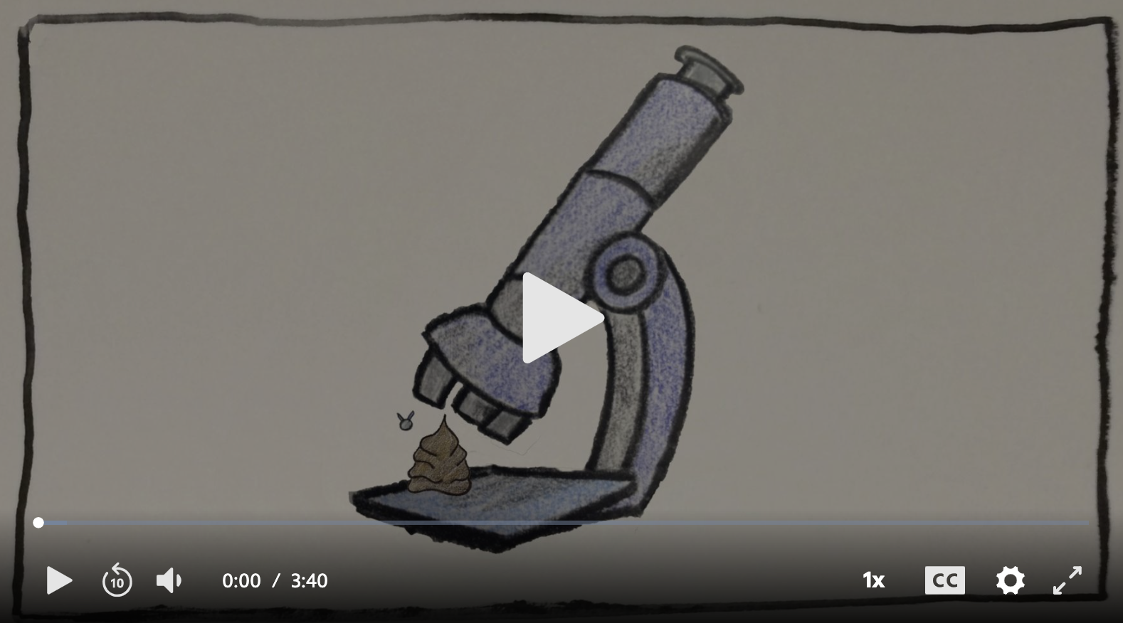
Lesson 9: EXPLAIN (part 2)
Lesson 9:
EXPLAIN
Much A-Doo About Poo
As you watch the video, think about how the technology compares to our model set up of a biodigester, and how that technology affects the environment.
Notes:
EXPLAIN Summary: Students explain how use of methane energy from farm biodigesters affects the environment.
Say to students: We figured out that it is possible to use waste as an energy source. Let’s see how this works on a farm. As you watch the video, think about how the technology compares to our model set up of a biodigester, and how that technology affects the environment.
Watch Much A-Doo About Poo (3:40) (3:40) from PBS Learning Media. Afterwards, discuss the focus questions previously mentioned. (For example, students should note that large-scale biodigesters similarly capture the waste in a container, but then put it in an electricity-producing engine. This technology makes sure the gas is burned for energy, instead of just going into the atmosphere causing pollution)
Ask students: How else do the materials from a biodigester get used? (The leftovers can be used as fertilizer to grow plants such as corn and hay, which can then be used to take care of the animals.)

Slide 43
Lesson 9: ELABORATE
Lesson 9:
ELABORATE
Do you think one solution is better than the other?
Do you think there are advantages to both solutions?
What all should we consider when deciding if one solution is better than the other?
Notes:
ELABORATE Summary: Students compare the advantages and disadvantages of wind turbine and biodigester design solutions.
Say to students: We have modeled two different solutions to address the problem of farms using resources, which can harm the environment. Do you think one solution is better than the other? Do you think there are advantages to both solutions? What all should we consider when deciding if one solution is better than the other? Think of ideas other than how well they produce energy.

Slide 44
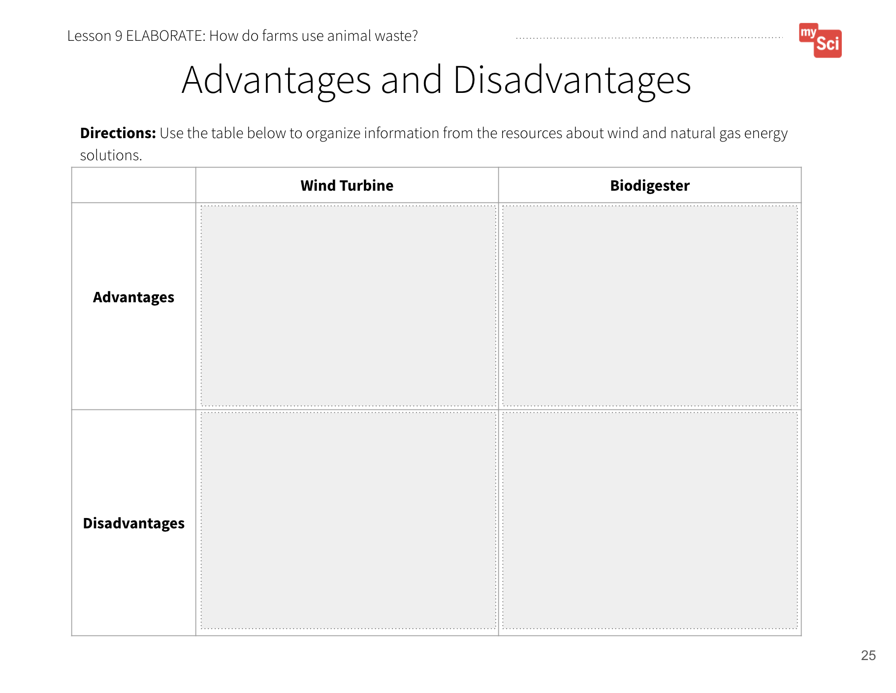
Lesson 9: ELABORATE (part 2)
Lesson 9:
ELABORATE
Let’s research the pros and cons of wind energy and biodigesters
Advantages and Challenges of Wind Energy
Wind Power Another Crop to Harvest
Advantages and Disadvantages of Biogas
Advantages and Disadvantages Student Journal page
Notes:
To help students think of pros and cons, provide students the following resources to learn more about wind energy and biodigesters:
Advantages and Challenges of Wind Energy from the U.S. Department of Energy
Wind Power Another Crop to Harvest from the American Clean Power Association
Advantages and Disadvantages of Biogas from HomeBiogas
Students can use the Advantages and Disadvantages Student Journal to organize the information from the resources.

Slide 45
Lesson 9: EVALUATE
Lesson 9:
EVALUATE
Let’s look at our new vision for farming and add to the models we’ve developed.
A Farm that Helps Protect the Earth Student Journal page
Notes:
EVALUATE Summary: Students refine their farm models to include solutions that address the anchoring problem of farms using resources that affect the environment.
Revisit A Farm That Helps Protect the Earth Student Journal page. Say to students: Let’s look at our new vision for farming and add to the models we’ve developed. Have students refine their models based on the new information from the wind turbine design and biodigester designs.

Slide 46
Lesson 9: EVALUATE (part 2)
Lesson 9:
EVALUATE
A good model of a system shows relationships between parts of the system!
How will we show how a farm can use natural resources in a way that doesn’t harm Earth systems as much?
“Gotta Have It” Checklist: Our Farm Model has to have...
✔
✔
✔
✔
✔
✔
Farm Model
Student Journal page
A Farm that Helps Protect the Earth Student Journal page
Notes:
Say to students: We need to use a “Gotta Have It Checklist” to show the components and relationships we need to include in the models. What would you add to the checklist today to make our models show how farmers can use resources in a way that protects Earth’s systems?
Examples of things the model’s “gotta have” might include:
One, Both, or Neither: Wind Turbine and Biodigester
Reasoning for the decision based on the advantages and disadvantages of the solutions
Representations of how the solution(s) transfers energy
Optimal design for the solution(s) based on evidence from designs
This activity is a chance to formatively assess students' understanding of the SEP Developing and Using Models, DCIs ESS3.C and ETS1.C, and CCC System and System Models. See the student journal answer key for an example. If students are struggling to apply what they have learned in developing a model, use the class consensus model you created to support students to further develop their models.

Slide 47
Lesson 9: EVALUATE (part 3)
Lesson 9:
EVALUATE
We’ve created two models of how humans affect Earth’s systems.
Let’s compare and contrast these models.
How does the new farm model allow us to use our resources wisely?
Farm Model
Student Journal page
A Farm that Helps Protect the Earth Student Journal page
Notes:
You can also have students compare their original farm models to their new farm models to help them reflect using the Farm ModelStudent Journal page and A Farm That Helps Protect the Earth Student Journal page.

Slide 48
Lesson 9: EVALUATE (part 4)
Lesson 9:
EVALUATE
Based on what you have learned in the unit, how can farmers use resources wisely to protect Earth’s systems?
Why is this important?
Notes:
To support student sensemaking across the unit, orient students back to the DQB. Ask students: What did we observe during today’s activity? (We observed how different conditions for biodigesters yield different amounts of natural gas. ) Record the activity and their observations. Next, ask students: What did we learn today? (Biodigesters that have soil and are warm make the most natural gas. We also learned about how engineering can be used to design solutions to problems. We learned how to use evidence from our tests to help us decide which design is the best. We also compared and contrasted our wind turbine and biodigester design solutions) Record their responses. If students need a reminder, they can reference their student journals.
Ask students: Based on what we have learned throughout this unit, how can farmers use resources wisely to protect Earth’s systems and why is it important? (Students may say that farms could use renewable resources such as wind energy and biodigesters in place of fossil fuels to protect Earth’s resources. This is important because Earth systems interact, and farms are part of these systems. When farms use fossil fuels for energy and water, it can take a long time for these resources to replenish. This is because fossil fuels are nonrenewable, and there is a limited amount of freshwater on Earth. Also, animal waste can pollute the atmosphere and hydrosphere, but biodigesters provide a solution to this problem by containing the waste and using it to make natural gas that can be burned for fuel.) To help students answer this question, have them refer back to the previous lessons on the DQB and look at what they learned from each lesson.

Slide 49
Lesson 9: EVALUATE (part 5)
Lesson 9:
EVALUATE
What new questions do you have?
Post-Assessment
Notes:
Next, ask students: What remaining questions do you have? Write student responses on the driving question board. (They may have new questions, such as: (They may have new questions, such as: What other human activities can harm Earth’s systems? How do my activities harm Earth’s systems, and what can I do about it?)
Administer the Post-Assessment. You can use this data to see how students have grown in their knowledge and skills, and to figure out next teaching steps.

