Slide 1
Creating an outline for a research paper

Slide 2
Thesis
Once you have your thesis statement your outline should follow it.
Example thesis: Despite the fact that putting a casino in Gettysburg would bring more income into the county, this is a bad idea because the casino will increase the crime rate, gamboling addictions will deplete family incomes and the historic and family feel of the area will be compromised.

Slide 3
Despite the fact that putting a casino in Gettysburg would bring more income into the county, this is a bad idea because the casino will increase the crime rate, gamboling addictions will deplete family incomes and the historic and family feel of the area will be compromised.
The first part of your outline matches the first part of your thesis, which in the case of an argumentative paper is the opposite side of your argument.
Example:
I. Benefits to county
A. Casino jobs
B. More tourism
Notice the headings and
Subheadings are SUBJECTS not facts

Slide 4
Despite the fact that putting a casino in Gettysburg would bring more income into the county, this is a bad idea because the casino will increase the crime rate, gamboling addictions will deplete family incomes and the historic and family feel of the area will be compromised.
The next part of your outline will be the next part of your thesis
Example
I. Benefits to county
A. Casino jobs
B. More tourism
II. Crime rate
A. Different type of tourist
B. Law enforcement increase
C. Traffic
Notice the length of each
Heading and subheading are short – NOT sentences

Slide 5
Despite the fact that putting a casino in Gettysburg would bring more income into the county, this is a bad idea because the casino will increase the crime rate, gamboling addictions will deplete family incomes and the historic and family feel of the area will be compromised.
Continue to have a heading with at least 2 subheadings for each part of your thesis.
Do not add introduction and conclusion as part of outline. These are mandatory so not needed as part of outline.

Slide 6
I. Benefits to county
A. Casino jobs
B. More tourism
II. Crime rate
A. Different type of tourist
B. Law enforcement increase
C. Traffic
III. Gambling addiction
A. Counseling costs
B. Family problems
IV. Historic atmosphere
A. Museums
B. Historic and family events
Despite the fact that putting a casino in Gettysburg would bring more income into the county, this is a bad idea because the casino will increase the crime rate, gamboling addictions will deplete family incomes and the historic and family feel of the area will be compromised.

Slide 7
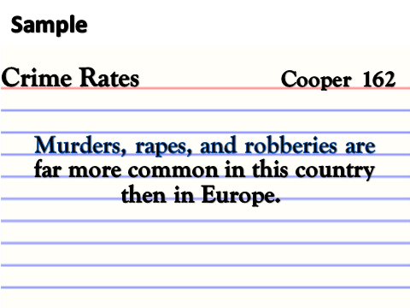
Note taking
From this outline you can take notes on these subjects and placing the subject in the upper left hand corner of your note card (the slug) means you cards can be easily organized.
Since the headings and subheadings are short this will be easy.

