Slide 1
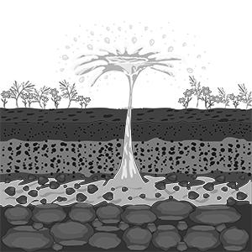


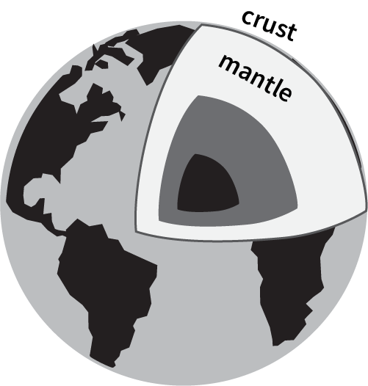

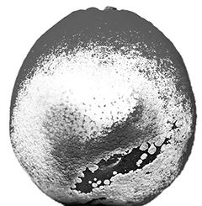
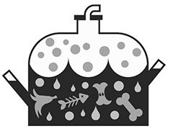


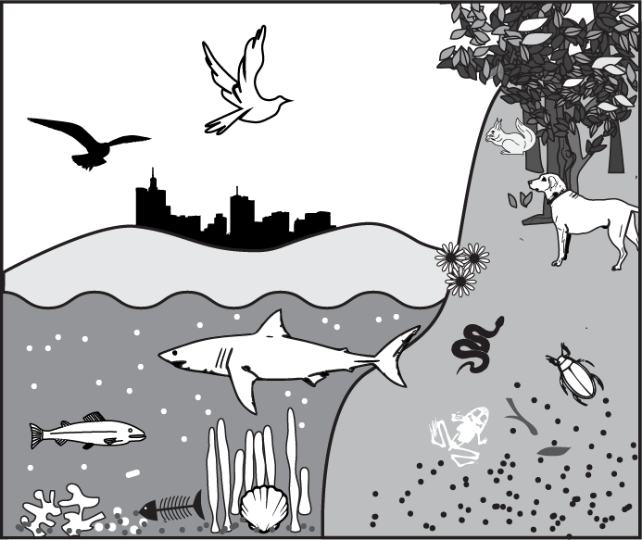
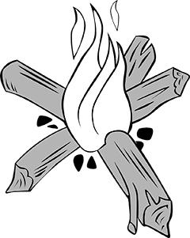
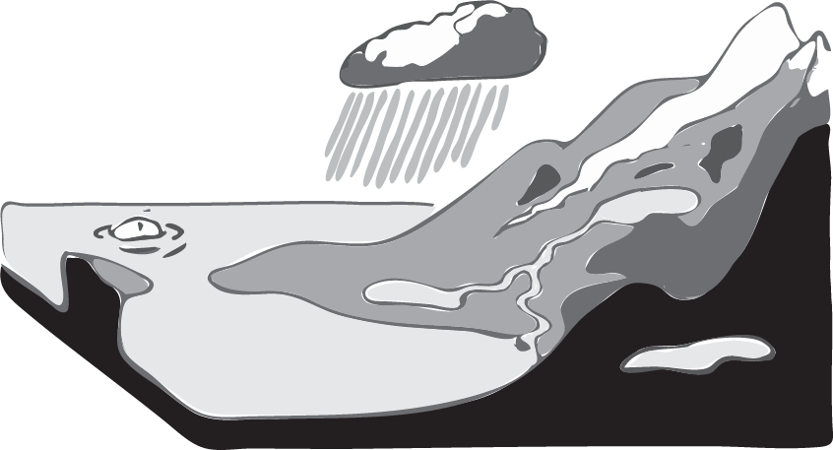
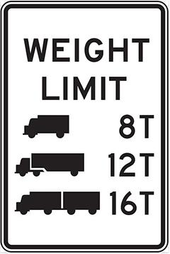

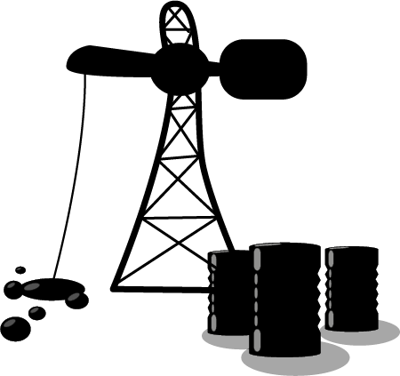
mySci Unit 22 Vocabulary and Glossary
mySci Unit 22 Vocabulary and Glossary
AQUIFER
large bodies of underground rock that contain fresh groundwater
CRITERIA
what the design must have or be like
FRESHWATER
water that does not contain a large amount of salt (like river or lake water)
GEOSPHERE
Earth’s crust and mantle (soil, rocks, and molten rock)
ATMOSPHERE
the air that surrounds Earth
DECOMPOSER
an organism, such as bacteria or fungi, that breaks down dead organisms
BIODIGESTER
a container that collects gas created by living things as they break down food
ENGINEER
someone who designs solutions to problems
GROUNDWATER
water that collects underground in cracks and spaces in rock
BIOSPHERE
parts of the Earth that contain organisms
HYDROSPHERE
liquid water on Earth’s surface, in the ground, and in the air
FLAMMABLE
able to be lit on fire
CONSTRAINT
what the design is limited by or cannot do
FOSSIL FUEL
a fuel that formed from the decayed remains of ancient plants and animals (coal, oil, and natural gas)
INTERACT
have an effect on each other
Notes:
Teaching Tip: While all vocabulary words for the unit are listed here, the intention is that you would only show students the vocabulary that has been covered in a lesson. For instance, after lesson 1 you may display the terms geosphere, biosphere, hydrosphere, and atmosphere. One way to do this could be creating a word wall that you add to as you progress through the unit. By the end of the unit, all vocabulary words would be on the word wall. The word wall can be used to support student talk as well as model building by giving them scientific words to reference.

Slide 2


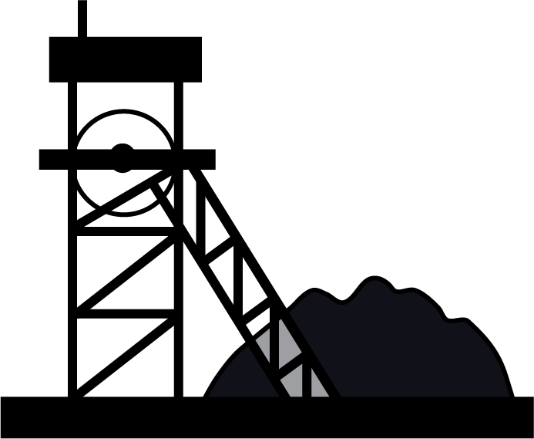

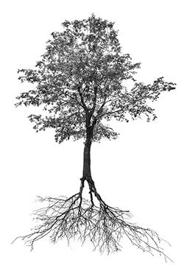
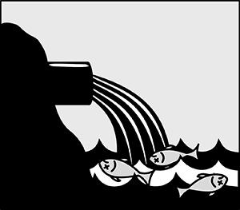
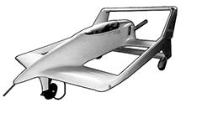
mySci Unit 22 Vocabulary and Glossary (part 2)
NATURAL RESOURCE
materials in Earth’s spheres that are useful to people
RENEWABLE RESOURCE
resources that are replaced by nature faster than they are used
NON-RENEWABLE RESOURCE
resource that is not replaced by nature as fast as it is used
SALTWATER
water that contains a lot of salt (like ocean water)
POLLUTION
adding a harmful or poisonous substance to the environment
SYSTEM
a group of related parts that function together as a whole
PROTOTYPE
a first model or design of something

