Slide 1
The Pennsylvania STEELS Assessment Foundations Toolkit
Module 2: Rigorous Science, Technology & Engineering, Environmental Literacy Sustainability (STEELS) Learning for All Students
[Date]

Slide 2
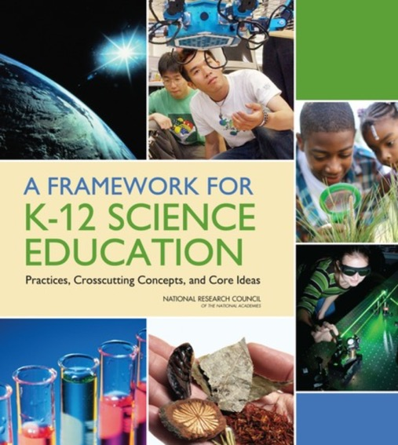

STEELS: Rigorous Learning Goals
In 2022, Pennsylvania adopted the Science, Technology & Engineering, Environmental Literacy Sustainability (STEELS) standards, new learning goals for K–12 students based on research of how kids learn.
Updated PSSA and Keystone exams will be operational in spring 2025 and 2026.

Slide 3
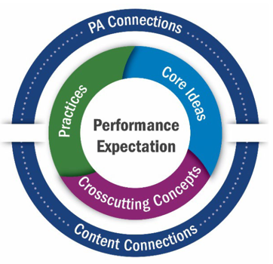
STEELS: Rigorous Learning Goals (continued)
Local Pennsylvania learning contexts
These K–12 standards represent not just what kids learn, but how they learn:
A shift from “learning about” to “figuring out” that puts students in the driver’s seat.
Cross-content connections
Learning about
Figuring out

Slide 4
STEELS Assessment Foundations Toolkit
The three modules in this toolkit will support participants to build a foundation in how to monitor and further student learning of the STEELS standards.
Module 1: Features of Quality STEELS Assessments
Module 2: Assessing Rigorous STEELS Learning for All Students
Module 3: Cultivating a System Where Assessments Work Together to Improve Student Learning

Slide 5
Module 2 Goal
Learn about key features of high-quality and rigorous STEELS-based assessments that allow all students to show what they know in STEELS content areas.

Slide 6
Assessing Rigorous STEELS Learning for All Students
Module 2 Progression
Session 2.1
Session 2.3
Session 2.4
Session 2.2
Phenomena, Multiple Dimensions, and Sense-Making
Assessments That Require Student Reasoning
Assessments That Support All Students
Rigorous Expectations for All Students

Slide 7
Norms: Cultivating a Culture of Caring
Recognize that we all need care at some point, in some way.
Share what you need in order to be cared for well.
Protect your (and other people’s) time to rest.
Practice vulnerability in ways that are reciprocal.
Get to know your colleagues and students.
Make connections between the micro and the macro.
Keep a record of your progress over time.
Honor and recognize the leadership and knowledge of the people indigenous to where you are.
Value insights from those with different backgrounds.
Nurture imagination.
Celebrate.
Adapted from Source: Othering & Belonging Institute, SPA-LC NGSS District Assessment Toolkit
Notes:
See supplement for more details: https://docs.google.com/document/d/1QFzXHdk2n8qdfj_XObgjFEQD_cV3fSZTvzdI19b_58I/edit?usp=sharing

Slide 8
Create Your Workspace
What could set you up to do your best learning, collaborating, and thinking in this context?
How do you want your workspace arranged today?
What resources do you want to have pulled up?
Source: SPA-LC NGSS District Assessment Toolkit

Slide 9
Assessing Rigorous STEELS Learning for All Students – Session 2.1
Module 2 Progression
Session 2.1
Session 2.3
Session 2.4
Session 2.2
Phenomena, Multiple Dimensions, and Sense-Making
Assessments That Require Student Reasoning
Assessments That Support All Students
Rigorous Expectations for All Students

Slide 10
Vision for STEELS Teaching and Learning
It’s important that assessments measure what we value for all learners.
Students as “doers” engaging as scientists and engineers
Critical thinking
All students
Flexible, creative reasoning
Figuring out the world around them
Relevant and authentic
Solving local community problems
Working in new contexts
Motivated, engaged, inspired students
Prepared for college, careers, and citizenship

Slide 11
Themes
Phenomena and Problems
Sense-making / reasoning
Multi-Dimensional
Phenomena (observable events) and problems (situations somebody wants to change) as context for learning

Slide 12
Themes (continued)
Phenomena and Problems
Sense-making / reasoning
Multi-Dimensional
Students engage in practices with core ideas in each discipline and crosscutting concepts as tools for thinking

Slide 13
Themes – Session 1.1
Phenomena and Problems
Sense-Making / Reasoning
Multi-Dimensional

Slide 14




Vision
What does it look like when students are sense-making?
What are the students doing?

Slide 15
A Working Definition
Sense-Making:
The application of reasoning (to generate evidence, support/refute claims, consider the validity of presented ideas) to connect ideas that have been previously learned to a new phenomenon or problem.
Source: SPA-LC NGSS District Assessment Toolkit

Slide 16
Dimensions, Phenomena/Problems, and Sense-Making
Individually, develop an initial model to explain your current thinking about the relationship between the multiple dimensions, phenomena/problems, and sense-making.
Your model should show:
Key components
Relationships between the components
Adapted from: SPA-LC NGSS District Assessment Toolkit

Slide 17
Dimensions, Phenomena/Problems, and Sense-Making (continued)
Individually, develop an initial model to explain your current thinking about the relationship between the multiple dimensions, phenomena/problems, and sense-making.
Share your model with your group, look for similarities and differences.
(Feel free to take notes or revise your individual model.)
Adapted from: SPA-LC NGSS District Assessment Toolkit

Slide 18

Reflection
What are some ways your thinking changed after sharing and discussing your model with your small group?
What are some things you’re still wondering about?

Slide 19
Sense-Making Models
We will be returning to these models at the end of the session to see if we have any revisions to make.

Slide 20

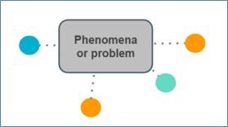
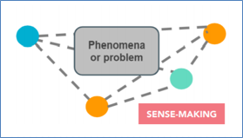
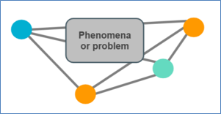
One Model of Sense-Making
Take skills and knowledge
Introduce uncertainty
DCIs
CCCs
Phenomenon or problem
SEPs
TEPs
Make connections
Figure out something new
Phenomenon or problem
Phenomenon or problem
Source: Task Annotation Project for Science (TAPS), nextgenscience.org

Slide 21
Assessing Rigorous STEELS Learning for All Students – Session 2.2
Module 2 Progression
Session 2.1
Session 2.3
Session 2.4
Session 2.2
Phenomena, Multiple Dimensions, and Sense-Making
Assessments That Require Student Reasoning
Assessments That Support All Students
Rigorous Expectations for All Students

Slide 22
Themes – Session 2.2
Phenomena and Problems
Sense-Making / Reasoning
Fair and Equitable
Multi-Dimensional

Slide 23



We Have Two Tasks with the Same Scenario: Survivors Stranded!
You and a group of survivors were stranded after your plane crashed near a remote island off the coast of New Zealand.
Water is necessary for human survival; however, the only water available is saltwater from the ocean.
While humans can safely ingest small amounts of salt, the salt content in seawater is much higher than what can be processed by the human body. Eventually the body will dehydrate and shut down.

Slide 24
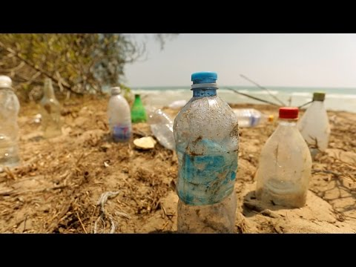
Survivors Stranded
This survival expert recommends you use a solar still made from plastic bottles washed up on the shore.
Source: Discovery, How to Desalinate Water on a Desert Island, YouTube
Notes:
https://www.youtube.com/watch?v=rUET3PnPZng&feature=youtu.be

Slide 25
Is This Sense-Making?
Take Version A and Version B as a student would.
After you complete each task, reflect:
When in the task did you feel like you were making sense of something rather than sharing rote memorization of science ideas?
Why?
Notes:
When did you use at least two dimensions to respond to a prompt?
What did it look like when you needed the scenario info to respond to the prompts?

Slide 26
Small Group Discussion
When in the task did you feel like you were making sense of something? What role did the multiple dimensions play in your sense-making?
How was the task scenario used in your sense-making?

Slide 27
Debrief
What are characteristics of tasks that support multi-dimensional sense-making?

Slide 28
Sense-Making Key Point
Requiring students to figure something out is a central feature that distinguishes tasks that represent the vision of the STEELS standards from more traditional expectations in STEELS content areas.
While tasks that do not regularly require sense-making can often provide a helpful window into specific ideas and skills students are developing, making a claim or inference about proficiency of STEELS requires tasks that elicit student sense-making.

Slide 29
Continuum Reflection: Sense-Making
Most can be completed using rote memorization of science ideas
Requires students to use multi-dimensional sense-making
Think of the assessments your students interact with. Where do they fall on this continuum right now?

Slide 30
Assessing Rigorous STEELS Learning for All Students – Session 2.3
Module 2 Progression
Session 2.1
Session 2.3
Session 2.4
Session 2.2
Phenomena, Multiple Dimensions, and Sense-Making
Assessments That Require Student Reasoning
Assessments That Support All Students
Rigorous Expectations for All Students

Slide 31

Reaching All Students
In your experience, who are the students who are most likely to feel left out of our vision?

Slide 32

Student Gallery Walk
Please visit the student profiles around the room. On separate sticky notes, write:
Potential barriers that prevent the student from feeling challenged, supported, and connected to the culture of science.
Represent information in ways the student is not able to understand
Think about barriers that:
Prevent student engagement in learning
Prevent the student from expressing ideas
The unique knowledge, experiences, or perspectives they bring to the table that could be leveraged in science.

Slide 33

Equity in Science Education
Equity in science education requires that all students are provided with equitable opportunities to learn science and become engaged in science and engineering practices; with access to quality space, equipment, and teachers to support and motivate that learning and engagement; and adequate time spent on science. In addition, the issue of connecting to students’ interests and experiences is particularly important for broadening participation in science.
— NRC Framework, p. 28

Slide 34
Equity in Science Education (continued)
Equity in science education requires that all students are provided with equitable opportunities to learn science and become engaged in science and engineering practices; with access to quality space, equipment, and teachers to support and motivate that learning and engagement; and adequate time spent on science. In addition, the issue of connecting to students’ interests and experiences is particularly important for broadening participation in science.
— NRC Framework, p. 28

Slide 35
Equitable Tasks Go Beyond Limiting Bias
They help monitor student progress while building students up.
They acknowledge that the diverse ways students interact with tasks influences how they show what they understand.
They intentionally support all learners in making their thinking visible.
What does this look like in practice?

Slide 36
Back to Our Task
You and a group of survivors were stranded after your plane crashed near a remote island off the coast of New Zealand.
Water is necessary for human survival; however, the only water available is saltwater from the ocean.
While humans can safely ingest small amounts of salt, the salt content in seawater is much higher than what can be processed by the human body. Eventually the body will dehydrate and shut down.

Slide 37
Examine Survivors Stranded Versions A and B
1–2 ways you could improve it to better engage that student
Think of a student
Examine Survivors Stranded Version A and Version B and identify for each:
1–2 strengths for engaging that student
One you know and care about or a student profile from this session
Be prepared to share

Slide 38


Give One to Get One
Find a partner
Each share a feature you identified that would help your student
Find a new partner and share again
In a whole group share out, be prepared to share an equitable feature you learned from a partner.

Slide 39
Example Features
Real-world relevance: Find ways for students to make connections to their experiences or something they care about (often through phenomena and problems)
Multiple ways for students to respond to the task and show what they know (text, develop models, verbally)
Scaffolds (e.g., model checklist, word bank, sentence starters) to support students to show what they know relative to grade-level assessment targets, not lowered expectations
Builds student confidence with science and engineering by allowing students to show what they do know (rather than limited right/wrong answer options) and make choices
Multiple ways for students to receive information they need to complete the task
Clarity: The task is concise and coherent with easy-to-understand words

Slide 40
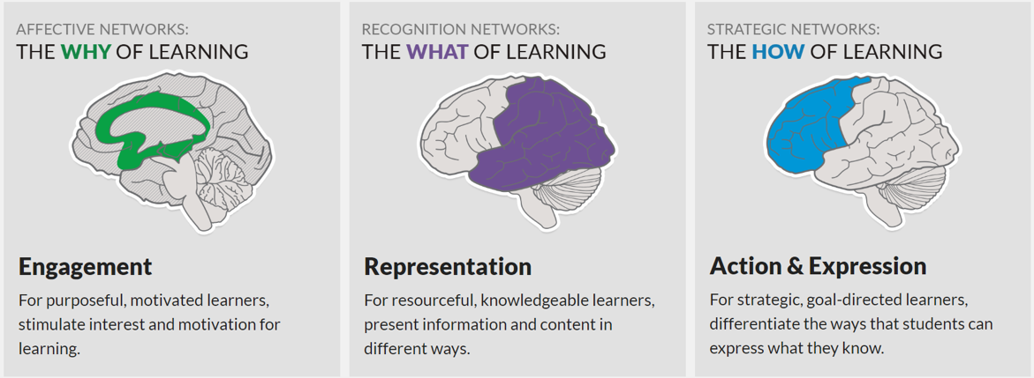
Universal Design for Learning (UDL)
UDL is a framework to improve and optimize teaching and learning for all people based on scientific insights into how humans learn.
Phenomena / problems motivate the need to complete the task
Multiple ways to receive information needed to complete task
Multiple ways to respond to the task

Slide 41
Claim, Evidence, Reasoning Reflection
Which version of Survivors Stranded was more equitable and accessible to students? Why?
Claim | Evidence | Reasoning
Version X is a more equitable and accessible task than Version Y. | Version X has features A, B, and C that Version Y does not have. | Features A, B, and C can help students show what they know and can do.

Slide 42
Continuum Reflection: Fair and Equitable
Presents barriers that prevent students from being able to demonstrate understanding
Fair and equitable for all students
Think of the assessments your students interact with. Where do they fall on this continuum right now?

Slide 43

Action Item
Write down at least one action item or next step for yourself.

Slide 44
Assessing Rigorous STEELS Learning for All Students – Session 2.4
Module 2 Progression
Session 2.1
Session 2.3
Session 2.4
Session 2.2
Phenomena, Multiple Dimensions, and Sense-Making
Assessments That Require Student Reasoning
Assessments That Support All Students
Rigorous Expectations for All Students

Slide 45

Quick Write
How would you describe “rigor” in your own words?
What are some tools you’ve used to measure rigor (i.e., depth of knowledge or cognitive complexity) and how have you used them in your role?

Slide 46
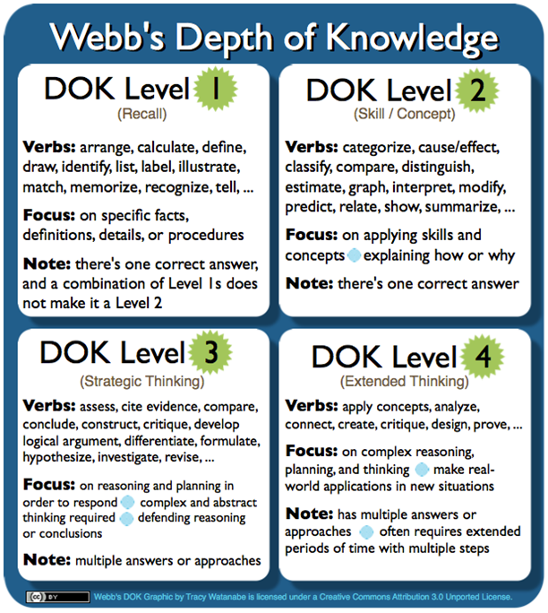
Depth of Knowledge (DOK) / Rigor
The field commonly uses Webb's DOK Levels to measure cognitive complexity / rigor.
In this framework design, how do students move from Level 1 to Level 4 knowledge?

Slide 47
Vote: Version A or Version B
In the last session, which version of the Survivors Stranded task had more equitable features?
Let's take one more look:
Which one is more rigorous?

Slide 48
Depth of Knowledge (DOK) / Cognitive Complexity
Did students have to master Level 1 before showing what they know and can do in Version B?
If Version B is both more equitable and more rigorous, what are the implications for supporting struggling students?

Slide 49
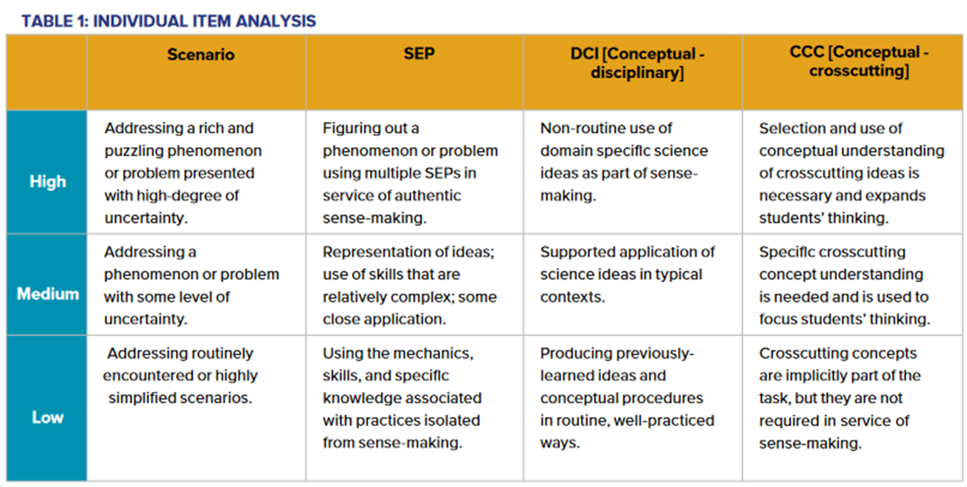
Complexity Framework Focused on Sense-Making
Source: A Framework to Evaluate Cognitive Complexity in Science Assessments, Achieve, 2019. bit.ly/ScienceComplexityFramework

Slide 50
Analyzing Rigor: Version B
Use the table to determine the extent to which students' use of each indicator below supports sense-making in this task.
Scenarios
SEPs
DCIs
CCCs

Slide 51
Continuum Reflection: Rigor
Provide students with scaffolding so they can show what they know of rigorous and grade-appropriate content.
Students memorize vocabulary and facts before engaging in more rigorous content
Think of the assessments your students interact with. Where do they fall on this continuum right now?

Slide 52
Dimensions, Phenomena/Problems, and Sense-Making (cont.)
Earlier in this module, you developed an initial model to explain your current thinking about the relationship between the three dimensions, phenomena/problems, and sense-making.
Let's revise and add in equitable features and rigor.
Adapted from: SPA-LC NGSS District Assessment Toolkit

Slide 53
Revising Models
In your group, develop a consensus model to explain your current thinking about the relationship between the three dimensions, phenomena/problems, sense-making, equitable features, and rigor.
Your model should show:
Key components
Relationships between the components
Adapted from: SPA-LC NGSS District Assessment Toolkit

Slide 54
Debrief Questions
What are the implications when one piece of the model isn't there?
What's one thing that surprised you in a different team's model?
What system-wide policies are in place that result in decreased rigor for some students?
Phenomena and Problems
Sense-Making / Reasoning
Fair and Equitable
Multi-Dimensional
Rigorous

Slide 55
Personal Reflection
What's one area where your ideas changed today?
What do you want to remember most?

Slide 56
STEELS Assessment Foundations Toolkit – Module 3
The three modules in this toolkit will support participants to build a foundation in how to monitor and further student learning of the STEELS standards.
Module 1: Features of Quality STEELS Assessments
Module 2: Assessing Rigorous STEELS Learning for All Students
Module 3: Cultivating a System Where Assessments Work Together to Improve Student Learning

Slide 57
Next Steps

Slide 58
Cultivating a Culture of Caring
Recognize that we all need care at some point, in some way.
Share what you need in order to be cared for well.
Protect your (and other people’s) time to rest.
Practice vulnerability in ways that are reciprocal.
Get to know your colleagues and students.
Make connections between the micro and the macro.
Keep a record of your progress over time.
Honor and recognize the leadership and knowledge of the people indigenous to where you are.
Value insights from those with different backgrounds.
Nurture imagination.
Celebrate.
Share one thing you can celebrate as a result of our time learning together.
Adapted from Source: Othering & Belonging Institute, SPA-LC NGSS District Assessment Toolkit
Notes:
See supplement for more details https://docs.google.com/document/d/1QFzXHdk2n8qdfj_XObgjFEQD_cV3fSZTvzdI19b_58I/edit?usp=sharing

Slide 59
Contact/Mission
For more information on the Science, Technology & Engineering, Environmental Literacy Sustainability (STEELS) assessments, please visit PDE’s website at www.education.pa.gov.
The mission of the Department of Education is to ensure that every learner has access to a world-class education system that academically prepares children and adults to succeed as productive citizens. Further, the Department seeks to establish a culture that is committed to improving opportunities throughout the commonwealth by ensuring that technical support, resources, and optimal learning environments are available for all students, whether children or adults.

