Slide 1


Engineering Design Processes

Slide 2
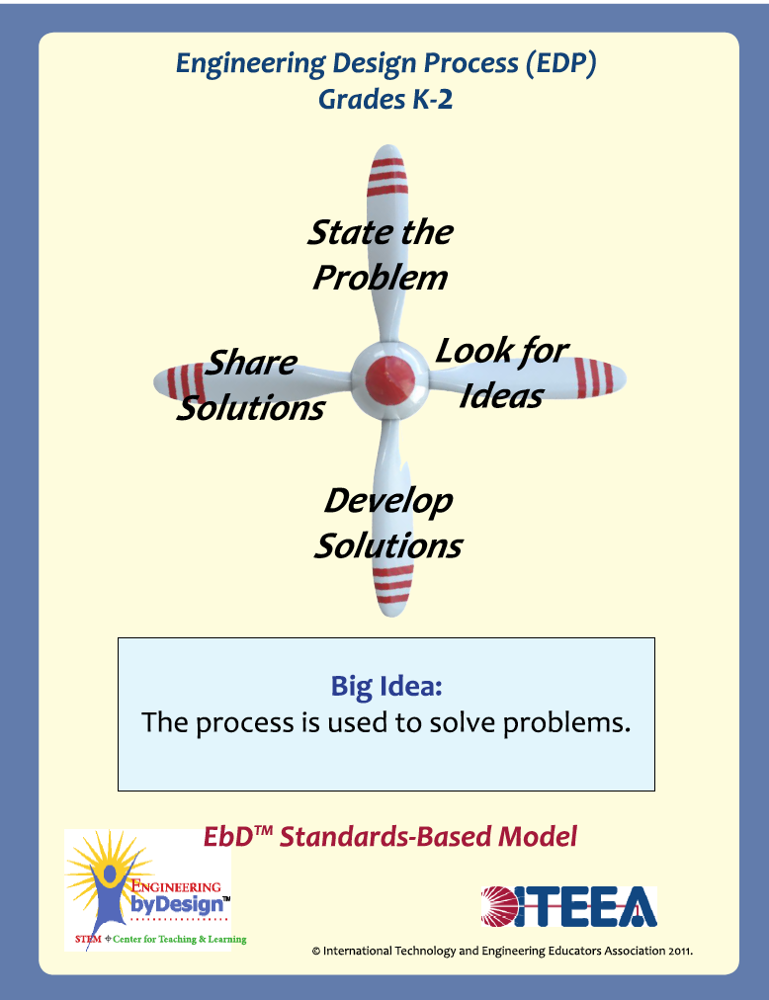
State the Problem
  What is the problem?
  Are there any constraints/restrictions?
  What do we need to solve the problem?
Look for Ideas
  Brainstorming
  Coming up with a variety of solutions to address the problem.
Develop Solutions
  Decide what solution you want to try.
  Create a plan
  Build
Share Solutions
  Share your solution with others.

Slide 3
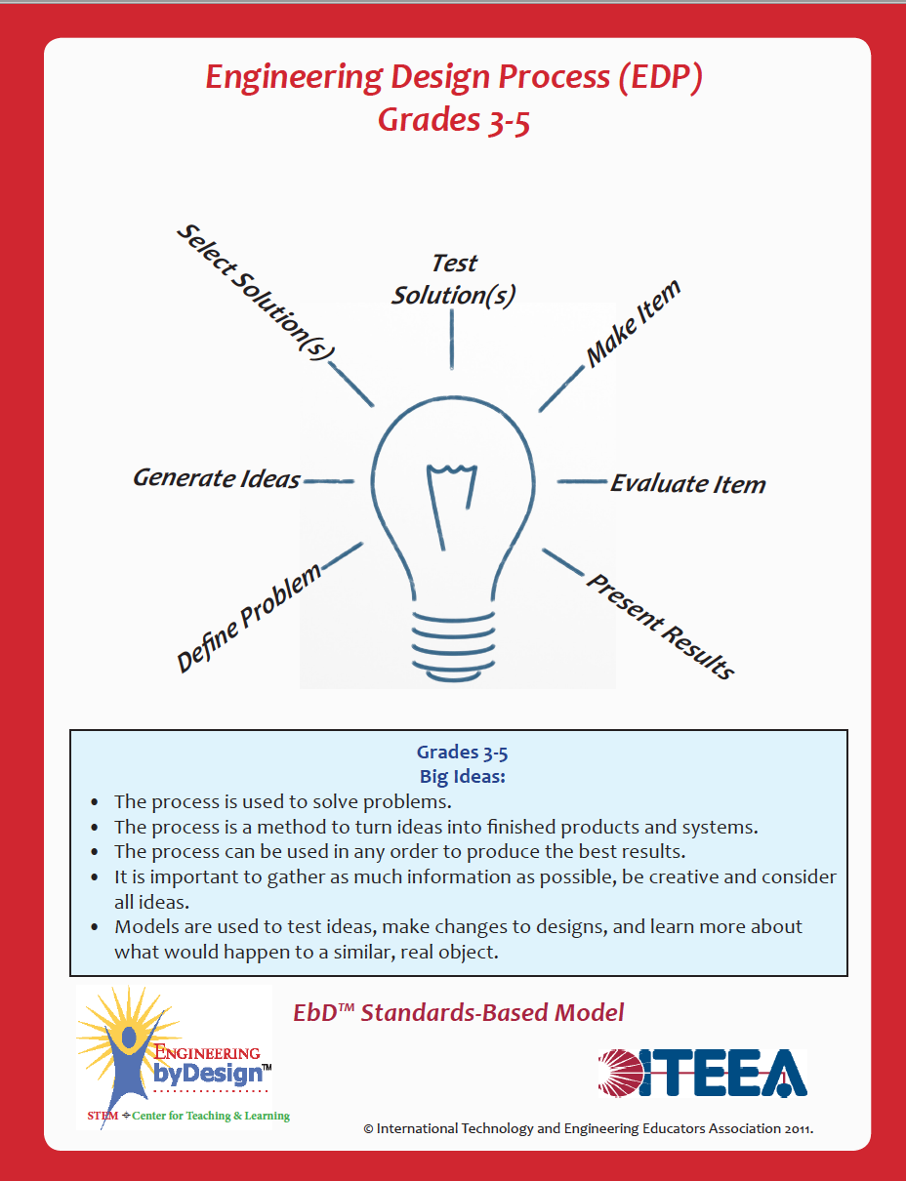
Define Problem
  What is the problem?
  Are there any constraints/restrictions?
  What do we need to solve the problem?
Generate Ideas
  Brainstorming
  Coming up with a variety of solutions to address the problem
Select Solution(s)
  Choose an idea that is best
  Feasibility of design (can you do it?)
  Constraints (time, money, supplies)
Test Solution(s)
  Further development
  Create models
  Create a plan
Make Item
  Build
Evaluate Item
  The good, the bad, and the ugly
  What would you change?
Present Results
  Share your solution with others.

Slide 4
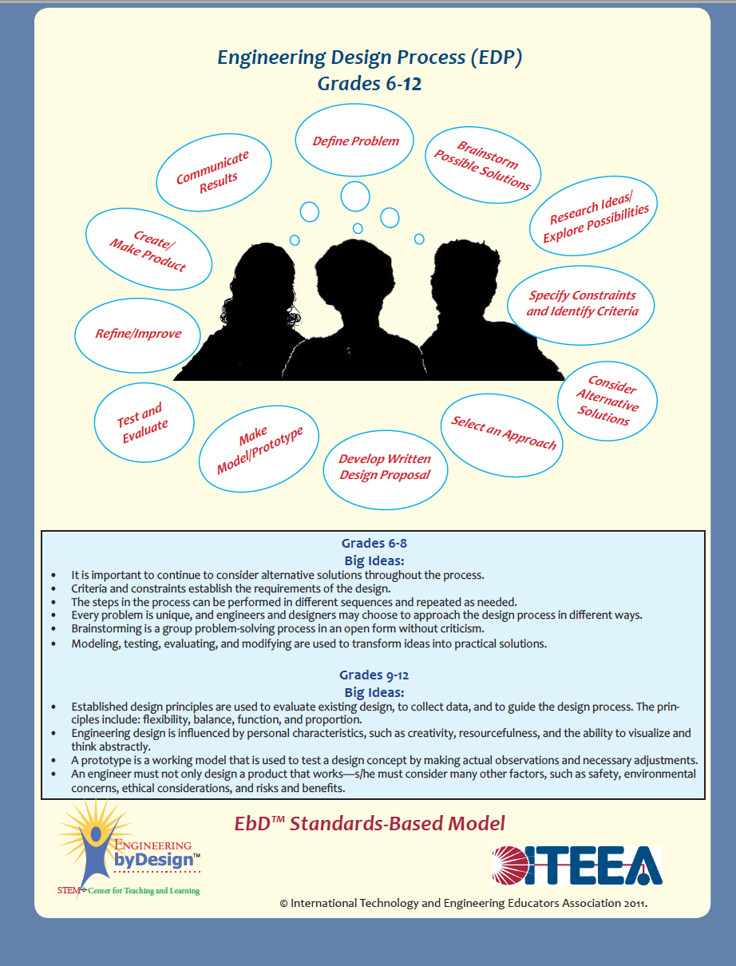
1. Define the Problem
What is the problem you are trying to solve?
Are there any constraints/restrictions?
What do we need to solve the problem?
2. Brainstorm
Develop multiple plausible ideas to solve the problem.
More than one possible solution is required.
3. Research and Generate Ideas
Ideas for possible solutions need to be backed by research.
Create accurate sketches and orthographic drawings of your design concepts.
4. Identify Criteria and Constraints
Restate the criteria clearly.
Identify as many constraints as possible.
5. Explore Possibilities
Analyze the positives and negatives or your possible solutions.
This can lead to a combination of your solutions to create a better solution to the problem.
6. Select an Approach
Select a promising solution based on your analysis, criteria, and constraints.
Make sure your solution can result in a high quality product.
7. Develop a Design Proposal
Develop a presentation to propose your design to classmates and instructor.
Clearly state the problem.
8. List all Criteria and Constraints.
Include, sketches, pictures, and any other information that helps explain your potential solution.
9. Make a Model or Prototype
Create a model or working prototype of your solution.
You can include materials that may NOT be used in the final product to make your prototype easier to construct and/or cheaper.
When creating a model it does NOT need to be functional, just serve to demonstrate the solution.
10. Test and Evaluate the Design
Use the design criteria to develop testing procedures.
The test procedures must provide real-world testing simulations.
Evaluate the test results.
11. Refine the Design
Using the testing results and evaluation make improvements to your design.
Make significant improvements to the design and prototype.
Retest as necessary.
12. Create the Solution
Build the actual product based on your prototype, testing, and refinements.
Make sure the product meets or exceeds design specifications.
Be sure the product has good ergonomics, form, and function.
13. Communicate Process and Results
Refine and update your design proposal to reflect the finished product.
Include pictures, videos, demonstrations of the product.
Show supporting evidence on how the solution meets the criteria and solves the problem. Create documentation of assembly (if applicable), correct use, and troubleshooting of product.

