Slide 1
ACT 158 Statewide Training 2021
Module 3 –
Tracking & Reporting

Slide 2
Agenda
Tracking Tool
Reporting in the FRCPP
Q&A

Slide 3
Act 158 Reporting
Established by Act 158:
  No later than December 1, 2023 (Act 136), and each December 1 thereafter, each school entity shall submit a report to the department which shall be posted by January 15 of each year on the department's publicly accessible Internet website.
Aggregate Totals:
  Total number of students in grade twelve in the previous school year.
  Total number of students who graduated in the previous school year.
  Total number of students who graduated under each pathway.
  Number of students that the chief school administrator granted a waiver.
  Number of students utilizing each type of evidence.

Slide 4
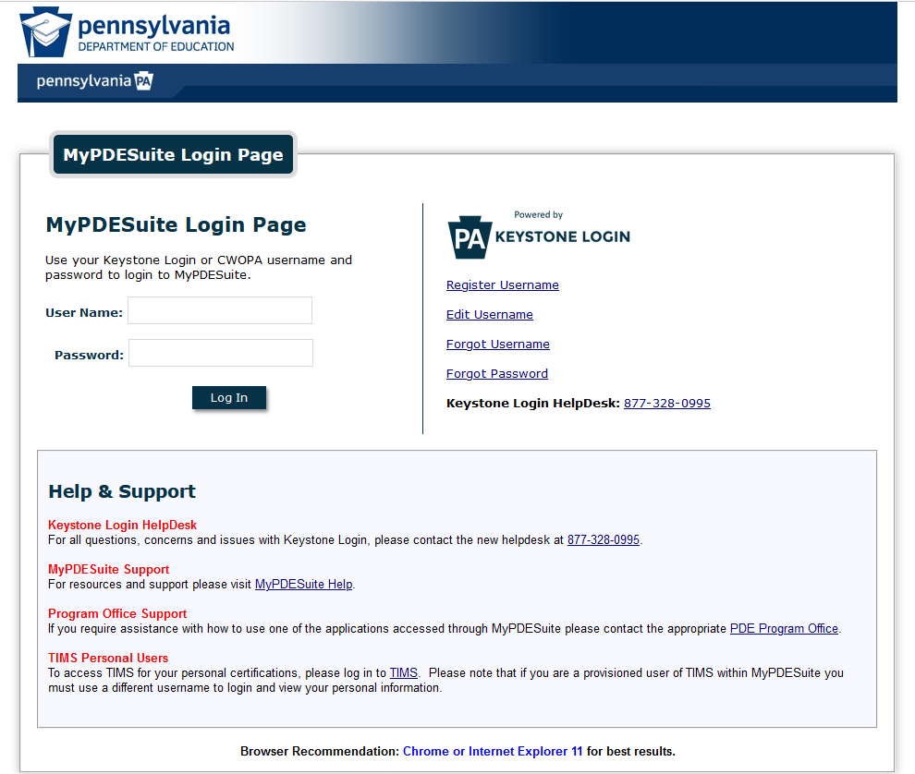
Accessing the Tool

Slide 5
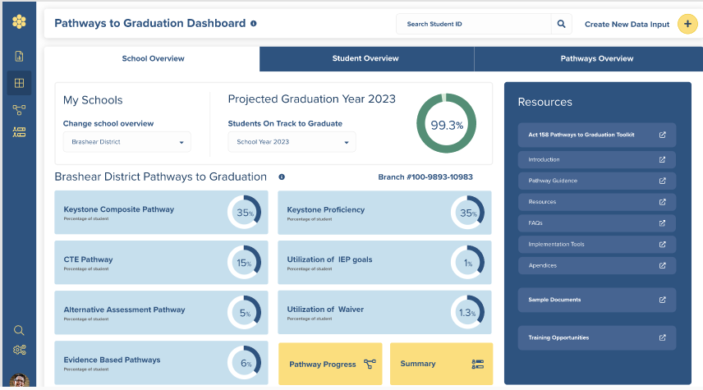
Pathways to Graduation Tool

Slide 6
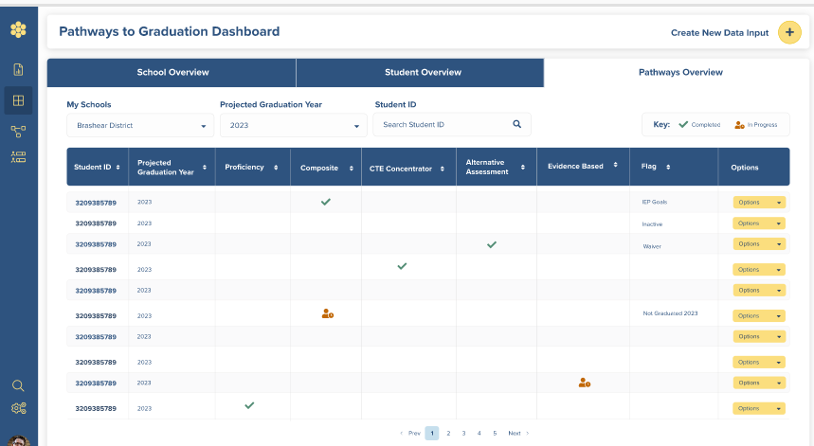
Uploading Student Information

Slide 7
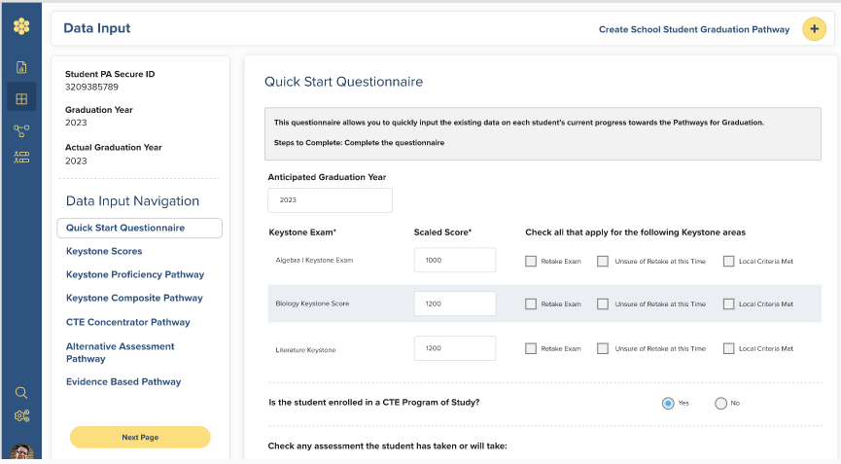
Quick Start Questionnaire

Slide 8
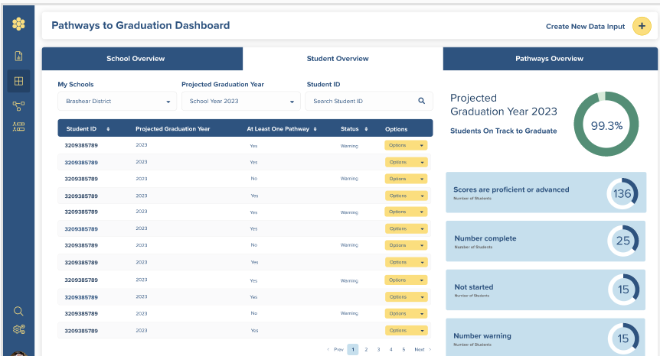
Student Overview

Slide 9
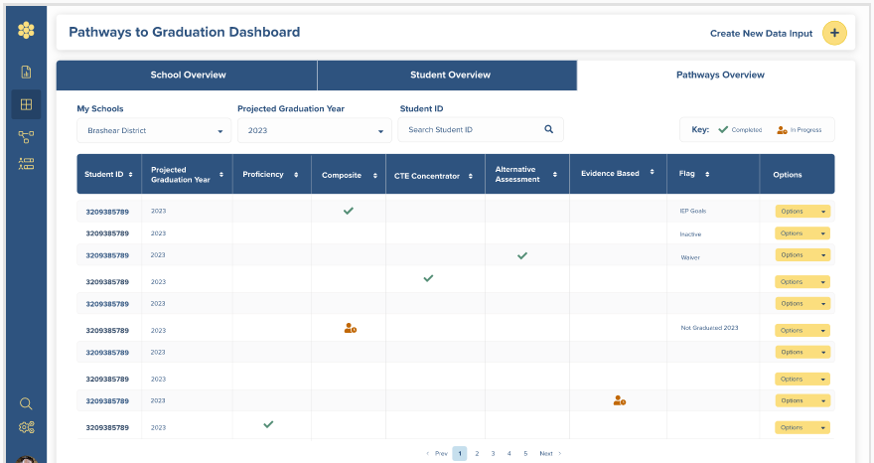
Pathways Overview

Slide 10
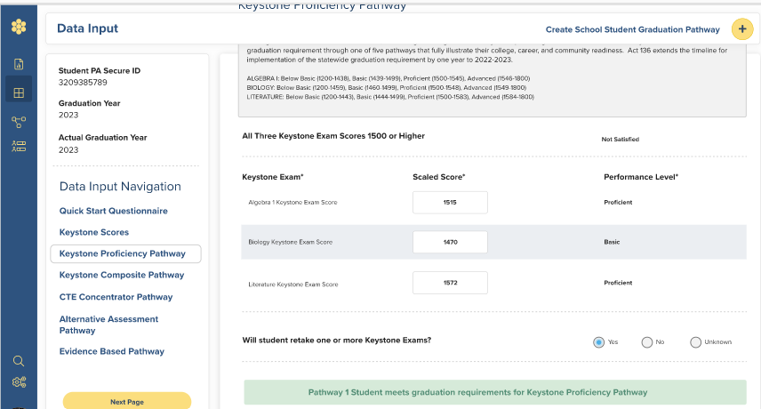
Keystone Proficiency Pathway 2

Slide 11
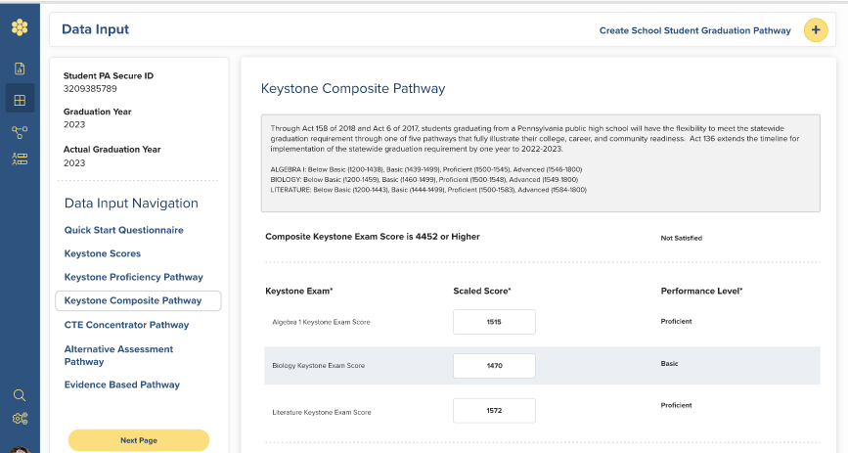
Keystone Composite Pathway 3

Slide 12
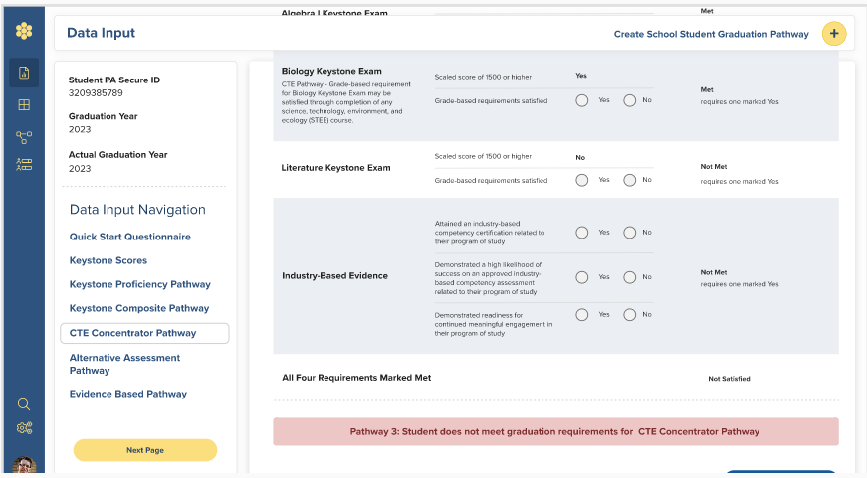
CTE Concentrator Pathway 2

Slide 13
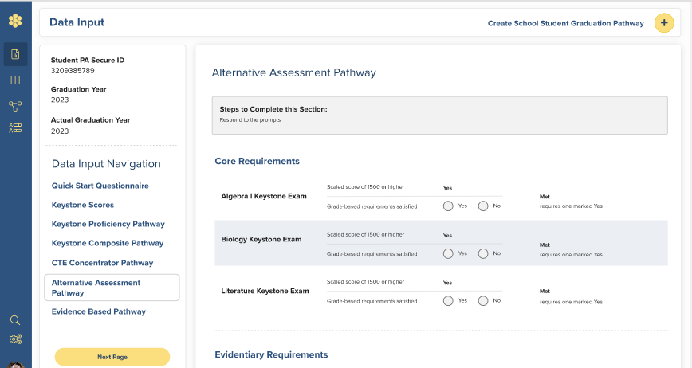
Alternative Assessment Pathway

Slide 14
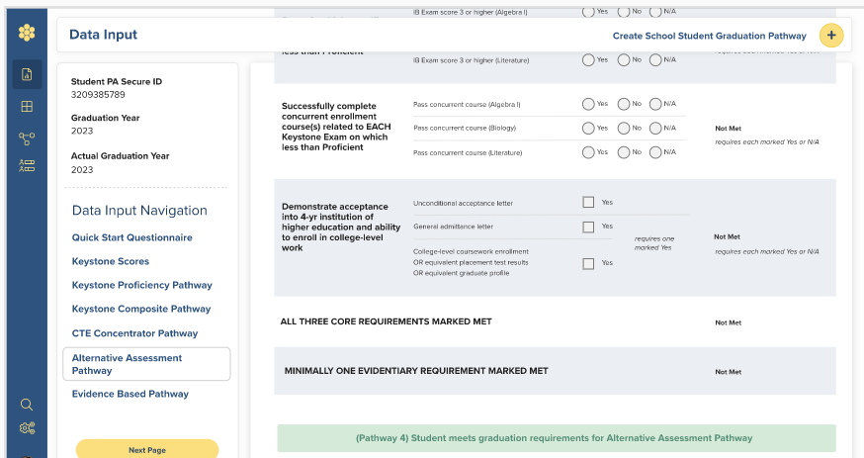
Alternative Assessment Pathway 3

Slide 15
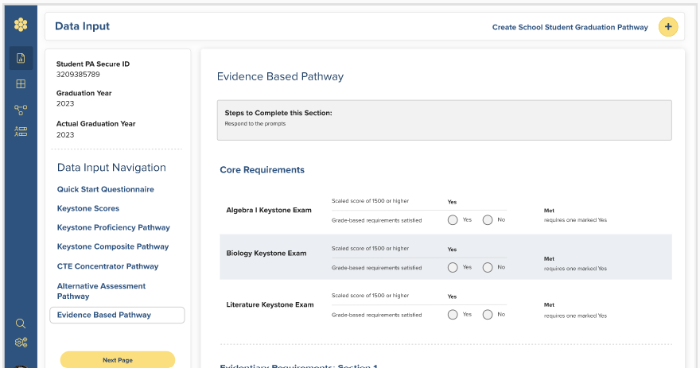
Evidence Based Pathway

Slide 16
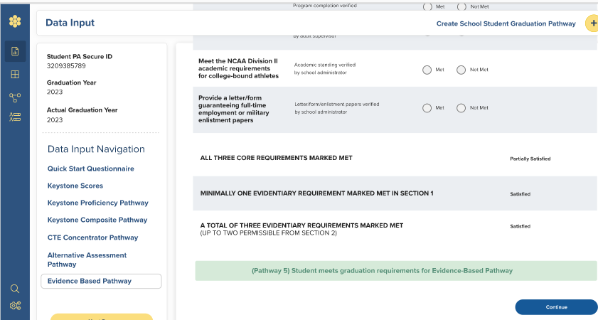
Evidence Based Pathway 5

Slide 17
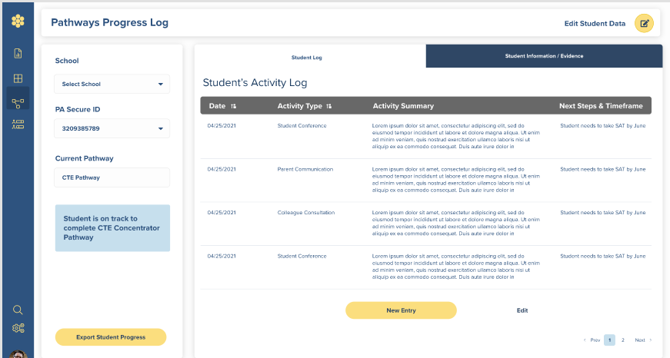
Progress Log

Slide 18
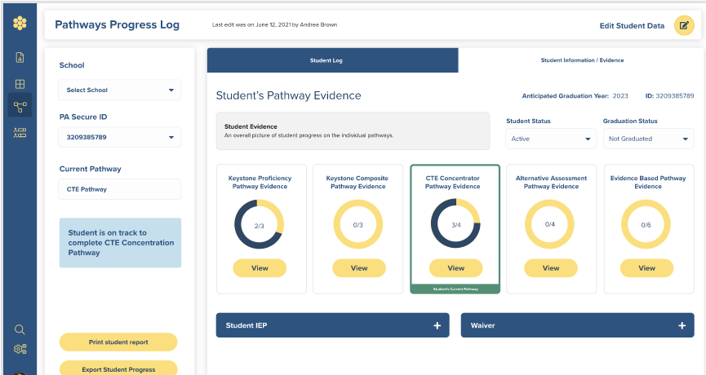
Progress Log 2

Slide 19
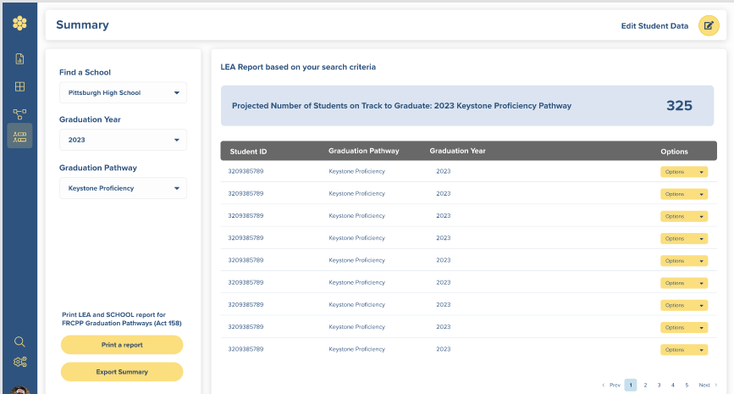
Summary

Slide 20
FRCPP
Reporting in the Future Ready Comprehensive Planning Portal
Open October 1 to December 1 each year, beginning with the reporting for the class of 2023
Technical assistance available at:
ra-edfrcpp@pa.gov

Slide 21

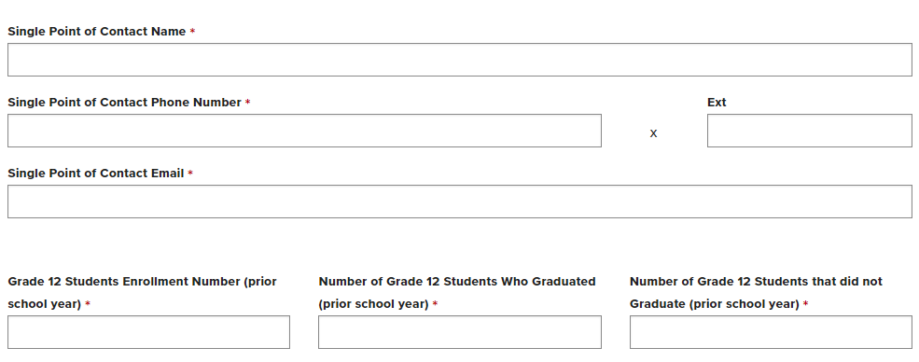
FRCPP 2

Slide 22
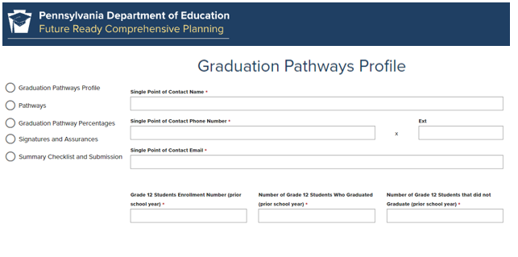
FRCPP 3

Slide 23
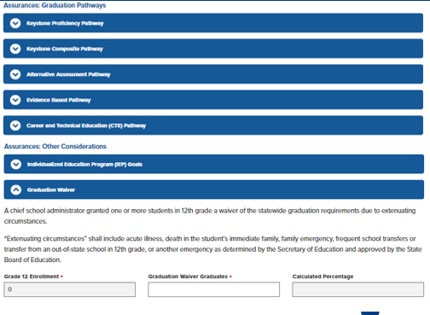
FRCPP 4

Slide 24
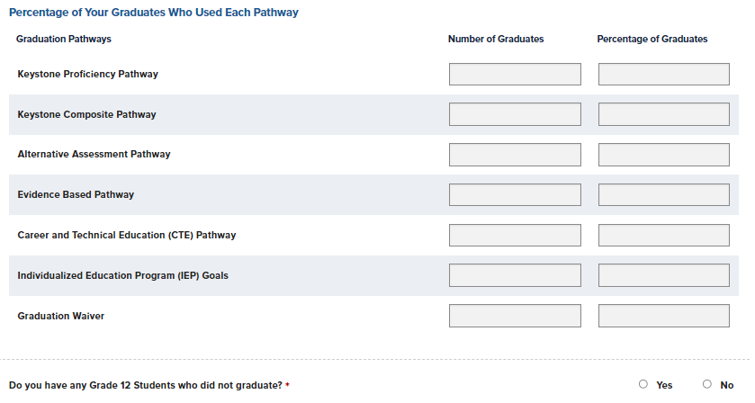
FRCPP 5

Slide 25
Office Hours
ACT 158
Open Office Hours
ZOOM link available on SAS
Wednesdays: 3:00 – 4:00 PM
November 3rd, 17th
December 1st, 15th

Slide 26
Contact/Mission
For more information on Act 158, please visit:
SAS
PDE
Act 158: ra-edgradrequirement@pa.gov
FRCPP: ra-edfrcpp@pa.gov
The mission of the Department of Education is to ensure that every learner has access to a world-class education system that academically prepares children and adults to succeed as productive citizens. Further, the Department seeks to establish a culture that is committed to improving opportunities throughout the commonwealth by ensuring that technical support, resources, and optimal learning environments are available for all students, whether children or adults.

