Slide 1
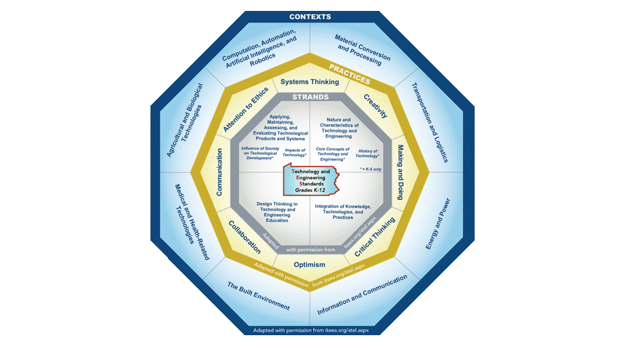
STEELS
Professional Learning Series
Science, Technology & Engineering,
Environmental Literacy & Sustainability
Standards
STEELS
TECHNOLOGY & ENGINEERING
FOUNDATION BOXES
Notes:
This webinar is part of the STEELS Professional Learning Series on the STEELS Hub.
This session will focus on the Technology & Engineering Foundation Boxes.
The foundation boxes are a rich resource for use by educators and curriculum developers during the implementation of the new standards.

Slide 2
Shift in Focus
Increased emphasis on design and design thinking.
Focus on a broader understanding of content as well as application of content.
Students create, utilize, and assess current and emerging technologies by developing and applying the Technology & Engineering practices and disciplinary core ideas in a variety of contexts.
Students practice inquiry, critical thinking, hands-on making and doing, and a focus on learning skills that can be applied throughout their lives, regardless of context.
Notes:
There is a major shift of focus with the new Technology & Engineering standards. (PAUSE)
This shift includes an emphasis on design and design thinking.
A focus on a broader understanding of content as well as application of content.
Students create, utilize, and assess current and emerging technologies by developing and applying the Technology & Engineering practices and disciplinary core ideas in a variety of contexts.
Students practice inquiry, critical thinking, hands-on making and doing, and focus on learning skills that can be applied throughout their lives, regardless of context.

Slide 3
Foundation Box Organization
The Technology & Engineering foundation boxes are organized by:
Grade Band
Standard Coding and Strand
Standard
Clarifying Statement and Assessment Boundary
Science & Engineering Practices
Disciplinary Core Ideas
Technology & Engineering Practices
PA Contexts
Pennsylvania Career Ready Skills
Connections to Other Standards and Practices
Notes:
The Technology & Engineering foundation box documents are organized by:
Grade Band
Standard Coding and Strand
Standard
Clarifying Statement and Assessment Boundary
Science & Engineering Practices
Disciplinary Core Ideas
Technology & Engineering Practices
PA Contexts
Pennsylvania Career Ready Skills and
Connections to Other Standards and Practices

Slide 4
Foundation Box Organization
PA Standards are performance expectations
All standards are multi-dimensional
Technology & Engineering Foundation Boxes include:
Alignment to the Science and Engineering Practices
Alignment to Disciplinary Core Ideas
Technology & Engineering Practices
Notes:
All of the Technology & Engineering standards are performance expectations that define what students know or can do.
All standards are multi-dimensional and are comprised of components. This is reflected in the foundation boxes.
For Technology & Engineering these components include:
Alignment to the Science and Engineering Practices
Alignment to Disciplinary Core Ideas
And Technology & Engineering Practices
These components are part of the standards as well as Technology & Engineering Contexts.
Contexts are not defined within the foundation boxes due to varying classrooms and laboratories in Pennsylvania and the standards can be applied in any or all of the contexts.

Slide 5
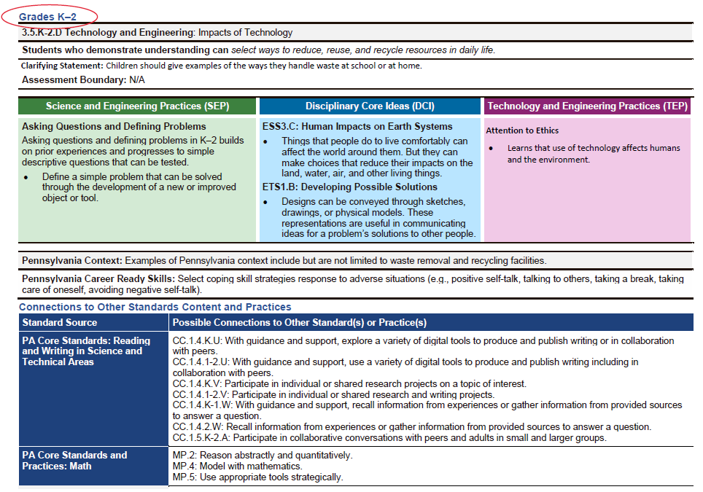
Grade Band
Notes:
This is an example of a Technology & Engineering foundation box. Each standard has a foundation box.
The Grade Band is circled on this slide indicating it is a Grade K-2 standard.

Slide 6
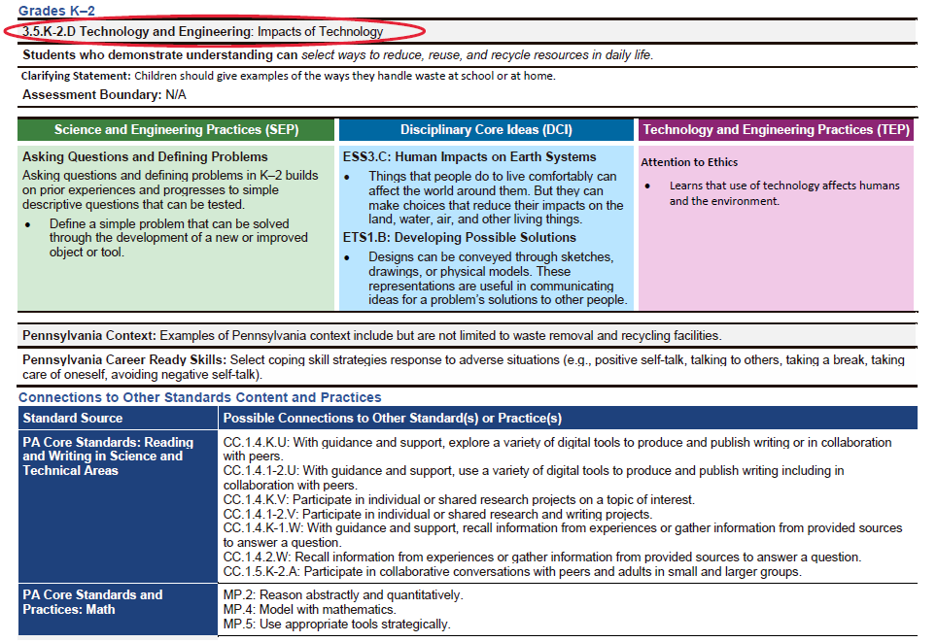
Standard Coding and Strand
Notes:
As we navigate down the foundation box, the coding, content area, and standard are listed. For this standard, The first digit (3) represents the content (T&E, Science, or ELS).
The second digit is the discipline. 5 represents Technology & Engineering.
The third number represents the grade band. For this example the grade band is K-2.
And the fourth character represents the standard: D.
Also included on this line is the name of the content area (Technology & Engineering for this example), and the strand the standard falls within, which is Impacts of Technology.

Slide 7
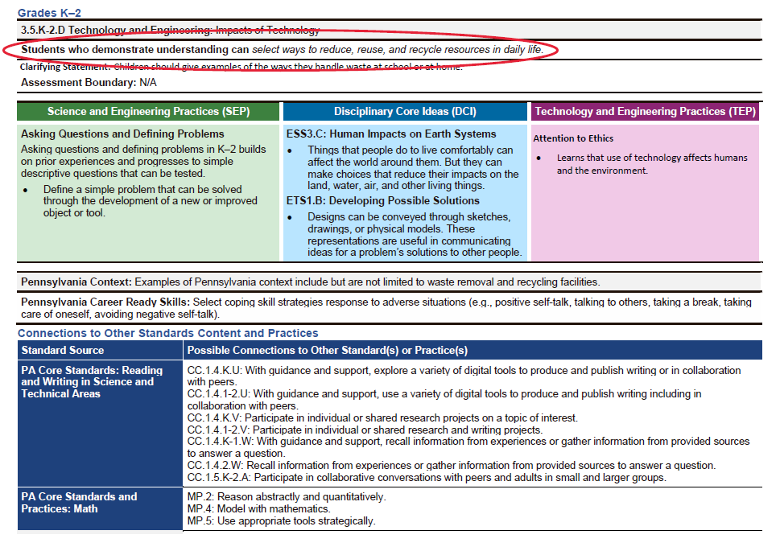
Standard
Notes:
The next line of the foundation box displays the standard.
This standard is looking at students who demonstrate understanding who can select ways to reduce, reuse, and recycle resources in daily life.

Slide 8
K-2 Technology & Engineering Standard
Students who demonstrate understanding can select ways to reduce, reuse, and recycle resources in daily life.
Each standard includes:
Disciplinary Core Ideas (aligned to NGSS, the National Assessment for Educational Progress Technology and Engineering Literacy Framework, and ISTE)
Alignment to the Science and Engineering Practices
Alignment to Disciplinary Core Ideas
Technology & Engineering Practices
Notes:
The way that this is stated in the standard, is that it includes multiple dimensions (or components) and the foundation box provides alignment to additional components or dimensions.
So students who demonstrate an understanding, can select ways to reduce, reuse, and recycle resources in daily life. In this example, while the students are selecting ways to reduce, reuse, and recycle, they are using the Technology & Engineering Practice of Attention to Ethics where they are learning that the use of technology affects humans and the environment.
Reduce, reuse, and recycle resources in daily life is the content.
As I will show on the later slides, the Technology & Engineering foundation boxes also provide alignment to the Science and Engineering Practices.

Slide 9
Clarifying Statement and Assessment Boundary
Notes:
Below the standards, are clarifying statements and assessment boundaries.

Slide 10
Clarifying Statement and Assessment Boundary
Clarifying Statements supply examples or additional clarification and emphasis to the language of the performance expectations.
Assessment Boundaries specify limits to large-scale assessment. They are not meant to put limits on what can be taught or how it is taught, but to provide guidance to assessment developers.
Notes:
The clarifying statement give examples or more ideas to help us understand what the expectation of the standard is.
The assessment boundaries are generally looked at as for those people or individuals that are looking at large scale assessment. Assessment boundaries are not defined for the Technology & Engineering Standards.

Slide 11
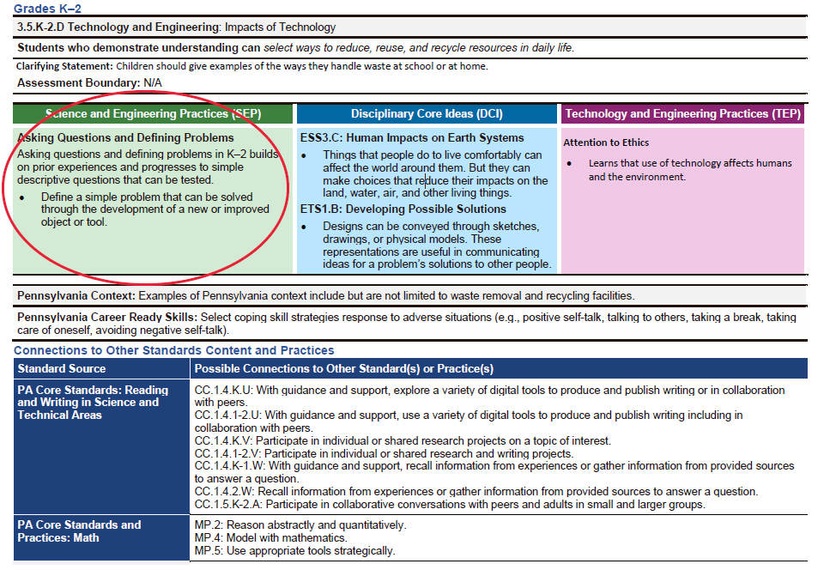
Science & Engineering Practices (SEP)
Notes:
Underneath the assessment boundaries, alignment to the Science and Engineering Practices is displayed.
For this standard, alignment to the Science and Engineering Practice of Asking Questions and Defining Problems has been made.

Slide 12
Science & Engineering Practices (SEP)
Asking questions (for science) and defining problems (for engineering)
Developing and using models
Planning and carrying out investigations
Analyzing and interpreting data
Using mathematics and computational thinking
Constructing explanations (for science) and designing solutions (for engineering)
Engaging in argument from evidence
Obtaining, evaluating, and communicating information
Notes:
Of the 8 Science and Engineering Practices that you see here, alignment has been made for this standard to the practice of Asking Questions and Defining Problems. This is the primary Science and Engineering Practice for this particular standard even though students may be using other practices on their way to achieving a standard.

Slide 13
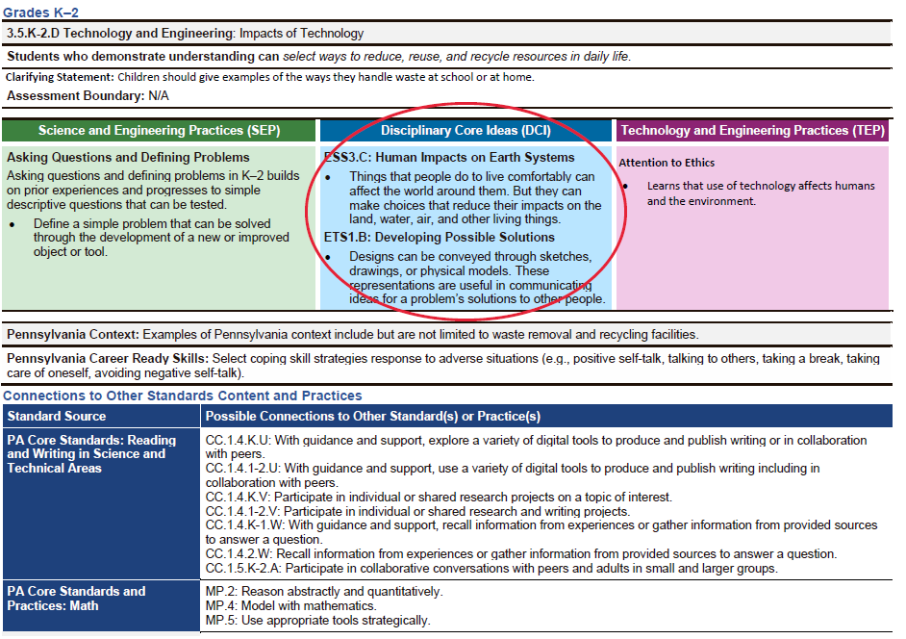
Disciplinary Core Ideas (DCI)
Notes:
The next box is the Disciplinary Core Ideas. This gives a brief description of aligned content (the disciplinary core idea) in the standard.
For Technology & Engineering, the Disciplinary Core Ideas are to aligned to NGSS, the National Assessment for Educational Progress Technology and Engineering Literacy Framework, and ISTE.

Slide 14
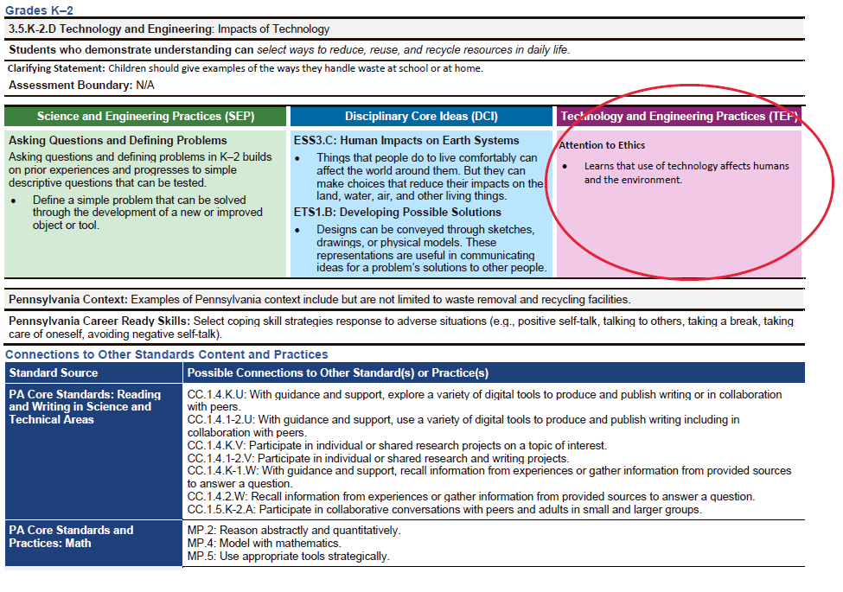
Technology & Engineering Practices (TEP)
Notes:
The third box contains the Technology & Engineering Practices.
The practices were adapted from the 21st Century Skills and from the research on Engineering Habits of Mind.
The practices are student centered and reflect the knowledge, skills, and dispositions students need in order to successfully apply the standards in different context areas.

Slide 15
Technology & Engineering Practices (TEP)
Systems Thinking
Creativity
Making and Doing
Critical Thinking
Optimism
Collaboration
Communication
Attention to Ethics
Notes:
Of the 8 Technology & Engineering Practices that you see here, Attention to Ethics is the primary practice identified within the foundation box.
This is the primary Technology & Engineering Practice for this particular standard even though students may be using other practices on their way to achieving a standard.

Slide 16
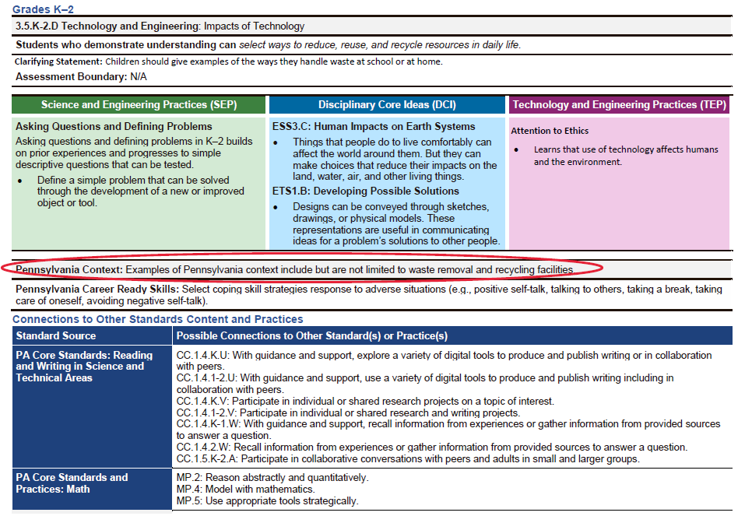
PA Context
Notes:
The next section of the foundation boxes is the Pennsylvania Context.
The provided contexts serve to make the standards more relevant to students regardless of their location in our commonwealth.

Slide 17
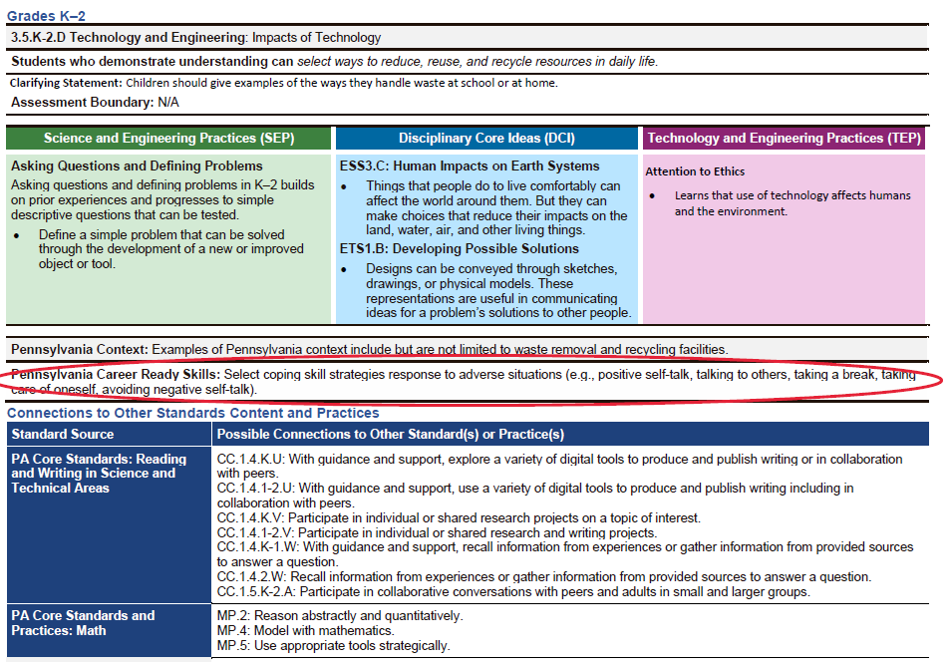
Pennsylvania Career Ready Skills
Notes:
Continuing down the foundation box, Pennsylvania Career Ready Skills aligned to this standard are identified.
These skills include social emotional learning progressions that support the development of student competence.

Slide 18
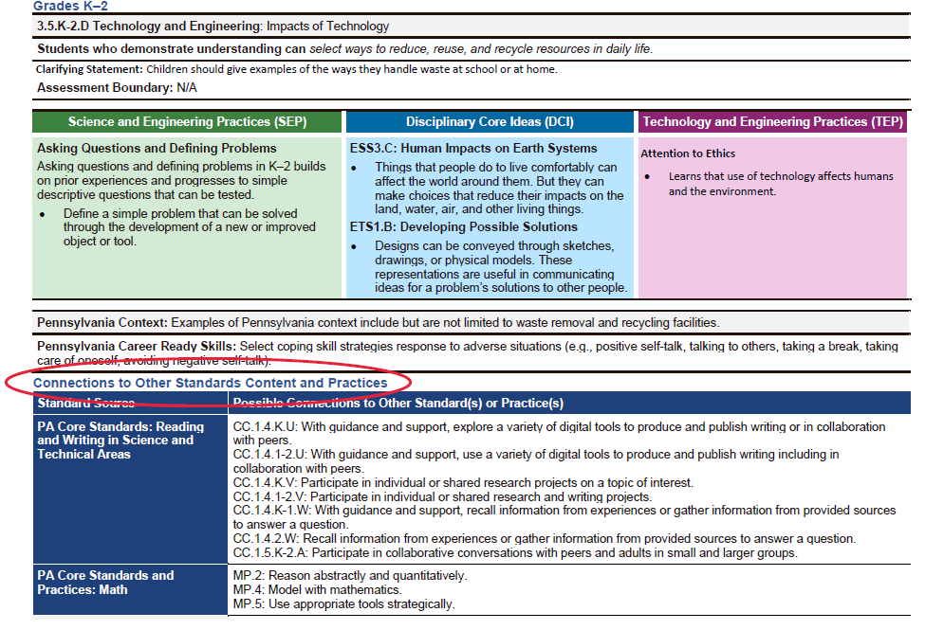
Connections to Other Standards and Practices
Notes:
And lastly, Connections to Other Standards Content and Practices connection boxes are provided to support interdisciplinary connections and integration.

Slide 19
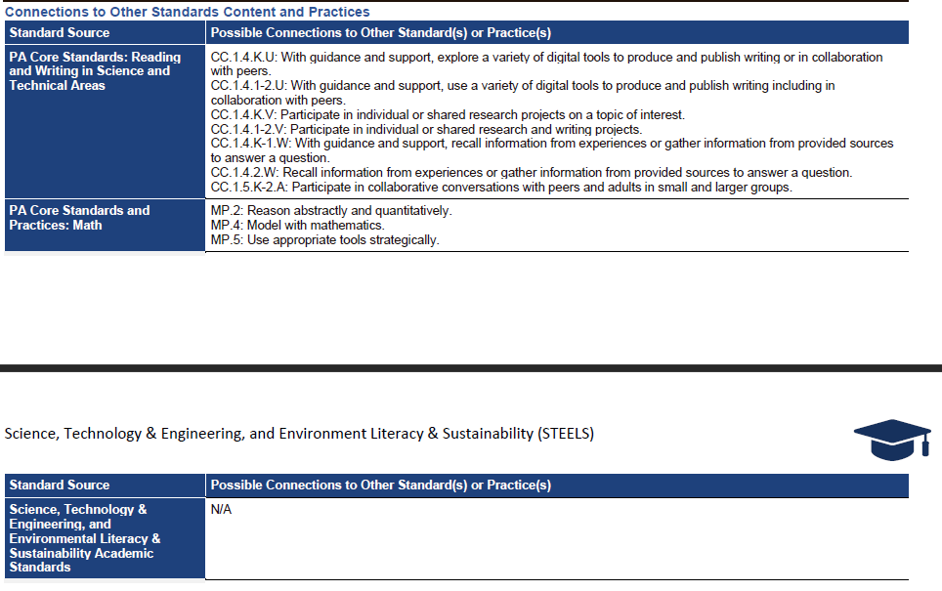
Connections to Other Standards and Practices
Notes:
Educators can use these connections to reinforce student learning by emphasizing experiences in multiple content areas and contexts to support authentic learning.
The foundation boxes provide a rich resource to be used when developing curriculum and to teach the Technology & Engineering standards with fidelity.

Slide 20
Contact/Mission
For more information, please visit the STEELS Hub on SAS.
The mission of the Department of Education is to ensure that every learner has access to a world-class education system that academically prepares children and adults to succeed as productive citizens. Further, the Department seeks to establish a culture that is committed to improving opportunities throughout the commonwealth by ensuring that technical support, resources, and optimal learning environments are available for all students, whether children or adults.
Notes:
For more information, please visit the STEELS Hub on SAS. If you have any questions, please reach out to the Pennsylvania Department of Education and we will be sure to address your needs. Thank you.

