Slide 1
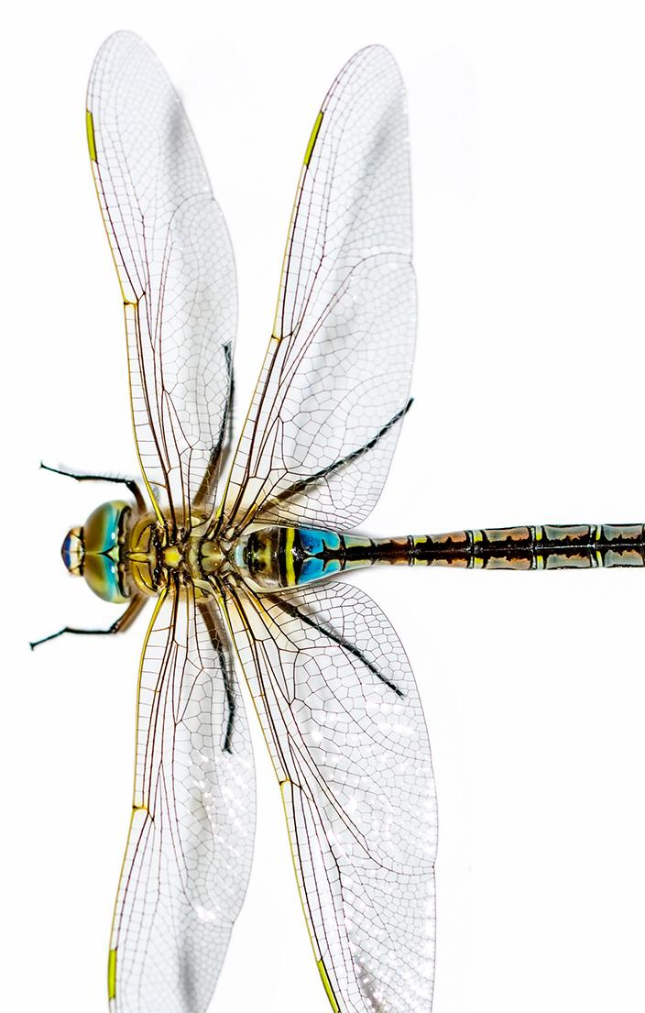



Unit 22: Lesson 8
Unit 22: Lesson 8
How can we use farms to harness wind energy?
Explore: Wind Turbine Design
and Performance

Slide 2
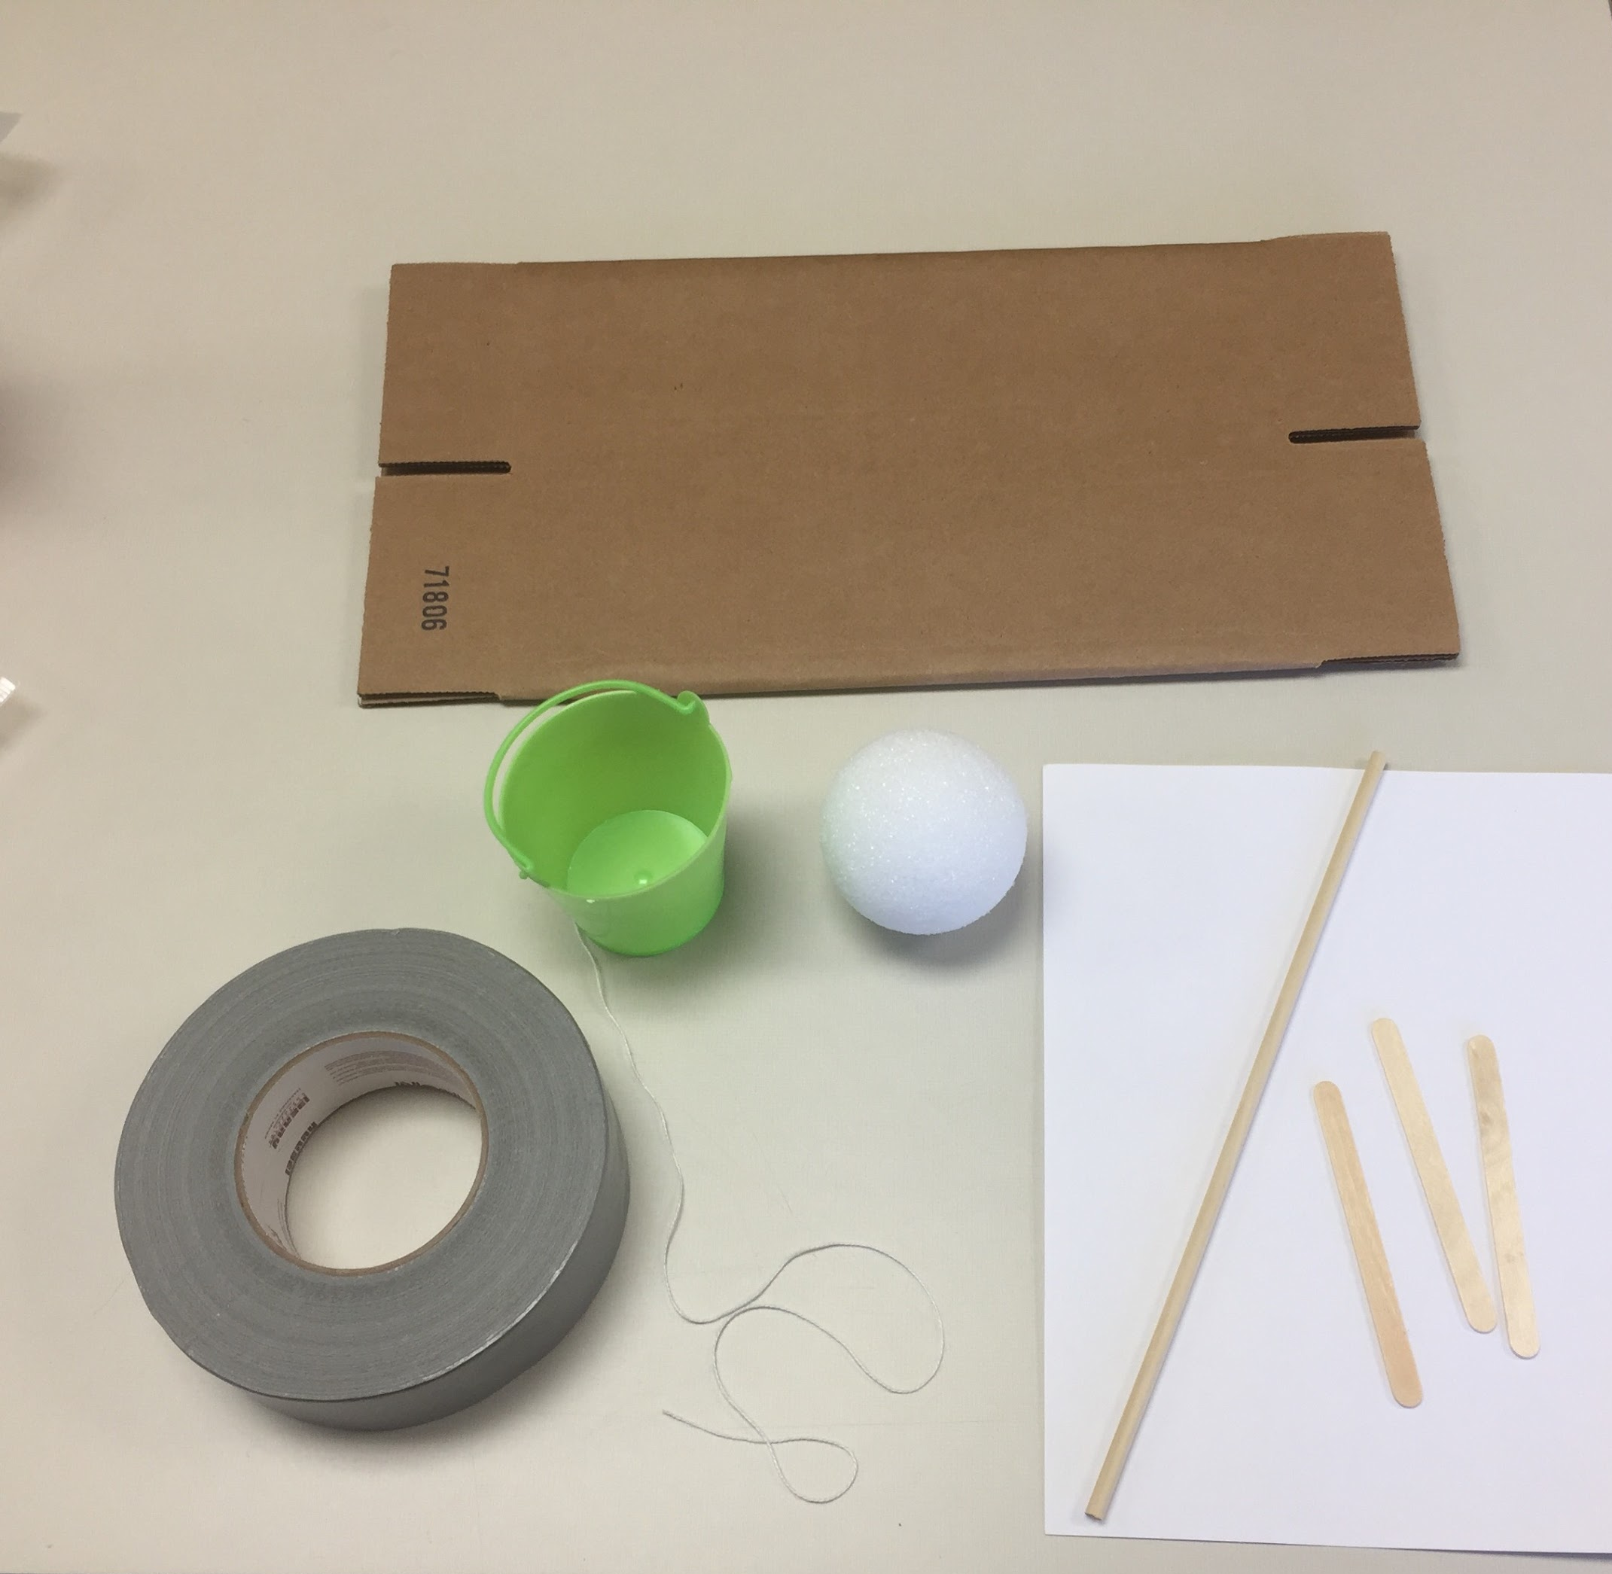
Teacher’s Notes
Teacher notes:
Here are the materials that students will use to build the wind turbine.

Slide 3
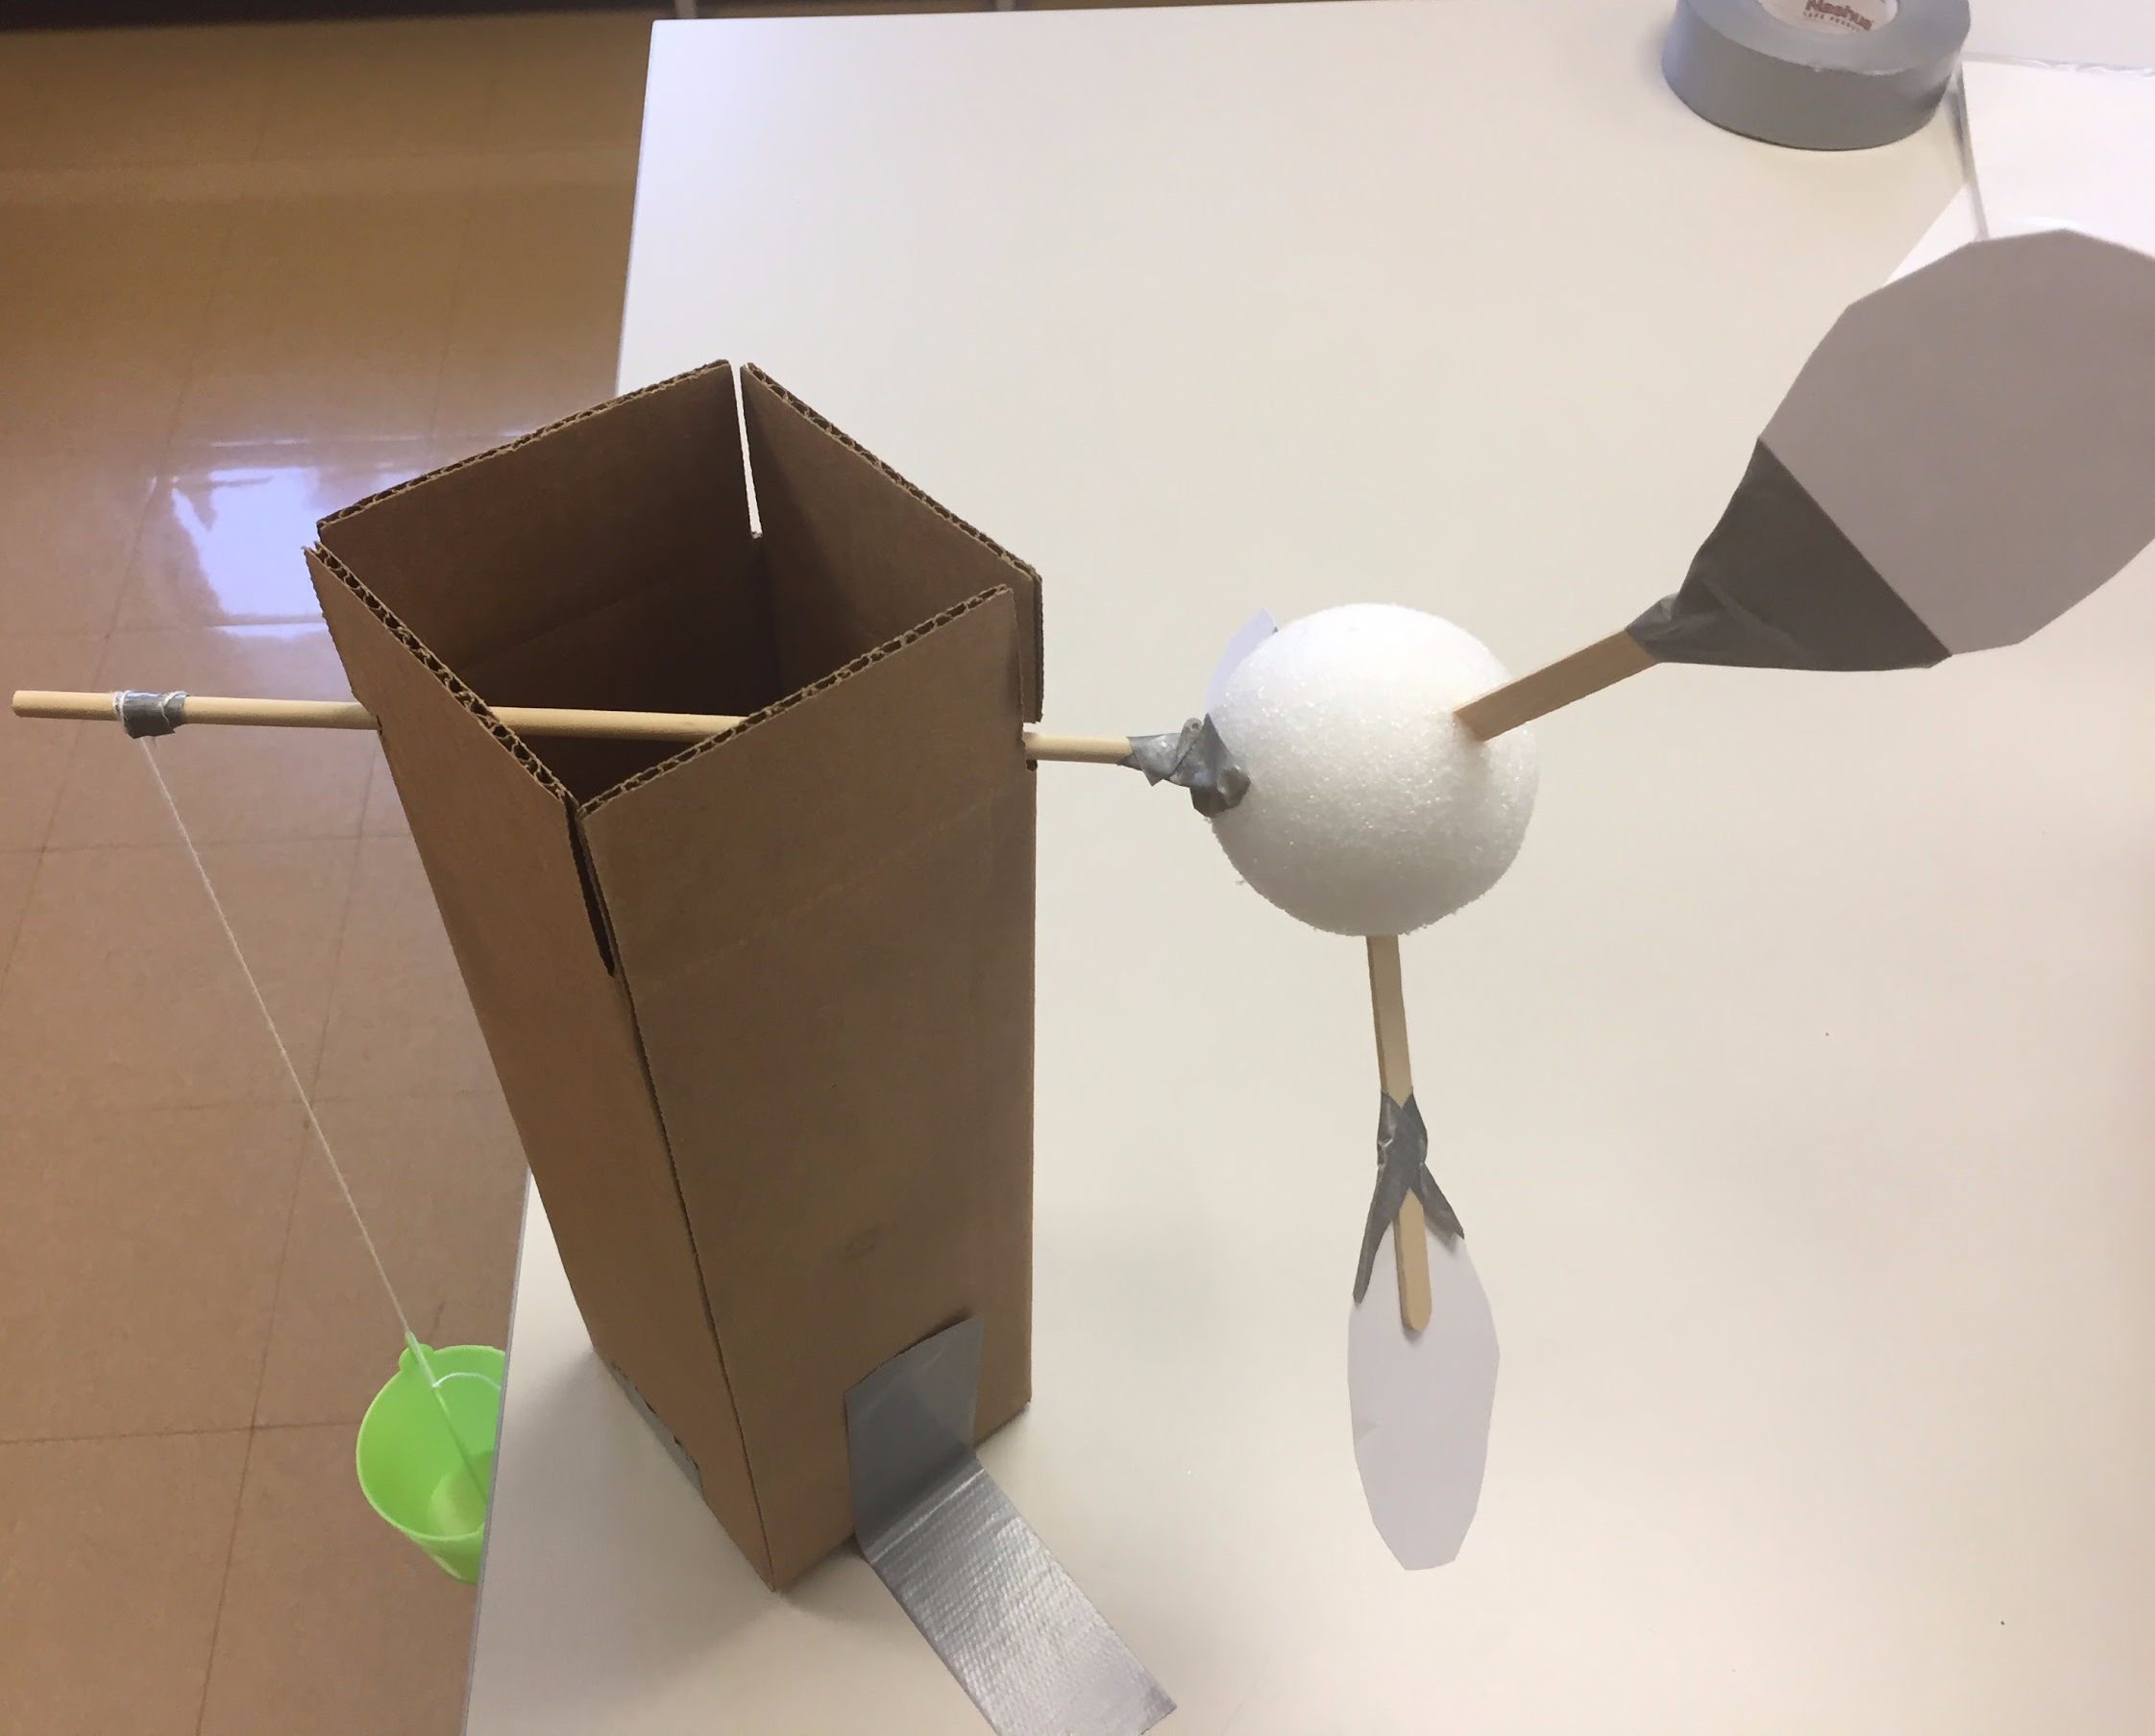
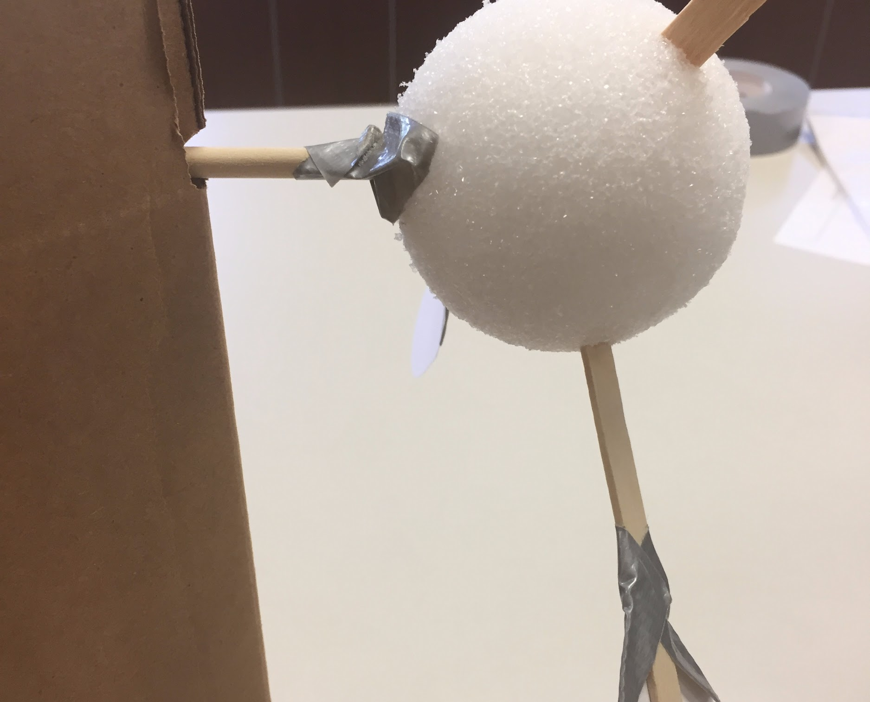
Constructing the Turbine
Teacher notes:
Here is a wind turbine built from the directions in the Elaborate section.
In the second photo note the tape must be used to secure the dowel to the styrofoam ball.

Slide 4
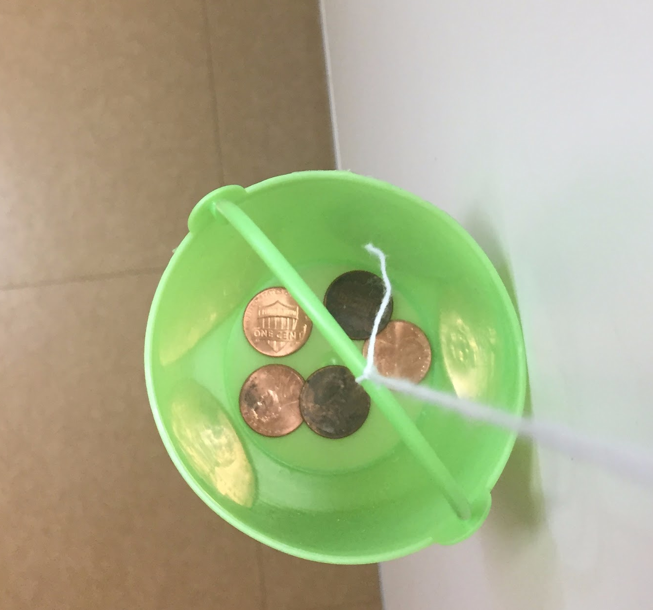
Counterweight
Teacher notes:
Use coins as an easy weight to place inside the bucket.

Slide 5
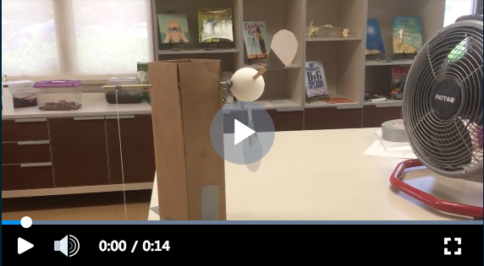
Turbine in Action
Teacher notes:
Here is a video of a sample wind turbine in action. Note, the fan is not provided in your kit, you must provide your own. A box fan is recommended, a small fan will not move the blades.
Notes:
https://www.youtube.com/watch?v=KXm9_dAaktk&t=0s&index=2&list=PL6pLaoA-8f3JPIJC4g20YQtCmJ-v5ZEkq

