Slide 1
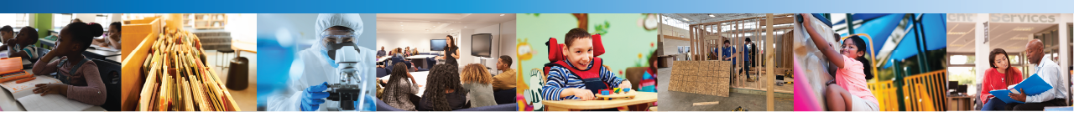
STEELS Safety Guide
A Resource for Safer and Inclusive STEELS Learning Environments
Brandt Hutzel, Technology & Engineering Content Advisor
Pennsylvania Department of Education

Slide 2
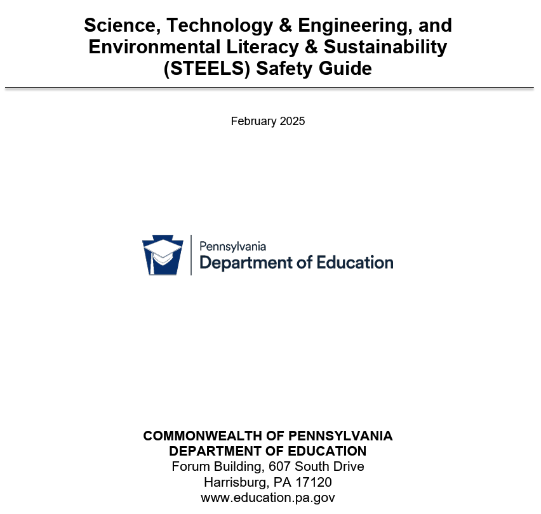
Why a Safety Guide?
Safety is not a stand-alone STEELS standard, it is embedded throughout STEELS Standards
Hands-on, minds-on learning requires safer environments
Supports teachers, administrators, and students in classrooms, labs, and field settings
Not meant to restrict or limit learning. Meant to maintain a hands-on, minds-on STEELS-aligned focus while looking out for the wellbeing of students and instructors
Safety standards and better practices evolve, periodic updates like this are important

Slide 3
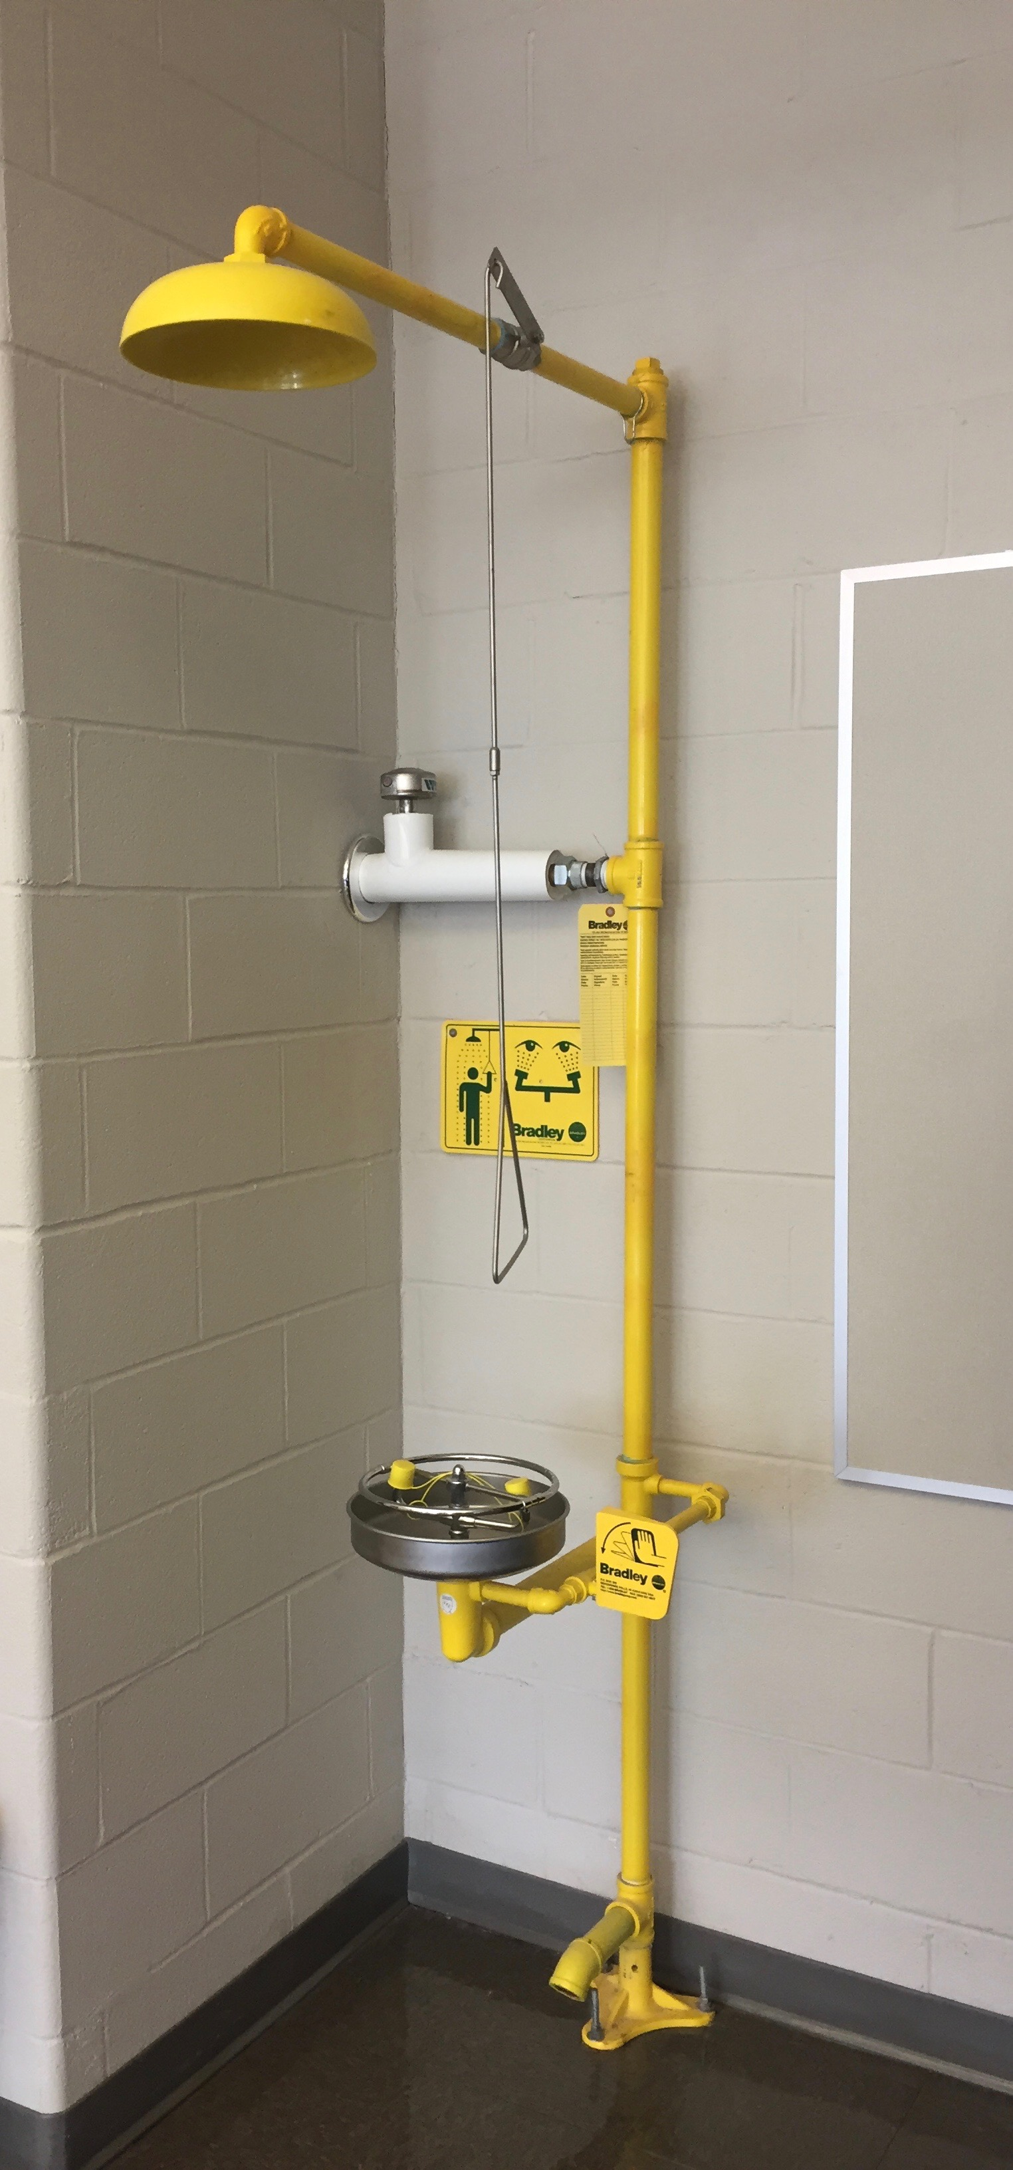
Why a Safety Guide? (cont.)
A 2021 Safety survey of 67 STEM teachers in PA Raises Awareness about Reflecting on Safety Standards, Procedures, Policies, and Practices
  9% had safety training upon initial hiring
  84% no safety training/updates in the past year
  37% had safety zones taped/painted on the floor
  62% had a plumbed or portable eyewash station within 10 second access of hazardous areas
  79% had an accessible emergency master power shut-off for electric, gas, or water
  84% believed they had good or excellent admin support for safety
  (Source: Love, Roy, & Sirinides, 2021 TEEAP Journal)

Slide 4
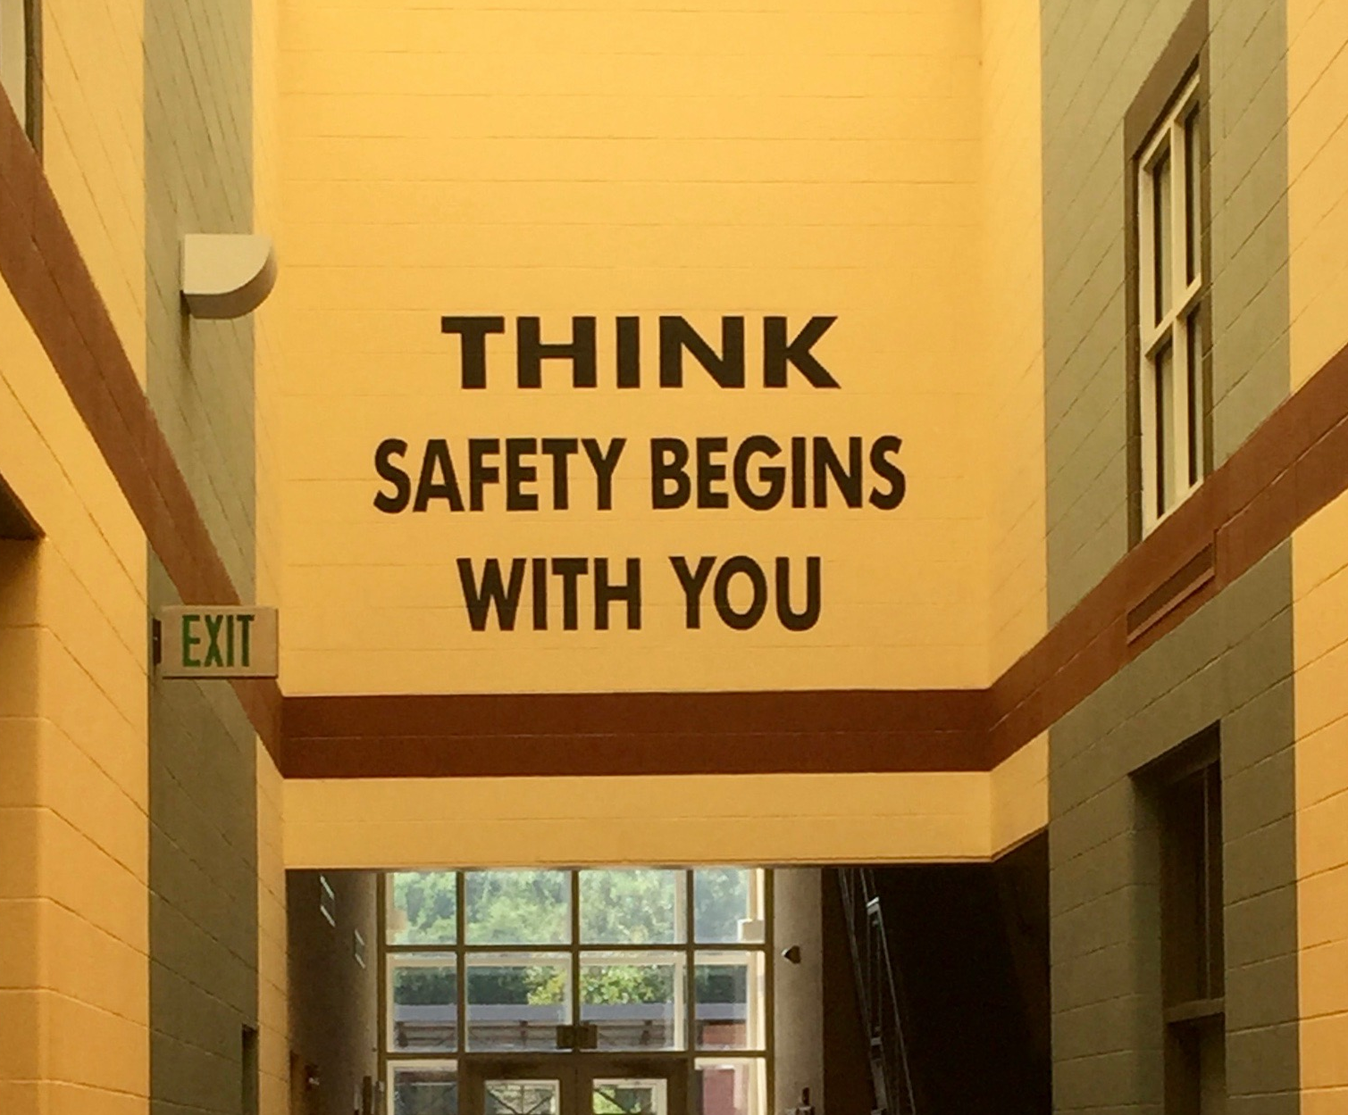
What the Guide IS a:
Convenient reference for science and T&E educators
Guide for what codes and standards could apply
Framework for developing policies and implementing safer teaching and learning practices
Resource aligned with STEELS Standards and safety ethical considerations for design-based learning
Tool to help embed safety in everyday instruction (develop safer habits students transfer to home, postsecondary education, and the workplace)

Slide 5

What the Guide IS NOT
Legal advice or a replacement for school/entity policies
A checklist of absolute rules. Local conditions and solicitor guidance still apply
A substitute for professional judgment, training, or supervision
Safety requires collaboration between teacher preparation programs, IUs, school districts, and other important stakeholders. This guide can help facilitate important safety discussions.

Slide 6
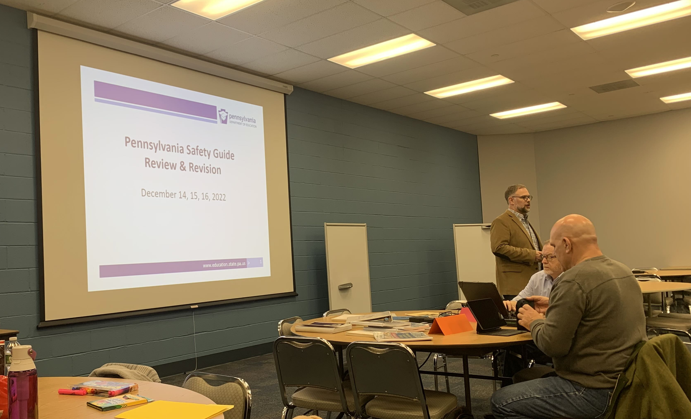
Development Process
22 Pennsylvania STEELS educators convened to review various resources, discuss, and propose the structure and content for the new guide (December 2022 @ Pattan)
The 22 STEELS Safety Guide Writing Team Members were from various backgrounds and regions
Shared valuable experiences on classroom, lab, and field safety

Slide 7
Development Process (cont.)
Collaboration with National Safety Consultants (January 2023-May 2024)
  Identified core needs
    Clear, accessible guidance
    Equity & UDL considerations
    Integration of safety into design thinking and inquiry
    Need for spanning across STEELS to help with various potential biological, chemical, physical, and environmental hazards
    Sensitivity to longevity of the guide (ex. additive manufacturing instead of 3D printing)
  Partnered with PDE and educators for review and to assemble the guide into a comprehensive resource (June 2024-October 2024)
  Regulatory and legal review, formatting (November 2024-February 2025)

Slide 8
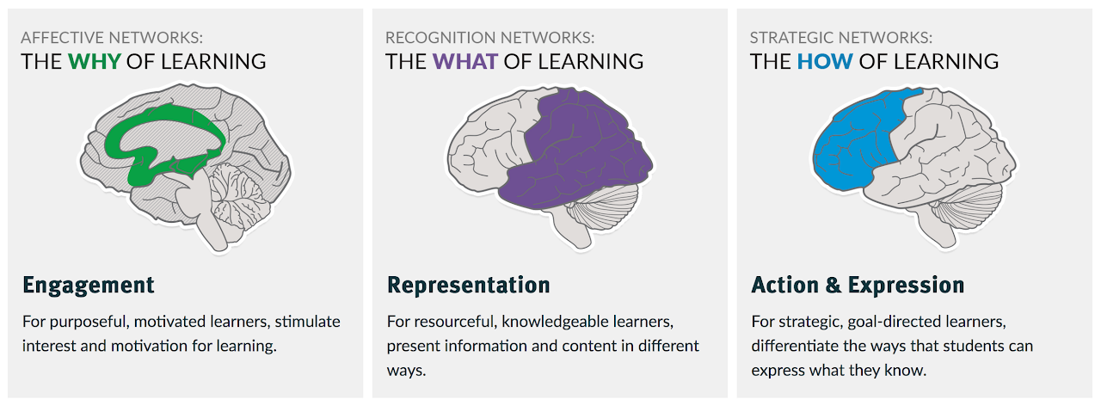
Structure of the Guide
Section I: Overview & UDL/Equity in Safety
Section II: Legal mandates & roles
Section III: Safety considerations for facilities,
equipment, labs, offsite learning
Section IV: Instructional strategies, pedagogy,
evaluation of safety knowledge
Section V: Appendices (sample forms, checklists, acknowledgements)

Slide 9
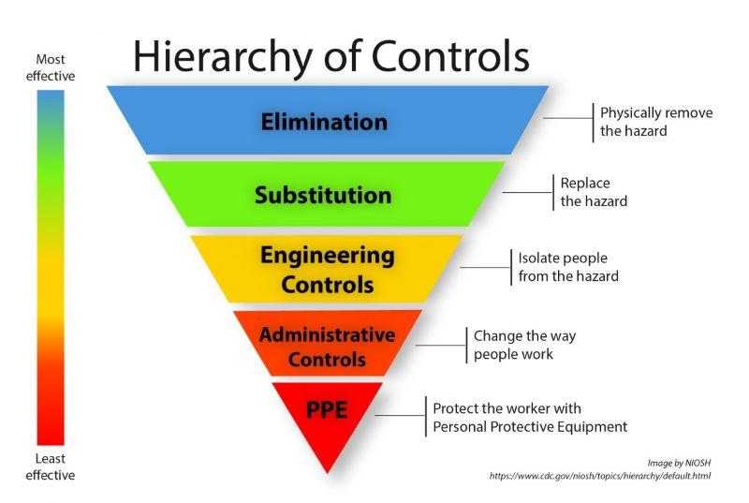
Key Features for Educators
Practical checklists and forms for daily use or modification in consultation with your school district
Guidance on hazard identification, risk management and mitigation, and emergency procedures
Strategies for developing a safety culture through improving safety consciousness, habits, and attitudes
Alignment with occupancy load (fire code), ADA, equity, and applicable safety standards
Photo Credit: OSHA

Slide 10

Benefits for Schools & Educators
Promotes consistent safety practices across PA
Promotes collaboration for safer teaching and learning
Serves as a starting point to engage in informed conversations with school safety personnel, admin, and others to work toward the same goal
Supports compliance with federal, state, and local standards
Strengthens student safety skills for school, home, postsecondary education, and the workplace
Serves as a good reflection and reminder tool for risk mitigation
Provides a foundation for ongoing professional
development

Slide 11
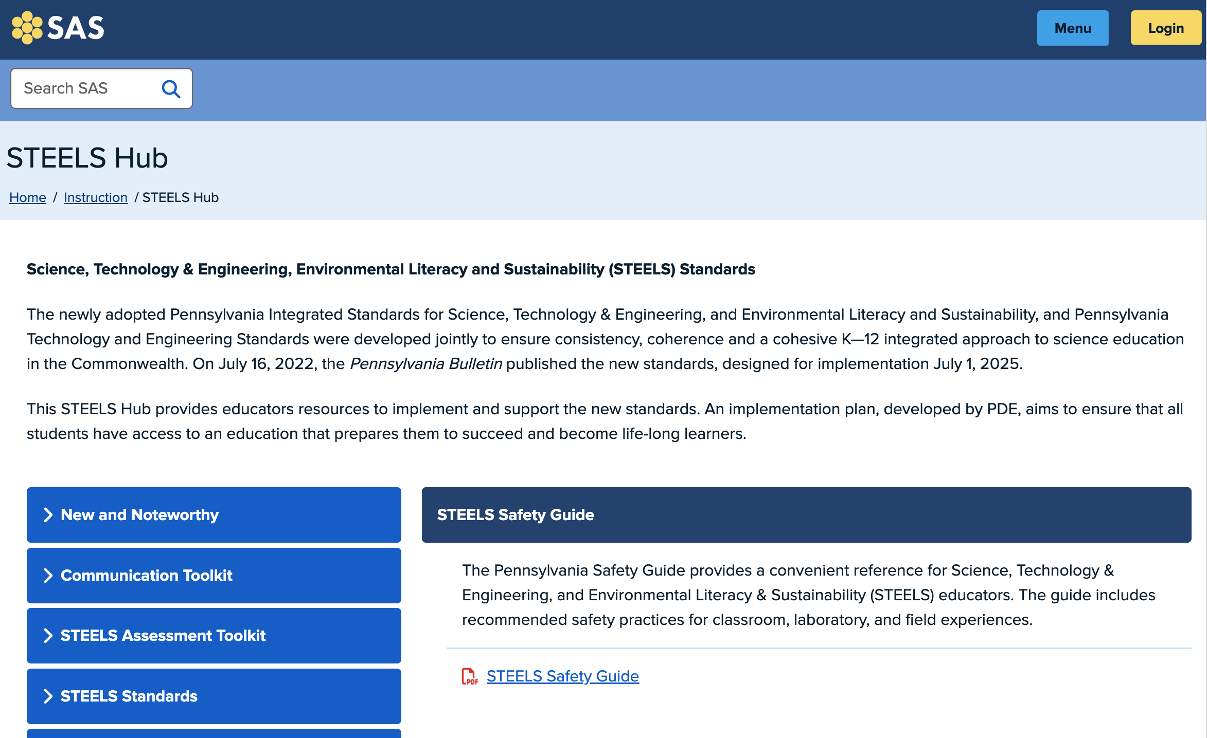
How to Use the Guide
The guide is available on the PDE STEELS Hub to print or download as a living document with interactive links.
Adapt and incorporate content into local safety plans with support of key stakeholders (school facilities and safety department, etc.).
Help guide safety assessments and checks to inform safety needs specific to your district or IU
Use as resource to inform areas of training needed for teachers, preservice educators, and administrators.
Use as a resource to request additional local support when warranted

Slide 12
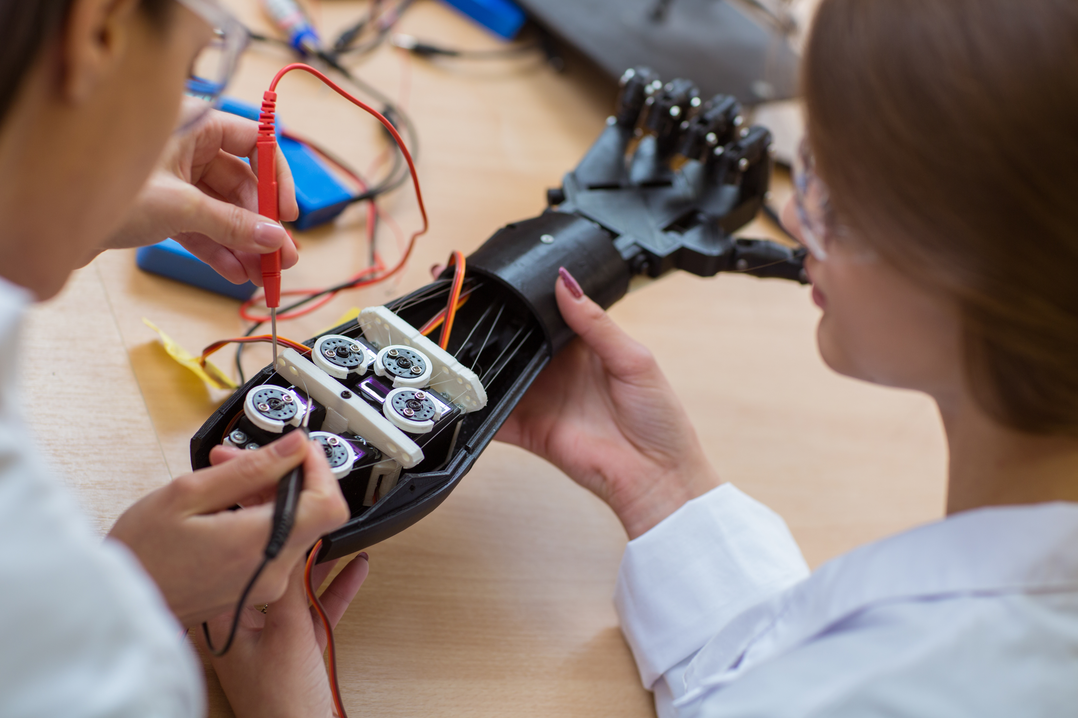
Closing & Next Steps
Safety is a shared responsibility, and this guide is a starting point
  STEELS educators have more in common than you might think when it comes to safety!
Explore the guide, adapt it locally with informed input, and integrate into instruction
Inspire the next generation of STEELS-literate innovators, problem solvers, and advocates with a safety-first mindset!

Slide 13
Contact/Mission
For more information on STEELS Safety Guide, please visit PDE’s STEELS Hub at https://www.pdesas.org/Page/Viewer/ViewPage/58/
The mission of the Department of Education is to ensure that every learner has access to a world-class education system that academically prepares children and adults to succeed as productive citizens. Further, the Department seeks to establish a culture that is committed to improving opportunities throughout the commonwealth by ensuring that technical support, resources, and optimal learning environments are available for all students, whether children or adults.

