Slide 1
How to create a movie using movie maker

Slide 2
Step one
Create a power point on your topic
Use more pictures than words
Graphs and charts are very useful
Choose a good design – remember people will need to see your pictures and words from far away on a video.

Slide 3
Step two
Keep each slide in your powerpoint simple.
You will be adding animation to pictures and too many words will slide by quickly or be zoned out.
Example:

Slide 4
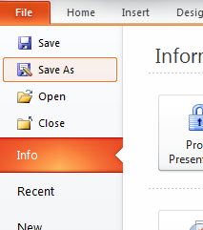
Step three
Save your powerpoint slides as pictures
Go to file and save as

Slide 5
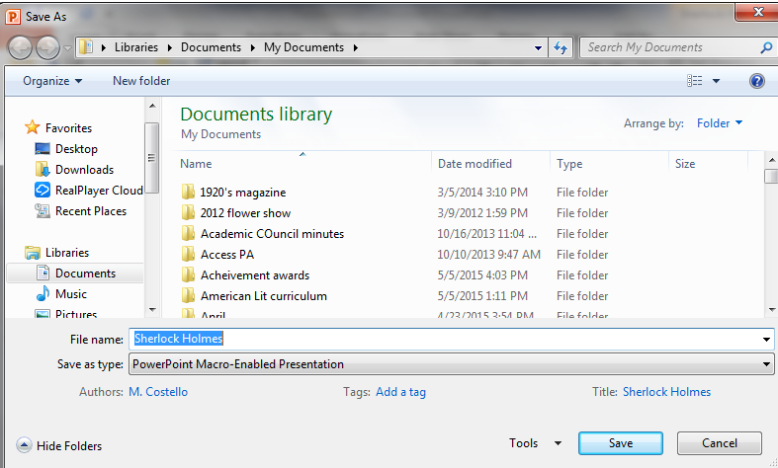
Step 4
At the bottom of the page is Save as type

Slide 6
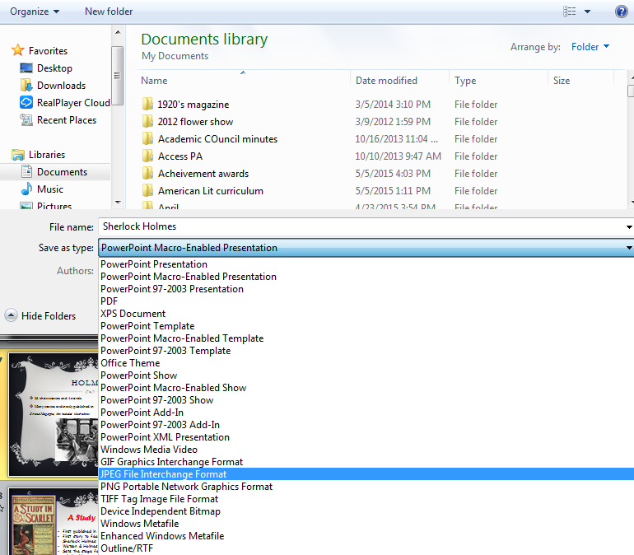
Save as type
Choose
JPEG format

Slide 7
Save as JPEG
Choose the every slide button.
This will save each slide as a separate picture IN ORDER

Slide 8
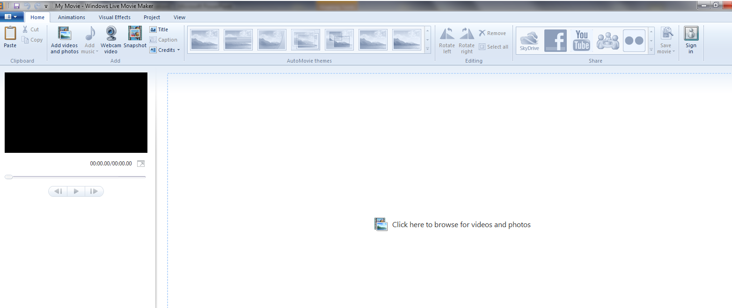
Step 5
Open Movie Maker
This is the opening page

Slide 9
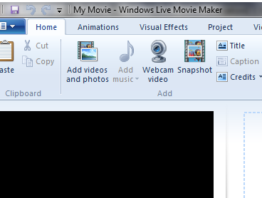
Step 6
Add pictures by clicking the add videos and photos button

Slide 10
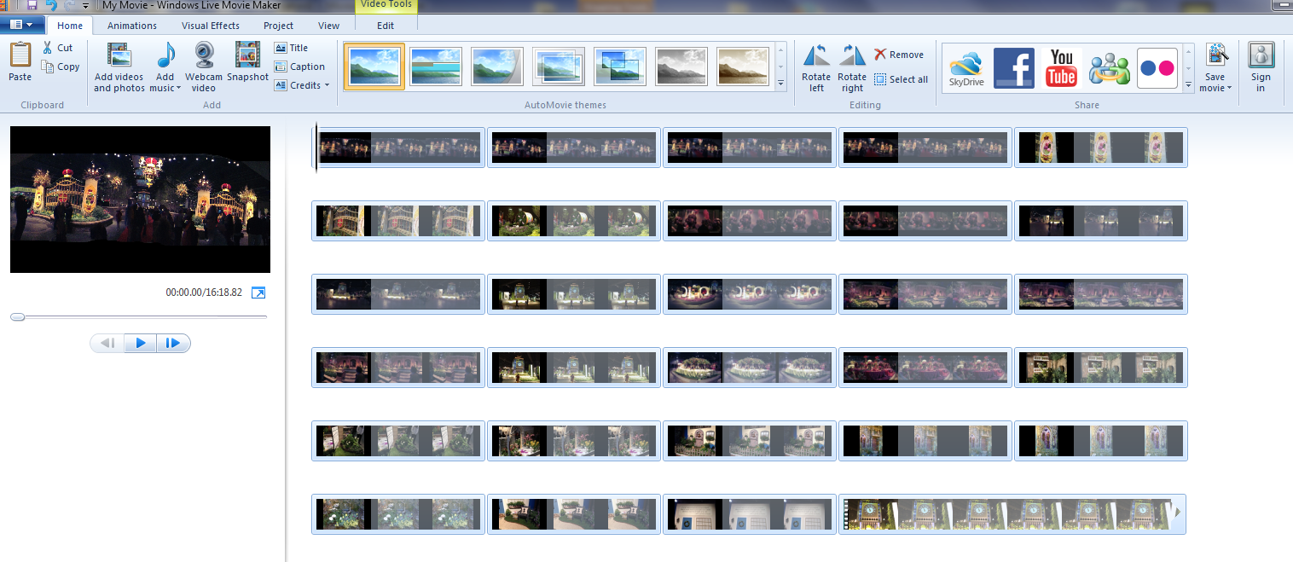
Add pictures
You can highlight all the slides and then open
Movie maker than looks like this

Slide 11
Step 7
Add Transitions – click animation tab at the top
You can choose a transition for each picture
separately or click apply to all
for the same transition on all
This arrow gives
even more choices

Slide 12
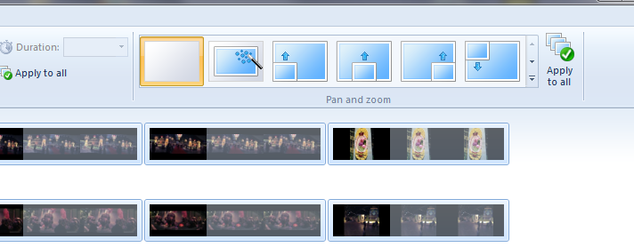
Step 7
For movement when picture is showing use the pan and zoom
You can pan and zoom for each picture
separately or click apply to all
for the same transition on all
This arrow gives
even more choices

Slide 13
Pan & Zoom
You can let the program choose the pan & zoom for you
Automatic Pan & Zoom

Slide 14
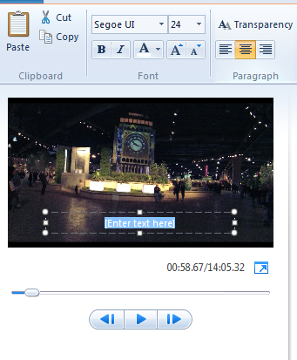
Step 8
If you want captions add them now. NOT TOO MANY LONG ONES
Click on the home tab
and then the slide you want
Click caption
Enter your caption

Slide 15
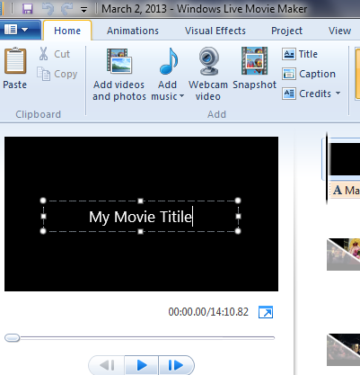
Step 9
If you haven’t created a title page with the power point create one by clicking title on the Home tab
Type your title
and author

Slide 16
Step 10
To add sound click add music BUT FIRST you need to record your dialog.

Slide 17
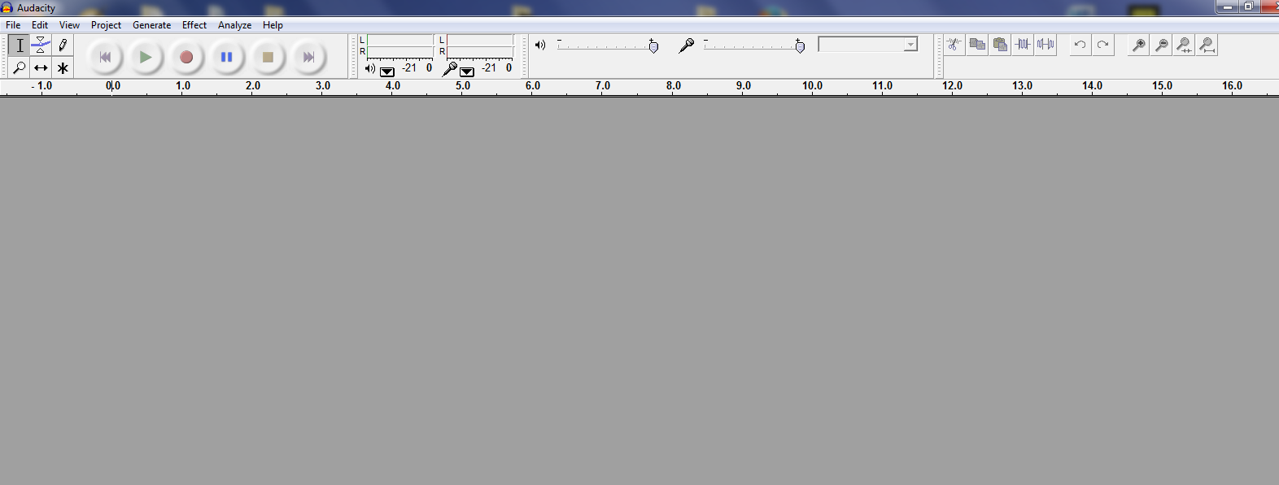
Step 11
The best program for recording your dialogue is Audacity.

Slide 18
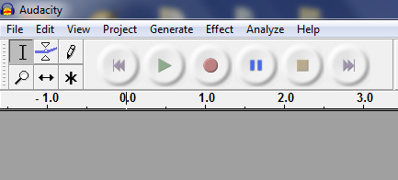
Audacity
All you have to do is write what you want to say and click the record button then the stop button when done

Slide 19
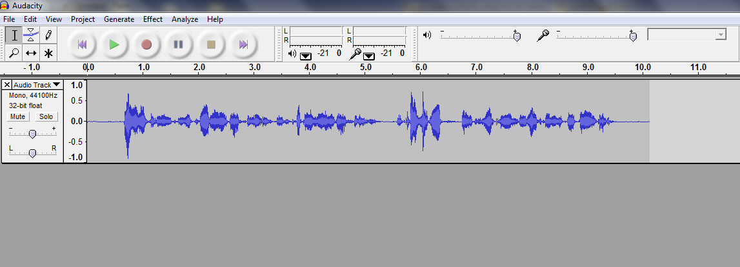
Audacity
This is what it looks like when you are done
Do one of these for each picture.
It makes it easier to match picture to sound length

Slide 20
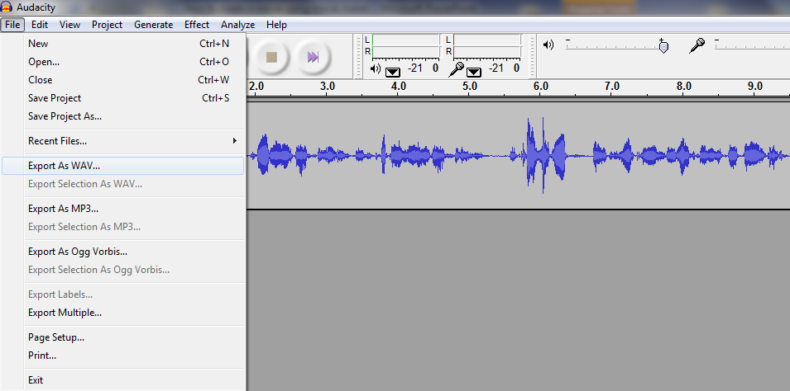
Audacity saving
To save export as a wav file and name slide 1, slide 2 etc.
Wav files work best in Movie maker

Slide 21
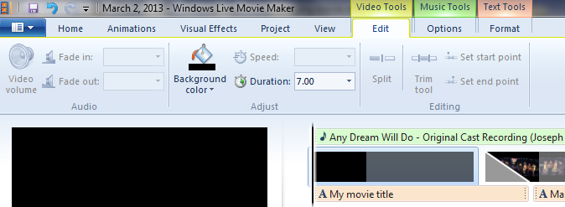
Finish sound
Now make sure you picture matches the length of you sound
Use Video tool tab
Use the duration line to lengthen or shorten you picture
You can tell because the audio will have a line at the end of each clip

Slide 22
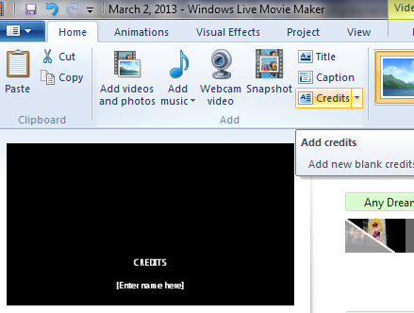
Step 12
You need to add credits.
This is your bibliography of where you got your pictures and info for your power point.
Click credits and
type in space provided
You could also paste
From a word document

Slide 23
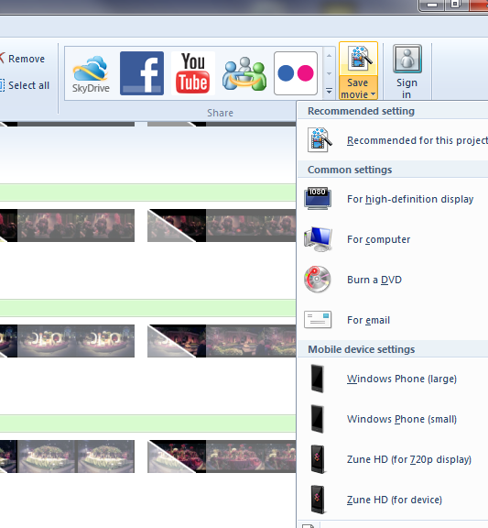
Step 13
To Finish movie you must save AS MOVIE, not just as movie maker.
In upper right hand corner
Click SAVE MOVIE and choose
For computer

Slide 24
Saving movie
This will take awhile but will then play on anything with Windows media player

Slide 25
Screencast-O-Matic
The starts screen give the choice of recording screen only, webcam only
Or this pictures shows both – the screen and yourself in the corner talking.

