Slide 1


The Power of STEELS Leadership Teams
Moving to the Science, Technology & Engineering, Environmental Literacy and Sustainability (STEELS) Standards
Vanessa Wolbrink
Associate Director, NextGenScience at WestEd

Slide 2






NextGenScience
Vision: All students experience a science education that honors their identities and experiences, motivates them to explore issues relevant to their lives, and prepares them to graduate from high school ready for college, career, and citizenship.

Slide 3


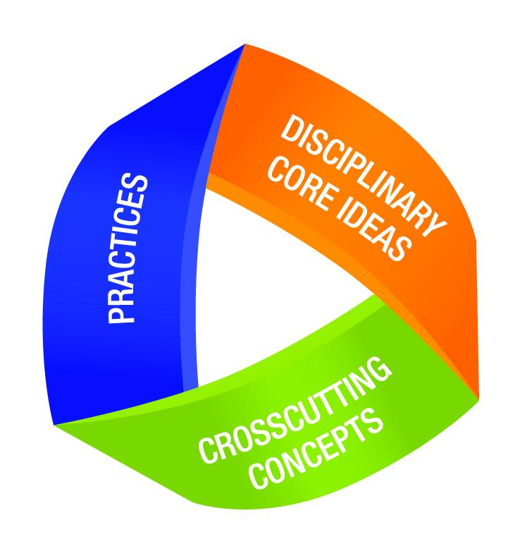

States across the country are moving towards learning goals for science that require students to make sense of the world around them and solve problems.

Slide 4
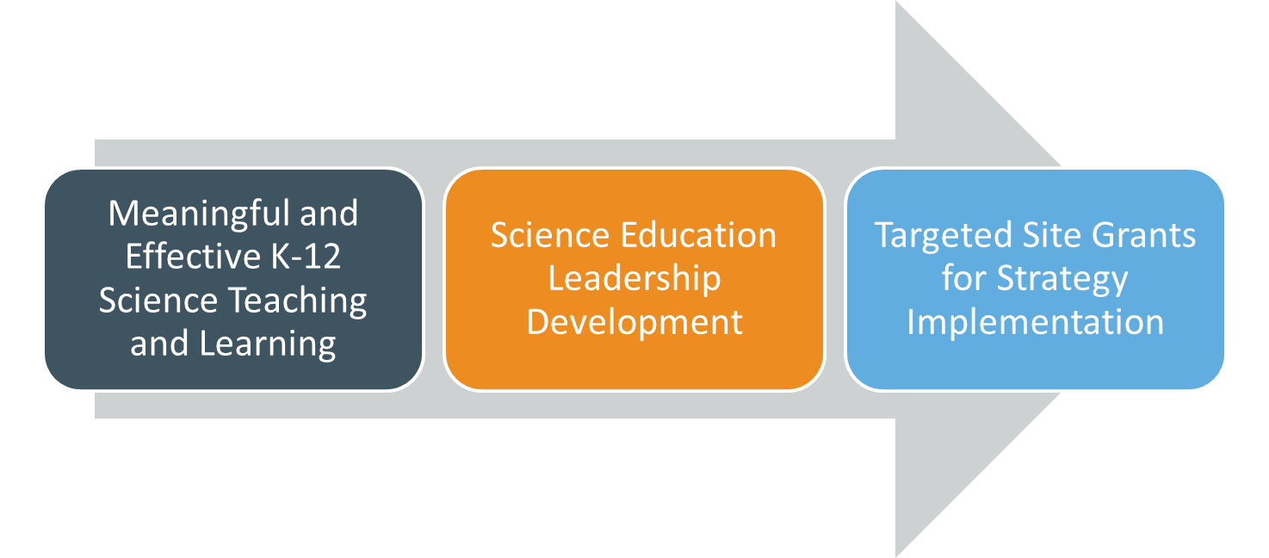

The PennSEL Network
Regional leadership teams working together to lead system-wide change toward meaningful and equitable science instruction as reflected in the STEELS standards.

Slide 5


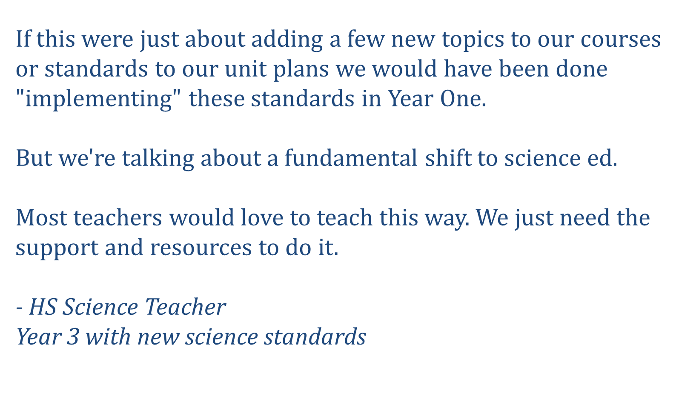
Moving to New Science Standards

Slide 6
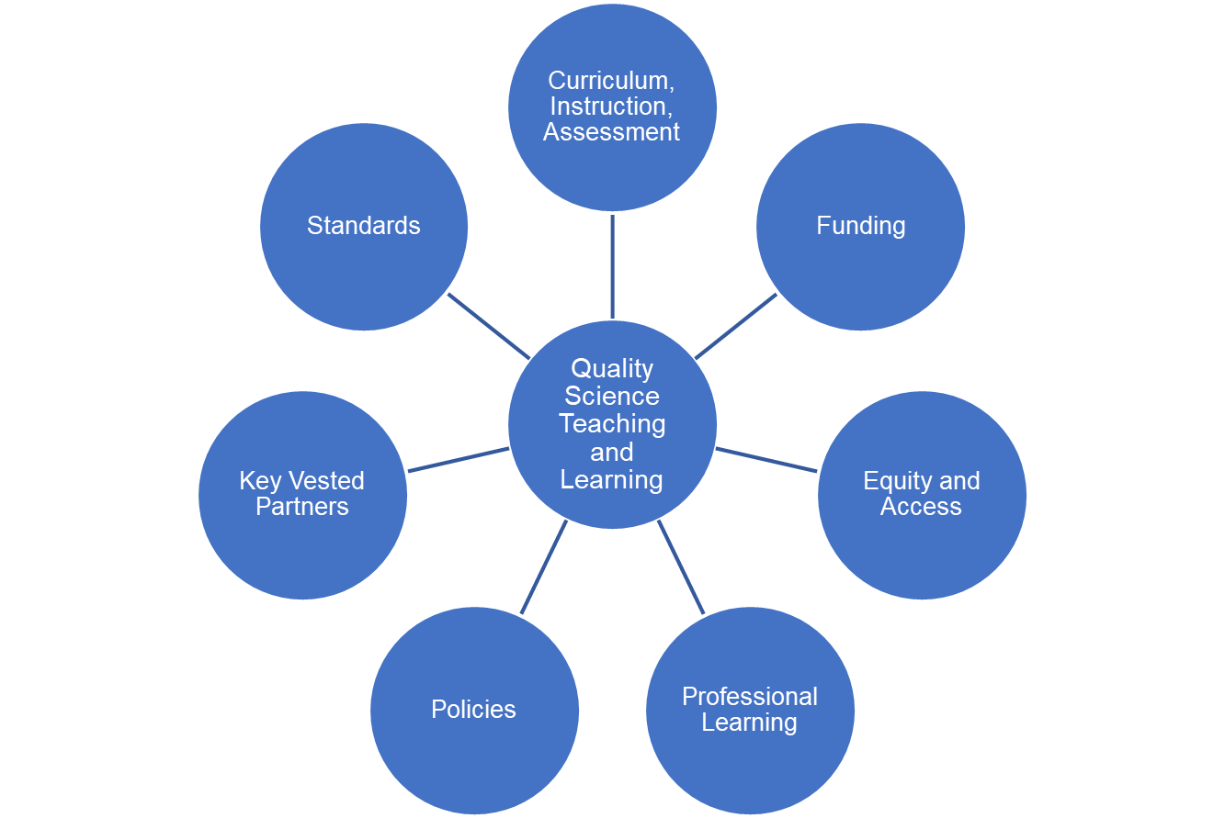
System Drivers
Quality science teaching and learning happens when you leverage system drivers in your implementation efforts.

Slide 7
People working in isolation cannot successfully implement the STEELS standards.

Slide 8
Five Key Takeaways for Achieving Equitable Science Instruction for All Students
1
2
Brought together a diverse group of educators and experts who had developed, adopted, and/or implemented instructional materials aligned with today’s science standards.
Then we conducted a series of focus groups in which we asked participants to share the essential lessons they learned about developing and delivering high-quality, equitable science learning experiences for all students.

Slide 9
Key Takeaway #1?

Slide 10
Key Takeaway #1
States, districts, and schools see positive outcomes when they invest time and energy into creating and sustaining science leadership teams to support the shifts in science education that today’s science standards demand.
Notes:
Even with PennSEL Network, district leadership teams are still vital. Your IU leader will be able to support the work, but the PennSEL network is not doing the work the district leadership team needs to do.

Slide 11
"Implementation" of new science standards is a journey, not an event
Pennsylvania’s Timeline for Science, Technology & Engineering, Environmental Literacy and Sustainability (STEELS) standards
PA STEELS Standards Adopted
Develop Leadership Teams and Build Capacity
Updated State Assessments
Summer 2022
Spring 2026
2026 +
Building Shared Vision
Engage Vested Partners in Professional Learning and Evaluate and Adopt New Curriculum
Continual Growth and Improvement

Slide 12
Challenges
Poll: What’s one big challenge around science teaching and learning you’d like to tackle in your district?
Creating a shared vision for science teaching and learning
Evaluating and selecting science instructional materials
Creating instructional supports (e.g., scope and sequence)
Developing and/or using assessments for the new standards
Building leadership capacity in science teaching and learning
Building teacher capacity in science teaching and learning
Advocating for policies that benefit science teaching and learning
Seeking additional funding for science education
Communicating with different audiences about science education in your community
Collecting data to measure progress and know whether your changes are working

Slide 13

Science Leadership Teams: Let’s dig in

Slide 14
Science Leadership Teams: What are they?

Slide 15
What is a district science leadership team?
A science leadership team is a group of people who provide the necessary infrastructure and accountability for implementing the standards, which includes, among other things, ensuring all educators in the district:
have access to high-quality materials,
are prepared to use those materials effectively in the classroom, and
are able to measure student learning through standards-aligned assessments.
The team must have the authority, resources, time, and access for this work.

Slide 16
Science Leadership Teams: Why?

Slide 17


Science Leadership Team Tradeoff #1
In the chat, share who you agree with more and why.
Jack
Jill
I created a science leadership team. It’s taking some time to get on the same page and make decisions, but it’s worth it to make real and meaningful change.
I have one dedicated leader moving our science planning forward. She knows the work like the back of her hand and is very efficient.

Slide 18
Science Leadership Teams: How?

Slide 19
Science Leadership Team Tradeoff #2
In the chat, share who you agree with more and why.
Jack
Jill
I want people on the team who are already familiar with STEELS. That way we can save time and money skipping initial PL for the team.
Regardless of the team’s experiences, it’s important to start with a shared learning experience about STEELS so we know we’re on the same page.

Slide 20

RECOMMENDATION 5: Begin with leadership. State, district, and school leaders should designate teams that include teachers to lead implementation of the Next Generation Science Standards.
Initial professional development efforts should be focused on these leadership teams.
Team members should then be engaged in continuing professional learning appropriate to their roles to lead implementation of the necessary changes in curriculum, instruction, and assessment.

Slide 21



Planning to Realize Our Vision
Leadership Teams
Engaging in learning
Building shared vision
Making plan to achieve that vision
Enacting and monitoring that plan

Slide 22
Science Leadership Teams: Who?

Slide 23
Science Leadership Team Tradeoff #3
In the chat, share who you agree with more and why.
Jack
Jill
I want our team to be full of people who are already passionate advocates for the STEELS standards.
We should seek out some people who might otherwise be resistant to this change to be on the science leadership team.

Slide 24
Science Leadership Team Tradeoff #4
In the chat, share who you agree with more and why.
Jill
Jack
I want to include the following: K-5 teacher, 6-8 teacher, 9-12 teacher, math/ELA representatives, school administrator, district leader, instructional coach, higher ed representative, museum representative, business/industry representative, parent representative, student representative…
I want our team to be small enough to function effectively, knowing we will consult or call on additional people for specific purposes as needed (e.g., an expert in assessment)

Slide 25
Science Leadership Team Tradeoff #6
In the chat, share who you agree with more and why.
Jack
Jill
We need a separate science leadership team for elementary and secondary. The challenges for each are just too different.
We need one science leadership team K-12 with representation from each grade band. Coherence is too important.

Slide 26
Science Leadership Teams: When?

Slide 27
Call To Action: Advocate for a Science Leadership Team
Developing a district science leadership team is a foundational step that sets the stage for the rest of the work to implement the STEELS standards.
Without a team and strategy, the process can be unclear or haphazardly implemented, which reduces the chances for meaningful, sustained shifts to take root in a system.
When science leaders engage stakeholders around a common vision, backed by a careful plan for achieving that vision, students' science learning experiences and outcomes improve.

Slide 28

Thank you!
ngs.wested.org
@OfficialNGSS
#PennSEL
Vanessa Wolbrink
vwolbri@wested.org

