Slide 1
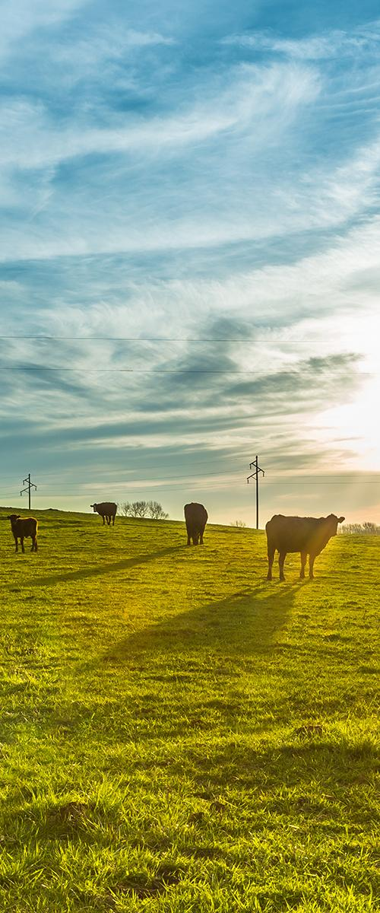



Unit 22: Using Our Resources Wisely
EARTH AND SPACE SYSTEMS
Unit 22
Using Our Resources Wisely
Section 1: Lessons 1 & 2
Section Driving Question:
How are farms part of Earth’s systems?
1
Notes:
Teacher Note: This section has 2 lessons.

Slide 2










mySci Symbols Key
mySci symbols key
Indicates link to a teacher facing mySci tutorial explaining how to set up the activity for students
Indicates an opportunity for students to write
Indicates an opportunity for the teacher to make a chart
Indicates link to a video
Indicates an opportunity for the teacher to read aloud to students
Indicates an opportunity to attend to equity and inclusion
Indicates a vocabulary word for the lesson
Indicates an opportunity to employ a driving question board
Indicates an opportunity for formative assessment
Indicates appropriate time to administer pre or post assessment
2
Notes:
Welcome to mySci google slides edition.
The following slides are designed to make the curriculum accessible to teachers and students in a presentation format.
Most slides should be viewed in presentation mode in order for all the features to work.
Each section of the unit is represented by a section question and photo. Each lesson in the unit begins with a lesson target slide followed by curriculum slides to support the 5E model. Student journal pages are shown, videos for students to watch are embedded in the slides and there are other interactive opportunities represented as well.
We at mySci encourage teachers to view this slideshow as they read through the unit in the planning phase and determine if there are additional slides, activities or photos to add. Personalizing this slideshow for your particular group of students will make the material even more relevant and exciting for young learners. As always feedback is welcomed and appreciated.

Slide 3
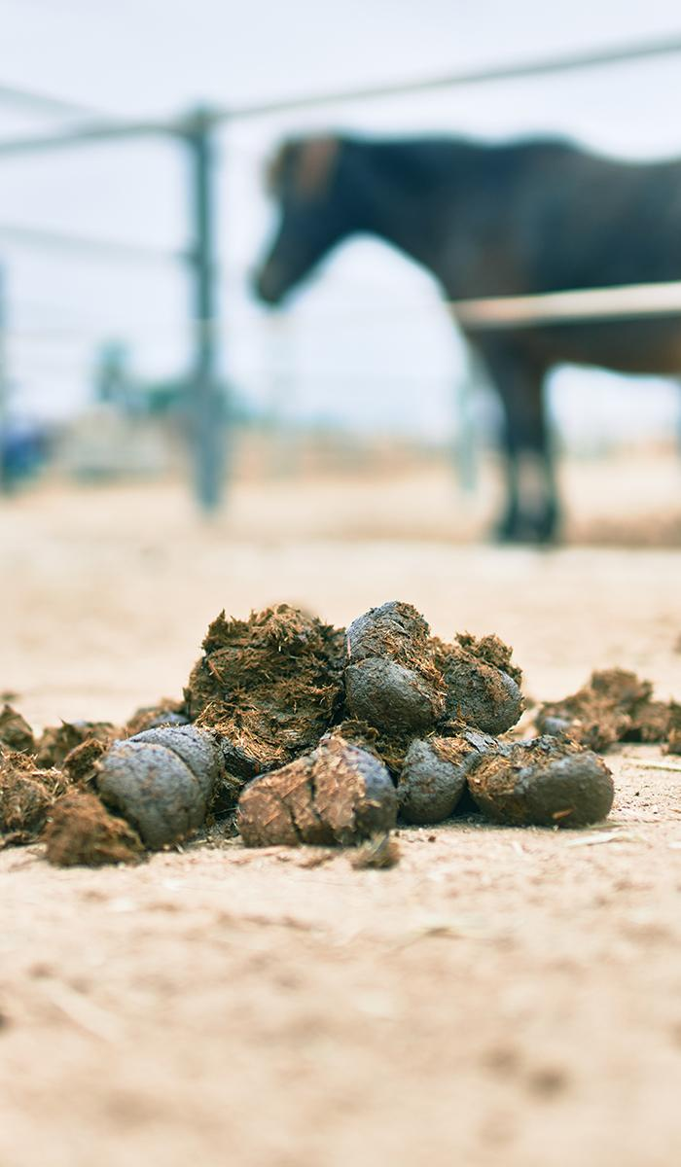
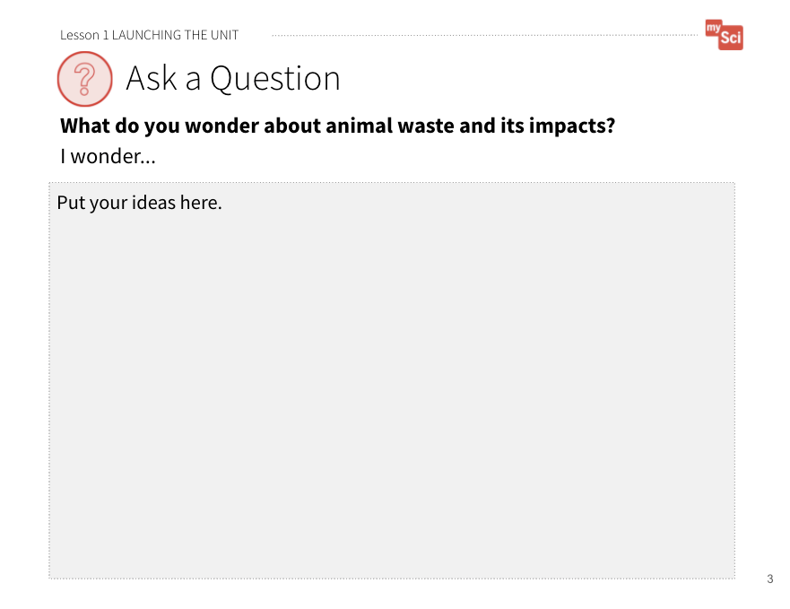
Unit 22: Anchoring Problem
Lesson 1:
LAUNCHING
THE UNIT
UNIT 22
ANCHORING PROBLEM:
We need farms to grow food, but the process of producing food for all of us can harm Earth systems.
An important opportunity to attend to equity is offered in the speaker notes area
Student Journal page:
Launching the Unit
Notes:
Students view a video to make observations and ask questions about the unit ANCHORING PROBLEM.
Introduce the ANCHORING PROBLEM by saying to students: Most of the food that we eat comes from a farm. In order to produce the food we eat, farms use resources. Have you ever thought about HOW farms produce the food we eat? What are the side effects of producing the food? How do you think we could reduce some of the side effects?
Attending to Equity:
Students will find the anchoring phenomenon more compelling if it is presented as a meaningful, real-world scenario that connects to their lives. You could ask students what their favorite foods are, and see if any meat is on the list. Some students may not consume animal products (or certain animal products). Encourage students to be respectful about others’ dietary choices, and allow them to express concern and empathy for animals on farms if those feelings come up for them. This concern can foster productive scientific discussion about real-world problems.

Slide 4
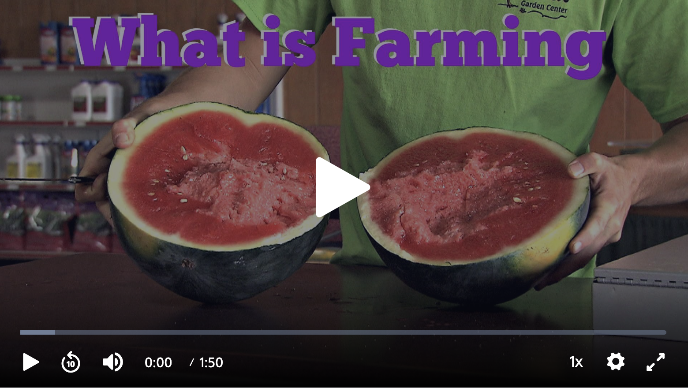
What is Farming?
Lesson 1:
LAUNCHING
THE UNIT
Student Journal page:
Launching the Unit
What is Farming from PBS
Notes:
Show the following: What is Farming from PBS. Watch the video all the way through the first time. Then, ask students to write down 2 observations and 2 questions from the video before showing it again. It may be helpful to pause the video as different processes of the farm are shown (i.e. using tractors to plant seeds, watering the plants, housing for animals, etc.). If students aren’t sure what to observe you can ask: What do you notice is happening during this part of the video? What questions do you have about what we just saw?
Give students time to write down their observations and individual questions on Student Journal page Launching the Unit as you go through the video.
Ask students to share their questions out loud and record them, or have students write their questions on post-it notes that can be placed on the driving question board.
Ask students to categorize their questions. To support students to do this, ask students: Are there any similarities between the questions on the DQB? Can we find a word, phrase, or question that encompasses the ideas here? Now that you have seen other student’s questions, do you have any questions to add?
Guidance for supporting students in asking questions: Discuss with students that we want to ask questions about the problem in order to think about what is known and not known about the problem. Scientists typically have more questions than answers when they begin an investigation. As the teacher, create a safe space for students to ask questions by emphasizing that we want to gather several questions to help us think about what we need to investigate. These investigations will then help us learn more about the problem. If students are not focused on the problem in the video, the teacher can model an observation and a question. One observation could be: The farmer is watering the plants. One question could be: How much water does a farm use? Do not answer questions at this time or correct their thinking – students will explore their questions and explain this anchoring problem throughout the unit. For example, if a student says something incorrect, you can say: Hmm. How could we investigate that?
If you want to change the ANCHORING PROBLEM, keep the following questions in mind:
Is it going to be relevant to my students’ lives and/or particularly engaging to them?
Is it going to motivate students to want to explain our use of natural resources, how Earth’s spheres interact, energy consumption, and how to protect our environment in the given context?

Slide 5
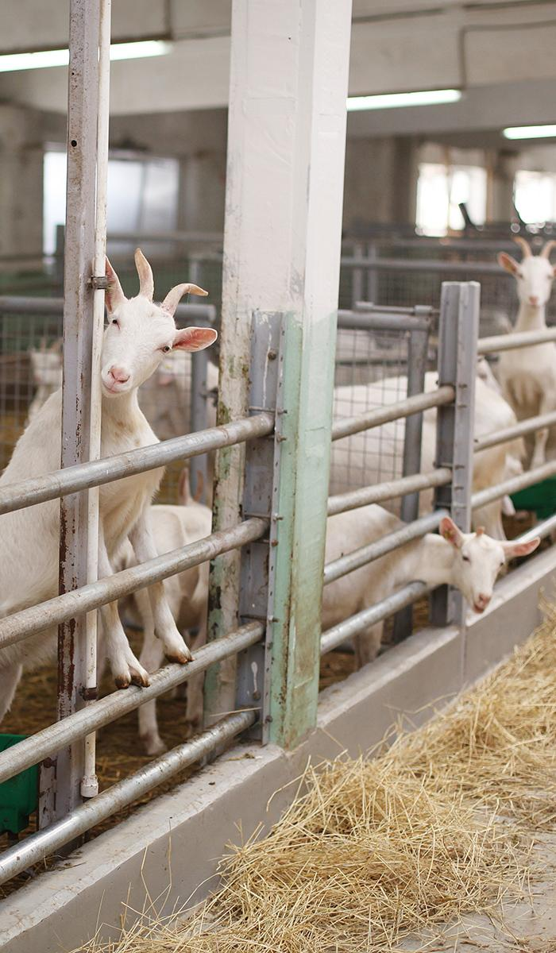
Unit 22: Driving Questions
Lesson 1:
LAUNCHING THE UNIT
UNIT 22
DRIVING QUESTIONS:
How are farms part of Earth’s Systems?
How does our use of natural resources on farms affect Earth’s systems?
How can farmers use resources wisely to protect Earth’s systems?
Notes:
Students are introduced to the unit DRIVING QUESTIONS.
Orient students to the categories they developed. Introduce the Driving Questions for the unit. Ask students if any of these driving questions relate to their categories/questions and allow students to Turn and Talk.
Some student categories may fall under one of the driving questions, or a category may connect to multiple driving questions. If students are struggling to see these connections, ask students to generate new questions they have based on the driving questions in order to help them bridge these connections. This process may include students regrouping the way they originally organized their questions and categories to include the introduced questions.
Say to students: If we want to be able to answer these driving questions, what do you think we need to know? (We need to think about how very different locations and parts of Earth are connected, how our use of natural resources affects the environment, and how we can protect the environment.)
We are going to use this knowledge to design our own solutions for our problem of farms harming Earth Systems when producing food.
Guidance for engaging students in a Turn and Talk: Turn and talks will be used throughout the unit. If students are not already familiar, take time to introduce the Turn and Talk strategy. Emphasize that students should share their ideas, listen carefully to their partner’s ideas, and build on each other’s ideas. It is also important to stay on topic.
To support students to Turn and Talk, consider using: Conversational Support for Sharing and Expanding on Each Other's Ideas from STEM Teaching Tools.

Slide 6
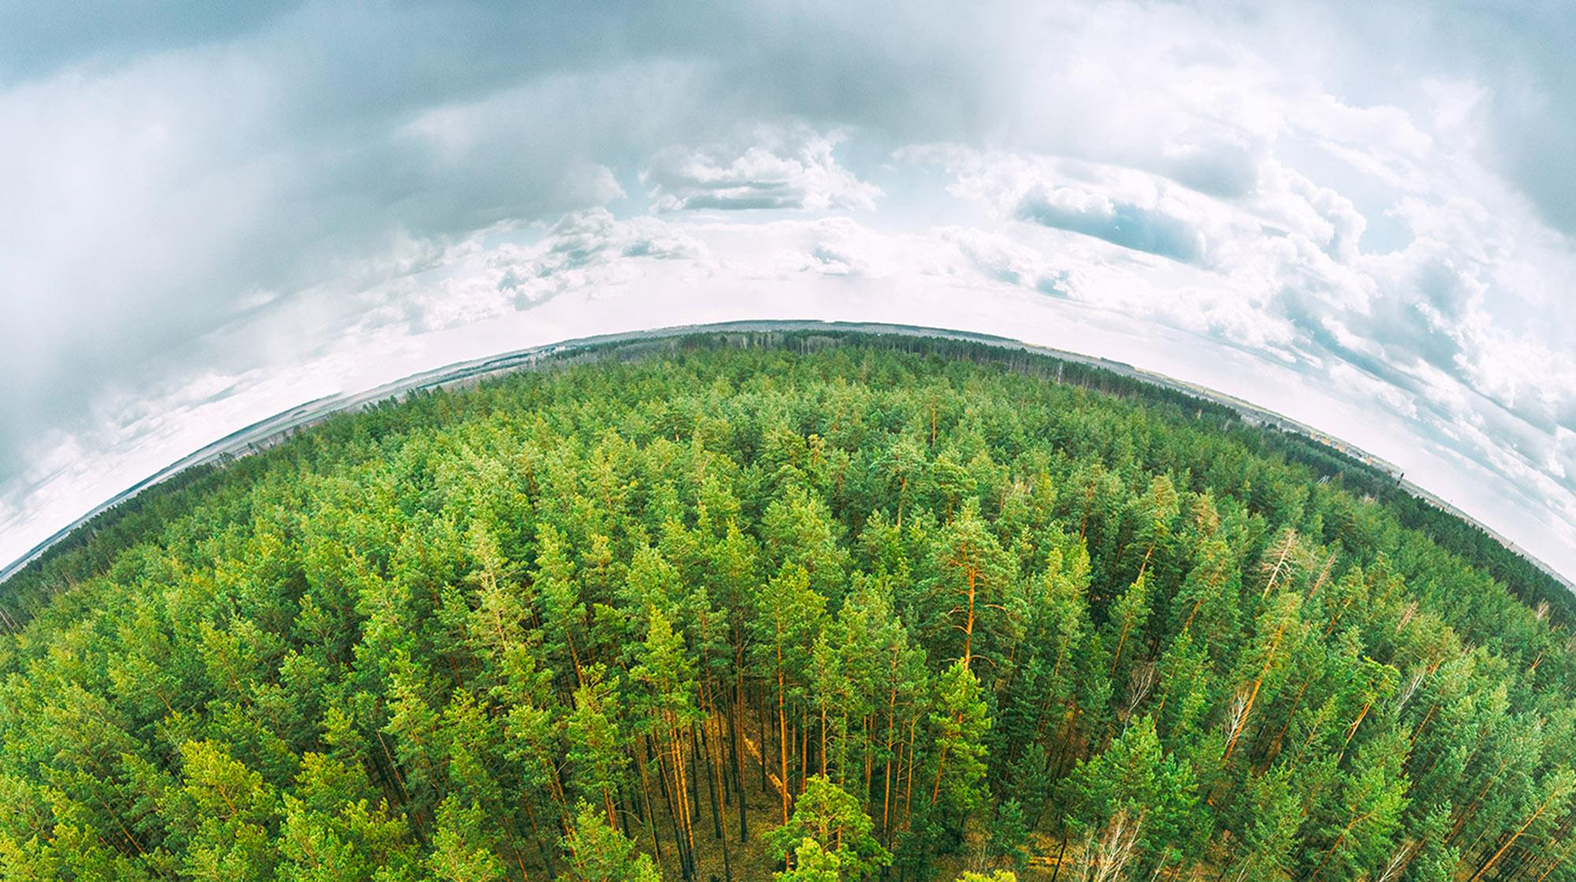
UNIT 22, SECTION 1 :
How are farms part of Earth’s systems?
Notes:
Section 1 consists of the first 2 lessons of this unit.
Total time: 6 days
NOTE: This question is provided for you as a model driving question to organize the learning progression. You can use this question to guide your instruction, however, you are encouraged to adapt this question using the language you develop with your students.
LESSON 1
How can we describe the different parts of the Earth?
(3 days)
LESSON 2
How do Earth’s systems interact?
(2 days)

Slide 7
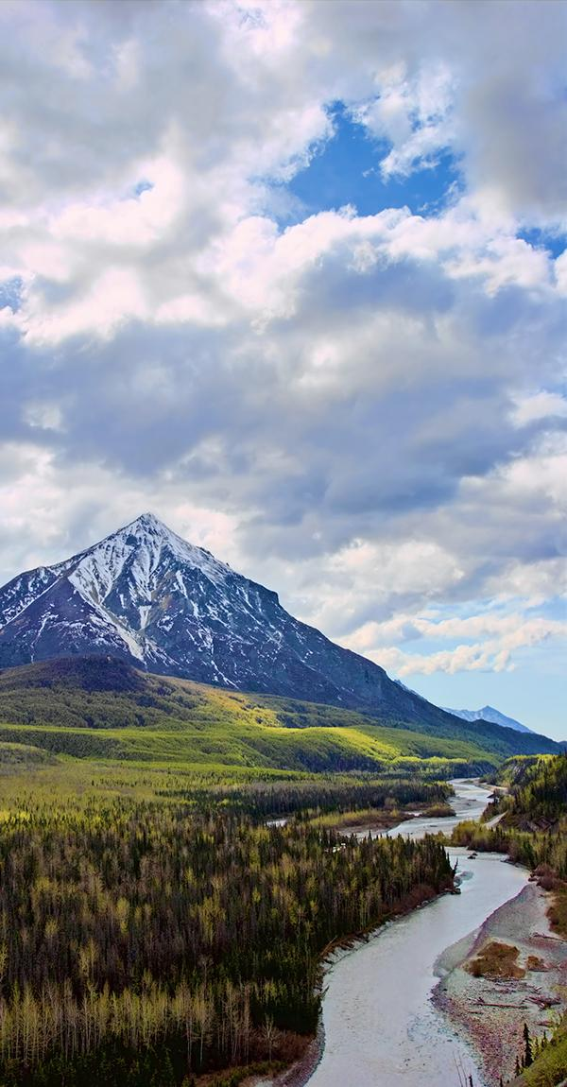
LESSON 1:
How can we describe the different parts of the Earth?
Lesson 1:
LEARNING TARGET
Notes:
Prior to this earth science unit, students may have knowledge that energy makes things happen. Students may understand that energy can move from place to place and be transformed from one form of energy to another (NGSS 4-PS3, MLS 4.PS3). They have considered the environment as an ecosystem of parts that interact.
In this lesson, students research the components of the hydrosphere, atmosphere, geosphere, and biosphere. They will develop and use a model to illustrate these systems on a farm.
Students figure out that we can classify the parts of the Earth by what they are made of- hydrosphere (liquid water), atmosphere (air), geosphere (land), and biosphere (organisms). Farms are human-designed, but they still have these systems.
In the next lesson, students consider how the different spheres of the Earth interact.

Slide 8
Lesson 1: Engage
Lesson 1:
ENGAGE
How would you describe the different parts of a farm environment, using science ideas?
I will make a model on chart paper based on what you describe. We will refine this model throughout the unit as we figure more out!
Notes:
ENGAGE Summary: Students co-construct an initial model showing the different parts of our environment.
Say to students: We are trying to figure out how farms use resources and how this affects the environment. Think back to previous science lessons. How would you describe the different parts of a farm environment, using science ideas?
Allow students to Turn and Talk, then share a few answers with the whole class. Listen for students discussing ideas from previous grade levels and possibly previous units in your class. They may have ideas about ecosystems, matter, and energy.
Draw a picture of the environment students describe on chart paper. Discuss with students the importance of models in science, and what parts are generally included in models. Ask students: what labels should we put on our drawing? Why is it important to include labels? What are some different ways we can add labels to our drawing?
Say to students: This is our initial model of a farm environment. We will refine our model over time in this unit and have a lot more ideas to add to it.
Guidance for engaging students in modeling: Modeling is an important science and engineering practice in this unit. This practice is initially done as a whole class, as a scaffold for students to engage in the practice. Students will develop and revise their own models as they progress through the unit.

Slide 9

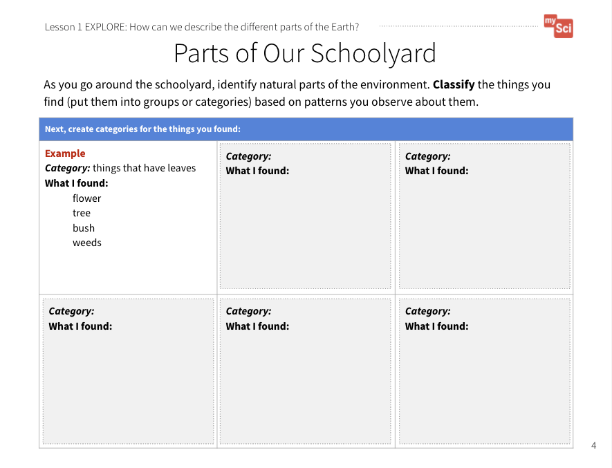
Lesson 1: Explore
Lesson 1:
EXPLORE
Let’s go on a nature walk to identify the different parts of our environment!
An important opportunity to attend to equity is offered in the speaker notes area
Parts of the Our Schoolyard
Student Journal page
Notes:
EXPLORE Students make observations about the parts of the environment and classify them according to patterns.
Say to students: We are going to go outside on a nature walk. While we are walking I would like you to record as many observations of natural things as possible. You are going to try to categorize the things you observe. Before we go, let’s discuss observations as a part of science. Why do you think scientists make observations? What are some observations we can make about our classroom?
Have students work in small groups to identify natural parts of the environment. Students can create a list of their observations on a blank piece of paper. They may write or draw their observations. As students are walking around, visit the groups and guide them as they explore their environment. If students need support in making observations ask: What observations can you make about things above you? Below you? Remember your environment does not just include what you are walking on. Point out things that might not be immediately obvious to them, such as air, clouds, a puddle of water, soil, or rocks. Encourage them to look closely, and in ways that they might not normally look at the world.
Have students organize them into categories based on similarities on the Parts of Our Schoolyard Student Journal page. If students need support you can ask: Do you see any similarities between the objects you identified? How could we group these based on those similarities?
Attending to Equity:
When students go outside, they are considering how their own environment has the same scientific principles as a farm or other parts of the natural world. Students can use self-documentation technique to take photos of the environment around their school or at home to make the experience “inclusive and meaningful”.
Attending to Equity:
When creating groups, we advise that the teacher creates the groups in order to make them more equitable. It is best to have students in groups of 3 or 4 that consist of mixed ability, gender, and cultural background. The article, Designing Group Work, from Ambitious Science Teaching has more information on group arrangements and facilitating discussions.

Slide 10
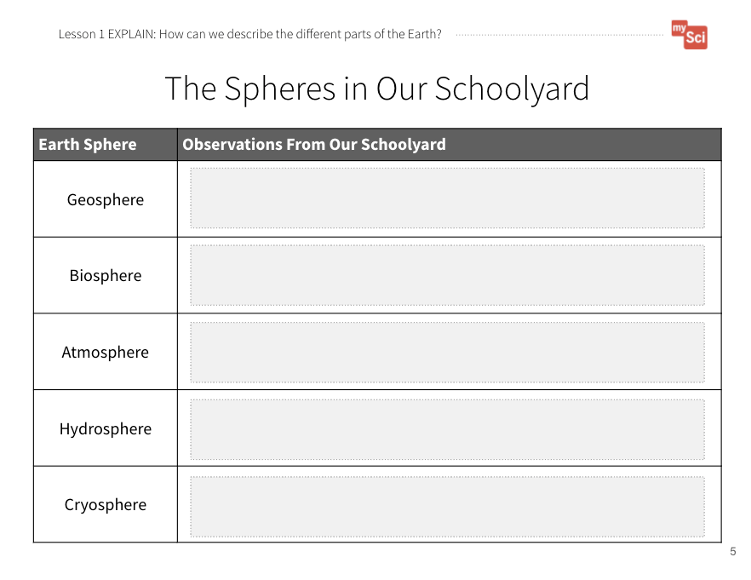
Lesson 1: Explain (cont.)
Lesson 1:
EXPLAIN
How did you categorize the parts of the environment?
Why?
The Systems in Our Schoolyard
Student Journal page
Notes:
EXPLAIN Summary: Students obtain information about the systems that make up Earth.
Once students return to class, have them share their observations and the different classifications they made. Push students to provide reasoning for how they categorized the different parts of the environment.
Say to students: Scientists have words to describe the different parts of our Earth. There are four different categories, or systems, that we can use to describe our planet. Now is a good time to introduce geosphere, biosphere, atmosphere, and hydrosphere to students. You can direct their attention to the Latin roots (geo, bio, atmo, hydr). Ask students: Have you ever heard these are part of any other words? (Students may have exposure to these roots as part of words like geode, geology, biology, biography, hydrate.) When introducing vocabulary, refer to the vocabulary slides that provide students with images to associate with these words as well as spanish translations to support ELL.

Slide 11
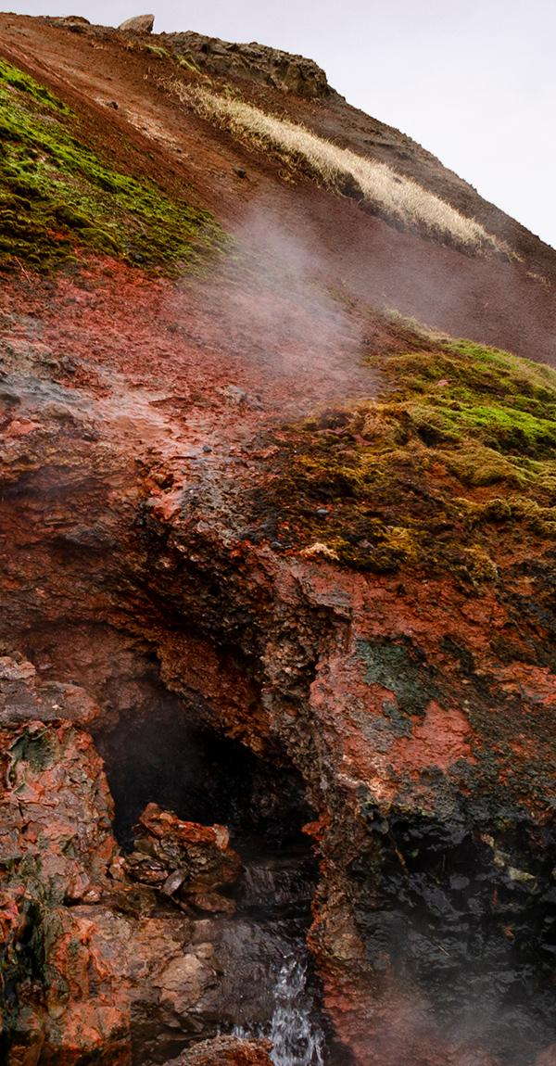
Geosphere
Lesson 1
geosphere
Earth’s crust and mantle (soil, rocks, and molten rock)

Slide 12
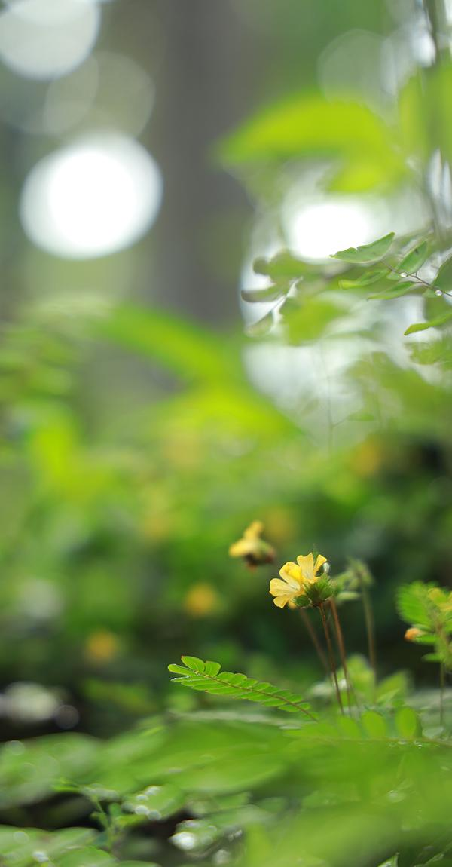
Biosphere
Lesson 1
biosphere
parts of the Earth that contain organisms

Slide 13

Atmosphere
Lesson 1
atmosphere
the air that surrounds the Earth

Slide 14

Hydrosphere
Lesson 1
hydrosphere
liquid water on Earth’s surface, in the ground, and in the air

Slide 15
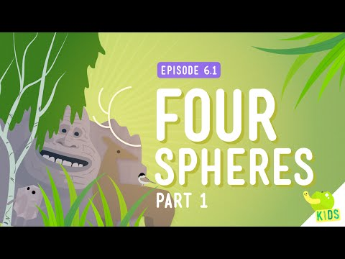
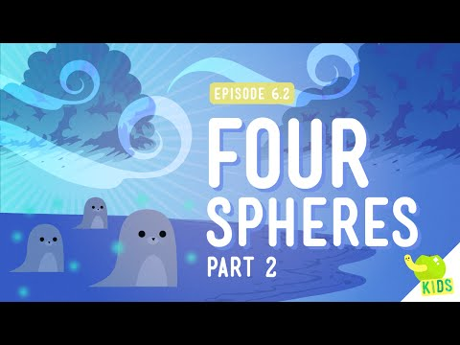
Four Spheres
Lesson 1:
EXPLAIN
Crash Course Kids Spheres Part 1
Crash Course Kids Spheres Part 2
Notes:
Next, have students watch the following videos:
Four Spheres Part 1 (Geo and Bio): Crash Course Kids #6.1 (4:00)
Four Spheres Part 2 (Hydro and Atmo): Crash Course Kids #6.2 (3:30)
These videos are used to introduce the terms to students. Each video covers two spheres. After each sphere is discussed, pause the video. Direct students to work with a partner or small group to come up with their own definition of the term. You can then have the students share their definitions with the class to come up with a class definition of each term. Then, return to the “investigate” portion of the video. This portion should be used as practice before they re-categorize their observations from nature. Next, have students re-categorize the parts of the environment they observed into the appropriate sphere using The Systems in Our Schoolyard Student Journal page.
This activity is a chance to formatively assess students' understanding of part of DCI ESS2.A. If students are struggling to categorize their observations into the different systems, rewatch the videos and go over the examples as a class.

Slide 16
Lesson 1: Explain (continued)
Lesson 1:
EXPLAIN
Re-categorize the parts of the environment you observed as either geosphere, biosphere,
atmosphere, or hydrosphere.
The Systems in Our Schoolyard
Student Journal page
Notes:
Next, have students re-categorize the parts of the environment they observed into the appropriate sphere using The Systems in Our Schoolyard Student Journal page.
This activity is a chance to formatively assess students' understanding of part of DCI ESS2.A. If students are struggling to categorize their observations into the different systems, rewatch the videos and go over the examples as a class.

Slide 17
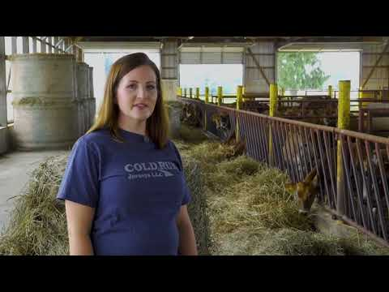
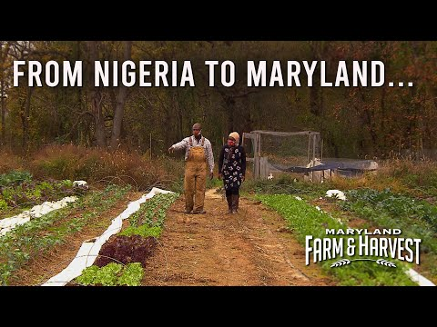
Lesson 1: Elaborate
Lesson 1:
ELABORATE
Dairy Farm
Immigrant Farmers Put Down New Roots
Notes:
ELABORATE Students develop a model of a farm and illustrate the different Earth systems on it.
Show students the following videos of a farm: Dairy Farm (5:33) by ADAMideast and Immigrant Farmers Put Down New Roots by Maryland Farm and Harvest. Pause the videos routinely to allow students to make observations about the things they see on the farm.

Slide 18
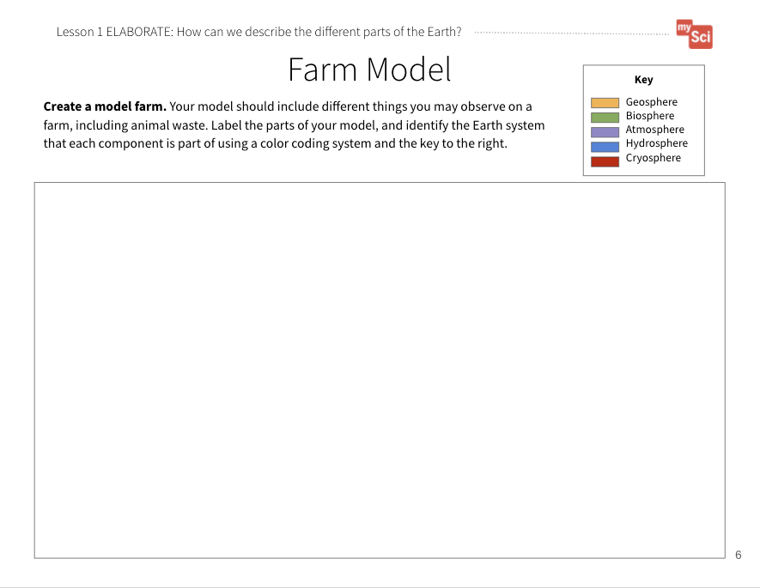
Lesson 1: Elaborate (cont.)
Lesson 1:
ELABORATE
Now you can develop your own model farm with our new way of looking at the environment.
What should your model include?
How will you label the different systems?
An important opportunity to attend to equity is offered in the speaker notes area
“Gotta Have It” Checklist: Our Farm Model has to have...
✔
✔
✔
✔
✔
✔
Farm Model
Student Journal page
Notes:
Say to students: You are now going to create your own initial model of a farm that you will revise throughout this unit. Let’s develop a “Gotta Have It checklist” that tells us what we want to show on our model. To do this, ask students: What have we learned about so far in this unit that we might want to include in our models? Examples of things the model’s “gotta have” include:
Representations of different things you would find on a farm
Labels correctly identifying the systems these things are part of
Students will create their models on the Farm Model Student Journal page. Students can create a digital drawing, a paper-based drawing that is uploaded, or a physical model. They can also represent their ideas through writing. Allow students to add in components they may know about that occur on farms, but were not included in the video. Students should identify each component, and label which of Earth’s systems it falls under. For example, a student may observe a cow and categorize this as being part of the biosphere, while categorizing a farm pond as the hydrosphere. Note that students can construct these models individually, or in small groups, throughout this unit. Provide students with colored pencils, markers, or crayons so that they can use colors to identify features of their farm if they would like.
Attending to Equity:
The “Gotta Have It Checklist” is a tool from the book Ambitious Science Teaching. By having students co-construct this checklist, rather than the teacher providing this up front, they are active participants in deciding what counts as important in their scientific explanations. This list can evolve over time, and you can provide an example or two at first so that you scaffold this process for them. Watch the Creating Gotta Have it Checklist Video from AST to support you in co-constructing this with your students.

Slide 19
Lesson 1: Evaluate
Lesson 1:
EVALUATE
Let’s share our models and give each other feedback.
Then use the feedback to revise our models.
Farm Model
Student Journal page
Notes:
EVALUATE Summary: Students evaluate each other’s farm models.
Have students share their models with a partner and give each other feedback. Did they have something to represent each system? Did they label all parts of their model? How do their models compare with each other’s? Bring the class back together, and ask students to share out the differences and similarities in their models. This supports students to see the different ways you can represent and label things in models. Based on their discussion, students should change their models to reflect feedback. This is the beginning of a model that will be used across all lessons as students explain the resources used on a farm, and how they impact the environment.
Return to the class consensus model that was created in the Engage portion of lesson 1. Revise the class model to include the Earth systems students identified.
This activity is a chance to formatively assess students' understanding of the SEP Developing and Using Models, DCI ESS2.A, and the CCC System and System Models. Look for students to have met the criteria of the “Gotta Have It” checklist. See the student journal answer key for an example. If students are struggling to apply what they have learned in developing a model, use the initial class model you created in the Engage to show students how to further develop a model.

Slide 20
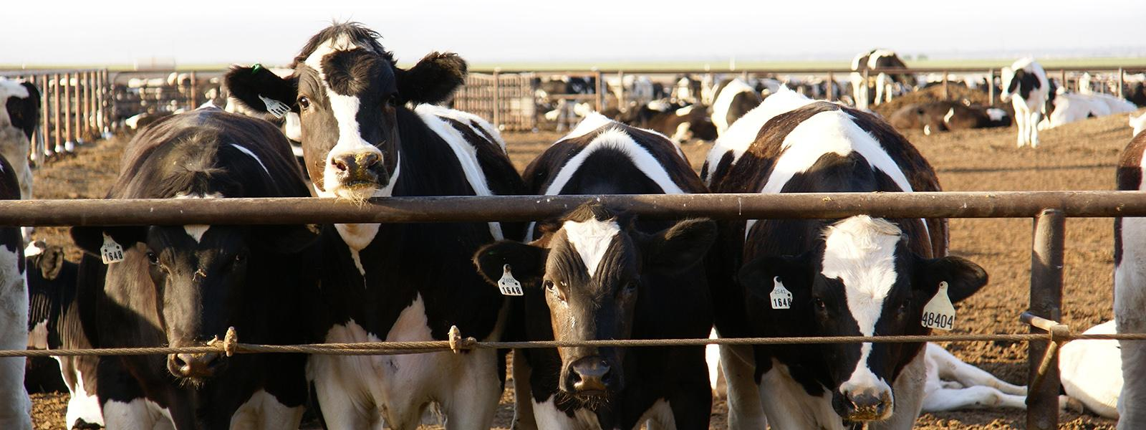
Lesson 1: Evaluate (cont.)
Lesson 1:
EVALUATE
How might this help us figure out how farms are part of Earth’s systems?
Notes:
To support student sensemaking across the unit, orient students back to the DQB. Ask students: What did we observe during today’s activity? Record the activity and their observations. Next, ask students: What did we learn today? Record their responses. If students need a reminder, they can reference their student journals.
Ask students: How might this help us figure out how farms are part of Earth’s systems? To support students in making connections, ask: What do we know about the environment? What systems are present on farms? (Students may discuss that there are different parts of the natural environment (biosphere, geosphere, atmosphere, hydrosphere), and that these parts exist on human-managed farms as well.)

Slide 21
What new questions do you have?
Lesson 1:
EVALUATE
Notes:
Next, ask students: What new questions do you have? (They may have new questions, such as: How can animals and plants on a farm affect the different Earth systems? How do the parts of our environment interact with one another? What happens to one part of the environment if there is a change in another? What role do humans play in the environment?)
Option A: Direct student to write down 2-3 questions they have. Then, write student responses on the driving question board.
Option B: Have students record their questions on sticky notes and then they can post their notes on the class driving question board.
Do not provide these questions for students, instead help them start thinking about these ideas by focusing their attention to the different systems that they labeled on their models and how that could relate to the anchoring problem: We need farms to grow food, but the process of producing food for all of us can harm Earth systems. Have students place their questions into existing categories, or create new categories.

Slide 22
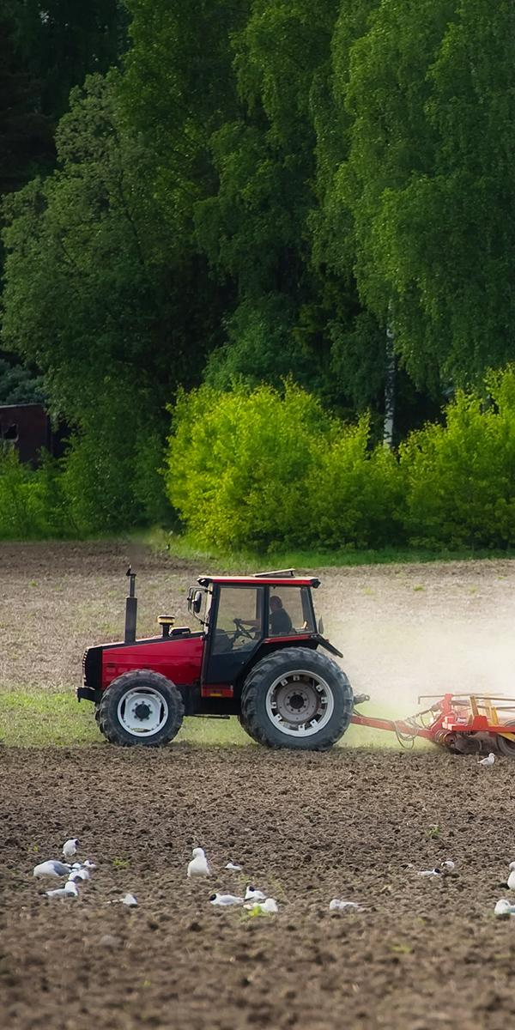
LESSON 2:
How do Earth’s systems interact?
Lesson 2:
LEARNING TARGET
Notes:
In the last lesson, students explained complex interactions between Earth systems. They refined their farm models to include interactions between the components on the farm.
In this lesson, students track their daily routines and research to see how natural resources can be used as energy for our daily lives.
Students figure out that natural resources are Earth materials, such as air, water, soil, and energy that are used by humans to live.
In the next lesson, students will learn about how the use of natural resources by humans can affect the environment.

Slide 23
Lesson 2: Engage
Lesson 2:
ENGAGE
What are the Earth’s systems we learned about in the previous lesson?
How do you think the different Earth systems interact with each other?
Can you give an example from something you have observed in your life?
Notes:
ENGAGE Summary: Students co-construct an initial model showing how different parts of the environment interact.
Begin the lesson by revisiting the Driving Question Board. Review the words, phrases, or questions used to categorize student questions. Also review specific student individual questions. Consider if any of these questions are connected to the learning of this lesson. If so, highlight this question for students. Say to students: Today’s activity will support us in answering this question. By answering this question, we will be able to build on our understanding of the anchoring problem.
Say to students: We are trying to figure out how farms are part of Earth’s systems in order to address the anchoring problem that producing food uses a lot of resources and that can harm Earth’s systems. In the previous lesson, we described the different parts of a farm environment. We considered what Earth systems these things were part of.
Have students name the Earth systems they worked on in the previous lesson- (hydrosphere, geosphere, biosphere, and atmosphere). They can refer back to their models to help them remember the names of the systems. Write them on the board or chart paper.
Ask students: How do you think the different Earth systems interact with each other? Can you give an example from something you have observed in your life? Allow students to Turn and Talk, then share a few answers with the whole class.

Slide 24
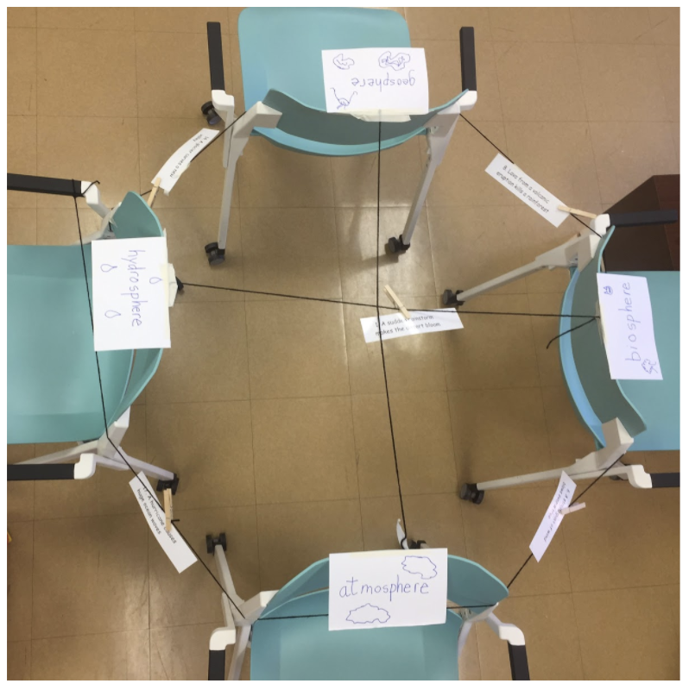
Lesson 2: Explore
Lesson 2:
EXPLORE
Read your card.
Decide which two spheres are interacting, and why you think that.
Clip the card on the string that connects those two spheres.
Notes:
EXPLORE Summary: Students use a model to explain how systems interact on Earth.
Say to students: Let’s explore ways that the systems of the Earth interact with each other. We’re going to look at examples of things that happen on our planet. Each group will decide which systems are interacting, and pin the card on the string that links the two systems. Then, we will look at what other groups decided and ask questions about why they made those choices.
Label the walls, chairs or desks: Atmosphere, Biosphere, Hydrosphere, Geosphere using the index cards. Tape a string between each of the four walls, chairs, or desks at the site of the posters, so that each sphere is connected to every other sphere (it will look like a box with an x in it — six pieces of string).
Explain that each student or group will get cards that show spheres interacting, and they should clip it on the correct string with the clothespin you will give them. To facilitate student discussions about the cards, as you walk around you can ask: What interactions do you see happening in your cards? How do you know those interactions are taking place? Which string do you think this card should go on? Why? If students are struggling, use the examples in the Teaching Tip to support them. Pass out Interaction Cards and clothespins to the students. Have the students use a clothespin to clip the interactions on the correct strings. Here is a teacher tutorial for this activity. You can also do this activity virtually using the Earth Systems Interaction game.
Teaching Tip:
Example of possible system interactions:
Fast flowing water erodes rocks (hydro/geo). The water is the cause, and erosion is the effect.
Water vapor creates clouds (atmo/hydro). Water vapor is part of the atmosphere, and when it condenses to form clouds, water drops are part of the hydrosphere.
Plants use carbon dioxide and give off oxygen. (bio/atmo). The plants are part of the biosphere, and the oxygen they give off is part of the atmosphere.

Slide 25
Lesson 2: Explain
Lesson 2:
EXPLAIN
Share what you think with the rest of the groups.
Other groups can ask questions or make alternative claims if you disagree- but you must use evidence!
Notes:
EXPLAIN Summary: Students use a model to explain how water moves through and influences systems on Earth.
Once students have placed their card, have each student or group share their card, explain which systems are interacting, and the evidence that supports why they think that. Give students time to ask questions and make alternative claims about which spheres are interacting. To support students to do this, consider using: Conversational Support for Sharing and Expanding on Each Other's Ideas from STEM Teaching Tools.

Slide 26
Lesson 2: Explain (cont.)
Lesson 2:
EXPLAIN
How does one of the systems in your example affect the function of the other system?
What would happen if one of the systems was removed?
Notes:
Next , ask students to use the model to explain why these interactions matter. Ask students: How does one of the systems in your example affect the function of the other system? What would happen if one of the systems was removed?

Slide 27
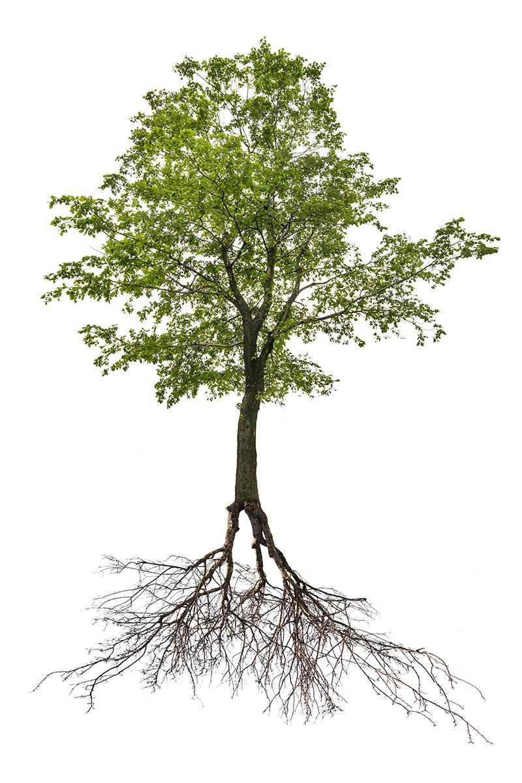
System
Lesson 2
system
a group of related parts that function together as a whole
Notes:
Now is a good time to introduce or review* what a system is with students – a group of related parts that function together as a whole. You may ask them what they think a system is, and what it is like.

Slide 28
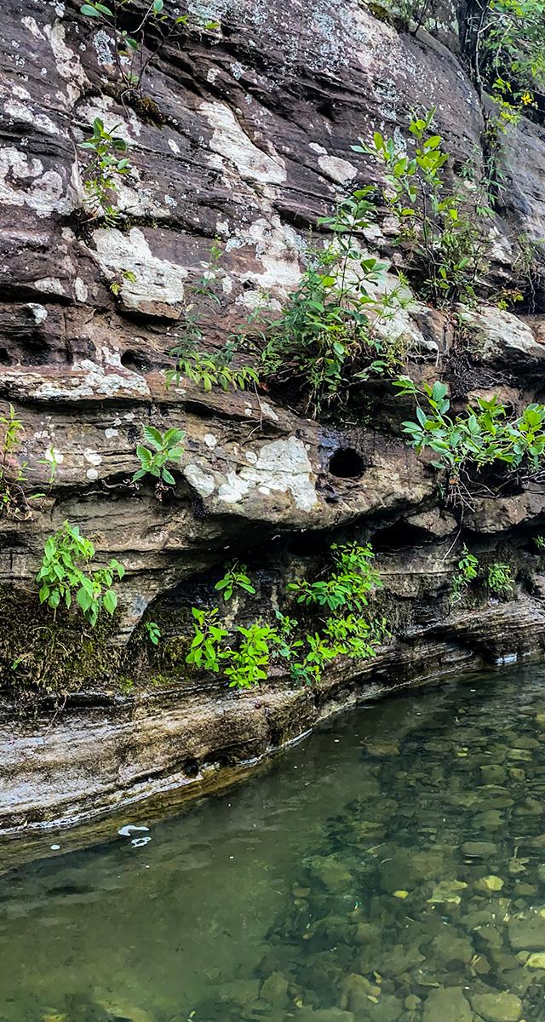
Interact
Lesson 2
interact
have an effect on each other
Notes:
Say to students: Earth is actually one big system. The different spheres are smaller systems within the larger whole of the Earth. The parts of a system interact, or have an effect on each other.

Slide 29
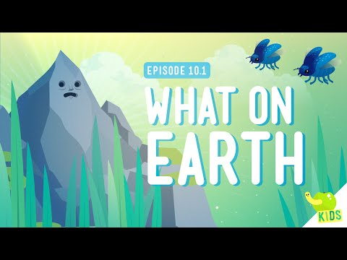
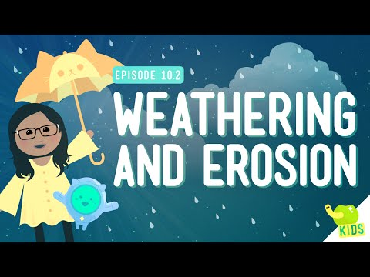
‘What on Earth’ and ‘Weather and Erosion’ Videos
Lesson 2:
EXPLAIN
What on Earth
Weather and Erosion
Notes:
You can also show the following videos to help students see an example of how the hydrosphere and geosphere interact and how the hydrosphere affects the geosphere: What on Earth (3:42) and Weathering and Erosion (4:05) by Crash Course Kids.

Slide 30
Lesson 2: Elaborate
Lesson 2:
ELABORATE
How would you describe the different parts of a farm environment interacting?
Dairy Farm
Immigrant Farmers Put Down New Roots
Notes:
Show students the following videos of a farm: Dairy Farm (5:33) by ADAMideast and Immigrant Farmers Put Down New Roots(6:04) by Maryland Farm and Harvest. Have students identify where they observe interactions occurring between the things on the farm. Students may observe cows eating the grass. They may also make note of the farmer who discusses drinking the water, and breathing the air on the farm.

Slide 31
Lesson 2: Elaborate (cont.)
Lesson 2:
ELABORATE
A good model of a system shows relationships between parts of the system!
“Gotta Have It” Checklist: Our Farm Model has to have...
✔
✔
✔
✔
✔
✔
What could we add to our Farm Model to show the interactions of the different Earth Systems?
Farm Model
Student Journal page
Notes:
After watching, say: What could we add to our Farm Model to show the interactions of the different Earth systems? Let’s develop a “Gotta Have It checklist” that tells the relationships we want to show on our model. What interactions should we include in our model? Think of all the possible interactions we discussed in this lesson. Students can refer back to the activity from the Explain phase. What else should we include as part of our model so that other people know what we drew? As students come up with suggestions, add them to the “Gotta Have It Checklist.” Examples of things the model’s “gotta have” include:
How the atmosphere interacts with the geosphere
How the atmosphere interacts with the biosphere
How the atmosphere interacts with the hydrosphere
How the geosphere interacts with the biosphere
How the geosphere interacts with the hydrosphere
How the biosphere interacts with the hydrosphere
A way of showing the interactions taking place (with a key or legend- for example, students may decide to use arrows to show waste particles moving into the geosphere or atmosphere)
Have students add these interactions to their model (Farm Model Student Journal page). Note: students are only expected to be assessed on two system interactions at a time. However, they may identify more than two interactions as part of their model. If students are struggling to make connections among systems, ask students: Are there components you could add to your farm model that would help you identify interactions?

Slide 32
Lesson 2: Evaluate
Lesson 2:
EVALUATE
Let’s share our models and give each other feedback.
Then use the feedback to
revise our models.
Notes:
EVALUATE Summary: Students evaluate each other’s farm models and give feedback.
Have students share their models with a partner and give each other feedback. Did they have an example of the different sphere interactions? Did they label all parts of their model? How do their models compare with each other’s? Bring the class back together, and ask students to share out the differences and similarities in their models. This supports students to see the different ways you can represent and label things in models. Based on their discussion, students should change their models to reflect feedback.
Return to the class consensus model that was created in the Engage portion of lesson 1. Revise the class model to include the interactions the students described from their individual models. Ask students what labels you should put on your drawing. This helps scaffold the revision process that students will engage with throughout this unit.
This activity is a chance to formatively assess students' understanding of the SEP Developing and Using Models, DCI ESS2.A, and the CCC System and System Models. Look for students to have met the criteria of the “Gotta Have It” checklist. See the student journal answer key for an example. If students are struggling to apply what they have learned in developing a model, use the class consensus model you created in the Engage to support students to further develop their models.

Slide 33
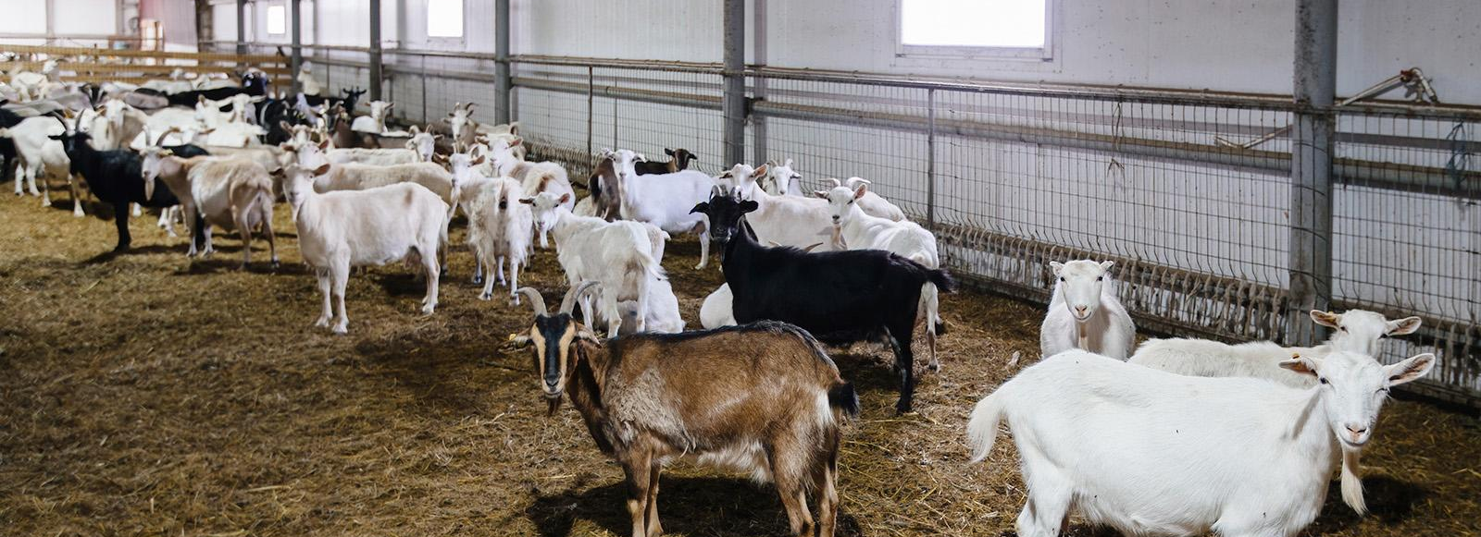
Lesson 2: Evaluate (cont.)
Lesson 2:
EVALUATE
How might this help us figure out how farms are part of Earth’s systems?
Notes:
To support student sensemaking across the unit, orient students back to the DQB. Ask students: What did we observe during today’s activity? Record the activity and their observations. Next, ask students: What did we learn today? Record their responses. If students need a reminder, they can reference their student journals.
Ask students: How might this help us figure out how farms are part of Earth’s systems? To support students in making connections, ask: What do we know about Earth systems? Are they isolated from one another? (Students may say that the parts of the environment interact with one another. These interactions affect how different Earth systems function. Animals (biosphere) on farms drink water (hydrosphere). Plants (biosphere) grow in soil (geosphere).)

Slide 34
Lesson 2: What new questions do you have?
Lesson 2:
EVALUATE
What new questions do you have?
Notes:
Next, ask students: What new questions do you have? (They may have new questions, such as: Are all interactions between Earth systems beneficial? Can some interactions cause problems?)
Do not provide these questions for students, instead help them start thinking about these ideas by focusing their attention to the interaction of different systems that they labeled on their models and how that could relate to the anchoring problem:We need farms to grow food, but the process of producing food for all of us can harm Earth systems. Have students place their questions into existing categories, or create new categories.

