Slide 1
The Pennsylvania STEELS Assessment Foundations Toolkit
Module 1: Features of Quality Assessments for the Science, Technology & Engineering, Environmental Literacy Sustainability (STEELS) Standards
[Date]

Slide 2
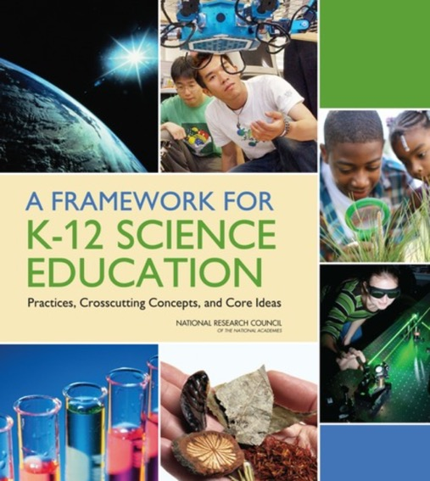

STEELS: Rigorous Learning Goals
In 2022, Pennsylvania adopted the Science, Technology & Engineering, Environmental Literacy & Sustainability (STEELS) standards, new learning goals for K–12 students based on research of how students learn.
Updated PSSA and Keystone exams are operational in spring 2026.

Slide 3
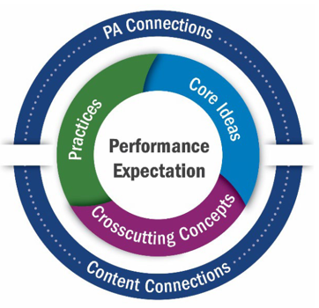
STEELS: Rigorous Learning Goals (continued)
These K–12 standards represent not just what kids learn, but how they learn:
A shift from “learning about” to “figuring out” that puts students in the driver’s seat.
Learning about
Figuring out
Local Pennsylvania learning contexts
Cross-content connections

Slide 4
STEELS Assessment Foundations Toolkit
The three modules in this toolkit will support participants to build a foundation in how to monitor and further student learning of Pennsylvania’s STEELS standards.
Module 1: Features of Quality STEELS-Based Assessments
Module 2: Assessing Rigorous Science Learning of All Students
Module 3: Cultivating a System Where Assessments Work Together to Improve Student Learning

Slide 5
Module 1 Goal
Build a common understanding of features of quality STEELS assessments, including:
Phenomenon- and problem-based assessments
Multi-dimensional assessments

Slide 6
Module 1: Features of Quality STEELS Assessments
Module 1 Progression
Session 1.1
Session 1.3
Session 1.4
Session 1.2
Assessments that Reflect Our Vision
Phenomenon /Problem-Based Assessment Scenarios
Multi-Dimensional Assessments
Evidence of Phenomena and Multiple Dimensions

Slide 7
Create Your Workspace
What could set you up to do your best learning, collaborating, and thinking in this context?
How do you want your workspace arranged today?
What resources do you want to have pulled up?
Source: SPA-LC NGSS District Assessment Toolkit

Slide 8
Module 1: Session 1.1 - Features of Quality STEELS Assessments
Module 1 Progression
Session 1.1
Session 1.3
Session 1.4
Session 1.2
Assessments that Reflect Our Vision
Phenomenon /Problem-Based Assessment Scenarios
Multi-Dimensional Assessments
Evidence of Phenomena and Multiple Dimensions

Slide 9

Vision
What is our vision for science and engineering learning and student performance?

Slide 10

Vision (continued)
Think of a student who means a lot to you (personal connection, student of yours, someone you are concerned about).
What do you want the student’s experience in science to look like?
What do you expect their performance to look like at the end of their science learning experience?

Slide 11
Common Answers
Students as “doers” engaging as scientists and engineers
Critical thinking
All students
Flexible, creative reasoning
Figuring out the world around them
Relevant and authentic
Solving local community problems
Working in new contexts
Motivated, engaged, inspired students
Prepared for college, careers, and citizenship

Slide 12

Assessments That Measure What We Value
If that vision is what we value in science and engineering education…
How many of our current assessments measure what we value?

Slide 13
Vision (cont.)
It’s important that assessments measure what we value for all learners and support us in reaching our vision.

Slide 14

Assessments That Support Our Vision
The STEELS standards require us to think about assessment differently.
Learning about topics in science
Figuring out phenomena / problems

Slide 15
Norms: Cultivating a Culture of Caring
Recognize that we all need care at some point, in some way.
Share what you need in order to be cared for well.
Protect your (and other people’s) time to rest.
Practice vulnerability in ways that are reciprocal.
Get to know your colleagues and students.
Make connections between the micro and the macro.
Keep a record of your progress over time.
Honor and recognize the leadership and knowledge of the people indigenous to where you are.
Value insights from those with different backgrounds.
Nurture imagination.
Celebrate.
Adapted from Source: Othering & Belonging Institute, SPA-LC NGSS District Assessment Toolkit
Notes:
See supplement for more details https://docs.google.com/document/d/1QFzXHdk2n8qdfj_XObgjFEQD_cV3fSZTvzdI19b_58I/edit?usp=sharing

Slide 16
What if… Assessment Were a Caring Practice?
What might this look like in assessment?
How would student experience change with assessments?
What might this look like in our work together?
Source: SPA-LC NGSS District Assessment Toolkit

Slide 17
Thought Experiment: Jack and Jill
Jack and Jill are discussing new STEELS assessments, and they’ve run into some issues balancing different considerations for their tasks.
They have a shared overall vision for science education for all students…
…but they disagree about the “right” trade-offs to make to support all students.

Slide 18


Thought Experiment: Jack and Jill (continued)
Do you agree more with Jack or Jill?
Jack
Jill
“Assessments are for gaining insight into students’ ideas that can help us build on their current thinking and further their learning.”
“Assessments are for generating a score or grade that shows student progress for several audiences.”

Slide 19

Reflection
In light of our vision, what are some
opportunities
challenges
goals
for science assessment in our school systems?

Slide 20

Features of Assessment
What are we looking for in classroom assessments?

Slide 21
Thought Experiment: Jack and Jill (cont.)
Do you agree more with Jack or Jill?
Jack
Jill
"It is most important that assessments clearly elicit learning of grade-level practices, ideas, and concepts even if it is not connected to a phenomenon or problem."
"It is most important that assessments ask students to use the dimensions as they make sense of phenomena and solve design problems, even if not all knowledge and practice is explicitly covered."

Slide 22



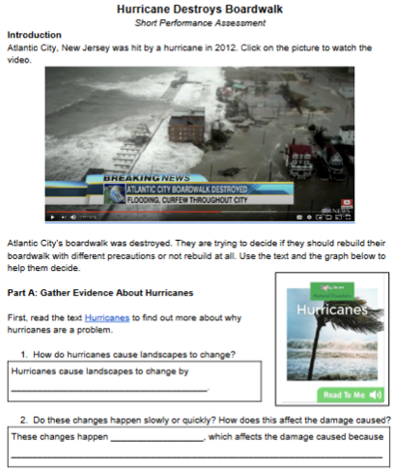
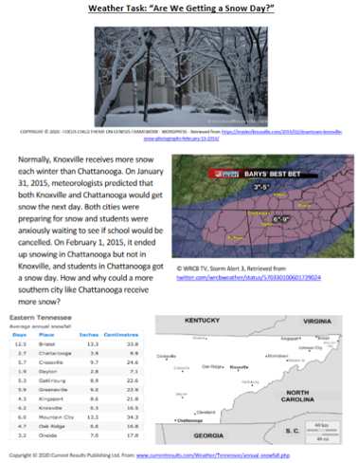
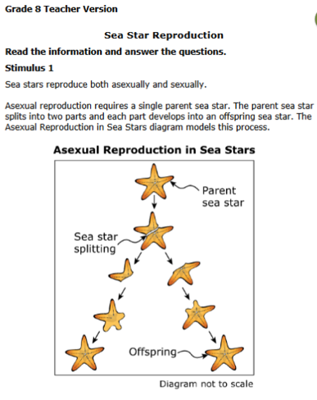
Three Tasks
These tasks are not exemplars. They are meant to spark discussion.
*An assessment task is a specific activity designed to collect evidence about a student's achievement of a targeted learning outcome.

Slide 23



What Do We Look for in Assessments?
You have three tasks. By yourself:
Work through each task as a student might. For each task, jot down what you like about the task and what concerns you about the task.
Order the tasks from most likely to support your vision of science education to least likely.
Make notes about what patterns in the tasks are driving your decisions, referring to evidence from each task.

Slide 24
What Do We Look for in Assessments? (Continued)
With your group, construct an argument for the “right” order of the tasks on chart paper. In your argument, make sure you include:
The order your group agreed upon;
An alternative order you considered;
Your evidence and reasoning for why the order you agreed on is right; and
A summary of the top 3–5 features that drove your decision making as a group.

Slide 25
Themes: Session 1.1
Phenomena and Problems
Sense-Making / Reasoning
Fair and Equitable
Multi-Dimensional

Slide 26
Reflection: Session 1.1
Take a moment to reflect on the task comparison and write a reflection for yourself:
What new understandings do you have now about eliciting use of the three dimensions?
What are you left wondering about?

Slide 27
Revisiting Our Vision
Do you have any new ideas you'd add to our vision?
What do you want the student’s experience in science to look like?
What do you expect their performance to look like at the end of their science learning experience?

Slide 28
Themes: Session 1.2
Phenomena and Problems
Sense-Making / Reasoning
Fair and Equitable
Multi-Dimensional

Slide 29
Module 1: Session 1.2 - Features of Quality STEELS Assessments
Module 1 Progression
Session 1.1
Session 1.3
Session 1.4
Session 1.2
Assessments that Reflect Our Vision
Phenomenon /Problem-Based Assessment Scenarios
Multi-Dimensional Assessments
Evidence of Phenomena and Multiple Dimensions

Slide 30
Topics-Phenomena-Problems Game
With a shoulder partner, sort the cards into three groups and note the reasons why:
We will discuss as a whole group after you have sorted.
Topics
Phenomena
Problems
Adapted from ACESSE Resource E: Selecting Anchoring Phenomena for Equitable 3D Teaching and Assessment

Slide 31
Uncertainty Is Key
Uncertainty is inherent in scientific understanding.
A good phenomenon or problem in both instruction and assessment poses uncertainty to students.

Slide 32
Topics-Phenomena-Problems
 | Working Definition | Example
Topics | General categories like those you might see in a science textbook. | Plants and animals in an ecosystem rely on each other.
Phenomena | Events that can be explained with science ideas. | When Melody hit the plunger against the wall, it stuck.
Problems | Situations somebody wants to change (that might be solved through science, technology, and engineering practices). | People are getting sick when eating a lot of fish from the Susquehanna River.
Adapted from: Phenomena & Problem Solving Bite-Sized Module, National Center for the Improvement of Educational Assessment in collaboration with The Alabama Math, Science, and Technology Initiative.

Slide 33
Phenomena and Problems in Assessment
We’ve thought about qualities of phenomena and problems themselves, but what do they look like in assessment?

Slide 34
Phenomenon → Scenario
Presenting a phenomenon in an assessment task creates a “scenario,” which carefully provides students with the context to make sense of the phenomenon or problem using science, engineering, and environmental ideas and practices.
Adapted from: Phenomena & Problem Solving Bite-Sized Module, National Center for the Improvement of Educational Assessment in collaboration with The Alabama Math, Science, and Technology Initiative.

Slide 35
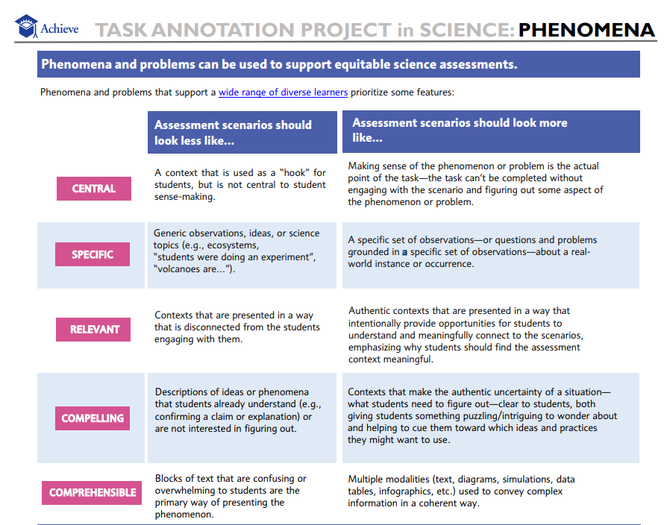
Quick Read: Quality Assessment Scenario Table
These features will provide a lens for us to analyze the quality of example assessments in a “Scenario Gallery Walk.”
Source: Task Annotation Project for Science (TAPS), nextgenscience.org

Slide 36
Scenario Gallery Walk Directions
Central
Choose one criterion as your focus.
Take a stack of the assigned color sticky notes for your criterion.
Visit and read each scenario (move at your own pace).
For each, leave a note with one thing you notice/one piece of feedback related to your criterion.
Specific
Relevant
Compelling
Comprehensible
Example for Comprehensible (blue)
Notice: Text is long and uses one modality.
Feedback: Consider shortening and adding relevant images.

Slide 37
Criterion Expert Groups
In criterion-specific groups, revisit the tasks and discuss whether:
There's a common understanding of the criterion
There are patterns across the tasks

Slide 38
Continuum Reflection: Assessments Use Authentic Scenarios
Stand-alone items disconnected from phenomena and problems
High-quality scenarios that focus on phenomena or problems
Think of the assessments your students interact with. Where do they fall on this continuum right now?
Source: SPA-LC NGSS District Assessment Toolkit

Slide 39
Reflection: Session 1.2
Why are phenomenon/problem-driven scenarios important for high-quality science assessments?

Slide 40

What Happens When Phenomena Are Used?
Multiple dimensions are used together to figure things out.
Connections are made across seemingly different events.
The "why do I need to learn this?" question is answered.
Students are positioned as developing experts who can take meaningful action.
A 2015 earthquake moved Mt. Everest southwest by 3 cm.
Adapted from: Phenomena & Problem Solving Bite-Sized Module, National Center for the Improvement of Educational Assessment in collaboration with The Alabama Math, Science, and Technology Initiative.

Slide 41
Key Point
STEELS assessments present phenomena or problems to students in ways that let them “do science and engineering” and figure something out.
In order to do this, students make visible their use of multiple dimensions.

Slide 42
Themes: Session 1.3
Phenomena and Problems
Sense-Making / Reasoning
Fair and Equitable
Multi-Dimensional

Slide 43
Module 1: Session 1.3 Features of Quality STEELS Assessments
Module 1 Progression
Session 1.1
Session 1.3
Session 1.4
Session 1.2
Assessments that Reflect Our Vision
Phenomenon /Problem-Based Assessment Scenarios
Multi-Dimensional Assessments
Evidence of Phenomena and Multiple Dimensions

Slide 44


Compare: Are They Multi-Dimensional?
Create a model to explain what effect the reintroduction of wolves had on the food web in Yellowstone National Park in 1990.
How do producers differ from consumers?
Create a model of a food web.
VS.

Slide 45
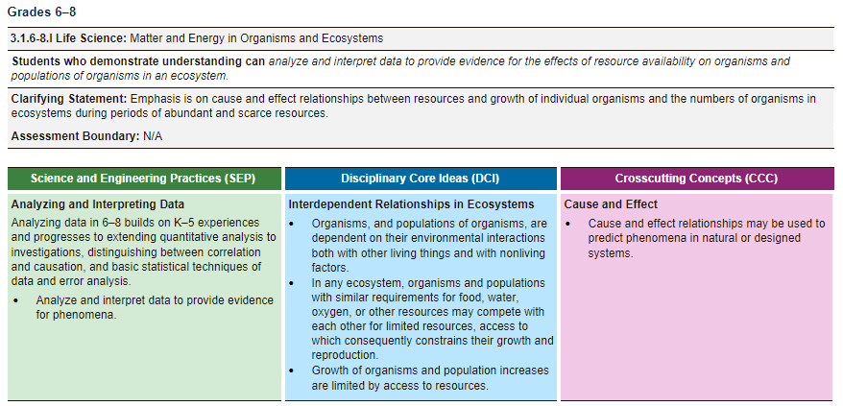
Integrated Performance Expectations
STEELS performance expectations integrate multiple dimensions for a reason.
Reflect: Why don’t the STEELS just list the dimensions separately?

Slide 46
Quick Review: What Are the Dimensions?
Disciplinary Core Ideas
Crosscutting Concepts
Science and Engineering Practices
Technology and Engineering Practices

Slide 47
Disciplinary Core Ideas (DCIs)
What are they?
Foundational ideas in each science discipline focused on in greater depth rather than shallow coverage of a larger number of topics
Life Science
Earth and Space Science
Engineering, Technology, & Applications of Science
Physical Science
Includes Environmental Literacy
Example
Students need to know “the amount (weight) of matter is conserved when it changes form, even in transitions in which it seems to vanish” (PS1.A: Structure and Properties of Matter, Grade 3–5) when explaining how a solar still works to produce fresh water.

Slide 48
Crosscutting Concepts (CCCs)
What are they?
Concepts and intellectual tools that bridge and help deepen understanding of core ideas and make sense of things
Patterns
Cause and Effect
Scale, Proportion, and Quantity
Systems and System Models
Energy and Matter
Stability and Change
Structure and Function
Examples
Students use the idea that “a system can be described in terms of its components and their interactions” (Systems and System Models, Grade 3–5) to help them think about how a solar still works to produce fresh water.
Students use the idea that “relationships can be classified as causal or correlational, and correlation does not necessarily imply causation” (Cause and Effect, Grade 6–8) to make sense of the relationship between mountain growth and earthquakes.
*CCCs are not included in Technology and Engineering Standards.

Slide 49
Crosscutting Concepts: Additional Example
The goal is for students to build and use CCCs as thinking skills.
Like other thinking skills (e.g., the process of elimination), students become much more proficient using them when they realize they are using them.
Students have been working toward explaining the phenomenon of how a seed became a tree (where did all that mass come from?). They are prompted to think about the different CCCs they have used before and consider which one they want to use to help them start figuring out the phenomenon.
They think about the CCC element “systems may interact with other systems; they may have sub-systems and be a part of larger complex systems” and that leads them to think about:
Whether a tree interacts with a larger system, and if so, what the components of that system are; and
What sub-systems might operate within a tree.

Slide 50
Science and Engineering Practices (SEPs)
What are they?
Practices used by scientists and engineers to build, deepen, and apply DCI and CCC knowledge
Asking questions (for science) and defining problems (for engineering)
Developing and using models
Planning and carrying out investigations
Analyzing and interpreting data
Using mathematics and computational thinking
Constructing explanations (for science) and designing solutions (for engineering)
Engaging in argument from evidence
Obtaining, evaluating, and communicating information
Example
Students “Develop a model using an analogy, example, or abstract representation to describe a scientific principle or design solution” (Developing and Using Models, Grade 3–5) when showing evaporated water on a model to explain how a solar still works to produce fresh water.

Slide 51
Technology and Engineering Practices (TEPs)
What are they?
Skills and abilities students have to successfully apply technology and engineering DCIs
Attention to Ethics
Systems Thinking
Creativity
Making and Doing
Critical Thinking
Optimism
Collaboration
Communication
Examples
Students “develop written and oral communication skills” (Communication, Grade 3–5) while engaging in argument from evidence about whether a solar still design will work.
Students “exhibit safe, effective ways of producing technological products, systems, and processes” (Making and Doing, Grade 6–8) while designing a solution to prevent a garden from flooding.
*TEPs are only included in Technology and Engineering Standards. They are represented by the same color as CCCs.

Slide 52

Performance Expectations
STEELS standards require students to use ideas and practices represented by these dimensions
together, not separately
to make sense of the world and solve problems.

Slide 53

Assessing Multiple Dimensions
How do we know we're really assessing all the dimensions?

Slide 54


Compare: CCCs
Should the survivors be worried about losing water they can drink from the solar still system? Use evidence from your model to explain why or why not.
What are the qualities of open and closed systems?
VS.
Notes:
CCC: Matter flows and cycles can be tracked in terms of the weight of the substances before and after a process
occurs. The total weight of the substances does not change. This is what is meant by conservation of matter. Matter is transported into, out of, and within systems.

Slide 55

Compare: SEPs
Draw a model that shows how matter changes state.
Use the model to explain how the salt is removed from the water in the solar still. Include how the changes in states of matter makes the solar still work.
VS.

Slide 56
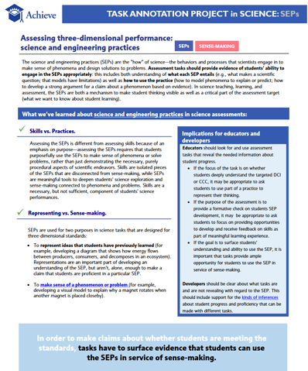
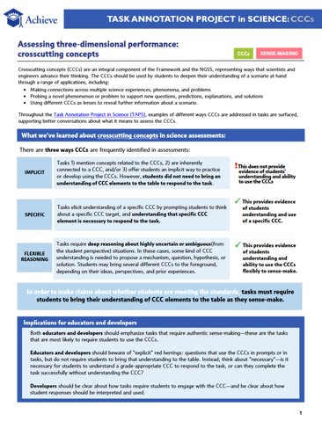
A B Each Teach
Resource A: SEPs
Resource B: CCCs
Find a partner
One partner reads Resource A
One partner reads Resource B
Teach each other what you learned
Source: Task Annotation Project for Science (TAPS), nextgenscience.org

Slide 57
What Else Should Be on the List?
SEPs for making sense
CCCs are explicit
Not just completing the mechanics/skill
Not just representing what the student already knows (“rote” knowledge)
Not just implicitly related
Requires use of a specific CCC

Slide 58
Continuum Reflection: Multiple Dimensions
Students only need one dimension to complete a task
Students use all three dimensions within the full set of questions in a task
Think of the assessments your students interact with. Where do they fall on this continuum right now?
Source: SPA-LC NGSS District Assessment Toolkit

Slide 59
Continuum Reflection: Integrated Multiple Dimensions
Most questions require students to use two dimensions together
Dimensions assessed in isolation / separate prompts
Think of the assessments your students interact with. Where do they fall on this continuum right now?
Source: SPA-LC NGSS District Assessment Toolkit

Slide 60
Module 1: Session 1.4 Features of Quality STEELS Assessments
Module 1 Progression
Session 1.1
Session 1.3
Session 1.4
Session 1.2
Assessments that Reflect Our Vision
Phenomenon /Problem-Based Assessment Scenarios
Multi-Dimensional Assessments
Evidence of Phenomena and Multiple Dimensions

Slide 61
Example
What does evidence of multiple dimensions look like in an example task?

Slide 62



Survivors Stranded 5th Grade Assessment Excerpt
You and a group of survivors were stranded after your plane crashed near a remote island off the coast of New Zealand.
Water is necessary for human survival; however, the only water available is saltwater from the ocean.
While humans can safely ingest small amounts of salt, the salt content in seawater is much higher than what can be processed by the human body. Eventually the body will dehydrate and shut down.

Slide 63
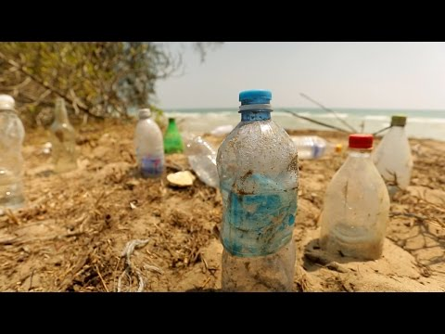
Survivor Stranded
This survival expert recommends you use a solar still made from plastic bottles washed up on the shore.
Source: Discovery, How to Desalinate Water on a Desert Island, YouTube
Notes:
https://www.youtube.com/watch?v=rUET3PnPZng&feature=youtu.be

Slide 64
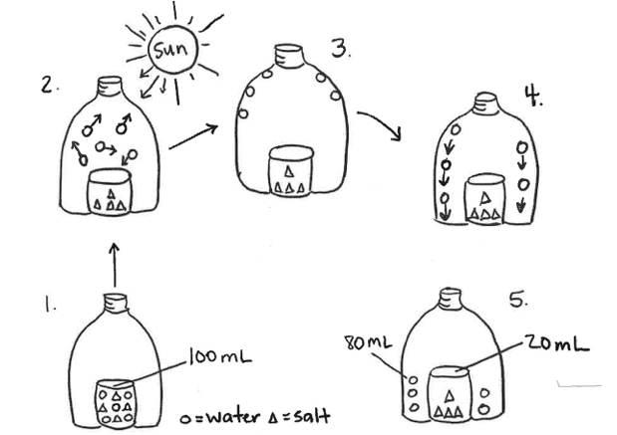
Survivors Stranded Excerpt
Prompt A: Use the steps in the model to explain how the salt is removed from the water in the solar still. In your explanations include how changes in states of matter make the solar still work as a system.
Notes:
For sake of time, we're going to focus on analyzing one prompt - this is a good example of a three-dimensional prompt that addresses the phenomenon of the assessment and we can get lots of useful information about our students just from this prompt.
We first need to get really clear about which aspects of the dimensions this prompt assesses by looking at the performance outcome (click) so that we know what we are looking for in student work.

Slide 65
Example Task Assessment Grade 3–5 Targets
Science and Engineering Practices (SEPs) | Disciplinary Core Ideas (DCIs) | Crosscutting Concepts (CCCs)
Developing and Using Models Grade 3-5 Elements Use models to describe phenomena. | PS1.A: Structure and Properties of Matter Grade 3-5 Elements Matter of any type can be subdivided into particles that are too small to see, but even then the matter still exists and can be detected by other means. A model shows that gases are made from matter particles that are too small to see and are moving freely around in space can explain many observations, including the inflation and shape of a balloon and the effects of air on larger particles or objects. The amount (weight) of matter is conserved when it changes form, even in transitions in which it seems to vanish. | Energy and Matter Grade 3-5 Elements The total weight of the substances does not change. This is what is meant by conservation of matter.
Structure and Properties of Matter

Slide 66
Multi-Dimensional Assessment Claim
Prompt A: Use the steps in the model to explain how the salt is removed from the water in the solar still. In your explanations include how changes in states of matter make the solar still work as a system.
Performance Outcome: Use a model to describe how changes in states of matter cause the movement and conservation of matter even when it seems to vanish.
Task Source: Tennessee District Science Network

Slide 67
Multi-Dimensional Assessment Claim (part 2)
Prompt A: Use the steps in the model to explain how the salt is removed from the water in the solar still. In your explanations include how changes in states of matter make the solar still work as a system.
Performance Outcome: Use a model to describe how changes in states of matter cause the movement and conservation of matter even when it seems to vanish.
SEP
Source: Scale Science at WestEd

Slide 68
Multi-Dimensional Assessment Claim (part 3)
Prompt A: Use the steps in the model to explain how the salt is removed from the water in the solar still. In your explanations include how changes in states of matter make the solar still work as a system.
Performance Outcome: Use a model to describe how changes in states of matter cause the movement and conservation of matter even when it seems to vanish.
DCI
Source: Scale Science at WestEd

Slide 69
Multi-Dimensional Assessment Claim (part 4)
Prompt A: Use the steps in the model to explain how the salt is removed from the water in the solar still. In your explanations include how changes in states of matter make the solar still work as a system.
Performance Outcome: Use a model to describe how changes in states of matter cause the movement and conservation of matter even when it seems to vanish.
CCC
Source: Scale Science at WestEd

Slide 70


Assessing Use of Multiple Dimensions
Color-code your answers by dimension.
Compare against the performance outcome to determine whether the assessment prompts fully require use of the intended three dimensions.
Why or why not?
SEP
DCI
CCC
In the first bottle, you can tell that the circles and triangles are meaning salt water. When you put the bottle in the sun, the water evaporates and then condenses onto the side and when you flick it, all the water droplets fall on to the rim of the water bottle.
Performance Outcome:
Use a model to describe how changes in states of matter cause the movement and conservation of matter even when it seems to vanish.
Indicates evidence of both DCI and CCC.
Source: Scale Science at WestEd

Slide 71
Is It Grade Appropriate?
 | K–2 Elements | 3–5 Elements | 6–8 Elements
DCI: PS1.A: Structure and Properties of Matter | Different kinds of matter exist and many of them can be either solid or liquid, depending on temperature. Matter can be described and classified by its observable properties. | The amount (weight) of matter is conserved when it changes form, even in transitions in which it seems to vanish. | In a liquid, the molecules are constantly in contact with others; in a gas, they are widely spaced except when they happen to collide.
SEP: Developing and Using Models | Develop and/or use a model to represent amounts, relationships, relative scales (bigger, smaller), and/or patterns in the natural and designed world(s). | Use models to describe phenomena. | Develop or modify a model—based on evidence—to match what happens if a variable or component of a system is changed.
CCC: Energy and Matter | Objects may break into smaller pieces, be put together into larger pieces, or change shapes. | The total weight of the substances does not change. This is what is meant by conservation of matter. | Matter is conserved because atoms are conserved in physical and chemical processes.

Slide 72
Reflection: Session 1.4
Take a moment to reflect on your work today, write a reflection for yourself:
What new understandings do you have now about eliciting use of the three dimensions?
What are you left wondering about?

Slide 73
Module 2
Phenomena and Problems
Sense-Making / Reasoning
Fair and Equitable
Multi-Dimensional

Slide 74
Next Steps

Slide 75
Cultivating a Culture of Caring
What's one act of caring you experienced in today's session?
Recognize that we all need care at some point, in some way.
Share what you need in order to be cared for well.
Protect your (and other people’s) time to rest.
Practice vulnerability in ways that are reciprocal.
Get to know your colleagues and students.
Make connections between the micro and the macro.
Keep a record of your progress over time.
Honor and recognize the leadership and knowledge of the people indigenous to where you are.
Value insights from those with different backgrounds.
Nurture imagination.
Celebrate.
Adapted from Source: Othering & Belonging Institute, SPA-LC NGSS District Assessment Toolkit
Notes:
See supplement for more details https://docs.google.com/document/d/1QFzXHdk2n8qdfj_XObgjFEQD_cV3fSZTvzdI19b_58I/edit?usp=sharing

Slide 76

A Parting Thought
A man came upon a construction site where three people were working. He asked the first, “What are you doing?”
“I am laying bricks.”
He asked the second, “What are you doing?” and the man replied,
“I am building a wall.”
As he approached the third, he heard him humming a tune as he worked, and asked, “What are you doing?” The man stood, looked up at the sky, and smiled,
“I am building a castle!”
Source: SPA-LC NGSS District Assessment Toolkit

Slide 77
Contact/Mission
For more information on the Science, Technology & Engineering, Environmental Literacy & Sustainability (STEELS) assessments, please visit PDE’s website at www.education.pa.gov.
The mission of the Department of Education is to ensure that every learner has access to a world-class education system that academically prepares children and adults to succeed as productive citizens. Further, the Department seeks to establish a culture that is committed to improving opportunities throughout the commonwealth by ensuring that technical support, resources, and optimal learning environments are available for all students, whether children or adults.

