Slide 1
Assessment Literacy Series
Review Process
Overview

Slide 2

Assessment Review
Definition
Assessment review is a series of steps intended to guarantee the quality of an assessment’s design and build processes.
Notes:
Assessment review is a series of steps intended to guarantee the quality of an assessment’s design and build processes. Assessments that are well designed and well built provide an accurate and consistent measure of what students know and can do.

Slide 3
The Assessment Cycle: Review
Design
Purpose Statement & Targeted Content Standards
Test Specifications & Blueprints
Build
Selected Response Items
Constructed Response Items
Performance Task Items
Review Overview
Pre-Administration
Post-Administration
Review
Scoring Keys and Rubrics
Operational Test Form Design
Design Overview
Build Overview
Notes:
The two assessment review tasks (Pre-Administration and Post-Administration) complete the larger assessment cycle. To effectively review an assessment, it is important to understand where these tasks exist in the larger assessment cycle.

Slide 4
Assessment Review Tasks
Pre-Administration Tasks
How does the “big picture” review of the assessment inform a quality completion of the assessment?
Checklists
Materials Screening
Alignment
Item Inspection
Test Form Rigor
Final Review
Post Administration Tasks
What do the item and operational form statistics reflect about the items and tasks that were built?
Item Analyses
Scoring Framework Process
Notes:
Some review tasks are appropriately completed prior to the administration of the assessment, while some review tasks will require at least one administration of the assessment.
Pre-Administration
Before the assessment is administered, a review of the “Build” processes and how they align to the ”Design” processes should be done. This review is enacted through a series of checklists.
Post-Administration
If there is intent for any assessment items (or the complete assessment) to be administered more than once, the items should be reviewed through several item analysis processes. Rubrics should be reviewed through a scoring frameworks process.

Slide 5
Validity and Reliability
Validity refers the extent to which an assessment measures what it is intended to measure.
Reliability refers to the extent to which an assessment consistently and accurately measures student achievement.
Notes:
The psychometric discipline of designing valid and reliable large-scale assessments may not be easily replicated when designing and building assessments for smaller scales of use, such as a classroom or school-wide assessment. However, adhering to the guidelines for designing and building an assessment that you use in your classroom will help to make classroom assessments more valid and reliable.
Validity refers to the accuracy of an assessment—the extent to which it measures what you intend it to measure. For example, if you were to write a test question to measure your students’ ability to add fractions, you could unintentionally measure your students’ advanced reading ability if you use vocabulary that is well above grade level.
Reliability refers to an assessment’s consistency—the extent to which a student’s score will be the same no matter when, where or in what form the student takes the assessment or who scores it—whether it’s you or the teacher down the hall. It should not make any difference whether a student takes the assessment in the morning or afternoon; one day or the next.
Implementing assessment review tasks helps to ensure validity and reliability.

Slide 6
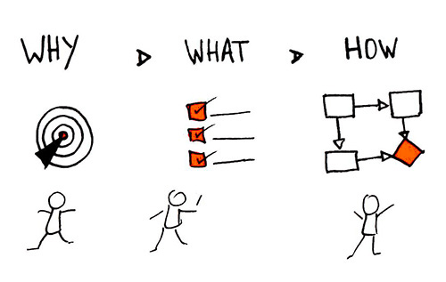
Meeting the Purpose with Quality
An assessment’s purpose statement outlines
why the assessment was developed,
what the assessment is measuring, and
how the results (scores) can be used.
Notes:
Review processes complete the assessment cycle by ensuring that the assessment meets its purpose with a high degree of alignment and quality.

Slide 7
Practice Makes Progress: Preparing for Review
Practice Makes Progress
Reflect on your assessment literacy learning by creating and completing a chart like the chart below:
Assessments Administered | Purpose for Administration | Things to consider changing based on learning from the Assessment Literacy Modules
Notes:
Before beginning a formal review process, consider assessments that you have administered and things that you might like to change based on learning from the Design and Build Assessment Literacy modules.

Slide 8
Contact/Mission
For more information on assessment literacy please visit PDE’s Standards Aligned System website at pdesas.org
The mission of the Department of Education is to ensure that every learner has access to a world-class education system that academically prepares children and adults to succeed as productive citizens. Further, the Department seeks to establish a culture that is committed to improving opportunities throughout the commonwealth by ensuring that technical support, resources, and optimal learning environments are available for all students, whether children or adults.

