Slide 1
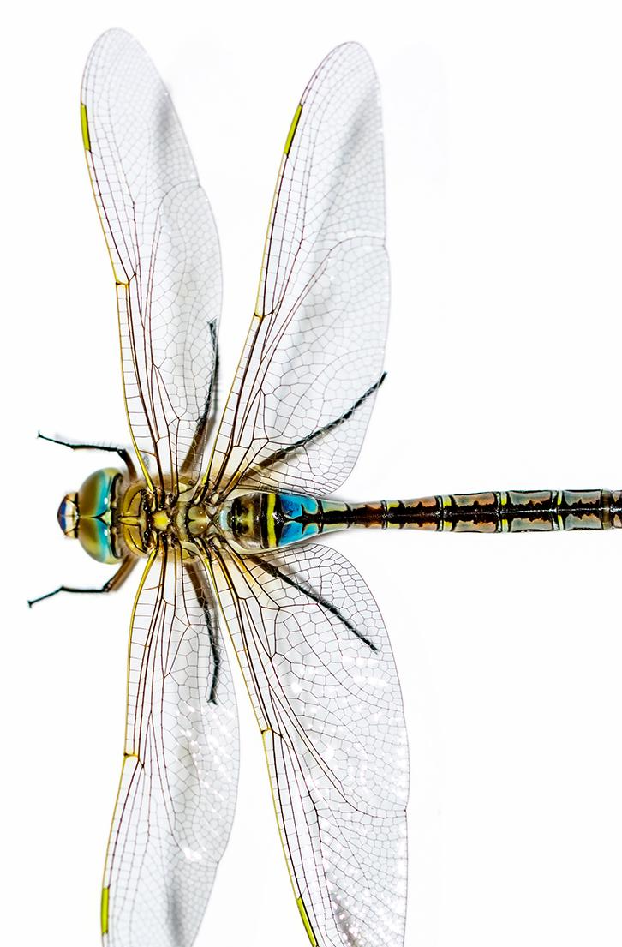



Unit 22: Lesson 6
How can we use animal waste as a natural resource?
Explore: Biodigester Set Up

Slide 2
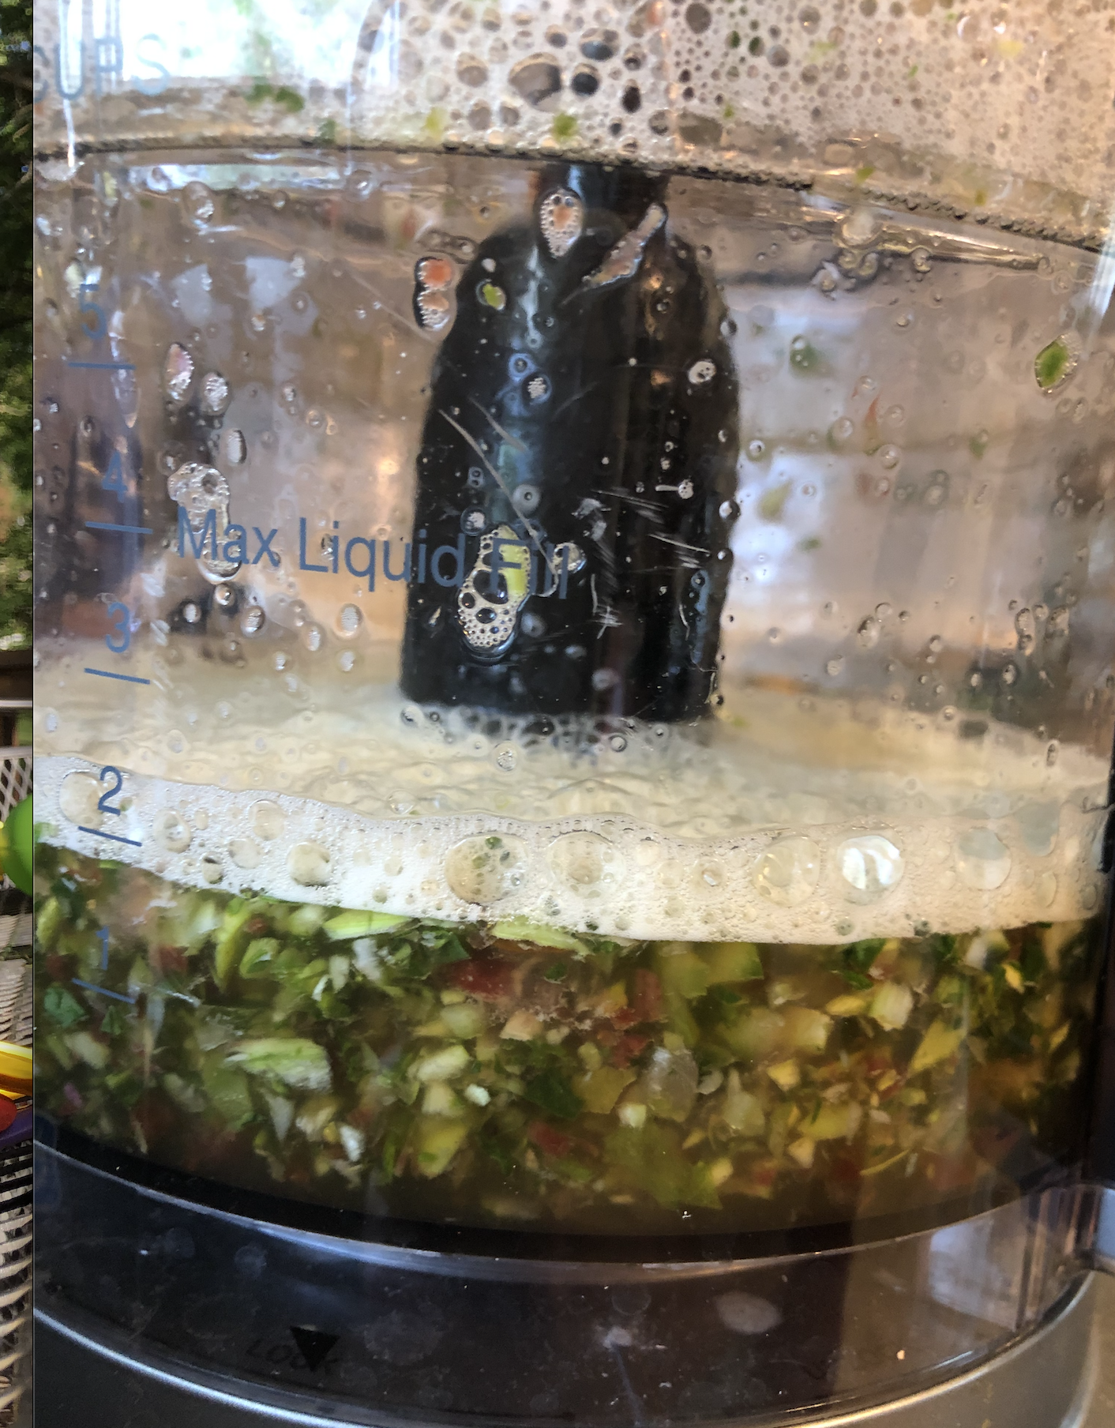
Pureed Food Scraps
Puree the food scraps into as small of pieces as possible. The smaller the pieces, the faster they will break down.

Slide 3
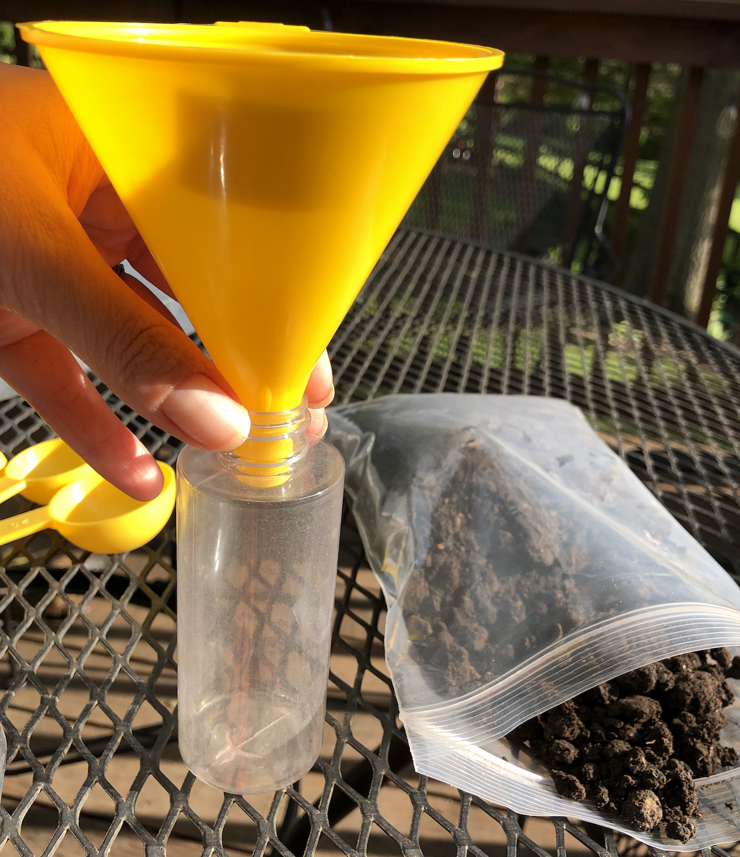
Adding Soil
Use the funnel and a measuring tablespoon to add the same amount of puree to all bottles. You may need to use the coffee straws in the kit to push the puree down the narrow filter opening.
To add the soil, use a smaller measuring spoon to add the same amount of soil to each bottle. You do not need to use the funnel for that.
Notes:
Note: If students choose to investigate how the presence of soil affects gas production in the biodigester, be sure to leave one bottle as the “No Soil” test bottle.

Slide 4
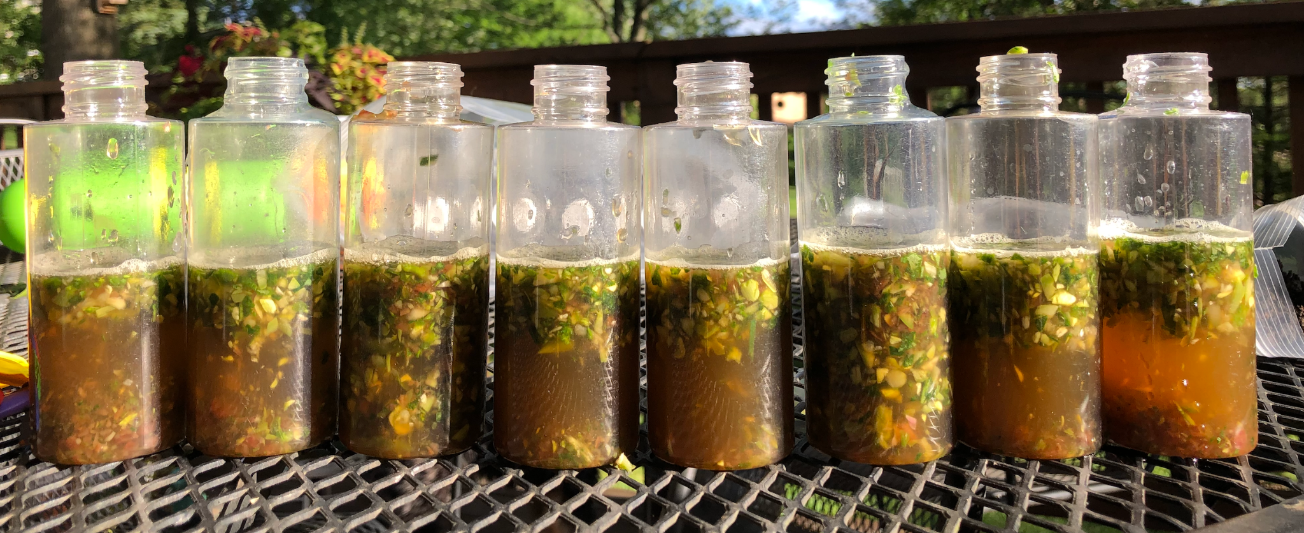
Finishing the Mixture
After you add the puree and the soil, fill the bottles up with water. You could fill them up higher than the picture shows, but if you do, add two tablespoons of food puree so that there is enough to have a reaction in the bottle.

Slide 5
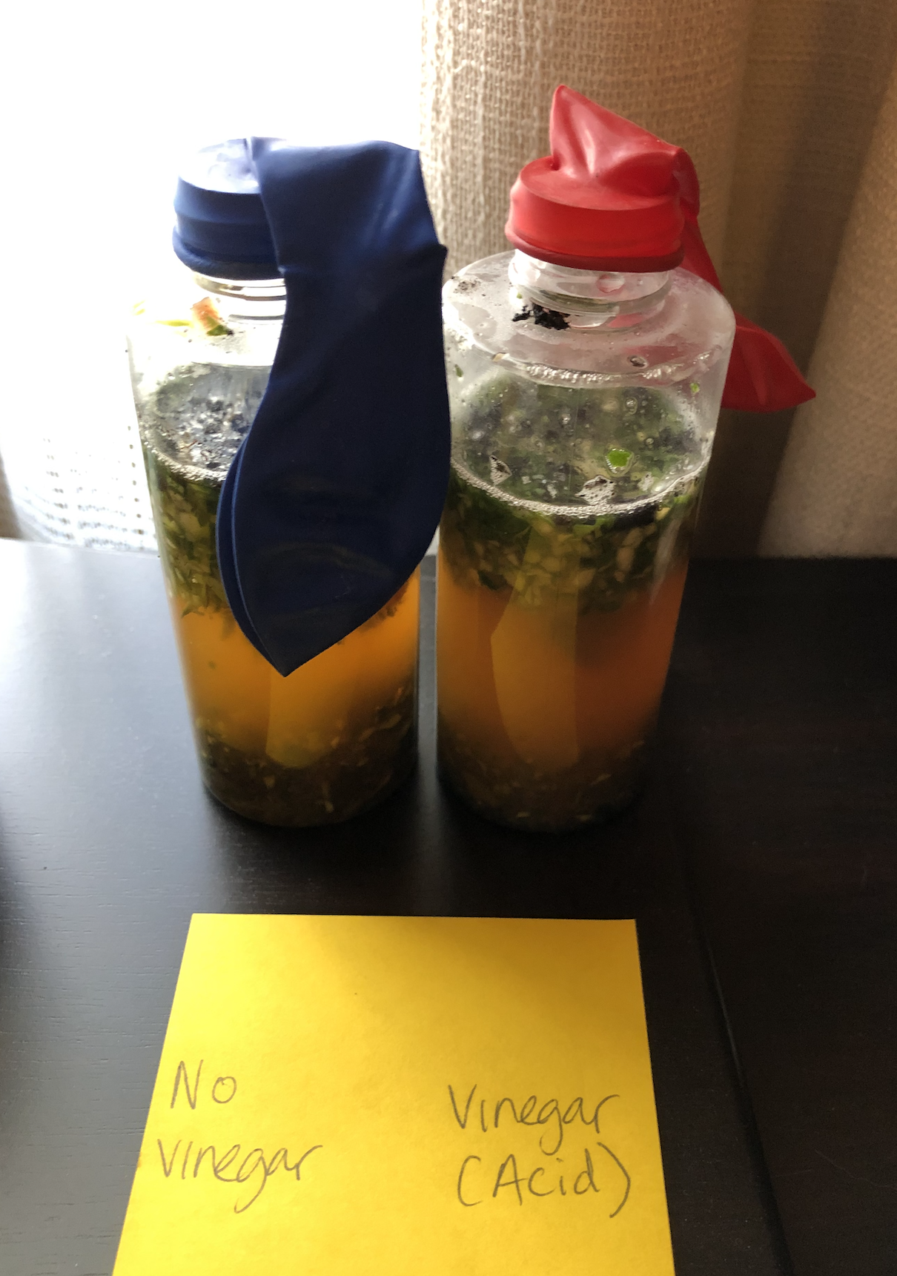
Observing the Experiment
Immediately place balloons over the bottlenecks. Label each set up with post-its or masking tape on the bottles so that students do not lose track of their bottles.
Place each bottle according to the experiment students chose (in the refrigerator, in a hot, sunny area, or in a room temperature area for non-temperature tests).
Note that if you place them in too cold of an environment, they may not produce much gas.
Also note that the balloons may inflate, then deflate. Any amount of gas production should be immediately measured and counted as methane production.
Notes:
Note: This is an example of an experiment setup that is testing to see if an acidic environment produces more gas than a non-acidic environment.

