Slide 1
Briceville

Slide 2
Terms and Concepts
Natural Resources: Materials or substances that exist freely in nature.
Living things depend on natural resources to survive. Many countries use their natural resources for economic gain.
What are some examples of natural resources?
Notes:
Review concept of natural resources. Ask students to brainstorm examples of natural resources.

Slide 3
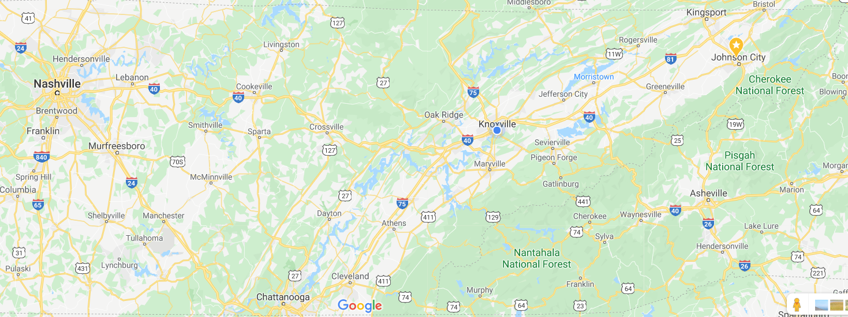
This is Briceville, TN. What natural resources do you think this community might have?
Notes:
Students will most likely point out the water and forest areas that are located close to Briceville, TN. Students would not be expected to identify coal as a natural resource that was located in the Briceville area at this point in the lesson.

Slide 4

Summer’s in Briceville
Every summer, Nicholas visits his great-grandmother in Briceville. Although he loves his great-grandmother, he dreads spending two weeks in a town that has so little to do. You can’t even get decent cell phone service in Briceville!
Bored out of his mind one day, Nicholas started rummaging through the attic. He was surprised to discover a large box with costumes and an old-fashioned advertisement for a play.

Slide 5
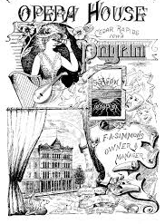
Briceville Opera House
Nicholas showed the playbill to his great-grandmother who exclaimed, “Why yes, dear, that sexy lady is me!”
Shocked, Nicholas asked her to explain. How could she be the lady in the picture?
Nicholas knew that his great-grandmother had lived in Briceville her whole life. But Briceville didn’t even have a stop light, much less a theater!
Nicholas’ great-grandmother began to explain. “Briceville has changed a lot in my lifetime,” she said. “It hasn’t always been the town you see today.”

Slide 6
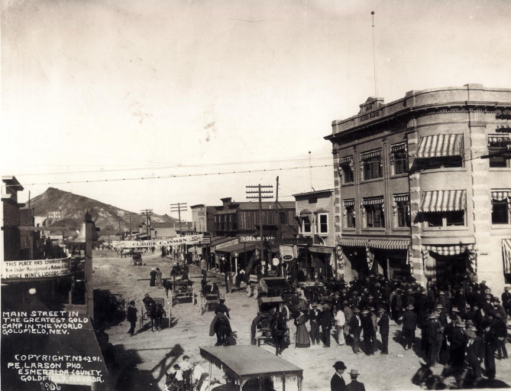
Early 1900’s Briceville
In the early 1900’s, when people in East Tennessee wanted to go to the theater, they didn’t have to travel to New York City. Instead, they went to the Odd Opera House in Briceville, Tennessee. The theater could seat 300 people and was a hub of activity for the bustling community of Briceville. Briceville was proud of its many businesses, churches, and homes.
However, the community of Briceville has changed over the past century.

Slide 7
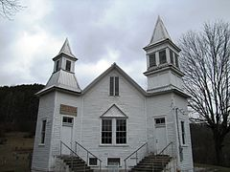
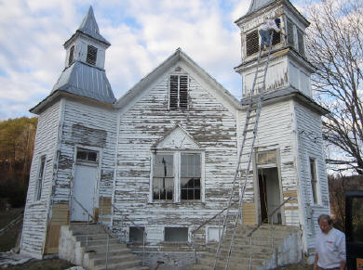
Photos of Briceville, TN Taken over 100 Years Apart
Briceville Community Church
Built in 1880
Briceville Community Church
Picture taken in 2002. The church has not been maintained
Notes:
Ask students: What do you notice? What do you wonder?
The goal is for students to infer that there has been a significant economic impact to Briceville. Teacher might ask for student ideas at this point to explain the observations.

Slide 8
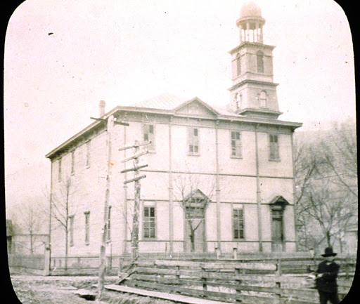
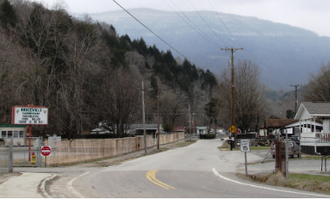
Photos of Briceville, TN Taken over 100 Years Apart.
Site of former Briceville Opera House
After it burned in 1918 it was never rebuilt.
Briceville Opera House
Built 1890
Notes:
Ask students: What do they notice? What do they wonder?
The goal is for students to infer that there has been a significant economic impact to Briceville. Teacher might ask for student ideas at this point to explain the observations.

Slide 9
Our Task:
(What the heck happened to Briceville?)
What factors have affected Briceville during the past 100 years to cause the changes noted in the photographs?
What has been the impact of each factor on the community?
Notes:
Students will be given data to use as evidence to answer this question.

