Slide 1
Act 13 Office Hour Targeted Topics
March 3, 2022

Slide 2
Agenda
Targeted Topics
Questions most frequently asked in the resource account and during webinars
Open Mic
Your opportunity to pose questions

Slide 3
Office Hours Etiquette
Listen to the presenter and enter relevant questions in the chat.
Use pause points to enter questions into the chat.
Monitor chat for responses.

Slide 4
Act 13 Frameworks
Classroom Teacher
Non-Teaching Professional
Principal
Includes Professional or Temporary Employee
Provides direct instruction to students related to specific subject or grade level
Includes Professional or Temporary Employee
Provides services other than classroom instruction
E.g., Counselor, Home School Visitor, IT Specialist, Nurse, Psychologist, Speech and Language Pathologist
Includes the following:
Principal
Assistant Principal
Vice Principal
Director of Career and Technical Education
Supervisor of Special Education (new with Act 13)
Notes:
Pull up the SAS site to showcase the Frameworks

Slide 5
Temporary Professional Employee
Article XI of the Pa. Public School Code defines the term "temporary professional employee" (TPE) to mean any individual who has been employed to perform, for a limited time (established by the LEA), the duties of a newly created position or of a regular professional employee whose services have been terminated by death, resignation, suspension, or removal.
Although Pa. Act 13 of 2020 amends the measures by which a TPE will be evaluated, the legislation does not alter the definitions of professional employees under Article XI. Administrators should check with their Human Resource personnel on how professional employees are currently classified by the LEA.
Notes:
Article XI defines the term to mean any individual who has been employed to perform, for a limited time, the duties of a newly created position or of a regular professional employee whose services have been terminated by death, resignation, suspension, or removal.
While the definition does not address tenure explicitly, commonwealth case law has held that the distinction between a professional employee and a temporary professional employee is that the former has secured tenure.

Slide 6
Act 13: Teacher Specific Data (Set 10%)
Academic Achievement
Only 2 Measures
available and directly attributable
Only 1 Measure
available and directly attributable
3 Measures
available and directly attributable
ELA 15 points
Math 15 points
Science 10 points
Applicable Measures (5% each)
State Assessments (2.5%)
PVAAS (5.0%)
IEP Goals Progress (2.5%)
Applicable Measure (10%)
If no measures are available and directly attributable to the teacher,
the 10% will be re-allocated to LEA Selected Measures.
Notes:
Reminder – these percentages cannot be altered.
In fall 2022, the Department will make available 21/22 SY Assessment data for Teacher-Specific Data attribution, where applicable to the professional employee.
Growth data for Teacher-Specific Data attribution will NOT be made available by the Department for the 21/22 SY or the 22/23 SY. However, the Department will make available 23/24 SY Growth data for Teacher-Specific Data attribution, where applicable to the professional employee, in the fall of 2024.

Slide 7
SLO vs. Student Performance Measure
SLO (Act 82)
Required and complex template
Rigid structure
Quantitative (assessment focus)
Lack of alignment between educator and principal templates
SPM (Act 13)
Optional and streamlined template
Flexible structure
Qualitative addition
Close alignment to Principal Performance Goal Template

Slide 8
IEP Goals Progress Measure
Chapter 19 of the Pennsylvania School Code clarifies “applicable and attributable” thusly: “Regardless of certification area, all classroom teachers shall be accountable for student progress toward IEP Goals.”
The IEP Goals Progress measure is required under the Individuals with Disabilities Education Act if:
the teacher provides instruction to a sufficient number of students with IEPs (meeting n count), and
those students have similar academic or non-academic IEP Goals to which the teacher contributes data used by the IEP team to monitor student progress.

Slide 9
IEP Goals Progress Measure Continued
The n count is defined as follows:
The n count set must be less than or equal to 11.
An “active n count” based on the portion of instructional responsibility may be used rather than an “actual n count”.
The n count should apply to a grade-level cohort or correlate to all students within a subject area rather than a single class or course taught by the teacher.
Notes:
Show completed IEP Goals Progress from IU 3’s module 3

Slide 10
Building Level Score
The Building Level Score will provide a quantitative academic score based upon a 100-point scale to represent the overall academic performance of each school in Pennsylvania.
Academic Achievement
Academic Growth
Academic Achievement
Other Academic Indicators
ELA 15 points
Math 15 points
Science 10 points
ELA 15 pts
Math 15 pts
Science 10 pts
ELA 15 points
Math 15 points
Science 10 points
Attendance Rate 10 pts
Graduation Rate 10 pts
*Absent a Graduation Rate, Attendance Rate is 20 Points.
Where a school is missing an Assessment or Growth indicator, the 100-point scale is reduced proportionally. For example, a K-3 school with no PVAAS data (40 points) and no Science Assessment data (10 points) will have a denominator of 50 points.
Notes:
In fall 2022, the Department will make available Building Level Scores comprised of Assessment, Growth, Attendance Rate, and Graduation Rate for the 21/22 SY, where the measures are applicable to the building.
PDE sends the scores and publishes them on its website. Chief School Administrator also receives them.

Slide 11
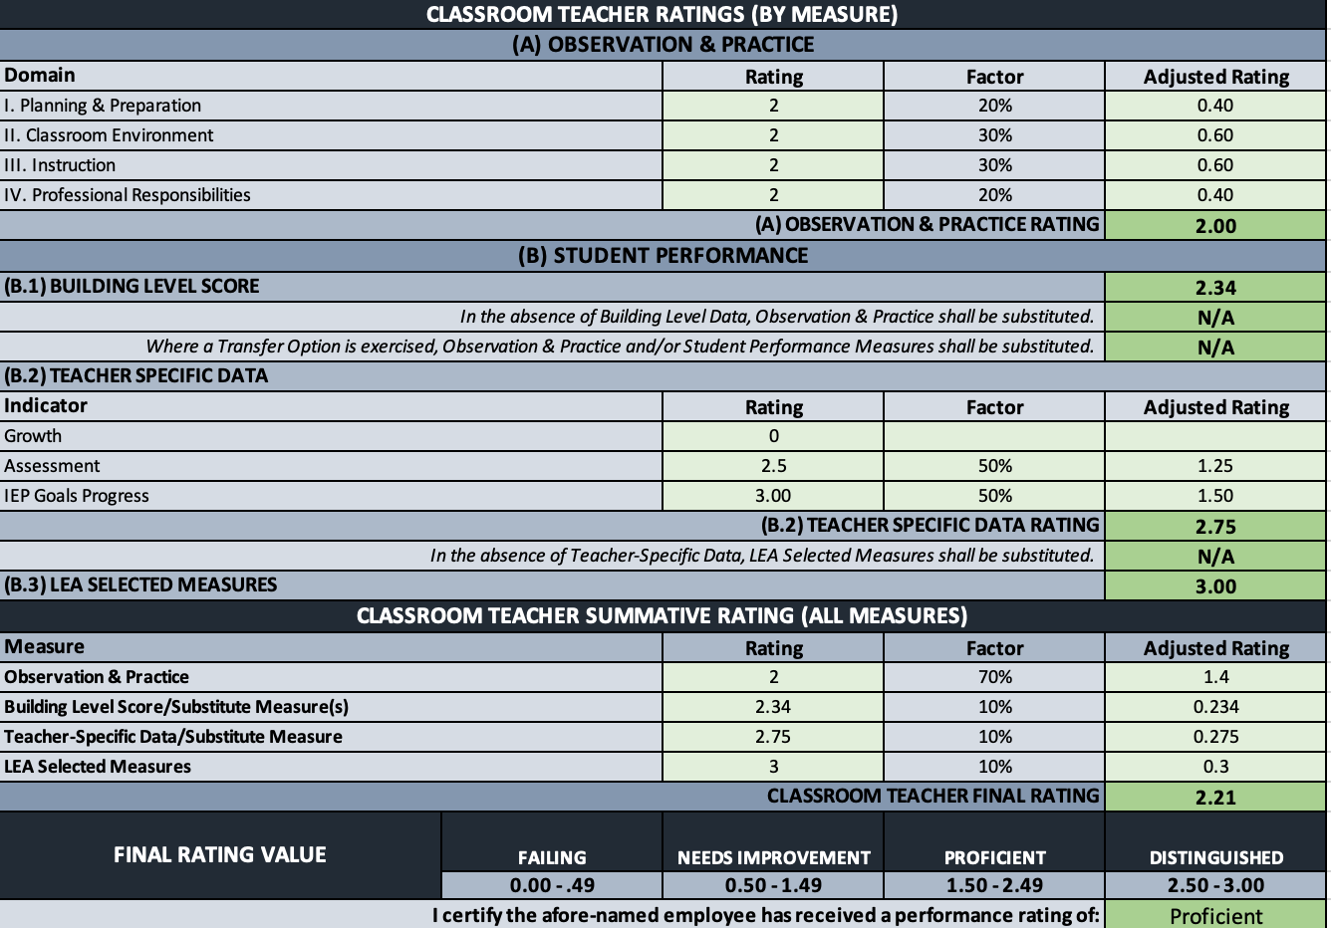
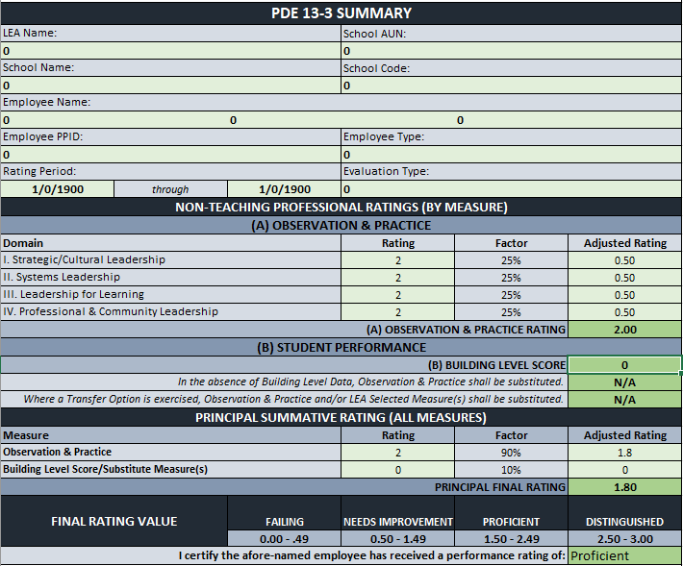
Rating Protocol
13-1
13-2
13-3
Notes:
PEERS will have all rating forms available by the end of the year for end of year evaluations.
Summary – The decimals do go out to the thousandth place (3 decimals), but it only displays to the hundredth place (2 decimals).

Slide 12
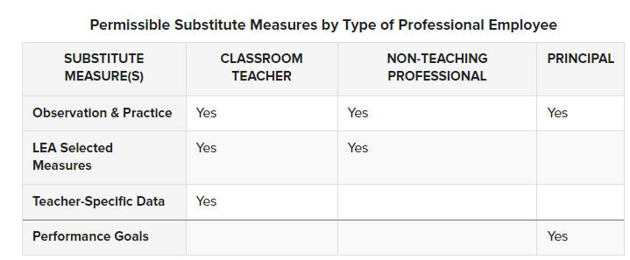
Transfer Option
A professional employee who transfers from one building to another within an LEA has the option of using a substitute measure in lieu of BLD for the first two school years of the new location assignment.
The following table delineates permissible substitute measures by type of professional employee:
Notes:
Before evaluation in the new location assignment, the employee and the LEA must agree on the substitute measure(s).

Slide 13
13-4 Interim Rating
Professional employees deemed Unsatisfactory in the last evaluation must be rated at least once a year using the measures and weightings appropriate to the employee, as indicated in the table above.
Subsequent ratings during the same evaluation period (i.e., interim evaluations) are not mandated; however, should an LEA elect to perform one, the interim evaluation must be comprised of the following:
70% Observation & Practice (aligns with the 13-1, 13-2, 13-3)
30% LEA Selected Measures
For the LEA Selected Measures rating, the LEA should use measure(s) appropriate to the type of professional employee. Examples as follows:
Performance Goal benchmarks might serve as a locally developed rubric in the evaluation of a principal.
Student career readiness portfolios might be used in the evaluation of a school counselor.
Notes:
For the Observation & Practice rating, the LEA should apply the same domains, weightings, and professional practice models utilized during the prior annual evaluation.
LEA Selected Measures reflective of the role and responsibility of the professional employee
Reminder: An interim rating is not a replacement for a semi-annual (TPE) or annual (TPE and PE) rating.

Slide 14
Performance Improvement Plan
Act 13 does not limit an employer's authority to design a Performance Improvement Plan; however, an employee who receives an overall performance rating of Failing or Needs Improvement must participate in a Performance Improvement Plan (PIP) designed by the employer with documented input from the employee. The PIP must:
Provide actionable feedback on the specific domain within the comprehensive observation and practice models that prevented the employee from achieving a Proficient rating, and
Identify employer resources to be provided to assist the employee in improving performance, including mentoring, coaching, professional development recommendations, and intensive supervision based on the contents of the rating tool.

Slide 15
What’s next?
Office Hour
Targeted Topics
March 10
3:00 pm
Notes:
Reminder that all three sessions are presenting the same information. So you only need to register for one session.

Slide 16
Contact/Mission
For more information on Act 13, please visit PDE’s website at www.education.pa.gov ​
https://www.pdesas.org/EducatorFrameworks/EducatorEffectiveness/
Act 13 Questions
RA-PDE-Evaluation@pa.gov
The mission of the Department of Education is to ensure that every learner has access to a world-class education system that academically prepares children and adults to succeed as productive citizens. Further, the Department seeks to establish a culture that is committed to improving opportunities throughout the commonwealth by ensuring that technical support, resources, and optimal learning environments are available for all students, whether children or adults.​

