Slide 1
Answer Key Unit 22 Using Our Resources Wisely: Student Journal (interactive version)
Table of Contents
Helpful Instructions for Using the Interactive Student Journal
Lesson 1: How can we describe the different parts of the Earth?
LAUNCHING THE UNIT: Ask a Question
EXPLORE: Parts of Our Schoolyard
EXPLAIN: The Systems in Our Schoolyard
ELABORATE & EVALUATE: Farm Model
Lesson 3: What are natural resources and how do humans use them?
ENGAGE: A Day in My Life
EXPLAIN: Fossil Fuel Energy Research
ELABORATE & EVALUATE: Farm Model
Lesson 4: How does our use of fossil fuels affect Earth’s systems?
EXPLORE: Research About Traffic and Asthma
EXPLORE: The Air We Breathe
EXPLORE: Effects of Fossil Fuels on the Environment
ELABORATE & EVALUATE: Farm Model
Lesson 5: How does our use of water affect Earth’s systems?
EXPLORE: Types of Water on Earth
Lesson 6: How does animal waste affect the environment and what can we do about it?
EXPLORE: Biodigestor Investigation
EXPLAIN: Biodigestor Investigation continued
EXPLAIN: Biodigestor Investigation continued
ELABORATE: Biodigestor Investigation continued
ELABORATE & EVALUATE: Farm Model
Lesson 7: How can people use resources in a way that is less harmful to the Earth?
EXPLAIN: Guiding Questions For Energy Island
EXPLAIN: Guiding Questions For Energy Island continued
ELABORATE & EVALUATE: A Farm that Helps Protect the Earth
Lesson 8: How can we use farms to harness wind energy?
EXPLORE: Engineering Design Cycle
EXPLORE: Design Challenge Rubric
EXPLORE: Wind Energy Design Challenge Notes
EXPLORE: Wind Energy Design Challenge Notes continued
EXPLORE: Wind Energy Design Challenge Notes continued
ELABORATE & EVALUATE: A Farm that Helps Protect the Earth
Lesson 9: How can farms make better use of animal waste?
ELABORATE: Advantages and Disadvantages

Slide 2
Helpful Instructions for Using the mySci Interactive Student Journal
Uploading a Paper Model or Drawing Tutorial
Creating a Digital Drawing or Model Tutorial
Creating a Digital Table or Graph Tutorial

Slide 3
Lesson 1 Launching the Unit: Ask a Question
Possible Student Questions:
What is an Earth system?
How do farmers produce food?
What all is on a farm?
Why would growing food harm an Earth system?
Are there positive impacts from growing food?
Do all the things grown on a farm have the same impact?

Slide 4
Parts of Our Schoolyard
Category: Things in the sky around my school
What I found:
Clouds
Birds
Category: Things on the ground around my school
What I found:
Rocks
Grass
Category: Things that are living
What I found:
Category: Things that are not living
What I found:
Category: Animals
What I found:

Slide 5
The Systems in Our Schoolyard
Soil and rocks
Grass, other plants, animals
Clouds
Water in a pond or creek

Slide 6
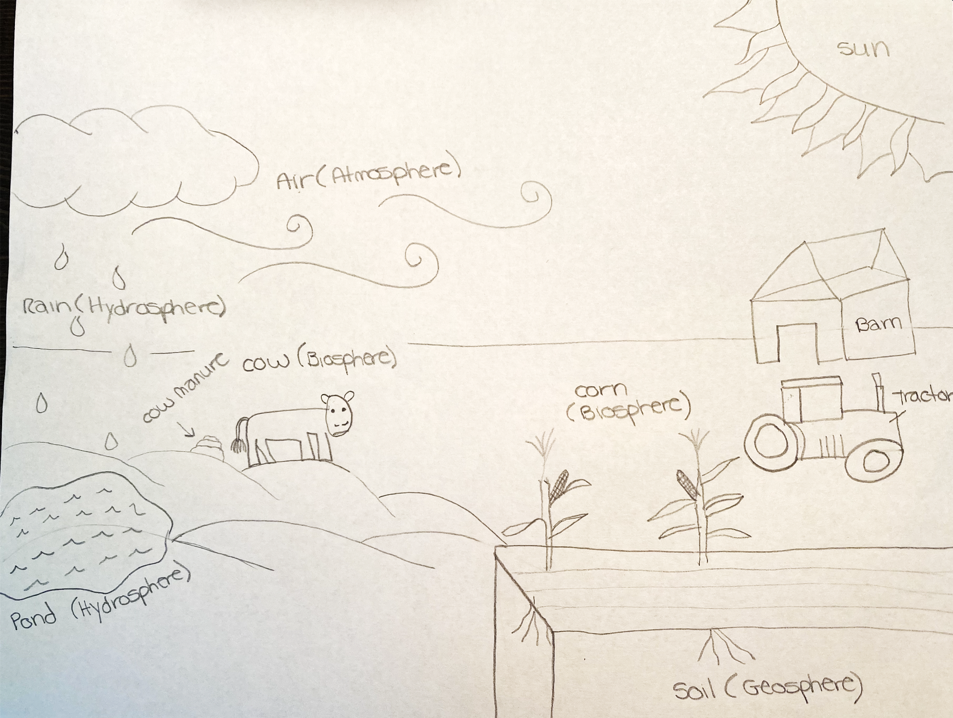
Farm Model
By the end of this lesson, students should have a model similar to this. The model should include different things you may observe on a farm, and identify the Earth system that each component is part of using labels. Students may identify systems by writing directly on their model, or creating a key.
Note: At the end of every lesson Evaluate in the curriculum, there is guidance for what components student models should have (Gotta Have It Checklist), as well as questions you can ask students if they are unable to add the components listed. Examples of revisions are provided at the end of the SJ.

Slide 7

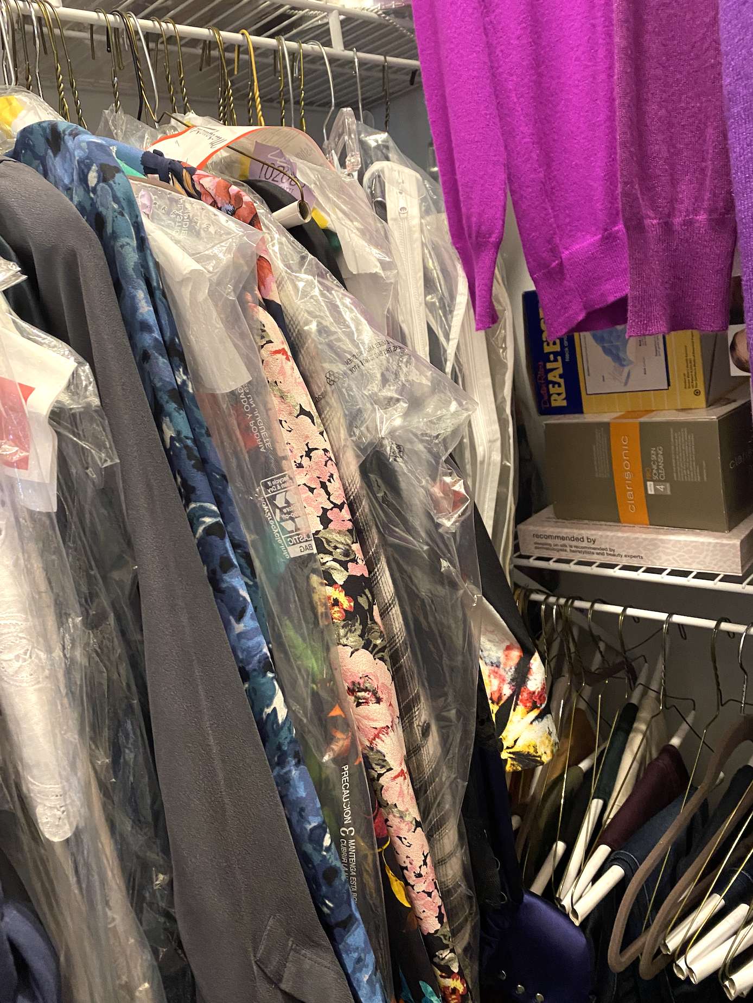
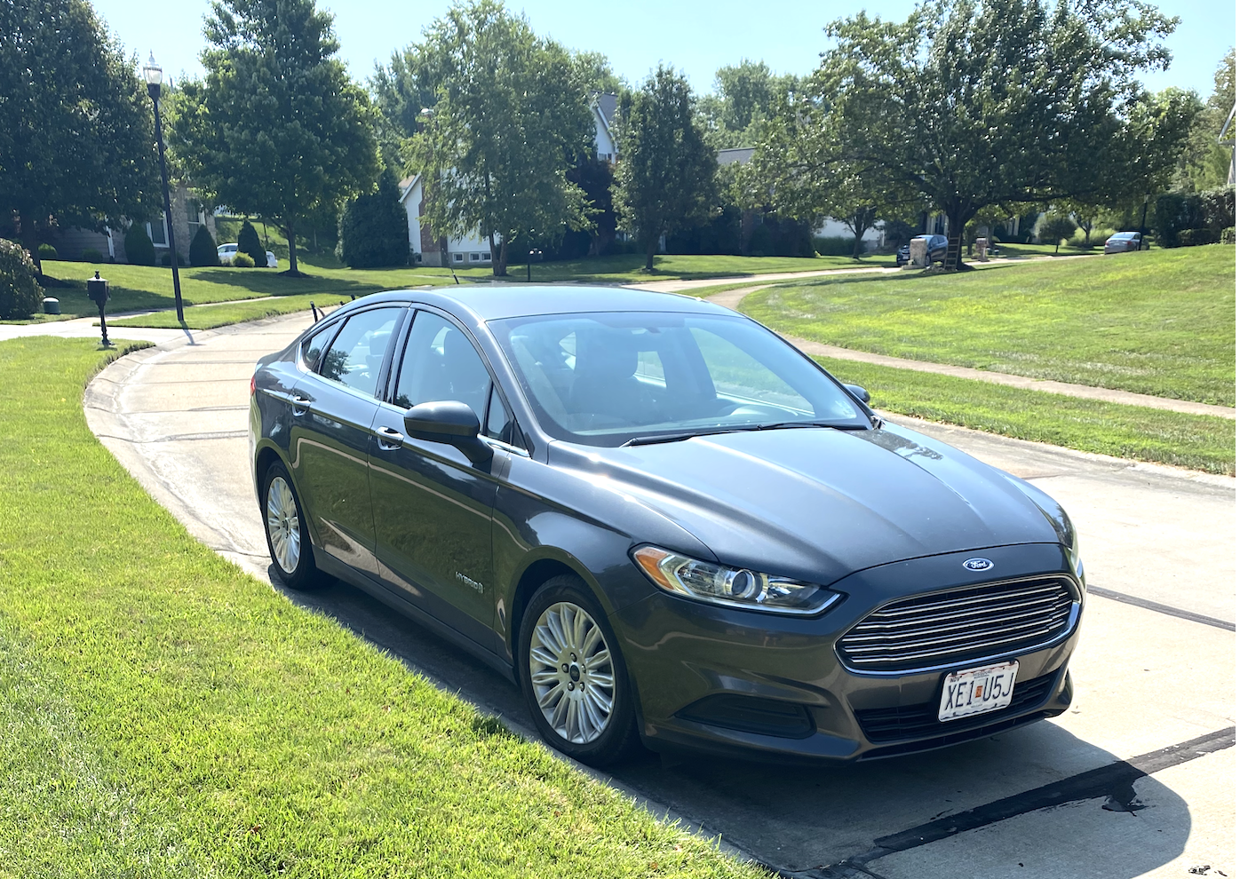
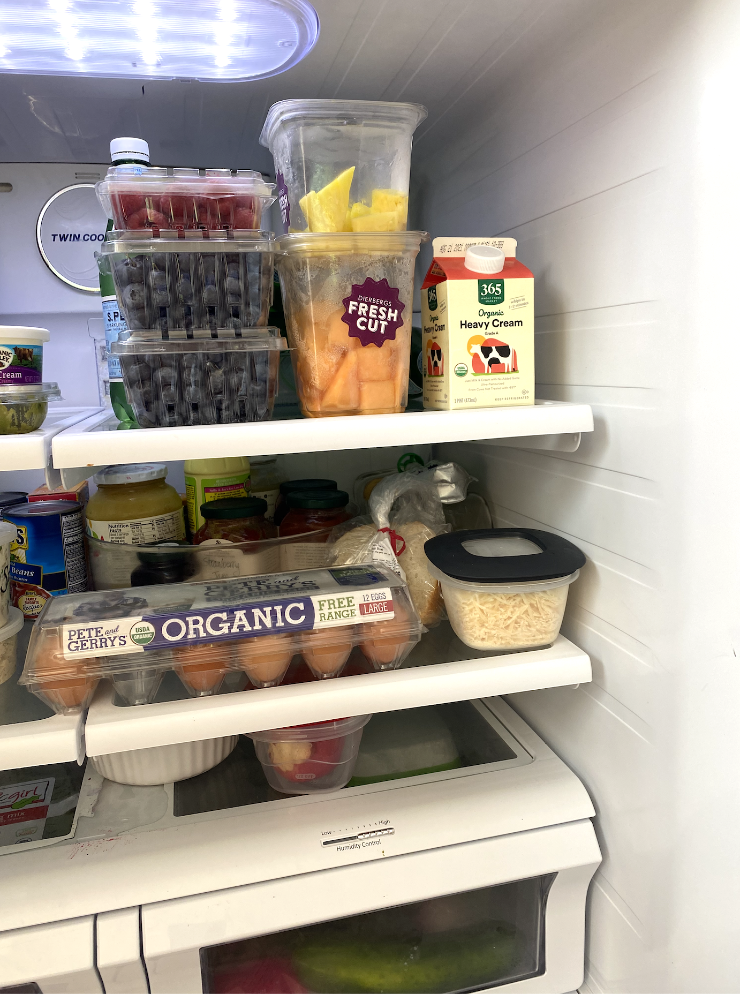
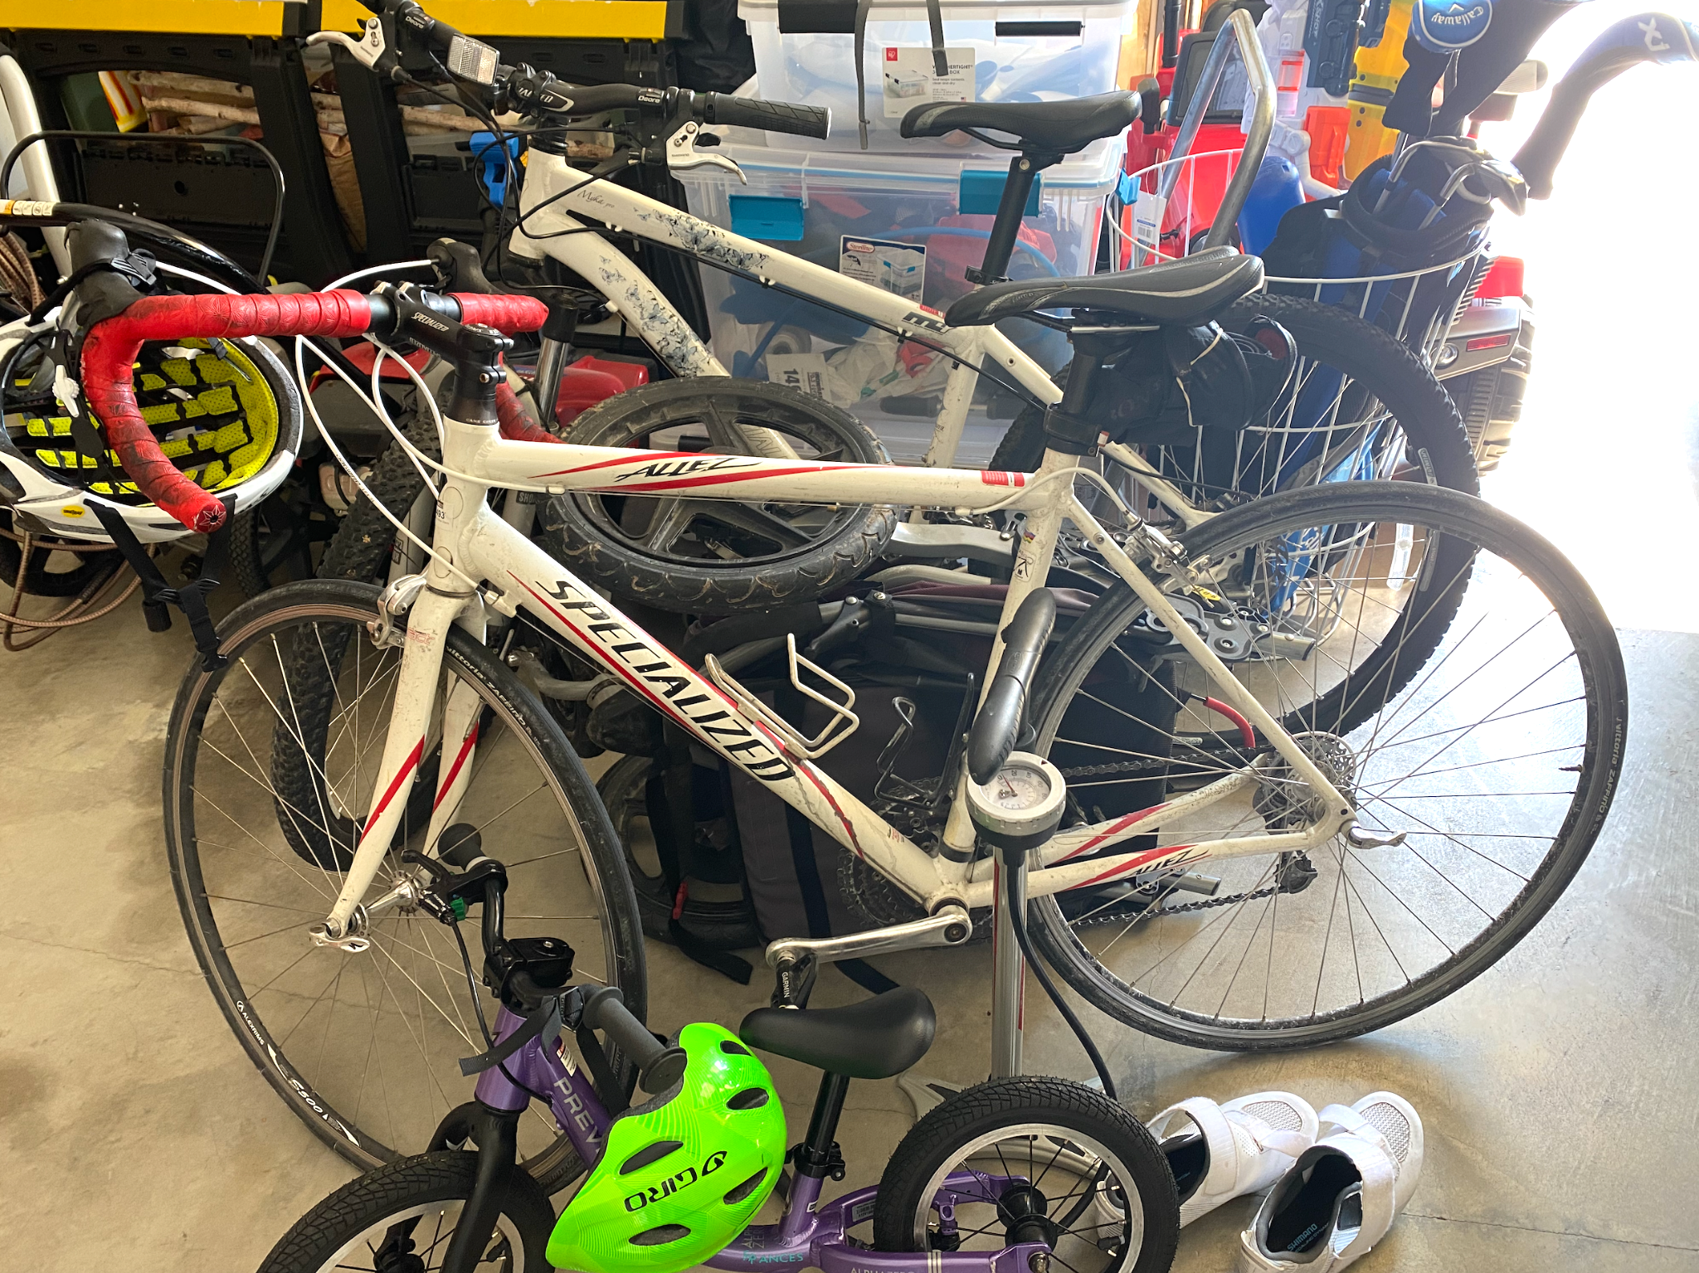
A Day in My Life
I took this photo at my desk.
Technology Use
I use my computer for work, to watch movies, to connect with friends who live far away.
I took this photo in my closet
Getting Dressed
I express myself through my style. Clothes also help protect your body from the climate and environment.
I took this photo in my driveway
Transportation
I use my car to get to and from work, take my kids to school, and take vacations
I took this photo in my refrigerator
Cooking
Your body needs food to function. Meals are also a time when I connect with my family.
I took this photo in my garage.
Bike riding
Bike riding helps me relax and is good for my health

Slide 8
Fossil Fuel Energy Research
Coal forms when plants are buried deep underground and subjected to intense heat and pressure for millions of years.
No. Not over human timescales
Large machines are used to mine coal at the surface and deep below ground.
Oil forms from plants and animals that live in oceans, lakes, and swamps. These things are buried beneath sediment and subjected to heat and pressure over millions of years.
No. Not over human timescales
Oil wells are used to extract oil from the ground. Oil is often transported via pipelines to refineries where it is separated into different petroleum products.
Natural gas forms in a similar way to oil. Plants and animals that live in oceans, lakes, and swamps are buried beneath sediment and subjected to heat and pressure over millions of years.
No. Not over human timescales
Hydraulic Fracturing or Fracking is a method used in the U.S. In this process chemicals, water, and sand are forced into rock to release natural gas.

Slide 9
Research About Traffic and Asthma
Most of our modes of transportation require fossil fuels for energy. When fossil fuels are burned the following air pollutants are release: particulate matter, ozone, Nitrogen Dioxide, Sulfur Dioxide, Carbon Monoxide, and toxic air pollutants.
Particulate matter can cause people to develop asthma, or increase the likelihood of hospitalization from asthma attacks. It can affect heart health. It increases the risk of heart attacks and death from other cardiovascular diseases. Particulate matter can affect lung function, and make symptoms of COPD worse. There are also links between exposure to particulate matter and cancer, brain function, and reproduction and development.
Exposure to Nitrogen Dioxide can affect your respiratory symptom. It can cause inflammation of the airways, worsened cough and wheezing, reduced lung function, and increased asthma attacks.

Slide 10
The Air We Breathe
Cars have gas in the gas tank.
When the car is turned on the fossil fuels are burned to make the car go.
Children are repeatedly exposed to polluted air.
Air pollutants are produced and released from the tailpipe into the air.
Children inhale particulate matter and Nitrogen Dioxide from the air.

Slide 11
Effects of Fossil Fuels on the Environment
Possible Example: Coral Bleaching in The Ocean
Burning fossil fuels releases CO₂ into the atmosphere.
CO₂ is a greenhouse gas that causes the Earth to warm.
Burning Fossil Fuels
Coral Bleaching
Corals become stressed and zooxanthellae can be damaged or lost.
This causes the ocean to become warmer.

Slide 12
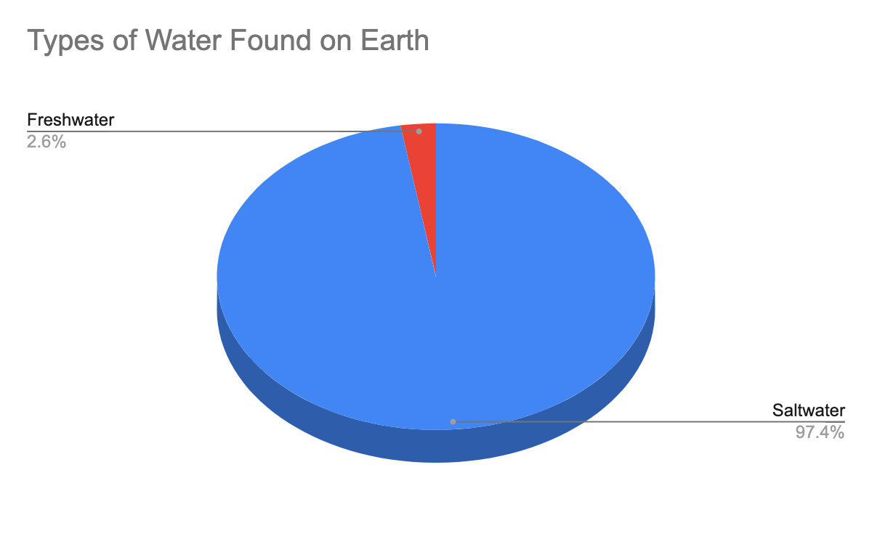
Types of Water on Earth

Slide 13

Biodigester Investigation

Slide 14
Biodigester Investigation (part 2)

Slide 15
Biodigester Investigation (part 3)

Slide 16
Biodigester Investigation (part 4)

Slide 17
Guiding Questions for Energy Island
They used wind turbines to create energy from the wind.
They used solar panels to create energy from the sun.
They used biomass furnaces and biofuel plants to create energy from plants.
Energy Island Page 24
Students may reference any of the examples of the energy projects listed on this page.
Wind was plentiful and already there
Renewable resources are better because they save money and people don’t have to worry about running out of them.
Page 4, Page 10
“That’s why it’s always very windy here!”
“We wouldn’t have to worry about all the world’s oil running out.”
“Renewable resources are so much cleaner. And think of the money we’d save!”

Slide 18
Guiding Questions for Energy Island (continued)
Fame and tourism increased
Electricity was still on in a storm
They talked and worked together as a community
Samsø became experts in renewable energy
Extra electricity was produce and could be sent/sold to others
Reduced carbon emissions
Page 3, Page 14-15, Page 22, Page 23, Page 27, Page 29
“Our little home has recently become quite famous and scientists travel from all over the world just to talk to us and learn what we’ve done.”
“Everything, that is, except Brian Kjaer’s house.”
“After that night, everyone was asking how they could make energy of their own.”
“He called lots of local meetings.”
“He talked to everyone.”
“...kids and grownups from all over the world come to learn about what we’ve achieved, and to talk about new ideas for creating, sharing and saving energy.”
“...we have so much power that we send our own electricity back through the cable under the sea for other people in Denmark to use!”
“...reducing our carbon emissions by 140 percent in just ten years.”

Slide 19
Engineering Design Cycle

Slide 20
Design Challenge Rubric

Slide 21

Wind Energy Design Challenge Notes

Slide 22
Wind Energy Design Challenge Notes (part 2)

Slide 23
Wind Energy Design Challenge Notes (part 3)

Slide 24
Advantages and Disadvantages
Wind turbines can be built on farmland.
Farmers receive some of the money from the energy produced. This can provide a stable income for farmers, whose income can vary from year to year. Income from crops can be unpredictable because of weather patterns.
It's a clean & renewable energy source.
It reduces soil & water pollution.
It’s a simple and low-cost technology.
It takes natural resources to build wind turbines.
They can impact wildlife.
They cost a lot to build.
They create noise and can block views.
The technology is not efficient.
Only available in rural areas
The gas produced is not always clean
It needs to be warm to produce the gas.

Slide 25
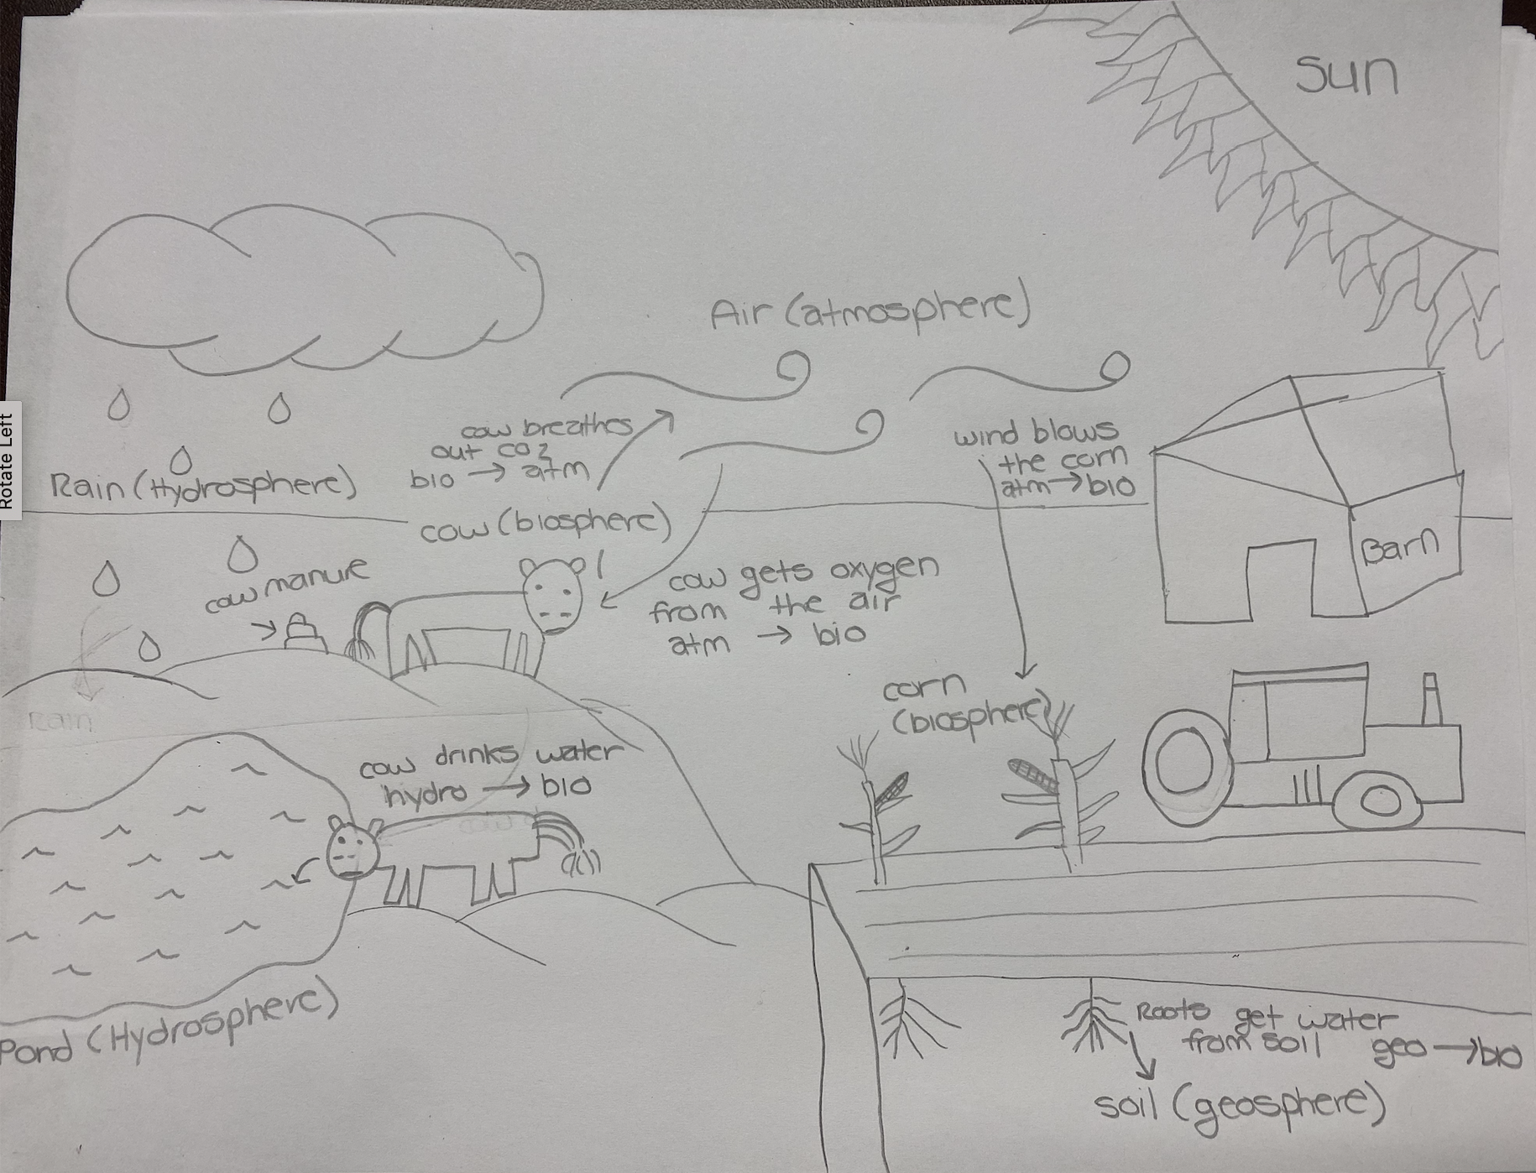
Farm Model (part 2)
By the end of this lesson, students should have a model similar to this. The model should include interactions you might observe on a farm between different Earth’s systems. They should label the parts of the model, and identify how the Earth systems that are interacting with each other. Students may use arrows or other symbols to denote interactions.

Slide 26
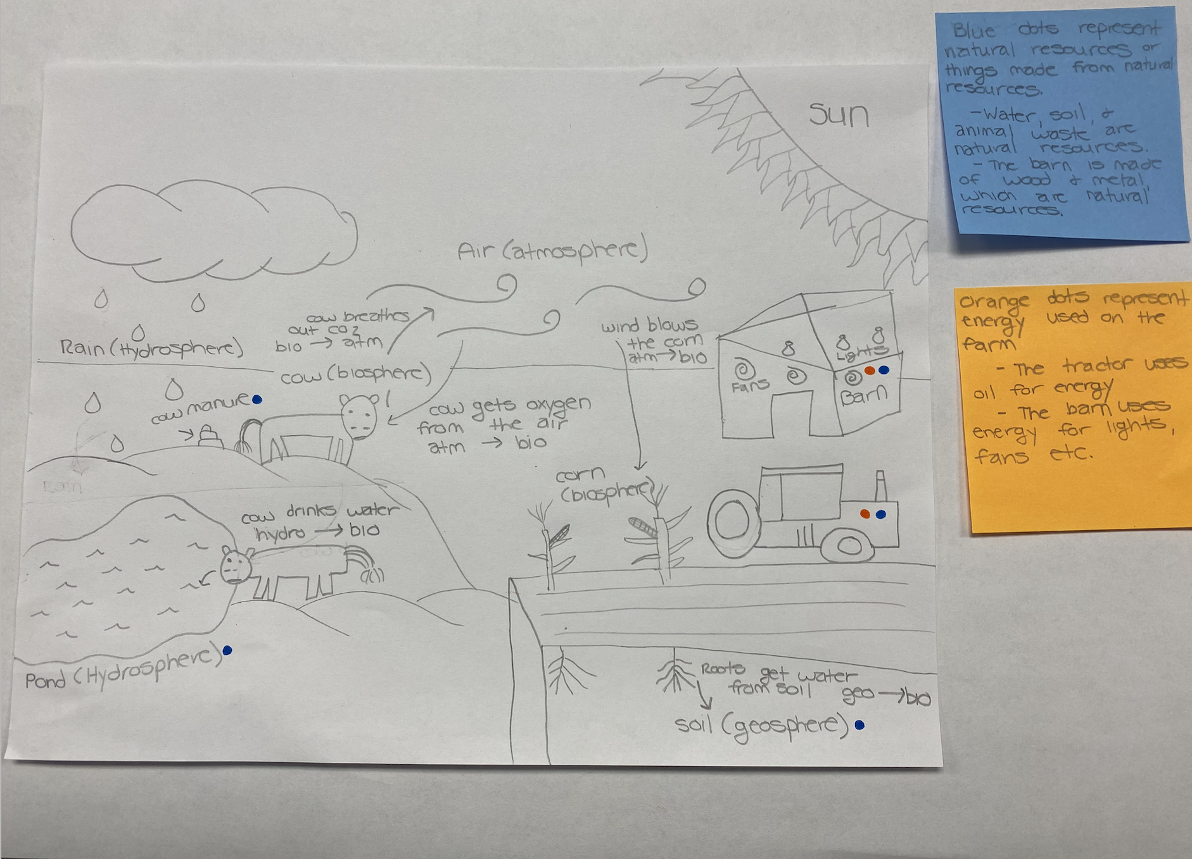
Farm Model (part 3)
By the end of this lesson, students should have a model similar to this. The model should include different natural resources or products made from natural resources found on the farm, how energy is used on a farm, and what energy sources are used. Students may label the parts of their model using a color coding system. As student models become more complex, it may be helpful for students to use sticky notes to elaborate on their ideas.

Slide 27
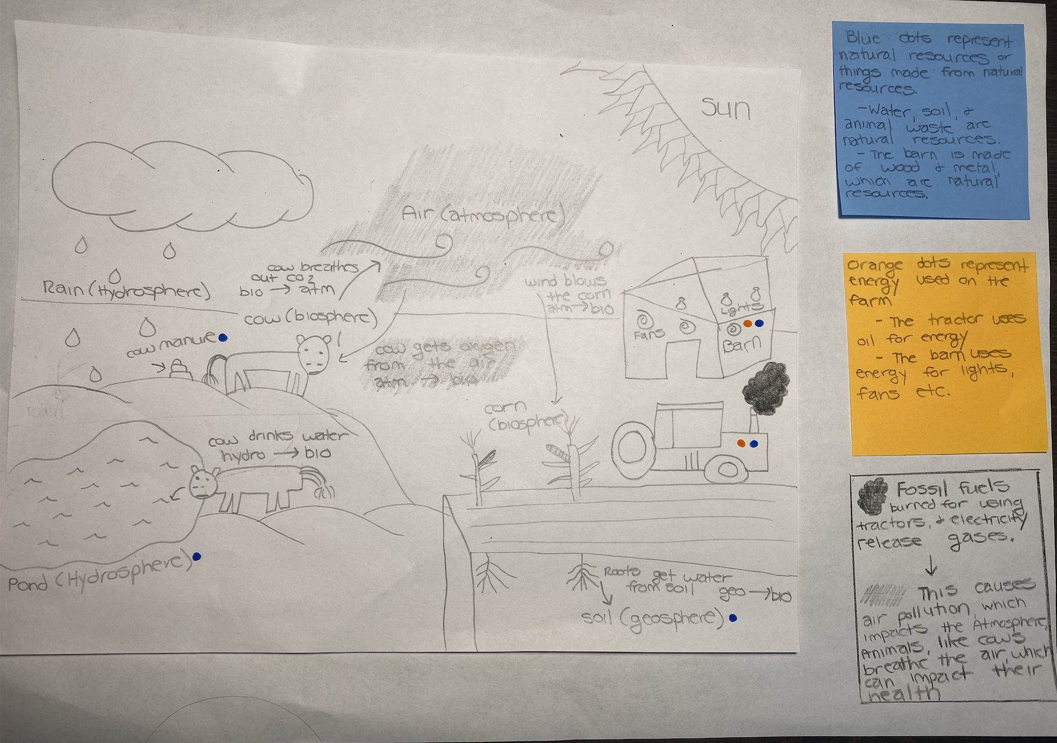
Farm Model (part 4)
By the end of this lesson, students should have a model similar to this. The model should include how the use of fossil fuels for energy on a farm affects different Earth systems. For example students may model how farms use energy to power barns and building and that this can cause air pollution, which impacts the atmosphere.

Slide 28
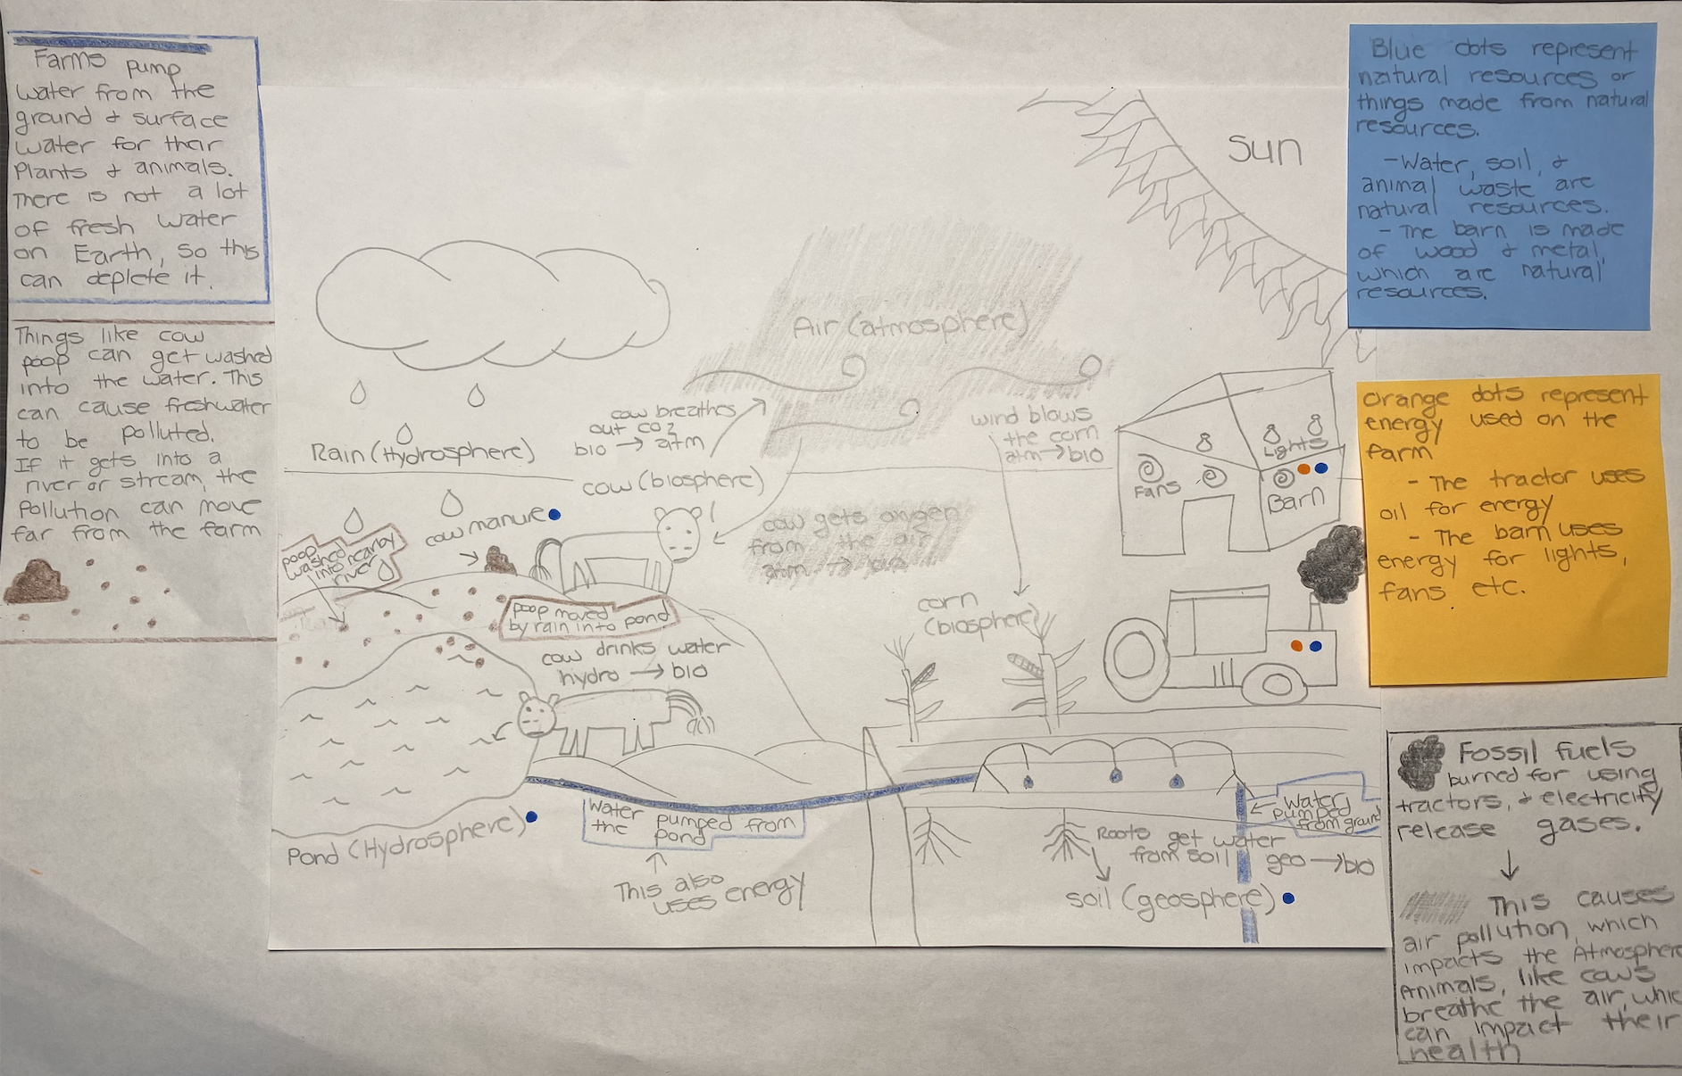
Farm Model (part 5)
By the end of this lesson, students should have a model similar to this.
The model should include how water is used on the farm, where is comes from, and the effects of this use. It should also include how water can become polluted on a farm. Label the parts of your model using a color coding system.

Slide 29
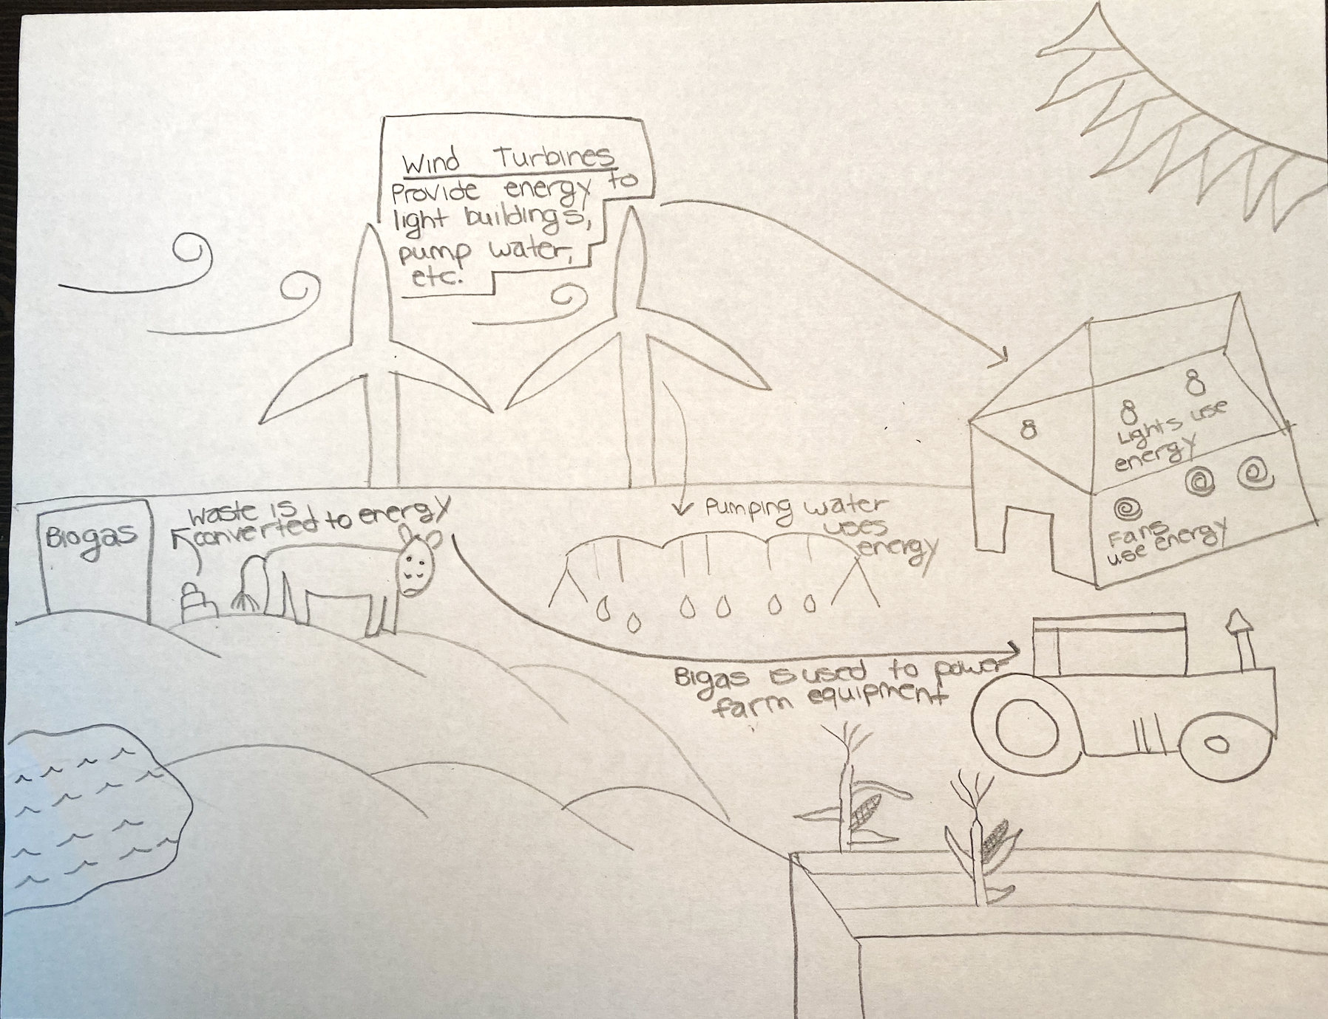
A Farm that Helps Protect the Earth
By the end of this lesson, students should have a model similar to this. Students should include renewable fuel sources for tractors and other farm equipment and renewable energy sources for electric power. They may include examples from their case study of Samso, including: Wind turbines, biodigesters, using the oil of plant for gas, etc.
Note: Students will revise this model after they have further explored solutions in Lessons 8&9.

Slide 30
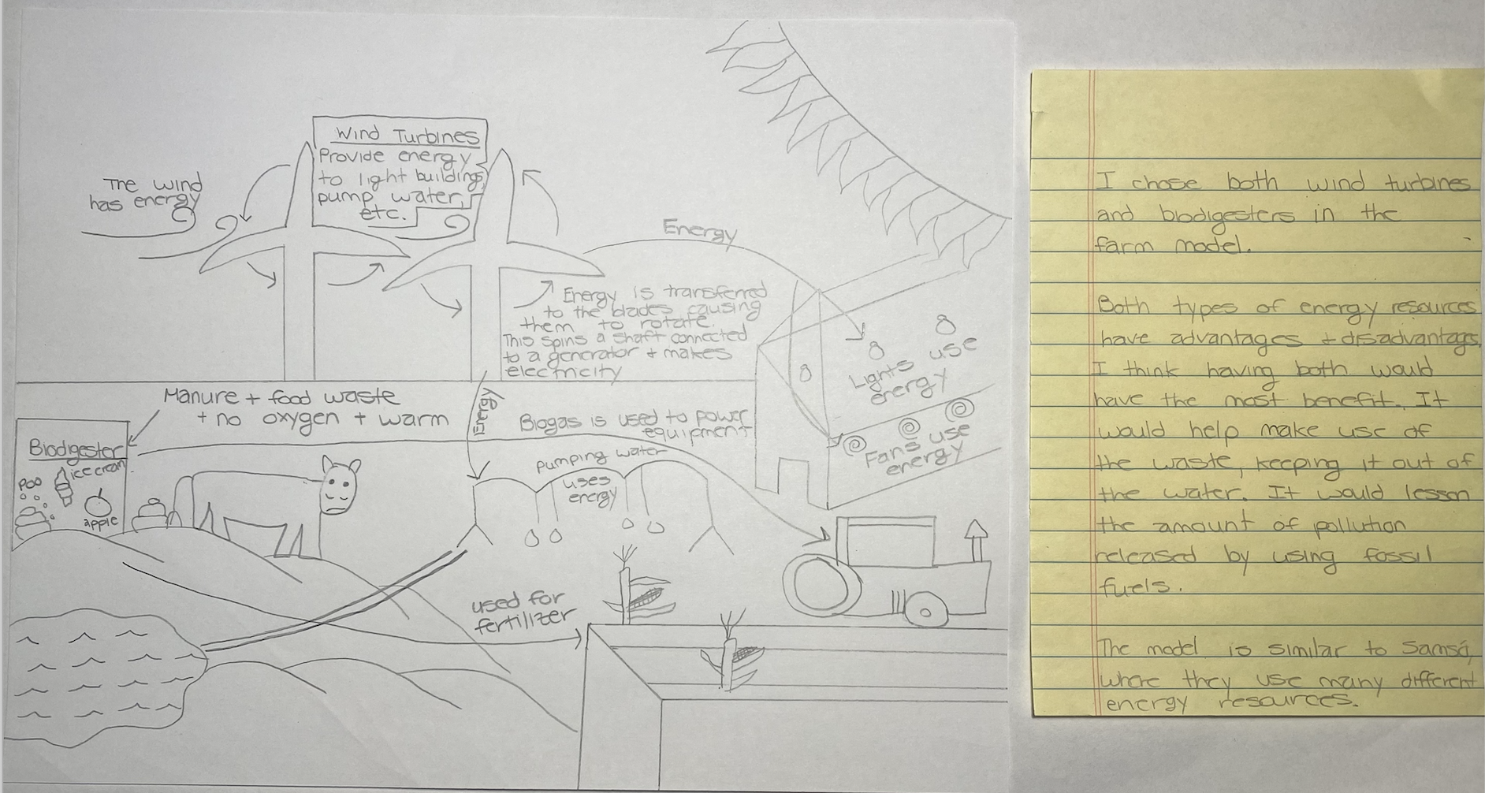
Farm Model (part 6)
By the end of this lesson, students should have a model somewhat similar to this. The model should include One, Both, or Neither: Wind Turbine and Biodigester, reasoning for the decision based on the advantages and disadvantages of the solutions, representations of how the solution(s) transfers energy, and the optimal design for the solution(s) based on evidence from designs.

