Slide 1
Act 13 and Educator Effectiveness Annual Report (EEAR)

Slide 2
Welcome!
Who We Are
Amy Lena
Director, Bureau of School Support Pennsylvania Department of Education
Amanda Lerew
Act 13 & FRCPP Content Support Specialist
Pennsylvania Department of Education
Questions? Email us!
Act 13 at RA-PDE-Evaluation@pa.gov

Slide 3
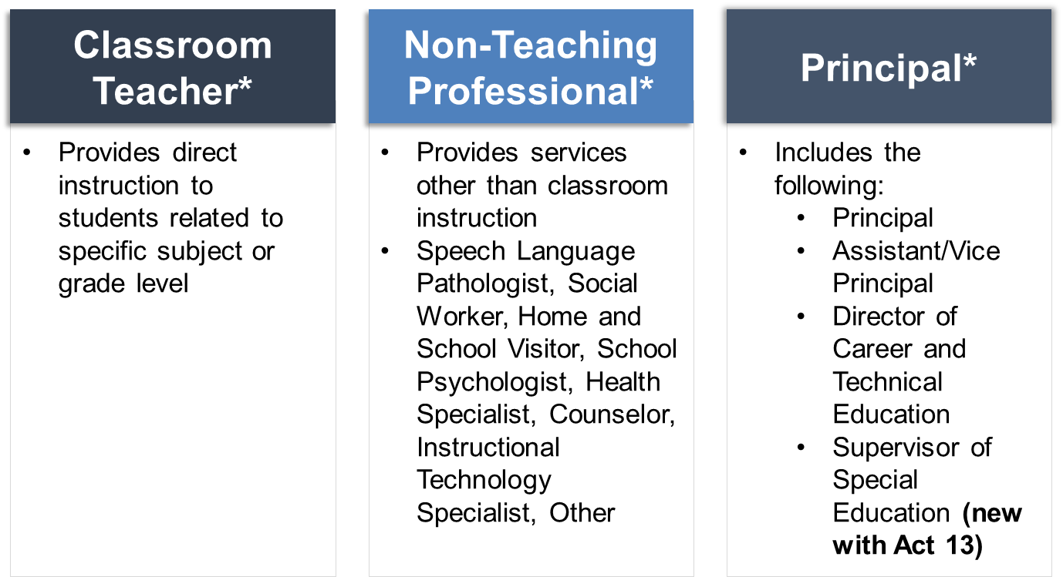
Areas of Evaluation
There are five areas in which an employee may be evaluated:
Observation & Practice
Building Level Data: Assessment, Growth, Attendance, Graduation Rate
Teacher-Specific Data: Assessment, Growth, IEP Goals Progress
LEA Selected Measures: comprised of one or more of the 6 types of evidence.
Performance Goals: Principal goals
Notes:
3 Classifications: Classroom Teacher, Non-Teaching Professional, & Principal
There are 5 areas in which employees are evaluated. Each classification and specific characteristics determine which areas are a part of the employees evaluation.

Slide 4
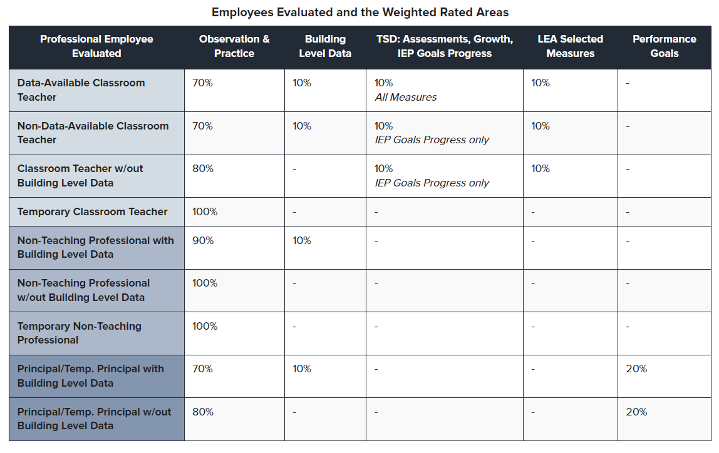
Weighted Rating Areas
Notes:
Review the various sub-classifications and weighted rated areas

Slide 5
Prerequisite Requirements
LEAs MUST establish a permanent record system containing the ratings for each employee within the LEA (i.e., PEERS, PAETEP, etc.)
The Pennsylvania Department of Education (PDE) collects Educator Effectiveness data annually to comply with reporting requirements associated with the American Recovery and Reinvestment Act (ARRA) and U.S. Department of Education (USDE) revised EdFacts regulations.

Slide 6
What is the EEAR?
Between mid-December and February 28, LEAs must complete the Educator Effectiveness Annual Report (EEAR) in the Future Ready Comprehensive Planning Portal (FRCPP).
The EEAR provides aggregate numbers of professional employees and temporary professional employees serving as classroom teachers, principals, and non-teaching professionals who were rated as Distinguished, Proficient, Needs Improvement or Failing and who were deemed Satisfactory or Unsatisfactory for the prior school year.
The EEAR is due February 28.
Notes:
Formerly was a spreadsheet that was submitted to PDE
Contains information regarding staff evaluations which is shared at the state and federal level.

Slide 7
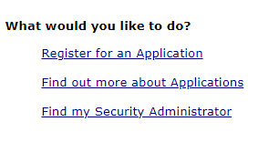
Registering for the FRCPP
Use the Application dropdown to select FRCPP and then click “Search”
Notes:
Users must first log into MyPDESuite
Users may register for a Keystone Login Account at https://keystonelogin.pa.gov/Account/Register.
Once logged in, users must select FRCPP to access the application

Slide 8
Gaining Access to Plan
Any user who has been assigned at the LEA level will appear on the LEA level user page.
For each user, select the plan or plans they will need access to and the role they will have in that plan.
You can remove users from individual plans by clicking on the delete button at the end of the plan row. You can also completely remove all user access by selecting Remove User Access.
If you need to add additional plans, select Add Another Plan.

Slide 9
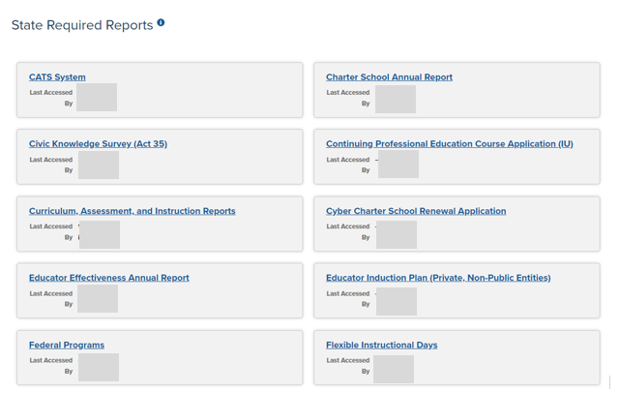
Report Location
Select Reports at the top of the screen.
Click on Educator Effectiveness Annual Report in the list of State Reports
Notes:
After logging into FRCPP, click “Reports” followed by the “Educator Effectiveness Annual Report”

Slide 10
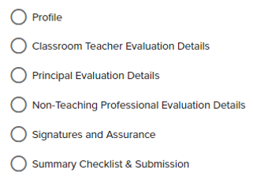
EEAR Components
Notes:
Six segments that need completed for the EEAR. We’ll dive deeper into each.

Slide 11
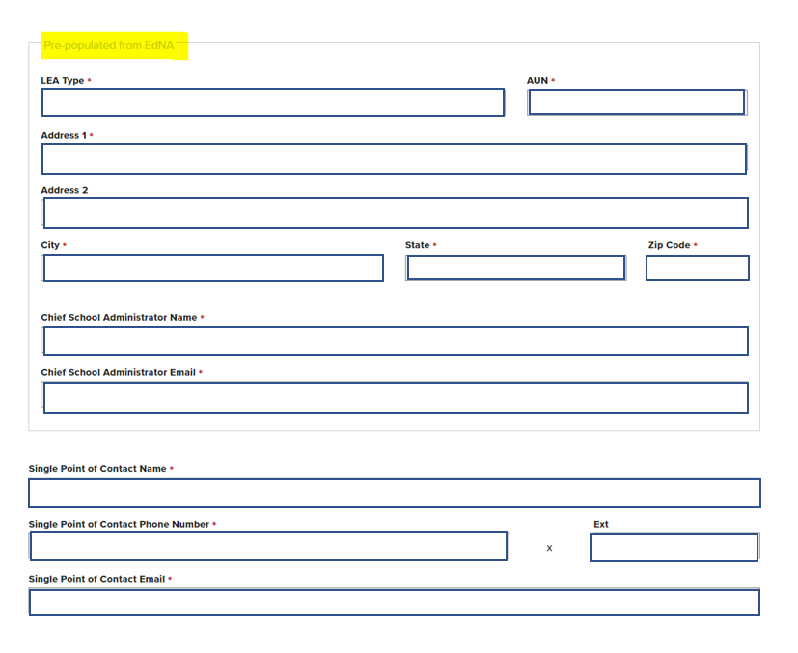
Profile Page
Profile information is pre-populated from EdNA.
ABC LEA
12345678
12 School Lane
Any City
PA
17555
John Doe
jdoe@abclea.org
Add a Single Point of Contact’s Name, Phone Number, and Email.
Notes:
The profile section includes basic demographic information that is pre-populated from EdNA. The single-point of contact needs to be manually added. If there have been changes with the Chief School Admin, the school’s address, etc. This must be updated in EdNA. You will not have access to change any information in the top portion of this section.

Slide 12
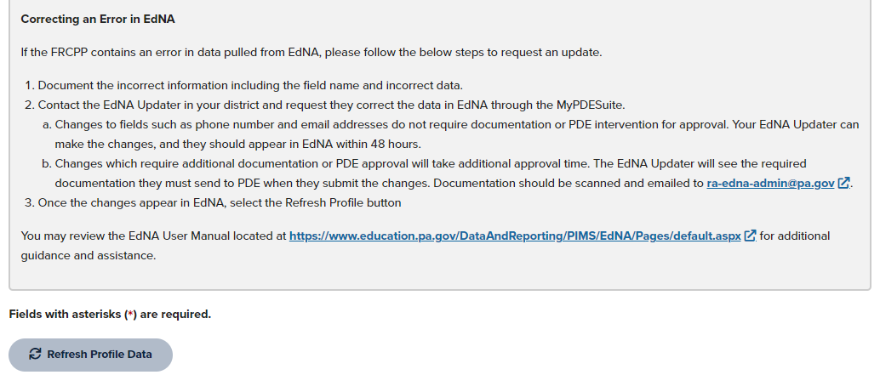
EDNA Profile Information
Notes:
EdNA must show the updates FIRST THEN the Refresh Profile Data button can be selected.

Slide 13
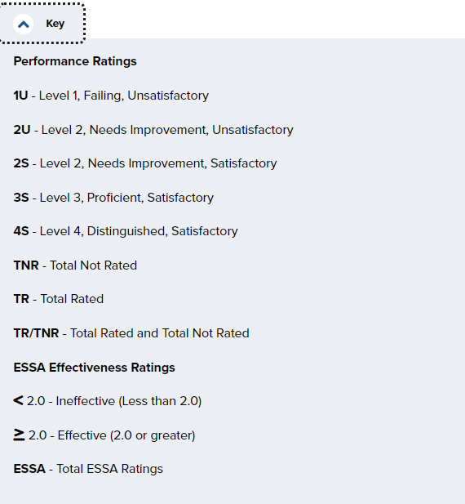
Evaluation - Key
Notes:
*Must be whole numbers* *TR and ESSA totals must match* Professional Employees with a rating of 2S, 2U, or 1U are going to fall in the <2.0 ESSA Effectiveness Rating (Ineffective) Professional Employees with a rating of 3S and 4S are going to fall in the Greater Than or Equal To 2.0 ESSA Effectiveness Rating (effective)

Slide 14
Evaluation - Classroom Teacher
Classroom Teacher consists of Professional Employees and Temporary Professional Employees, who provide direct instruction.
All entries must be in whole numbers. Fractional reporting is not allowed on this page. If a Classroom Teacher is assigned to more than one school, choose the school you consider to be the primary assignment and only count that Teacher once.
Notes:
*Must be whole numbers* *TR and ESSA totals must match* Professional Employees with a rating of 2S, 2U, or 1U are going to fall in the <2.0 ESSA Effectiveness Rating (Ineffective) Professional Employees with a rating of 3S and 4S are going to fall in the Greater Than or Equal To 2.0 ESSA Effectiveness Rating (effective)

Slide 15
Federal ESSA Requirements
To meet federal ESSA requirements, LEAs must submit aggregate numbers of classroom teachers found to be Effective or Ineffective.
Temporary Professional Employees
Professional Employees
Domain II 37.5%
Domain III 37.5%
Domain IV 25%
Domain II 30%
Domain III 30%
Domain IV 20%
LEA Selected Measures 20%
Notes:
Both PEERS and PAETEP have EEAR with ESSA Ratings already calculated.

Slide 16
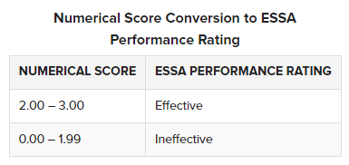
Federal ESSA Required Fields
Notes:
Must use the calculation on the previous slide for each classroom teacher rated. This portion is a MANDATORY piece for all LEAs because it is a Federal Requirement (all LEAs including charter schools)
We’ll revisit these performance ratings within the Classroom Teacher page within the EEAR.

Slide 17
Evaluation – Adding a Row
If there are Principals or Non-Teaching Professionals, who are not linked to a building, please add the LEA as a school with branch 0000 under "Add School Not Listed". For the pages where there this is not applicable, 0s may remain in the columns.

Slide 18
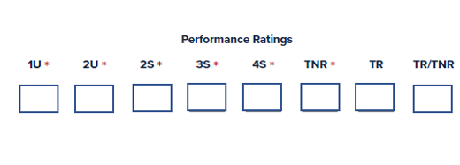
Evaluation - Principal
Principal Evaluation Details include the ratings for Principals, Assistant/Vice Principals, Directors of Career and Technical Education Schools, and (new with Act 13) Supervisor of Special Education.
Notes:
Be sure to include all admin falling under the principal evaluation framework

Slide 19
Principal Details Page
Professionals within the Principal Evaluation category that are shared among buildings should be entered using a decimal up to two decimal places.
Special Ed Supervisors must be included on this page.
Notes:
*May use a number up to TWO DECIMAL places for administrators shared between buildings

Slide 20
Evaluation - Non-Teaching Professional
Non-Teaching Professional Evaluation Details include the ratings for professional employees who do not provide direction instruction (i.e., counselors, nurses, school psychologists, etc.).
Notes:
Include all nonteaching professionals

Slide 21
Non-Teaching Professional Details Page
Professionals within the Non-Teaching Professionals category that are shared among buildings should be entered using a decimal up to two decimal places.
Notes:
*May use a number up to TWO DECIMAL places for administrators shared between buildings

Slide 22
All Evaluation Pages
Aggregate Totals will pre-populate from the information entered for all schools.
Notes:
You will not type within this table

Slide 23
PEERS- Populate Summary Reporting
When an evaluator marks an evaluation as “Ready for Conference” an administrative user can release it.
When it is released, it is classified as final. No user can edit or change its status.
Go to the Evaluation List in PEERS.
Optionally, set the Status filter to Ready for Conference so that you only see evaluations that are ready for release.
Click Release Evaluations at the top of the page to release all the evaluations in the current view. Alternatively, click Release in the same row as an individual evaluation to release just that one evaluation.
Notes:
PEERS- evals must be released to be classified as final and release to the summary report

Slide 24
PEERS-Export Evaluation Summary
Users can only export from the Evaluation Summary page.
Only released evaluations are included in the Evaluation Summary.
To export data:
Navigate to the Evaluation Summary by going through the Reports menu.
Click Download to XLSX to download an Excel file that contains the same data that is displayed in the Evaluation Summary.
Notes:
Releasing evaluations from PEERS

Slide 25
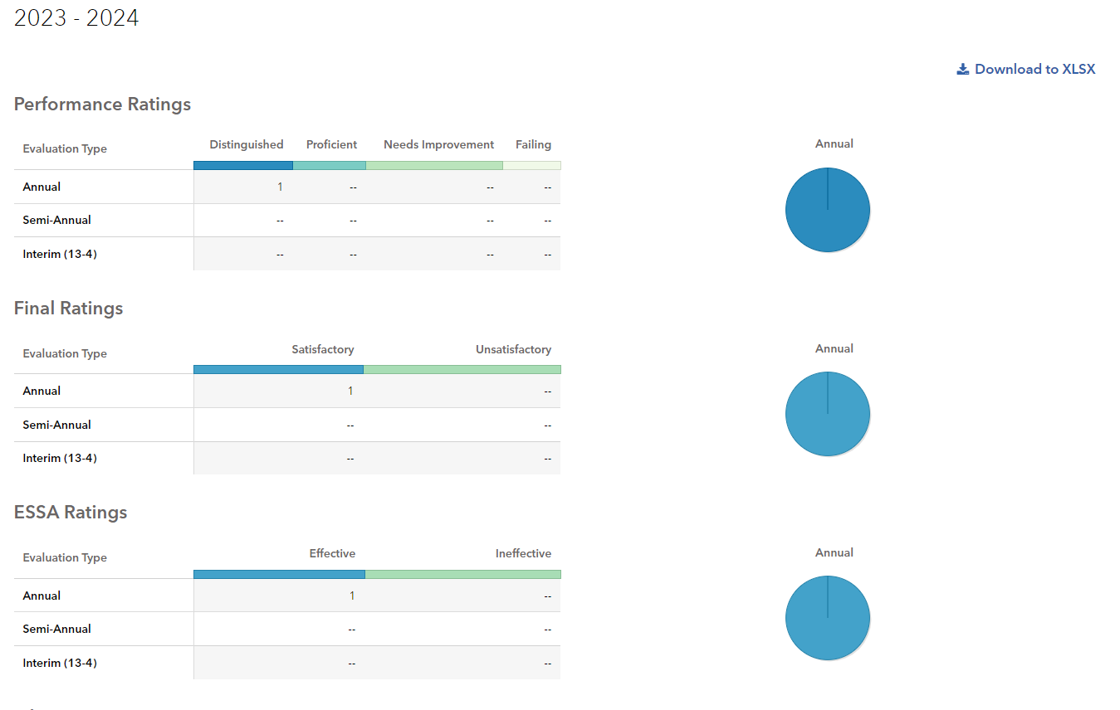
PEERS Performance Summary Report
Notes:
Example of what a PEERS EEAR report

Slide 26
PAETEP Populate Summary Reporting
PAETEP provides clients with the summative data needed to complete the Educator Effectiveness Annual Report (EEAR).
To access the data within PAETEP, School District Admin users should follow the steps below:
Log into PAETEP.
Go to the Administration tab - Reporting.
Click on the Educator Effectiveness Annual Report tab.
Click on the Buildings tab.
Notes:
How to get your summative data in PA Etep

Slide 27
PAETEP Important Information
Important Notes
The EEAR report within PAETEP only reflects data for 13 forms that have been completed/finalized. Please ensure that all 13 forms have been finalized.
The EEAR report within PAETEP can be filtered by school year and type of 13 form (i.e., 13-1, 13-2, 13-3). Data can also be exported, if desired.
For more detailed information regarding the EEAR report within PAETEP, see the link below:
PAETEP – Educator Effectiveness Annual Report (EEAR)
Notes:
Forms must be finalized to be accounted for within the summative report

Slide 28
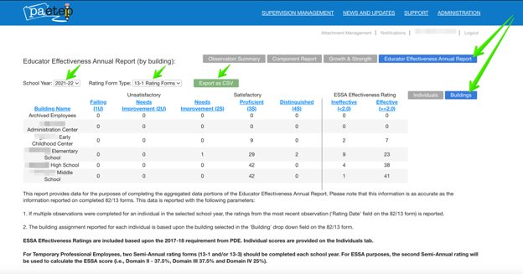
PAETEP EEAR Summary
Notes:
Example of a EEAR report from PaEtep

Slide 29
Signatures and Assurance
The Chief School Administrator, listed in EdNA, is the ONLY individual who can sign and submit the Educator Effectiveness Annual Report.
Notes:
Must sign each time prior to submission. If a revision is needed, a re-signing is necessary

Slide 30
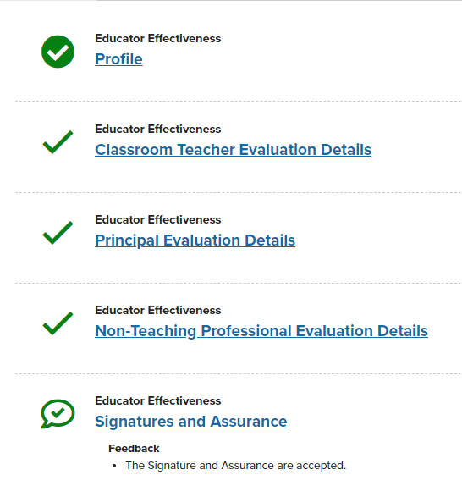
Summary Checklist and Submission
All components will be green when the report is ready to submit.
The Chief School Administrator must click the blue SUBMIT button at the bottom right corner.
The report is now submitted!
Notes:
If the submit button does NOT show up blue you may need to check your permissions in MyPDESuite – must have localAdminUser rights ONLY or check that you have access to the EEAR (all boxes should be checked for a Chief School Administrator).

Slide 31
What’s Next?
Once the EEAR is submitted, it is sent to a reviewer at PDE. If the reviewer notes an error, they will return it to the LEA for a revision with a note as to what needs to be revised.
Notes:
When your report goes in review mode, anyone on the profile page will receive an email from the PDE that it is being reviewed. If your report requires a revision, anyone on the profile page will receive an email from the FRCPP noting a revision is needed. If you’re unsure, login to FRCPP, choose reports, and review the report. It will either be noted as: Approved, Submitted, PDE Review, or In Revision. If you see Ready for Submittal, it means the Chief School Admin needs to hit submit.

Slide 32
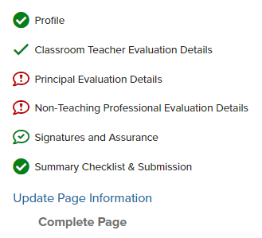
In Revision
Should your report need a revision, the area needing attention will have a red exclamation mark
Notes:
The exclamation mark will NOT disappear even though a revision is made. Many will not submit because they believe it should disappear once the correction is made, however it does not.

Slide 33
Common Errors
The number in the Total Rated (TR) column MUST match the ESSA Total.
You may ONLY type in the boxes with a red asterisks.
Notes:
The TR and ESSA totals box must match.

Slide 34
Common Errors
In the Principal Ratings & Non-Teaching Professionals segments, all professional staff ratings must be included.
If professional staff are shared between schools, enter a number up to TWO DECIMAL PLACES for Principals and Non-Teaching Professionals.
Special Ed Supervisors must be included in the Principal Ratings.
Notes:
All professional staff must be accounted for

Slide 35
Resubmission
Once you have fixed the error, the RED EXCLAMATION MARK WILL REMAIN. It alerts PDE to review the page that was initially marked incorrect.
The Chief School Administrator will need to RE-SIGN the report on the Signatures and Assurances page.
Finally, the Chief School Administrator will need to submit the report by clicking the blue Submit button found on the Summary Checklist and Submission page.
PDE will then review the report.
Notes:
The exclamation mark remains for the reviewer to note the revisions. Many will not submit because they believe it should disappear once the correction is made, however it does not.

Slide 36
Checking EEAR Status
Submitted
Notes:
Anyone with permission can check the status.

Slide 37
Checking EEAR Status continued
Notes:
Anyone with permission can check the status.

Slide 38
Contacts
For more information on Act 13, please visit:
https://www.pdesas.org/EducatorFrameworks/EducatorEffectiveness/
Act 13 and Educator Effectiveness Annual Report Questions
RA-PDE-Evaluation@pa.gov
PEERS Questions
Contact Us
pdepvaas@iu13.org

