Slide 1
Pennsylvania
HS Graduation Requirements
Grad Report: Collecting & Reporting Data
September 8, 2025
Notes:
[welcome & introductions]
Today’s presentation will cover the data you are submitting in the FRCPP Grad Report – which will open October 1st and close December 1st.
In accordance with legislation, the data you submit will be posted publicly on your LEA Future Ready PA Index profile January 15th.

Slide 2
TODAY’S TOPICS
Grad Class vs. Grad Cohort
The Grad Report: How to Access
The Grad Report: Collecting the Right Data
  LEA Profile
  Reporting Graduates: Totals & Pathways
  Reporting Alternative Assessment Criteria
  Reporting Evidence-Based Criteria
  Reporting Other Diploma Options
Q&A
Resources & Contact Information
Notes:
As you can see, we have a lot to cover in the next thirty minutes - so we ask that you refrain from dropping your questions into the chat until the end of the overview when we’ve scheduled about 30 minutes for open Q&A.

Slide 3
Grad Class vs. Grad Cohort
Grad Class
Grad Cohort
Students who were on-track to graduate by the end of the prior school year, including:
Students in Grade 12
Multi-year seniors
Students identified as seniors based upon credits earned
Students who entered 9th grade for the first time a specified number of years ago (4, 5, or 6 years prior to the reporting year)
NOTE: The Cohort Graduation Rate (reflected in the Future Ready PA Index) is calculated using the percentage of students graduated within a specified cohort
Notes:
When collecting and reporting data related to graduation requirements, LEAs will be referencing the graduating class rather than a graduation cohort. A “graduating class” is comprised of all LEA students who should have fulfilled graduation requirements during the reported school year, regardless of whether they did – not just 12th graders, but also multi-year seniors and students identified as seniors based on credits.
[OUTPLACED] A student placed into another educational setting with the intention of granting that student a diploma from your LEA upon successful completion of the program should be included in your counts if that student was on-track to graduate within the reported school year.
[SPECIAL EDUCATION PROGRAM] A student anticipated to graduate via successful completion of their special education program should be reported as ‘eligible to graduate’ if there is a reasonable expectation that the student will, during the reported school year, either meet their goals or leave the program (e.g., age-out).
NOTES:
- The numbers reported in the Grad Report won’t match a single PIMS data field; however, some of the student template data may be referenced to inform the total Grad Class and the total Graduated. For example, the total Grad Class number may include students reported in the May snapshot as well as any students reported later in October as dropouts (but not transfer students as the assumption is that they will continue with their education and meet graduation requirements elsewhere).
- Data reported for a graduating class does not impact the Grad Rate in the Future Ready Pa. Index (which is calculated using only the grad cohort data).

Slide 4
The Grad Report
Grad Report is submitted in MyPDESuite: FRCPP Reports
Data collection begins October 1 and ends December 1*
Data should reflect graduates and non-graduates for the prior school year
*Per legislation, PDE publicly posts LEA Grad Reports no later than January 15 (approximately 6 weeks after the reporting window closes)
Notes:
The FRCPP Grad Report submitted via MyPDESuite collects data on the graduating class of the prior school year – therefore, the Grad Report due December 1, 2025, will collect data on the 24/25 school year (i.e., the graduating class of 2025).
Remember, students have through September 30 (just before the Grad Report window opens on October 1) to complete any graduation requirements in order to be reported as 24/25 graduates.
Your LEA Grad Report will be publicly posted on your Future Ready PA Index subsite – so please ensure the accuracy of the data you submit!

Slide 5
The Grad Report
Collecting the Right Data
Notes:
Let’s look at the data you will need to complete the Grad Report in the FRCPP by December 1 …

Slide 6

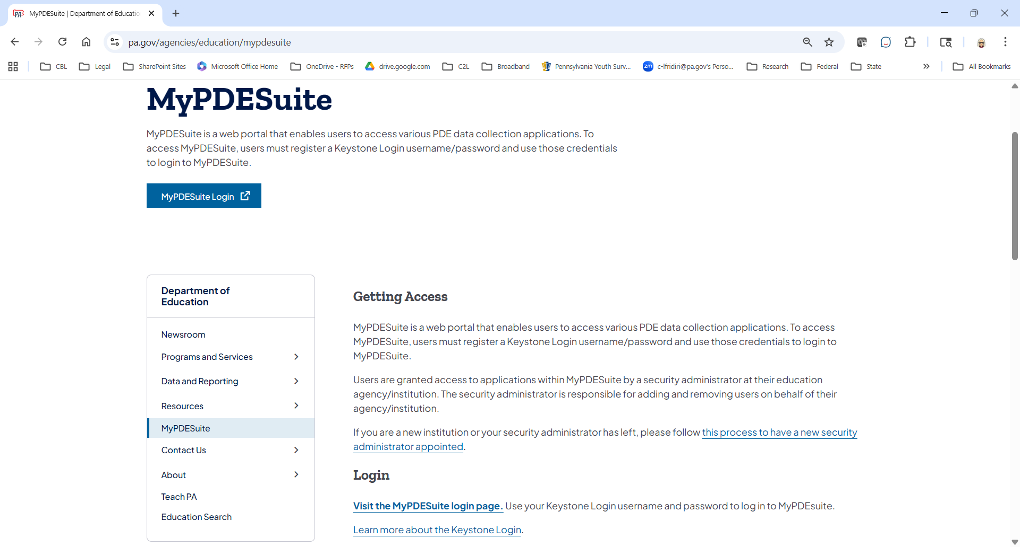
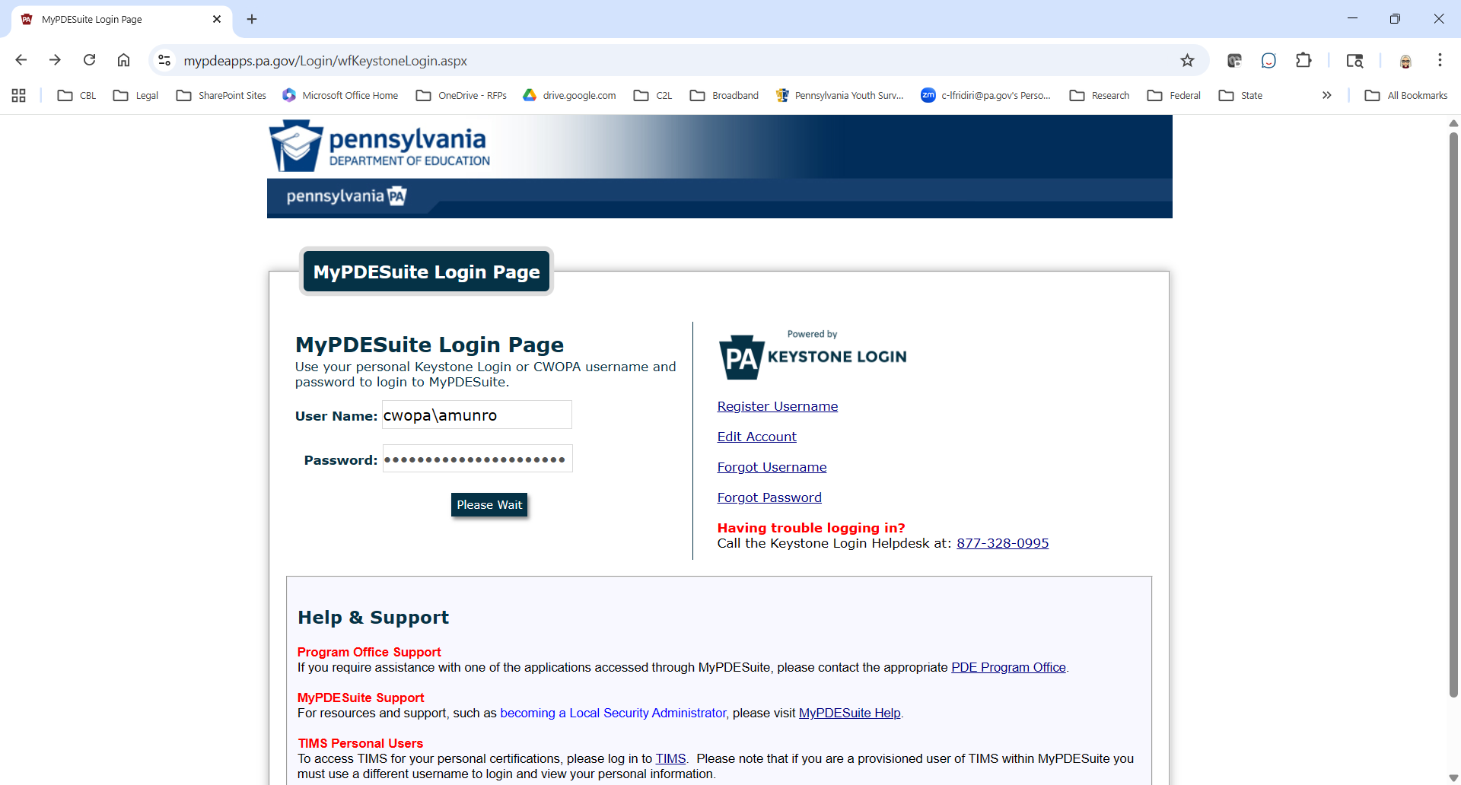
Accessing the FRCPP Grad Report
Notes:
MyPDESuite may be easily accessed from the PDE home page at pa.gov/agencies/education.
Select MyPDESuite in the left menu - then click on “Visit the MyPDESuite login page” to enter your user name and password.
You must have a registered Keystone Login to be granted permission to access this report by the MyPDESuite security administrator at your LEA.

Slide 7
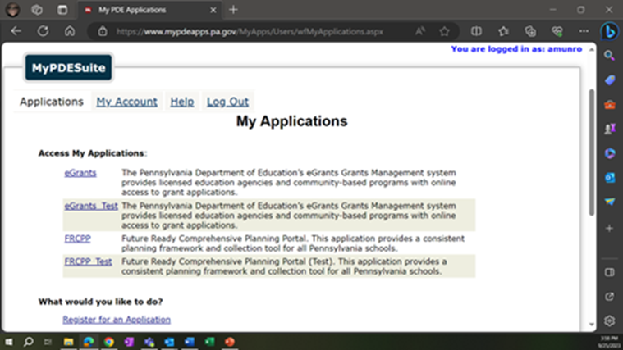
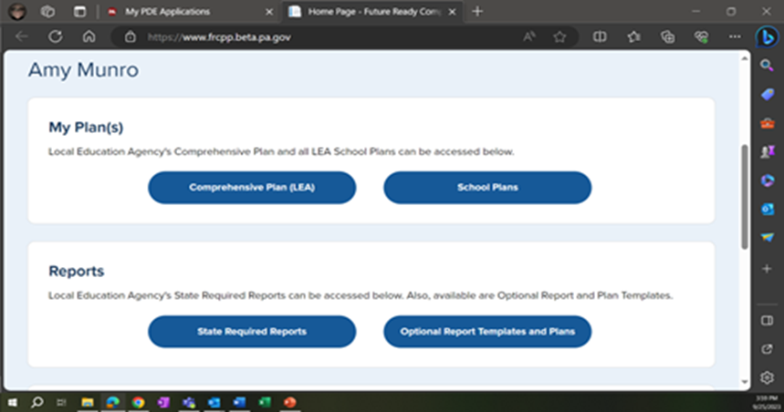

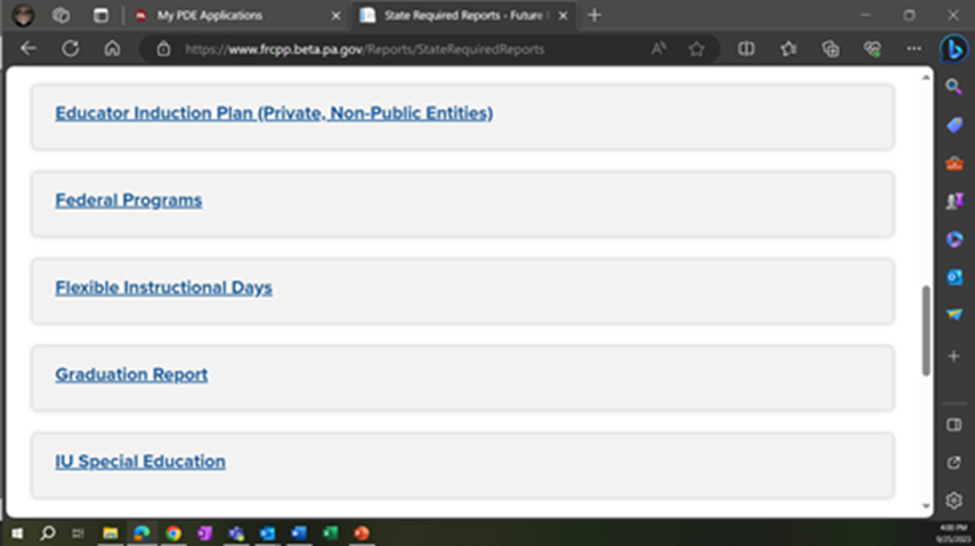
Accessing the FRCPP Grad Report (cont.)
Notes:
If your security administrator has granted you the appropriate permissions, you should see FRCPP listed under “Access My Applications”.
Click on FRCPP and, once in the Planning Portal, click on State Required Reports – then select Graduation Report from your list.

Slide 8
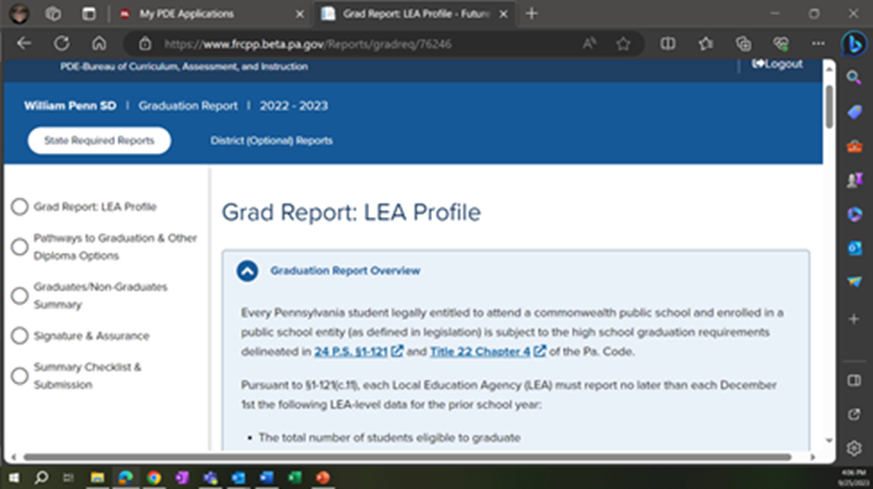
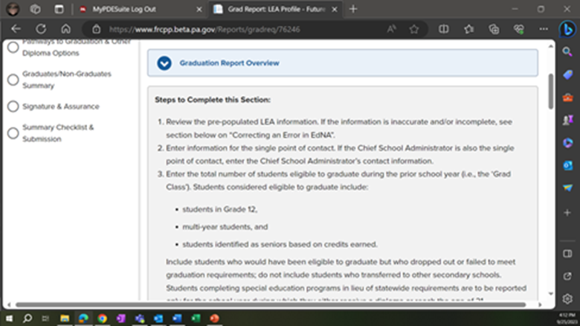

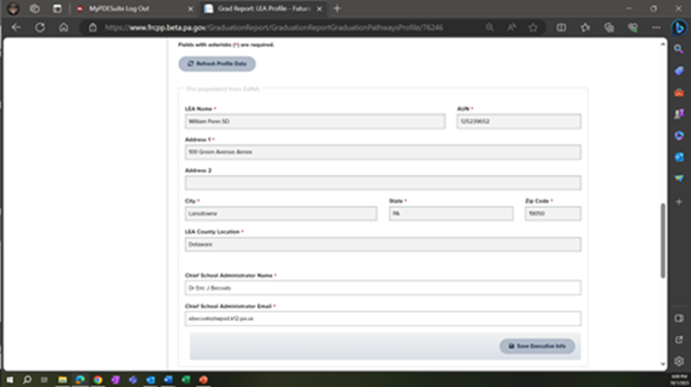
Grad Report: LEA Profile
Pre-Populated
Notes:
As you can see in the left menu, the Grad Report has 5 pages - the first of which is the LEA Profile.
The light blue box provides a brief overview of the report and its requirements. Once you’ve read the narrative, you may click the caret to collapse this section.
The light grey box provides instructions on completing this page. The data fields below it containing LEA and Chief School Administrator information are pre-populated from EdNA. If the LEA or the Chief School Administrator information is incomplete or inaccurate, follow the instructions for updating the data in EdNA before proceeding.

Slide 9
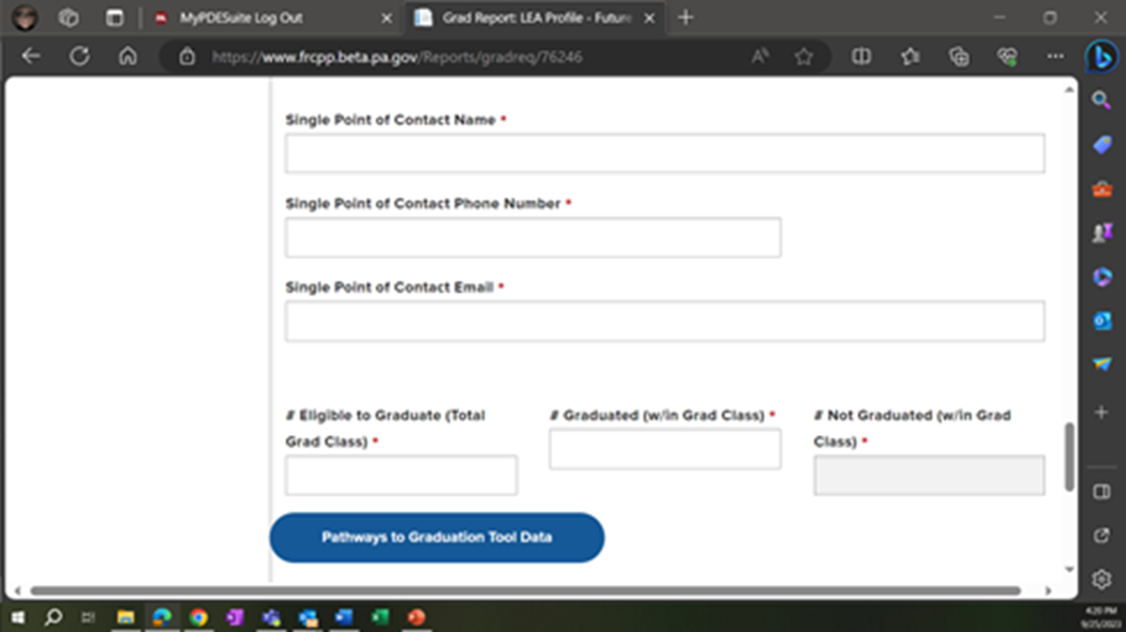


Grad Report: LEA Profile (cont.)
Pre-Populated
Notes:
Just as the grey fields indicate prepopulated fields, white fields indicate data that will need to be reported by the LEA and red asterisks indicate where an entry is required.
At the bottom of the LEA profile page, you will enter the details for a designated single point of contact for the Grad Report. If the CSA will also serve as the SPOC, enter that information here.
Below the SPOC information, you will enter the total number of students within the LEA who were eligible to graduate during the prior school year – and, of those students, the number who graduated during that school year. The system will calculate the remainder and populate the #Not Graduated field.
If you are using the PDE Pathways to Graduation tracking tool, you may click on this blue button to upload your data. Please note, doing so will overwrite any student data previously entered for this report. Also, you will want to reconcile any discrepancies in the tracking tool prior to uploading your data (e.g., where a student may have satisfied more than the required number of criteria for the AA or EB Pathway).

Slide 10
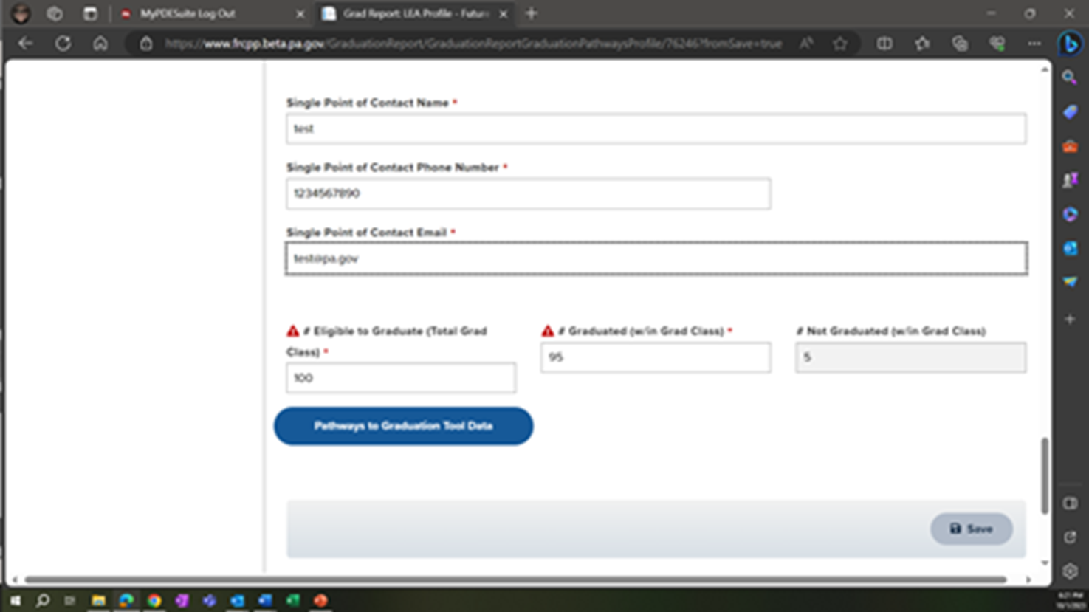


Grad Report: LEA Profile (continued)
Notes:
Under LEA Profile, you’ll notice that I’ve entered 100 as the total number of students Eligible to Graduate and 95 as the total number of students who graduated. Those numbers will either appear or be used in calculations on the next two pages.
And don’t forget to select SAVE at the bottom of the page before clicking on Continue.

Slide 11
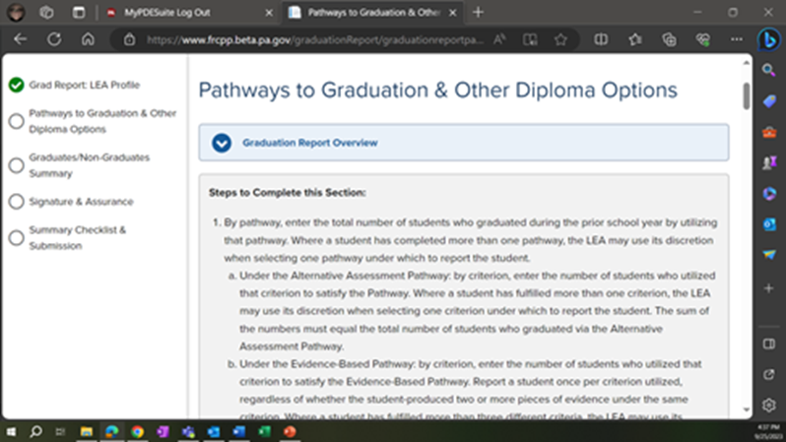
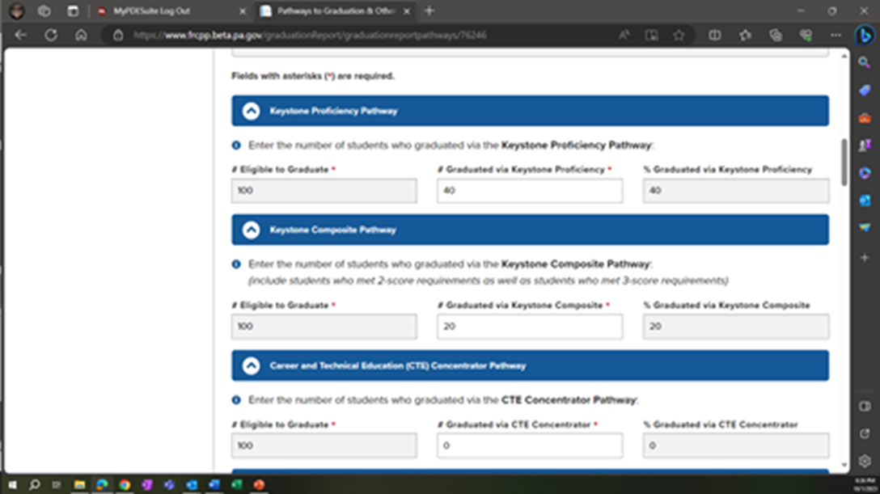
Pathways to Graduation &
Other Diploma Options
Notes:
If you’ve saved data in each of the required fields under LEA Profile before proceeding to this section, you will notice a green check appears next to LEA profile in the left menu. All pages must have a green check before the report can be submitted. However, it’s worth noting that a page may have errors and still display a green check – so it’s always a good idea to review the accuracy of data on the first three pages prior to submission.
The Pathways to Graduation & Other Diploma Options page is where you will report most of your graduate data.
For the Keystone Proficiency Pathway, the Keystone Composite Pathway, and the CTE Concentrator Pathway, you will enter only the total number of students who graduated via that pathway.
The system will calculate and display the percentage in the data field to the right based on the #Eligible to Graduate (which is pre-populated from the data I entered under LEA Profile and displayed in the data field to the left).
The system will also check to ensure that the number of students you enter as graduated via a pathway or other diploma option never exceeds the total number of students reported as graduated under LEA Profile.
Under the Keystone Proficiency Pathway, report all students who graduated via this pathway as one number regardless of whether they met the requirements via Keystone Exams scores or non-numeric scores of Proficient.
Under the Keystone Composite Pathway, report all students who graduated via this pathway as one number – include both students who met the 3-score composite requirements as well as students who qualified for and met the 2-score composite requirements.
Similarly, under the CTE Concentrator Pathway, report all students who graduated via this pathway as one number regardless of whether the student met the pathway through attainment of an industry-based certification, demonstrated likelihood of success on an industry-based competency assessment, or demonstrated readiness for continued meaningful engagement in the program of study.
Do not report a student under more than one pathway or diploma option. Where a student has satisfied more than one pathway, the LEA may use their discretion in determining which to report as the pathway by which the student graduated.

Slide 12
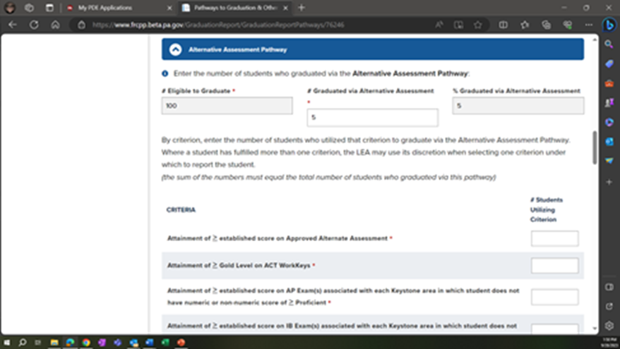

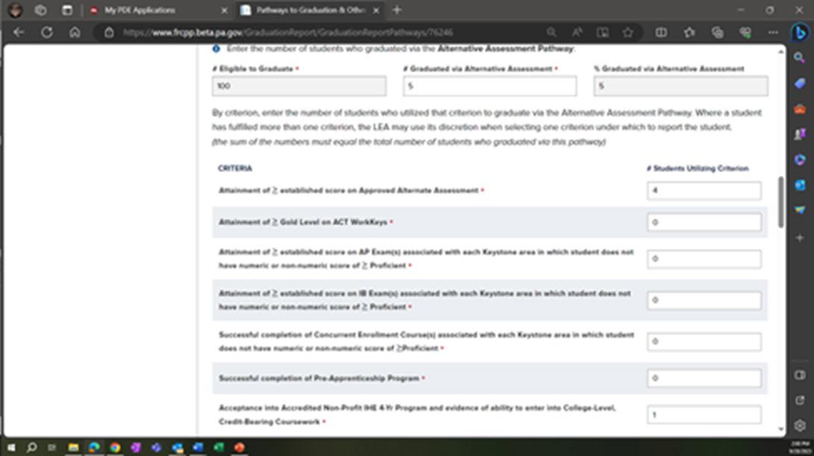

Alternative Assessment Pathway
Notes:
The next Pathway down on this page of the report is the Alternative Assessment Pathway.
In addition to entering the total number of students who graduated via this Pathway, you must enter, by criterion, the number of students who utilized that criterion to satisfy the AA Pathway. Students graduating via the Alternative Assessment Pathway are required to meet only one of the seven criteria listed. Where a student fulfilled more than one criterion, the LEA may use its discretion when selecting the one criterion under which to report the student.
Remember - an entry is required everywhere you see a red asterisk; therefore, if no student attained Gold Level or higher on the ACT WorkKeys (for example), you would enter a zero in that field.

Slide 13
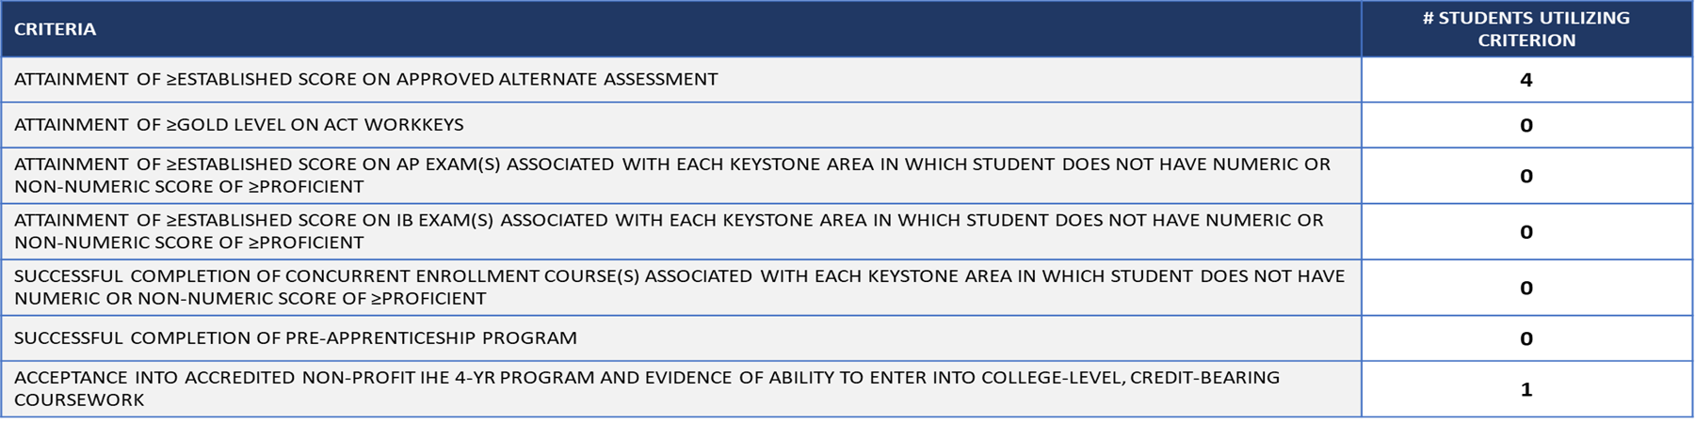
Alternative Assessment Criteria
5
Notes:
For clarity, here are the criteria listed in table form.
Because a student will be reported next to only one criterion, the sum of the numbers reported in this table should match the total number of students who graduated via the Alternative Assessment Pathway - otherwise, you will receive an error upon saving this page.
NOTE: If you receive an error in this or any other table, the red alerts will not disappear until after you have corrected the error(s) and clicked SAVE at the bottom of the page.

Slide 14
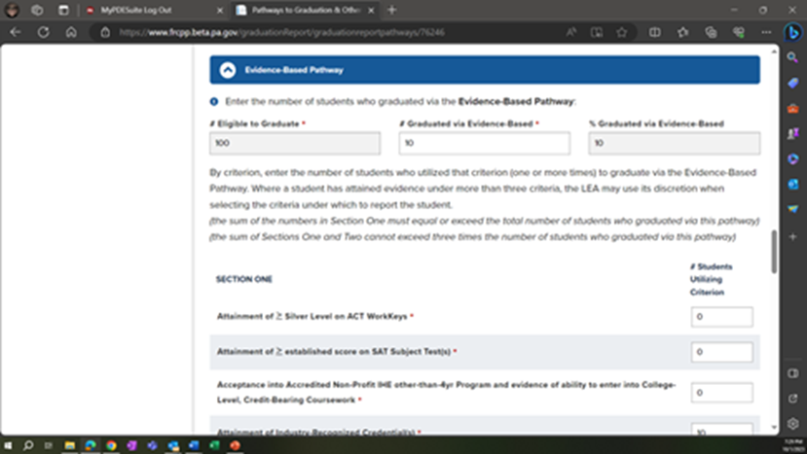

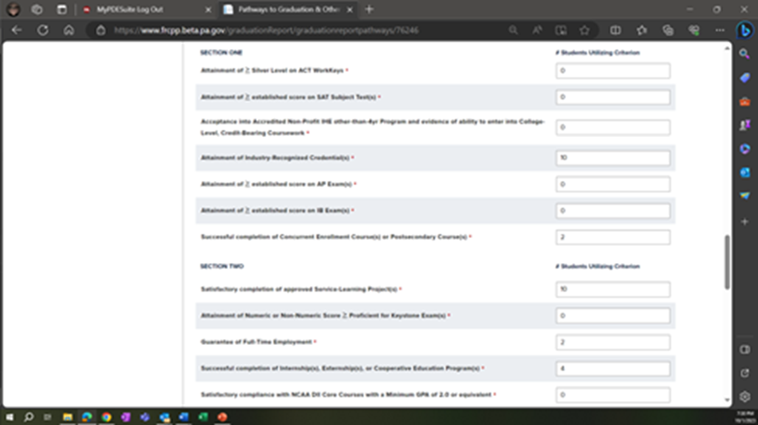
Evidence-Based Pathway
Notes:
Next is the Evidence-Based Pathway.
Similar to the AA pathway, you must enter the total number of students who graduated via the Evidence-Based Pathway - AND, by criterion, the number of students who utilized that criterion to produce one (or more) of the three pieces of evidence needed to satisfy this pathway.
Where a student fulfilled more than three pieces of evidence, the LEA may use its discretion when selecting under which criteria to report the student.

Slide 15
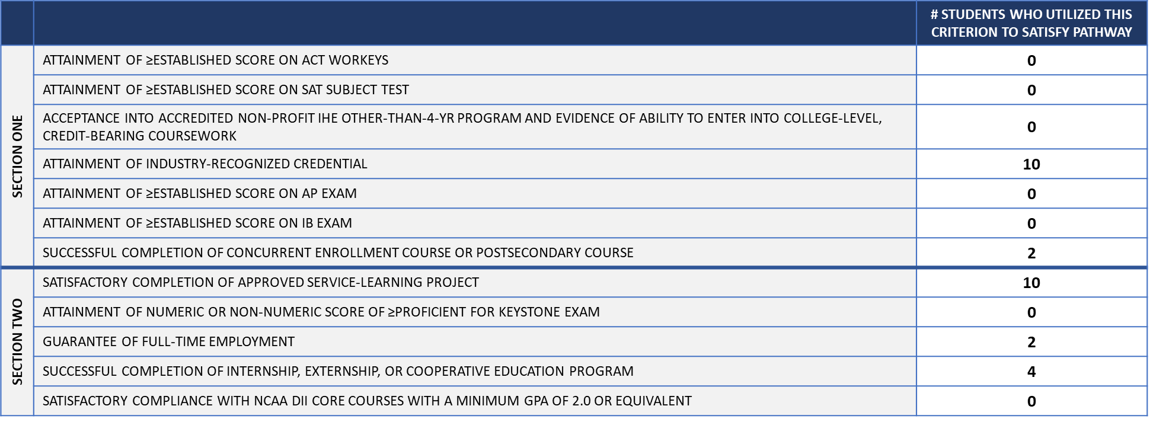
Evidence-Based Criteria
12
28
Notes:
It’s important to note that the number of students utilizing the type of artifact/evidence are reported, not the number of artifacts/evidence.
The sum of the numbers reported in Section One will always equal or exceed the total number of students reported as graduating via this pathway - because at least one of the three pieces of evidence must come from Section One, every student graduating via the EB Pathway will be reported next to at least one criterion in this section.
The subtotals (Sections One and Two combined) will never exceed three times the total number of students satisfying the pathway – however, it might equal an amount less than three times the total number of students satisfying the pathway. For example: a student completing one industry-recognized credential and two service-learning projects will be reported twice (once under IRC in Section One and once under SLP in Section Two).

Slide 16
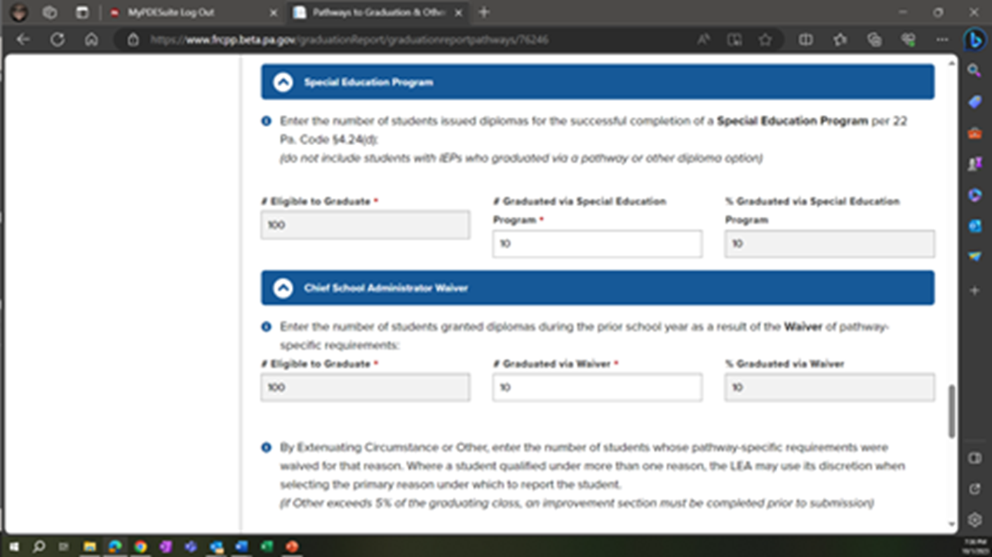
Special Education Program
Notes:
Most students with IEPs will graduate via one of the five pathways and be included in the reporting for that pathway.
However, where a student with disabilities is engaged in a special education program that, by design, does not meet graduation requirements, the student is issued a regular HS diploma for successful completion of that program (i.e., meeting their IEP goals) and reported here in the Grad Report (just below the EB Pathway).

Slide 17
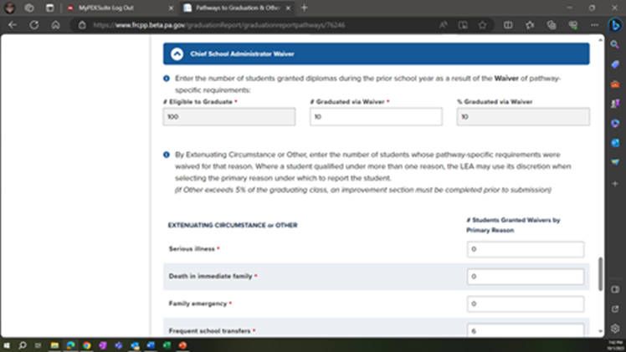
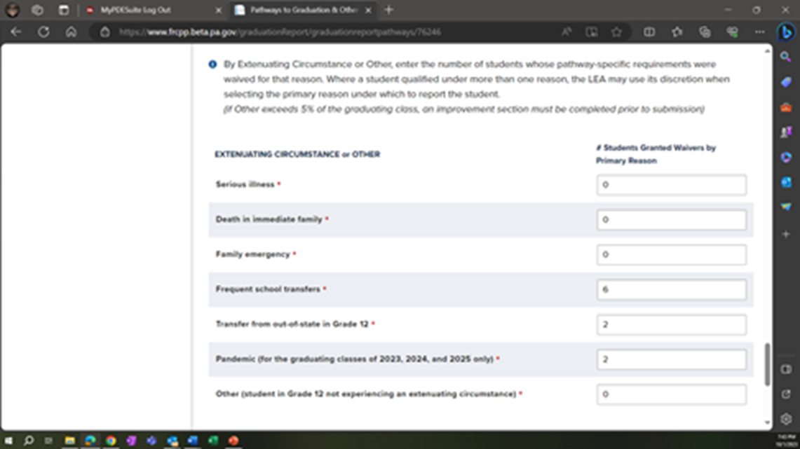
Chief School Administrator Waiver
Notes:
The last section on this page of the Grad Report is the Chief School Administrator Waiver.
You must enter the total number of students who graduated via a waiver – and complete a table indicating the subset of students by the primary reason the waiver was granted.

Slide 18
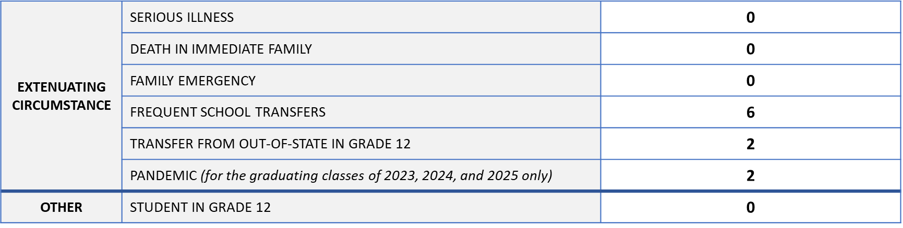
Waivers by Reason Granted
Extenuating Circumstance or Other
10
Notes:
Similar to the AA Pathway, the sum of the table must equal the total number of students graduating via waiver. Where students experience more than one extenuating circumstance, the LEA may use its discretion in determining which is the primary impacting circumstance.
NOTE: Act 1 eligible students requesting Keystone diplomas are not considered LEA graduates and, therefore, are NOT reported under waivers – nor are students granted diplomas for completion of their special education programs (remember, they are reported in the prior section).
In this scenario, I granted waivers to more than 5% of the graduating class (#Eligible to Graduate) – however, I did not grant waivers to more than 5% of the graduating class for reasons other than approved extenuating circumstances. Therefore, I’m not required to complete the improvement plan section.

Slide 19
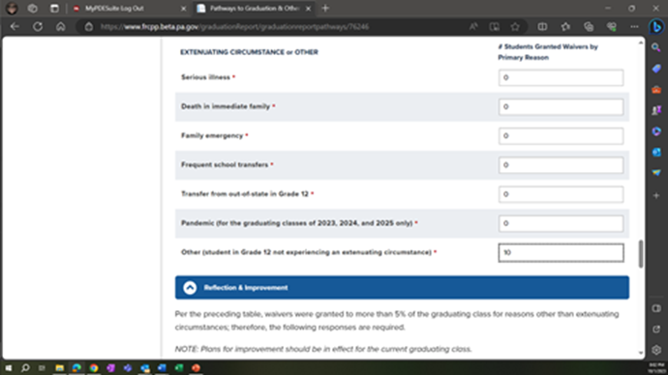
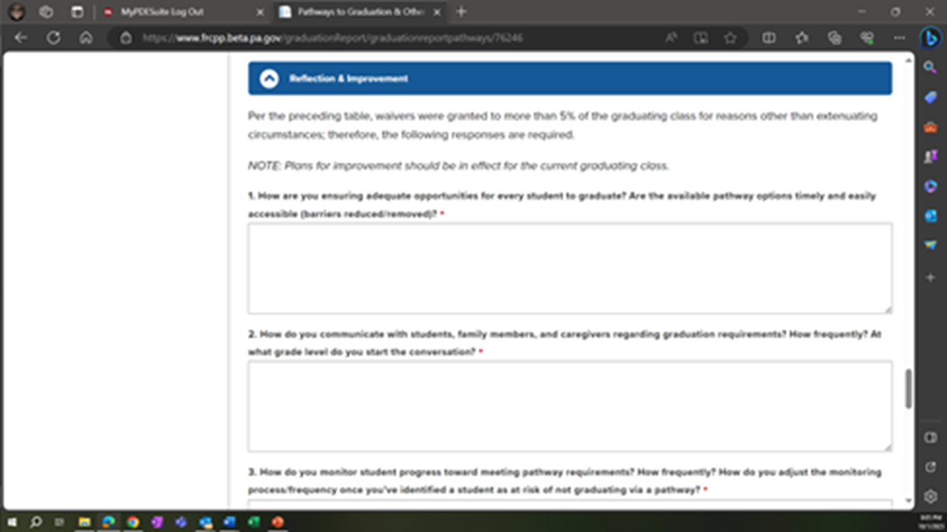
Waivers >5% for Other
Notes:
If I were to indicate that waivers were granted to more than 5% of the #Eligible to Graduate for reasons other than extenuating circumstances, the system would display a Reflection & Improvement section that I must be complete before the Grad Report can be submitted.
Given the approval of the pandemic as an extenuating circumstance for the classes of 23, 24, and 25, we anticipate the majority/totality of waivers granted during that period will be for extenuating circumstances.

Slide 20
Reflection & Improvement
How are you ensuring adequate opportunities for every student to graduate? Are the available pathway options timely and easily accessible (barriers reduced/removed)?
How do you communicate with students, family members, and caregivers regarding graduation requirements? How frequently? At what grade level do you start the conversation?
How do you monitor student progress toward meeting pathway requirements? How frequently? How do you adjust the monitoring process/frequency once you’ve identified a student as at risk of not graduating via a pathway?
Notes:
There are 7 narrative responses required in the Reflection & Improvement section. Here are the first three…

Slide 21
Reflection & Improvement (cont.)
How do you engage family members and caregivers in assisting students whose progress may be lagging to meet graduation requirements?
How and when do you identify students as eligible for waivers?
How do you provide targeted assistance to students who have been identified as eligible for waivers but who might still meet pathway requirements?
What might you do differently? Identify opportunities to revise and/or expand your current practices and protocols to ensure that waivers granted in future years do not exceed 5% of a graduating class. Where appropriate, include steps to be taken, by when, and by whom.
Notes:
…and the last four.

Slide 22
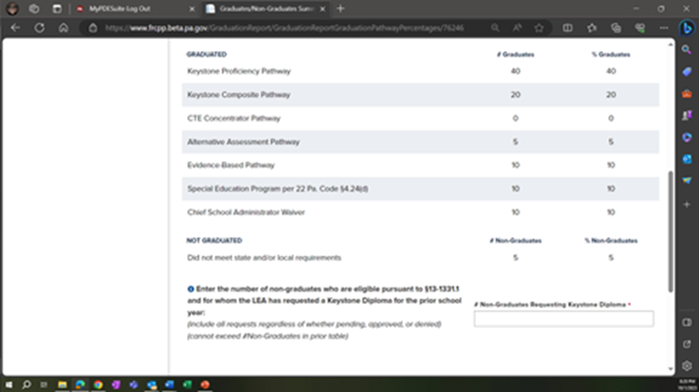

Graduates/Non-Graduates Summary
Notes:
The last page in the Grad Report that we’ll be covering today is the Graduates/Non-Graduates Summary page. The two after this page are standard (boilerplate) pages with which you should be familiar from other reports – and they will require special user permissions to sign and submit on behalf of the LEA (i.e., your CSA).
From data entered on the prior pages, this page will prepopulate the numbers and percentages of graduates by pathway or other diploma option and the number and percentage of non-graduates.
You will see an alert if:
1) the sum of the # Graduates column does not equal the total #Graduated or
2) the sum of the #Graduates and #Non-Graduates does not equal the #Eigible to Graduate – and you will need to go back and correct the LEA Profile page and/or the Pathways to Graduation & Other Diploma Options page accordingly.
There is one required data entry field on this page – that for the #Non-Graduates requesting a Keystone Diploma. Include all requests regardless of whether pending, approved, or denied. If none, enter zero.

Slide 23
Questions & Comments

Slide 24
Resources
Upcoming Office Hour
MAY 18, 2026 (11am – noon)
  PA HS Graduation Requirements: Options & Opportunities
The mission of the Department of Education is to ensure that every learner has access to a world-class education system that academically prepares children and adults to succeed as productive citizens.
Further, the Department seeks to establish a culture that is committed to improving opportunities throughout the commonwealth by ensuring that technical support, resources, and optimal learning environments are available for all students, whether children or adults.
WWW.PDESAS.ORG
WWW.EDUCATION.PA.GOV
Contact
RA-EDGRADREQUIREMENT@PA.GOV
Notes:
The next office hour (scheduled for May 18) will discuss options and opportunities for students to meet statewide requirements – with a particular focus on graduating seniors in exceptional situations.
The zoom link for that office hour is posted under the Professional Learning tab in the Grad Requirements Toolkit at pdesas.org.
[drop Toolkit link in chat]
Still have questions? Email us at ra-edgradrequirement@pa.gov.
[drop email in chat]

