Slide 1


Toy Engineer Design Teacher Guide
Tennessee District Science Network Task Library
Toy Engineer Design Teacher Guide
Third Grade Physical Science
Three-Dimensional Claim
In this task, students will apply scientific ideas to solve design problems to explain how a device converts electrical energy to other forms of energy through using understanding of open and closed circuits to determine how their related parts make up a whole that will carry out their functions properly.
Tennessee Academic Standards for Science
This task is intended to elicit student learning of the following Tennessee Science Standard:
3.PS3.2: Apply scientific ideas to design, test, and refine a device that converts electrical energy to another form of energy, using open or closed simple circuits.
Next Generation Science Standards
This task is intended to elicit student learning of the following NGSS elements for each of the three dimensions:
Science and Engineering Practices
Constructing Explanations and Designing Solutions
Grade 3-5 Element: Apply scientific ideas to solve design problems
Crosscutting Concepts
System and System Models
Grade 3-5 Element: A system is a group of related parts that make up a whole and can carry out functions its individual parts cannot.
Disciplinary Core Ideas
3.PSA. Definitions of Energy
Grade 3-5 Element: Energy can be moved from place to place by moving objects or through sound, light, or electric currents.
3.PSB. Conservation of Energy and Energy Transfer
Grade 3-5 Element: Energy can also be transferred from place to place by electric currents, which can then be used locally to produce motion, sound, heat, or light. The currents may have been produced to begin with by transforming the energy of motion into electrical energy.
These materials were developed by the Tennessee District Science Network, a NextGenScience network that included educators six districts in TN, with support from Arconic Foundation. Except where otherwise noted, this work is licensed under the Creative Commons Attribution-NonCommercial 4.0 International License.
1

Slide 2
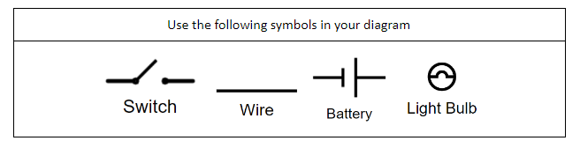
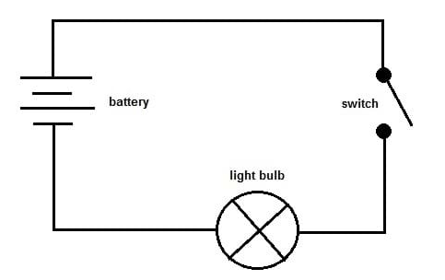
Three-Dimensional Claim
Tennessee District Science Network Task Library
Toy Engineer Design Task Teacher Guide
Third Grade Physical Science
Three-Dimensional Claim
In this task, students will apply scientific ideas to solve design problems to explain how a device converts electrical energy to other forms of energy through using understanding of open and closed circuits to determine how their related parts make up a whole that will carry out their functions properly.
How is this student understanding elicited from this task?
DCI: An electrical circuit is a complete loop that an electrical current flows through. Electric currents are a way to transfer energy from one location (battery, i.e., power source) to another (device in the circuit, i.e., lightbulb, buzzer, motor). A circuit is closed when the loop is complete and there are no breaks in the path that the current passes through to transfer energy from one component (energy source) to another. A circuit is open if the loop is incomplete and there is a break in the path. Energy cannot be transferred through the entire circuit if any part is not connected.
CCC: Students will use the crosscutting concept of systems and system models and their informal understanding of systems as an organized group of related parts/components that work together to make a device that will carry out functions by working together in specific ways. Students will explain how energy is transferred from the power source, a battery, to the object that receives the power from the energy, the light bulb, to work resulting in some type of motion, light, or sound, etc. The electrical current only flows in an electrical circuit if the path of the loop is completely closed when all parts are connected appropriately. Students need to be aware of the function of each of the following components: battery, wires that conduct electric current, light bulb, and use of a switch to complete a circuit that controls the flow of energy within that system. Students will use models to demonstrate understanding of and predict the behavior of this type of system.
Note: Provide experiences for students to build simple circuits using the components listed above and explaining in different ways to explain how the parts work together in that system. Students will also need to take their physical models and create drawings or diagrams to show how these parts work together to function properly. Give students opportunities to problem solve circuits that do not work properly and refine the examples to get them to work correctly.
Teach symbols of universal circuit diagrams as a way for students to represent visually what they were able to create using physical components. (See Part A of Toy Troubles Task.)
2

Slide 3
How is This Student Understanding Elicited From This Task?
Tennessee District Science Network Task Library
Toy Engineer Design Task Teacher Guide
Third Grade Physical Science
Three-Dimensional Claim
In this task, students will apply scientific ideas to solve design problems to explain how a device converts electrical energy to other forms of energy through using understanding of open and closed circuits to determine how their related parts make up a whole that will carry out their functions properly.
How is this student understanding elicited from this task?
SEP: Students will use the science and engineering practice of constructing arguments and designing solutions as they work through the questions of this task, specifically applying scientific ideas to solve design problems. In the context of a creating a prototype of a new toy, students will need to use their knowledge of transfer of electrical energy through circuits, as a system, where their components relate in such a way to cause to function properly in order to answer the questions in this task. Students must also be able to problem solve examples that include an issue that would cause the energy flowing through the system not to work properly and offer suggestions/solutions to fix the problems presented so it will function properly.
Students will also need to understand that a closed circuit, which is a complete loop, is a closed system, which ensures it will work every time. Students should be able to contrast this to their understanding of an open circuit, as an open system, a break in the path for the energy to transfer, which would cause this system not to transfer energy currents therefore it will not work properly every time. Students should know how to draw and label models to communicate how they will analyze these models to diagnose and fix closed and open circuits problems. (See note above under crosscutting concepts.)
Suggestions for Use
This task should be used at the end of a sequence of instruction to reveal students’ ability to apply their ideas about the flow of energy and explain how energy is transferred within open and closed circuits to solve design problems. From this task, teachers should be able to make claims about students' use of and development of applying scientific ideas to solve problems with a focus on open and closed circuits to explain how energy can be transferred into various forms.
3

Slide 4
Assumptions
Tennessee District Science Network Task Library
Toy Engineer Design Task Teacher Guide
Third Grade Physical Science
Assumptions
In order for all students to be successful with this assessment task, students should be familiar with basic terminology of open and closed circuits for this assessment. It is recommended that students have had time spent with building and constructing basic circuits of various forms (i.e., light circuits, buzzer circuits, fan circuits). Students need to have an understanding that a switch is a component that opens and closes a circuit.
Students need to be exposed to phenomena that reveal energy changing forms, for instance, that a battery can be used to make light, sound, and wind energy. Students can be exposed to phenomena where a light strand (i.e., Christmas lights) may have several lights out, it does not mean all lights will go out, thus illustrating that certain parts of a simple circuit system may function independently (closed) of another part functioning (open). It is recommended that students have had time working through misconceptions as to how circuits work through independent lab times to figure out what works regarding making open and closed circuits.
Have students deconstruct flashlights in order to investigate and explain how flow or energy and circuits are used to make them work. (See like for possible design challenge:) https://www.teachengineering.org/activities/view/cub_electricity_lesson05_activity2
Here is a video that could be used to show students how toy engineers work together to design toys.
https://pbskids.org/designsquad/video/nerf-toys/
Video: PBS-Designing Electric Circuits--Door Alarm
https://tnlearn.pbslearningmedia.org/resource/phy03.sci.phys.mfw.zalarm/designing-electric-circuits-door-alarm/
Logistics
Intended duration of task: This task is intended to take roughly 60 minutes to complete or could be broken into smaller parts across two days in shorter 30-minute sessions.
Prep work or materials required: The teacher will need to be able to discuss with students the role of suggested symbols for Part A when drawing a diagram to answer the question and highlight the word bank for communicating explanations in their responses using accurate terminology in the second part of Part A and throughout the entire task.
You may want to have a discussion where students compare/contrast the open switch to closed switch in a circuit model and the important role both play on the function of the circuit.
Other than that, students will just need paper and pencil to complete the task.
Students could be given components from a class kit (i.e., batteries, wires, switches, little light bulbs etc..) and build a circuit or make the models of circuit diagrams with their component parts to test and refine ideas to support sense making and problem solving as they work through each part of the assessment task.
Students could use Phet Circuit Construction Kit Simulator on computers or Chromebooks to support diagrams, models, and sense making throughout the task. https://phet.colorado.edu/sims/html/circuit-construction-kit-dc-virtual-lab/latest/circuit-construction-kit-dc-virtual-lab_en.html
.
4

Slide 5

Task and Rubric Scoring
Tennessee District Science Network Task Library
Toy Engineer Design Task Teacher Guide
3rd Grade Physical Science
Task and Rubric Scoring
On the pages that follow, you’ll find a scoring rubric and feedback guide for each prompt.
Scenario
Congratulations! You have been hired by the Build-A-Toy Company to design, test, refine and fix toys that incorporate batteries and moving parts such as motors, lights, and sounds. The toys you design will be sold on Amazon for children all across the world to enjoy. It is important that all the toys designed by the Build-A-Toy Company work correctly so the children who buy the toys have a lot of fun.
Your new boss has asked you to be a part of a design team that will build a toy camera that will use flashing lights for young children to pretend to take pictures. However, the flashing light on your first design is not bright enough.
Photo by Tanaphong Toochinda on Unsplash
Use your knowledge about energy flow and circuit design to answer the following questions using the key ideas you and your team will need in order to make the flashing light brighter on your camera.
5

Slide 6
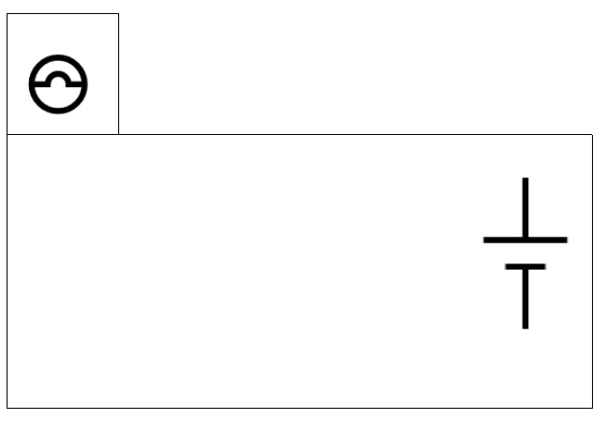


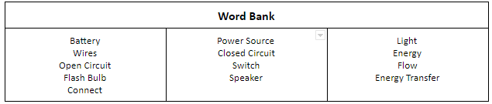
Part A
Tennessee District Science Network Task Library
Toy Engineer Design Task Teacher Guide
Third Grade Physical Science
Part A
A1: Before making the flash brighter, your team decides to think about how the current prototype of the camera works. Your team's camera uses a battery, wires, a switch, and a light bulb that lights up. Draw and label a diagram to show how these materials work in your current prototype.
Use the symbols provided in the key below in your diagram.
(Diagram inserted into image in teacher guide below, but not on Part A of the student answer document—see scoring guide on next page for more details on student solution paths.)
A2: How does your diagram help to explain why the prototype of the camera works? Use words from the word bank below in your explanations.
6

Slide 7
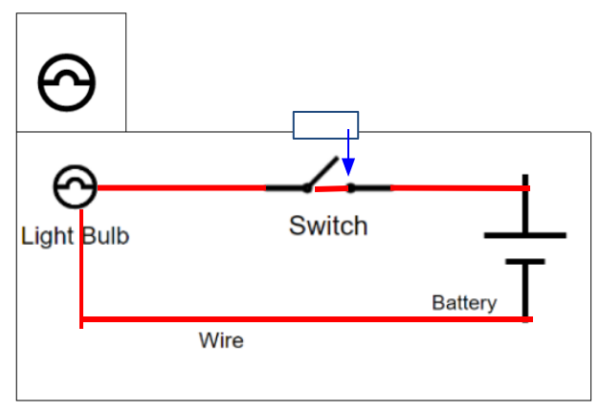
Part A - Continued
Tennessee District Science Network Task Library
Toy Engineer Design Task Teacher Guide
Third Grade Physical Science
Part A - Continued
This prompt assesses:
TN Standard | 3.PS3.2: Apply scientific ideas to design and refine a device that converts electrical energy to another form of energy, using open or closed simple circuits.
SEP | Constructing Explanations and Designing Solutions Apply scientific ideas to solve design problems
CCC | System and System Models A system is a group of related parts that make up a whole and can carry out functions its individual parts cannot.
Prompt Scoring Guidance
Score | Components of Student Response (SEP, CCC, and/or DCI) | Example Responses/Look Fors
+1 | Students will design a model of a working device using a diagram modeling a closed circuit that demonstrates understanding that this representation would allow electrical energy to flow and be converted into light energy for flash on camera to work. The diagram must include all the parts of the circuit in the key (battery, switch, wires, and light bulb). All parts must be connected to represent a closed circuit which represents a closed system where all parts much work together to function. (DCI, SEP, CCC) Note: The switch must indicate that it is closed in some way to complete the circuit to allow for transfer of energy and flow from the battery to the light. | Note: Students must include symbols from circuit diagrams using the key and provide labels. Students may or may not add a shape for the button to press to align with the switch.
+1 | Students provide evidence and terminology from the word box provided to explain how their diagram solved the problem of a building a closed circuit that would allow electrical energy to flow (to be transferred) and be converted into light energy for flash on camera to work properly. Students should reference the parts/components they used in their diagram (battery, wires, switch, light bulb) in their response and provide reasoning about how the must be connected in order to create a design the functions properly. (DCI, SEP, CCC) | My diagram shows how I used a battery for the power source, a switch that is closed, because the line connects the dots, and a light bulb that lights up because all my wires connect all the parts together so it will work. I know it will work because when I drew my closed circuit the energy from the battery can flow through all the connected parts without being stopped. When the energy can be transferred without being stopped the light will flash because it is getting the power from the battery.
7

Slide 8
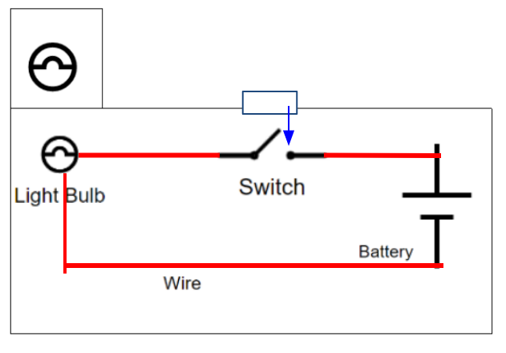



Part A – Cont.
Tennessee District Science Network Task Library
Toy Engineer Design Task Teacher Guide
Third Grade Physical Science
Part A - Continued
Incomplete Student Response - Example A The student does not indicate in some way that the switch is closed in their model creating a closed system of all the parts working together for energy transfer to reach the light bulb from the battery power source. or... students leave gaps in their drawings while connecting the parts to create the whole closed circuit system The student may only put the symbols in the camera without drawing all parts connected to create a complete circuit. |  | Score and Score Rationale, if applicable: Provide students the opportunity to give an oral explanation to determine if it was a misconception or a misrepresentation of a diagram. If students can give an accurate oral explanation connecting to their diagram or score the second question in Part A accurately you can use professional judgement with scoring points. (+1 or +0 depending on student oral explanation) If students leave and open switch or gaps indicates the student may not completely understand all parts of the circuit must be connected in order for it to work properly.(+0) Students may not know how to use the symbols provided to create an accurate representation of a diagram of a closed circuit needed for the camera to work. (+0) Feedback & Next Steps for Students to Make Progress: Students may need more opportunities building, testing, and refining models of closed circuits with emphasis on how it supports the flow and transfer of energy as well as connecting the roles of these parts that make up the whole system. Make sure students have opportunities to explore the use of switches and how they relate to open and closed circuits. Students may also need additional opportunities to make drawings and diagrams of the circuits they build in order to communicate their thinking visually in the modality as well.
Incomplete Student Response - Example B The student demonstrates an incomplete understanding of how the closed circuit transfers energy flow with specificity or missing key ideas the demonstrate mastery of how electric current transfers within the device in order for it to work properly. |  | Score and Score Rationale, if applicable: Provide students the opportunity to give an oral explanation to determine if it was a misconception. If students can give an accurate oral explanation connecting to their diagram or score the first question in Part A accurately you can use professional judgement with scoring points. (+1 or +0 depending on student oral explanation) The student response lacks a complete description of the diagram above or does not use terminology accurately in their response. (+0) Feedback & Next Steps for Students to Make Progress: Students may need more opportunities building, testing, and refining models of closed circuits with emphasis on how it supports the flow and transfer of energy as well as connecting the roles of these parts that make up the whole system. Make sure students have opportunities to explore the use of switches and how they relate to open and closed circuits. Students should have additional opportunities to write descriptions and claims with evidence and supporting reasoning (see Claims Evidence Reasoning (CER) strategy in science) using accurate terminology in their answers.
8

Slide 9
Part B
Tennessee District Science Network Task Library
Toy Engineer Design Task Teacher Guide
Third Grade Physical Science
Part B
B1: A teammate wonders how they could make the flash shine brighter when a pretend picture is taken. Draw a model or write to explain what you would change to make flash brighter?
B2: Explain to your teammate why you think this change will work to make the flash brighter.
9

Slide 10
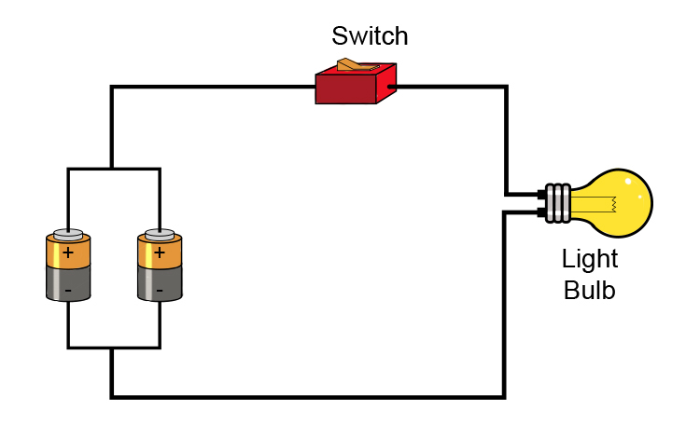
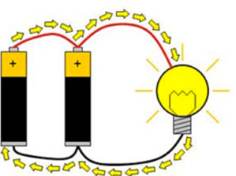
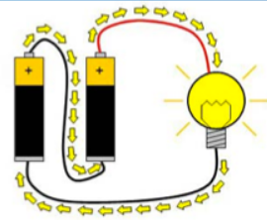
Part B - Continued
Tennessee District Science Network Task Library
Toy Engineer Design Task Teacher Guide
Third Grade Physical Science
Part B - Continued
This prompt assesses:
TN Standard | 3.PS3.2: Apply scientific ideas to design and refine a device that converts electrical energy to another form of energy, using open or closed simple circuits.
SEP | Constructing Explanations and Designing Solutions Apply scientific ideas to solve design problems
CCC | System and System Models A system is a group of related parts that make up a whole and can carry out functions its individual parts cannot.
Prompt Scoring Guidance
Score | Components of Student Response (SEP, CCC, and/or DCI) | Example Responses/Look Fors
+1 | Students should provide an alternative solution to the components of the camera (light bulb, wire, batteries, and/or switch) that would change the function of the camera--creating a way to cause the flash to shine brighter when used. (DCI, SEP, CCC) | I would change the camera design from using one battery to using two batteries to see if that would make the flash shine brighter when the camera takes a picture. Possible Diagrams of a Model using two batteries:
+1 | Students should provide reasoning, based on their experience and understanding of exploring and building a variety of closed circuits, to support their suggested alternative solution to altering one or mover of the components of the camera (light bulb, wire, batteries, and/or switch) that would change the function of the camera--creating a way to cause the flash to shine brighter when used. (DCI, SEP, CCC) | I think that using two batteries in our camera instead of one battery would make the light shine brighter when the flash works because there would be more energy going through the camera’s circuit. There is more energy because we are using more batteries as our power source. The camera system would use more energy to make the flash look brighter when the button is pressed.
10

Slide 11
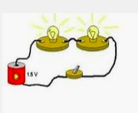
Part B – Cont.
Tennessee District Science Network Task Library
Toy Engineer Design Task Teacher Guide
Third Grade Physical Science
Part B - Continued
Incomplete Student Response - Example A I would add a battery so that there are 2 batteries. That would make the light brighter. |  | Score and Score Rationale, if applicable: +1 out of +2 Student knows that you can add a battery and it will brighten the light but does not explain why. Feedback & Next Steps for Students to Make Progress: -More hands-on experiences with making and testing circuits and the role of a battery -Circuit simulations. -Support in understanding energy sources
Incomplete Student Response - Example B A student might offer using two light bulbs as a solution to having a brighter flash. |  | Score and Score Rationale, if applicable: 0 out of +2 The question was to make one light brighter Feedback & Next Steps for Students to Make Progress: -More hands-on experiences with making and testing circuits -Circuit simulations -Support in understanding energy sources
11

Slide 12
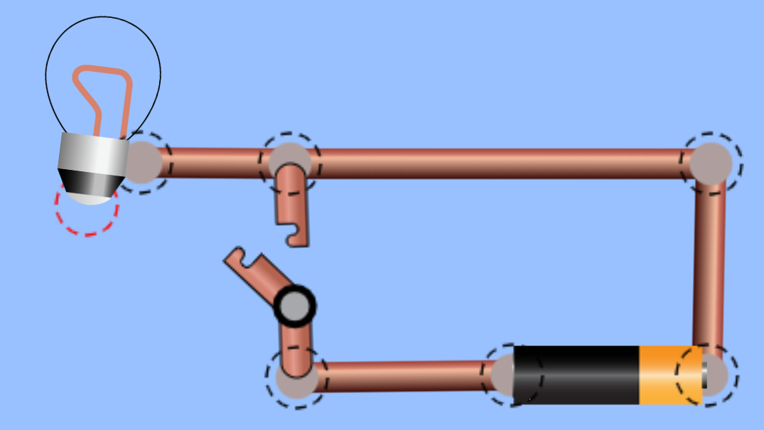
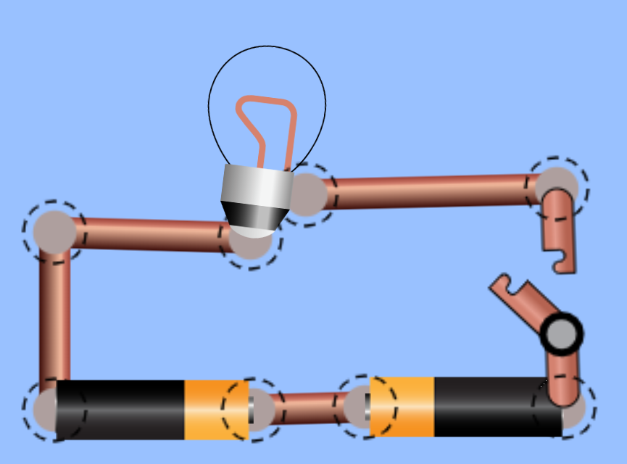
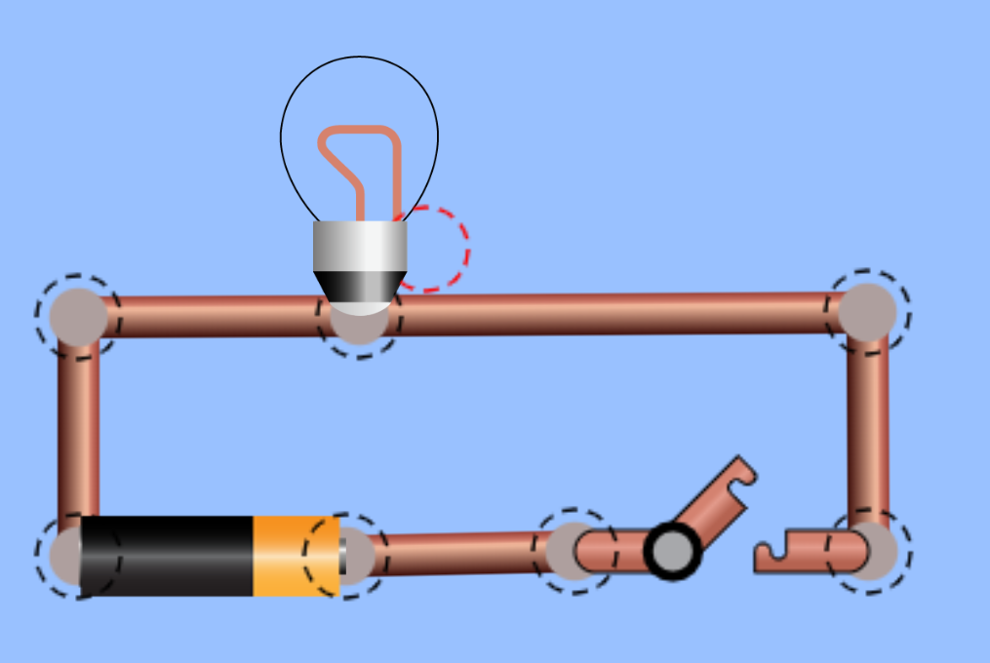
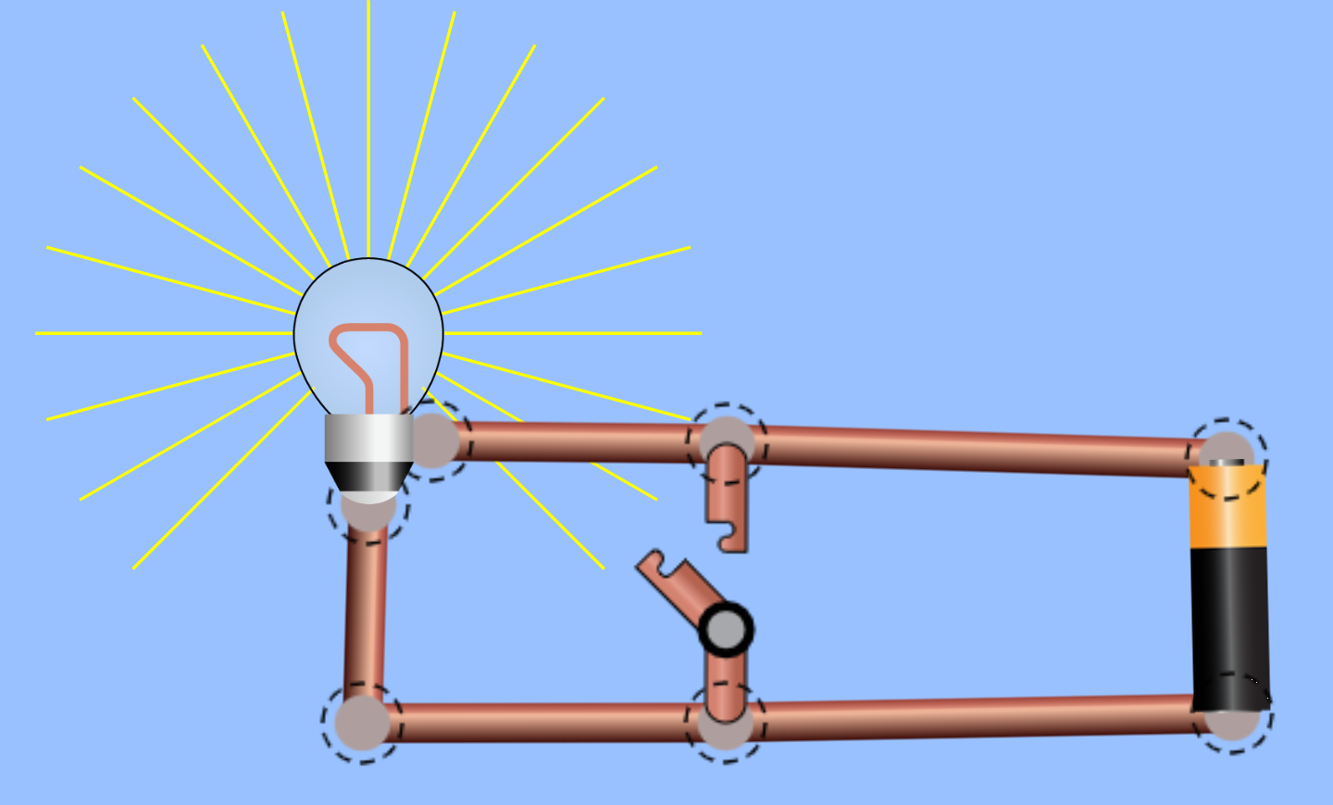
Part C
Tennessee District Science Network Task Library
Toy Engineer Design Task Teacher Guide
Third Grade Physical Science
Part C
The Build-A-Toy Company owner has asked to see the different prototypes the team has designed. Your team needs to make sure all the parts of your camera work together before your boss looks over the different designs.
Oops! You tested the four designs below and none of them work!
Redesign two out of the four designs below and write on the models to show how you would solve the problem before you show your boss.
Option 1
Option 2
Option 3
Option 4
12

Slide 13
Part C – Continued
Tennessee District Science Network Task Library
Toy Engineer Design Task Teacher Guide
Third Grade Physical Science
Part C - Continued
Rubric Scoring Template
This prompt assesses:
TN Standard | 3.PS3.2: Apply scientific ideas to design and refine a device that converts electrical energy to another form of energy, using open or closed simple circuits.
SEP | Constructing Explanations and Designing Solutions Apply scientific ideas to solve design problems
CCC | System and System Models A system is a group of related parts that make up a whole and can carry out functions its individual parts cannot.
Prompt Scoring Guidance
Score | Components of Student Response (SEP, CCC, and/or DCI) | Example Responses/Look Fors
+1 | Option 1: Students acknowledge in some way that the wires are not correctly connected to the light bulb. Students should also recommend a redesign to make the circuit function properly. (DCI, SEP, CCC) | If a student chooses option 1: You are looking for students to demonstrate the knowledge of a complete circuit by identifying that the light bulb is not connected correctly. The student should identify that the electricity has to flow through the light bulb. Students may acknowledge that the battery will overheat with the switch not connecting the light bulb. Students need to redesign the model by drawing over the existing model. See complete answer for option 1 on next slide.
+1 | Option 2: Students should acknowledge in some way that the batteries are not connected correctly to allow for the proper flow of electricity. Students should also recommend a redesign to make the circuit function properly. (DCI, SEP, CCC) | If a student chooses option 2: You are looking for students to demonstrate knowledge of how electricity comes from batteries. They have to be oriented in the same direction for the flow of electrons to reach the light. In this current configuration for option 2 the two batteries facing each other will simply cancel each other out and the circuit will not look like it is working. Students need to redesign the model by drawing over the existing model. See complete answer for option 2 on next slide.
+1 | Option 3: Students should acknowledge in some way that the wires are not correctly connected to the light bulb thus the circuit does not work. Students should also recommend a redesign to make the circuit function properly. (DCI, SEP, CCC) | If a student chooses option 3: You are looking for students to demonstrate the knowledge of a complete circuit by identifying that the light bulb is not connected correctly. The student should at some point identify that the electricity has to flow through the light bulb. Students need to redesign the model by drawing over the existing model. See complete answer for option 3 on next slide.
13

Slide 14
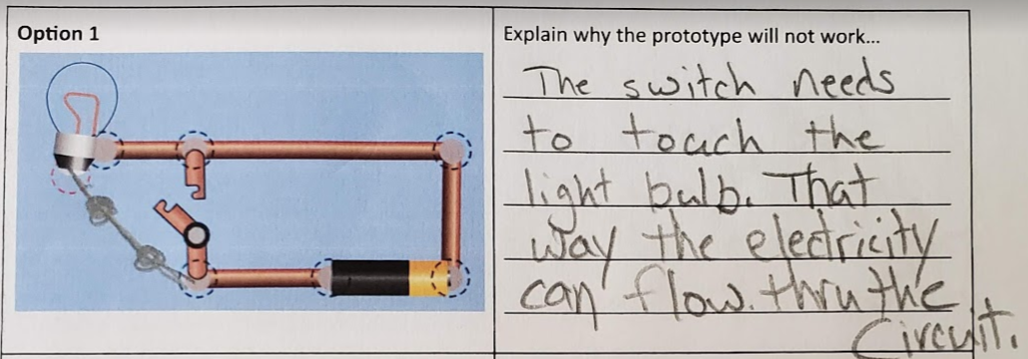
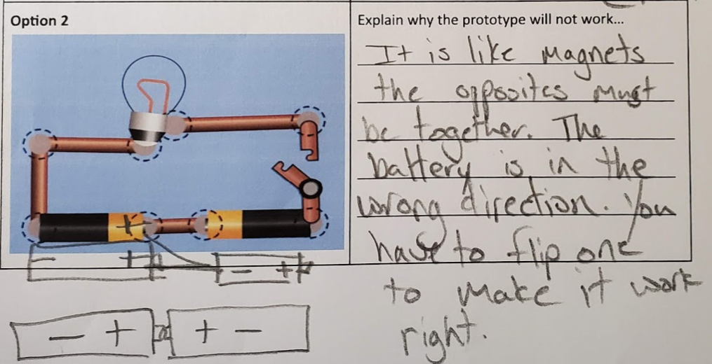
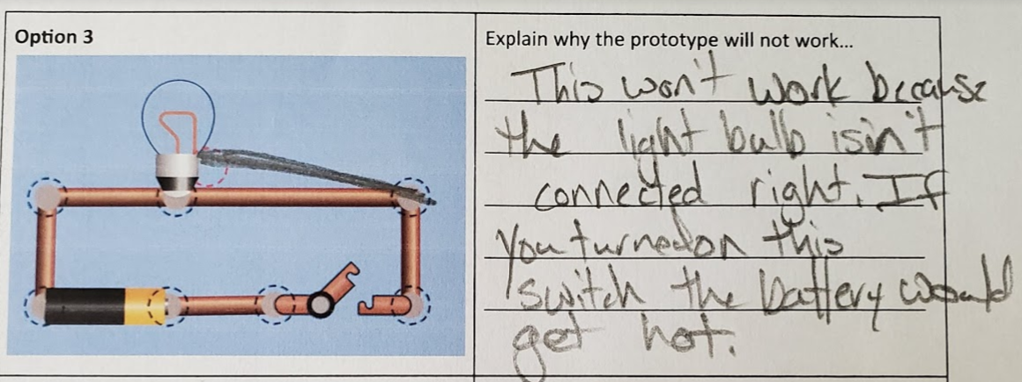
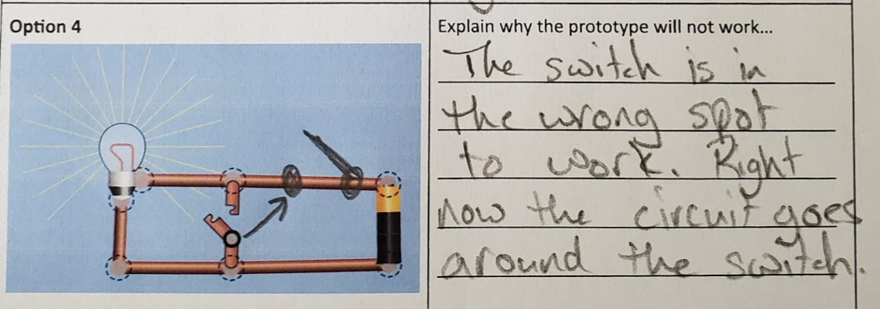
Part C – Cont.
Tennessee District Science Network Task Library
Toy Engineer Design Task Teacher Guide
Third Grade Physical Science
Part C - Continued
Prompt Scoring Guidance
Score | Components of Student Response (SEP, CCC, and/or DCI) | Example Responses/Look Fors
+1 | Option 4: Students should acknowledge that the battery is directly connected to the bulb thus skipping the switch. The switch is not installed correctly. Students should also recommend a redesign to make the circuit function properly. (DCI, SEP, CCC) | If a student chooses options 4: You are looking for students to demonstrate the knowledge that the switch must be incorporated into the outside of the circuit by including the switch through the middle of the circuit the flow of electricity does not make it to the light bulb. Students should demonstrate in their redesign a place where they moved the switch. Students need to redesign the model by drawing over the existing model. See complete answer for option 4 below.
 |  | Score and Score Rationale, if applicable: +2 to +4 points depending on number of student answers teacher would like students to provide, however, students were only requested to pick two. Feedback/Questions to support next level thinking for students: This student has demonstrated mastery. All examples include a proposed redesign drawn on the models and an explanation of what needs to happen for the flow of electricity. This student even demonstrates a connected idea of magnetism related to flow of electrons. To support next level thinking for this student you should have them explore parallel and series circuits. They will thrive given the opportunity to expand upon what they already know.
14

Slide 15
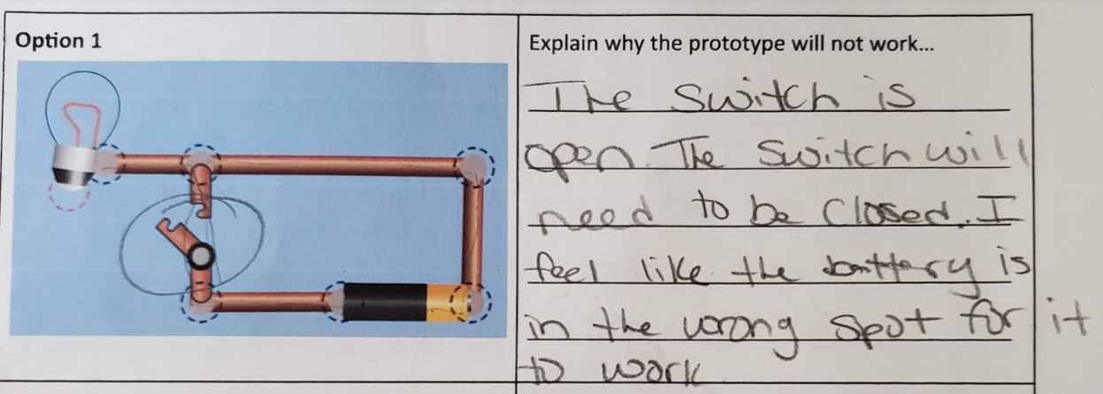
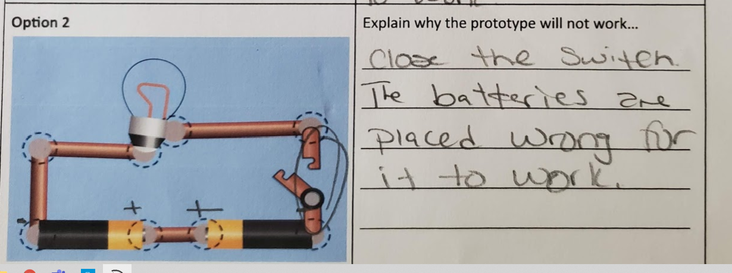
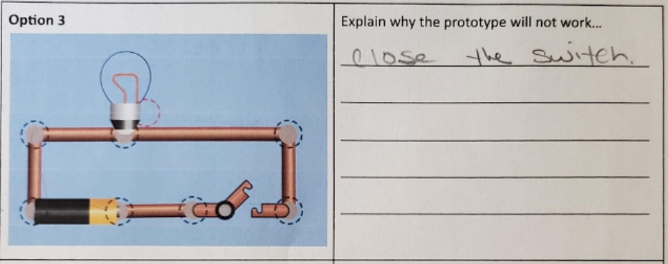
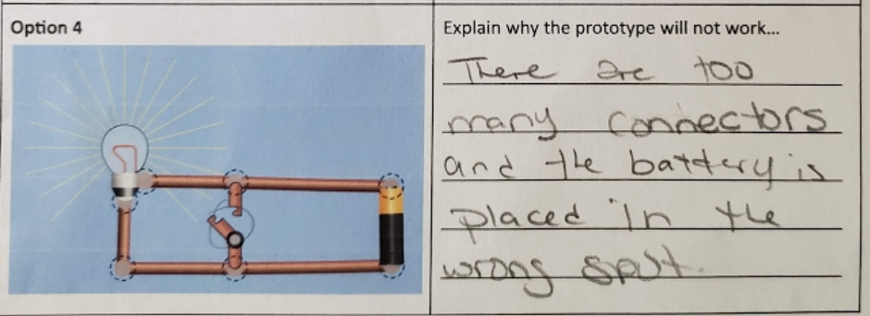
Part C – (continued)
Tennessee District Science Network Task Library
Toy Engineer Design Task Teacher Guide
Third Grade Physical Science
Part C - Continued
Incomplete Student Response - Example A |  | Score and Score Rationale, if applicable: +1 out of 2 This student demonstrates basic knowledge of an open and closed circuit but has failed to offer a potential solution to any of the options. Feedback & Next Steps for Students to Make Progress: -More hands-on experiences with making and testing circuits and the role of a battery -circuit simulations -support in understanding energy sources -additional support with understanding how a light bulb works - additional instruction with how electricity flows through a circuit
15

Slide 16
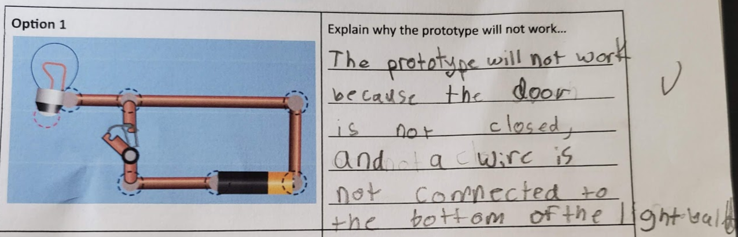
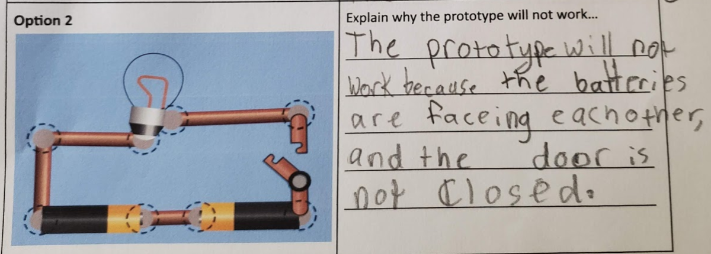
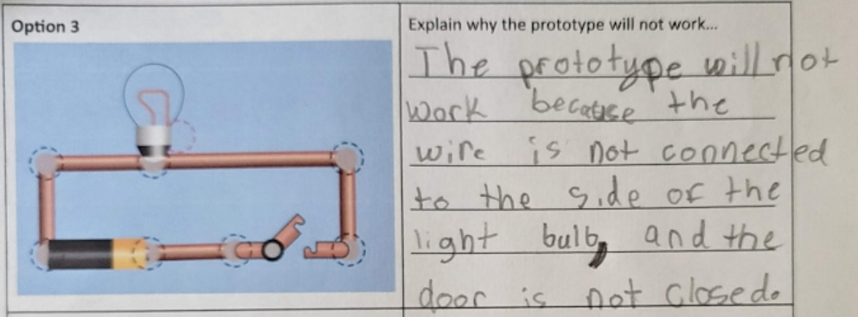
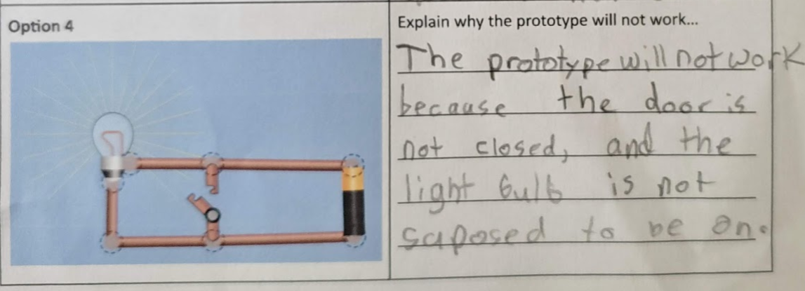
Part C – (cont.)
Tennessee District Science Network Task Library
Toy Engineer Design Task Teacher Guide
Third Grade Physical Science
Part C - Continued
Incomplete Student Response - Example B |  | Score and Score Rationale, if applicable: +2 out of 4 This student demonstrates the basic knowledge of how open and closed circuits work and the CCC of individual parts. They need additional support in the SEP of solving design problems. It is anticipated that the majority of students will demonstrate this level of mastery. They know what they need to do but fail to demonstrate the appropriate vocabulary and did not illustrate solutions. In option 4, you can see that the student does not demonstrate the knowledge of how electricity flows through a circuit. If the switch were closed, the light bulb would stop working and the battery would heat up as the flow of electricity would completely miss the light bulb. Feedback & Next Steps for Students to Make Progress: -More hands-on experiences with making and testing circuits -circuit simulations -support in understanding energy sources -additional instruction with how electricity flows through a circuit
These materials were developed by the Tennessee District Science Network, a NextGenScience network that included educators six districts in TN, with support from Arconic Foundation. Except where otherwise noted, this work is licensed under the Creative Commons Attribution-NonCommercial 4.0 International License.
16

