Slide 1


Plate Tectonics Teacher Guide
Tennessee District Science Network Task Library
Plate Tectonics Teacher Guide
Middle School Earth and Space Science
Three-Dimensional Claim
In this task, students will construct scientific explanations of the current location of matching rock types on different continents and the age of rocks on the seafloor using graphs, charts, and images in data to identify patterns in the distributions of fossils on different continents as evidence of the gradual process of plate tectonics.
Tennessee Academic Standards for Science
This task is intended to elicit student learning of the following Tennessee Science Standard:
8.ESS2.5: Construct a scientific explanation using data that explains the gradual process of plate tectonics accounting for (A) the distribution of fossils on different continents, (B) the occurrence of earthquakes, and (C) continental and ocean floor features (including mountains, volcanoes, faults, and trenches). Note: The strikeout language is not targeted in this assessment.
Next Generation Science Standards
This task is intended to elicit student learning of the following NGSS elements for each of the three dimensions:
Disciplinary Core Ideas
ESS2.B: Plate Tectonics and Large-Scale System Interactions
Middle School Element: Maps of ancient land and water patterns, based on investigations of rocks and fossils, make clear how Earth’s plates have moved great distances, collided, and spread apart.
Science and Engineering Practices
Constructing Explanations and Designing Solutions
Middle School Element: Apply scientific ideas, principles, and/or evidence to construct, revise and/or use an explanation for real-world phenomena, examples, or events.
Analyzing and Interpreting Data
Middle School Element: Analyze and interpret data to provide evidence for phenomena.
Crosscutting Concepts
Patterns
Middle School Element: Graphs, charts, and images can be used to identify patterns in data.
How is student understanding elicited from this task?
DCI: Students will demonstrate their understanding of plate tectonics accounting for the distribution of fossils on different continents and continental and ocean floor features by constructing explanations using data.
SEP: Students will apply scientific ideas, principles, and/or evidence to construct, revise and/or use an explanation for real-world phenomena, examples, or events and/or analyze and interpret data to provide evidence for phenomena.
CCC: Students will construct explanations by using graphs, charts, and images to identify patterns in data.
These materials were developed by the Tennessee District Science Network, a NextGenScience network that included educators six districts in TN, with support from Arconic Foundation. Except where otherwise noted, this work is licensed under the Creative Commons Attribution-NonCommercial 4.0 International License.
1

Slide 2
Suggestions for Use
Tennessee District Science Network Task Library
Plate Tectonics Teacher Guide
Middle School Earth and Space Science
Suggestions for Use
This task could be used during instruction as a formative assessment to give students an opportunity to apply their learning in context or as a summative task as an outcome of their learning. It can be used to make inferences about students’ ability to engage in components of science and engineering practices and crosscutting concepts together to sense-make. Students need additional opportunities to demonstrate their knowledge and use of grade-level science and engineering practices and crosscutting concepts together with disciplinary core ideas before inferences can be made about their mastery of those elements.
Assumptions
Students should have prior knowledge of constructing explanations using data or representations. Students should also have knowledge that graphs, charts, and images can be used to identify patterns in data. Plate boundaries are intentionally not included in the task in order to require students to use the evidence from prompts to determine the explanations instead of being able to answer “because of plate tectonics” for each explanation. Spatial reasoning might be a challenge for some students. It might be difficult to understand that the shapes in the graphics represent fossils or rock types.
Logistics
The duration of the task depends on the length of the class period and could span 1-2 two class periods. Prep work would include printing the teacher directions, teacher guide with grading rubrics, and task sheets for the students.
Task and Rubric Scoring
On the pages that follow, you’ll find a scoring rubric and feedback guide for each prompt. After scoring each prompt, the following criteria is designed for numerical grading guidance and can be adapted to fit your grading scales.
There are a total of 18 possible points. The rubric is designed as a plus 1 system, whereas students demonstrate levels of mastery towards each question, they receive one point for each part of their answers. The following grading criteria is completely optional based upon your classroom grading practices.
.
Grading Criteria
18/18 - 100%
17/18 - 94%
16/18 - 89%
15/18 - 83%
14/18 - 78%
13/18 - 72%
12/18 - 67%
11/18 - 61%
10/18 - 56%
9/18 - 50%
8/18 - 44%
7/18 - 39%
6/18 - 33%
5/18 - 28%
4/18 - 22%
3/18 - 17%
2/18 - 11%
1/18 - 6%
2

Slide 3
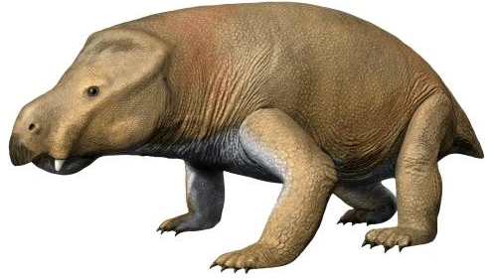
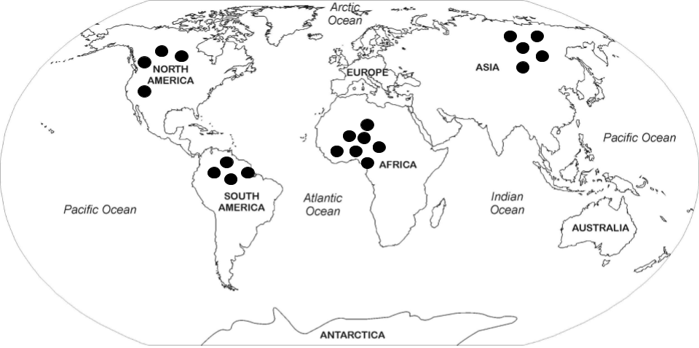
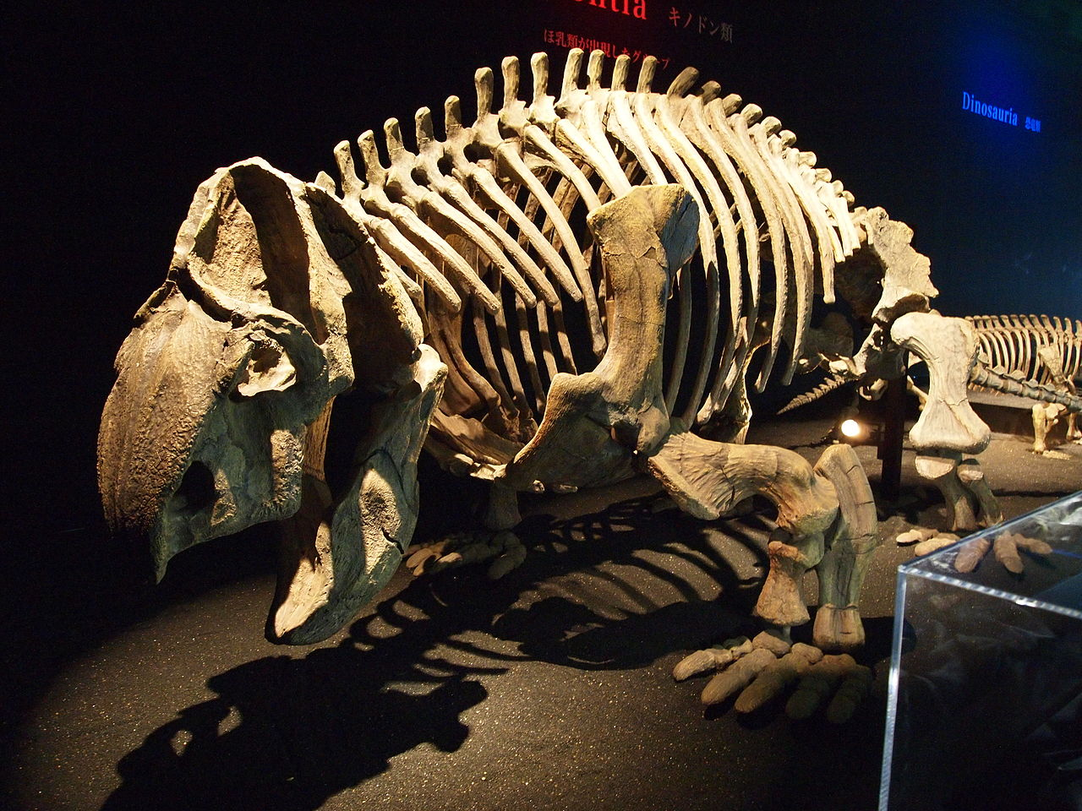
Traveling Kannemeyeria
Tennessee District Science Network Task Library
Plate Tectonics Teacher Guide
Middle School Earth and Space Science
Traveling Kannemeyeria
One of the greatest survivors in all of Earth’s history was a humble creature named Kannemeyerid (Kannemeyeria in groups). Fossils of Kannemeyeria are currently found in rock layers across North America, South America, Africa, and Asia.
© N. Tamura
Copyright © 2020 Printable Map Collection. Theme by AdSensia.com.
The dots on the map above show the current location of most Kannemeyeria fossils.
Kannemeyeria are extinct therapsid (mammal-like reptiles) that lived approximately 250 million to 230 million years ago, during the Early to Middle Triassic Period. Data from the fossils describe Kannemeyeria as herbivores (plant eater). They were about the size of an ox or large cow, about 3 meters long, and weighed approximately 90 kg (about 200 pounds). Kannemeyeria were land-dwellers that traveled throughout plains and swamps. They stayed in warm, dry climates close to the equator. Finding these fossils in so many places is very puzzling especially since these continents are all separated by oceans and do not all have warm, dry climates.
Copyright © Torene Project. Retrieved from www.torenecapital.com/dinosaurs-from-dawn-to-extinction
3

Slide 4
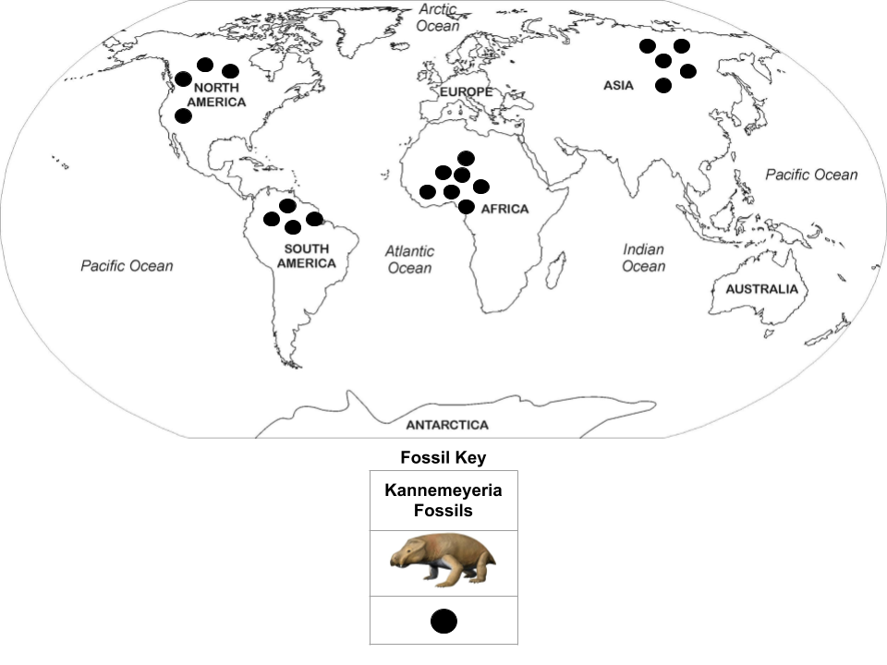
Kannemeyeria Fossil Locations
Tennessee District Science Network Task Library
Plate Tectonics Teacher Guide
Middle School Earth and Space Science
The locations of the fossils of Kannemeyeria show an interesting pattern. The images on the map represent the Kannemeyeria fossils. Examine the image below to collect evidence of this pattern. (Give 3 pieces of evidence)
Copyright © 2020 Printable Map Collection. Theme by AdSensia.com.
Copyright © N. Tamura
Question 1 Part A: What do you observe about the Kannemeyeria fossils above and the pattern of fossil distribution from the
map above? ________________________________________________________________________________________________________
________________________________________________________________________________________________________
________________________________________________________________________________________________________
________________________________________________________________________________________________________
4
Notes:
Copyedits: Changed “which” to “that” and fixed some formatting issues

Slide 5
Prompt 1 A.
Tennessee District Science Network Task Library
Plate Tectonics Teacher Guide
Middle School Earth and Space Science
Prompt 1 A. assesses:
TN Standard | 8.ESS2.5 - Construct a scientific explanation using data that explains the gradual process of plate tectonics accounting for (A) the distribution of fossils on different continents, (B) the occurrence of earthquakes, and (C) continental and ocean floor features (including mountains, volcanoes, faults, and trenches). (TN)
SEP | Constructing explanations: Apply scientific ideas, principles, and/or evidence to construct, revise and/or use an explanation for real-world phenomena, examples, or events.
CCC | Patterns: Graphs, charts, and images can be used to identify patterns in data.
Prompt 1 A. Scoring Guidance
Score | Components of Student Response (SEP, CCC, and/or DCI) | Example Responses/Look Fors
+1 | TN Standard - 8.ESS2.5 SEP - Constructing explanations CCC- Patterns | Student observation shows an understanding of the text and graphics. Possible examples of evidence would include: a. Positions of fossils
+1 | TN Standard - 8.ESS2.5 SEP - Constructing explanations | b. Environment where species lived
+1 | TN Standard - 8.ESS2.5 SEP - Constructing explanations | c. Separation of fossils across bodies of water
Complete Student Response - Example Student observation shows an understanding of the text and graphics. Possible examples of evidence would include all three: a. Positions of fossils b. Environment where species lived c. Separation of fossils across bodies of water |  | Score and Score Rationale, if applicable: 1 point for 1 piece of evidence. 2 points for 2 pieces of evidence. 3 points for 3 pieces of evidence. Feedback/Questions to support next level thinking for students: Excellent job including 3 pieces of evidence from your observation of the map.
5

Slide 6
Prompt 1 B.
Tennessee District Science Network Task Library
Plate Tectonics Teacher Guide
Middle School Earth and Space Science
Question 1 Part B: How could the Kannemeyeria, which were land dwelling animals, have traveled to these different continents if they were unable to swim? Explain.
______________________________________________________________________________________________________________________________________________
Prompt 1 B. assesses:
TN Standard | 8.ESS2.5 - Construct a scientific explanation using data that explains the gradual process of plate tectonics accounting for (A) the distribution of fossils on different continents, (B) the occurrence of earthquakes, and (C) continental and ocean floor features (including mountains, volcanoes, faults, and trenches). (TN)
SEP | Constructing explanations: Apply scientific ideas, principles, and/or evidence to construct, revise and/or use an explanation for real-world phenomena, examples, or events.
CCC | Patterns: Graphs, charts, and images can be used to identify patterns in data.
Prompt 1 B. Scoring Guidance
Score | Components of Student Response (SEP, CCC, and/or DCI) | Example Responses/Look Fors
+1 | TN Standard - 8.ESS2.5 SEP - Constructing explanations CCC - Patterns | The fossils of the Kannemeyeria found on different continents that were once together millions of years ago show that the continents drifted apart due to plate movement or seafloor spreading (plate tectonics).
Complete Student Response - Example The fossils of the Kannemeyeria found on different continents that were once together millions of years ago show that the continents drifted apart due to plate movement or seafloor spreading (plate tectonics). |  | Score and Score Rationale, if applicable: 1 point if the student answered the question completely referencing the continents drifting (plate tectonics) being the reason for the Kannemeyerid fossils found on the different continents. Feedback/Questions to support next level thinking for students: I like that you used your prior knowledge of the continents moving (plate tectonics) to explain how fossils of the Kannemeyerid were found on the different continents.
6

Slide 7
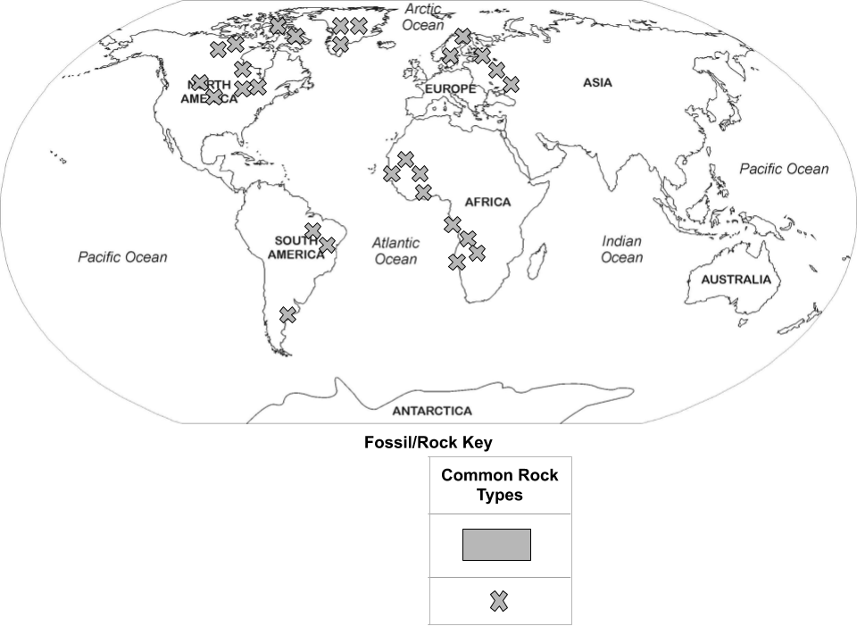
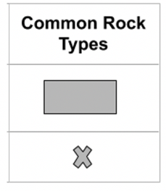
Similar Rock Types
Tennessee District Science Network Task Library
Plate Tectonics Teacher Guide
Middle School Earth and Space Science
Rock types near and around the location of the fossils of Kannemeyeria show an interesting pattern. The “X” images on
the map represent the same rock types. Examine the image below to collect evidence of this pattern.
Question 2: What patterns do you notice in the locations of the matching rock types? What could cause these particular patterns?
Evidence (Patterns):
___________________________________________________________________________________________________
___________________________________________________________________________________________________
___________________________________________________________________________________________________
Evidence (Cause): ___________________________________________________________________________________________________
___________________________________________________________________________________________________
___________________________________________________________________________________________________
7
Notes:
Copyedits: Fixed some formatting issues

Slide 8
Prompt 2
Tennessee District Science Network Task Library
Plate Tectonics Teacher Guide
Middle School Earth and Space Science
Prompt 2. assesses:
TN Standard | 8.ESS2.5 - Construct a scientific explanation using data that explains the gradual process of plate tectonics accounting for (A) the distribution of fossils on different continents, (B) the occurrence of earthquakes, and (C) continental and ocean floor features (including mountains, volcanoes, faults, and trenches). (TN)
SEP | Constructing explanations: Apply scientific ideas, principles, and/or evidence to construct, revise and/or use an explanation for real-world phenomena, examples, or events.
CCC | Patterns: Graphs, charts, and images can be used to identify patterns in data.
Prompt 2. Scoring Guidance
Score | Components of Student Response (SEP, CCC, and/or DCI) | Example Responses/Look Fors
+1 | TN Standard - 8.ESS2.5 SEP - Constructing Explanations CCC - Patterns | Student addressed “matching” rock types along the coast of South America, Africa, Europe, and North America.
+1 | TN Standard - 8.ESS2.5 SEP - Constructing Explanations CCC - Patterns | Student recognizes that there is a causal effect between the continents once being connected and the matching rock types being found across the now disconnected continents that were once closer to the equator.
Complete Student Response - Example Evidence (Patterns): Matching rock types are located along the coast of South America and Africa as well as Europe and North America and in areas that were once located near the equator. Evidence (Cause): The continents must have been connected in the past for these matching rock types to have formed where they did. |  | Score and Score Rationale, if applicable: 1 point if student response only gives evidence of matching rock types or the cause of the matching rock types. 2 points if students response gives evidence of matching rock types AND the cause of the matching rock types. Feedback/Questions to support next level thinking for students: Excellent job on constructing explanations that show both evidence of matching rock types and the cause of the matching rock types. Can you expand on your answer?
8

Slide 9
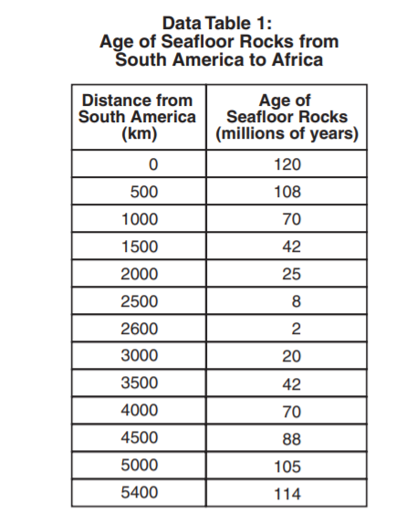
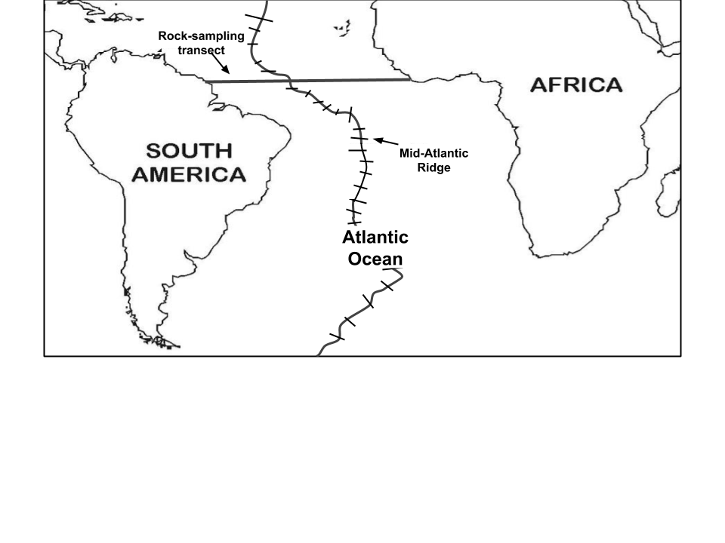
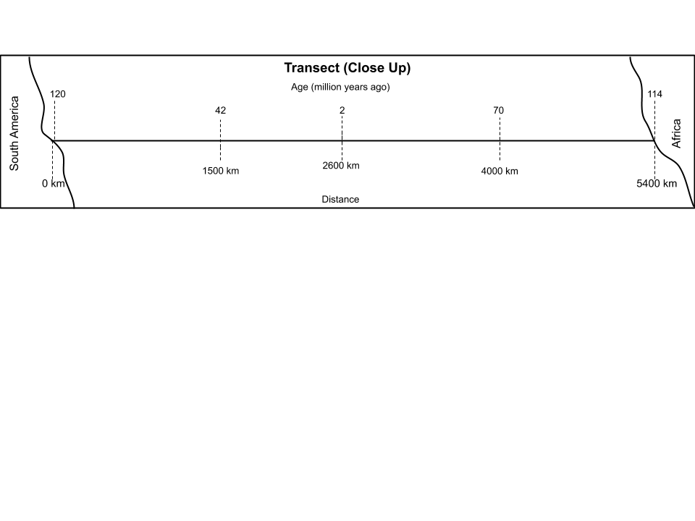
Question 3
Tennessee District Science Network Task Library
Plate Tectonics Teacher Guide
Middle School Earth and Space Science
Question 3: Diagram 1 below shows data from an investigation in which scientists sampled rocks along a transect, a straight line of travel, across the Mid-Atlantic Ridge from South America to Africa. Data Table 1 shows the data collected from this investigation.
Diagram 1
Some of the data from Data Table 1 is plotted along the transect below. Use the data table information and the transect below to describe the pattern of the age of the Atlantic Ocean floor from South America to Africa.
Question 3 Part A: What pattern can you observe? Evidence (Patterns) _______________________________________________________________________________________________________________________________________________________________________________________________________________________________________________________________________________________________________________
Question 3 Part B: What caused these patterns to occur? Evidence (Cause)
__________________________________________________________________________________________________________________________________________________________________________________________________________
9

Slide 10
Prompt 3
Tennessee District Science Network Task Library
Plate Tectonics Teacher Guide
Middle School Earth and Space Science
Prompt 3 Part A. assesses:
TN Standard | 8.ESS2.5 - Construct a scientific explanation using data that explains the gradual process of plate tectonics accounting for (A) the distribution of fossils on different continents, (B) the occurrence of earthquakes, and (C) continental and ocean floor features (including mountains, volcanoes, faults, and trenches). (TN)
SEP | Constructing explanations: Apply scientific ideas, principles, and/or evidence to construct, revise and/or use an explanation for real-world phenomena, examples, or events.
CCC | Patterns: Graphs, charts, and images can be used to identify patterns in data.
Prompt 3 Part A. Scoring Guidance
Score | Components of Student Response (SEP, CCC, and/or DCI) | Example Responses/Look Fors
+1 | TN Standard - 8.ESS2.5 SEP: Constructing Explanations | The oldest rock (120 million years ago and 114 million years ago) is located on the edges of South America and Africa.
+1 | TN Standard - 8.ESS2.5 SEP: Constructing Explanations | The age of the rock gets younger the closer it is to the Mid Atlantic Ridge with the youngest rock (2 and 8 million years ago) located on either side of the ridge.
+1 | TN Standard - 8.ESS2.5 SEP: Constructing Explanations CCC: Patterns | The rock gets older as you move from the ridge toward the continents.
Complete Student Response - Example Evidence (Patterns): The oldest rock (120 million years ago and 114 million years ago) is located on the edges of South America and Africa. The age of the rock gets younger the closer it is to the Mid Atlantic Ridge with the youngest rock (2 and 8 million years ago) located on either side of the ridge. The rock gets older as you move from the ridge toward the continents. |  | Score and Score Rationale, if applicable: 1 point if student response reflects only 1 piece of evidence (patterns) using the data given. 2 points if student response reflects only 2 pieces of evidence (patterns) using the data given. 3 points if student response reflects only 3 pieces of evidence (patterns) using the data given. Feedback/Questions to support next level thinking for students: You did an excellent job using evidence from the data given to show what caused the patterns to occur. I wonder if you could come up with other causes of the patterns occurring?
10

Slide 11
Prompt 3 Part B.
Tennessee District Science Network Task Library
Plate Tectonics Teacher Guide
Middle School Earth and Space Science
Prompt 3 Part B. assesses:
DCI | 8.ESS2.5 - Construct a scientific explanation using data that explains the gradual process of plate tectonics accounting for (A) the distribution of fossils on different continents, (B) the occurrence of earthquakes, and (C) continental and ocean floor features (including mountains, volcanoes, faults, and trenches). (TN)
SEP | Constructing explanations: Apply scientific ideas, principles, and/or evidence to construct, revise and/or use an explanation for real-world phenomena, examples, or events.
CCC | Patterns: Graphs, charts, and images can be used to identify patterns in data.
Prompt 3 Part B. Scoring Guidance
Score | Components of Student Response (SEP, CCC, and/or DCI) | Example Responses/Look Fors
+1 | TN Standard - 8.ESS2.5 SEP - Constructing Explanations | The newer rock at the mid-atlantic ridge is pushing the older rock away.
+1 | TN Standard - 8.ESS2.5 SEP - Constructing Explanations | The seafloor is spreading apart (divergent plate boundary).
+1 | SEP - Constructing Explanations CCC - Patterns | The age of the oldest rock indicates this process has been occurring for millions of years.
+1 | TN Standard - 8.ESS2.5 SEP - Constructing Explanations | Because continents are located on plates, this plate movement is causing the continents to separate or spread apart.
Complete Student Response - Example Evidence (Cause): The newer rock at the mid-atlantic ridge is pushing the older rock away. The seafloor is spreading apart (divergent plate boundary). Because continents are located on plates, this plate movement is causing the continents to separate or spread apart. The age of the oldest rock indicates this process has been occurring for millions of years. Because continents are located on plates, this plate movement is causing the continents to separate or spread apart. | Score and Score Rationale, if applicable: 1 point if student response reflects only 1 observation from the data given. 2 points if the student response reflects 2 observations from the data given. 3 points if the student response reflects 3 observations from the data given. 4 points if the student response reflects 4 observations from the data given. Feedback/Questions to support next level thinking for students: It really impressed me that you gave multiple examples using the data given. I wonder if you could come up with another cause on your own?
11

Slide 12
Prompt 4
Tennessee District Science Network Task Library
Plate Tectonics Teacher Guide
Middle School Earth and Space Science
Question 4: Construct an explanation to describe how Kannemeyeria fossils have been found in such varied locations.
Be sure to include the evidence you collected about Kannemeyeria fossils being found in such varied locations,
rock type locations, and the pattern of seafloor rock ages between South America and Africa as evidence in your explanation.
Prompt 4 assesses:
TN Standard | 8.ESS2.5 - Construct a scientific explanation using data that explains the gradual process of plate tectonics accounting for (A) the distribution of fossils on different continents, (B) the occurrence of earthquakes, and (C) continental and ocean floor features (including mountains, volcanoes, faults, and trenches). (TN)
SEP | Constructing explanations: Apply scientific ideas, principles, and/or evidence to construct, revise and/or use an explanation for real-world phenomena, examples, or events.
CCC | Patterns: Graphs, charts, and images can be used to identify patterns in data.
Prompt Scoring Guidance
Score | Components of Student Response (SEP, CCC, and/or DCI) | Example Responses/Look Fors
+1 | TN Standard - 8.ESS2.5 SEP - Constructing Explanations | Kannemeyeria have been found on South America, Africa, North America, and Asia which are all separated by oceans.
+1 | TN Standard - 8.ESS2.5 SEP - Constructing Explanations | Kannemeyeria were land dwelling reptiles so they were not able to swim across these oceans to these locations.
+1 | TN Standard - 8.ESS2.5 SEP - Constructing Explanations CCC - Patterns | Matching rock types have also been located on the edges of South America, Africa, North America, and Europe which indicates that these continents must have been connected in the past.
+1 | TN Standard - 8.ESS2.5 SEP - Constructing Explanations CCC - Patterns | The pattern of seafloor rock ages between South America and Africa indicates that the seafloor is spreading apart causing South America and Africa to move away from each other. That is how the Kannemeyerid fossils have been found in such varied locations.
These materials were developed by the Tennessee District Science Network, a NextGenScience network that included educators six districts in TN, with support from Arconic Foundation. Except where otherwise noted, this work is licensed under the Creative Commons Attribution-NonCommercial 4.0 International License.
12

Slide 13
Prompt 4 (continued)
Tennessee District Science Network Task Library
Plate Tectonics Teacher Guide
Middle School Earth and Space Science
Prompt 4 Continued
Score | Components of Student Response (SEP, CCC, and/or DCI) | Example Responses/Look Fors
+1 | TN Standard - 8.ESS2.5 SEP - Constructing Explanations CCC - Patterns | They lived on the continents when they were connected (250 million years ago) but their fossils have been spread out by the movement of the plates and continents over millions of years.
Complete Student Response - Example Kannemeyeria have been found on South America, Africa, North America, and Asia which are all separated by oceans. Kannemeyeria were land dwelling reptiles so they were not able to swim across these oceans to these locations. Matching rock types have also been located on the edges of South America, Africa, North America, and Europe which indicates that these continents must have been connected in the past. The pattern of seafloor rock ages between South America and Africa indicates that the seafloor is spreading apart causing South America and Africa to move away from each other. The matching rock types prove that South America and Africa were once connected and the sea floor rock ages prove that South America and Africa have since moved apart. That is how the Kannemeyeria fossils have been found in such varied locations. They lived on the continents when they were connected (250 million years ago) but their fossils have been spread out by the movement of the plates and continents over millions of years. | Score and Score Rationale, if applicable: 1-4: if student responses/explanations show a limited understanding of the relationship. Limited evidence from previous prompts. 5: if student response/explanations show a complete understanding of the relationships. Evidence from previous prompts included in explanations. Feedback/Questions to support next level thinking for students: You did a phenomenal job in providing evidence to explain how Kannemeyeria fossils have been found in varied locations around the world. How can you expand on your explanation?
These materials were developed by the Tennessee District Science Network, a NextGenScience network that included educators six districts in TN, with support from Arconic Foundation. Except where otherwise noted, this work is licensed under the Creative Commons Attribution-NonCommercial 4.0 International License.
13
Notes:
Copyedits: Fixed some formatting issues

Slide 14
Student Evidence Collection Sheet
Question Number | Evidence | Interpretation
1. | Part A. Explanation: _______________________________________ _______________________________________ _______________________________________ _______________________________________ _______________________________________ _______________________________________ _______________________________________ | Part B. Explanation: ______________________ ______________________ ______________________ ______________________ ______________________ ______________________ ______________________ ______________________
2. | Evidence (Patterns): _______________________________________ _______________________________________ _______________________________________ _______________________________________ _______________________________________ _______________________________________ _______________________________________ _______________________________________ _______________________________________ _______________________________________ _______________________________________ _______________________________________ | (Cause): ______________________ ______________________ ______________________ ______________________ ______________________ ______________________ ______________________ ______________________ ______________________ ______________________ ______________________ ______________________ ______________________
14
Notes:
Note: Should the evidence collection sheet be in the teacher guide?

Slide 15
Student Evidence Collection Sheet (continued)
3. | Part A. Evidence (Patterns): ___________________________ ___________________________ ___________________________ ___________________________ ___________________________ ___________________________ ___________________________ ___________________________ ___________________________ ___________________________ ___________________________ ___________________________ ___________________________ ___________________________ ___________________________ ___________________________ | Part B. (Cause): _______________________________ _______________________________ _______________________________ _______________________________ _______________________________ _______________________________ _______________________________ _______________________________ _______________________________ _______________________________ _______________________________ _______________________________ _______________________________ _______________________________ _______________________________ _______________________________
4. Evidence: _____________________________________________________________________________________ _____________________________________________________________________________________ _____________________________________________________________________________________ _____________________________________________________________________________________ _____________________________________________________________________________________ _____________________________________________________________________________________ _____________________________________________________________________________________
15

