Slide 1
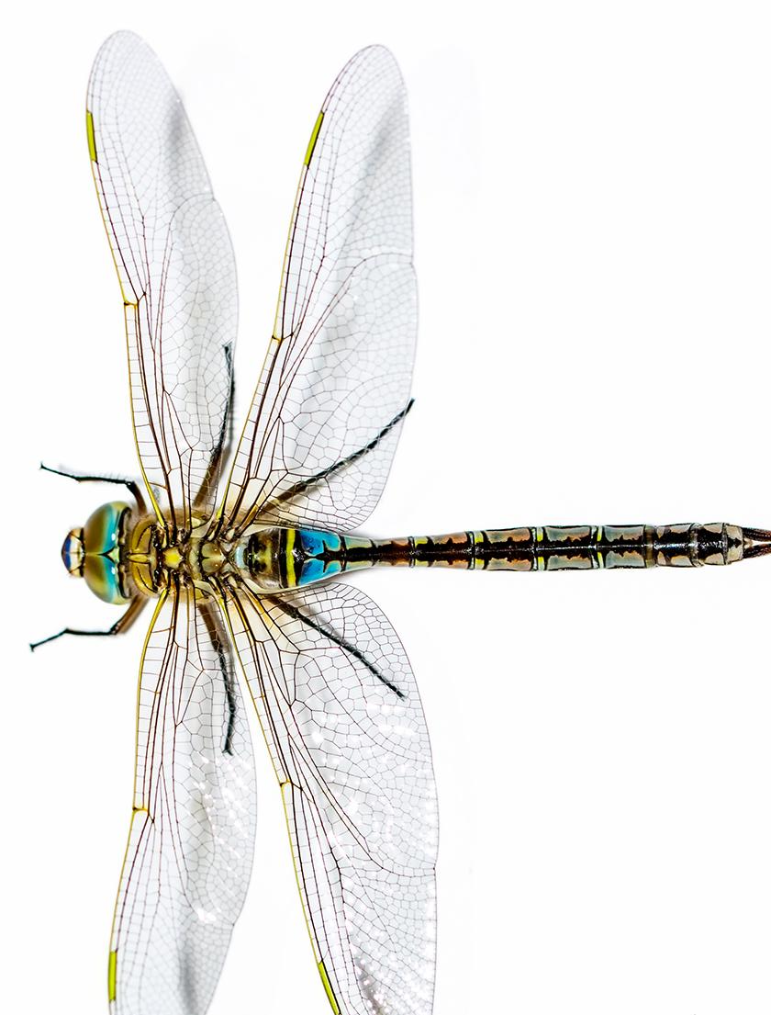



Unit 22: Lesson 2
Unit 22: Lesson 2
How do Earth’s systems interact?
Explore: Systems

Slide 2
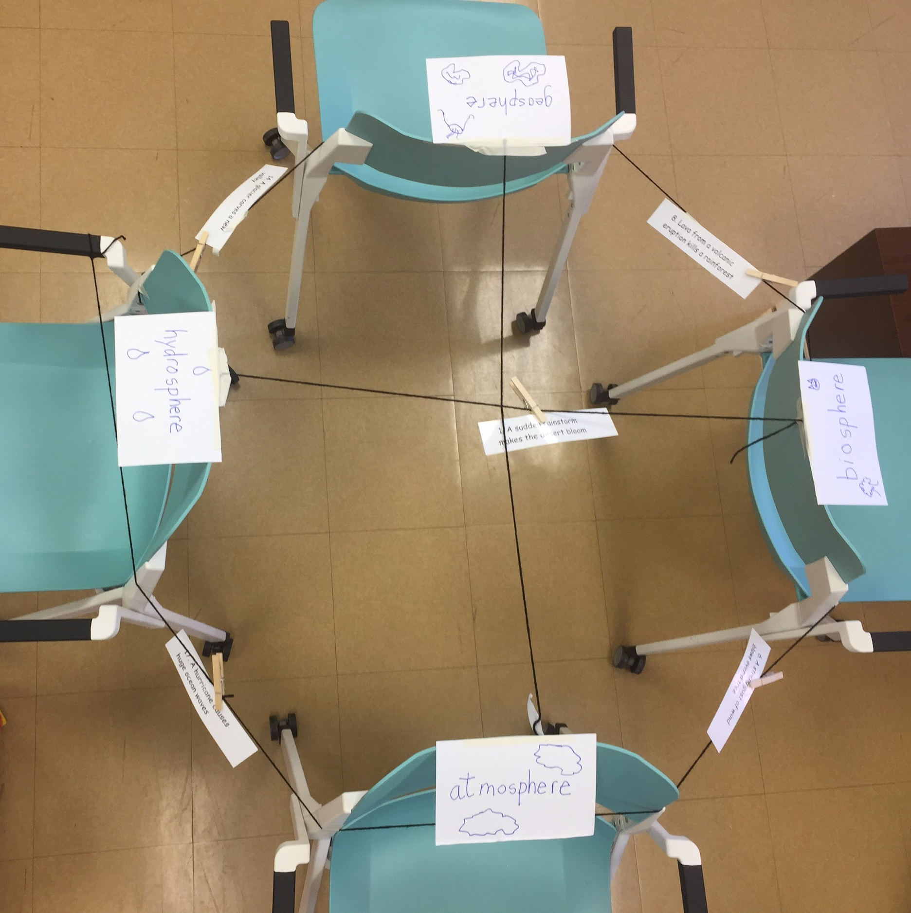
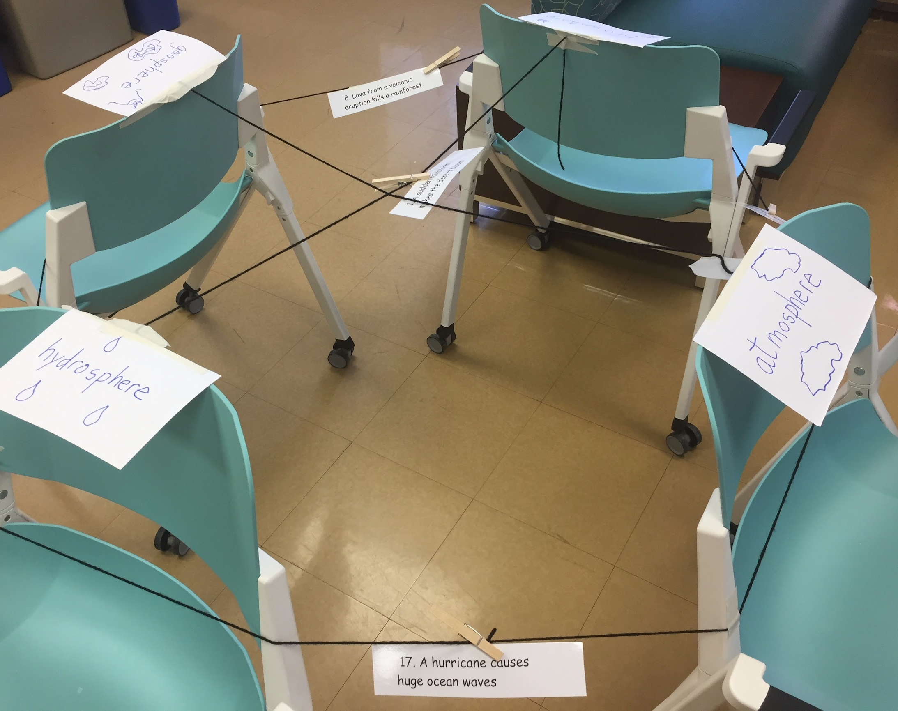
Explore: Systems
In the Explore portion of this lesson students use cards to show how the spheres interact with one another. Here are photos of the configuration. It is recommended that the sphere posters (generated by the students, here illustrated by 8x11 cards) and string are set up on a larger space to accommodate the class. This picture is a model.

