Slide 1
Compounds and Mixtures
Covalent and Ionic Bonds
General Physical Science
Chapter 4

Slide 2
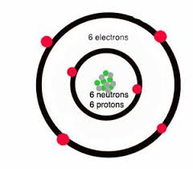
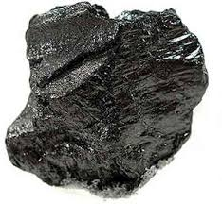
Element
Element Substance that cannot be chemically broken down into simpler substances.
Example: Carbon
------------------>

Slide 3
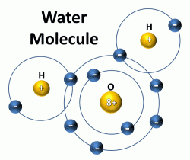
Compound
Compound substance made up of two or more elements that are chemically combined.
When the compound forms, the
Compound takes on its own properties.
Example: water is made up of 2 gases,
Hydrogen and oxygen. When chemically
combined, they form a liquid.

Slide 4
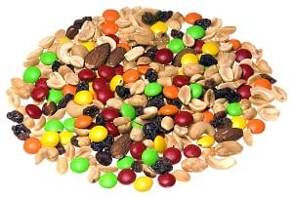
Mixture
Mixture two or more substance that have been physically combined.
Example: trail MIX
Everything in the mixture still retains its properties, m&m’s still taste like m&m’s, peanuts still taste like peanuts, etc. and the mixture can be easily separated. The mixture is NOT evenly distributed.

Slide 5
Substance
Substance any element or compound.

Slide 6
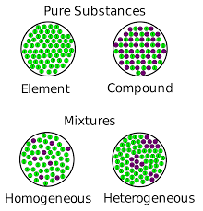
Element - Compound- Mixtures

Slide 7
Heterogeneous mixture
Heterogeneous mixture a mixture that is not evenly distributed.
Example: Think of the trail mix

Slide 8
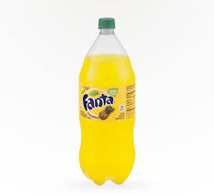
Homogenous Mixture
Homogeneous mixture mixture on which substances are evenly distributed among one another.
Example: Soda

Slide 9
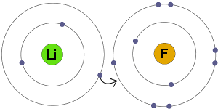
Ionic Bonds
Ionic bonds they form when atoms gain or lose electrons. Ionic bonds happen between metals and nonmetals. The metal usually gives up and electron to the nonmetal.
Example: In this example, lithium (metal) loses an electron to fluorine (nonmetal).

Slide 10
Covalent Bonds
Covalent bonds Form when electron are shared. Covalent bonds form between two nonmetals.
Example: H₂O (water), shares an electron
from each hydrogen (nonmetal) with the
Oxygen (nonmetal).

Slide 11
Lewis Dot Structure
Lewis dot structure of water H₂O

