Slide 1
3-7 through 3-10 study guide
General Physical Science

Slide 2
Periodic Table
Element symbols are usually one, two, or even 3 letters
Examples:
O (oxygen)
Hg (mercury)
Uun (ununnilium)

Slide 3
Periodic Table
Dmitri Mendeleev developed a list of elements by increasing atomic mass (1896)

Slide 4
Periodic Table
Elements are arranged in Periods and Groups
Periods run left to right, think of them as sentence with a period.
Groups also known as columns run vertical, up and down. Think of a column holding up your porch roof which stands vertical.
The periodic table allows us to predict how atoms of elements will combine

Slide 5
Metals and Nonmetals
Dark zigzag lines running along the right side of the table separates metals from nonmetals.
Elements to the left of the zigzag line are metals (except H)
Elements to the right of the zigzag line are nonmetals

Slide 6
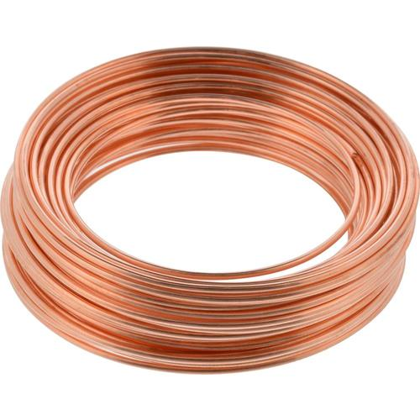
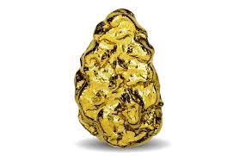
Metals
Malleable can be hammered into thin sheets
Memory tool: malleable sounds like mallet which can hammer metal into thin sheets
Ductile can be bent and drawn into thin wire
Memory tool: ducts run through walls like wires do
Metals are shiny (luster), good conductors of heat and electricity

Slide 7
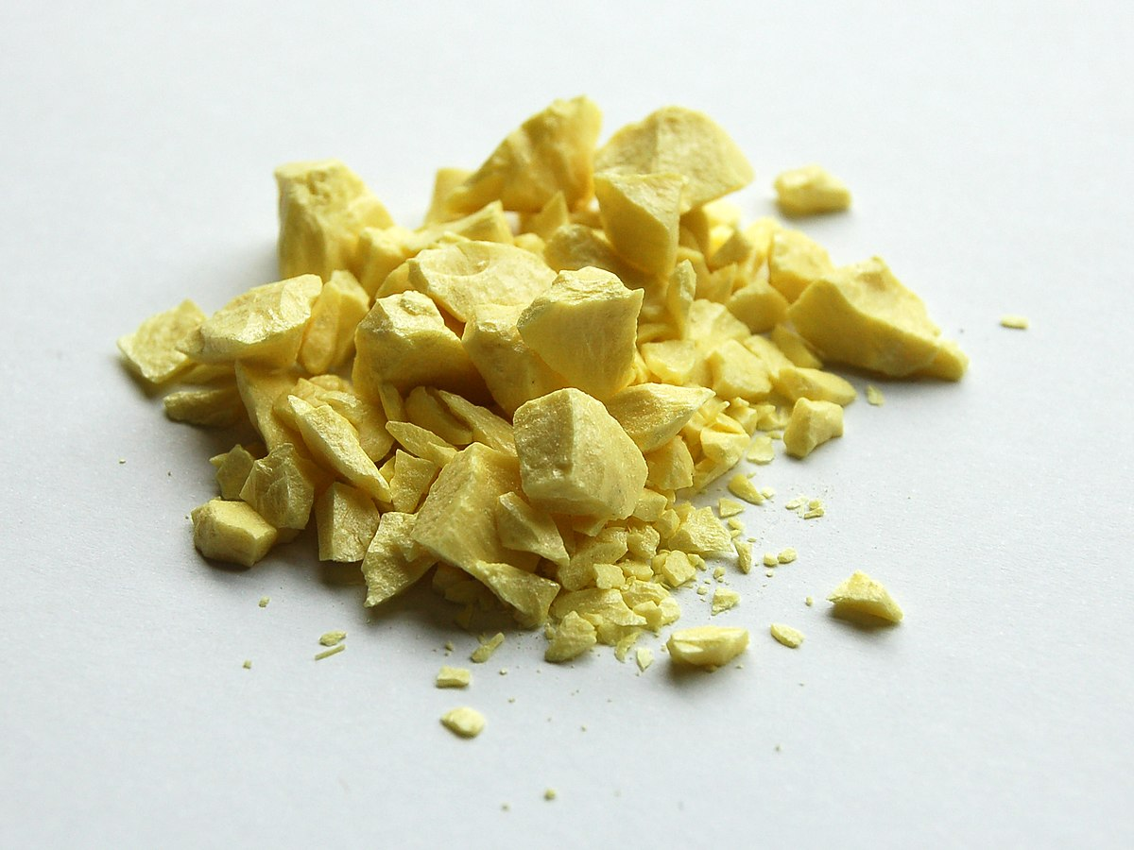
Nonmetals
Dull and brittle
Poor conductors of electricity and heat
SOLIDS, LIQUIDS and GASES at room temperature

Slide 8
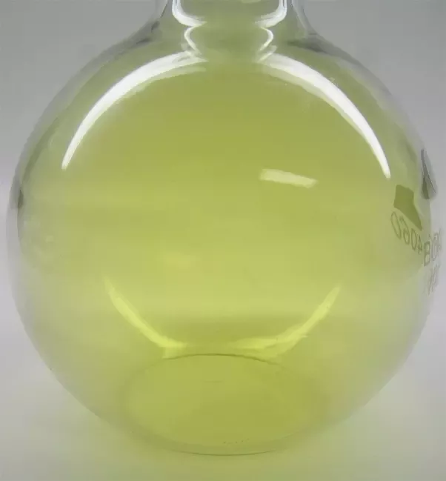
Halogens
Group (column) 17 contains 5 elements that are halogens (F, Cl, Br, I, At)
Halogens are poisonous and burn the skin
They DO NOT occur free in nature
When they combine with other elements, they form useful compounds like table salt (NaCl) and fluoride to prevent tooth decay (NaF).

Slide 9
Noble Gases
Group (column) 18 contains 6 elements that are Noble Gases (He, Ne, Ar, Kr, Xe, Rn)
Used in neon lights and helium balloons

Slide 10
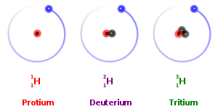
Isotopes
Isotopes are the same element with different atomic masses because of a different number of NEUTRONS in their nucleus. Hydrogen is an example:

