Slide 1
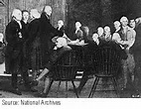
The Confederation Era (1781 – 1789)
CHAPTER 8 - Section 1

Slide 2
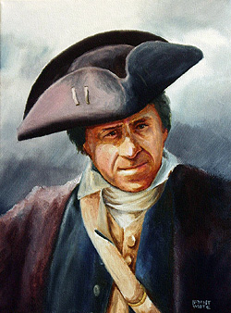
One American’s Story
Main Idea: The United States economy was in terrible shape and many farmers and former soldiers were ready to revolt.
Little money in the economy – but state taxes were high.
2. Massachusett’s farmers started a revolt called Shays’s Rebellion
Armed takeover of courts
Prevented foreclosures of land
3. New NATIONAL gov’t on peoples’ minds –
DEAL WITH NATIONAL CRISES

Slide 3
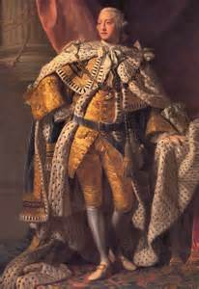
Main Idea: When the U.S. was established, the MAIN GOAL in the new government was to PREVENT TYRANNY and allow for a role for some individual citizens.
Forming a New Government –
Republicanism and Citizenship
King George III

Slide 4
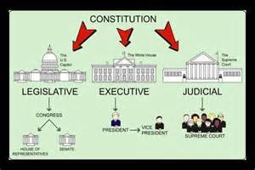
State Constitutions Lead The Way
Main Idea: In 1776, states created their own constitutions that tried to improve representation.
1. Many had SEPARATION OF POWERS by having multiple branches of government.

Slide 5
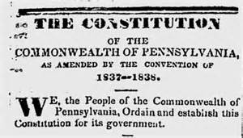
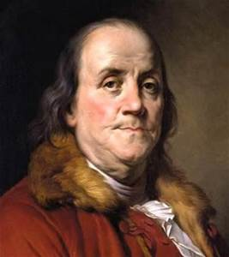
State Constitutions Lead the Way (cont.)
2. Many state constitutions included a Bill of Rights.
3. Many state constitutions limited the power of the Governor
Example: In the Pennsylvania Constitution of 1776, a Supreme Executive Council made up of 12 members ruled PA.

Slide 6
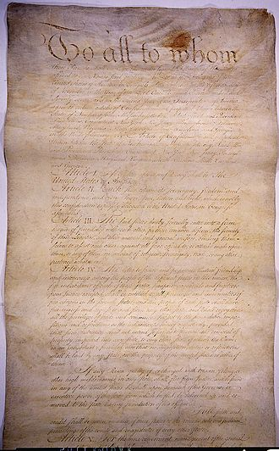
Articles of Confederation (A of C)
Main Idea:
The Continental Congress’s plan for unity was called the Articles of Confederation (A of C) which was created in 1776.

Slide 7
Major Disagreements
1) Number of votes for each state
2) What level of gov’t should have more power – state or national?
3) Who controls the Northwest Territory - delayed ratification of A of C.

Slide 8
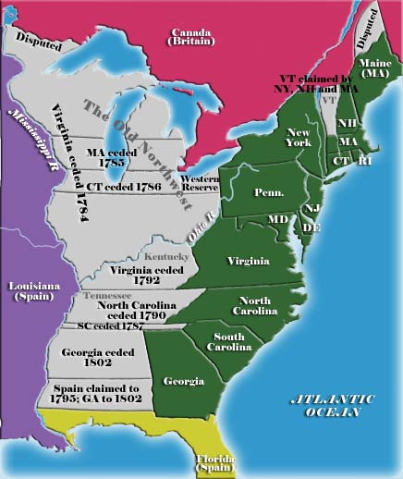
Western Land Disputes during the Confederation
What states claimed land in the “gray” area?
What states had no claims to land?
Why would states want land in the West?

Slide 9
Importance of Western Lands
Land sales pay off war debts
2. The more western land – war debt free
3. States with western lands wanted state control of sales.
4. States without western lands wanted national control

Slide 10
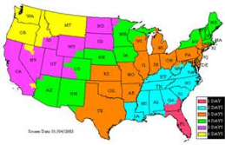
Solutions to the Disagreements
Each state would have ONE vote.
2) STATES keep more power than the national gov’t.
3) States cede (give up) claims to NW Territory to NATIONAL government
>

Slide 11
The Articles are Ratified
Ratification means approval – took four yrs
2. Maryland - last to approve

