Slide 1
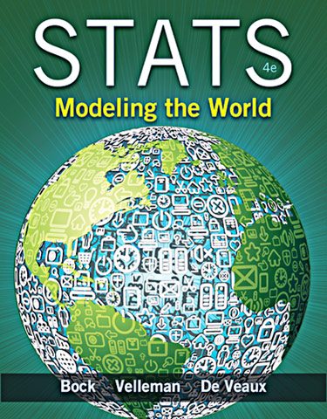
Chapter 22
Inferences about Means

Slide 2
Getting Started
Now that we know how to create confidence intervals and test hypotheses about proportions, it’d be nice to be able to do the same for means.
Just as we did before, we will base both our confidence interval and our hypothesis test on the sampling distribution model.
The Central Limit Theorem told us that the sampling distribution model for means is Normal with mean μ and standard deviation

Slide 3
Getting Started (cont.)
All we need is a random sample of quantitative data.
And the true population standard deviation, σ.
Well, that’s a problem…

Slide 4
Getting Started (cont.)
Proportions have a link between the proportion value and the standard deviation of the sample proportion.
This is not the case with means—knowing the sample mean tells us nothing about
We’ll do the best we can: estimate the population parameter σ with the sample statistic s.
Our resulting standard error is

Slide 5
Getting Started (cont.)
We now have extra variation in our standard error from s, the sample standard deviation.
We need to allow for the extra variation so that it does not mess up the margin of error and P-value, especially for a small sample.
And, the shape of the sampling model changes—the model is no longer Normal. So, what is the sampling model?

Slide 6
Gosset’s t
William S. Gosset, an employee of the Guinness Brewery in Dublin, Ireland, worked long and hard to find out what the sampling model was.
The sampling model that Gosset found has been known as Student’s t.
The Student’s t-models form a whole family of related distributions that depend on a parameter known as degrees of freedom.
We often denote degrees of freedom as df, and the model as t_{df}.

Slide 7
A Confidence Interval for Means?
A practical sampling distribution model for means
When the conditions are met, the standardized sample mean
follows a Student’s t-model with n – 1 degrees of freedom.
We estimate the standard error with

Slide 8
A Confidence Interval for Means? (cont.)
When Gosset corrected the model for the extra uncertainty, the margin of error got bigger.
Your confidence intervals will be just a bit wider and your P-values just a bit larger than they were with the Normal model.
By using the t-model, you’ve compensated for the extra variability in precisely the right way.

Slide 9
A Confidence Interval for Means? (cont.)
One-sample t-interval for the mean
When the conditions are met, we are ready to find the confidence interval for the population mean, μ.
The confidence interval is
where the standard error of the mean is
The critical value depends on the particular confidence level, C, that you specify and on the number of degrees of freedom, n – 1, which we get from the sample size.

Slide 10
A Confidence Interval for Means? (cont.)
Student’s t-models are unimodal, symmetric, and bell shaped, just like the Normal.
But t-models with only a few degrees of freedom have much fatter tails than the Normal. (That’s what makes the margin of error bigger.)

Slide 11
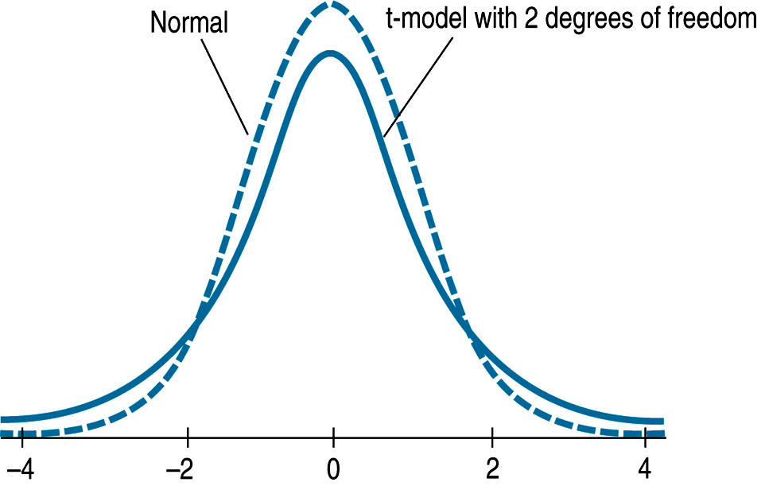
A Confidence Interval for Means? (cont.)
As the degrees of freedom increase, the t-models look more and more like the Normal.
In fact, the t-model with infinite degrees of freedom is exactly Normal.

Slide 12
Assumptions and Conditions
Gosset found the t-model by simulation.
Years later, when Sir Ronald A. Fisher showed mathematically that Gosset was right, he needed to make some assumptions to make the proof work.
We will use these assumptions when working with Student’s t.

Slide 13
Assumptions and Conditions (cont.)
Independence Assumption:
Independence Assumption. The data values should be independent.
Randomization Condition: The data arise from a random sample or suitably randomized experiment. Randomly sampled data (particularly from an SRS) are ideal.
10% Condition: When a sample is drawn without replacement, the sample should be no more than 10% of the population.

Slide 14
Assumptions and Conditions (cont.)
Normal Population Assumption:
We can never be certain that the data are from a population that follows a Normal model, but we can check the
Nearly Normal Condition: The data come from a distribution that is unimodal and symmetric.
Check this condition by making a histogram or Normal probability plot.

Slide 15
Assumptions and Conditions (cont.)
Nearly Normal Condition:
The smaller the sample size (n < 15 or so), the more closely the data should follow a Normal model.
For moderate sample sizes (n between 15 and 40 or so), the t works well as long as the data are unimodal and reasonably symmetric.
For larger sample sizes, the t methods are safe to use unless the data are extremely skewed.

Slide 16
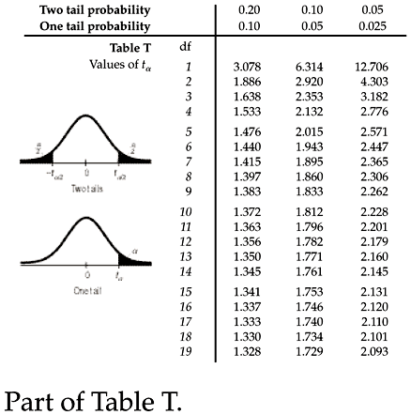
Finding t-Values By Hand
The Student’s t-model is different for each value of degrees of freedom.
Because of this, Statistics books usually have one table of t-model critical values for selected confidence levels.

Slide 17
Finding t-Values By Hand (cont.)
Alternatively, we could use technology to find t critical values for any number of degrees of freedom and any confidence level you need.
What technology could we use?
The Appendix of ActivStats on the DVD
Any graphing calculator or statistics program

Slide 18
Teaching Tip
While using Table B for small samples is easy enough to carry out. But don’t hesitate to have students use their calculators for large sample t-procedures. Yes, the t* value for a confidence interval will then be an unknown value. But it is ok to write a formula with just the symbol, even on the AP test. You can find this table in the appendix of the text on page A-84.

Slide 19
More Cautions About Interpreting Confidence Intervals
Remember that interpretation of your confidence interval is key.
What NOT to say:
“90% of all the vehicles on Triphammer Road drive at a speed between 29.5 and 32.5 mph.”
The confidence interval is about the mean not the individual values.
“We are 90% confident that a randomly selected vehicle will have a speed between 29.5 and 32.5 mph.”
Again, the confidence interval is about the mean not the individual values.

Slide 20
More Cautions About Interpreting Confidence Intervals (cont.)
What NOT to say:
“The mean speed of the vehicles is 31.0 mph 90% of the time.”
The true mean does not vary—it’s the confidence interval that would be different had we gotten a different sample.
“90% of all samples will have mean speeds between 29.5 and 32.5 mph.”
The interval we calculate does not set a standard for every other interval—it is no more (or less) likely to be correct than any other interval.

Slide 21
More Cautions About Interpreting Confidence Intervals (cont.)
DO SAY:
“I am 90% confident that the true mean is between 29.5 and 32.5 mph.”

Slide 22
Make a Picture, Make a Picture, Make a Picture
Pictures tell us far more about our data set than a list of the data ever could.
The only reasonable way to check the Nearly Normal Condition is with graphs of the data.
Make a histogram of the data and verify that its distribution is unimodal and symmetric with no outliers.
You may also want to make a Normal probability plot to see that it’s reasonably straight.

Slide 23
A Test for the Mean
One-sample t-test for the mean
The conditions for the one-sample t-test for the mean are the same as for the one-sample t-interval.
We test the hypothesis H₀: μ = μ₀ using the statistic
The standard error of the sample mean is
When the conditions are met and the null hypothesis is true, this statistic follows a Student’s t model with n – 1 df. We use that model to obtain a P-value.

Slide 24
Significance and Importance
Remember that “statistically significant” does not mean “actually important” or “meaningful.”
Because of this, it’s always a good idea when we test a hypothesis to check the confidence interval and think about likely values for the mean.

Slide 25
Intervals and Tests
Confidence intervals and hypothesis tests are built from the same calculations.
In fact, they are complementary ways of looking at the same question.
The confidence interval contains all the null hypothesis values we can’t reject with these data.

Slide 26
Intervals and Tests (cont.)
More precisely, a level C confidence interval contains all of the plausible null hypothesis values that would not be rejected by a two-sided hypothesis text at alpha level 1 – C.
So a 95% confidence interval matches a 0.05 level two-sided test for these data.
Confidence intervals are naturally two-sided, so they match exactly with two-sided hypothesis tests.
When the hypothesis is one sided, the corresponding alpha level is (1 – C)/2.

Slide 27
Sample Size
To find the sample size needed for a particular confidence level with a particular margin of error (ME), solve this equation for n:
The problem with using the equation above is that we don’t know most of the values. We can overcome this:
We can use s from a small pilot study.
We can use z* in place of the necessary t value.

Slide 28
Sample Size (cont.)
Sample size calculations are never exact.
The margin of error you find after collecting the data won’t match exactly the one you used to find n.
The sample size formula depends on quantities you won’t have until you collect the data, but using it is an important first step.
Before you collect data, it’s always a good idea to know whether the sample size is large enough to give you a good chance of being able to tell you what you want to know.

Slide 29
Teacher Tips
The next slide is optional.

Slide 30
Degrees of Freedom*
If only we knew the true population mean, µ, we would find the sample standard deviation as
But, we use instead of µ, though, and that causes a problem.
When we use to calculate s, our standard deviation estimate would be too small.
The amazing mathematical fact is that we can compensate for the smaller sum exactly by dividing by n – 1 which we call the degrees of freedom.

Slide 31
What Can Go Wrong?
Don’t confuse proportions and means.
Ways to Not Be Normal:
Beware of multimodality.
The Nearly Normal Condition clearly fails if a histogram of the data has two or more modes.
Beware of skewed data.
If the data are very skewed, try re-expressing the variable.
Set outliers aside—but remember to report on these outliers individually.

Slide 32
What Can Go Wrong? (cont.)
…And of Course:
Watch out for bias—we can never overcome the problems of a biased sample.
Make sure data are independent.
Check for random sampling and the 10% Condition.
Make sure that data are from an appropriately randomized sample.

Slide 33
What Can Go Wrong? (cont.)
…And of Course, again:
Interpret your confidence interval correctly.
Many statements that sound tempting are, in fact, misinterpretations of a confidence interval for a mean.
A confidence interval is about the mean of the population, not about the means of samples, individuals in samples, or individuals in the population.

Slide 34
What have we learned?
Statistical inference for means relies on the same concepts as for proportions—only the mechanics and the model have changed.
What we say about a population mean is inferred from the data.
Student’s t family based on degrees of freedom.
Ruler for measuring variability is SE.
Find ME based on that ruler and a student’s t model.
Use that ruler to test hypotheses about the population mean.

Slide 35
What have we learned?
The reasoning of inference, the need to verify that the appropriate assumptions are met, and the proper interpretation of confidence intervals and P-values all remain the same regardless of whether we are investigating means or proportions.

Slide 36
AP Tips
Check conditions!
When you check a graph for a small sample procedure, make sure to draw the graph on your paper. This is the only graph where you don’t have to label or scale it. You’re just looking at shape.
If the AP test just gives you the summary statistics, it is probably an indication that the sample size is big enough for the CLT to kick in.

