Slide 1
Chapter 5
The Integumentary System

Slide 2
INTRODUCTION
The skin and its accessory structures; hair, nails & glands make up the integumentary system.
The integumentary system functions to guard the body’s physical and biochemical integrity, maintain a constant body temperature, and provide sensory information about the surrounding environment.

Slide 3
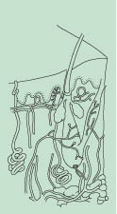
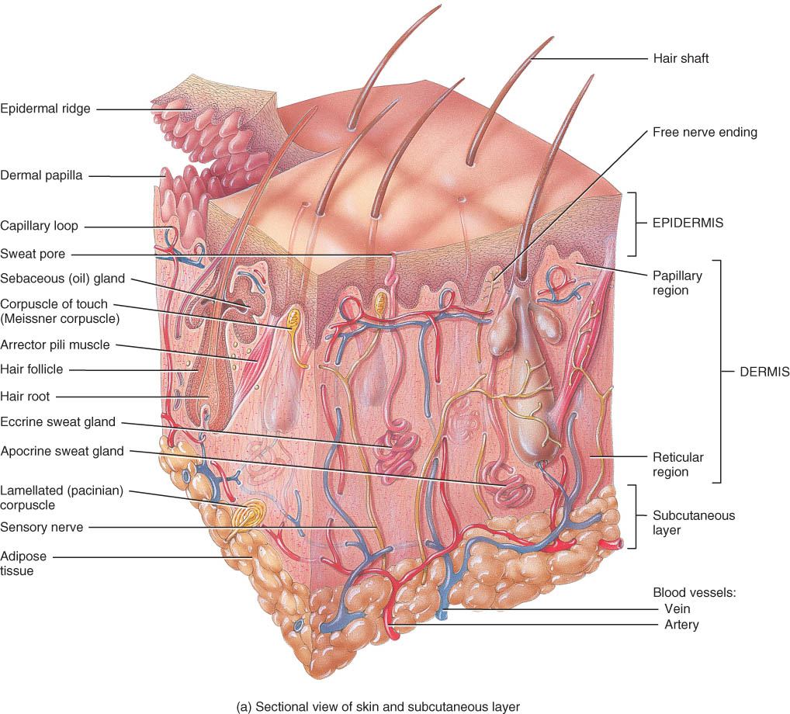
Chapter 5 The Integumentary System
Skin and its accessory structures
structure
function
growth and repair
development
aging
disorders

Slide 4
General Anatomy
A large organ composed of all 4 tissue types
22 square feet
1-2 mm thick
Weight 10 lbs.

Slide 5
STRUCTURE OF THE SKIN
The superficial portion of the skin is the epidermis and is composed of epithelial tissue.
The deeper layer of the skin is the dermis and is primarily composed of connective tissue.
Deep to the dermis is the subcutaneous layer or hypodermis. (not a part of the skin)
It consists of areolar and adipose tissue.
fat storage, an area for blood vessel passage, and an area of pressure-sensing nerve endings.

Slide 6
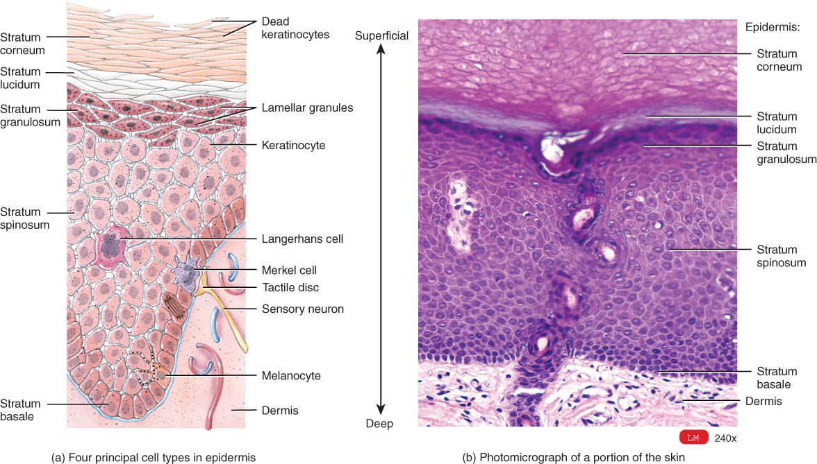
Overview of Epidermis
Stratified squamous epithelium
avascular (contains no blood vessels)
4 types of cells
5 distinct strata (layers) of cells

Slide 7
Four Principle Cells of the Epidermis
Keratinocytes
produce the protein keratin, which helps protect the skin and underlying tissue from heat, microbes, and chemicals; and lamellar granules, which release a waterproof sealant
Melanocytes
produce the pigment melanin which contributes to skin color and absorbs damaging ultraviolet (UV) light
Langerhans cells
derived from bone marrow
participate in immune response
Merkel cells
contact a sensory structure called a tactile (Merkel) disc and function in the sensation of touch

Slide 8
Layers of the Epidermis
There are four or five layers of the epidermis, depending upon the degree of friction and mechanical pressure applied to the skin.
From deepest to most superficial the layers of the epidermis are:
stratum basale (stratum germinativum)
stratum spinosum
stratum granulosum
stratum lucidum (only in palms and soles)
stratum corneum

Slide 9
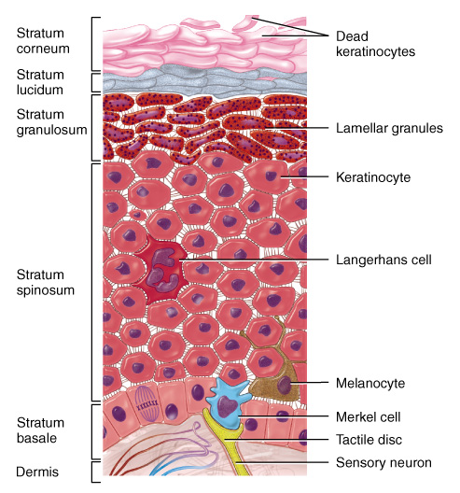
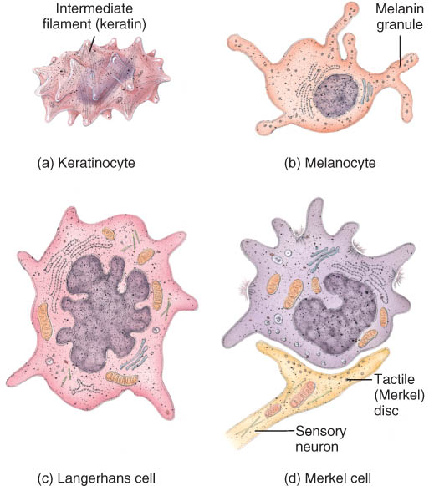
Layers (Strata) of the Epidermis
Stratum corneum
Stratum lucidum
Stratum granulosum
Stratum spinosum
Stratum basale

Slide 10
Stratum Basale
Deepest single layer of epidermis
merkel cells, melanocytes, keratinocytes & stem cells that divide repeatedly
keratinocytes have a cytoskeleton
Cells attached to each other & to basement membrane
When this germinal portion of the epidermis is destroyed, new skin cannot regenerate with a skin graft.

Slide 11
Stratum Spinosum
provides strength and flexibility to the skin
8 to 10 cell layers are held together
Melanin is taken in by keratinocytes (by phagocytosis) from nearby melanocytes.

Slide 12
Stratum Granulosum
transition between the deeper, metabolically active strata and the dead cells of the more superficial strata
3-5 layers of flat dying cells that show nuclear degeneration

