Slide 1
Lesson 2: The Age of Railroads
The Big Idea: The growth and consolidation of railroads benefitted the nation but also led to corruption and required government regulation.
Why It Matters Now: Railroads made possible the expansion of industry across the United States.
Key Terms and People: George M. Pullman / Transcontinental Railroad / Cornelius Vanderbilt / Credit Mobilier / Munn v. Illinois / Interstate Commerce Act

Slide 2
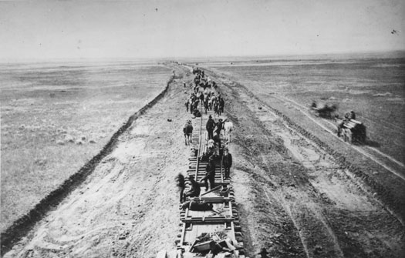
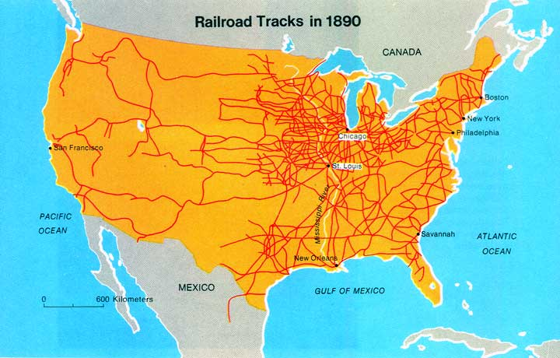
I. Railroads Span Time and Space
A. A National Network
1856: Railroads extend to the Mississippi River
1869: The Transcontinental Railroad is completed
1890 saw six times the number of railroads as in 1860
Cornelius Vanderbilt: bought and linked small railroads to create a large network of over 4,500 miles

Slide 3
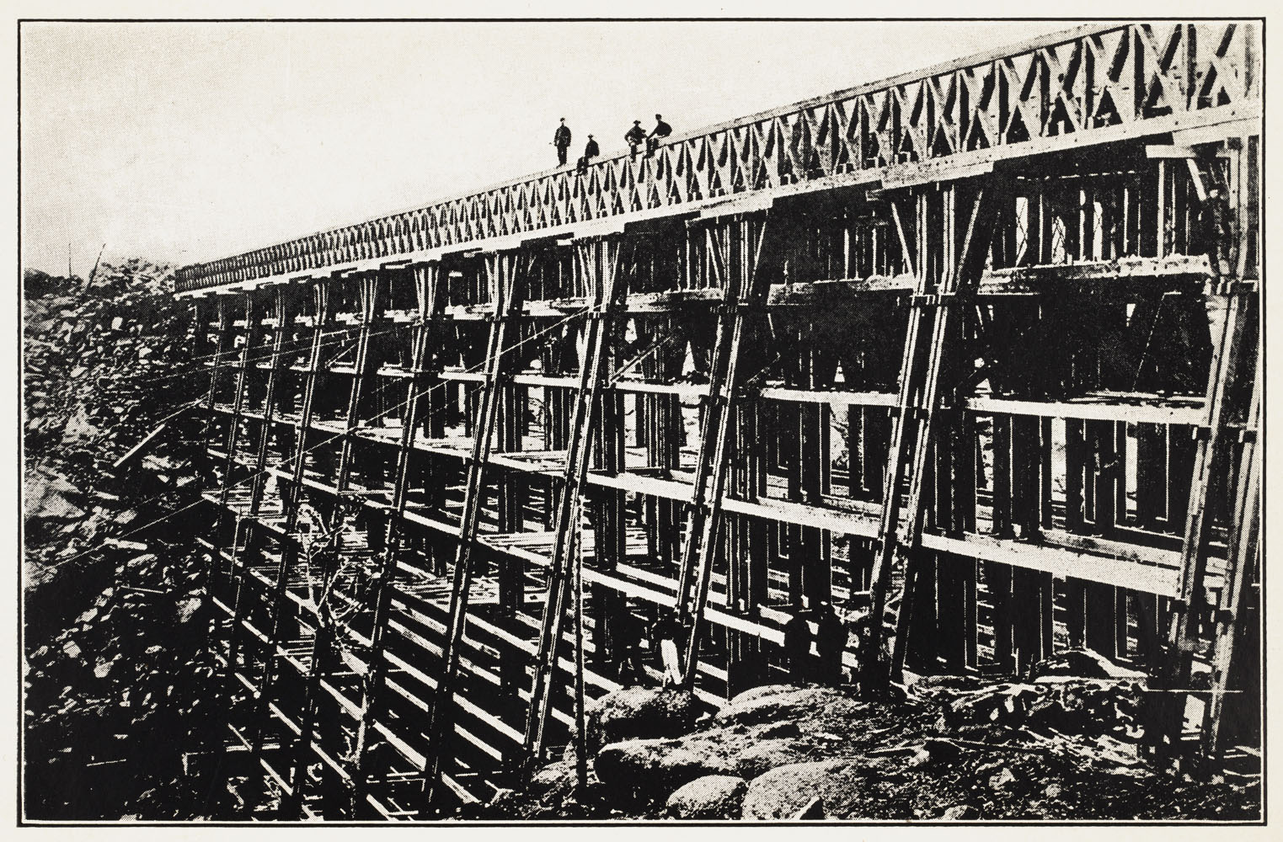
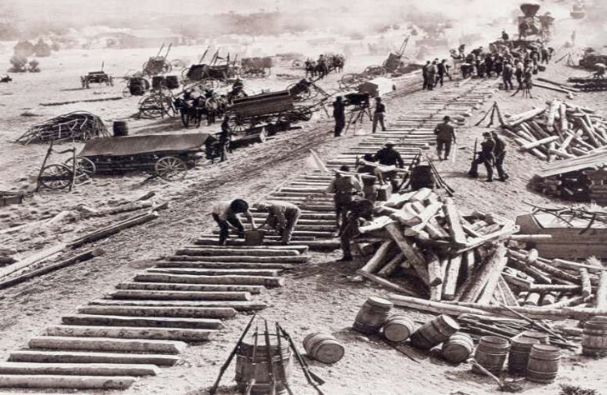
B. Romance and Reality
RR’s created dreams of land, adventure & fresh starts
RR workers experienced the opposite
Chinese and Irish immigrants were exploited
Avg. pay for white workers was $40-$60 per month… half that for minorities
Working conditions were horrendous
In 1888: 2,000 employees killed / 20,000 injured

Slide 4
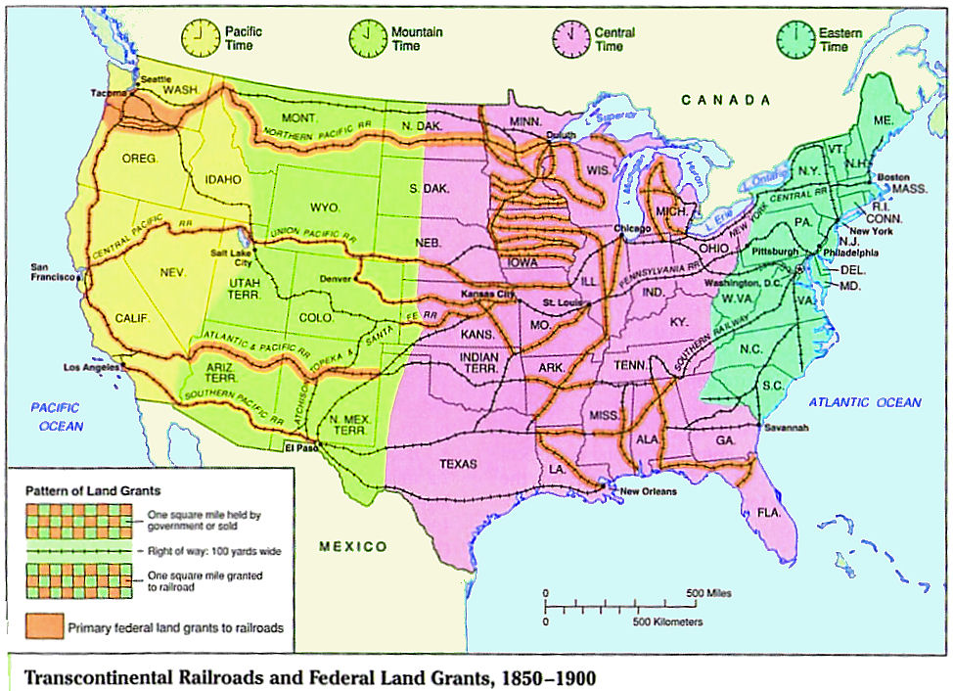
C. Railroad Time
Railroads helped to unite the country
Originally, noon was when the sun was overhead
1869: Professor C.F. Dowd introduces Standard Time (24 Time Zones)
1883:The railroads adopt the system. 1884 it is adopted globally. U.S. doesn’t officially adopt it until 1918.
Many railroad companies took advantage of customers

Slide 5
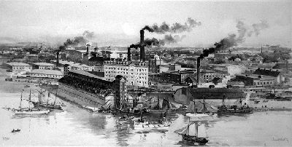
II. Opportunities and Opportunities
A. Supply and Demand
Supply: The amount of goods or services produced
Demand: The amount of a good consumers want to buy
This era saw both supply and demand increase
Also causing profits to skyrocket

Slide 6
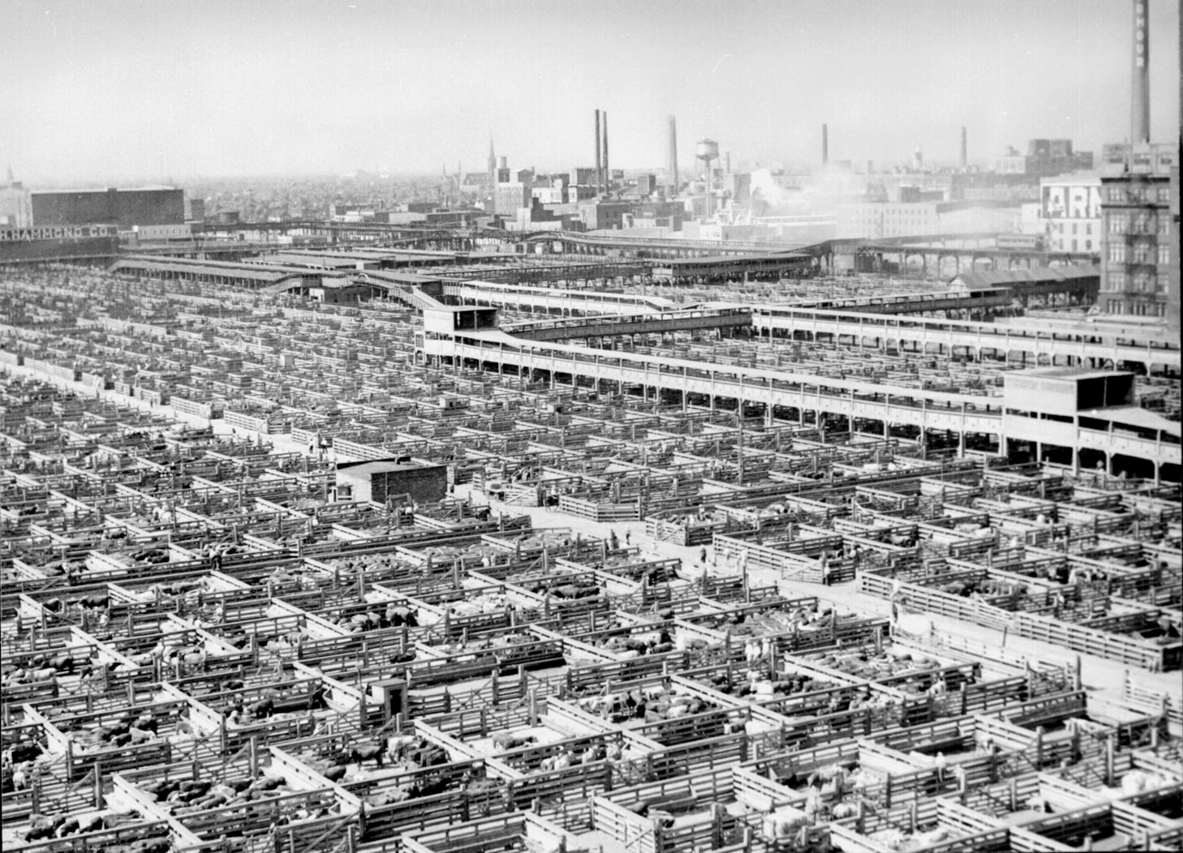
B. New Towns and Markets
New railroads promoted trade & interdependence
Individual towns began to specialize in particular products
Ex. Chicago for stockyards & Minneapolis for grain
Tourists began traveling where they had never been before
Ex. The Florida Keys
Towns also grew along railroad lines
The nation began to fill as it had not before

Slide 7
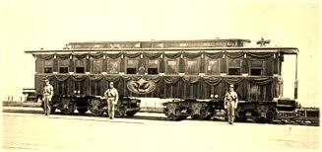
C. Pullman
George M. Pullman: Builds a sleeper car factory in Illinois
The nearby company town of Pullman provided housing and other resources
Doctors offices, shops, recreational areas were also provided
Firm rules were established
No loitering
No Alcohol
Firm rent prices
Eventually led to a violent strike in 1894

Slide 8
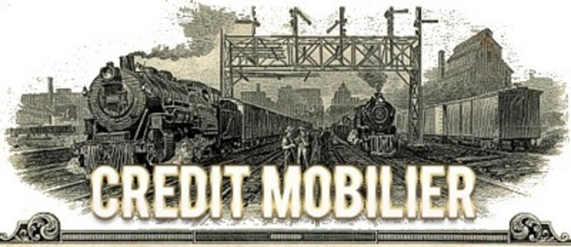
D. Credit Mobilier
Profit Motive states that the main goal of a business is to make money
In some cases, this created corruption
1864: Union Pacific Railroad stockholders create Credit Mobilier
They paid CM 2-3X the normal rate to build railroads
They pocketed the profits and gave stocks to 20 Congressmen in 1867
This totaled over $23 million
Many reputations were tarnished in the incident

Slide 9
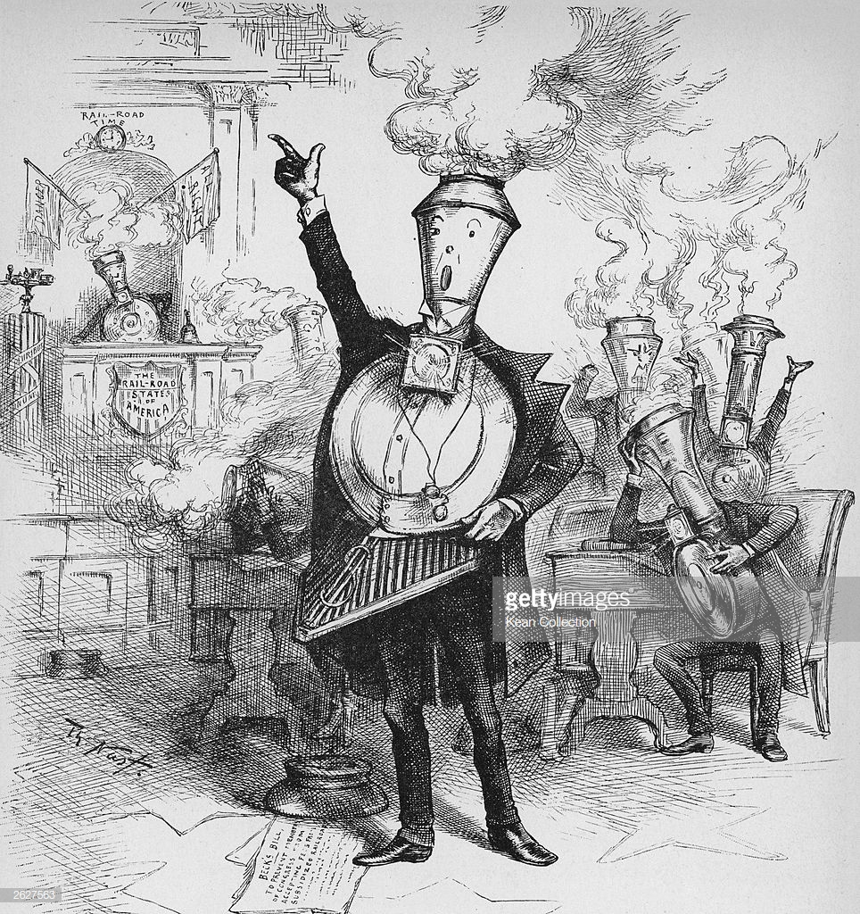
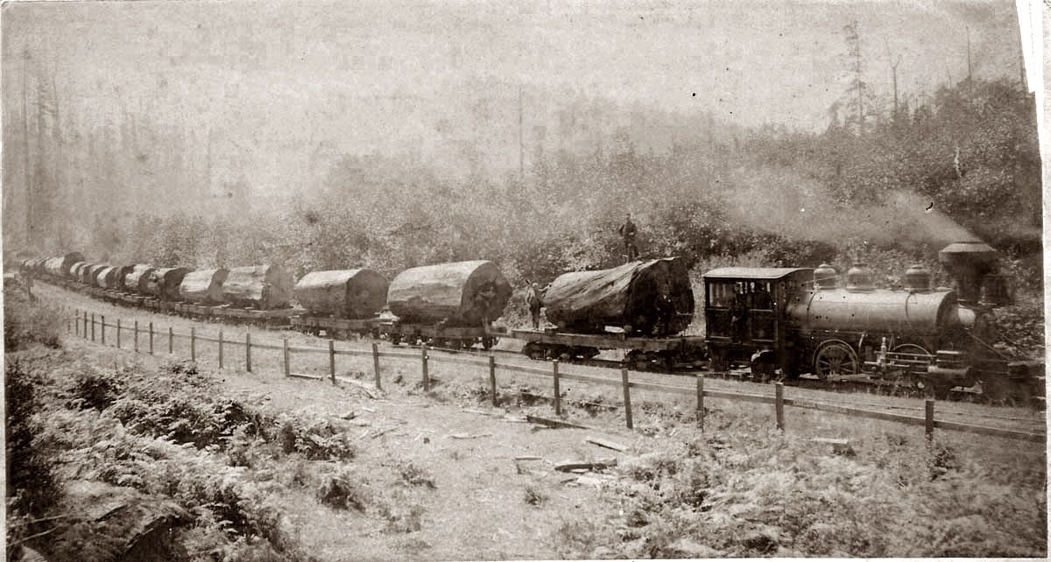
III. The Grange and the Railroads
A. Railroad Abuses
Farmers argued that RR’s misused land grants, fixed prices, charged different rates to different customers, and demanded higher prices for shorter trips

Slide 10
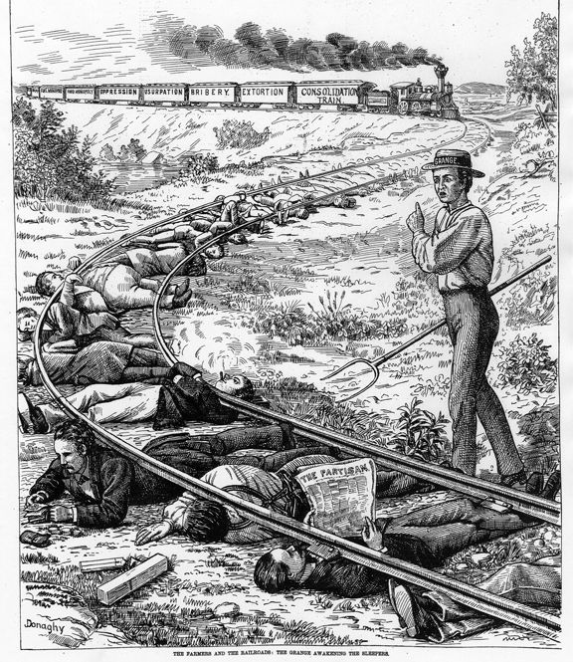
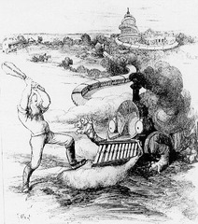
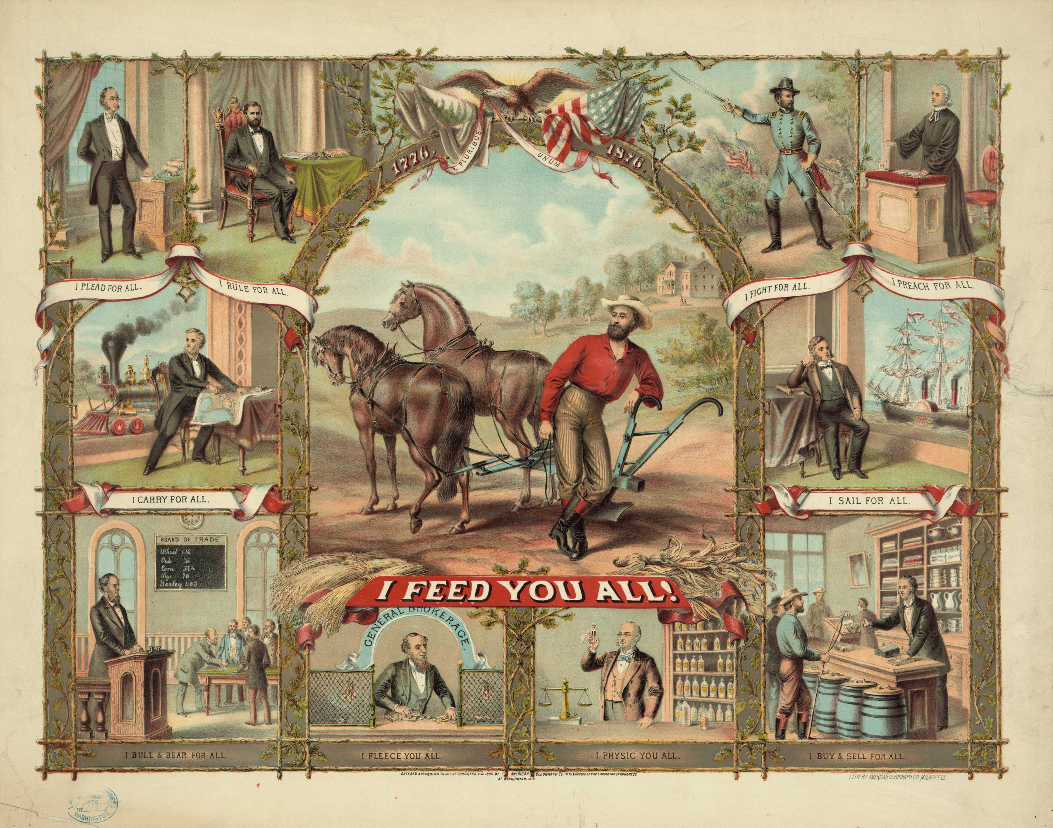
B. Granger Laws
Passed in response to the abuses listed above
1871: Illinois laws created maximum freight and passenger rates. They also prohibited discrimination.
RR’s fought back. 1877: Munn v. Illinois saw the courts uphold the Granger Laws
States were granted the right to regulate the RR’s
Government showed it would regulate in the interest of the public

Slide 11
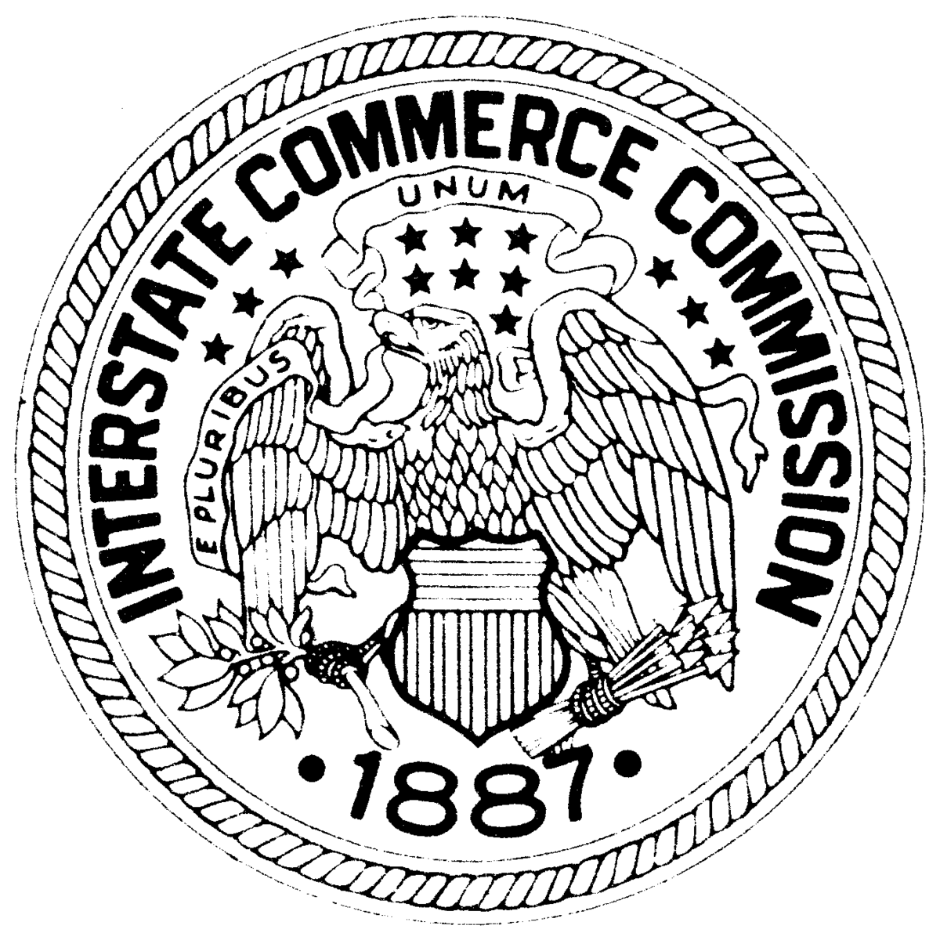
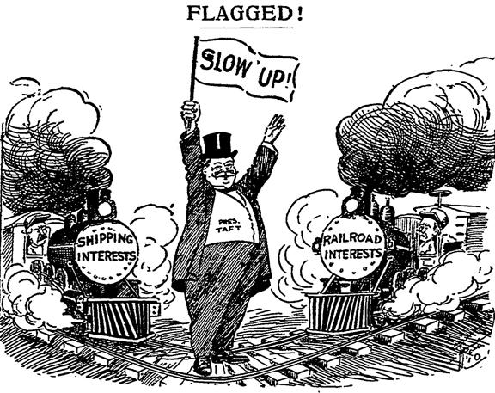
C. Interstate Commerce Act
1886: Wabash v. Illinois
The Supreme Court rules that a state could not set rates on interstate commerce.
1887: Interstate Commerce Act
After public outrage, Congress declared the federal government would regulate the railroads through the ICC
Their job was to ensure “reasonable and just” rates
1897: The Supreme Court rules that the ICC cannot set maximum rates
Theodore Roosevelt would restore this power in 1906

Slide 12
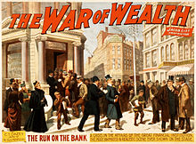
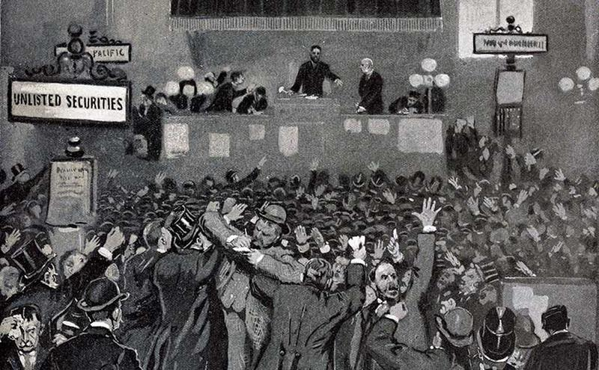
D. Panic and Consolidation
The fight against regulations nearly bankrupt many railroads
This lead to an economic crash in 1893
These crashes happen as part of the business cycle
600 banks and 15,000 businesses closed that year
By 1895, 4 million people lost their jobs
As RR’s failed, investment firms like J.P. Morgan took over, gaining a large influence over the nation
By 1897, recovery had begun and business expansion continued

