Slide 1



Franklin Elementary “Moving On…”

Slide 2
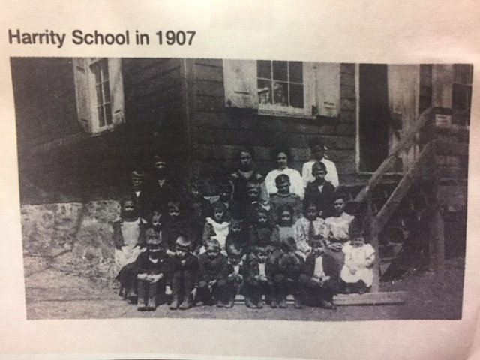
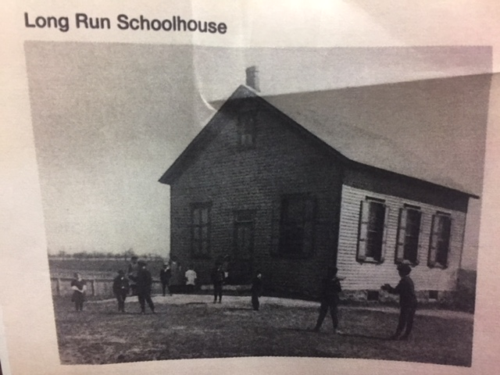
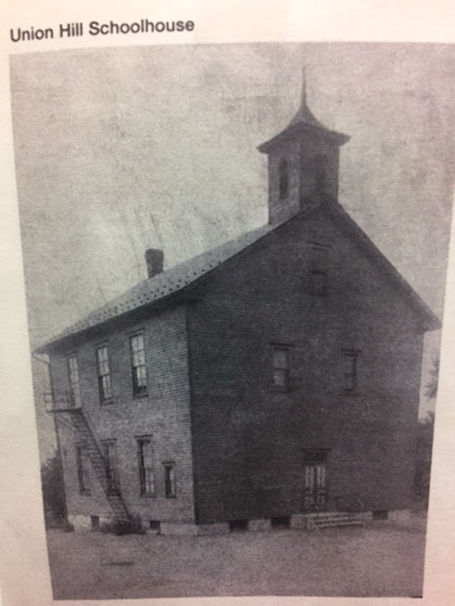
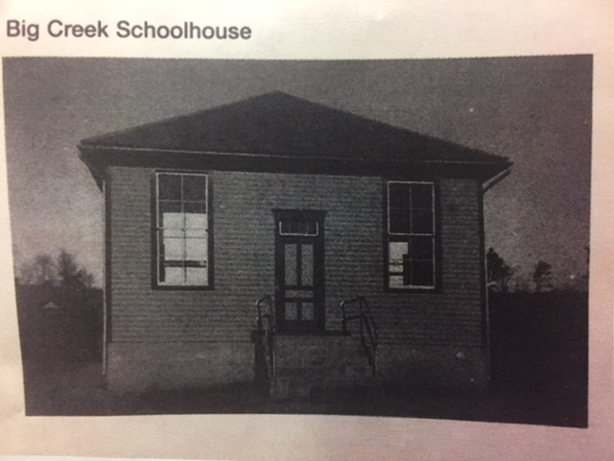
From one room schoolhouses…

Slide 3
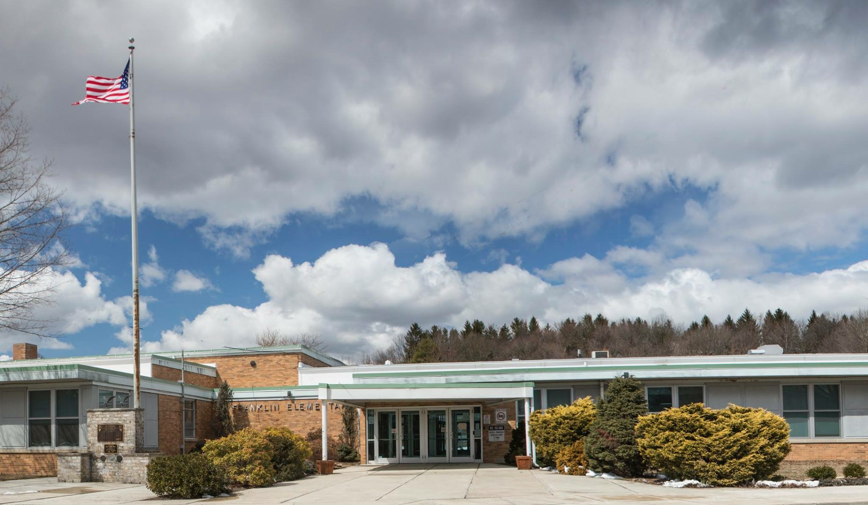
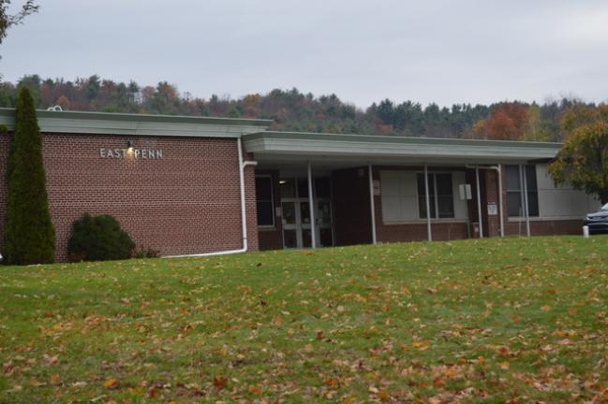
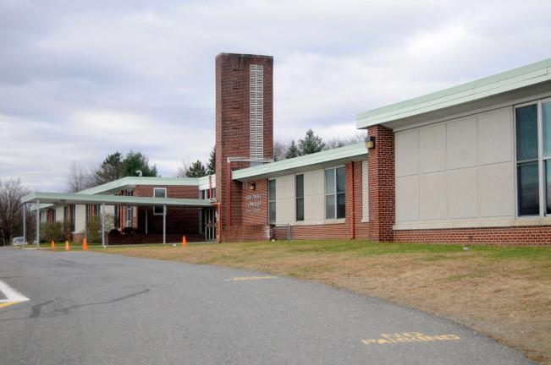
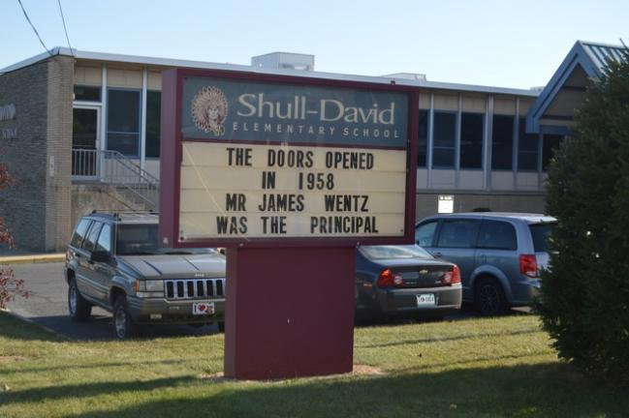
to township buildings,
Franklin Elementary
East Penn Elementary
Mahoning Elementary

Slide 4
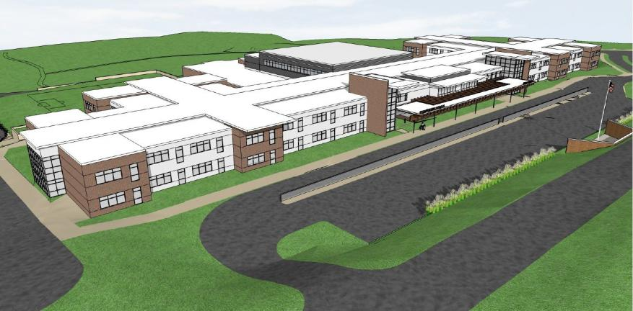
To one Elementary Center

Slide 5
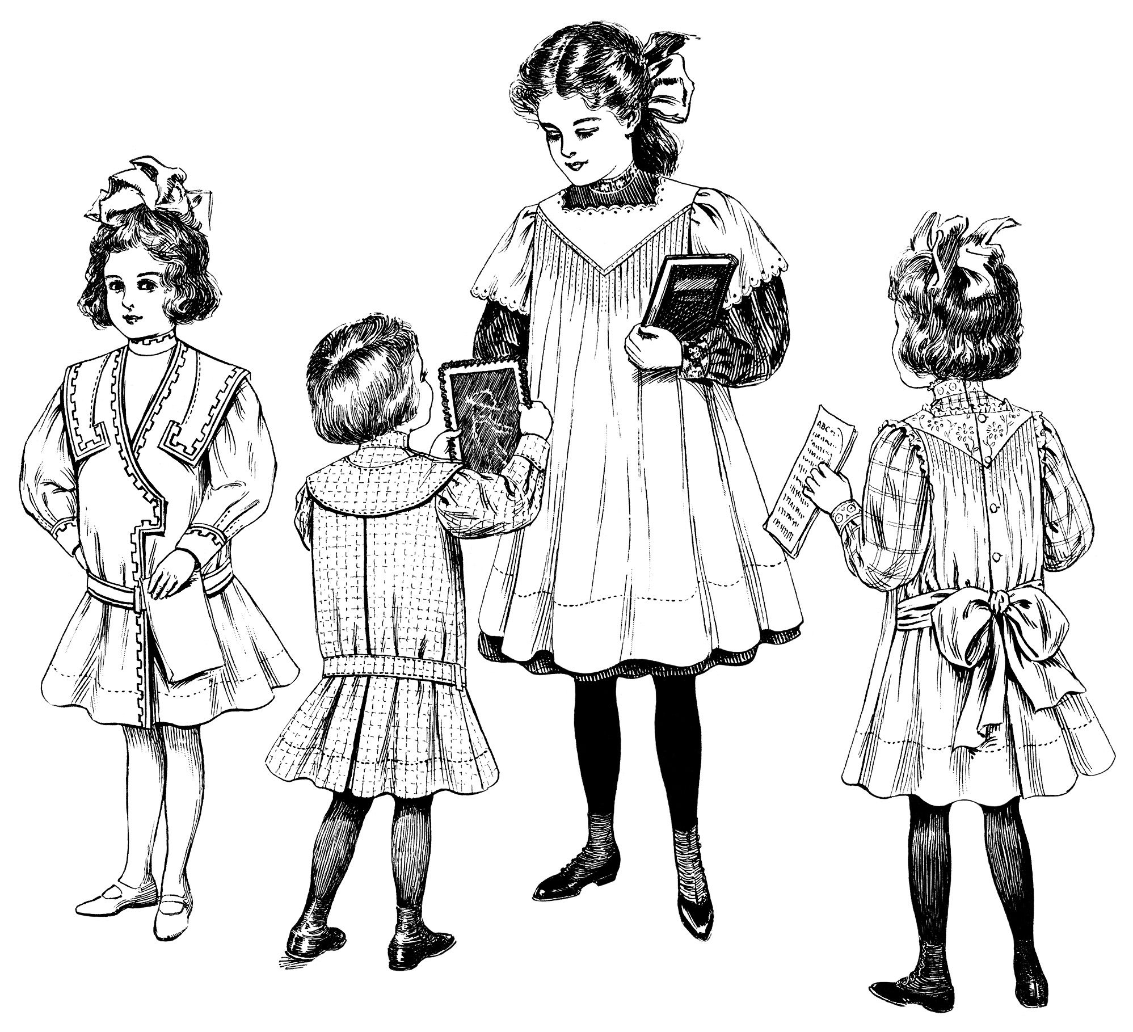

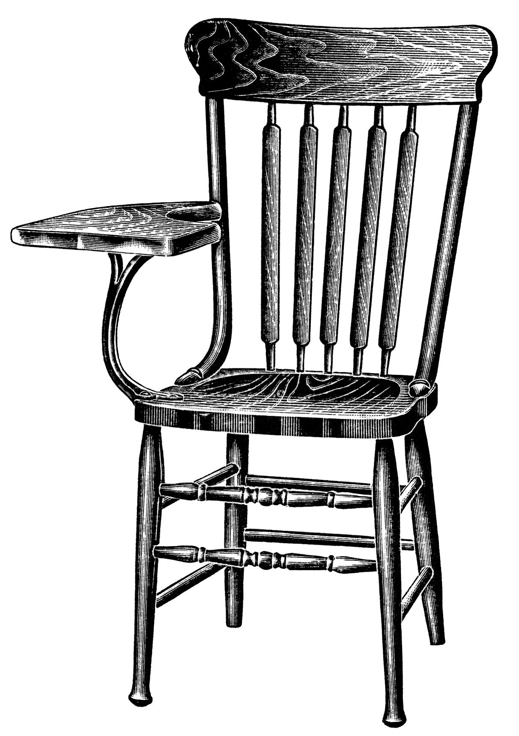
Franklin History
1955-2018

Slide 6
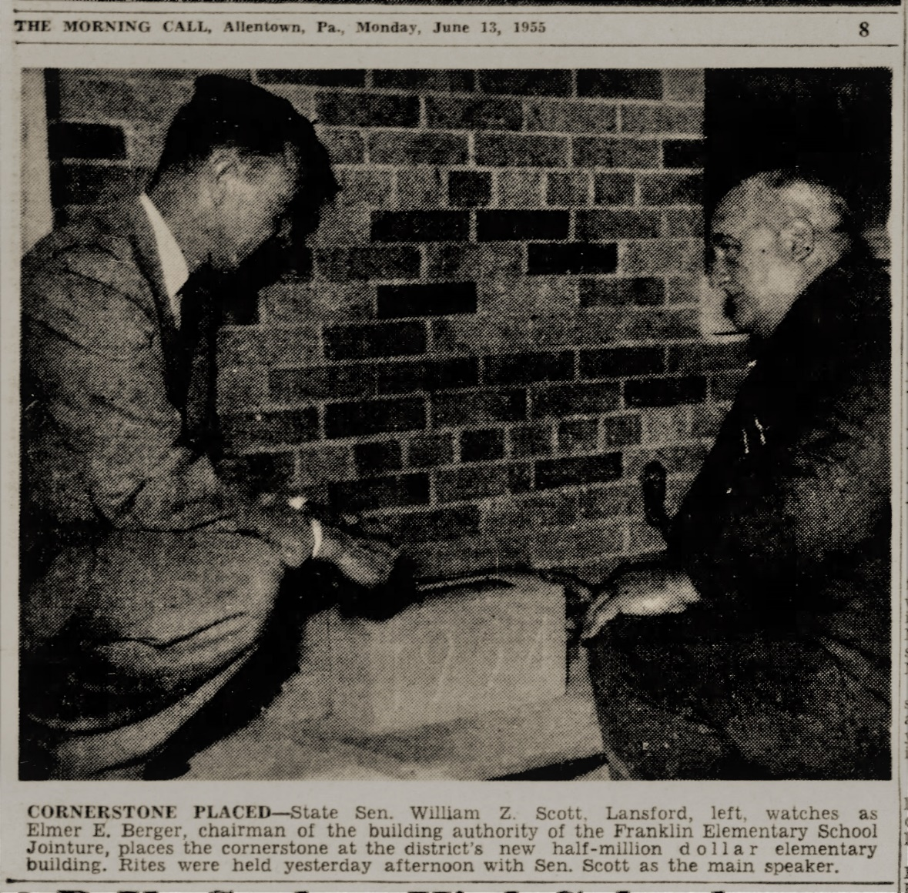
Cornerstone Placement
July 13th 1955

Slide 7
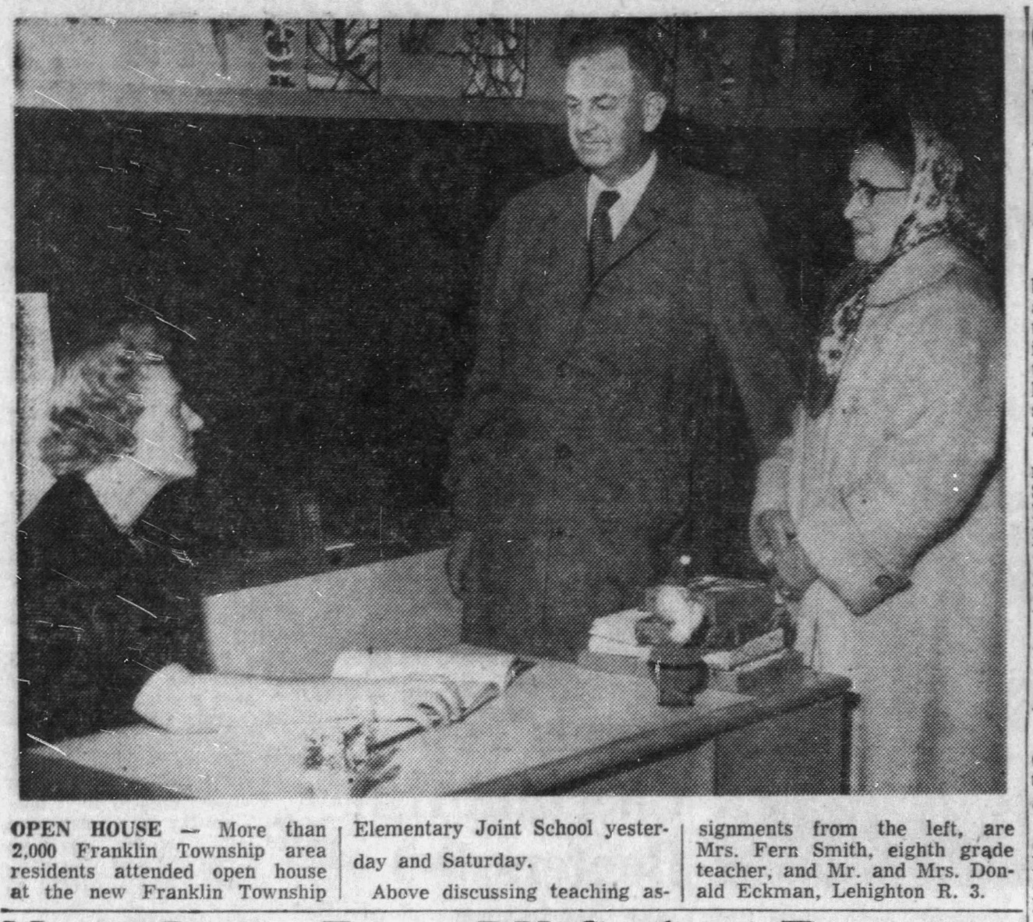
Open House
December 19th 1955

Slide 8
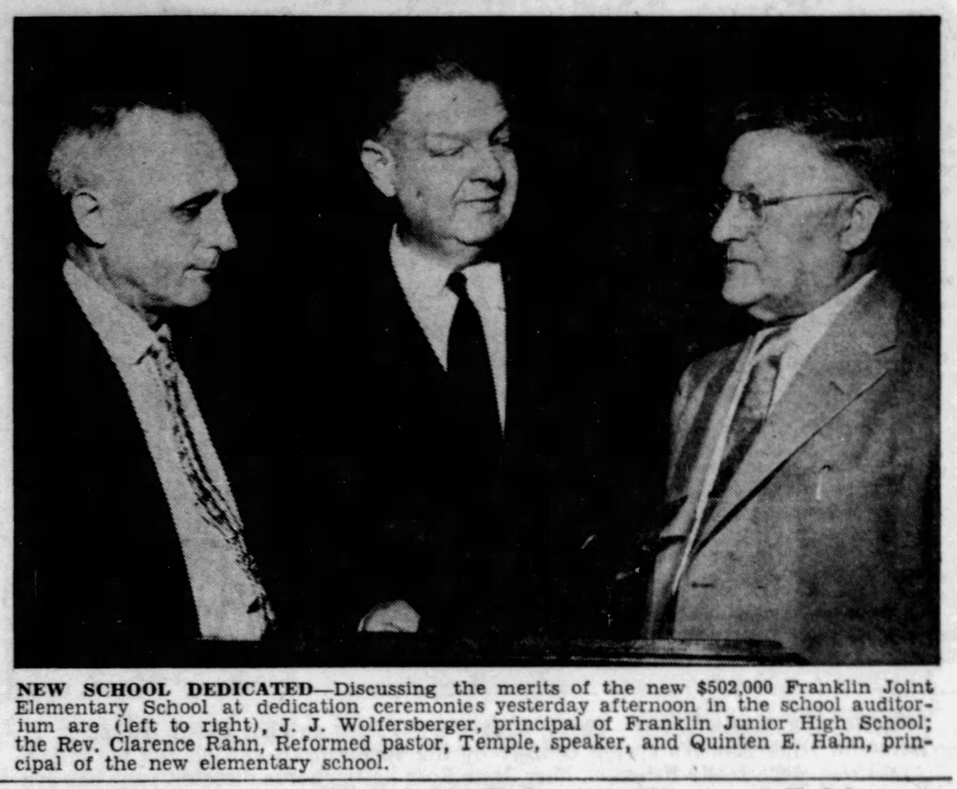
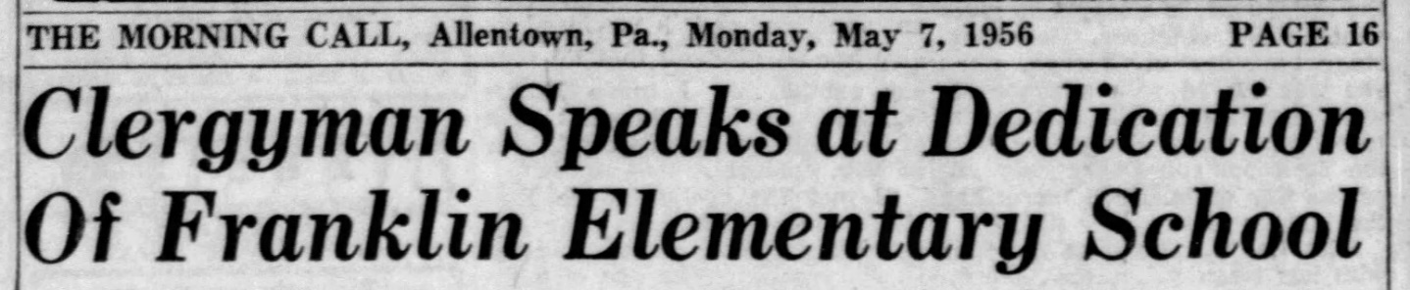
School Dedication
May 7th 1956

Slide 9
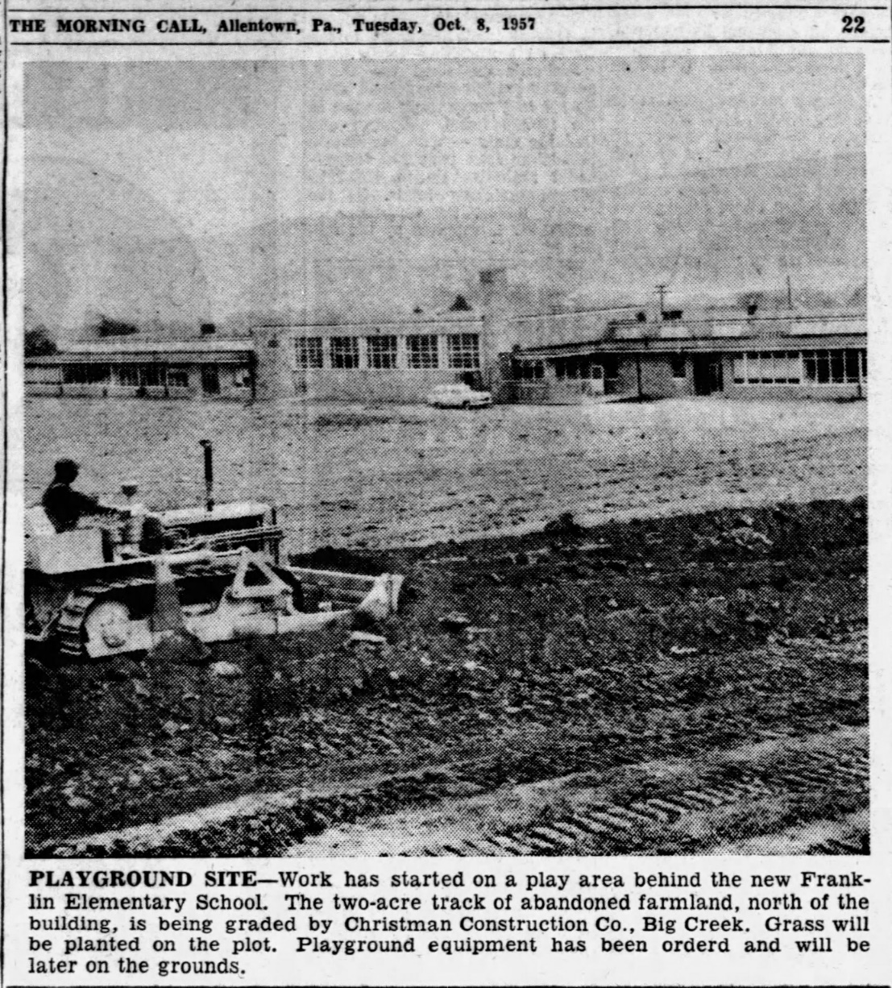
Playground Construction
October 8th 1957

Slide 10
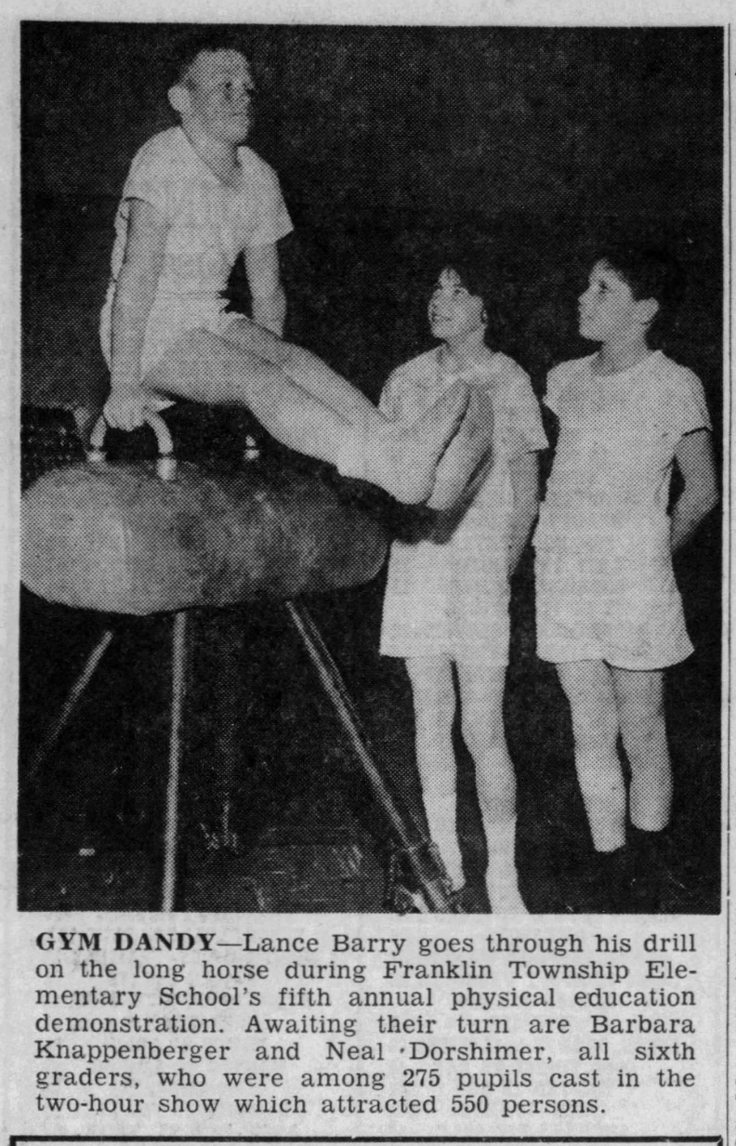
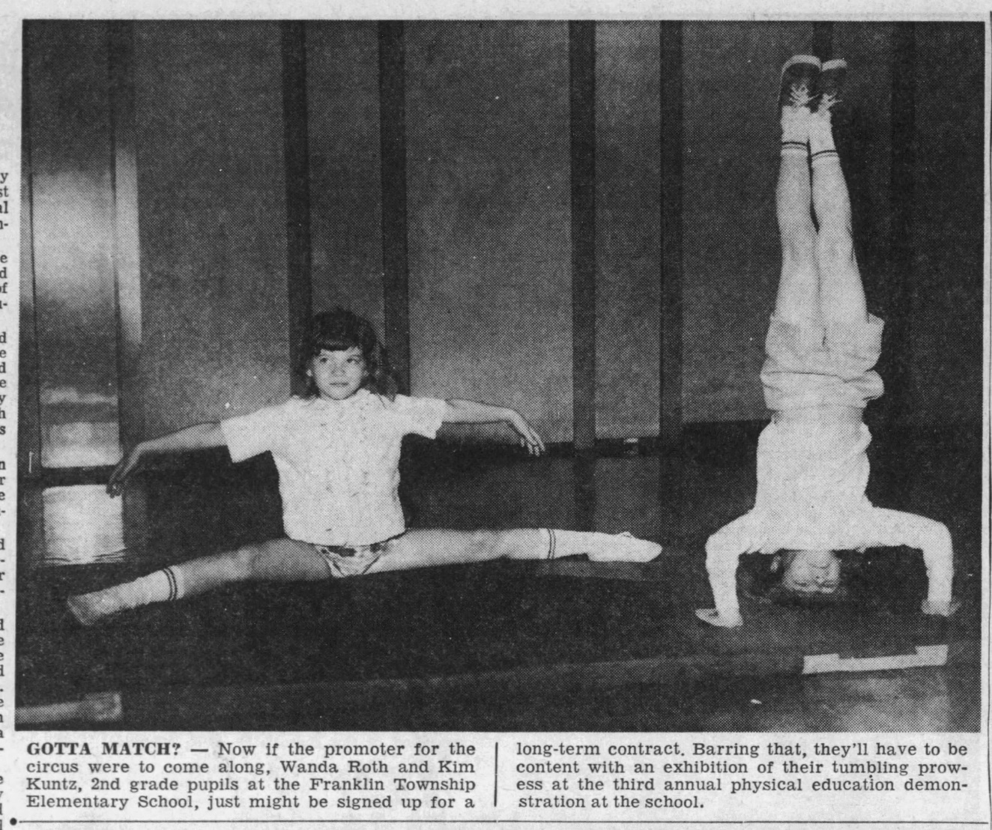
Physical Education Demonstrations 1960’s

Slide 11
New Playground – 1970’s

Slide 12
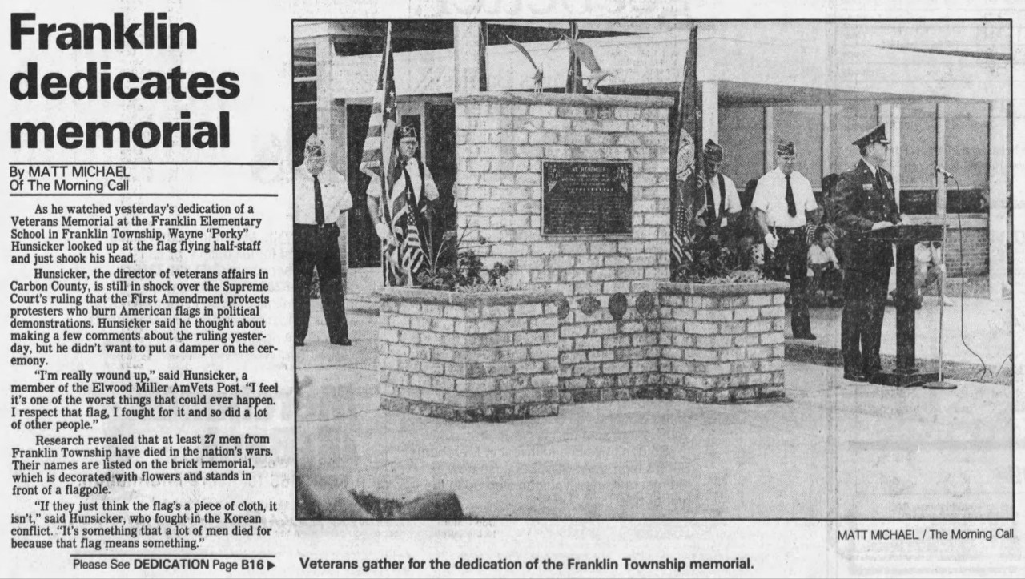
War Memorial Dedication
May 25th 1989

Slide 13
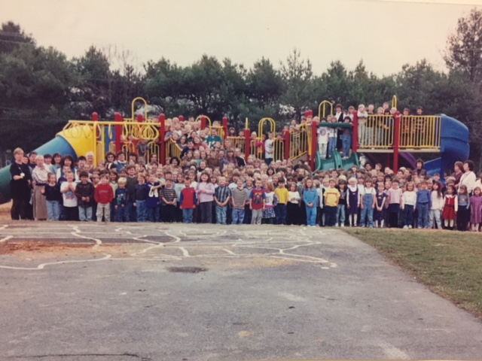
New Playground
November 1999

Slide 14
USA Tulips
Earth Day 2000

Slide 15
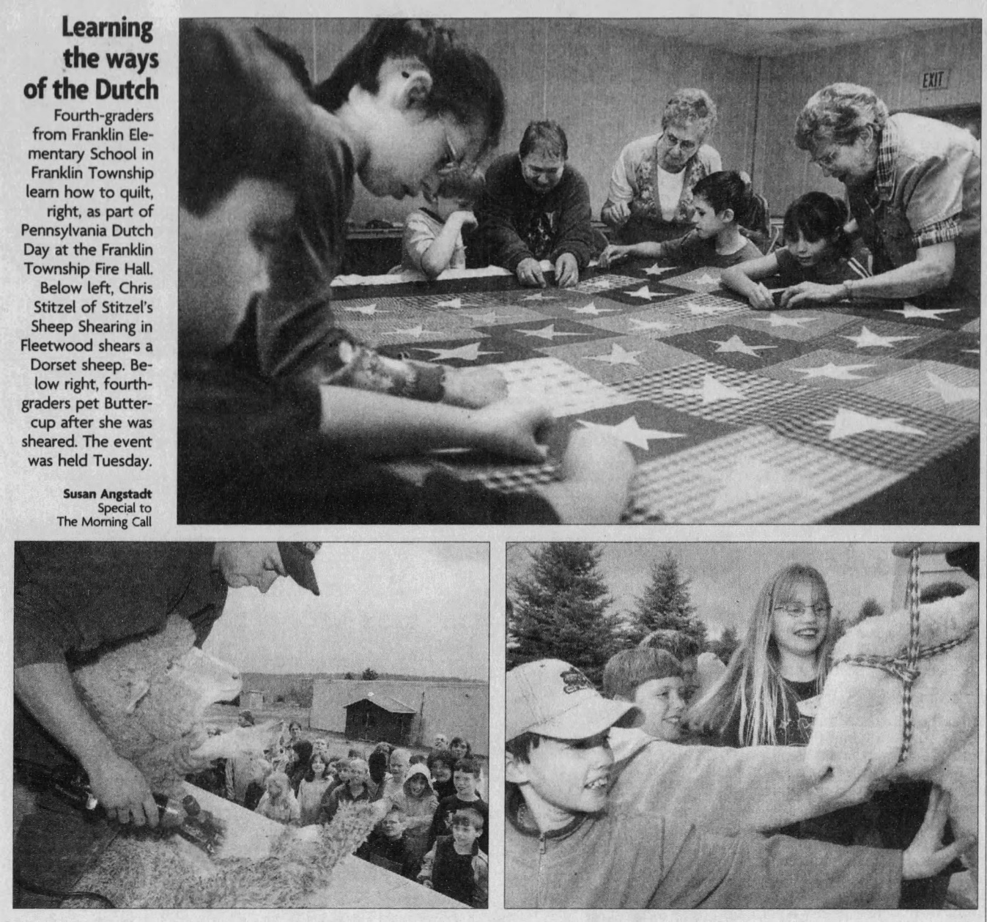
PA Dutch Day – 2000’s

Slide 16
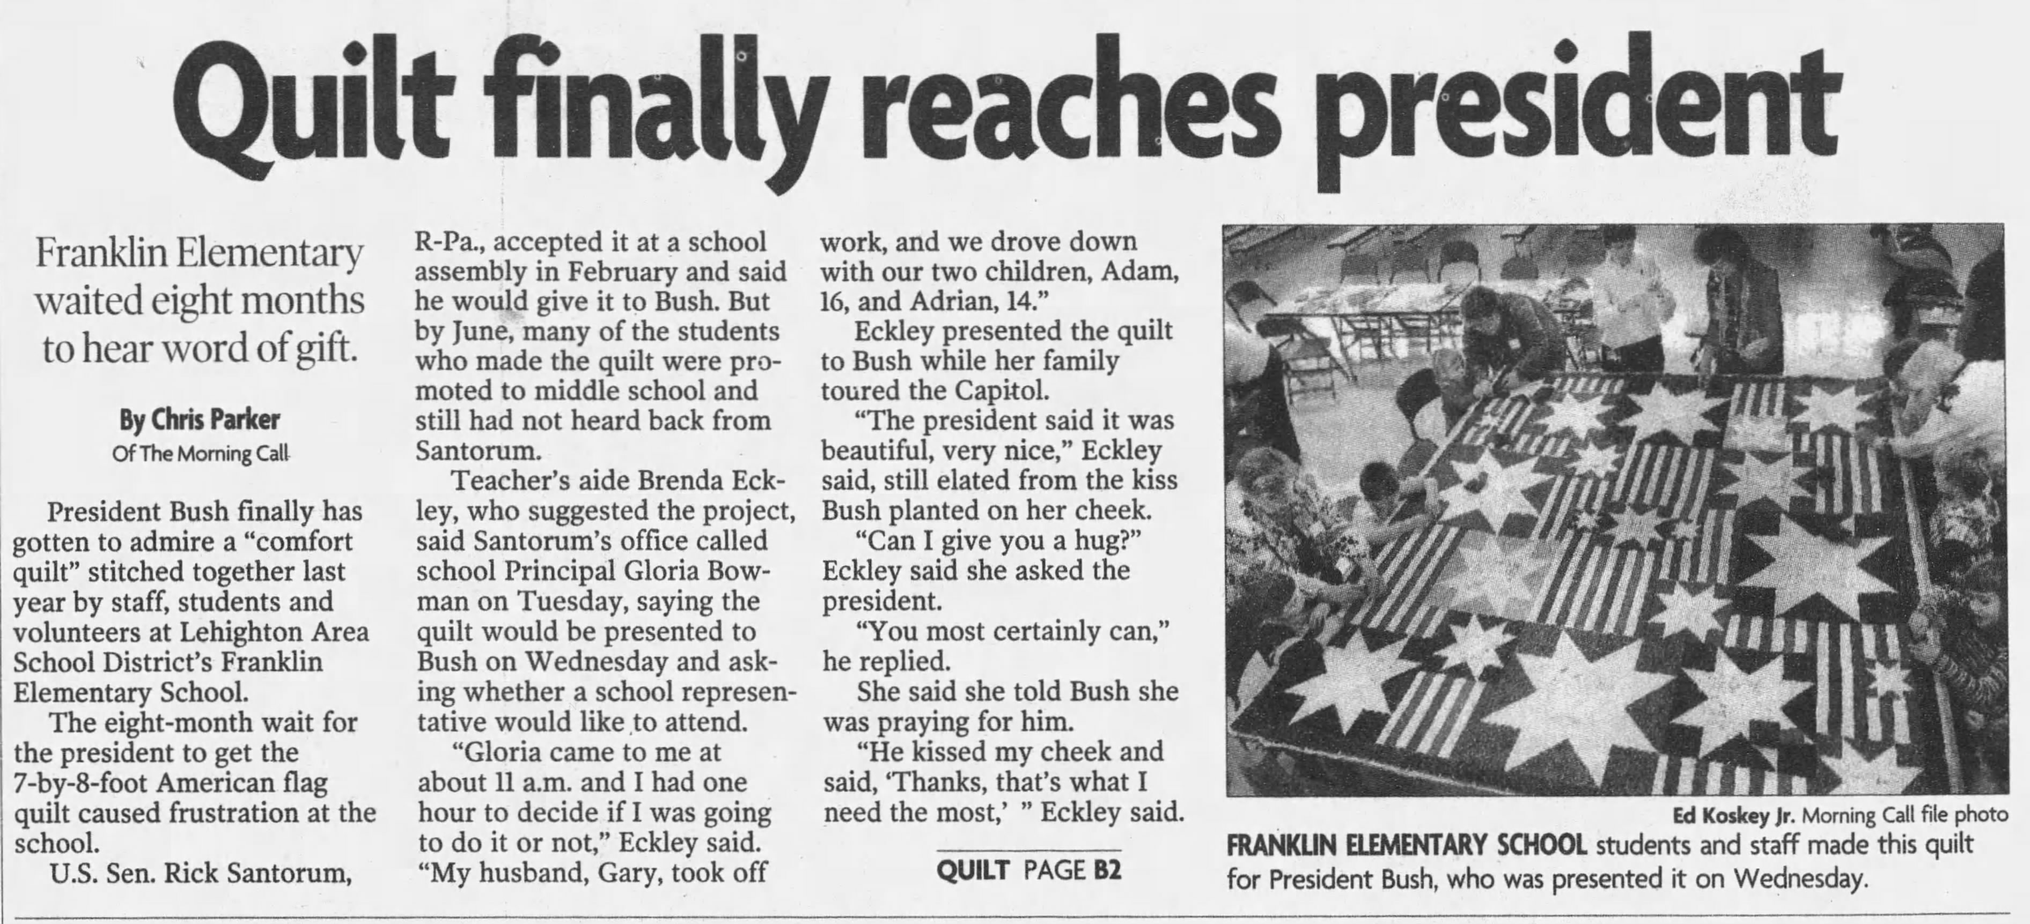
“Comfort Quilt”
October 11th 2002

Slide 17
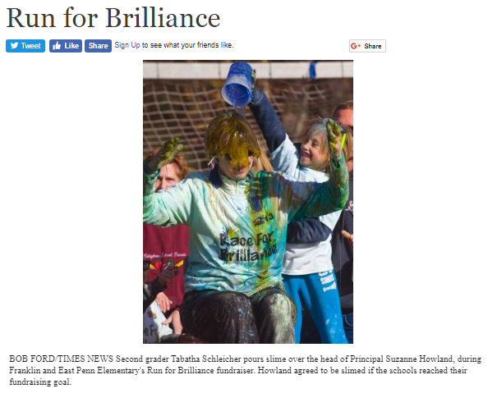
First Race for Brilliance
November 3rd 2013

Slide 18

Franklin’s Final Year
Staff & Students
2017-2018

Slide 19
Principal
Dr. McGalla
New 2017

Slide 20
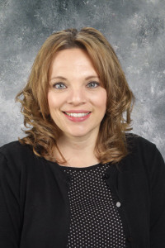
Mrs. Gandy
Kindergarten
Now
Then
2016

Slide 21
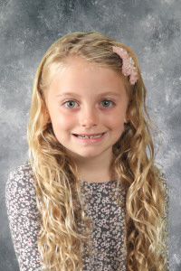
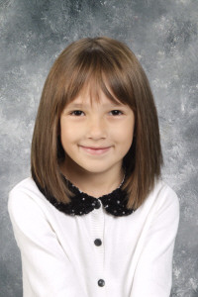
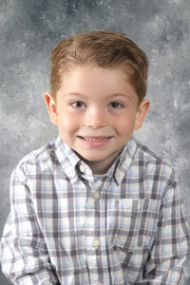
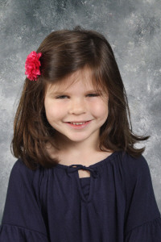
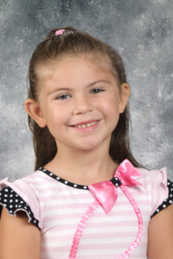
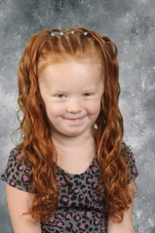
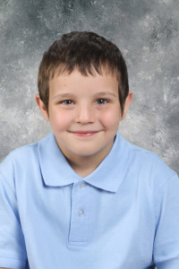
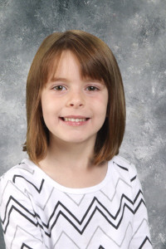

Slide 22
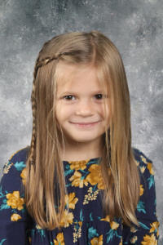
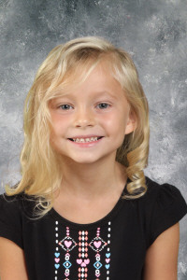
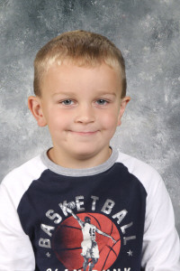
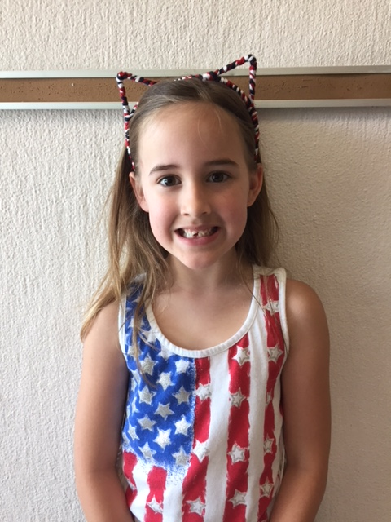
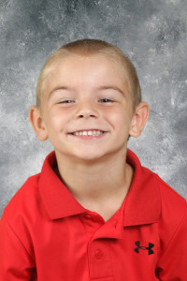
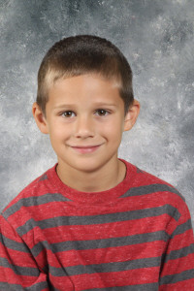
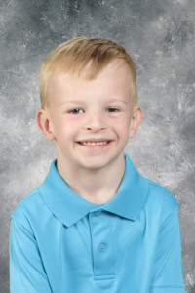
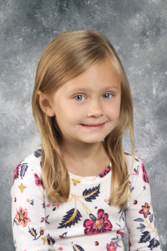

Slide 23
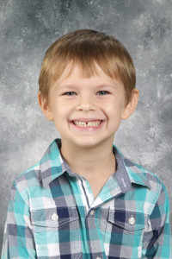
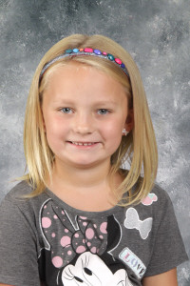
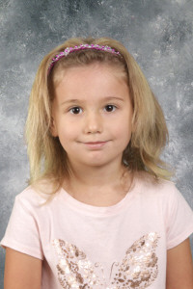

Slide 24
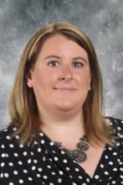
Mrs. Smith
Kindergarten
New 2017

Slide 25
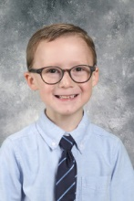
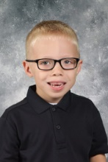
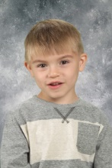
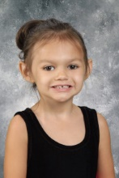
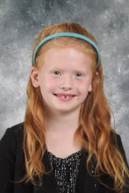
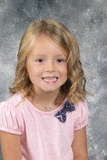



Slide 26









Slide 27



Slide 28


Mrs. Bussey-Williams
1st Grade
Now
Then
2005

Slide 29









Slide 30








Slide 31







Slide 32


Mrs. Scimeca
1st Grade
Now
Then
2012

Slide 33









Slide 34









Slide 35






Slide 36


Miss Cox
2nd Grade
Now
Then
1974

Slide 37









Slide 38









Slide 39


Slide 40


Mrs. Roberts
2nd Grade
Then
1995
Now

Slide 41









Slide 42









Slide 43




Slide 44


Mrs. Zimmerman
2nd Grade
Now
Then
2008

Slide 45









Slide 46









Slide 47



Slide 48


Mrs. Rheinhardt
3rd Grade
Now
Then
2013

Slide 49









Slide 50









Slide 51







Slide 52


Mrs. Strausberger
3rd Grade
Now
Then
2008

Slide 53









Slide 54









Slide 55









Slide 56


Mr. Fritz
4th Grade
Now
Then
2014

Slide 57









Slide 58









Slide 59





Slide 60


Mrs. Gerber
4th Grade
Now
Then
1999

Slide 61









Slide 62









Slide 63



Slide 64


Mrs. Hedash
4th Grade
Now
Then
2004

Slide 65









Slide 66









Slide 67



Slide 68




IU Classroom

Slide 69







Slide 70

Miss Schafer
Learning Support
Now
Then
2016

Slide 71


Mrs. Sirsky
Learning Support
Now
Then
1995

Slide 72


Ms. Lindh
Guidance
Now
Then
1998

Slide 73


Mrs. Harris
Library
Now
Then
2012

Slide 74

Mr. Koons
Gym
Now
Then
1996

Slide 75

Mrs. Scholl
Art
Now
Then
2009

Slide 76


Mrs. Stufflet
Music
Now
Then
1991

Slide 77


Mrs. Boyer
Title I Math
Now
Then
2007

Slide 78


Mrs. Cordes
Title I Reading
Now
Then
2000

Slide 79

Mrs. Ebbert
MTSS
Now
Then
2007

Slide 80

Mr. Zarelli
Speech
Now
Then
2013

Slide 81



Staff
Miss
Brong
Mrs. Carpenter
Mrs.
Eckley

Slide 82



Staff
Mrs.
Kemmerer
Mrs.
Kline
Mrs.
Lobien

Slide 83



Staff
Mrs.
Lutsko
Mrs.
Shoenberger
Mrs.
Simmons

Slide 84


Staff

Slide 85
Year in Review
Big Kahuna
Christmas Concert
Say Goodbye to Summer
Field Trip
Halloween
Earth Day
Fire Prevention
Humph Day
Race for Brilliance
Memorial Day
Pep Rally

Slide 86




Say Goodbye To Summer

Slide 87




Decade Days

Slide 88





Fire Prevention

Slide 89





Race Pep Rally

Slide 90








Race For Brilliance

Slide 91










Halloween

Slide 92





Christmas Concert K-2nd

Slide 93





Christmas Concert 3rd–4th

Slide 94





Humphrey Kickoff

Slide 95






Earth Day

Slide 96







Camden Aquarium
Field Trip

Slide 97











Big Kahuna

Slide 98




Humph Day

Slide 99



Spring Concert

Slide 100







Memorial Day Program

Slide 101

Created by:
Tech Wizard Jr.
Aiden Solt, Madison Serfass, Hailey Heimbach

Slide 102





Final Farewell

Slide 103
Goodbye Franklin
We will miss you!!!

