Slide 1
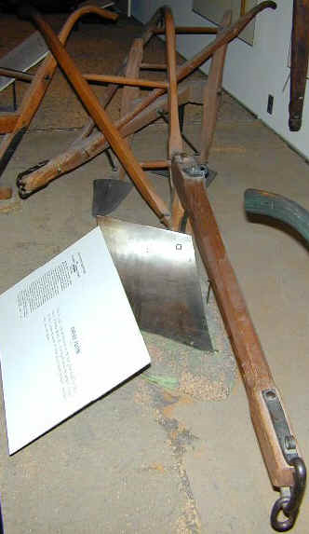
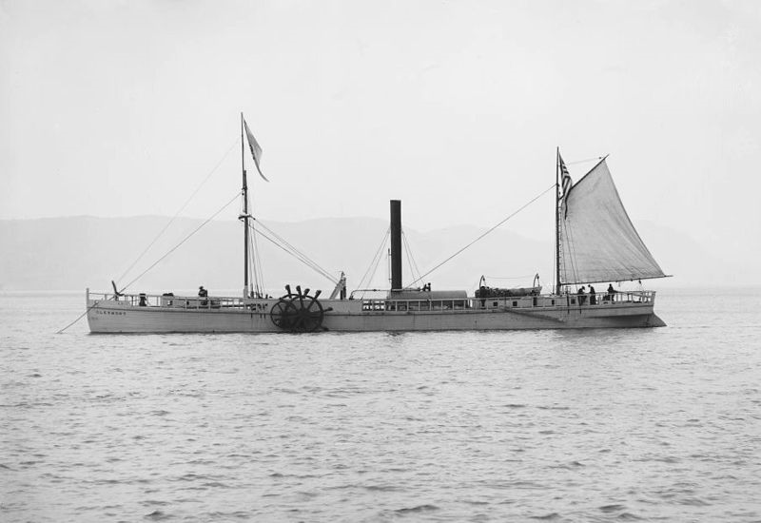
CH 11 Sec 1 Reading Guide Inventions
Visuals to accompany answers to Questions 10 - 18

Slide 2
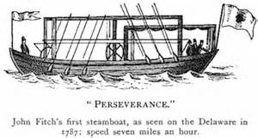
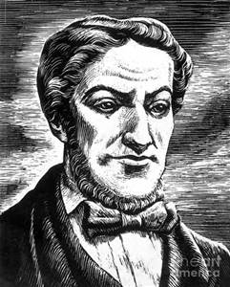
An Early Attempt at a Steamboat
John Fitch -
https://www.youtube.com/watch?v=wQYQfi0foUw

Slide 3
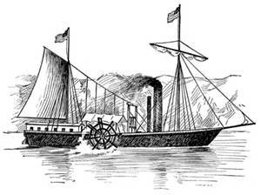
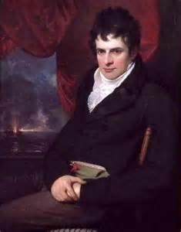
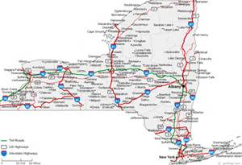
Fulton’s Folly?
Northern River Boat
Nicknamed the “Clermont”
- Easily moved against current/wind
- Two side wheels – need 7 foot draft
Round trip from Albany to NYC
What is the approximate average speed of the Clermont on a round trip from NYC to Albany?
Robert Fulton

Slide 4
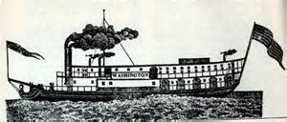
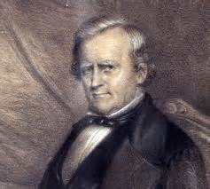
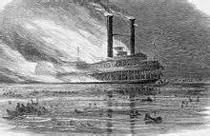
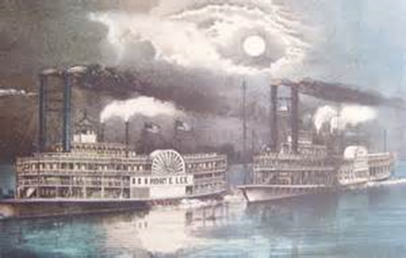
Mississippi Steamboat
Developed by Henry Miller Shreve
Importance – only needed 4’ draft
One could move goods up + down
the Mississippi faster + easier.
The Washington
Fast Boat Races Common
BUT
So too were Explosions

Slide 5
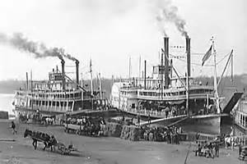
Mississippi River Steamboat in Action
https://www.youtube.com/watch?v=sLhI4WwUjds

Slide 6
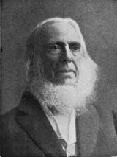
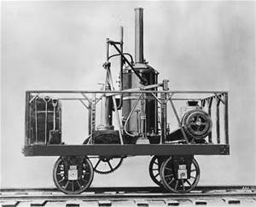
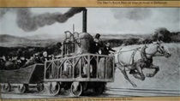
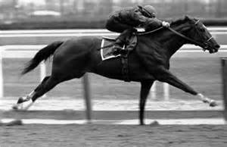
Peter Cooper Invented
U.S’s 1st Successful Steam-powered Locomotive
Famous for a race between it (The Tom Thumb) and a horse drawn train
https://www.youtube.com/watch?v=vJV-CDbsr4E
The Tom Thumb
The HORSE
Guess who won?
Secretariat

Slide 7
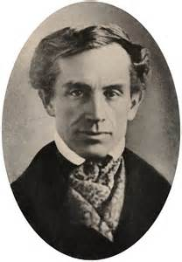
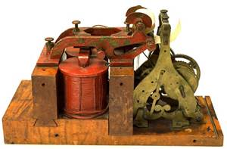
Samuel F.B. Morse “Invented”
Problems of insulation and distance
Congress approved $30,000 for line between Baltimore and Washington, DC – 40 miles
Famous line: “What hath God wrought!”
Used to relay the results of the 1844 Democratic Presidential Nominating Convention
The Telegraph
For more info:
https://www.youtube.com/watch?v=ID6r4-2_0bc

Slide 8
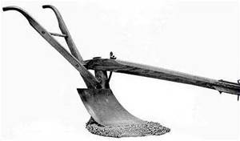
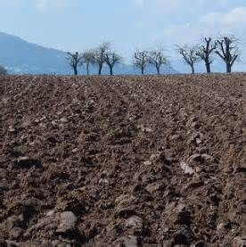
John Deere Invented the
Lightweight Steel Plow
Midwest soil is heavier, richer
Eastern plows couldn’t “cut it”
Deere’s plow cuts through tough, rich soil.
Effect: Western movement of eastern farmers looking for new land to cultivate

Slide 9
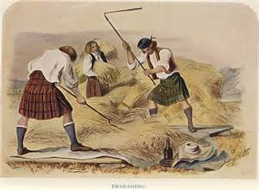
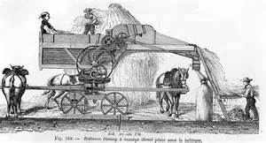
Andrew Meikle Invented …
Before by hand to separate the kernels from the shafts
Modern Demonstration:
https://www.youtube.com/watch?v=SgX_Uy3kdZk
Mechanical Thresher

Slide 10
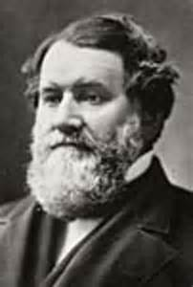
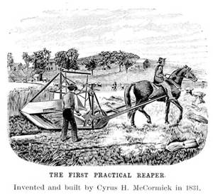
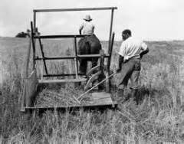
Cyrus McCormick Invented …
… the Mechanical Reaper
Purpose : Cuts ripe grains at harvest
Demonstration Video -
https://www.youtube.com/watch?v=CZNHRXOWptw

Slide 11
Links Across the Nation
Northeast –
sends manufactured goods to Midwest & South
Midwest –
sends food stuffs (grains) to both North and South
South
– sends cotton to Northeast mills
Which regions will develop the stronger bonds? Why isn’t Northeast – South strong?

