Slide 1
Chapter 4
The Tissue Level of Organization

Slide 2
INTRODUCTION
A tissue is a group of similar cells that usually have a similar embryological origin and are specialized for a particular function.
Pathologists, physicians who specialize in laboratory studies of cells and tissues, aid other physicians in making diagnoses; they also perform autopsies.
Histology
the study of tissues

Slide 3
TYPES OF TISSUES AND THEIR ORIGINS
Four principal types based on function and structure
Epithelial tissue
covers body surfaces, lines hollow organs, body cavities, and ducts; and forms glands.
Connective tissue
protects and supports the body and its organs, binds organs together, stores energy reserves as fat, and provides immunity.
Muscle tissue
is responsible for movement and generation of force.
Nervous tissue
initiates and transmits action potentials (nerve impulses) that help coordinate body activities.

Slide 4
Origin of Tissues
Primary germ layers within the embryo
endoderm
mesoderm
ectoderm
Tissue derivations
epithelium from all 3 germ layers
connective tissue & muscle from mesoderm
nerve tissue from ectoderm.

Slide 5
Biopsy
Removal of living tissue for microscopic examination
surgery
needle biopsy
Useful for diagnosis, especially cancer
Tissue preserved, sectioned and stained before microscopic viewing

Slide 6
Epithelial Tissue General Features
Closely packed cells with little extracellular material
Cells sit on basement membrane
Apical (upper) free surface
Basal surface against basement membrane
Avascular---without blood vessels
nutrients and waste must move by diffusion

Slide 7
Good nerve supply
Rapid cell division (high mitotic rate)
Functions
protection, filtration, lubrication, secretion, digestion, absorption, transportation, excretion, sensory reception, and reproduction.

Slide 8
Types of Epithelium
Covering and lining epithelium
epidermis of skin
lining of blood vessels and ducts
lining respiratory, reproductive, urinary & GI tract
Glandular epithelium
secreting portion of glands
thyroid, adrenal, and sweat glands

Slide 9
Classification of Epithelium
Classified by arrangement of cells into layers (this is how the notes are organized)
simple = one cell layer thick
stratified = two or more cell layers thick
pseudostratified = cells contact BM but all cells don’t reach apical surface
nuclei are located at multiple levels so it looks multilayered

Slide 10
Classified by shape of surface cells
squamous =flat
cuboidal = cube-shaped
columnar = tall column
transitional = shape varies with tissue stretching

Slide 11
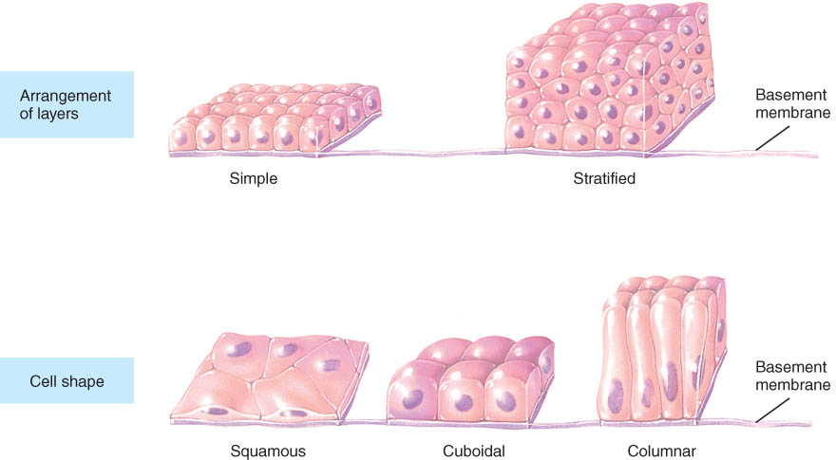
Epithelium

