Slide 1
Module 5 Lesson 5: Theodore Roosevelt
The Big Idea
As president, Theodore Roosevelt worked to give citizens a Square Deal through progressive reforms.
Why It Matters Now
As part of his Square Deal, Roosevelt’s conservation efforts made a permanent impact on environmental resources.

Slide 2
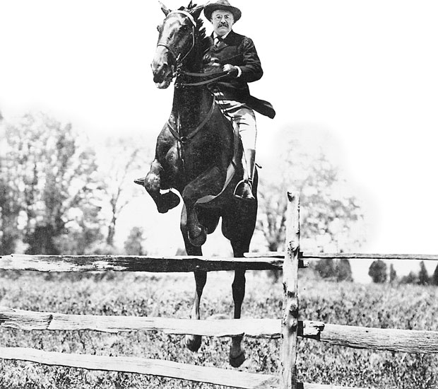
Lessons 5, 6, & 7: T.R., Taft, & Wilson as Progressives
I. Theodore Roosevelt
A. A Rough-Riding President
Spanish American War
Rough Riders
Kettle & San Juan Hills
Pres. McKinley’s V.P.
Big Stick Diplomacy
Offered Americans a Square Deal

Slide 3
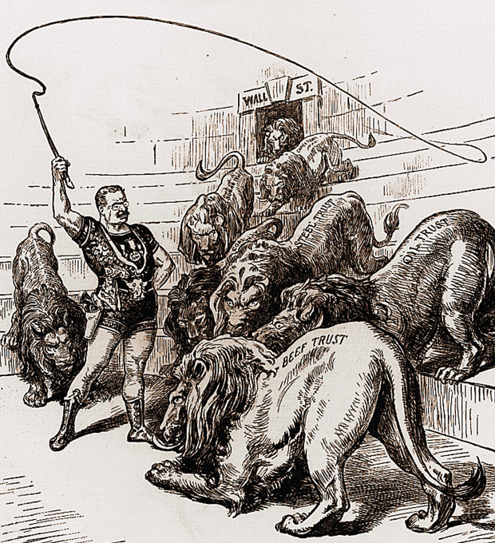
B. Using Federal Power: the Bully Pulpit
Earned a reputation as a trustbuster
Could tell the difference between good and bad trusts
1902 Coal Strike
140,000 miners demanded a 20% raise & 9 hr. workday
TR threatened to take over the mine
Established a new norm in gov’t intervention
Promoted gov’t regulation
Established the I.C.C. – Interstate Commerce Commission
Passed the Mann Elkins Act – made rebates illegal
Hepburn Act – limited free railroad passes

Slide 4
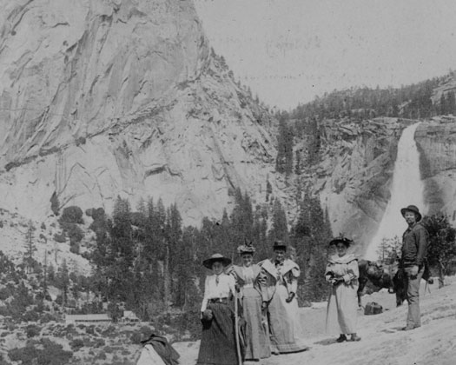
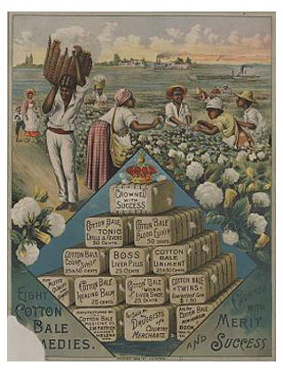
C. Health and the Environment
T.R. was impacted by The Jungle
Meat Inspection Act
Pure Food & Drug Act
FDA – Food and Drug Administration
John Muir & Gifford Pinchot
Est. National Parks
Muir pushed Conservation
National Reclamation Act – Redistributed water

Slide 5
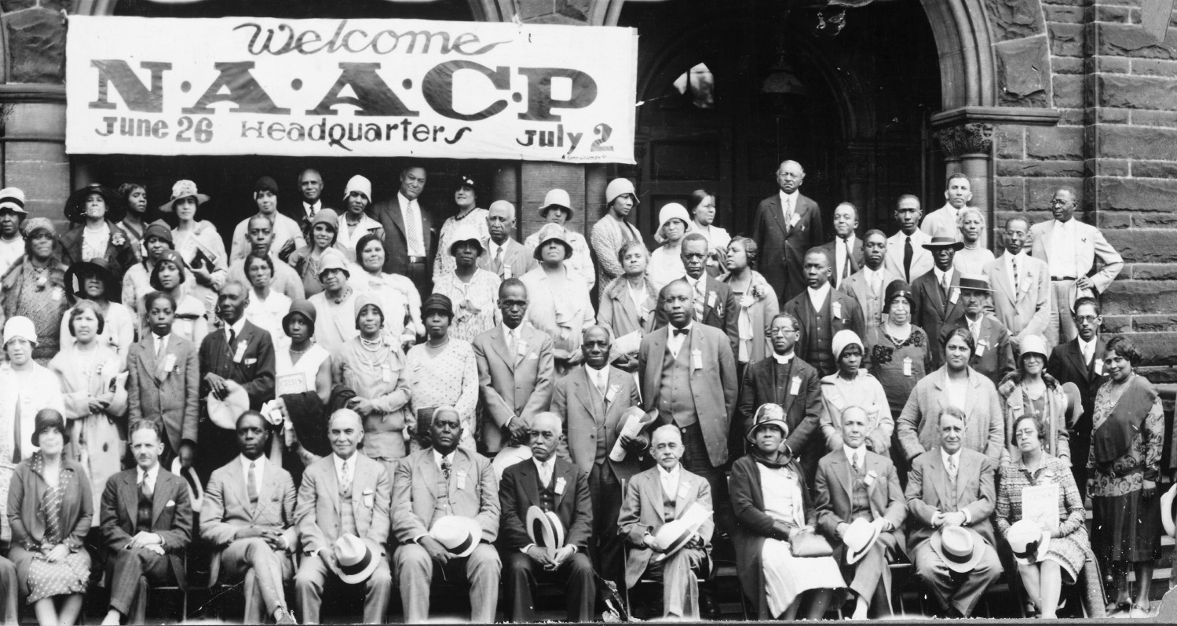
D. Roosevelt & Civil Rights
Was minimally involved
Ex. Niagara Movement
Some progress is still seen
The NAACP is founded
Du Bois’ magazine The Crisis is started.

Slide 6
Progressivism Under Taft
The Big Idea
Taft’s ambivalent approach to progressive reform led to a split in the Republican Party and the loss of the presidency to the Democrats.
Why It Matters Now
Third-party candidates continue to wrestle with how to become viable candidates.

Slide 7
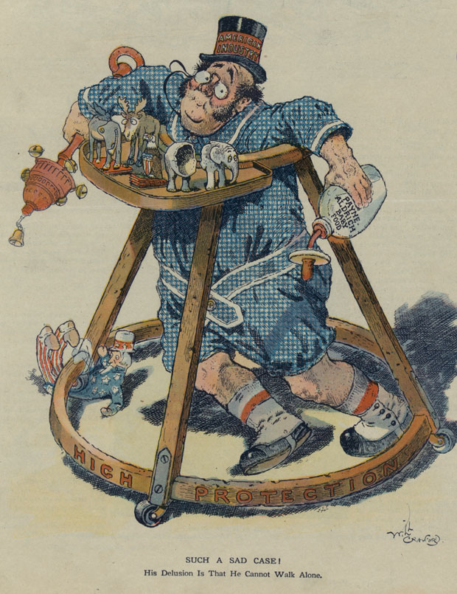
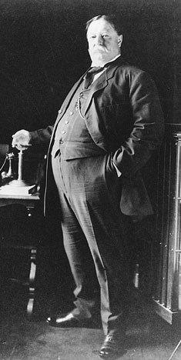
II. William Howard Taft
A. Taft Becomes President
Groomed by TR
Never “felt like the president”
Dollar Diplomacy
Payne-Aldrich Tariff – Disappointed progressives
Appointed Richard Bollinger Sec. of Interior
He removed 1 million acres of protected land
Criticized heavily by muckrakers

Slide 8
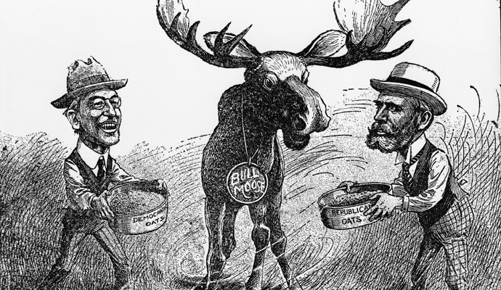
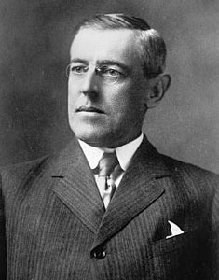
B. The Republican Party Splits
1910 Mid-Term Elections
Democrats gain control in the House
Election of 1912
Republicans run William Howard Taft
Democrats run Woodrow Wilson
Theodore Roosevelt created the Progressive “Bull Moose” Party
The split allows Wilson to win easily

Slide 9
Wilson’s New Freedom
The Big Idea
Woodrow Wilson established a strong reform agenda as a progressive leader.
Why It Matters Now
The passage of the Nineteenth Amendment during Wilson’s administration granted women the right to vote.

Slide 10
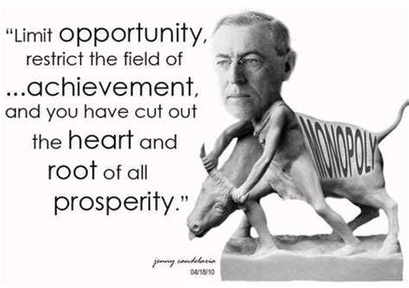
III. Woodrow Wilson & the New Freedom
Moral Diplomacy
A. Wilson Wins Financial Reform
The Clayton Anti-Trust Act: prohibited the creation of a monopoly
Federal Trade Commission Act: the FTC acted as a “watchdog” and investigated possible violations
Both were criticized by those who felt gov’t was overstepping its boundaries

Slide 11
1913 - Underwood Act: reduced tariffs greatly
1913 – 16th Amendment: created a graduated income tax
1913 – Federal Reserve Act: created 12 national districts
Each had a central bank
Provided government influence over the economy
The Federal Reserve system is still the basis of US banking

Slide 12
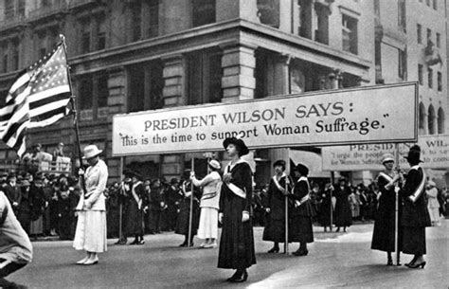
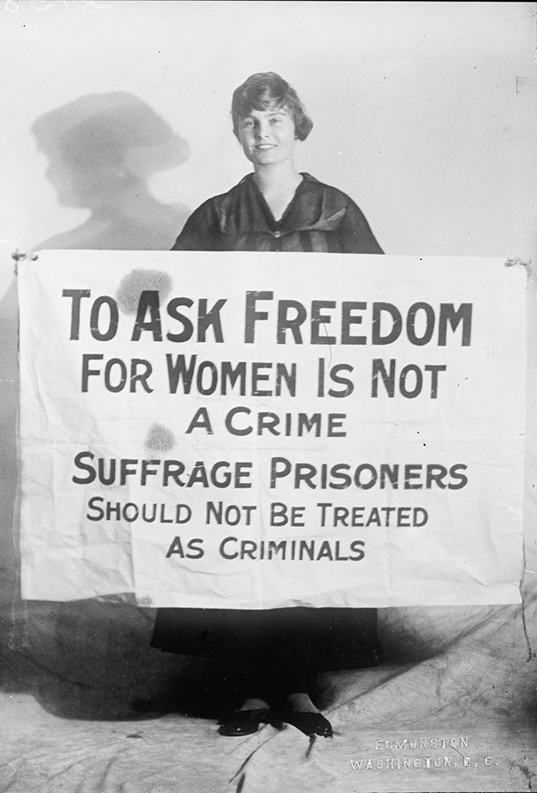
B. Women Win Suffrage
Susan B. Anthony was followed
by Carrie Chapman Catt
President of NAWSA
5 Tactics
Organization, ties between local/state/national workers, wide base of support, lobbying, ladylike behavior
Lucy Burns & Alice Paul: Created Congressional Union & Nat’l Women’s Party.
More aggressive tactics
WWI Makes the difference
1919 – 19th Amendment

Slide 13
C. The Limits of Progressivism
Few progressives focused on civil rights
Minorities were often ignored
Still much progress to be made
WWI would distract Wilson from the movement

