Slide 1
Matrix of Bone
Inorganic mineral salts provide bone’s hardness
calcium phosphate, calcium carbonate
Organic collagen fibers provide bone’s flexibility
their tensile strength resists being stretched or torn
remove minerals with acid & rubbery structure results
Bone is not completely solid since it has small spaces for vessels and red bone marrow
spongy bone has many such spaces
compact bone has very few such spaces

Slide 2
Compact Bone
Compact bone is arranged in units called osteons or Haversian systems
Osteons contain blood vessels, lymphatic vessels, nerves, and osteocytes along with the calcified matrix.
Osteons are aligned in the same direction along lines of stress. These lines can slowly change as the stresses on the bone changes.

Slide 3
Compact or Dense Bone
Looks like solid hard layer of bone
Makes up the shaft of long bones and the external layer of all bones
Resists stresses produced by weight and movement

Slide 4
Histology of Compact Bone
Osteon is concentric rings (lamellae) of calcified matrix surrounding a vertically oriented blood vessel
Osteocytes are found in spaces called lacunae
Osteocytes communicate through canaliculi filled with extracellular fluid that connect one cell to the next cell

Slide 6
Spongy Bone
Spongy (cancellous) bone does not contain osteons. It consists of trabeculae surrounding many red marrow filled spaces.
It forms most of the structure of short, flat, and irregular bones, and the epiphyses of long bones.
Spongy bone tissue is light and supports and protects the red bone marrow.

Slide 7
The Trabeculae of Spongy Bone
Latticework of thin plates of bone called trabeculae oriented along lines of stress
Spaces in between these struts are filled with red marrow where blood cells develop
Found in ends of long bones and inside flat bones such as the hipbones, sternum, sides of skull, and ribs.

Slide 8
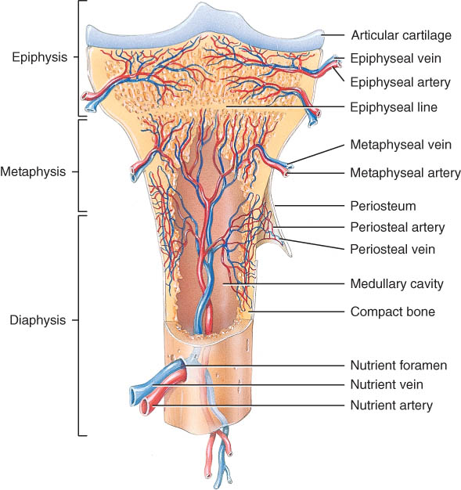
Blood and Nerve Supply of Bone
Periosteal arteries
supply periosteum
Nutrient arteries
enter through nutrient foramen
supplies compact bone of diaphysis & red marrow
Metaphyseal & epiphyseal arteries
supply red marrow & bone tissue of epiphyses

Slide 9
BONE FORMATION
All embryonic connective tissue begins as mesenchyme.
Bone formation is termed osteogenesis or ossification and begins when mesenchymal cells provide the template for subsequent ossification.
Begins in the 6th or 7th week of embryonic life and continues until adulthood…
approximately age 25 .

Slide 10
Two types of ossification occur.
Intramembranous ossification is the formation of bone directly from or within fibrous connective tissue membranes.
Endochondrial ossification is the formation of bone from hyaline cartilage models.

Slide 11
Intramembranous
Intramembranous ossification forms the flat bones of the skull and the mandible.
An ossification center forms from mesenchymal cells as they convert to osteoblasts and lay down osteoid matrix.

Slide 12
2. The matrix surrounds the cell and then calcifies as the osteoblast becomes an osteocyte.
3. The calcifying matrix centers join to form bridges of trabeculae that constitute spongy bone with red marrow between.
4. On the periphery the mesenchyme condenses and develops into the periosteum.

Slide 13
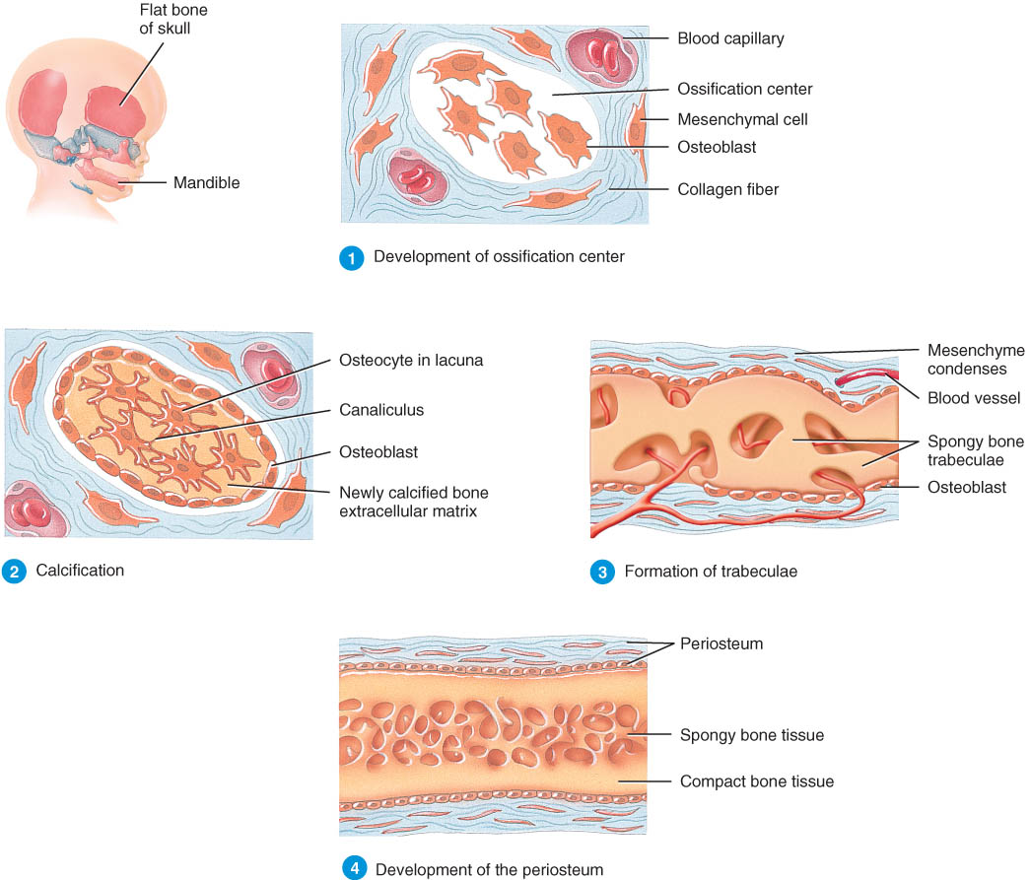

Slide 14
Endochondrial
Endochondrial ossification involves replacement of cartilage by bone and forms most of the bones of the body.
The first step in endochondrial ossification is the development of the cartilage model.

Slide 15
Endochondrial Bone Formation
Development of Cartilage model
Mesenchymal cells form a cartilage model of the bone during development

Slide 16
Growth of Cartilage model
in length by chondrocyte cell division and matrix formation
( interstitial growth)
in width by formation of new matrix on the periphery by new chondroblasts from the perichondrium (appositional growth)
cells in midregion burst and change pH triggering calcification and chondrocyte death

Slide 17
Endochondral Bone Formation
Development of Primary Ossification Center
perichondrium lays down periosteal bone collar
nutrient artery penetrates center of cartilage model

Slide 18
periosteal bud brings osteoblasts and osteoclasts to center of cartilage model
osteoblasts deposit bone matrix over calcified cartilage forming spongy bone trabeculae
osteoclasts form medullary cavity

Slide 19
Development of Secondary Ossification Center
blood vessels enter the epiphyses around time of birth
spongy bone is formed but no medullary cavity
Formation of Articular Cartilage
cartilage on ends of bone remains as articular cartilage.

