Slide 1
Chapter 8 Cell Growth and Division 8-1 Cell Growth The Ameoba Sisters

Slide 2
Organisms grow because they produce more cells, not because the cells grow in size.
Food and oxygen enter the cell across the membrane by diffusion. This is a very slow process, so a lot of membrane surrounding a little cell would be best.

Slide 3
The optimum condition is a large surface area to volume ratio.
Individual cells grow by increasing in size. When they get to large for the entire cell to be nourished, cell division occurs.

Slide 5
A single cell can produce a huge number of cells in a very short period of time due to exponential growth (the story of the development of chess)
Most cells do not continue to grow and divide for long. They usually stop growing when they come in contact with other cells.

Slide 6
If cells continue to grow out of control, the result is cancer.
Some cells do not grow at all (heart cells and nerve cells)

Slide 7
Chapter 8 Cell Growth and Division 8-2 Cell Division: Mitosis and Cytokenesis

Slide 9
Cell division in eukaryotic cells occur in two stages, mitosis and cytokinesis.
Mitosis (M phase): The process by which the nucleus of the cell is divided into two nuclei. Each new cell has the same kinds and number of chromosomes as the parent cell.
Cytokenesis: The process by which the cytoplasm of the cell divides forming two distinct cells.

Slide 10
What are chromosomes? Chromosomes are found in a cell’s nucleus and contain genetic information. They are composed of chromatin.
Chromatin is composed of DNA and protein. The special protein found in chromatin is histones and was discovered in the year 1973 by American scientists.
How many chromosomes are found in each human somatic cell? 46 . chimpanzee? 48 Lettuce? 18 ameba? 50 .

Slide 12
Chromosome structure:
After DNA replication, the chromosomes become visible. This is the beginning of mitosis (prophase) .
The chromosomes contain two chromatids or identical parts, which are often called sister chromatids .
Each pair of chromatids is attached at an area called the centromere .

Slide 14
The Cell Cycle (see fig 8-10)
The cell cycle is the period of time from the beginning of one mitosis to the beginning of the next mitosis . Each cell cycle includes mitosis, cytokinesis and the three phases of interphase.
In short, during the cell cycle:
The cell grows .
The cell prepares for a division .
The cell divides to form two daughter cells .
Each daughter cell begins a new cell cycle .

Slide 16
Interphase
Interphase: Longest part of the cell cycle
Nucleolus is visible
Divided into 3 phases:
G₁ (Growth phase 1) Cell grows and carries out normal life activities
S (DNA Synthesis phase) DNA is replicated (copied)
forming 2 identical sister chromatids which are
joined together by a centromere
G₂ (Growth phase 2) Cell prepares for mitosis

Slide 17
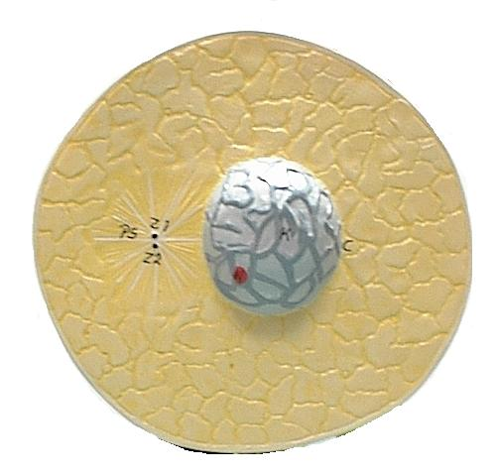
Interphase

Slide 18
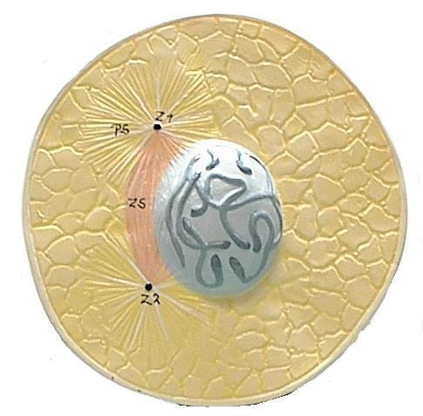
Prophase (fig 8-12)
Replicated chromosomes thicken and
become visible
Centrioles move to opposite poles of the cell
forming spindle fibers between them
Spindle attaches near the centromere of
each chromosome
Nucleolus and nuclear envelope disappear

Slide 19
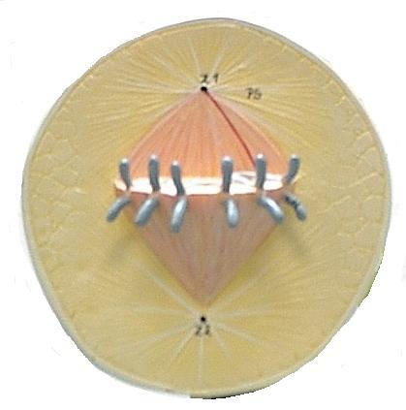
Metaphase
The chromosomes’
centromeres line up
on the cell’s equator

Slide 20
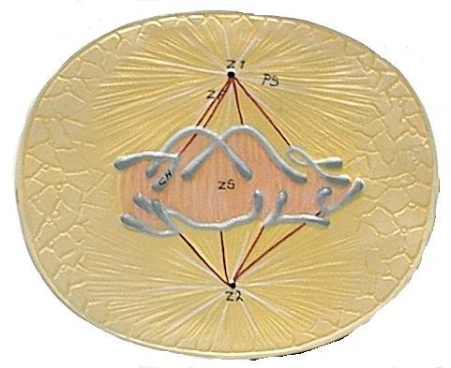
Anaphase
The centromeres attaching
sister chromatids split
The sister chromatids
(now called chromosomes)
move towards opposite
poles using the spindle as
a guide

Slide 21
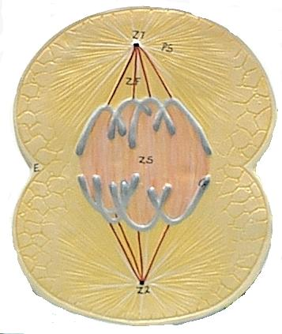
Telophase
The chromosomes uncoil
and disappear
The nuclear envelope
reforms

Slide 22
The end result of mitosis is one cell containing 2 distinct nuclei with identical chromosomes in them

Slide 23
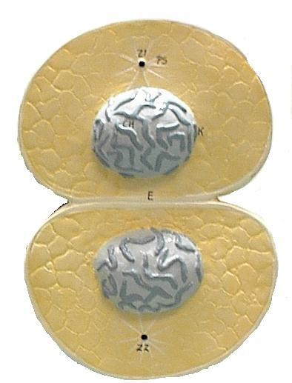
Cytokinesis
In animal cells (fig 8-16)
The cell membrane pinches in
between the 2 nuclei thus
separating the cytoplasm and
forming 2 new daughter cells.

Slide 24
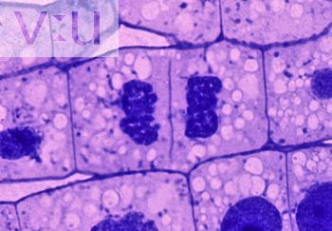
Cytokinesis
In plant cells (fig 8-17)
A cell plate forms between the 2 nuclei. This will eventually develop into a cell wall.
cell plate

