Slide 1
Lesson 2: Education Reform
The Big Idea: Reforms in public education led to a rise in national literacy and the promotion of a public education
Why It Matters Now: The public education system is a foundation of the democratic ideals of American society.
Key Terms & People: Booker T. Washington / Tuskegee Normal & Industrial Institute / W.E.B. Du Bois / Niagara Movement

Slide 2
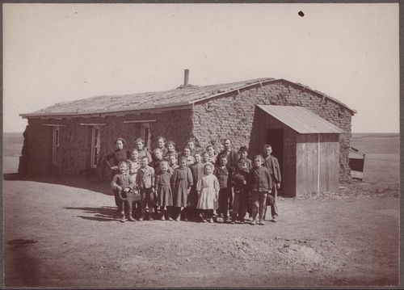
I. Expanding Public Education
  A. Schools for Children
    1865-1895: states required 12-16 weeks of school annually
    Applied to students 8-14
    The Three R’s
    Strict rules & physical punishment
    By 1900, 3,000 kindergarten’s existed
      Added to public schools by William Torrey Harris
    1880: 63% of whites attended, only 34% of African Americans

Slide 3
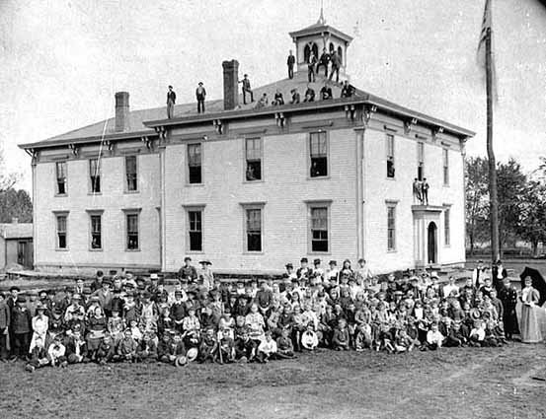
  B. The Growth of High Schools
    Industrialization demanded tech. and managerial skill
    1900: 500,000 + students attended
    Courses expanded to science, civics, social studies
    Vocational courses followed
      Drafting, carpentry, mechanics

Slide 4
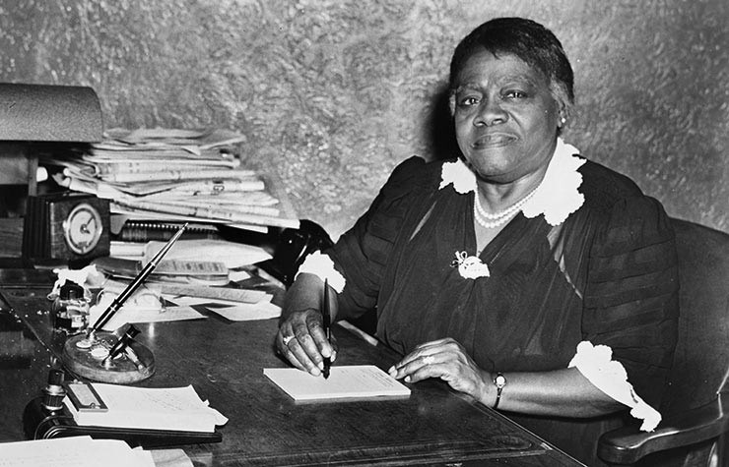
  C. Racial Discrimination
    African Americans excluded from Sec. Ed.
    1890: fewer than 1% attended
    Even those who went attended private school
    Mary McLeod Bethune
      Opened her own school
      Given donations by Rockefeller & Eleanor Roosevelt
      Became Bethune-Cookman College

Slide 5
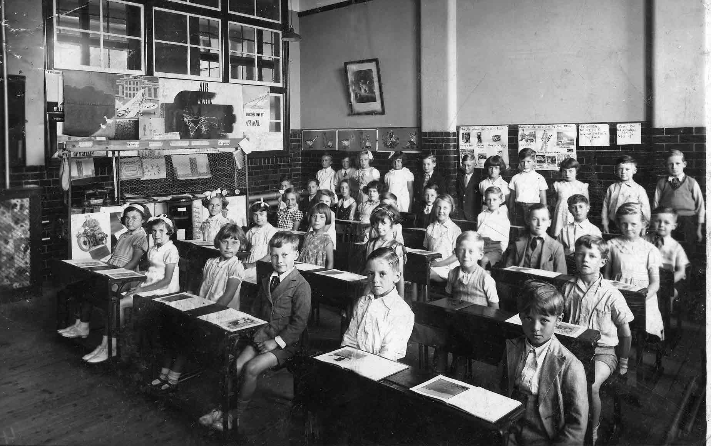
  D. Education for Immigrants
    Encouraged to attend
    Many were “Americanized”
    Some resented suppression of native language
    Catholics created private schools
    1,000’s of adults attended night school
    Ford offered a Sociology Department

Slide 6
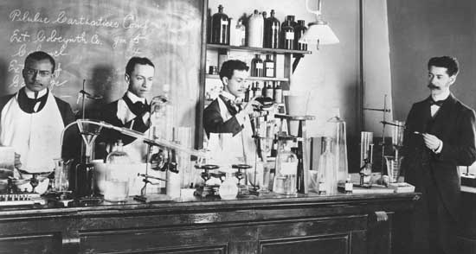
II. Expanding Higher Education
  A. Changes in Universities
    From 1880 – 1920 college #’s quadrupled
    Research universities emerged
      Language, physical science, psychology, sociology
      Law
      Medicine
    Began requiring H.S. diplomas
      Some used entrance exams

Slide 7
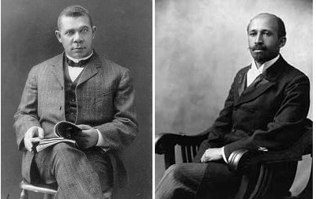
  B. Higher Education for African Americans
    Pursued by many after the Civil War
    1900: 3,880 attended out of 9 million
    Booker T. Washington
      Felt labor skills & economic value would end racism
      Created the Tuskegee Normal & Industrial Institute
    W.E.B. Du Bois
      Disagreed
      Founded the Niagara Movement – pushed liberal arts ed. to promote educated leadership
      Pushed for immediate inclusion

