Slide 1
Chapter2 Economic Systems

Slide 2
Section 1 Answering the Three Economic Questions

Slide 3
A. Three Key Economic Questions
1. What goods and services should be produced?
2. How should these goods and services be produced?
3. Who consumes these goods and services?
Economic System – “the structure of methods and principles a society uses to produce and distribute goods and services

Slide 4
Factor Payments – The income people receive in return for supplying factors of production
Rent, wages, or interest
Profit – The amount of money a business receives in excess of its expenses

Slide 5
B. Economic Goals and Societal Values
1. Economic Efficiency
Societies try to maximize what they can produce considering the resources they have
2. Economic Freedom
We buy what we can pay for, work where we want, own property, and become entrepreneurs
3. Economic Security
Avoiding uncertainty.
Will goods and services be available when necessary?
Governments often provide safety nets

Slide 6
4. Economic Equity
Could also be called economic fairness
What regulates the production vs. the consumption of an individual?
5. Economic Growth
A nation’s economy must grow with its population
This allows for an increased standard of living
Innovation accelerates this process
6. Goals in Conflict
Environment, employment, industry, etc. etc. etc.
Striving for one goal may keep a nation from achieving another
All nations must prioritize their economic goals

Slide 7
C. Traditional Economies
Relies on habit, custom, and ritual to answer the 3 questions
Revolves around the family unit
Usually found in small or close communities
Successful if they meet their needs
However, there are few mechanisms in place to deal with disaster

Slide 8
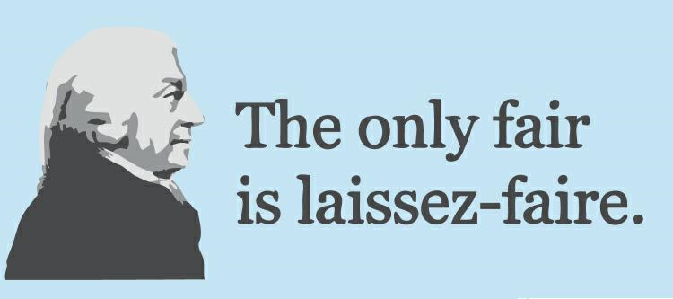
Section 2: The Free Market

Slide 9
I. Why Markets Exist
Market – Any arrangement where buyers and sellers exchange things
A. Specialization
The concentration of the productive efforts of individuals and businesses on a limited number of activities
Leads to efficient use of land, labor, and capital
B. Buying and Selling
The mechanism that allows us to exchange what we produce and buy what we want

Slide 10
II. Free Market Economy
All three economic questions are answered by individuals and businesses. AKA capitalist economy
I. Households and Firms
Household: person or group in a single residence, they own the factors of production and are also consumers
Firms: an organization that uses resources to produce goods and services
This can all be represented in a circular flow model

Slide 11
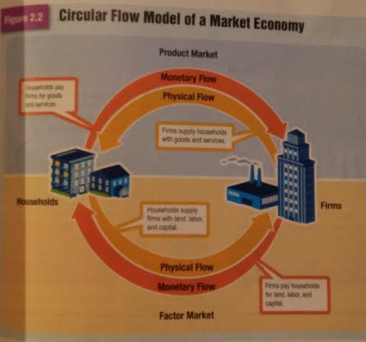

Slide 12
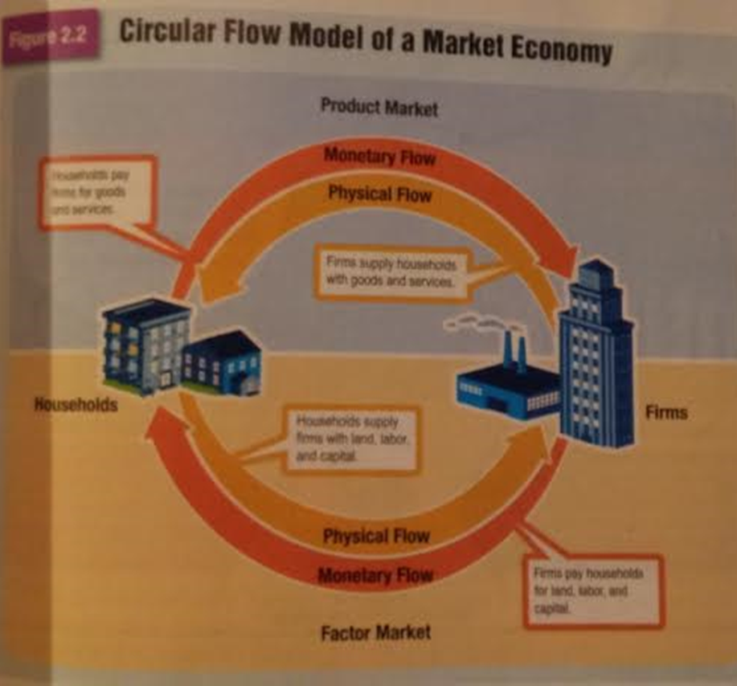
II. Factor and Product Markets
Factor Market – This is where firms purchase factors of production from households
Product Market – This is where households buy goods and services from firms
This create a market that is truly circular

Slide 13
III. The Self-Regulating Nature of the Marketplace
A. Self-Interest
Buyers and sellers always consider their self interest- their own personal gain
B. Competition
The struggle among consumers for the dollars of consumers
Incentives – the hope of reward or the fear of penalty
How do we react to sales?
C. The Invisible Hand
Idea that the market is self-regulating…

Slide 14
IV. Advantages of the Free Market
1. economic efficiency
Produces the goods people want, at the prices they are willing to pay
2. economic freedom
Work where you want, produce what you want, consume what you want
3. economic growth
Competition encourages innovation
Free market encourages growth
4. additional goals
Wider variety of goods and services
Consumer sovereignty- buyers decide what is produced

Slide 15
Section 3 Centrally Planned Economies

Slide 16
I. How Central Planning Works
The Government answers all 3 economic questions
Government owns both land and capital
Also owns labor by controlling where people work and their wages
A.K.A. Command economies
Direct contrast to free market systems
No consumer sovereignty

Slide 17
II. Socialism and Communism
A. Socialism
Not a single economic system
Believe that wealth should be evenly distributed throughout society
This is done by the government
Can exist with free markets
Under “Market Socialism,” government collects taxes to redistribute wealth and provide a wide array of services and goods
Usually seen as an intermediate stage between capitalism and communism

Slide 18
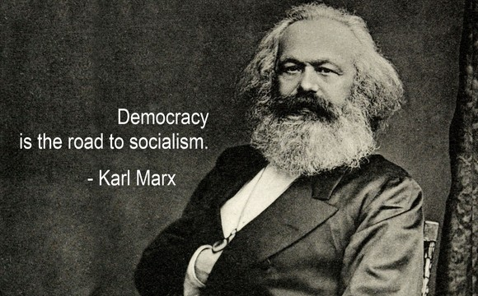
B. Communism
Central government controls resources and means of production
Central government makes all economic decisions
Derived from the writings of Karl Marx
Believed all value was in labor
Under capitalism, factory owners ended up controlling that value
Inevitable, workers would be exploited
Could only be achieved by violent revolution and could only be maintained by an authoritarian government

Slide 19
III. Two Communist Economies
A. The Soviet Union
1917 Bolshevik Revolution – instills communism in Russia
Lead by Vladimir Lenin
He would be followed by Joseph Stalin
Focused on heavy industry and military strength
Created shortages and poor quality in consumer goods
The same happened in agriculture
The Soviet Union would fall and collapse by 1991

Slide 20
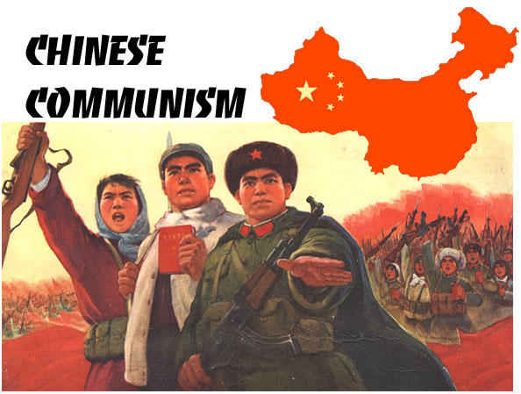
B. China
Also adopted communism after a revolution
Every aspect of the economy was controlled
Even created communes in the 1950’s
Provided more freedoms in the 1970’s and saw economic growth
This trend is still continuing today.

Slide 21
IV. Disadvantages of Centrally Planned Economies
1. Economic Efficiency
Workers lack incentive to be faster or more productive
2. Economic Freedom
There is very little. In some cases governments (Stalin’s Russia) even slaughtered millions to enforce their plans
3. Economic Growth
No rewards for innovation and a discouragement toward growth
No incentive for entrepreneurship
4. Economic Equity
Wide gap between those in control and the workforce
5. Additional Goals
Guarantees jobs and income
Government can jumpstart industries

Slide 22
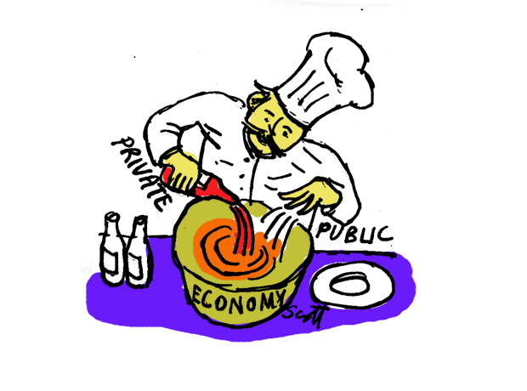
Section 4 Mixed Economies

Slide 23
I. The Rise of Mixed Economies
A. Reasons for Government Involvement
These are reasons why people feel laissez faire economics do not work
1. The needs of modern society cannot be met in the marketplace
2. Markets cannot ensure benefits for all society’s members where government can
3. Governments help to protect private property
4. Governments try to ensure that marketplace exchanges are fair
Today… no pure free market economies and no pure command economies
Today we mostly have mixed economies

Slide 24
B. Balancing Needs and Freedom
Priorities must be evaluated by society
Opportunity cost vs. goals?
Mixed economies find themselves in many heated debates over these issues.

Slide 25
II. Circular Flow Model of a Mixed Economy
A. Government in the Factor Market
Governments purchase land, labor, and capital
US government = 2.7 million employees at $152.2 billion per year

Slide 26
B. Government in the Product Market
Governments purchase goods and services
Usually, these are made from private firms
Provide goods and services through these purchases

Slide 27
C. Transferring Money
Governments collect taxes from households
This can be transferred to businesses or individuals
Bailouts / healthcare
Social Security is an example. It is the greatest expenditure of the Federal Government

Slide 28
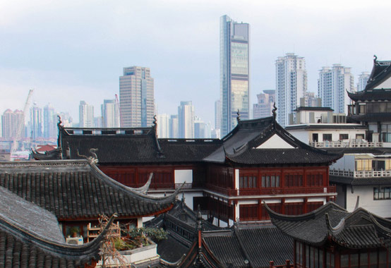
III. Comparing Mixed Economies
A. Mixed Economies Where Government Intervention Dominates
N. Korea / Soviet Union
- Gov’t owns all property and economic output
- Nearly all imports from other countries are banned
- Goods and services from foreign countries are prohibited
China is moving away from this
Going through an Economic Transition
It is currently privatizing state-owned firms

Slide 29
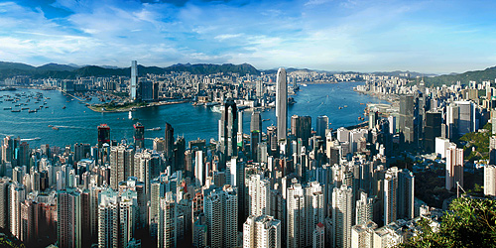
B. Mixed Economies Where the Free Market System Dominates
Hong Kong
Once under British Control, now Chinese, but with an agreement to have a free market system
The private sector is the most dominant
Government rarely interferes
Highly receptive to foreign investment with no trade barriers

Slide 30
IV. The United States Economy
A. Government Intervention
Government plays a substantial role in this “free market economy”
Marketplace operates with a degree of government regulation
This is a highly debated issue

Slide 31
B. Economic Freedom
US = high level of economic freedom
Foreign investment is encouraged
Free trade and banking are rarely restricted

