Slide 1
Alterations of Chromosome Number and Structure

Slide 2
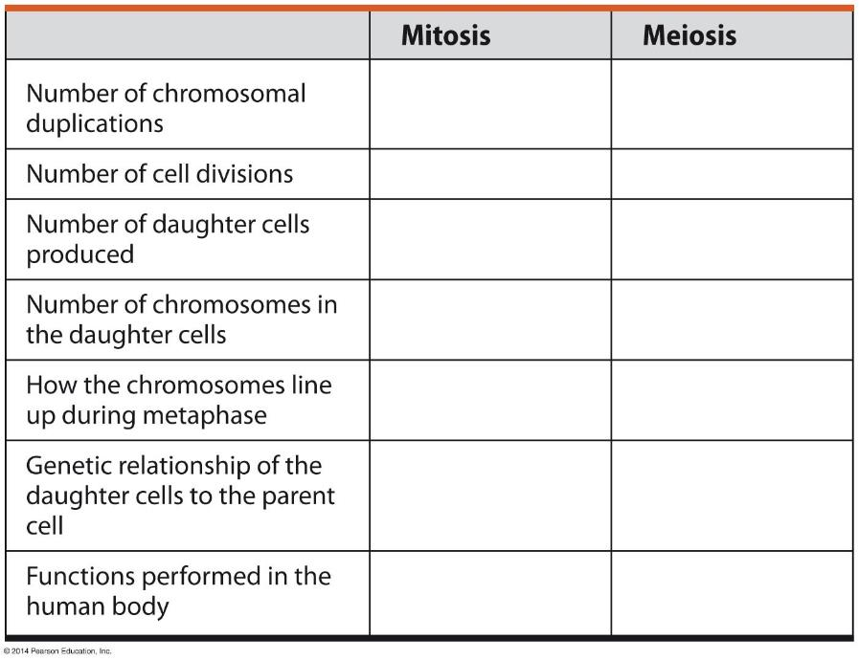
Figure 8.UN03
Notes:
Figure 8.UN03 Connecting the concepts, question 1

Slide 3
8.18 Accidents during meiosis can alter chromosome number
Nondisjunction is the failure of chromosomes or chromatids to separate normally during meiosis.
meiosis I, if both members of a homologous pair go to one pole
meiosis II, if both sister chromatids go to one pole
Fertilization after nondisjunction yields zygotes with altered numbers of chromosomes.
Notes:
Student Misconceptions and Concerns
• Before addressing karyotyping and nondisjunction events, consider reviewing the general structure and terminology associated with replicated chromosomes and the arrangement of chromosomes during metaphase of mitosis, meiosis I, and meiosis II. Figures 8.3B and 8.14 will be particularly helpful. A firm foundation in chromosome basics is necessary to understand the irregularities discussed in Modules 8.19–8.23.
Teaching Tips
• Students might be confused by the term nondisjunction. But simply put, it is an error in the sorting of chromosomes during mitosis or meiosis.
• The Human Genome website is a tremendous asset for nearly every discussion related to human genetics. It can be accessed at www.genomics.energy.gov.

Slide 4
Figure 8.18-1-1
Meiosis I
Nondisjunction
Notes:
Figure 8.18-1-1 Nondisjunction in meiosis I (part 1, step 1)

Slide 5
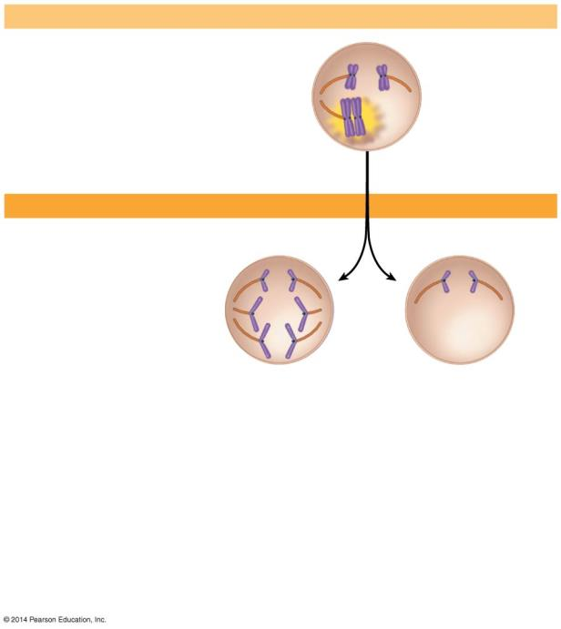
Figure 8.18-1-2
Meiosis I
Nondisjunction
Meiosis II
Normal meiosis II
Notes:
Figure 8.18-1-2 Nondisjunction in meiosis I (part 1, step 2)

Slide 6
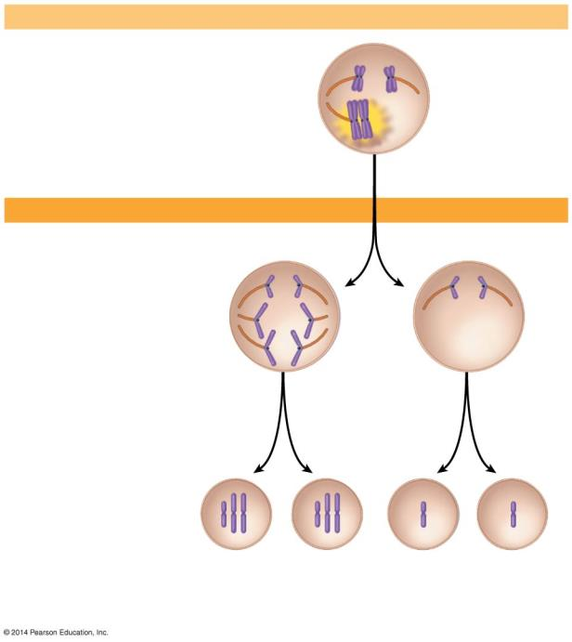
Figure 8.18-1-3
Meiosis I
Nondisjunction
Meiosis II
Normal meiosis II
Gametes
Number of chromosomes
n + 1
n + 1
n − 1
n − 1
Abnormal gametes
Notes:
Figure 8.18-1-3 Nondisjunction in meiosis I (part 1, step 3)

Slide 7
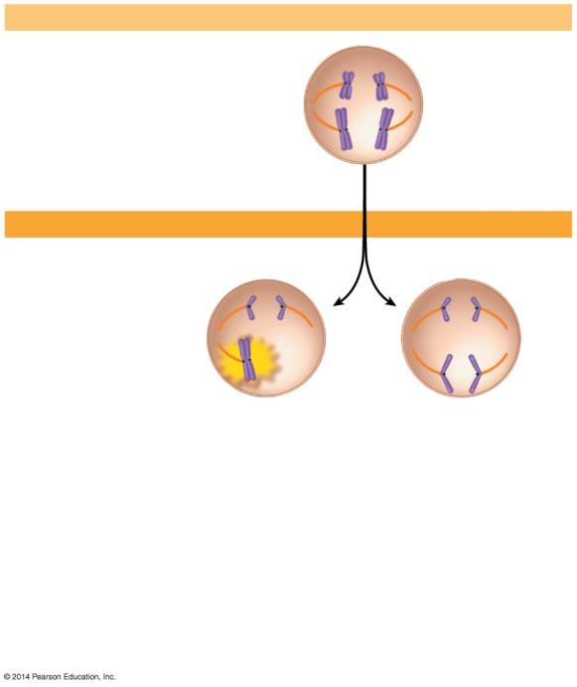
Figure 8.18-2-2
Meiosis I
Normal meiosis I
Meiosis II
Nondisjunction
Notes:
Figure 8.18-2-2 Nondisjunction in meiosis II (part 2, step 2)

Slide 8
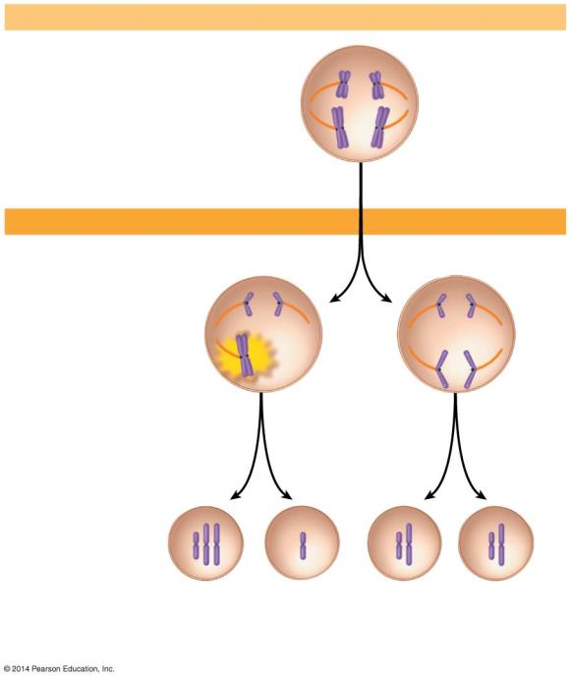
Figure 8.18-2-3
Meiosis I
Normal meiosis I
Meiosis II
Nondisjunction
n + 1
n − 1
n
n
Abnormal gametes
Normal gametes
Notes:
Figure 8.18-2-3 Nondisjunction in meiosis II (part 2, step 3)

Slide 9
Non disjunction

Slide 10
8.19 A karyotype is a photographic inventory of an individual’s chromosomes
A karyotype is an ordered display of magnified images of an individual’s chromosomes arranged in pairs.
Notes:
Student Misconceptions and Concerns
• Before addressing karyotyping and nondisjunction events, consider reviewing the general structure and terminology associated with replicated chromosomes and the arrangement of chromosomes during metaphase of mitosis, meiosis I, and meiosis II. Figures 8.3B and 8.14 will be particularly helpful. A firm foundation in chromosome basics is necessary to understand the irregularities discussed in Modules 8.19–8.23.
Teaching Tips
• The Human Genome website is a tremendous asset for nearly every discussion related to human genetics. It can be accessed at www.genomics.energy.gov.

Slide 11
8.19 A karyotype is a photographic inventory of an individual’s chromosomes
Karyotypes
are often produced from dividing cells arrested at metaphase of mitosis
allow for the observation of
homologous chromosome pairs
chromosome number
chromosome structure

Slide 12
Figure 8.19-1-1
Packed red and white blood cells
Centrifuge
Blood culture
Fluid
Notes:
Figure 8.19-1-1 Preparation of a karyotype from a blood sample (part 1, step 1)

Slide 13
Figure 8.19-1-2
Packed red and white blood cells
Hypotonic solution
Centrifuge
Blood culture
Fluid
Notes:
Figure 8.19-1-2 Preparation of a karyotype from a blood sample (part 1, step 2)

Slide 14
Figure 8.19-1-3
Packed red and white blood cells
Hypotonic solution
Fixative
Stain
White blood
cells
Centrifuge
Blood culture
Fluid
Notes:
Figure 8.19-1-3 Preparation of a karyotype from a blood sample (part 1, step 3)

Slide 15
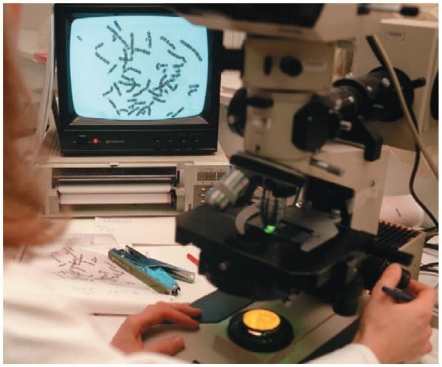
Figure 8.19-2
Notes:
Figure 8.19-2 Preparation of a karyotype from a blood sample (part 2)

Slide 16
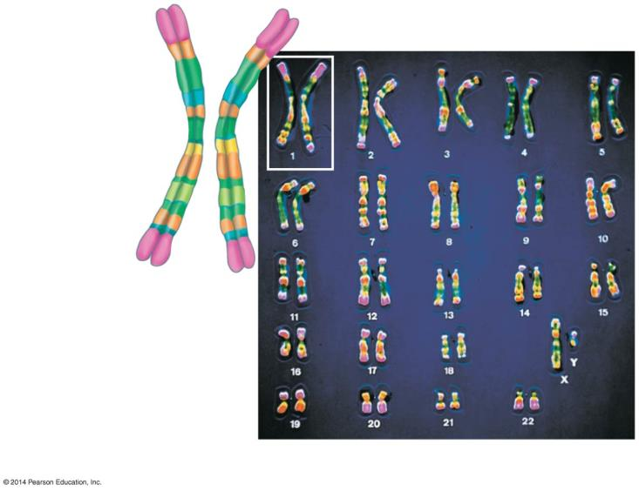
Figure 8.19-3
Centromere
Sister chromatids
Pair of homologous
chromosomes
Sex chromosomes
Notes:
Figure 8.19-3 Preparation of a karyotype from a blood sample (part 3)

Slide 17
8.20 CONNECTION: An extra copy of chromosome 21 causes Down syndrome
Trisomy 21
involves the inheritance of three copies of chromosome 21
the most common human chromosome abnormality
Notes:
Student Misconceptions and Concerns
• Before addressing karyotyping and nondisjunction events, consider reviewing the general structure and terminology associated with replicated chromosomes and the arrangement of chromosomes during metaphase of mitosis, meiosis I, and meiosis II. Figures 8.3B and 8.14 will be particularly helpful. A firm foundation in chromosome basics is necessary to understand the irregularities discussed in Modules 8.19–8.23.
Teaching Tips
• If you have several hundred students or more in your class, it is likely that at least one of your students has a sibling with Down syndrome. The authors note that overall, about one in every 700 babies are born with Down syndrome.
• The National Down Syndrome Society has a website at www.ndss.org. It is a wonderful resource.
• The Human Genome website is a tremendous asset for nearly every discussion related to human genetics. It can be accessed at www.genomics.energy.gov.
Active Lecture Tips
• See the Activity Applying the Concept of Non-Disjunction to Trisomy on the Instructor Exchange. Visit the Instructor Exchange in the MasteringBiology instructor resource area for a description of this activity.

Slide 18
8.20 CONNECTION: An extra copy of chromosome 21 causes Down syndrome
A person with trisomy 21 has a condition called Down syndrome
characteristic facial features
short stature
heart defects
susceptibility to respiratory infections, leukemia, and Alzheimer’s disease
varying degrees of developmental disabilities.
The incidence increases with the age of the mother.
Notes:
Student Misconceptions and Concerns
• Before addressing karyotyping and nondisjunction events, consider reviewing the general structure and terminology associated with replicated chromosomes and the arrangement of chromosomes during metaphase of mitosis, meiosis I, and meiosis II. Figures 8.3B and 8.14 will be particularly helpful. A firm foundation in chromosome basics is necessary to understand the irregularities discussed in Modules 8.19–8.23.
Teaching Tips
• If you have several hundred students or more in your class, it is likely that at least one of your students has a sibling with Down syndrome. The authors note that overall, about one in every 700 babies are born with Down syndrome.
• The National Down Syndrome Society has a website at www.ndss.org. It is a wonderful resource.
• The Human Genome website is a tremendous asset for nearly every discussion related to human genetics. It can be accessed at www.genomics.energy.gov.
Active Lecture Tips
• See the Activity Applying the Concept of Non-Disjunction to Trisomy on the Instructor Exchange. Visit the Instructor Exchange in the MasteringBiology instructor resource area for a description of this activity.

Slide 19
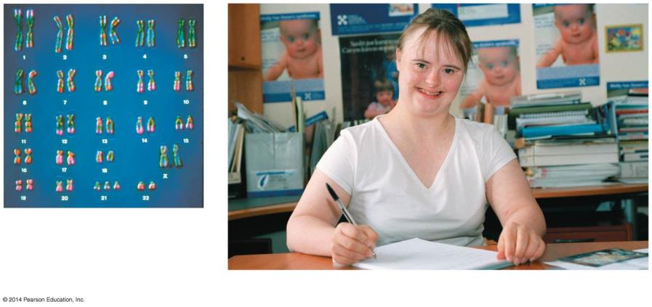
Figure 8.20a-0
Trisomy 21
A person with Down syndrome
Notes:
Figure 8.20a-0 A karyotype showing trisomy 21 and an individual with Down syndrome

Slide 20
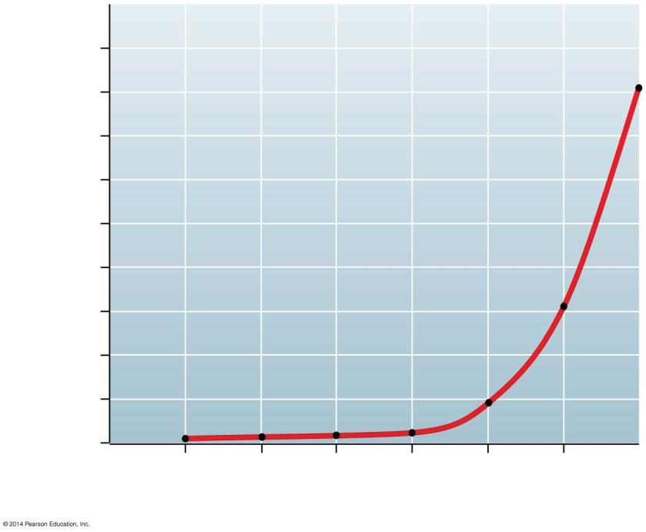
Figure 8.20b
90
80
70
60
Infants with Down syndrome (per 1,000 births)
50
40
30
20
10
0
20
25
30
35
40
45
Age of mother
Notes:
Figure 8.20b Maternal age and incidence of Down syndrome

Slide 21
8.21 CONNECTION: Abnormal numbers of sex chromosomes do not usually affect survival
Sex chromosome abnormalities seem to upset the genetic balance less than an unusual number of autosomes.
The small size of the Y chromosome
X chromosome inactivation
Notes:
Student Misconceptions and Concerns
• Before addressing karyotyping and nondisjunction events, consider reviewing the general structure and terminology associated with replicated chromosomes and the arrangement of chromosomes during metaphase of mitosis, meiosis I, and meiosis II. Figures 8.3B and 8.14 will be particularly helpful. A firm foundation in chromosome basics is necessary to understand the irregularities discussed in Modules 8.19–8.23.
Teaching Tips
• Some syndromes related to human sexuality are not the result of abnormalities in sex chromosome number. Androgen insensitivity syndrome produces sterile males who possess mostly female sex characteristics. People with this condition are genetically male but have bodies that fail to respond to male sex hormones. The National Institutes of Health website “Genetics Home Reference” can provide additional details about this and most genetic disorders at http://ghr.nlm.nih.gov.
• The Human Genome website is a tremendous asset for nearly every discussion related to human genetics. It can be accessed at www.genomics.energy.gov.

Slide 22
8.21 CONNECTION: Abnormal numbers of sex chromosomes do not usually affect survival
The following table lists the most common human sex chromosome abnormalities.
a single Y chromosome is enough to produce “maleness,” even in combination with several X chromosomes
the absence of a Y chromosome yields “femaleness.”
Notes:
Student Misconceptions and Concerns
• Before addressing karyotyping and nondisjunction events, consider reviewing the general structure and terminology associated with replicated chromosomes and the arrangement of chromosomes during metaphase of mitosis, meiosis I, and meiosis II. Figures 8.3B and 8.14 will be particularly helpful. A firm foundation in chromosome basics is necessary to understand the irregularities discussed in Modules 8.19–8.23.
Teaching Tips
• Some syndromes related to human sexuality are not the result of abnormalities in sex chromosome number. Androgen insensitivity syndrome produces sterile males who possess mostly female sex characteristics. People with this condition are genetically male but have bodies that fail to respond to male sex hormones. The National Institutes of Health website “Genetics Home Reference” can provide additional details about this and most genetic disorders at http://ghr.nlm.nih.gov.
• The Human Genome website is a tremendous asset for nearly every discussion related to human genetics. It can be accessed at www.genomics.energy.gov.

Slide 23
Table 8.21
Notes:
Table 8.21 Abnormalities of sex chromosome number in humans

Slide 24
8.22 EVOLUTION CONNECTION: New species can arise from errors in cell division
Errors in mitosis or meiosis may produce polyploid species, with more than two chromosome sets.
The formation of polyploid species
Notes:
Student Misconceptions and Concerns
• Before addressing karyotyping and nondisjunction events, consider reviewing the general structure and terminology associated with replicated chromosomes and the arrangement of chromosomes during metaphase of mitosis, meiosis I, and meiosis II. Figures 8.3B and 8.14 will be particularly helpful. A firm foundation in chromosome basics is necessary to understand the irregularities discussed in Modules 8.19–8.23.
Teaching Tips
• In general, flowering plants are more likely to form new species through polyploidy than animals, because unlike most animals, many flowering plants can fertilize themselves.
• The gray tree frog, which is found over most of the eastern half of the United States, from Florida and Texas to Ontario and Maine, consists of two species: Hyla chrysoscelis, which is diploid, and Hyla versicolor, which is tetraploid. The two species cannot be distinguished, except by the number of chromosomes in their cells. The tetraploid species is thought to have been formed by an error in meiosis, similar to that frequently seen in plants.
• The Human Genome website is a tremendous asset for nearly every discussion related to human genetics. It can be accessed at www.genomics.energy.gov.

Slide 25
8.23 CONNECTION: Alterations of chromosome structure can cause birth defects and cancer
Chromosome breakage can lead to rearrangements that can produce genetic disorders or, if changes occur in somatic cells, cancer.
Notes:
Student Misconceptions and Concerns
• Before addressing karyotyping and nondisjunction events, consider reviewing the general structure and terminology associated with replicated chromosomes and the arrangement of chromosomes during metaphase of mitosis, meiosis I, and meiosis II. Figures 8.3B and 8.14 will be particularly helpful. A firm foundation in chromosome basics is necessary to understand the irregularities discussed in Modules 8.19–8.23.
Teaching Tips
• Challenge students to create a simple sentence and then modify that sentence to represent (a) a deletion, (b) a duplication, and (c) an inversion as an analogy to these changes to a chromosome.
• The Human Genome website is a tremendous asset for nearly every discussion related to human genetics. It can be accessed at www.genomics.energy.gov.

Slide 26
8.23 CONNECTION: Alterations of chromosome structure can cause birth defects and cancer
These rearrangements can lead to four types of changes in chromosome structure.
1. A deletion is the loss of a chromosome segment.
2. A duplication is the repeat of a chromosome segment.
Notes:
Student Misconceptions and Concerns
• Before addressing karyotyping and nondisjunction events, consider reviewing the general structure and terminology associated with replicated chromosomes and the arrangement of chromosomes during metaphase of mitosis, meiosis I, and meiosis II. Figures 8.3B and 8.14 will be particularly helpful. A firm foundation in chromosome basics is necessary to understand the irregularities discussed in Modules 8.19–8.23.
Teaching Tips
• Challenge students to create a simple sentence and then modify that sentence to represent (a) a deletion, (b) a duplication, and (c) an inversion as an analogy to these changes to a chromosome.
• The Human Genome website is a tremendous asset for nearly every discussion related to human genetics. It can be accessed at www.genomics.energy.gov.

Slide 27
8.23 CONNECTION: Alterations of chromosome structure can cause birth defects and cancer
3. An inversion is the reversal of a chromosome segment.
4. A translocation is the attachment of a segment to a nonhomologous chromosome. A translocation may be reciprocal.

Slide 28
8.23 CONNECTION: Alterations of chromosome structure can cause birth defects and cancer
Inversions are less likely than deletions or duplications to produce harmful effects, because in inversions all genes are still present in their normal number.
Many deletions cause serious physical or mental problems.
Translocations may or may not be harmful.
Notes:
Student Misconceptions and Concerns
• Before addressing karyotyping and nondisjunction events, consider reviewing the general structure and terminology associated with replicated chromosomes and the arrangement of chromosomes during metaphase of mitosis, meiosis I, and meiosis II. Figures 8.3B and 8.14 will be particularly helpful. A firm foundation in chromosome basics is necessary to understand the irregularities discussed in Modules 8.19–8.23.
Teaching Tips
• Challenge students to create a simple sentence and then modify that sentence to represent (a) a deletion, (b) a duplication, and (c) an inversion as an analogy to these changes to a chromosome.
• The Human Genome website is a tremendous asset for nearly every discussion related to human genetics. It can be accessed at www.genomics.energy.gov.

Slide 29
8.23 CONNECTION: Alterations of chromosome structure can cause birth defects and cancer
Chronic myelogenous leukemia (CML)
one of the most common leukemias
affects cells that give rise to white blood cells (leukocytes)
Notes:
Student Misconceptions and Concerns
• Before addressing karyotyping and nondisjunction events, consider reviewing the general structure and terminology associated with replicated chromosomes and the arrangement of chromosomes during metaphase of mitosis, meiosis I, and meiosis II. Figures 8.3B and 8.14 will be particularly helpful. A firm foundation in chromosome basics is necessary to understand the irregularities discussed in Modules 8.19–8.23.
Teaching Tips
• Challenge students to create a simple sentence and then modify that sentence to represent (a) a deletion, (b) a duplication, and (c) an inversion as an analogy to these changes to a chromosome.
• The Human Genome website is a tremendous asset for nearly every discussion related to human genetics. It can be accessed at www.genomics.energy.gov.

Slide 30
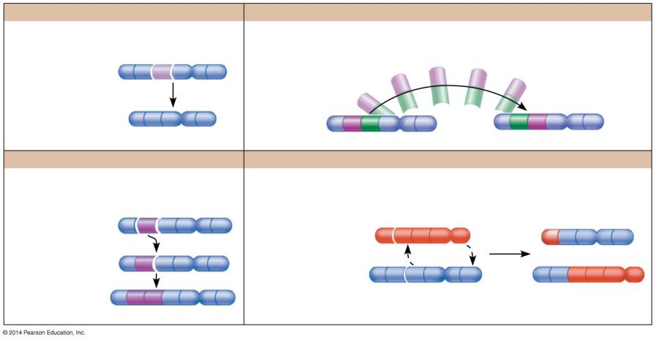
Figure 8.23a-0
Deletion
Inversion
Duplication
Reciprocal translocation
Homologous chromosomes
Nonhomologous chromosomes
Notes:
Figure 8.23a-0 Alterations of chromosome structure

Slide 31
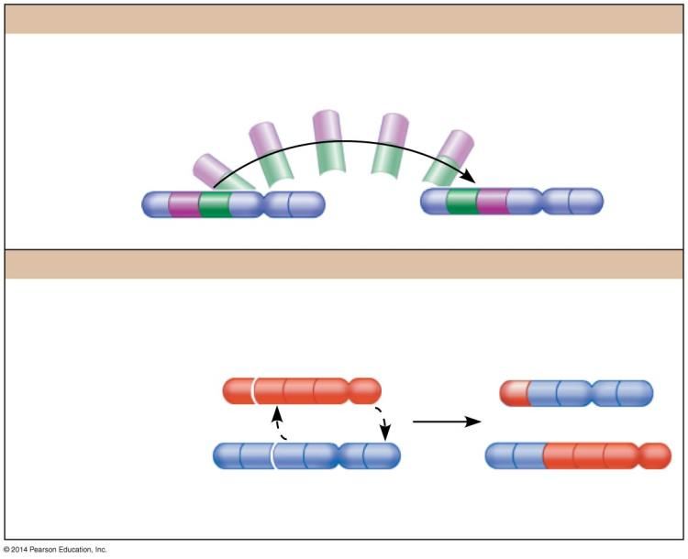
Figure 8.23a-2
Inversion
Reciprocal translocation
Nonhomologous chromosomes
Notes:
Figure 8.23a-2 Alterations of chromosome structure (part 2)

